Slide 1
Tb45 Maps

Slide 2
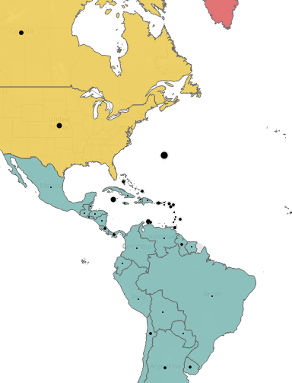
Map
Best for
Geographic data
1-2 measures
Pre-attentive attributes
Color
Size
Process
Add 2 measures (control+drag)
Go to Marks, and change one to Map or Circle
Right-click pill and change to dual axis

Slide 3
Context
Distressed Communities Index
Use tb45-maps-dcidata
Research Questions
What are the 5 distressed states?
What is the distribution of distressed variable?
What are the best predictor variables of being distressed?

Slide 4
Data Cleanup
Fix CountyID
Six digit text code, name as FIP
Join State / County tables
Split County name
Hide duplicate fields
Geographic datatype
Longitude / Latitude
Remove geographic type from county type

Slide 5
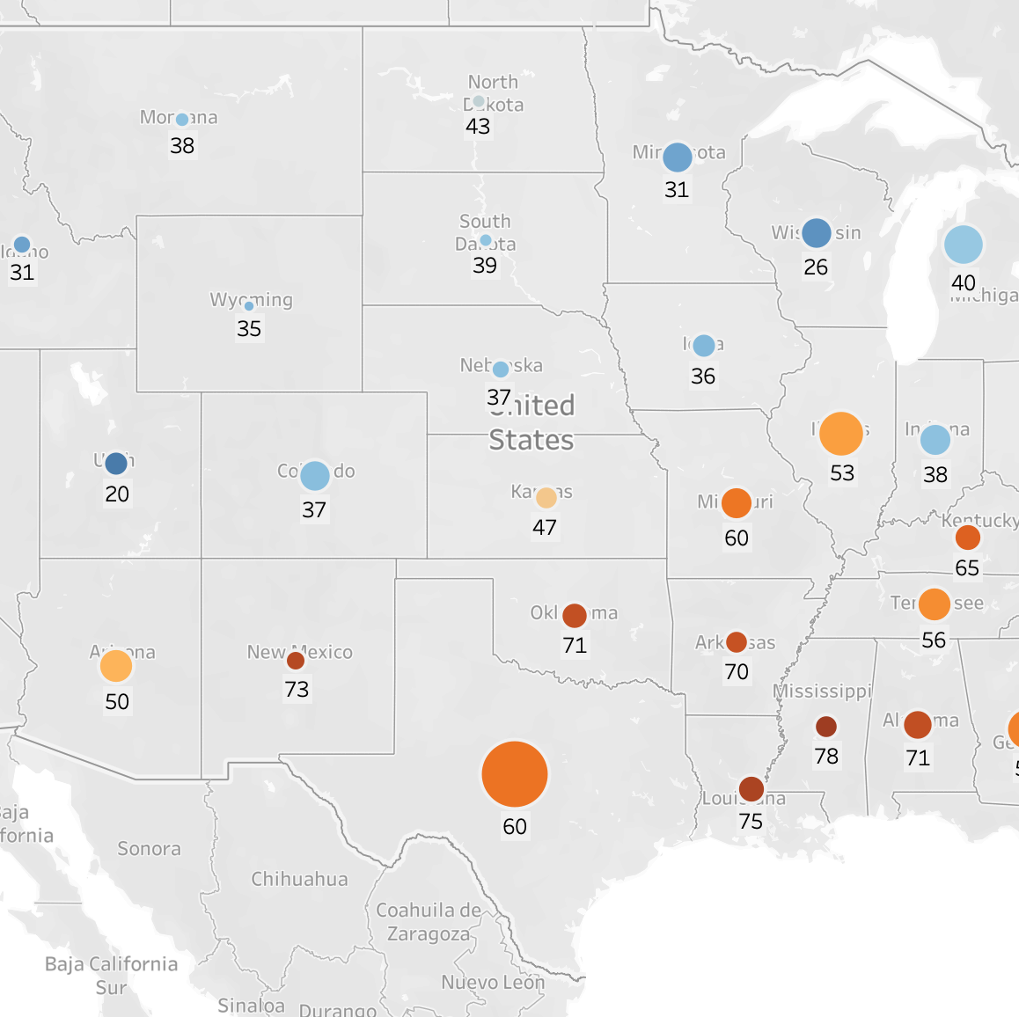
Latitude / Longitude
Create a map using state center point long/lat
Size dots by population
Color dots by avg distress score
Add labels for the distress score (round to the decimal point)

Slide 6
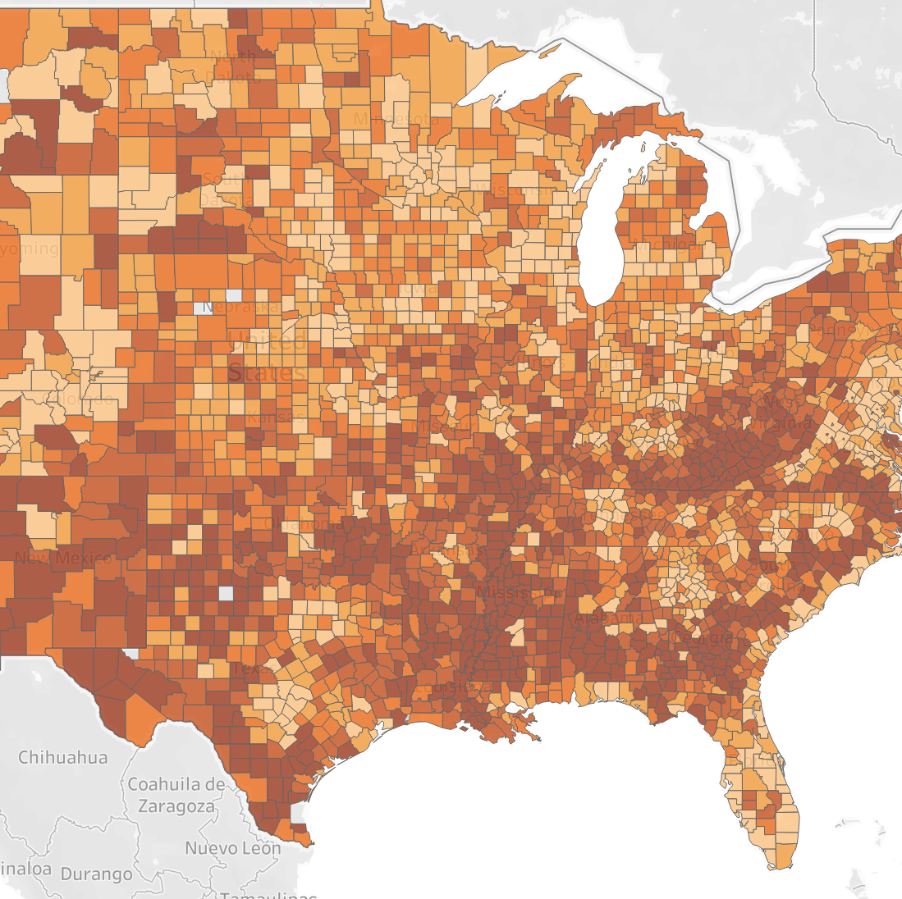
Names v. FIP codes
Create a map with County Name
What goes wrong?
Notice the generated long/lat, and the center v. fill
Create a second map with FIP Code
Show distress score as a color
What is the difference between state and county level views of distress?

Slide 7
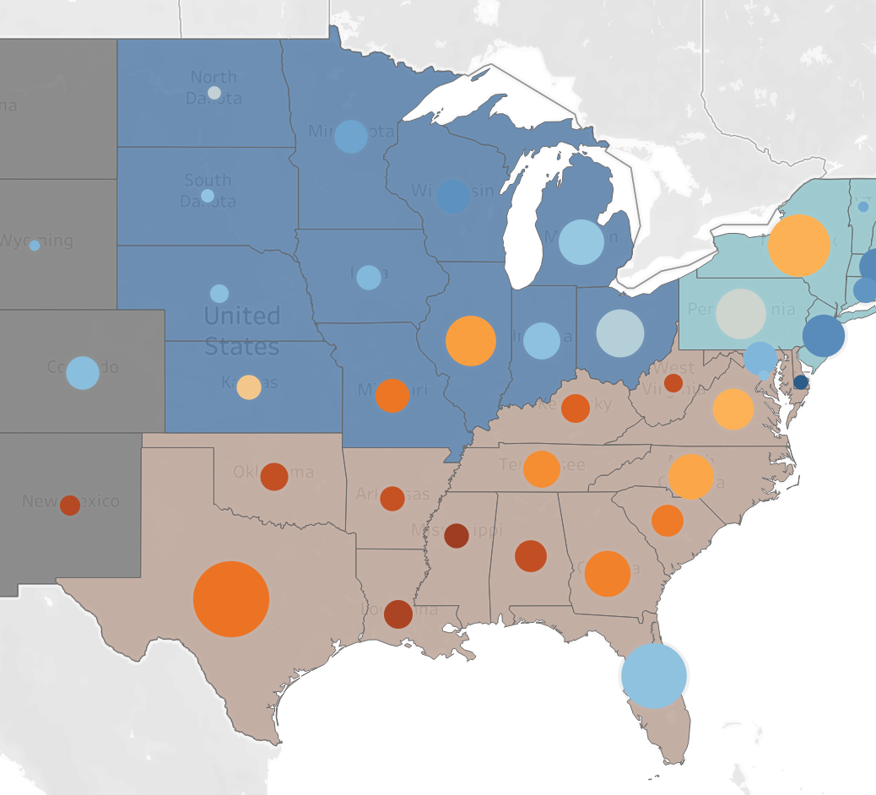
Combo Charts
Create a state chart showing region as color
Control+Drag Latitude to second pill
Change to circle
Show distress as color
Show population as size

Slide 8
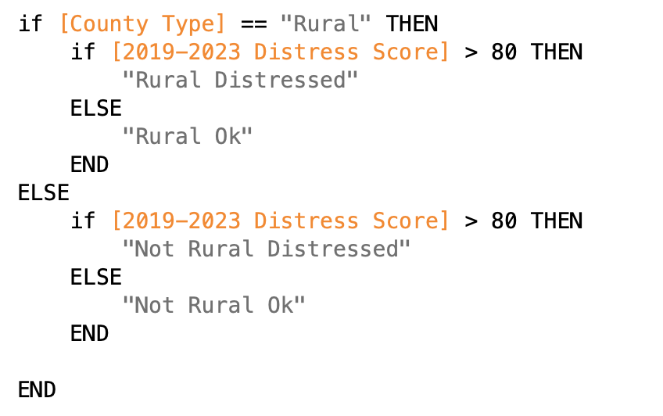
On your own!
What is the interaction between rural and distressed?
Options
Use a combo chart
Create bins for distressed and county type
Show one as a fill, and one as a dot
Create a calculated field
Write an IF statement that combines the two fields

Slide 9
Example maps

Slide 10
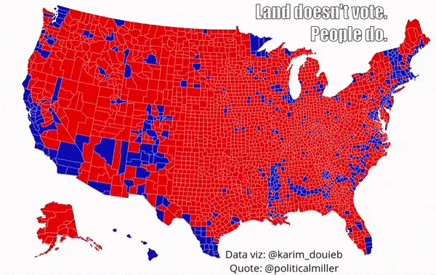

Slide 11
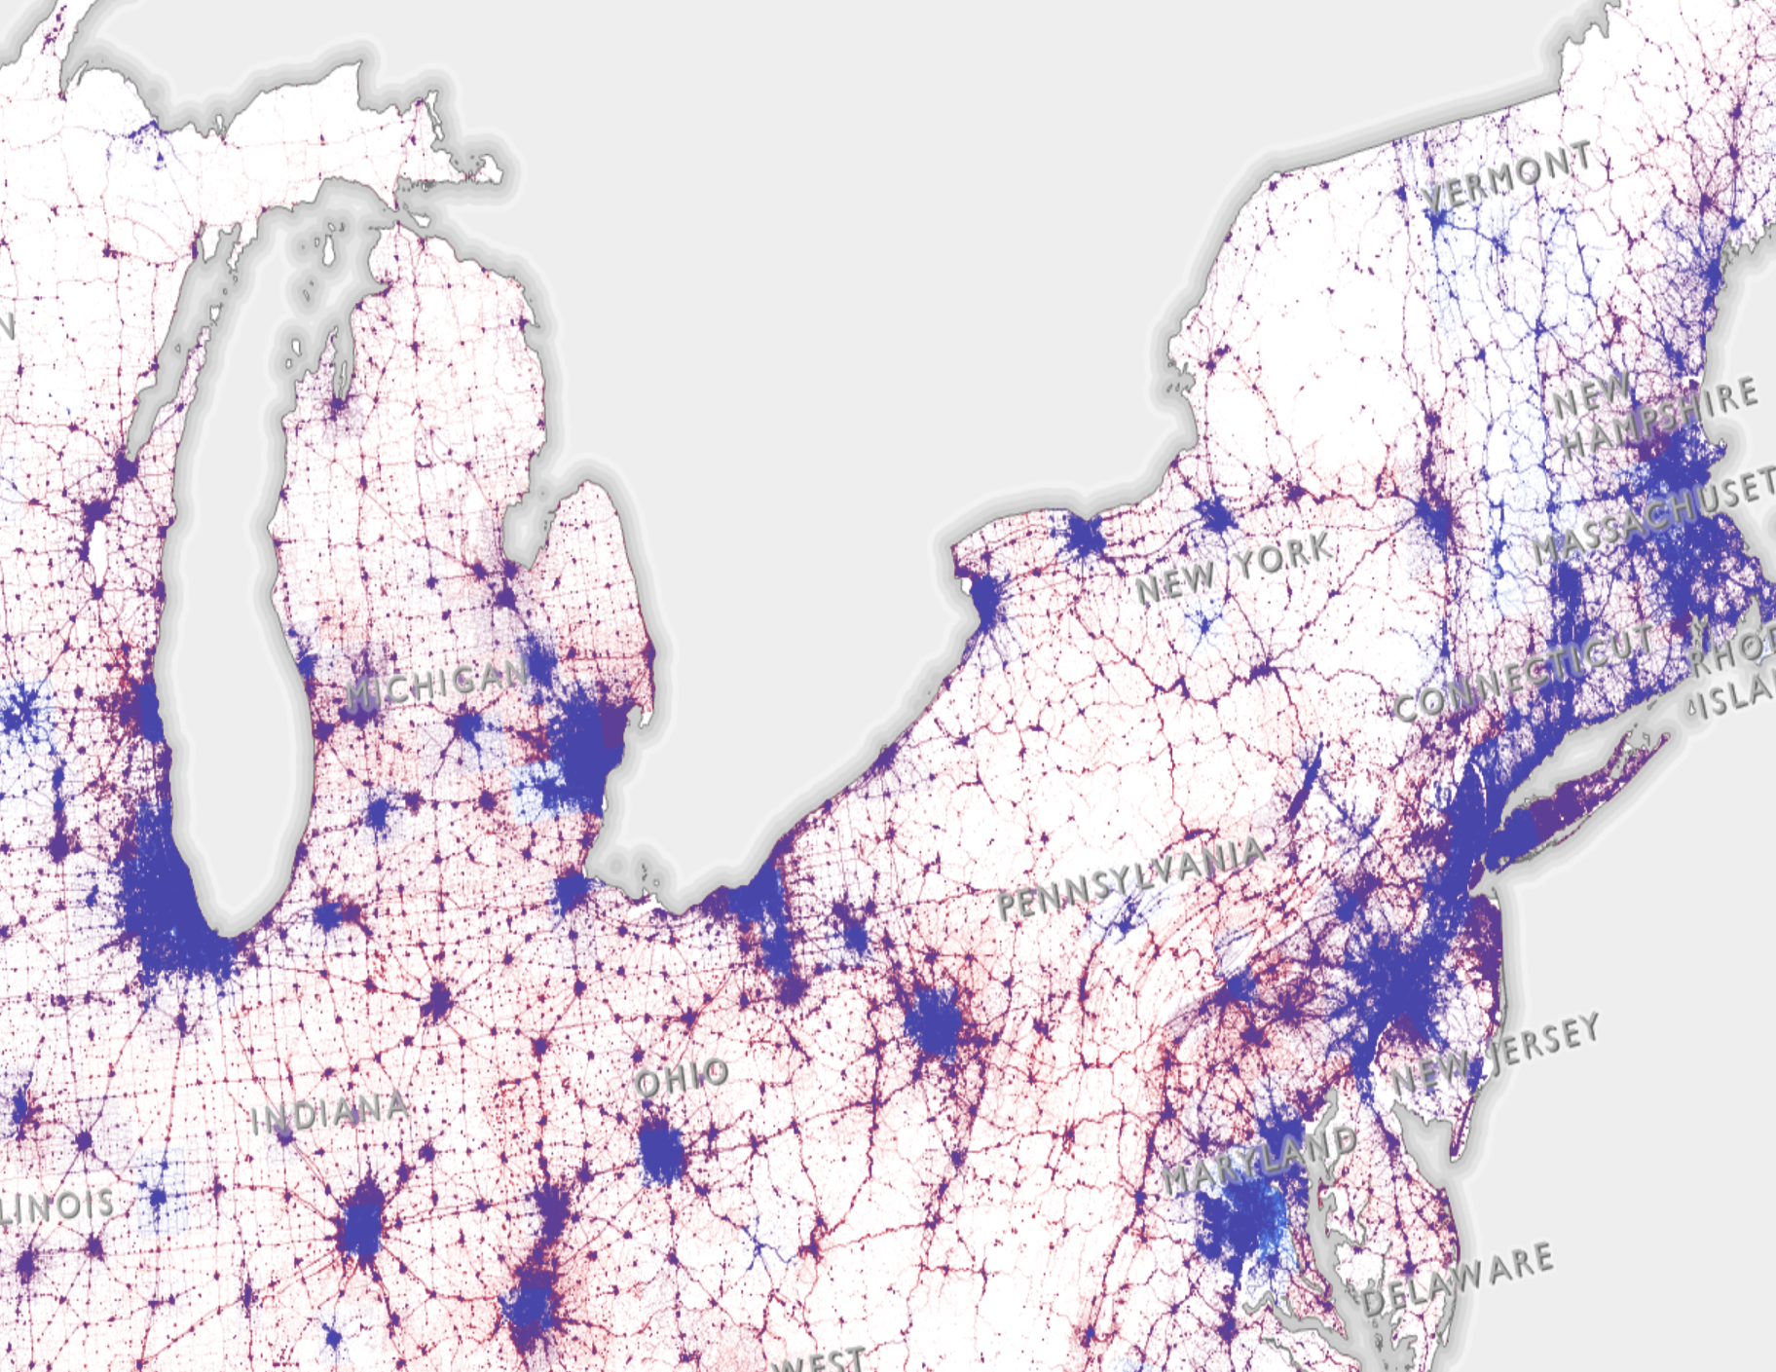
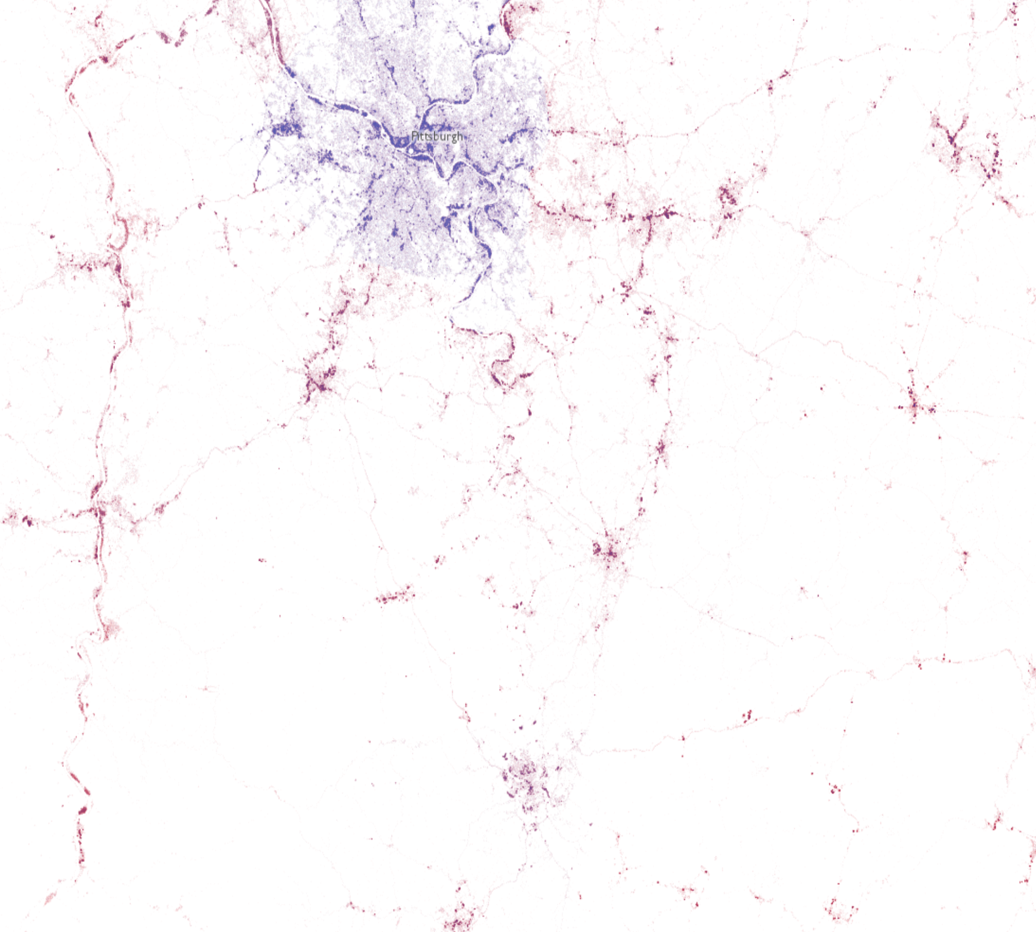
https://www.esriuk.com/en-gb/map-gallery/election-2016-dot-density

Slide 12
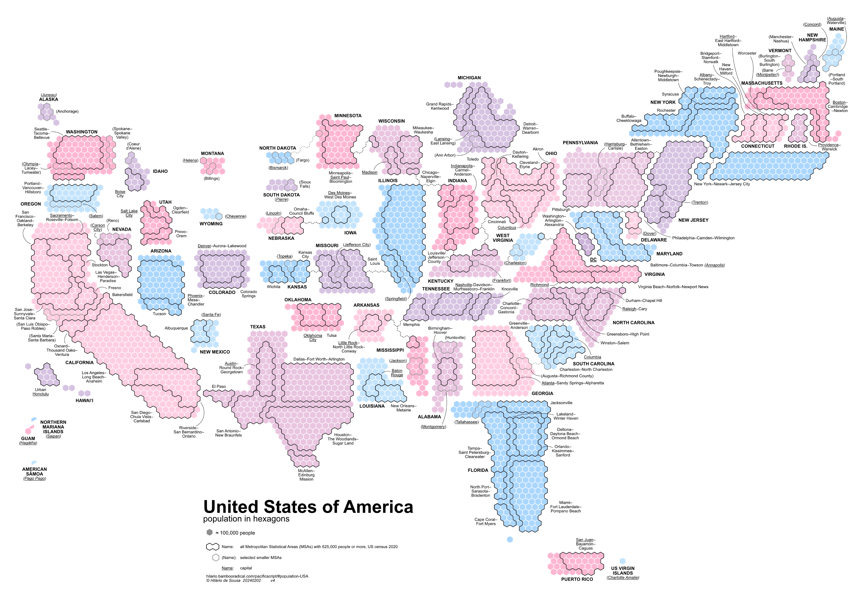

Slide 13
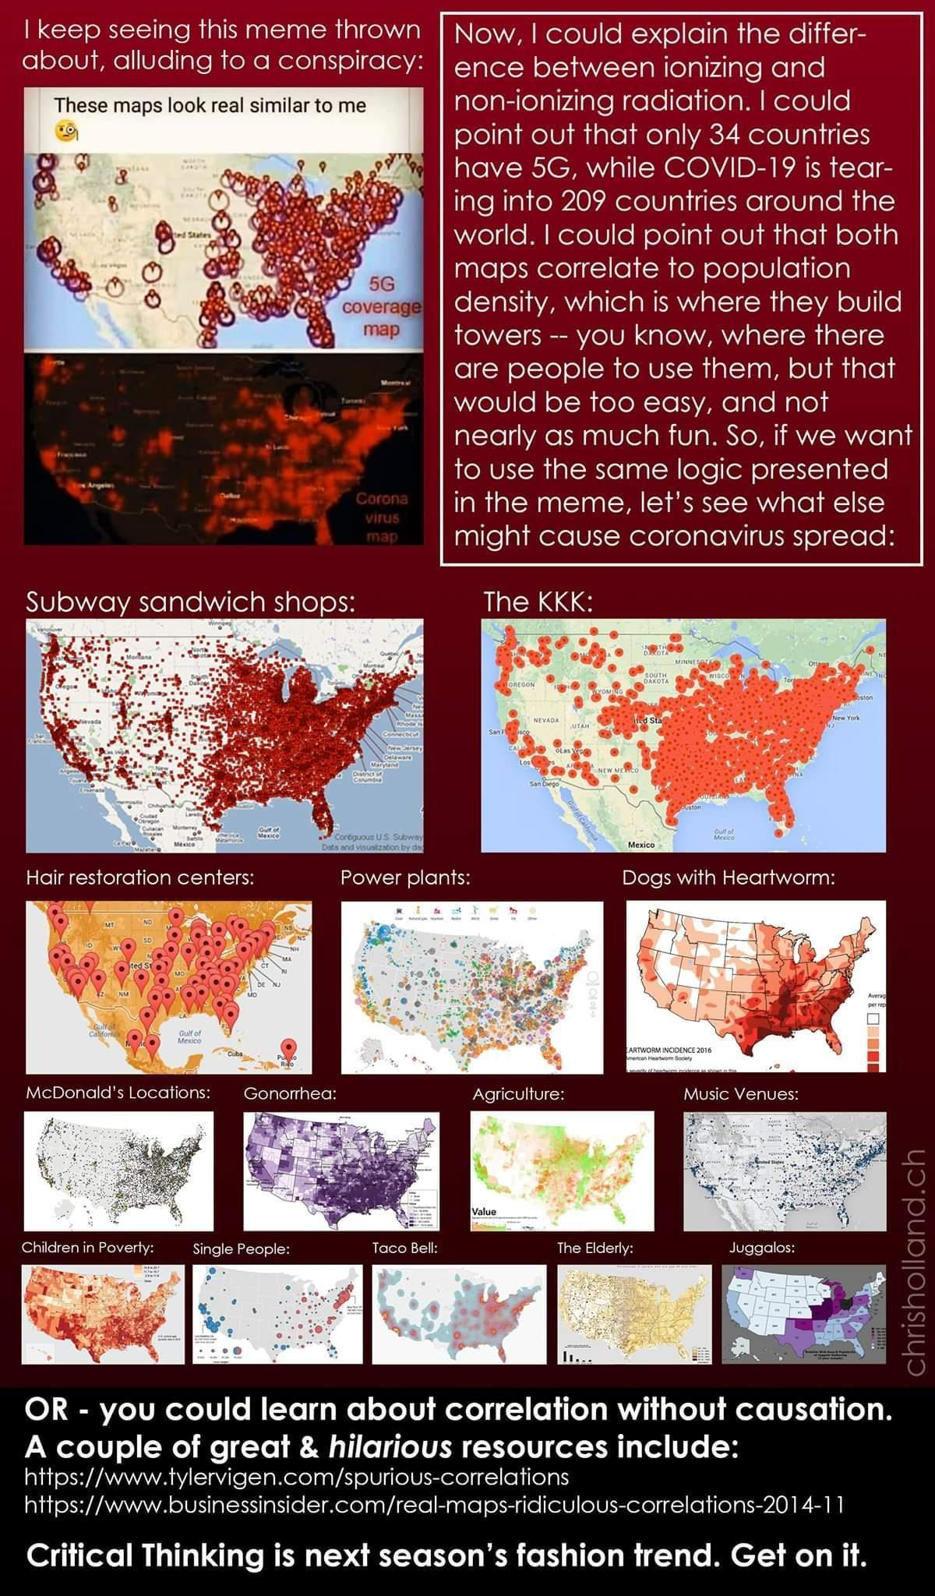

Slide 16
