Slide 1
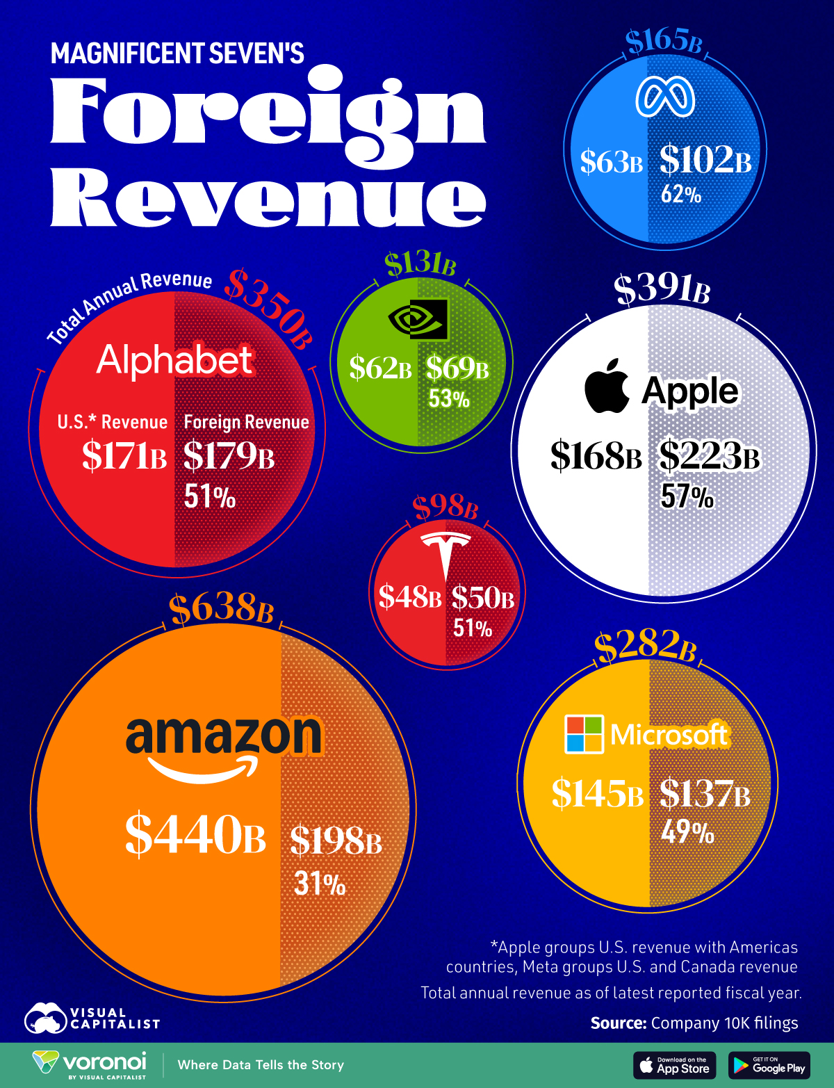
https://www.visualcapitalist.com/magnificent-sevens-foreign-revenue/#google_vignette
Results

Slide 2

How good are these charts?
https://forms.gle/h6GxryC7dmeQ1n9v5

Slide 3
Facebook (Meta)
https://www.visualcapitalist.com/magnificent-sevens-foreign-revenue/#google_vignette
Tesla

