Slide 1
Storytelling
Updated 2/16/26 by NDG

Slide 2
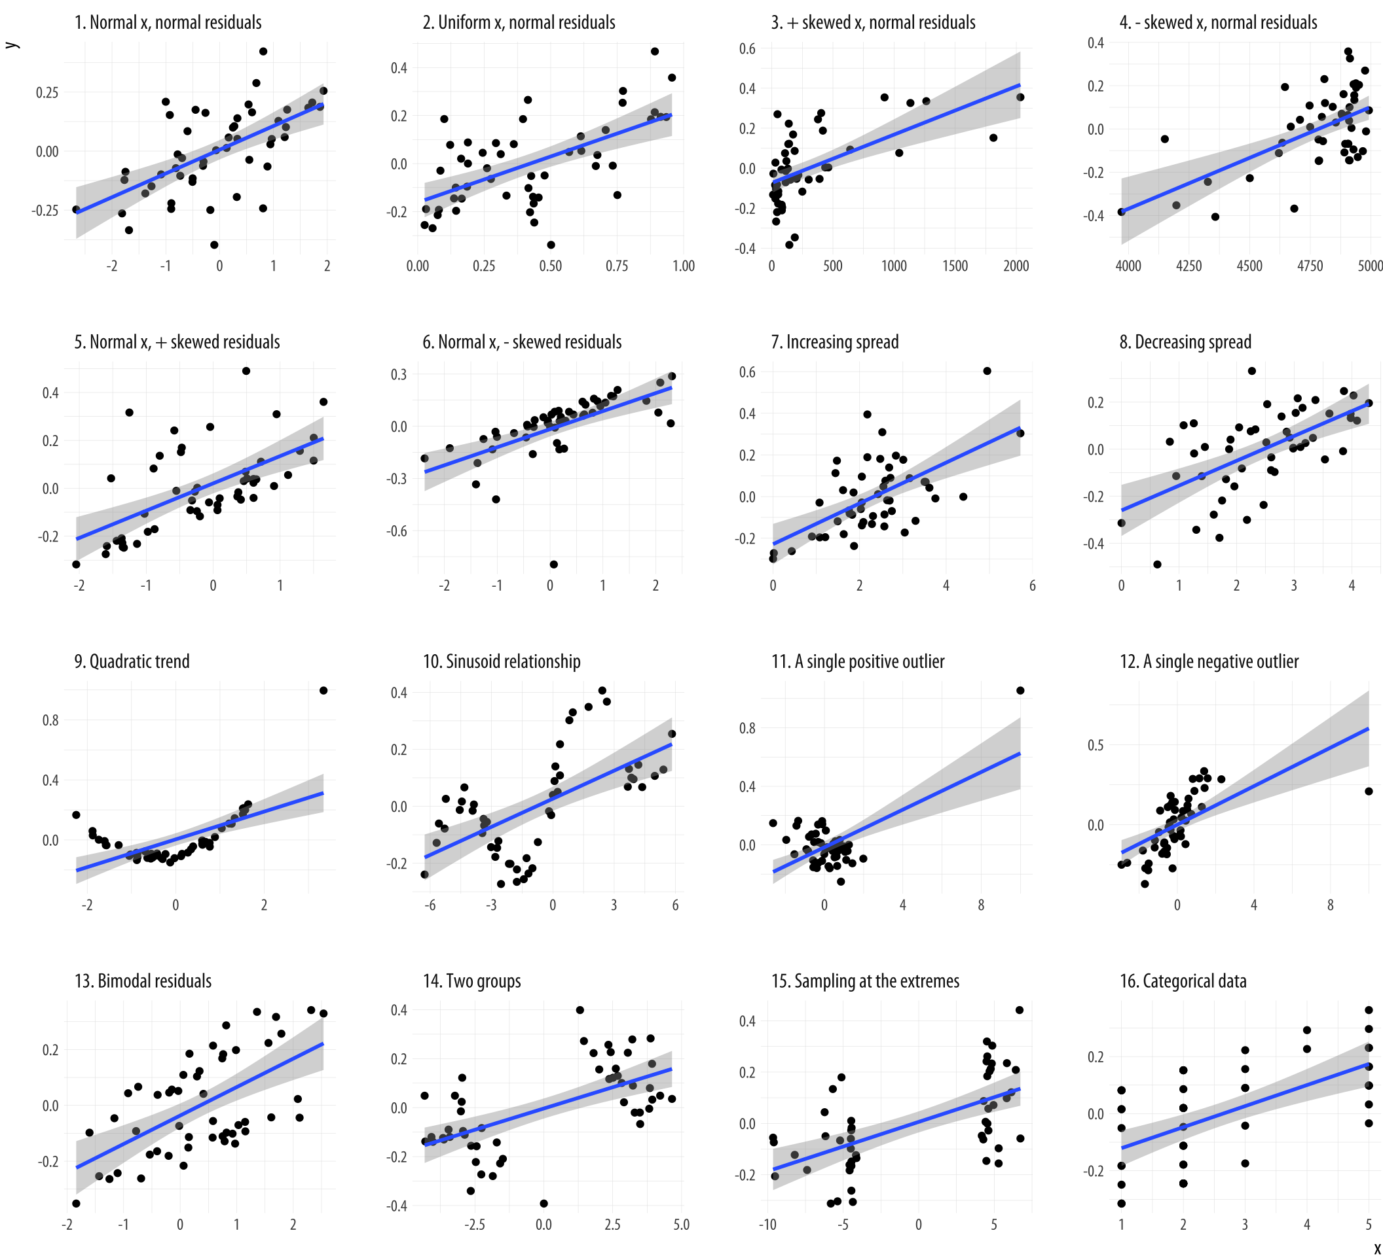
Storytelling

Slide 3
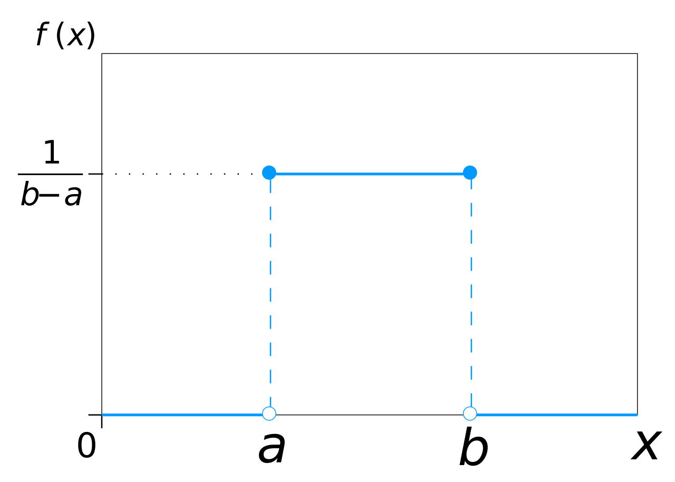
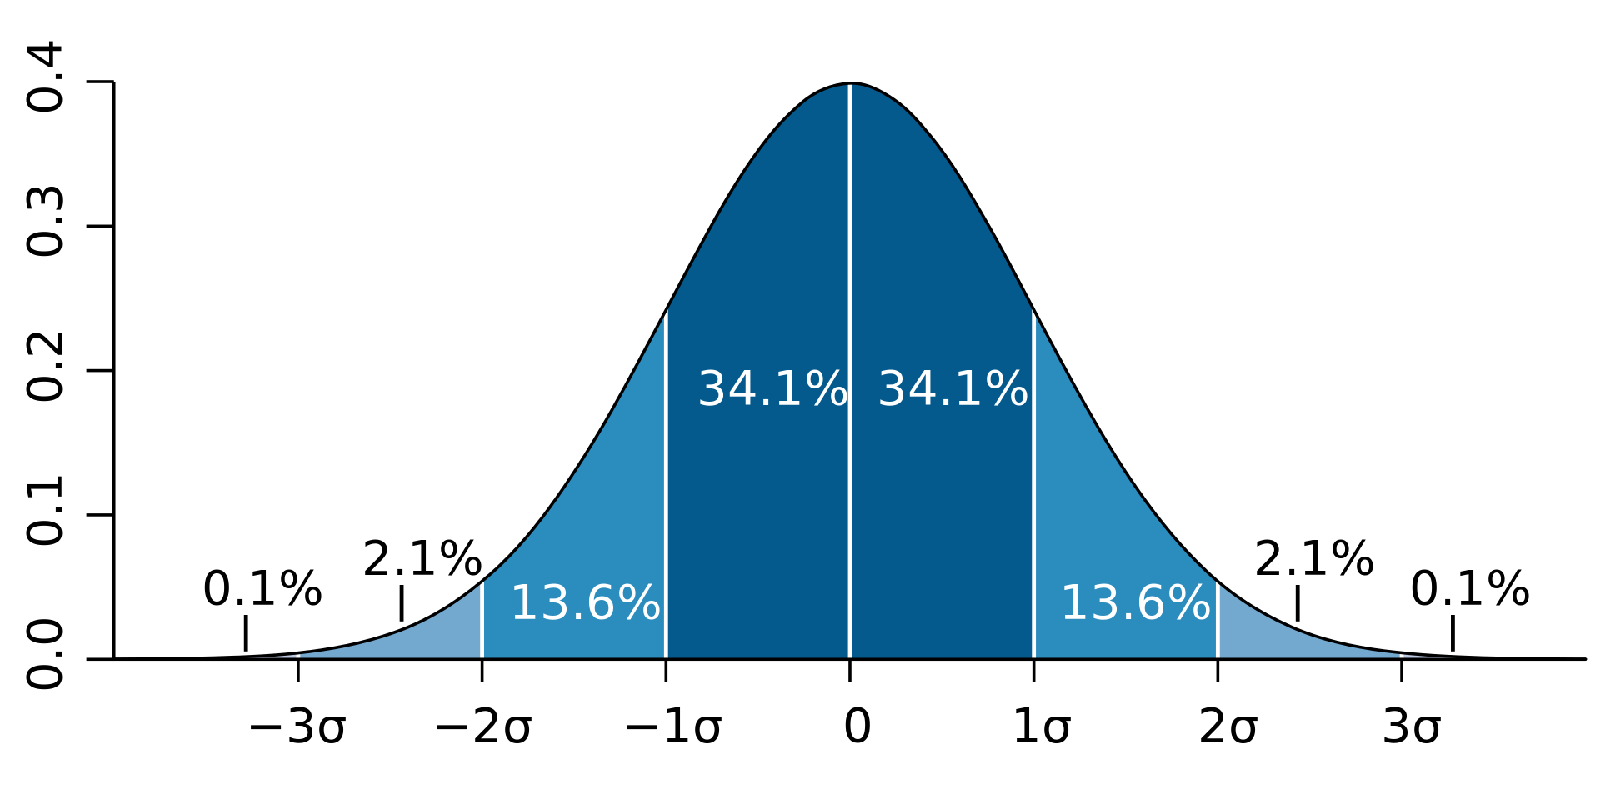
Compare x versus residuals (errors) Match the stories
Each salesperson is assigned a city. Since cities are different sizes, evaluate their performance in context.

Slide 4
Sales performance (y) versus city size (x) Match the stories
City size can vary widely
Most cities are large, with a few exceptions
Most cities are small, with a few exceptions
Most cities are around average

Slide 5
Sales performance (y) versus city size (x) Match the stories
Predicted sales vary a lot for big cities, but are consistent for small cities
While most people are a bit below average, a few superstars are outperforming the average
While most people are a bit above average, a few bad people are dragging down the average
Predicted sales vary a lot for small cities, but are consistent for big cities

Slide 6
Compare x versus residuals (errors) Match the stories
Bob’s assignment to NY throws off our model, as he outperforms the average
Bob’s assignment to Los Angeles throws off our model, as he underperforms the average
Cities that are very small and very large outperform
Cities that are certain sizes outperform and underperform

Slide 7
Compare x versus residuals (errors) Match the stories
We have either small or big cities, but none in the middle
We have data from cities in 5 different size categories
We may have some measurement errors, as our data only covers very small or very big cities
We have either great or terrible sale staff

