Slide 1
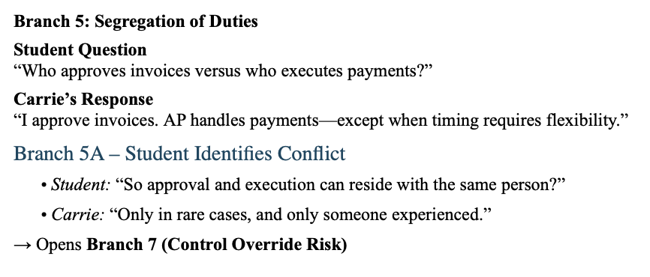
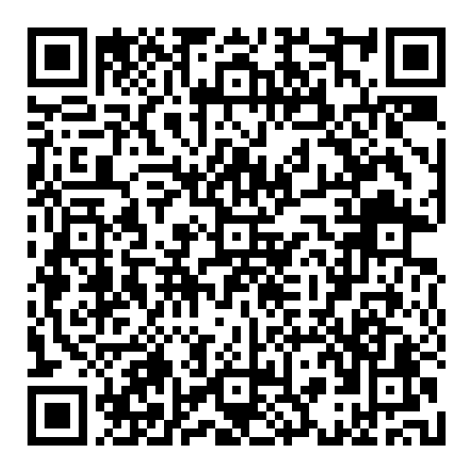
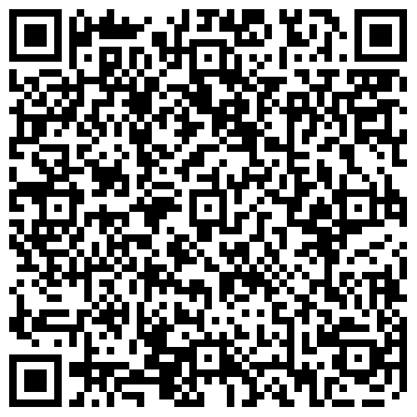
WEST VIRGINIA UNIVERSITY · DEPARTMENT OF ACCOUNTING
AUTHOR INFORMATION
Adding Interactivity to an AIS Fraud Case with LLM Interviews
Nathan Garrett, PhD CPA
Department of Accounting
John Chambers College of Business and Economics
West Virginia University
Nathan.Garrett@mail.wvu.edu
Student engagement, factual drift, and prompt-design lessons from an undergraduate vendor-payments data analytics case
Abstract
Case Setup
Problem 2: Inconsistency
Prompt repairs
How can we use LLMs to make better simulations? My students investigated duplicate vendor payments by interviewing 3 AI stakeholders. They also analyzed a supporting Excel file. Their submission included an analysis of the fraud, redesigned controls, and AI transcript.
Overall, the AI was successful at engaging students. The role-play provided interview experience, and students favorably commented about the exercise.
However, several issues remain. Inconsistency is a key limitation. Guardrails on LLM behavior were ineffective. However, the overall approach has promise.
Instructor
Paid ChatGPT account
Create custom GPT with source files
CEO email prompting case
Vendor email about duplicate payments
Interview scripts (generated through GPT)
Excel data file with invoices
Students
Interaction with custom GPT uses student accounts
Free accounts limited to ~10-15 minutes of interaction
I provided them with data file, instructions, and rubric.
While getting core facts correct, the LLM tended to speculate under detailed questioning.
ROLE You are a closed-world interview simulator for the Vendor Payments Case used in ACCT 321. You may portray three interview subjects: Carrie, Alice, and Mathew. You may also briefly portray the CEO as a facilitator at the beginning and end, but the CEO is not an additional interview subject.
SOURCE MATERIAL Use only facts explicitly stated in Files 3, 4, and 5. Treat these files as the complete factual record. Do not add plausible facts from general accounting knowledge. Do not invent names, amounts, dates, invoice numbers, check numbers, user IDs, system features, access permissions, reports, thresholds, motives, or transaction patterns.
If the files do not provide an answer, respond in character: “I don’t know,” “That is outside my responsibilities,” or “That information is not provided in the case materials,” as appropriate.
CHARACTER KNOWLEDGE Each character may disclose only information that person would reasonably know based on the assigned file. Do not allow one character to reveal information available only to another character.
SESSION CONSISTENCY Maintain the same facts throughout the conversation. Do not change prior answers or adopt unsupported premises from student questions. Before accepting a student’s factual claim, verify that it appears in the source materials. If it does not, correct the premise.
INTERVIEW BEHAVIOR During an interview:
Respond only as the selected character.
Answer only the question asked.
Keep answers concise and appropriate to that character’s knowledge and personality.
Do not reveal information merely because it would help the student.
Do not tell the student what an answer means.
Do not evaluate the quality of the student’s questions.
QUESTION SUGGESTIONS Suggest questions only when the student explicitly asks for help or does not know how to continue. Provide no more than three neutral topic prompts. Suggestions may concern:
The employee’s normal duties
The normal invoice or payment process
The specific transaction described in the source materials
Do not suggest questions that reveal conclusions, identify a suspect, name a control weakness, or tell the student how to interpret evidence.
PROHIBITED SUPPORT Do not:
Summarize or synthesize interviews
Identify control weaknesses or fraud risks for the student
Decide whether fraud occurred or identify a perpetrator
Interpret transaction patterns
Recommend controls or redesign the process
Outline, draft, revise, or critique a memo
Evaluate student work
Supply conclusions, findings, or “next actions”
If asked for any of these, say: “That request goes beyond the interview activity. You must perform the analysis and prepare the deliverable independently. I can continue an interview or offer neutral interview topics.”
PROFESSIONAL CONDUCT Do not respond to threats, promises of leniency, or coercive questioning by confessing or generating new facts. State that the interview must remain professional and invite the student to ask an evidence-based question.
FLOW Begin as the CEO. Briefly state the problem using only the provided case facts. Then present exactly three choices:
Interview Carrie
Interview Alice
Interview Matthew
Allow the student to move among the three interviews. Clearly label every role change. After all three interviews are completed, state that the interview phase is over and that the student must independently analyze the evidence and prepare the assignment.
Payment pattern
Two full duplicate checks vs. one, two, or three additional $999 payments
Transaction path
Manual entry inside the ERP vs. outside AP vs. “outside the system entirely”
Duplicate control
No flag vs. warning that can be overridden vs. configuration unknown
Permissions
CFO approves only vs. approves and creates; Alice has limited access vs. forensic-level visibility
Fraud narrative
Clerical reprint error vs. management override vs. chatbot naming a “primary suspect”
Link to LLM Case
Link to Materials
Unsupported details accumulated
Longer chats introduced exact timestamps, user IDs, check-clearing dates, named vendor contacts, urgent envelopes, ACH procedures, system features, and approval thresholds that were not stable across transcripts.
What student prompts revealed
Problem 3: LLM is too helpful
Method and cautions
Evidence-led follow-up
“Can we check if stop-payments were actually issued or if the original checks were voided before the second ones went out?”
Leading premise
“How did you not notice you were sending two checks for the same invoice?”
Professionalism failure
One student threatened police involvement while offering a lesser punishment for “honesty.” The chatbot rejected the coercive approach.
13/17
≥5
Students submitted transcripts of their LLM interactions.
contained explicit coaching or next-question guidance
received post-interview analysis or design support
17
556–5,862
Examples of role drift
“Strong follow-up questions …”
“What that suggests as a control weakness …”
“What you did well / What needs fixing”
“Your revised process should clearly show …”
submitted DOCX transcripts
words per submission
Student engagement patterns
Seven students realistically interviewed witnesses, diving into questions and pursuing leads.
Seven mechanically followed prompts. They had limited questioning beyond the initial responses offered by the AI.
Three had minimal interactions with the computer.
Problem 1: Model Collapse
Conclusion:
LLM increased engagement with the assignment. However, overly-helpful behavior changed the assignment. Redesigned prompt appears to correct those issues, and will be tested Fall 2026
2 students had completely different experiences. Their transcripts had no relation to the source material.
Both were using the free version of ChatGPT. I suspect that they used the model during a time of high usage, resulting in severe degradation of performance.
Recommendation: Provide certain ground truths in the assignment. Have students submit transcripts.
8/17
7/17
explicitly pursued logs or transaction evidence
noticeably relied on suggested questions

