Slide 1
Tableau Chart Types
Updated 9/10/26 by NDG

Slide 2
Use “Education Graduate Degree Payoff” dataset
Question: What degree programs pay off the most? Least?

Slide 3
Understand your data structures and values

Slide 4
Questions
Data Values
  Missing values?
  Outliers?
  Codes?
Field types
  Number v. text
  Discrete v. continuous
Data structure
  Cross-sectional, longitudinal, roll-up
  Wide v. tall data
Your Task:
Go through the dataset and answer these questions

Slide 5
Clean-up Data
Join tables
  Start with Program, and include Institutional with a join
Cleanup
  Rename fields
  Hide
  Create calculated field / ratio / rounding (divide function)
    Debt to Salary Ratio (rounded)
Types
  Text
  Integer/Money
  Float/Double
  Boolean
  Dates
  Geography
Dimensions
Measures (mode, median, mean)

Slide 6
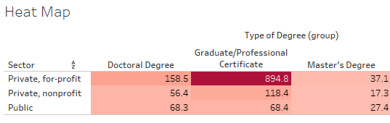
Table/Heat Map
Heat Map 1
Row: Institutional
Columns: median debt, earnings, and number of graduates
Heat Map 2: Show median earnings for the degree type compared between sector.
Best for
  2 dimensions
  1 measure
Pre-attentive attributes
  Color (sequential, diverging)
Limits
  Color has limited accuracy
  Many numbers are hard to visualize
Features:
  Sort by dimension name or by measure value
Formatting:
Filter data, Group data, Sort by name, value
Color by value (measure)

Slide 7
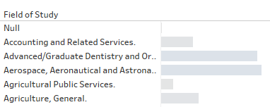
Bar
Bar 1
Show median debt by field of study and sector
Best for
  0-1 dimension
  1 measure
Pre-attentive attributes
  Length
  Color (categorical, sequential)
Limits
  Best for n<10
  Hard to visualize very precise data (use histogram instead)
Features:
  Sort by dimension name or by measure value
Formatting:
Filter rows
Show filter

Slide 8
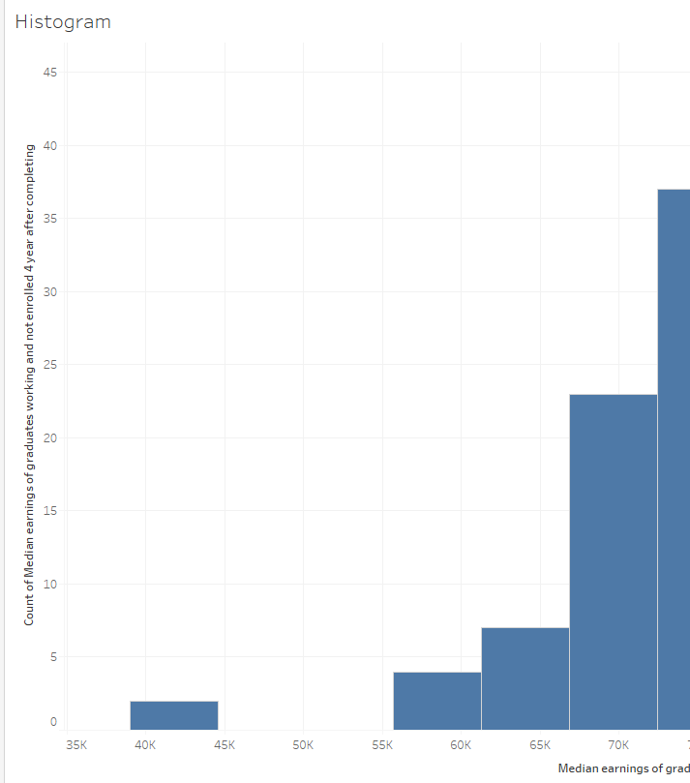
Histogram
Bar
Show distribution of debt for WVU programs
Best for
  1 measure (no dimensions)
Pre-attentive attributes
  Position on common axis
Limits
  No dimensions
Features:
  Change bin size
  Limit outliers
Formatting:
Bin size

Slide 9
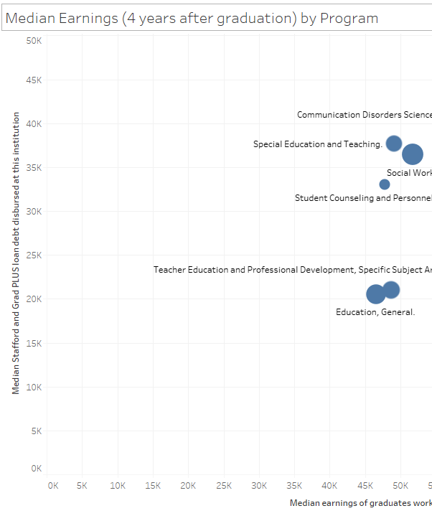
Scatterplot
Scatterplot
Show median earnings v. median debt for Computer Science for different institutions
Best for
  2 numeric dimensions
  0-1 measure (aggregate or disaggregate)
Pre-attentive attributes
  Color (<5 categorical)
  Position on common axis
  Size
  Trend lines
Limits
  Overplotting
Features:
  Use aggregated or disaggregated data
Formatting:
Custom scale
Reference lines
Trend lines

Slide 10
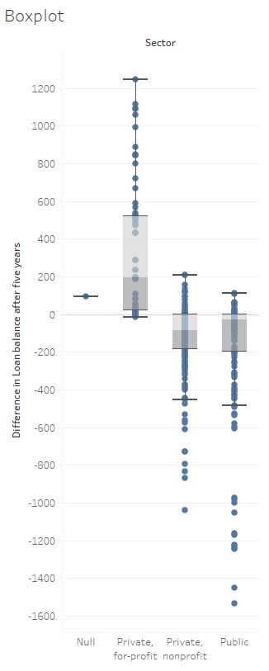
Boxplot
Boxplot
Show earnings by sector
Filter to only show doctoral degrees
Best for
  1 dimension
  1 measure
Pre-attentive attributes
  Position on common axis
Limits
  Overplotting
Features:
  Very good for showing very precise data by a category
  Very good at simplifying large amounts of data to show overall values

Slide 11
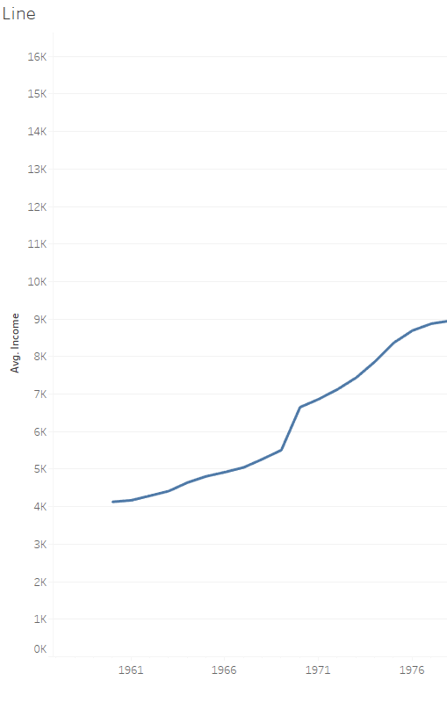
Line
Line
Show average tuition by year (fees table)
Color by sector
Best for date data
  0-1 dimensions
  1 measure
Pre-attentive attributes
  Position on common axis, angle
Limits
  Must be for dates
Features:
  Discrete v. continuous data
  Use dual axis to show dots on points
Formatting:
Custom date scale

Slide 12
Publish!
Create dashboard / story
Create data extract
Post on Tableau Public

Slide 13
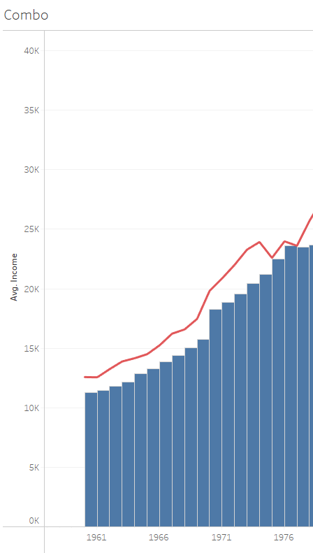
Combo
Best for
  0-1 dimension
  2 measures
Pre-attentive attributes
  Position on common axis
Process
  Add 2 measures
  Go to Marks, and change one to Bar
  Right-click pill and change to dual axis
Formatting:
Synchronize scales

