Slide 1
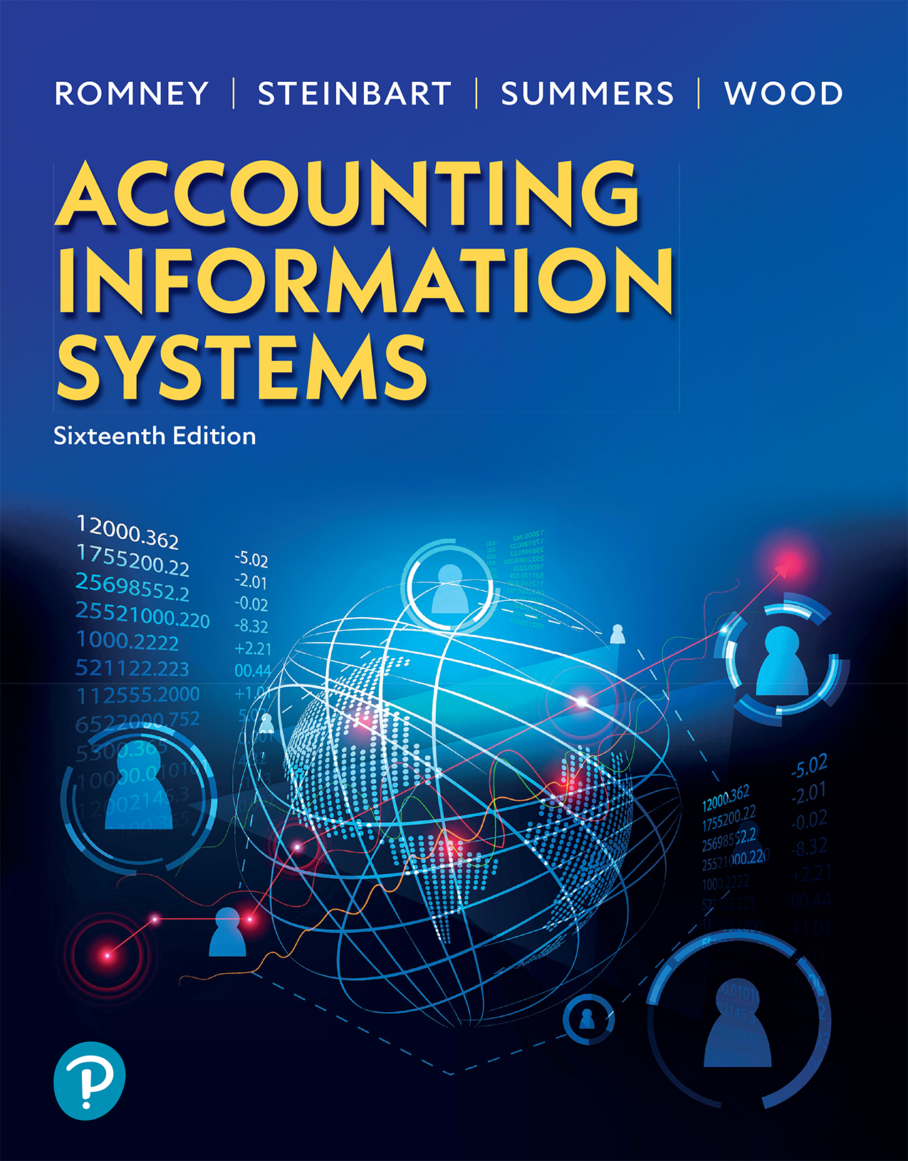

Accounting Information Systems
Sixteenth Edition
Chapter 1
Accounting Information Systems: An Overview
Copyright © 2024, 2021, 2018 Pearson Education, Inc. All Rights Reserved
Notes:
If this PowerPoint presentation contains mathematical equations, you may need to check that your computer has the following installed:
1) MathType Plugin
2) Math Player (free versions available)
3) NVDA Reader (free versions available)

Slide 2
Learning Objectives
Why do we care about IT?
  What is a system?
  What is an AIS?
Understand business processes
  Describe a business value chain
  Describe the cycles in accounting
  Explain IT’s role in the value chain

Slide 3
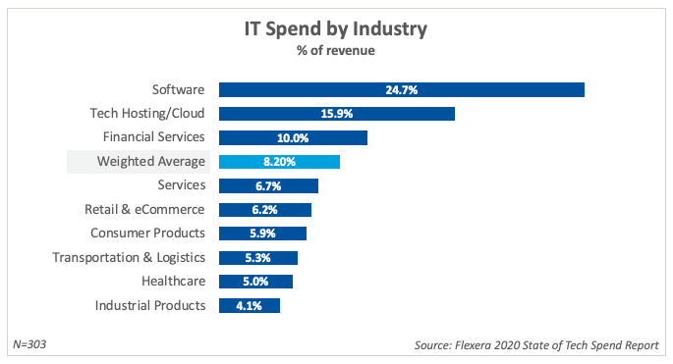
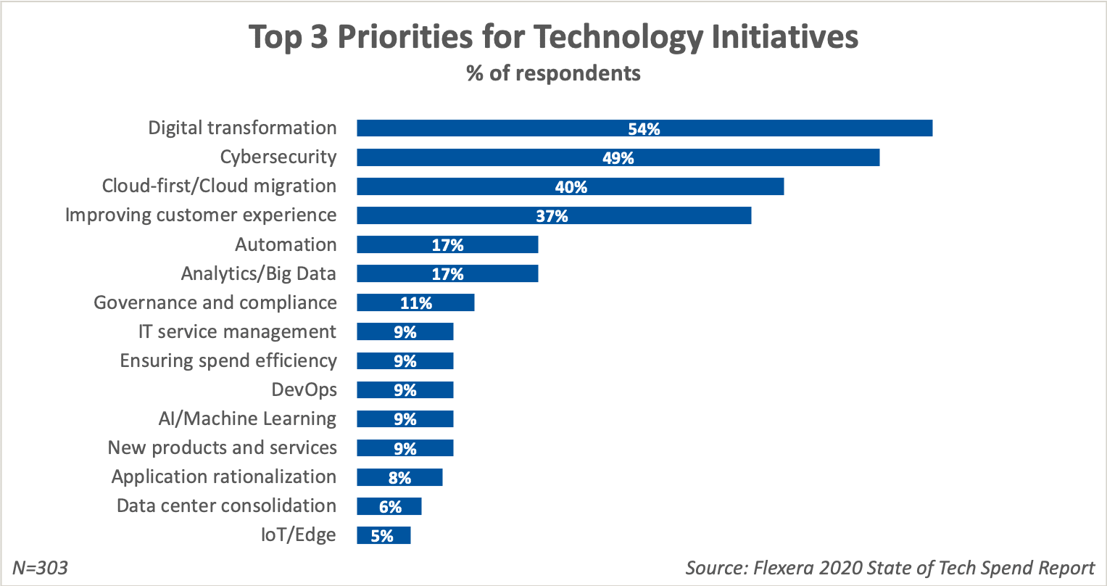
https://www.flexera.com/blog/technology-value-optimization/it-spending-by-industry/

Slide 4
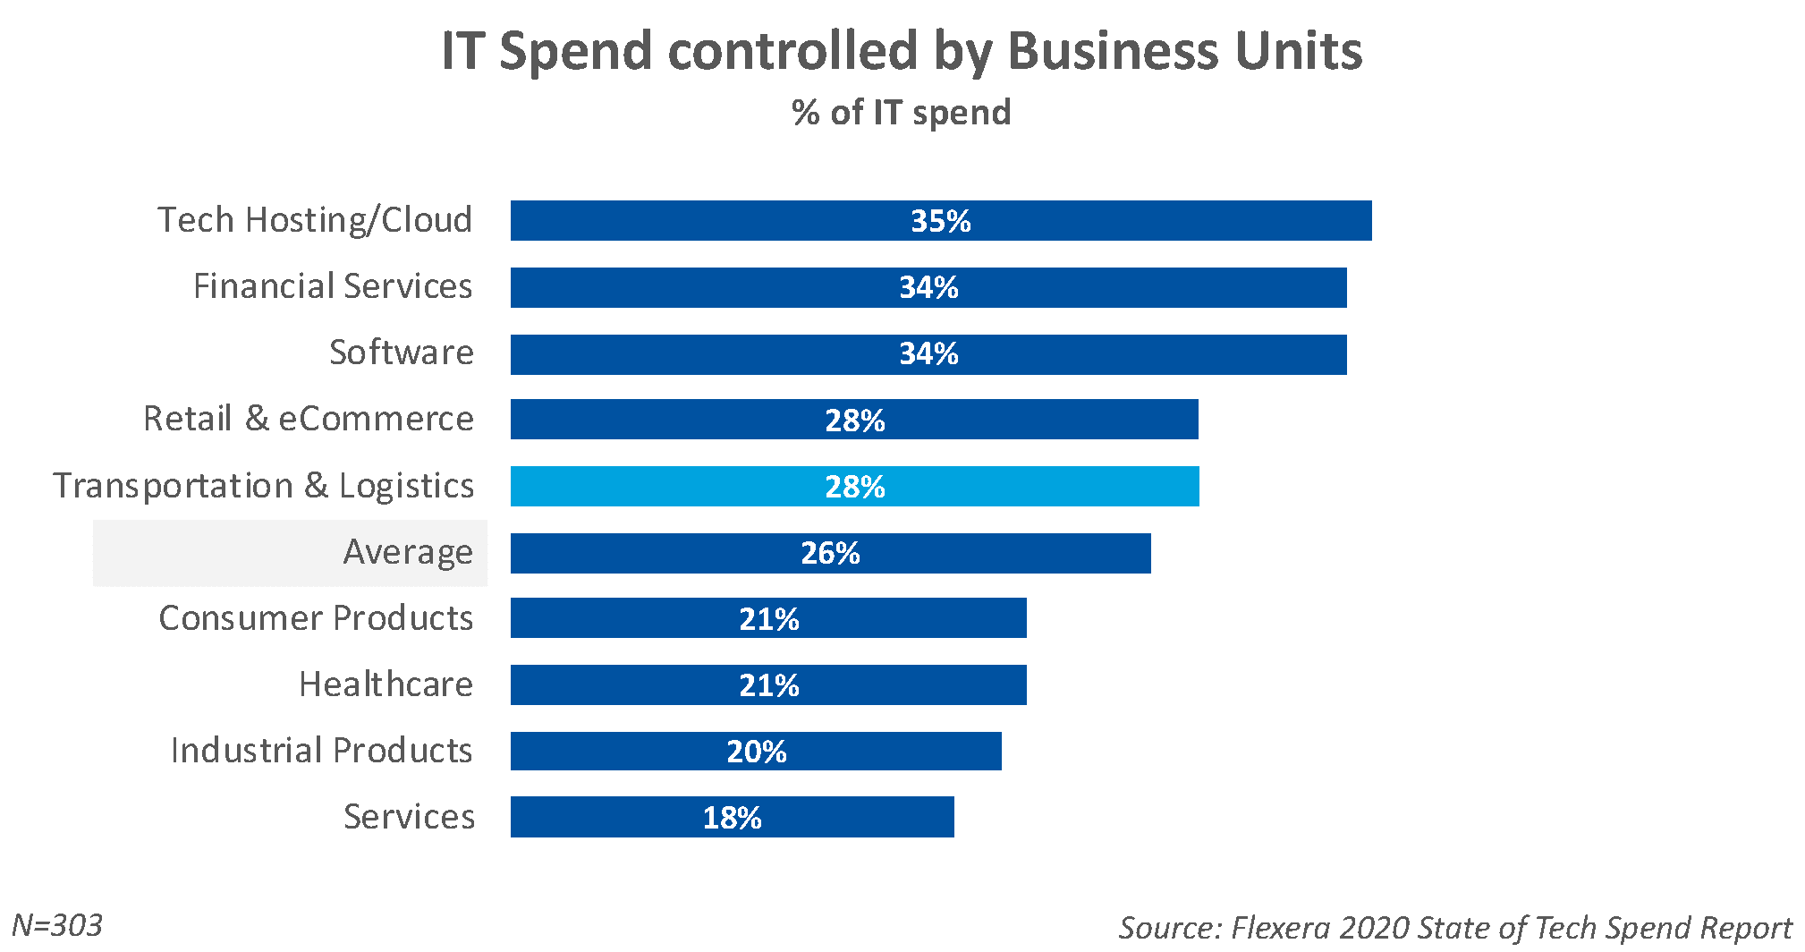

Slide 5
Defining an Information System
A system is a set of detailed methods, procedures, and routines that carry out specific activities, perform a duty, achieve goals or objectives, or solve one or more problems.
  Most systems are composed of smaller subsystems (e.g., department within a college of business)
Notes:
Consider using a tangible example that is contextualized to your institution to introduce students to how information affects decision making.

Slide 6

What Is an Accounting Information System (A I S)?
Acts to:
  Collect data
  Safely store data
  Processes data into information
Consists of:
  People who use the system
  Processes
  Technology (data & software)
  Controls
Controls
Notes:
There are six components to an AIS:
People use the system
Procedures and instructions used to collect, process, and store the data
Data
Software used to process the data
Information technology (i.e., computers)
Internal controls and security
These six components help the AIS fulfill three important business functions:
Collect and store data about organizational activities (through business processes).
Transform data into information so management can make decisions (plan, execute, control and evaluate activities, resources, and personnel).
Provide adequate controls to safeguard the organization’s assets and data.

Slide 7
A I S and Corporate Strategy
Strategy drives A I S (and vice versa)
  AIS limits strategic opportunities
  AIS supports strategic goals by providing data/monitoring
Notes:
For example, if the strategy is increase profitability, an organization can increase sales revenue and decrease manufacturing costs. Each of these actions will have different informational needs to measure progress. To increase sales revenue, the company can increase prices, increase volume, or change the product mix. To decrease manufacturing costs, the company can reduce the cost of the inputs into the manufacturing process or improve the process.
Technological developments and advances have an effect on corporate strategy. Data analytics is becoming more widespread in organizations as they continue to take advantage of the technological advancements. An example is the use of predictive analysis.

Slide 8
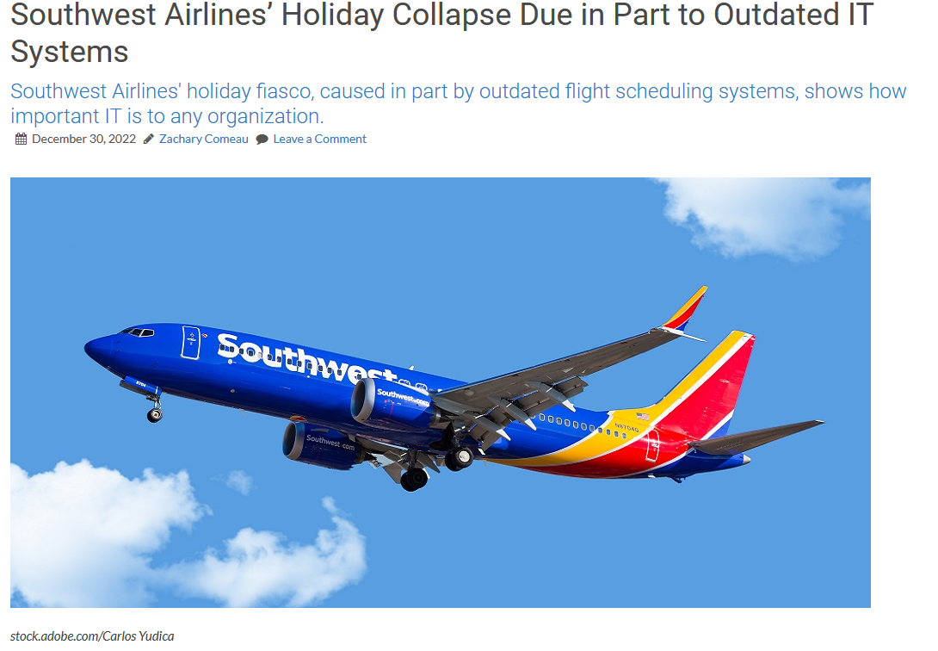
https://mytechdecisions.com/it-infrastructure/southwest-airlines-holiday-collapse-due-in-part-to-outdated-it-systems
Notes:
Bob Jordan, the airline’s CEO, in a statement released on the company’s website, said the airline, the largest carrier in the country, operates a highly complex network that requires all aircraft and crews to “remain in motion” to their destination to keep scheduled flights operational. However, that didn’t happen due to weather-related flight cancellations during one of the busiest travel seasons of the year.
Those conditions forced an “unprecedented” number of daily schedule changes that overwhelmed the airline’s flight scheduling tools and ability to recover. While public statements don’t dive much into details, Jordan says the airline needs to upgrade its systems.
“The tools we use to recover from disruption serve us well, 99% of the time; but clearly, we need to double down on our already existing plans to upgrade systems for these extreme circumstances so that we never again face what’s happening right now,” the airline executive says in a statement.
According to statements from the Southwest Airlines Pilot Association (SWAPA) and social media comments, the airline’s IT challenges were a long time coming.
SWAPA, the union representing the airline’s pilots, says the operational collapse was not a surprise to anyone but the airline’s leadership.
“A systemic failure of Southwest Airlines leaders to modernize, support, and staff its operation leaves every frontline employee, Pilots included, tired of apologizing to our passengers,” the statement reads. “For more than a decade, leadership shortcomings in adapting, innovating, and safeguarding our operations have led to repeated system disruptions, countless disappointed passengers, and millions in lost profits.”
The airline’s network has grown increasingly complex and has essentially outgrown the airline’s ability to withstand weather and technology-related disruptions, the union says, adding that it has called on leadership to fix those technical issues.
“Once again, we call for investing in infrastructure that will improve conditions for both our passengers and pilots. Infrastructure in the forms of crew scheduling software that takes into account our point-to-point network, a modern collective bargaining agreement that reflects best practices in today’s demanding operation, and communication tools that would have allowed for displaced crews to remain in constant contact with our Company.”
The union also detailed how these concerns have been brought to leadership for many years, but the issues remained.
In an article about the fiasco, The Washington Post also cited SWAPA and other unions who have long raised concerns about the airline’s scheduling systems.
The Transport Workers Union, whose Local 556 represents flight attendants at Southwest, likewise said on Twitter on Wednesday that the meltdown was avoidable, and said that the airline should have invested in passengers and workers, rather than paying dividends to shareholders.
Southwest declined to answer questions about its technology investments and didn’t share new information about its recovery efforts Wednesday. Its scheduling system relies on manual reports that crew members give of their locations and available time remaining to work within a period.
In short, the moral of the story here is that viewing IT systems and technology as a cost center rather than a department of highly skilled technologists who can help make the organization more efficient and resilient will likely lead to disastrous consequences.
Those consequences include an anticipated significant impact on fourth-quarter revenues. According to CNBC, a similar incident in October 2021 cost the airline about $75 million, but this event has lasted longer and impacted more travelers.
Imagine what operating at a third of your organizations normal capacity for several days would do to your bottom line, not to mention what it would do to your relationship with customers. On top of that, your communications staff is sent into emergency mode to deal with the barrage of bad press.
If there is an IT system that is holding the operation together with toothpicks and bubble gum, have those conversations with leadership before it is too late

Slide 9
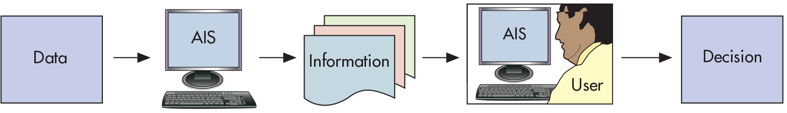
Figure 1.4
An A I S Processes Data to Produce Information for Decision Makers
Notes:
Examining Figure 1.2 provides a great amount of detail and insights as to the flow of information going from the internal and external stakeholders for business processes. Note that this information can be easily mapped to Figure 1.3 which shows the transactional activity “give–get” exchange.

Slide 10
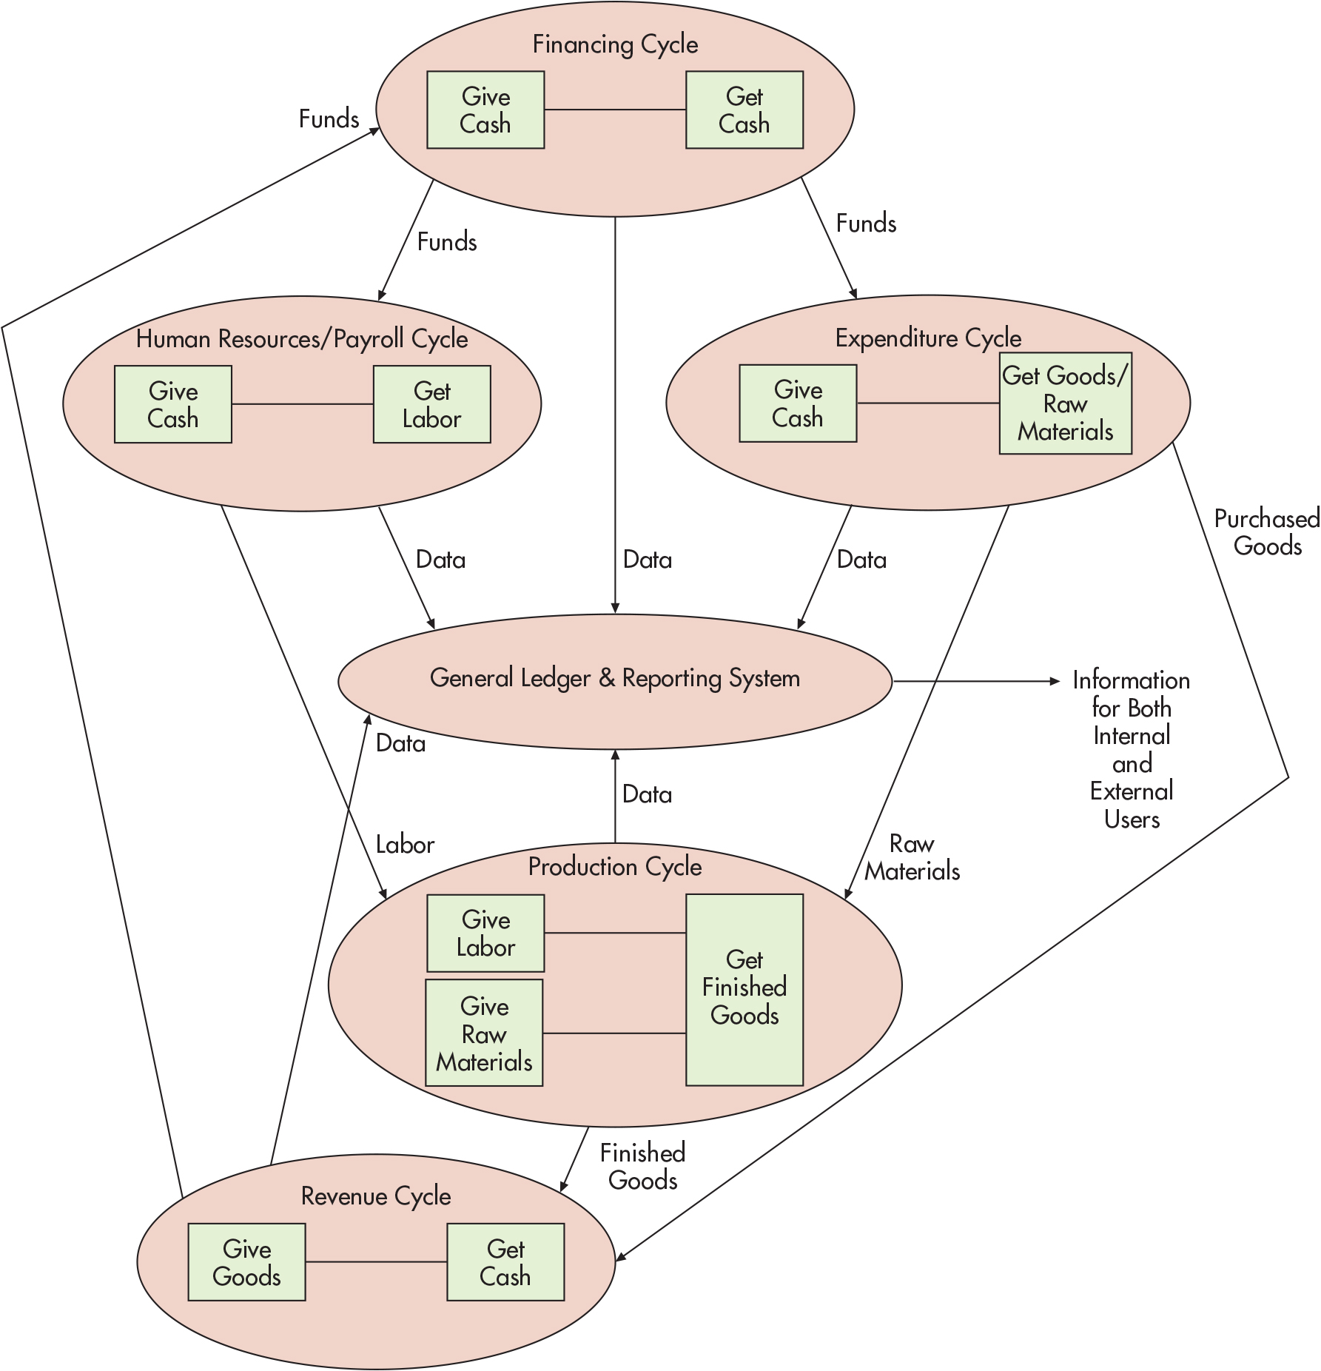
Figure 1.3
The A I S and Its Subsystems
Notes:
Examining Figure 1.2 provides a great amount of detail and insights as to the flow of information going from the internal and external stakeholders for business processes. Note that this information can be easily mapped to Figure 1.3 which shows the transactional activity “give–get” exchange.
Long Description:
Financing cycle: give cash points to the get cash; financing cycle points to the human resources or payroll cycle via funds; human resources or payroll cycle: give cash points to the get labor; financing cycle points to the general ledger and reporting system via data; general ledger and reporting system point to the information for both internal and external users; financing cycle points to the expenditure cycle via funds; expenditure cycle: give cash points to the get goods or raw materials. Human resources or payroll cycle points to the general ledger and reporting system via data and production cycle via labor. The expenditure cycle points to the following: the general ledger and reporting system via data; the production cycle via raw materials; and the revenue cycle via purchased goods. Production cycle: give labor and give raw materials points to the get finished goods; the production cycle points to the general ledger and reporting system via data and revenue cycle via finished goods. Revenue cycle: give goods points to get cash; the revenue cycle points to the financing cycle via funds.

Slide 11
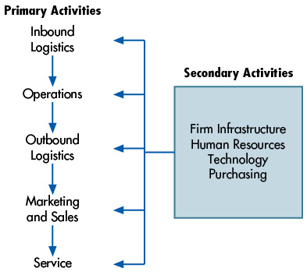
Figure 1.6 The Value Chain
Notes:
Long Description:
The value chain for “Primary activities” appears as follows:
Step 1. Inbound Logistics
Step 2. Operations
Step 3. Outbound Logistics
Step 4. Marketing and Sales
Step 5. Service
The “Secondary activities” that influence the primary activities are as follows:
Firm Infrastructure
Human Resources
Technology
Purchasing

Slide 12
Breakout Task
By group, identify the value chain for the following industries:
  A: Small private college
  B: Town Newspaper
  C: Package delivery
  D: Furniture maker
  E: Hobby retail store
  F: House cleaning
  G: Book author
  H: Website design
  I: YouTube “unboxing” video creator
  J: CPA firm specializing in tax
  K: Consulting company

Slide 13
A I S in the Value Chain
The value chain links together the different activities within an organization that provide value to the customer.
  Value chain activities are primary and support activities.
    Primary activities provide direct value to the customer.
    Support activities enable primary activities to be efficient and effective.
A supply chain is an extended system that includes the organization’s value chain as well as its suppliers, distributors, and customers.
Notes:
Please note that students may see primary and then assume secondary is next. This is a common mistake and using the visual from Figure 1-5 in the book also as an example can help mitigate this common misperception.
A basic example involves buying a textbook. Ask the students how they generally buy a textbook (usually they buy it online or go to the bookstore); either way you can walk through the primary and support activities that are needed for them to get their textbook in time for the first day of class!

Slide 14
Basic Business Processes
Transactions between the business organization and external parties fundamentally involve a “give–get” exchange. These basic business processes are:
  Revenue cycle: give goods / give service—get cash
  Expenditure cycle: get goods / get service—give cash
  Production cycle: give labor and give raw materials—get finished goods
  H R / Payroll cycle: give cash—get labor
  Financing cycle: give cash—get cash
Notes:
It seems odd that the financing cycle is give cash—get cash; what does this really mean?
It basically means that a business organization can get cash in the form of a bank loan but will need to give that cash back over time in the form of monthly payments to the bank.
Or it may mean that the company can get cash from investors and give equity (which eventually turns into cash in the form of dividend payments).

Slide 15
Stopped 9/25

Slide 16
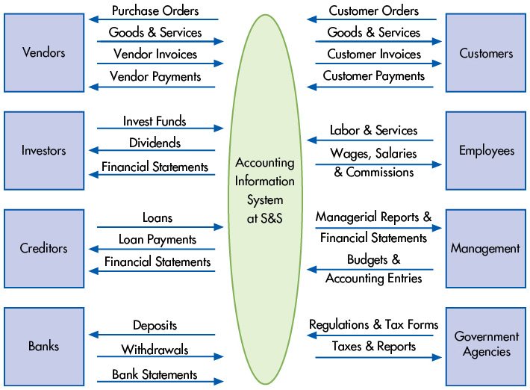
Figure 1.2 Interactions Between S&S and External and Internal Parties
Notes:
Examining Figure 1-2 provides a great amount of detail and insights as to the flow of information going from the internal and external stakeholders for business processes. Note that this information can be easily mapped to Figure 1-3 which shows the transactional activity “give–get” exchange.
Long Description:
The interaction of the system with various parties appears in the diagram as follows.
Parties
From S and S to the parties
From Parties to S and S
Vendors
Purchase orders
Vendor payments
Goods and services
Vendor invoices
Investors
Dividends
Financial statements
Invest funds
Creditors
Loan payments
Financial statements
Loans
Banks
Deposits
Withdrawals
Bank statements
Customers
Goods and services
Customer invoices
Customer orders
Customer payments
Employees
Wages, salaries and commissions
Labor and services
Management
Managerial reports
Financial statements
Budgets
Accounting entries
Government agencies
Taxes and Reports
Regulations and tax forms

Slide 17
How Does an A I S Add Value to an Organization?
A well thought out A I S can add value by:
  Improving the quality and reducing the costs of products or services
  Improving efficiency
  Sharing knowledge
  Improving efficiency and effectiveness of its supply chain
  Improving the internal control structure
  Improving decision making
Notes:
A good example here is thinking back to the pizza restaurant example in the earlier slides. The owner uses an AIS to determine which pizzas are the most popular. The sales information in the AIS is used to help answer this question and provides the owner with information to know how much of certain ingredients should be on hand to make those popular pizza pies. If ingredients were to run out, then the quality of this decision would be considered poor as there would be many dissatisfied customers. In addition, this information helps the owner not to buy too much of an ingredient to have on hand to where there may be waste if the ingredients go stale.
Taking this example further to each bullet point made above can help students begin to think more about how transactional data provides information for better decision making in an organization.

Slide 18
Artificial Intelligence
Artificial intelligence (A I) is the use of computer systems to simulate human intelligence processes such as learning, reasoning, and self-improvement.
A I can be used in the following fields
  Business
  Education
  Finance
  Healthcare

Slide 19
Data Analytics
Data analytics is the use of software and algorithms to find and solve problems and improve business performance.
Analytics can help improve decision making by
  Identifying a problem/issue for management to resolve.
  Collecting the data needed to solve the problem, analyze it, and make recommendations to management on how to resolve it.
  Integrating actionable insights into the systems used to make decisions.

Slide 20
Cloud Computing
Cloud computing is the use of a browser to remotely access software, data storage, hardware, and applications.

Slide 21
Key Terms
https://quizlet.com/653888163/ais-chapter-1-terms-flash-cards/

Slide 22
Copyright
This work is protected by United States copyright laws and is provided solely for the use of instructors in teaching their courses and assessing student learning. Dissemination or sale of any part of this work (including on the World Wide Web) will destroy the integrity of the work and is not permitted. The work and materials from it should never be made available to students except by instructors using the accompanying text in their classes. All recipients of this work are expected to abide by these restrictions and to honor the intended pedagogical purposes and the needs of other instructors who rely on these materials.

