Slide 1


Accounting Information Systems
Sixteenth Edition
Chapter 2
Overview of Transaction Processing and Enterprise Resource Planning Systems
Copyright © 2024, 2021, 2018 Pearson Education, Inc. All Rights Reserved
Notes:
If this PowerPoint presentation contains mathematical equations, you may need to check that your computer has the following installed:
1) MathType Plugin
2) Math Player (free versions available)
3) NVDA Reader (free versions available)

Slide 2
Learning Objectives
Describe the data processing cycle used to process transactions, including how data is input, stored, and processed and how information is output.
Discuss how organizations use enterprise resource planning (E R P) systems to process transactions and provide information.
Notes:
This chapter is a good overview of the details that will be forthcoming in the text. This is also a good opportunity to put the class in perspective and how it relates to the other financial accounting courses that the students are taking. For example, students taking financial accounting classes understand the transaction focusing only on the proper debit and credit accounts and how the financial statements are prepared. This chapter provides a good pathway to connect those concepts from the journal entries to understanding the flow of the accounting information in a system from the detailed level, data from source documents, to subledgers and the general ledger and then to the financial statements or management reports necessary to make business decisions.

Slide 3
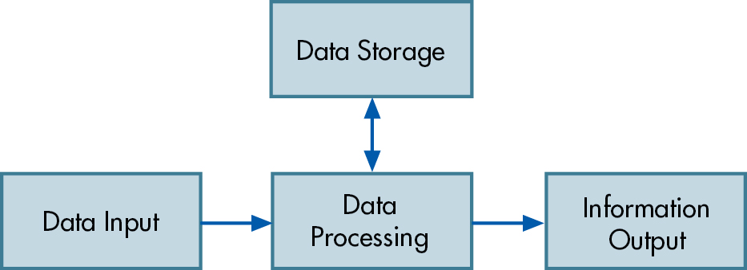
Figure 2.1 The Data Processing Cycle
Notes:
The data processing cycle is a descriptive means of demonstrating the operations performed on data to make the information meaningful for decisions. Using the revenue cycle as an example, the data input would include the sales activity between the company and the customer involving the resources of inventory and cash (when money is ultimately collected from the customer).
Walking through the basic activities found on Table 2-1 in the text for the revenue cycle involves the sales order as the initial source document for the data input. This information is stored and often updated once other activities occur for this transaction in the revenue cycle such as an update to the sales record when the order is shipped from the warehouse. As seen in Table 2-1, the various activities that occur throughout the revenue cycle can impact the sales record and require updating of new information once that activity happens. The information that management can retrieve from the AIS can be in the form of reports such as Customer Sales Report.

Slide 4
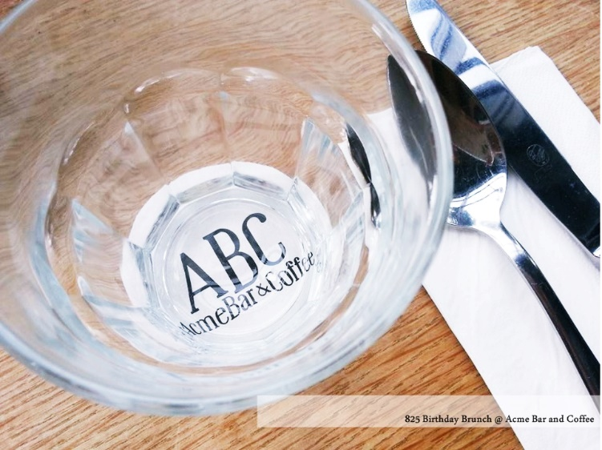
Accounting Cycle
Analyze source documents
Transactions into Journal
Journal to General Ledger
End of period adjusting entries
Prepare Trial Balance
Prepare Financial Statement
Closing entries
This Photo by Unknown Author is licensed under CC BY-NC-ND

Slide 5
Data Input
Steps in getting input are:
Capture transaction data triggered by a business activity (event).
Make sure captured data are accurate and complete.
Ensure company policies are followed (e.g., approval of transaction).

Slide 6
Data Capture
Information collected for an activity includes:
  Activity of interest (e.g., sale)
  Resources affected (e.g., inventory and cash)
  People who participated in the activity (e.g., customer and employee)
Information comes from source documents.

Slide 7
Source Documents
Captures data at the source when the transaction takes place
  Paper source documents
  Turnaround documents
  Source data automation (captured data from machines, e.g., point-of-sale scanners at grocery store)
Notes:
It is important to emphasize Table 2-1 in the text as this sets the stage for understanding the transaction cycles and the source documents associated with those activities in the transaction cycle. A solid foundational understanding of:
Activities
Source documents associated with the activity
Information flows (i.e., debit and credit postings in the ledger)
This helps the students understand how to establish controls for this information in the subsequent chapters. For example, the text in Chapter 2 does mention that prenumbering documents is a good control. A good question to ask students is why do they think prenumbering of the source documents would be important to have in an organization? This gets them thinking more intuitively based on their own experiences as a consumer and it may not make learning controls seem like memorizing a list and seem more like something that a student can think about as they understand the details and fit it to a bigger picture.
Another good class discussion is thinking about all the data that is collected using sensors (e.g., RFID tags). How much of this data would be important for the organization to capture?

Slide 8

ABC End of Month Entries (part 1)
Coffee Mug Sales
  Sales are made via a 3rd party eCommerce website.
  Mugs are automatically shipped from distributor to customer without any company interaction.
  Payments are made with a credit card at time of sale
  To limit fraud, new customers are limited to 10 orders per month.
  A manual review of all chargebacks happens every month to identify risk factors.
Identify:
  Process for entering sales data
  Source documents
  Verifying accuracy & policies
This Photo by Unknown Author is licensed under CC BY

Slide 9
Data Storage
Data organization
  Chart of accounts
    Coding schemas
  Transaction journals (e.g., Sales)
  Subsidiary ledgers (e.g., Accounts receivable)
  General ledger
    Note: With the above, one can trace the path of the transaction (audit trail)
Notes:
Figure 2.2 on page 37 is a great example of showing students how to follow a transaction to the various subledgers and the general ledger. This helps them visualize the structure of how data is stored in an AIS.

Slide 10
Coding Techniques
Sequence codes—items numbered consecutively to account for all items (i.e., prenumbered forms)
Block code—blocks of numbers reserved for specific categories of data (i.e., product numbers that start with a 2 are refrigerators)
Group codes—two or more subgroups of digits used to code items (i.e., car V I N #’s)
Mnemonic codes—letters and numbers interspersed to identify an item (i.e. Dry300W05 is low end (300), white (W) dryer (D R Y) made by Sears (05))
Notes:
The importance of data storage cannot be stressed enough. Many organizations change and evolve, but rarely do accountants have the luxury to really think ahead to organize how they want the information to be stored. Yet many AIS allow you to run special reports based on the coding schemas in the chart of accounts. For example, if your organization is expanding, is it important to have individual location financials as well as roll them up into regional financials? The coding schema of the chart of accounts, if not well thought out, can limit an organization and cause additional work; however, if the schema is well thought out, it can be more efficient to get the information to management.

Slide 11
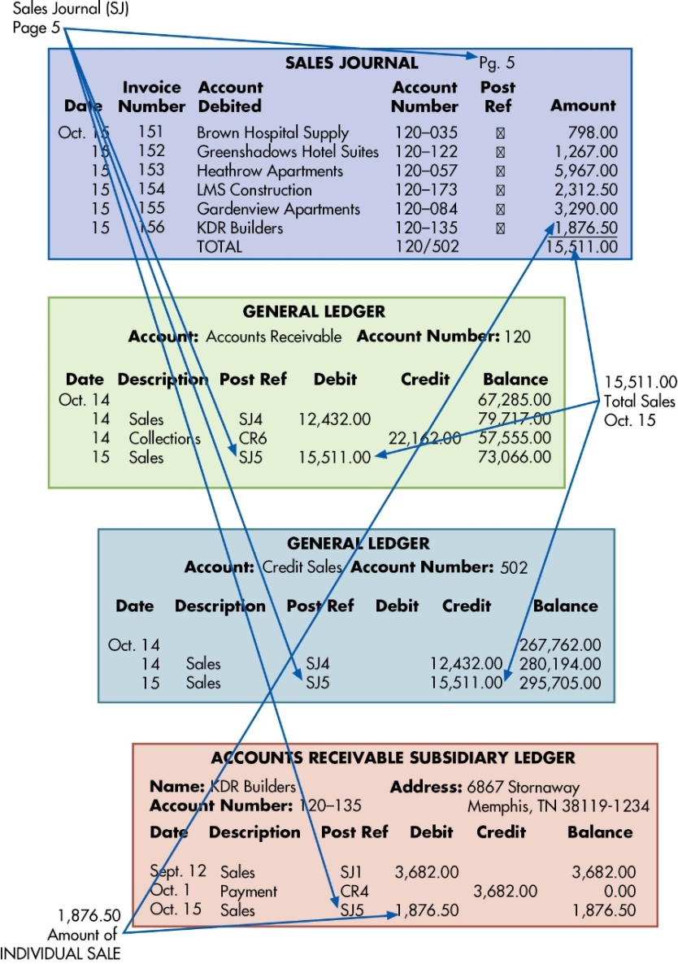
Figure 2.2 Recording and Posting a Credit Sale
Audit trail for Invoice #156 for $1,876.50 sold to K D R Builders
Notes:
Figure 2-2 from the text shows how the different ledgers and journals are used to trace the path of one transaction found in Table 2-3 (invoice # 156 from KDR Builders). This example should also reinforce the accounting knowledge for the student as they may understand the debit and credit of a sale transaction but not necessarily understand how the AIS would store that transactional data.
A good question to ask the students is why are there transactional journals and subledgers and not just one big general ledger? As they may have learned in their introductory accounting class, this becomes a very large file and it is easier to parcel out the information that is specific to the transaction (e.g., sales or purchasing) and the associated subsidiary ledgers.
Long Description:
The diagram shows four types of accounts, “Sales journal,” “General ledger of credit sales,” “General ledger of accounts receivable,” and “Accounts receivable subsidiary ledger.” Each credit sale is recorded in the sales journal, and each sales journal entry is posted to the appropriate customer account in the accounts receivable subsidiary ledger. The recording and posting of the credit sale are linked to particular entries in all the four accounts through arrows.
It further shows the following linking and audit trail between the entries of different accounts:
The sales journal (S J) of linked to page 5, post reference S J 5 in general ledgers (Accounts Receivable and Credit Sales), and post reference S J 5 in general ledgers accounts receivable subsidiary ledger.
An amount of individual sale of 1,876.50 dollars to K D R Builders in the sales journal on October 15 is linked to the debit for as 1,876.50 dollars in the accounts receivable subsidiary ledger.
The general ledger for accounts receivable shows an entry on October 15 as sales of 15,511.00 dollars (debit) with post reference as S J 5 (sales journal, page 5).
The general ledger for credit sales shows an entry on October 15 as sales of 15,511.00 dollars (credit) with post reference as S J 5 (sales journal, page 5).
The accounts receivable subsidiary ledger for KDR Builders shows an entry on October 15 as sales of 1,876.50 dollars (debit) with post reference as S J 5 (sales journal, page 5).

Slide 12
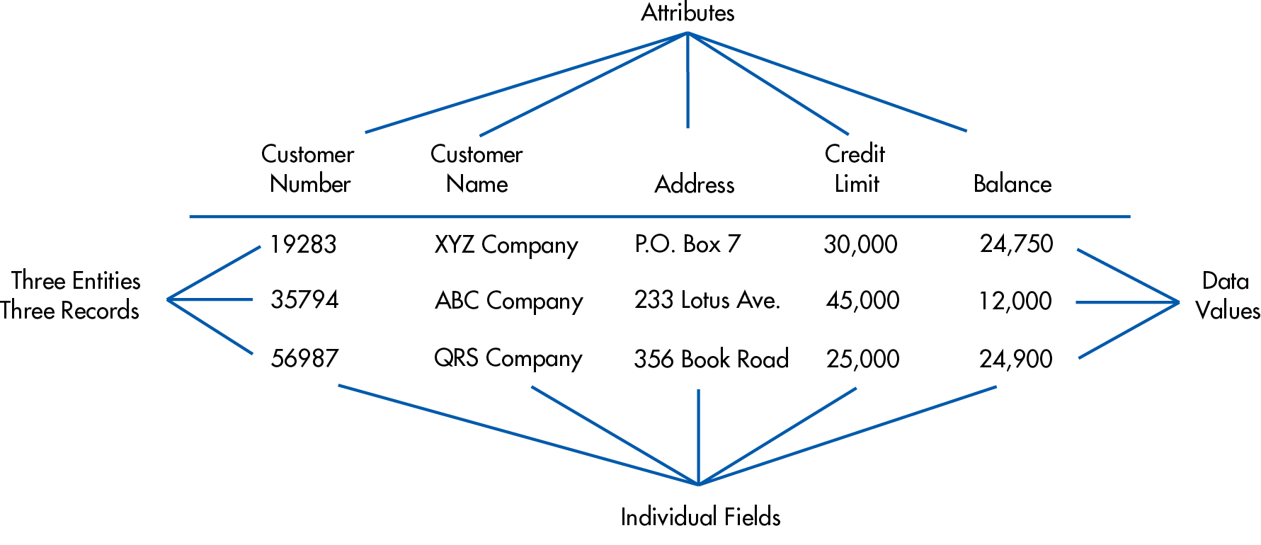
Figure 2.3 Data Storage Elements
Data is stored in master files or transaction files.
Notes:
Its important to understand how the data aggregates as this will be useful in subsequent chapters for designing query (questions) of the data or reports.
Students should be thinking about what information is in master files and what would be in transaction files. It is helpful to refer to slide 2-5 such that master files usually include “resource” and “people” data (i.e., inventory master files store information of all items the company sells) and the transaction file is the activity or event data that is captured (i.e., sales transactions).
Thus, there is the following hierarchy:
Database includes
Files (master/transaction) which include
Records (entities) which include
Attributes (individual fields)
Long Description:
The table shows the elements of data storage with three entries or three records. It has five columns denoting “Attributes” and three rows denoting “Three Entities or Three Records.” The attributes are as follows: “Customer Number,” “Customer Name,” “Address,” “Credit Limit,” and “Balance.”
Each attribute has a data field filled with data values. The data values for different attributes in the table are as follows:
First entry: Customer Number, 19283; Customer Name, XYZ; Company; Address, P.O. Box 7; Credit Limit, 30,000; Balance, 24,750.
Second entry: Customer Number, 35794; Customer Name, ABC Company; Address, 233 Lotus Avenue; Credit Limit, 45,000; Balance, 12,000.
Third entry: Customer Number, 56987; Customer Name, QRS Company; Address, 356 Book Road; Credit Limit, 25,000; Balance, 24,900.

Slide 13
ABC End of Month Entries (part 2)
Coffee Mug Sales
  Sales are made via a 3rd party eCommerce website.
  Mugs are automatically shipped from distributor to customer without any company interaction.
  Payments are made with a credit card at time of sale
  To limit fraud, new customers are limited to 10 orders per month.
  A manual review of all chargebacks happens every month to identify risk factors.
Identify :
  Storage method
  Accounts
  Master and transaction files
  Coding schemes
This Photo by Unknown Author is licensed under CC BY

Slide 14
Data Processing
Four types of processing (C R U D):
Creating new records (e.g., adding a customer)
Reading existing data
Updating previous record or data
Deleting data
Data processing can be batch processed (e.g., post records at the end of the business day) or in real-time (process as it occurs).

Slide 15
ABC End of Month Entries (part 3)
Coffee Mug Sales
  Sales are made via a 3rd party eCommerce website.
  Mugs are automatically shipped from distributor to customer without any company interaction.
  Payments are made with a credit card at time of sale
  To limit fraud, new customers are limited to 10 orders per month.
  A manual review of all chargebacks happens every month to identify risk factors.
Identify staff permissions for:
  Create
  Read
  Update
  Delete
This Photo by Unknown Author is licensed under CC BY

Slide 16
Information Output
The data stored in the database files can be viewed
Online (soft copy)
Printed out (hard copy)
  Document (e.g., sales invoice)
  Report (e.g., monthly sales report)
  Query (question for specific information in a database, e.g., Which division had the most sales for the month?)
Notes:
Queries are shown in Chapter 4 and are a very useful tool used in accounting to get specific information out of a database.

Slide 17
ABC End of Month Entries (part 4)
Coffee Mug Sales
  Sales are made via a 3rd party eCommerce website.
  Mugs are automatically shipped from distributor to customer without any company interaction.
  Payments are made with a credit card at time of sale
  To limit fraud, new customers are limited to 10 orders per month.
  A manual review of all chargebacks happens every month to identify risk factors.
Identify :
  Documents
  Reports
  Queries
This Photo by Unknown Author is licensed under CC BY

Slide 18
Enterprise Resource Planning (E R P) Systems
Integrates activities from the entire organization
  Revenue Cycle
  Expenditure Cycle
  Production Cycle
  H/R Payroll Cycle
  General Ledger and Reporting System
Notes:
This is a good place to emphasize that good internal controls are necessary, as an integrated database has the benefit of inputting data once in the system; if that input is inaccurate, it will be useless. That is why most people only have access to certain portions of the system and that good data entry controls are necessary.

Slide 19
Advantages of E R P System
Integrated enterprise-wide single view of the organization’s data which streamlines the flow of information
Data captured once (i.e., no longer need sales to enter data about a customer and then accounting to enter same customer data for invoicing)
Greater visibility and monitoring capabilities for management
Improve access of control of the data through security settings
Standardization of procedures and reports
Improves customer service
Increases productivity through automation

Slide 20
Disadvantages of E R P System
Costly
Significant amount of time to implement
Customizing or standardizing a business process
Complexity
User resistance (learning new things is sometimes hard for employees)
Notes:
Although there are many advantages of an ERP system and most companies small and large use some form of an ERP system, understanding the issues of implementation can determine a successful ERP implementation from a failed implementation.
Most notable, a business process will need to map to the ERP software, and management will need to determine if they want to customize the ERP software or standardize their business process to fit the ERP system.
A good discussion question is to ask students why they think user resistance occurs and how can this be mitigated if they were a manager handling the ERP implementation? Although there will be many answers in this discussion, one important takeaway is to highlight that training and support as well as communication of the change that will occur will help employees understand the change and also feel supported. A great article to bring into the classroom is from Harvard Business Review on change management (Kanter September 25, 2012). Access via https://hbr.org/2012/09/ten-reasons-people-resist-chang.

Slide 21
Key Terms
https://quizlet.com/653892696/ais-chapter-2-terms-flash-cards/
https://quizlet.com/760658523/ais-chapter-2-master-v-transaction-file-examples-flash-cards

Slide 22

Copyright
This work is protected by United States copyright laws and is provided solely for the use of instructors in teaching their courses and assessing student learning. Dissemination or sale of any part of this work (including on the World Wide Web) will destroy the integrity of the work and is not permitted. The work and materials from it should never be made available to students except by instructors using the accompanying text in their classes. All recipients of this work are expected to abide by these restrictions and to honor the intended pedagogical purposes and the needs of other instructors who rely on these materials.

