Slide 1


Accounting Information Systems
Sixteenth Edition
Chapter 3
Systems Documentation Techniques
Copyright © 2024, 2021, 2018 Pearson Education, Inc. All Rights Reserved
Notes:
If this PowerPoint presentation contains mathematical equations, you may need to check that your computer has the following installed:
1) MathType Plugin
2) Math Player (free versions available)
3) NVDA Reader (free versions available)

Slide 2
Learning Objectives
Prepare and use flowcharts to understand, evaluate, and document information systems.

Slide 3
Why Document Systems?
Accountants must be able to read documentation and understand how a system works (e.g., auditors need to assess risk)
Sarbanes-Oxley Act (S O X) requires management to assess internal controls and auditors to evaluate the assessment
Used for systems development and changes
Notes:
It has been said that a picture is worth a thousand words, and that certainly is true when it comes to an easy way to understand an organization’s information system. Documenting an information system requires great skill; however, the ability to understand and read a documentation can be quite intuitive.
Although there are many methods used in business to document systems, the text uses the three most popular for accountants: data flow diagrams, systems flowcharts, and Business Process Modeling Notation (BPMN).

Slide 4
Flowcharts
Describe an information system showing:
Inputs and outputs
Information activities (processing data)
Data storage
Data flows
Decision steps
Key strengths of flowcharts are that they can easily capture control via decision points, show manual versus. automated processes.

Slide 5
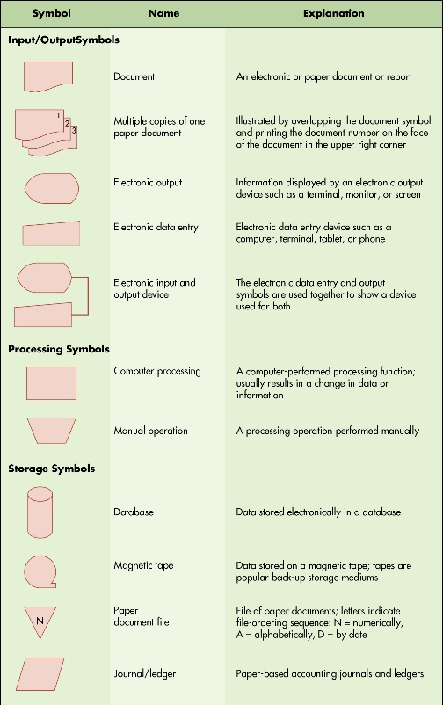
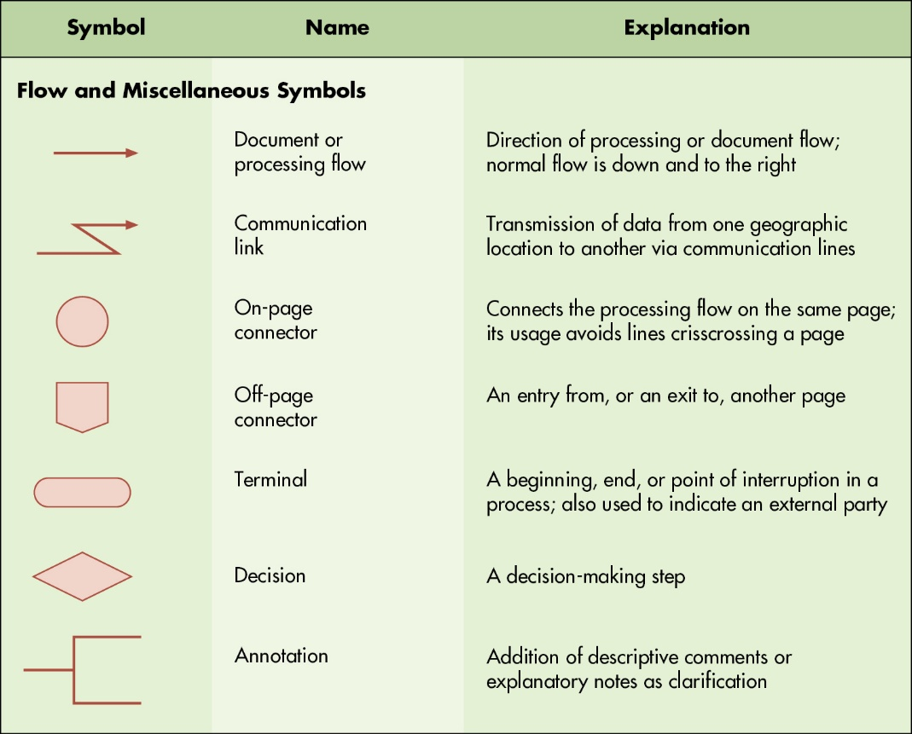
Figure 3.3 Common Flowcharts Symbols
Notes:
Long Description:
The table with common flowcharting symbols for input/output, processing, and storage appears as follows:
Symbol
Name
Explanation
Input/Output Symbols
A rectangle with a wave-like base
Document
An electronic or paper document or report
Three rectangles numbered 1, 2, and 3, each with a wave-like base
Multiple copies of one paper document
Illustrated by overlapping the document symbol and printing the document number on the face of the document in the upper right corner
A pentagon with one curved side
Electronic output
Information displayed by an electronic output device such as a terminal, monitor, or screen
A trapezoid with non-parallel sides much longer than the parallel sides
Electronic data entry
Electronic data entry device such as a computer, terminal, tablet, or phone
Symbol for electronic output connected to symbol for electronic data entry
Electronic input and output device
The electronic data entry and output symbols are used together to show a device used for both
Processing Symbols
Rectangle
Computer processing
A computer-performed processing function; usually results in a change in data or information
Trapezoid
Manual operation
A processing operation performed manually
Storage Symbols
Cylinder
Database
Data stored electronically in a database
A circle with a terminal point at the bottom
Magnetic tape
Data stored on a magnetic tape; tapes are popular back-up storage mediums
An inverted triangle with letter N inside it
Paper document file
File of paper documents; letters indicate file-ordering sequence: N: numerically, A: alphabetically, D: by date
Parallelogram
Journal/ledger
Paper-based accounting journals and ledgers
Long Description:
The table with common flow and miscellaneous symbols appears as follows:
Symbol
Name
Explanation
Flow and Miscellaneous Symbols
Right arrow
Document or processing flow
Direction of processing or document flow; normal flow is down and to the right
Right arrow with a zig-zag tail
Communication link
Transmission of data from one geographic location to another via communication lines
Circle
On-page connector
Connects the processing flow on the same page; its usage avoids lines crisscrossing a page
Pentagon
Off-page connector
An entry from, or an exit to, another page
Rounded rectangle
Terminal
A beginning, end, or point of interruption in a process; also used to indicate an external party
Rhombus
Decision
A decision-making step
A line connected to a square open on the right
Annotation
Addition of descriptive comments or explanatory notes as clarification

Slide 6
Yes - leave
start
Stand in line
Wait over 5m?
Place order
No
“Excuse me”
Stand in line
Receive receipt
Receive coffee
No
Correct drink?
Yes
end

Slide 7
start
Design the flowchart for contesting an unfairly graded assignment
Process
Document
IF Branching Condition
Yes
No
end

Slide 8
Guidelines for Drawing Flowcharts
Understand the system you are trying to represent.
Identify business processes, documents, data flows, and data processing procedures.
Organize the flowchart so that it reads from top to bottom and left to right.
Clearly label all symbols.
Use page connectors (if it cannot fit on a single page).
Edit/review/refine to make it easy to read and understand.

Slide 9

Copyright
This work is protected by United States copyright laws and is provided solely for the use of instructors in teaching their courses and assessing student learning. Dissemination or sale of any part of this work (including on the World Wide Web) will destroy the integrity of the work and is not permitted. The work and materials from it should never be made available to students except by instructors using the accompanying text in their classes. All recipients of this work are expected to abide by these restrictions and to honor the intended pedagogical purposes and the needs of other instructors who rely on these materials.

