Slide 1


Accounting Information Systems
Sixteenth Edition
Chapter 22
Introduction to Systems Development and Systems Analysis
Copyright © 2024, 2021, 2018 Pearson Education, Inc. All Rights Reserved
Notes:
If this PowerPoint presentation contains mathematical equations, you may need to check that your computer has the following installed:
1) MathType Plugin
2) Math Player (free versions available)
3) NVDA Reader (free versions available)

Slide 2
Learning Objectives
Explain the five phases of the systems development life cycle, and discuss the people involved in systems development and the roles they play.
Explain the importance of systems development planning, and describe the types of plans and planning techniques used.
Discuss the various types of feasibility analysis, and calculate economic feasibility using capital budgeting techniques.
Explain why system changes trigger behavioral reactions, what form this resistance to change takes, and how to avoid or minimize the resulting problems.
Discuss the key issues, objectives, and steps in systems analysis.

Slide 3
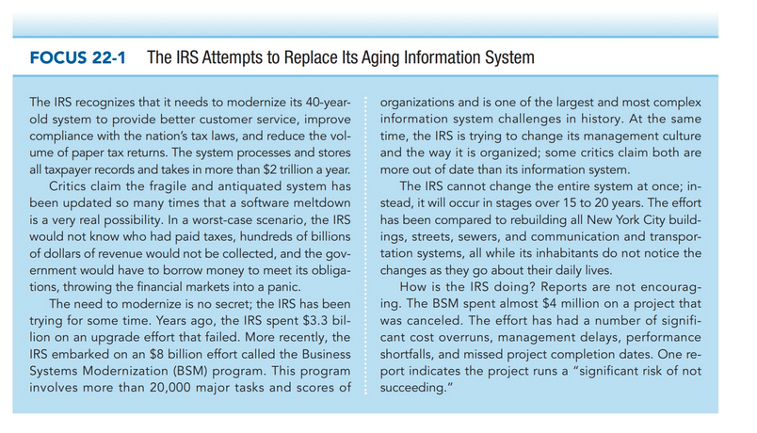

Slide 4
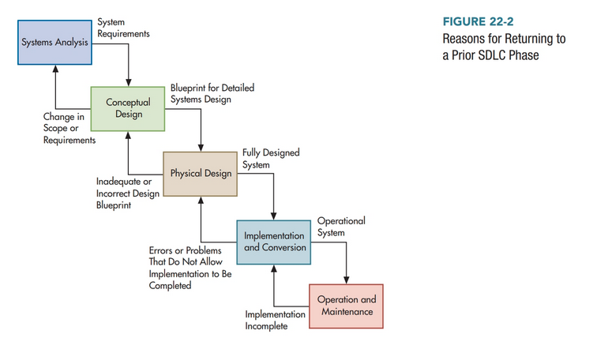

Slide 5
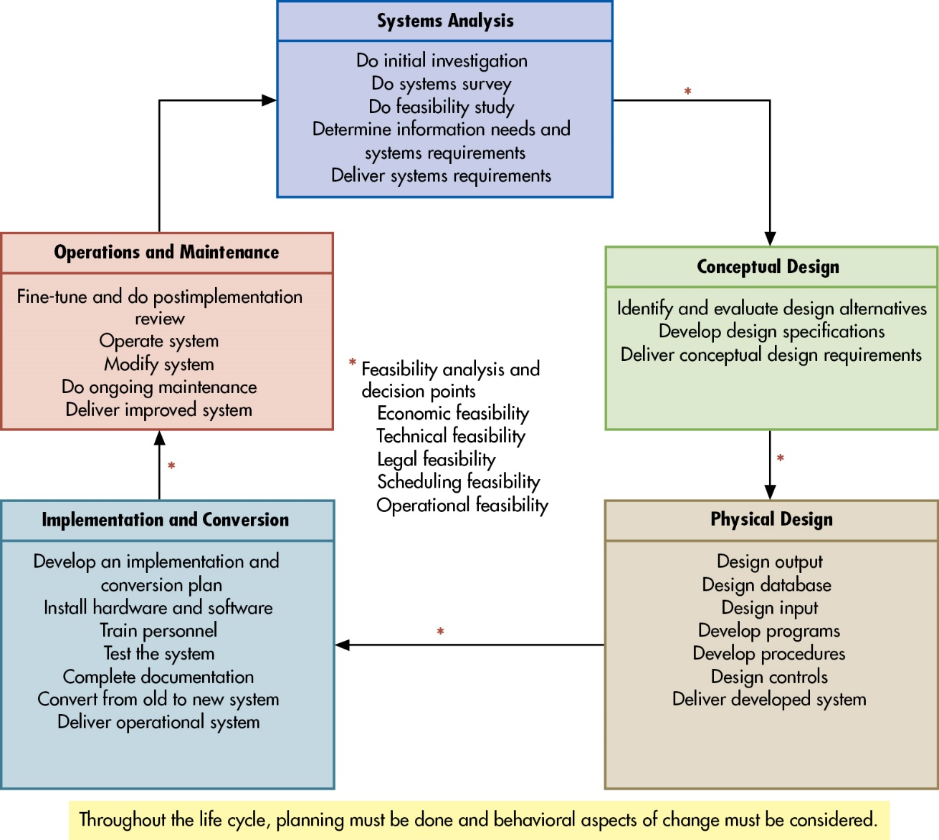
Figure 22.1 The Systems Development Life Cycle
Notes:
There are many reasons why organizations continue to change their information systems whether it’s a full systems replacement or an upgrade to an existing system. This can be due to technology changes, to become more effective and efficient in the organization (productivity gains), improve business processes, or for competitive advantage reasons.
Because of an organization’s desire to change an information system, it’s best to proceed using the following five steps known as the systems development lifecycle (SDLC):
Systems analysis: feasibility of the proposed project occurs. What is actually needed and when will it be done (scope of the project)? If it is feasible, then identify system requirements with an analysis report provided to the steering committee.
Conceptual design: determine how to meet user needs. Does project involve purchasing software, developing program in house, or outsourcing?
Physical design: translates broad conceptual design into the specific code, input and output source documents, and building the database.
Implementation and conversion: install and test new hardware and software, train employees after which conversion to the new system will be complete.
Operations and maintenance: ongoing reviews of the system with improvements and modifications made if necessary.
Long Description:
The steps in the systems development life cycle are as follows:
Systems Analysis
Do initial investigation
Do systems survey
Do feasibility study
Determine information needs and systems requirements
Deliver systems requirements
Conceptual Design
Identify and evaluate design alternatives
Develop design specifications
Deliver conceptual design requirements
Physical Design
Design output
Design database
Design input
Develop programs
Develop procedures
Design controls
Deliver developed system
Implementation and Conversion
Develop an implementation and conversion plan
Install hardware and software
Train personnel
Test the system
Complete documentation
Convert from old to new system
Deliver operational system
Feasibility analysis and decision points
Economic feasibility
Technical feasibility
Legal feasibility
Scheduling feasibility
Operational feasibility
Operations and Maintenance
Fine-tune and do post implementation review
Operate system
Modify system
Do ongoing maintenance
Deliver improved system

Slide 6
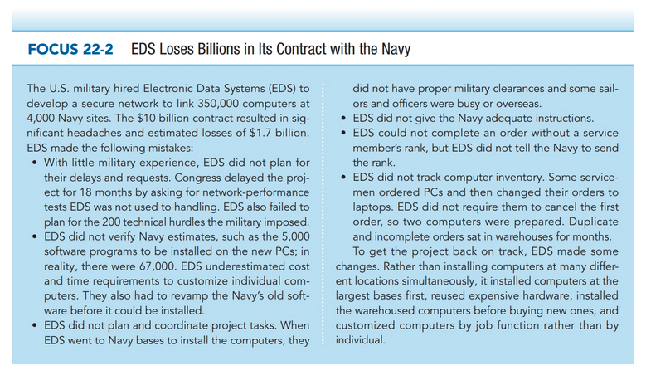

Slide 7
Why should we care about this?
Standish Group’s report on software projects
  70% late
  54% over budget
  66% unsuccessful
  30% canceled
Accountants are original system users/developers
CA DMV
  Took 18 people a year to add SSN to drivers’ license
  7 year, 44m project to overhaul system canceled

Slide 8
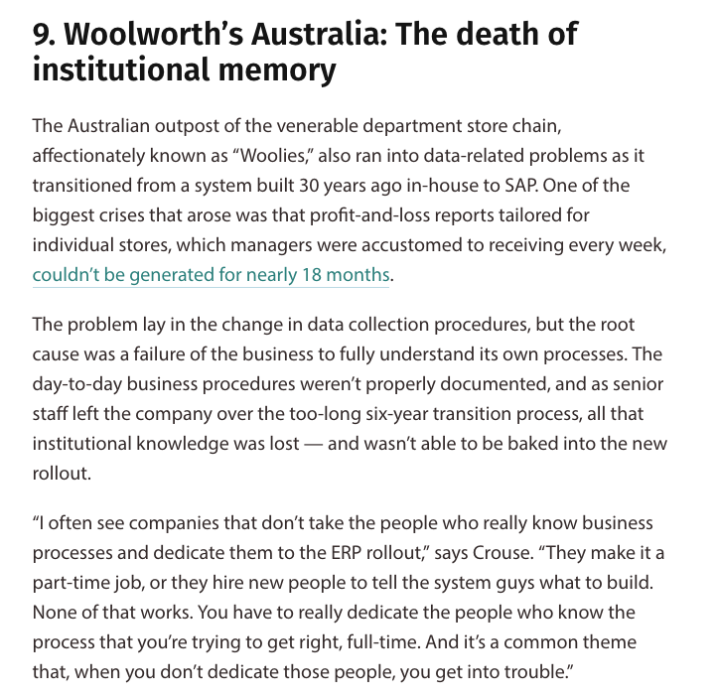
https://www.cio.com/article/278677/enterprise-resource-planning-10-famous-erp-disasters-dustups-and-disappointments.html

Slide 9
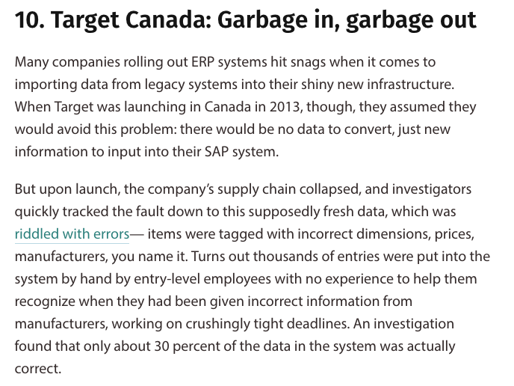
https://www.cio.com/article/278677/enterprise-resource-planning-10-famous-erp-disasters-dustups-and-disappointments.html

Slide 10
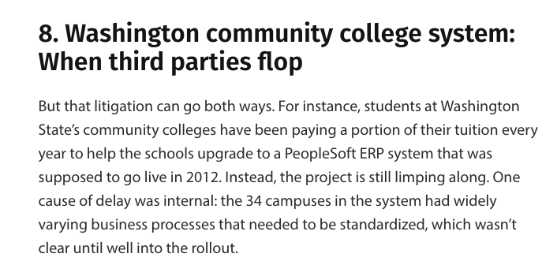
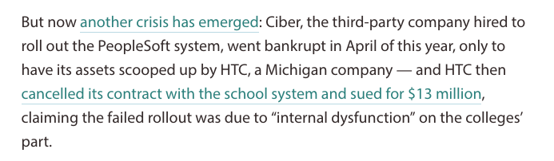
https://www.cio.com/article/278677/enterprise-resource-planning-10-famous-erp-disasters-dustups-and-disappointments.html

Slide 11
How people resist change
Aggression towards system (errors, disruptions, sabotage)
Projection (blaming system for everything)
Avoidance (ignoring with hopes it’ll go away)

Slide 12
Why do Behavioural Problems Occur?
Fear
  Of failure, the unknown, losing status
Lack of top-management support
  If the top management is not supportive, why should the employee change?
Bad prior experiences
  Bad experience with prior IS changes
Poor communication
  Employees need to understand why change is necessary
Disruption
  Additional requests for information and additional burdens of time is distracting and prompts negative feelings
Manner change is introduced
  Approaches are different for top level and lower level employees
Biases and emotions
Personal characteristics and background
  Age
  Open to technology and comfortable with it
Notes:
Change is hard; think about a time when you had to change your habits, how successful were you the first time? Did it take practice and setting your mind to it? Did you have to make it a priority until it became more automatic? Did it require a lot more of your time and energy to focus on the change?
Probably from your personal experience you can see why an IS change may be difficult for many employees.
Because there are many reasons why employees resist change, it usually comes in one of three forms:
Aggression: behaviors that are intended to produce errors with the new system, or weaken the effectiveness of the new system
Projection: blame the new system for everything that goes wrong
Avoidance: ignore the new system in hopes that it will eventually go away

Slide 13
How to Prevent Behavioural Problems
Management support
  Provide resources and motivation
Satisfy user needs
Involve users
  Participation improves communication and commitment
Reduce fears, emphasize opportunities
Avoid emotionalism
Provide training
Performance evaluation
  Re-evaluate to ensure performance standards are consistent with the new system
Keep open communications
Test the system prior to implementation
Keep system simple
  Avoid radical changes
Control user’s expectations
  Be realistic

Slide 14
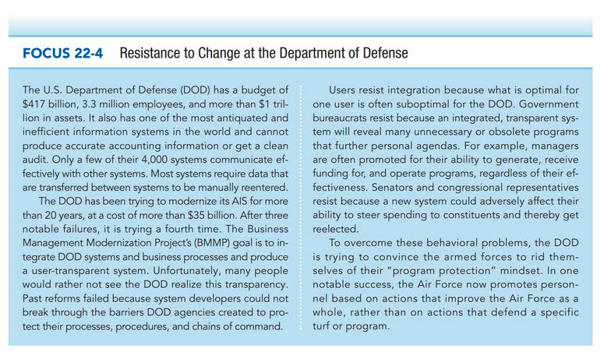
“It is difficult to get a man to understand something, when his salary depends on his not understanding it.”
— Upton Sinclair

Slide 15
Who Is Involved in the S D L C?
Information Systems Steering Committee
  Executive level, plans and oversees IS function; facilitates coordination with integration of systems activities
Project Development Team
  Plan and monitor project progress
Programmers
  Write and test programs according to analysts’ specifications
Systems Analysts
  Determine information needs, prepare specifications for programmers
Management
  Get users involved in the process, provide support for development projects, align projects to meet organization’s strategic needs
Users
  Communicate needs to system developers, help design and test to ensure complete and accurate processing of data
Notes:
Cooperation amongst the many people involved in SDLC is important for a successful implementation of a system.
In addition, external players may also have some level of involvement in the SDLC. External players will not be responsible for the success of the implementation; however, external auditors, for example, may be able to provide information that would be useful for reports needed to be efficient and effective in the audit process. Other external players may be vendors, customers, and government entities.

Slide 16
Systems Development Planning
Proper planning provides for achieving goals and objectives
For systems development, two plans needed:
  Project Development Plan
    Specific to a project and authored by the project team; identifies people, hardware, software, and financial resources needed
  Master Plan
    Long-range and authored by steering committee outlining prioritized projects and timetables
Notes:
Planning is 95% of success. Inadequate planning at either the master plan or project development plan can result in undesired results.

Slide 17
Planning Techniques
Program evaluation and review technique (P E R T)
  Diagram that depicts all project activities that require time and resources with completion estimates. Determines critical path.
Gantt chart
  Bar chart that organizes activities on the left-hand side and project time scheduled with a bar drawn to show the progress to date for that particular activity.
Notes:
The critical path in the PERT diagram means that if this is delayed, the entire project will be delayed.
The Gantt chart is a good way to visualize how the activities break down and are scheduled for the entire IS project.

Slide 18
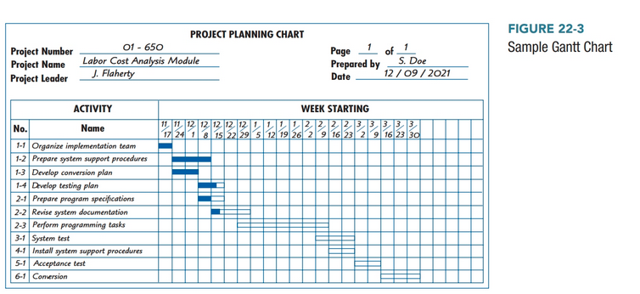

Slide 19
Business Case (Feasibility Analysis)
Economic
  Do benefits of new system justify the costs (time and resources) to implement?
Technical
  Can we use existing technology?
Legal
  Does a new system comply with regulations, laws, and contractual obligations?
Scheduling
  Can the system be developed in the time allotted?
Operational
  Do we have the people to design and implement the system? Will people use the new system?
Notes:
Feasibility analysis is prepared during the systems analysis stage and updated throughout the SDLC as needed.

Slide 20
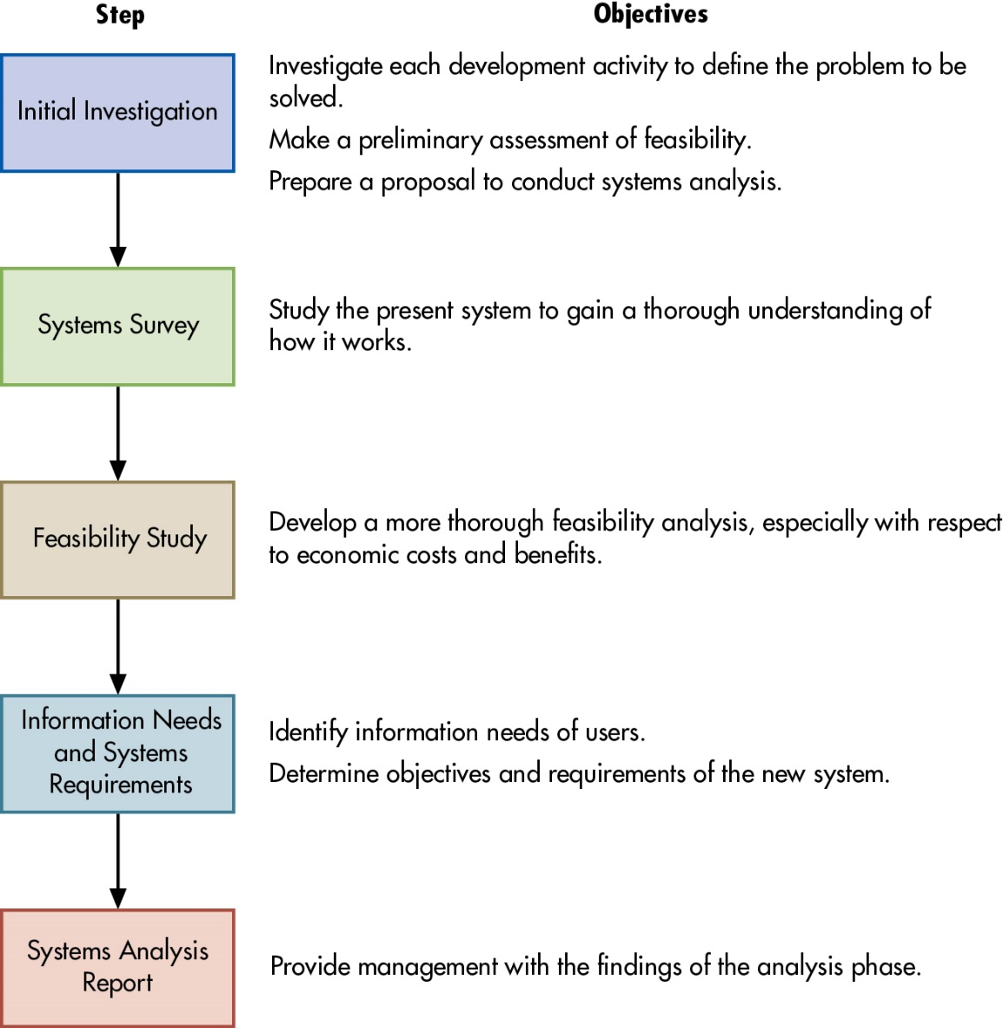
Figure 22.4 Steps in Systems Analysis
Ends with proposal & go/no-go decision
Notes:
For the first phase of the SDLC, systems analysis, there are five steps:
Initial investigation—examines the IS problem to be solved, determine the project scope (what the project should and should not accomplish)
Systems survey—studies the current system to understand how it works, its strengths, and weaknesses. Collect data to identify user needs. Data can be gathered by interviews, questionnaires, observations, and systems documentation.
Feasibility study is formally conducted (usually with one of the three methods discussed on Slide 20-8).
Information needs and assessments requirements—this is usually determined by:
Asking users what they need
Analyzing external systems (if solution exists, no need to recreate it)
Examining existing systems (determines if modification or replacement is needed)
Creating a prototype
Systems analysis report—summarizes and documents analysis activities
Long Description:
The steps involved in the process of systems analysis are as follows:
Step
Objective
Initial Investigation
Investigate each development activity to define the problem to be solved.
Make a preliminary assessment of feasibility.
Prepare a proposal to conduct systems analysis.
Systems Survey
Study the present system to gain a thorough understanding of how it works.
Feasibility Study
Develop a more thorough feasibility analysis, especially with respect to economic costs and benefits.
Information Needs and Systems Requirements
Identify information needs of users.
Determine objectives and requirements of the new system.
Systems Analysis Report
Provide management with the findings of the analysis phase.

Slide 21
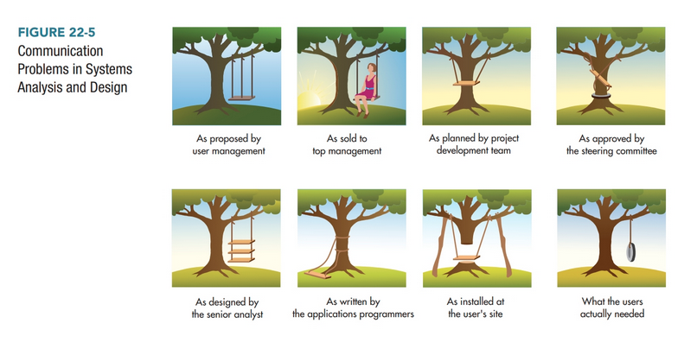

Slide 22
Key Terms (1 of 2)
Systems development life cycle (S D L C)
Systems analysis
Conceptual design
Physical design
Implementation and conversion
Operations and maintenance
Information systems steering committee
Systems analyst
Computer programmers
Project development plan
Master plan
Program evaluation and review technique (P E R T)
Critical path
Gantt chart
Feasibility study
Economic feasibility
Technical feasibility
Legal feasibility
Scheduling feasibility
Operational feasibility
Capital budgeting model
Payback period

Slide 23
Key Terms (2 of 2)
Net present value (N P V)
Internal Rate of Return (I R R)
Behavioural aspects of change
Aggression
Projection
Avoidance
Request for systems development
Initial investigation
Proposal to conduct systems analysis
System survey
Systems documentation
Physical models
Logical models
Systems survey report
Systems analysis report

Slide 24

Copyright
This work is protected by United States copyright laws and is provided solely for the use of instructors in teaching their courses and assessing student learning. Dissemination or sale of any part of this work (including on the World Wide Web) will destroy the integrity of the work and is not permitted. The work and materials from it should never be made available to students except by instructors using the accompanying text in their classes. All recipients of this work are expected to abide by these restrictions and to honor the intended pedagogical purposes and the needs of other instructors who rely on these materials.

