Slide 1


Accounting Information Systems
Sixteenth Edition
Chapter 23
A I S Development Strategies
Copyright © 2024, 2021, 2018 Pearson Education, Inc. All Rights Reserved
Notes:
If this PowerPoint presentation contains mathematical equations, you may need to check that your computer has the following installed:
1) MathType Plugin
2) Math Player (free versions available)
3) NVDA Reader (free versions available)

Slide 2
Learning Objectives
How do we
  Buy software?
    RFP
  Build software?
    Agile process
    Prototyping
    Cost of software development
Outsource

Slide 3
How to Obtain an A I S
“Buy versus build?”
Three primary approaches
  Purchase
  Develop in-house
    End-user computing
  Outsource to outside organization
Notes:
Obtaining an AIS can be done in one of three ways.
Purchasing software can be a “canned” software solution. A good example of canned software is Quickbooks. In addition, a company can also rent software (e.g., Quickbooks online essentially allows you to rent the software monthly to use it online).
The AIS can be developed in-house to meet the end user’s needs or you can hire an organization outside of your company by outsourcing the data processing activities.

Slide 4
Purchasing
Select a vendor (from referrals, trade shows, etc.)
Request for proposal (R F P) that meets needs
Evaluate proposals
  Top vendors invited to give demonstrations on how their system will fit your needs
Make a final selection based upon your criteria
Notes:
An RFP can help you save time and can simplify the decision-making process. It is important that when doing an RFP with software vendors that if any requirement requires specialized programming from the vendor, it should not be considered functionality from the canned software. Many vendors will answer yes, but with constraints or require additional investment to meet the requirement. These “special considerations” should be noted in the RFP.
Evaluation of software for purchase includes:
Hardware evaluation
Software evaluation
Vendor evaluation

Slide 5
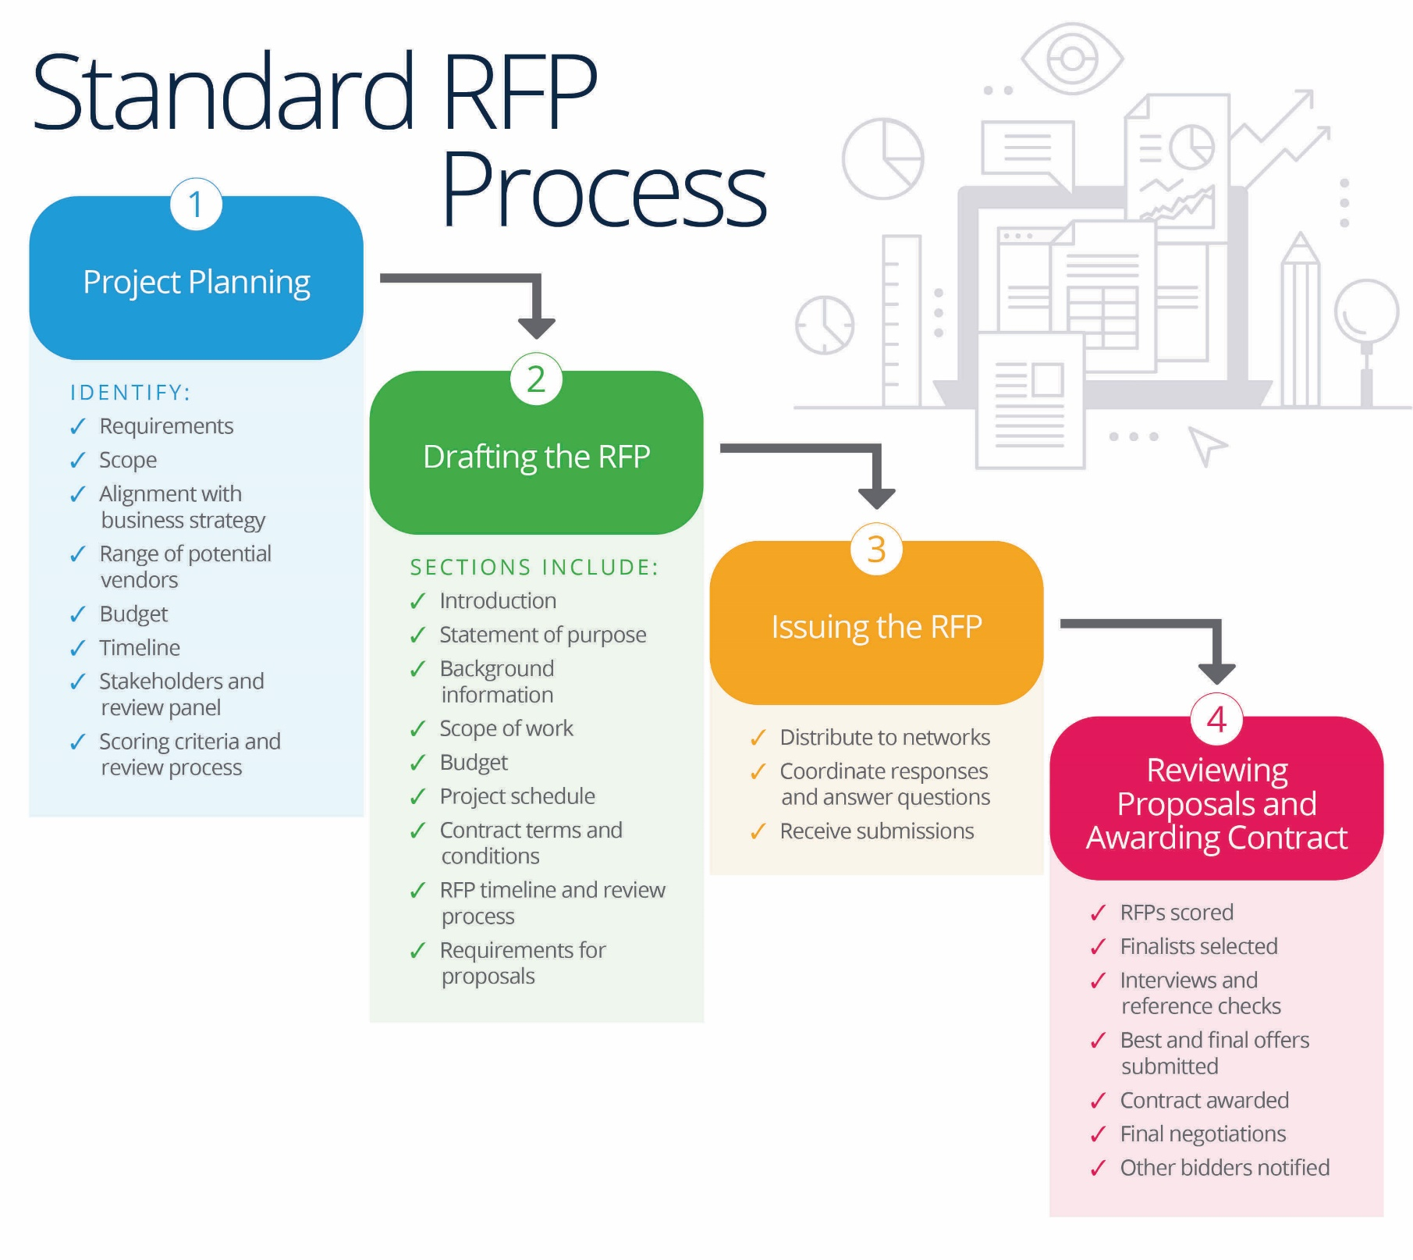
RFP (request for proposal)
https://www.smartsheet.com/request-for-proposal

Slide 6
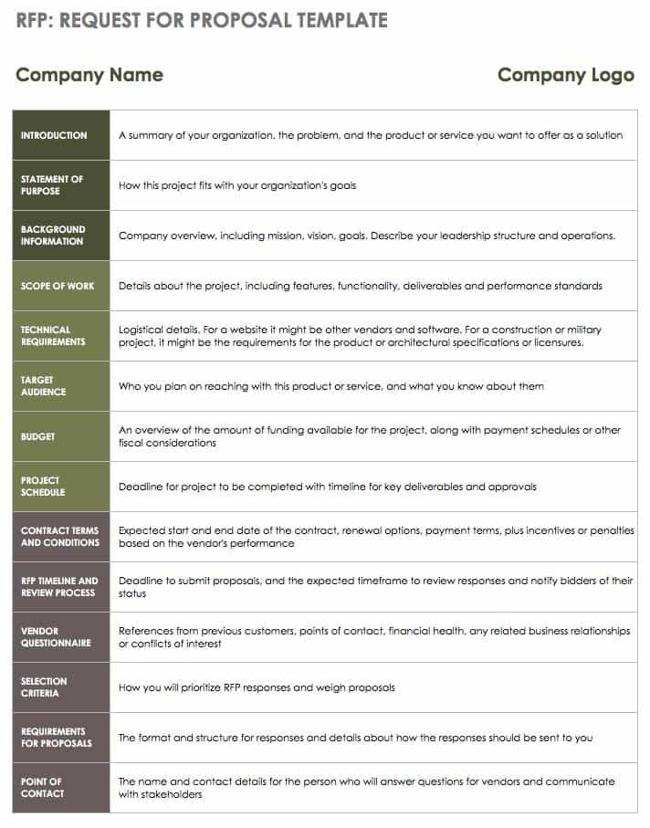
https://www.smartsheet.com/request-for-proposal

Slide 7
https://www.smartsheet.com/request-for-proposal

Slide 8
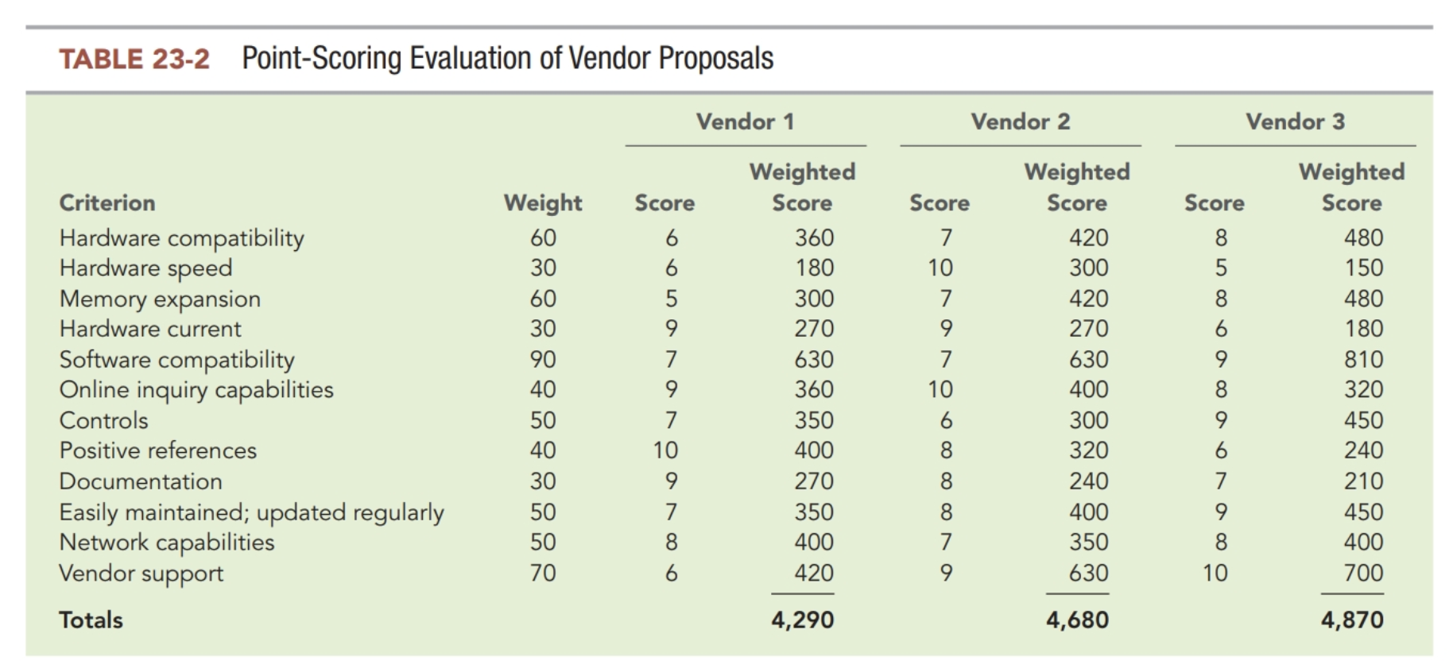
Example of Point Scoring Evaluation

Slide 9
When to purchase software?
Yes
Task specified by external parties (i.e., bookkeeping, i.e. GAAP)
Task used by many companies (i.e, A/P)
Task requires significant complex/inter-related programming (i.e., ERP, Excel)
Allows pooling of development resources between many clients
No
Task part of your company’s differentiating “secret sauce”? (i.e. delivery algorithm for UberEats)
Task related to idiosyncratic environment? (i.e., expert witness case management)
Task acts as glue between multiple systems (i.e., RPA, interfaces)
Customization of larger software package (i.e., SalesForce)
Investment leads to efficiency or quality of end-product

Slide 10
Develop Software In-House
Advantages
  Provides a significant competitive advantage
Risks
  Requires significant amounts of time
  Complexity of the system
  Poor requirements defined
  Insufficient planning
  Inadequate communication and cooperation
  Lack of qualified staff
  Poor top management support
Notes:
Compared to the previous slide of purchasing, the major decision in obtaining an AIS is “build or buy.”
Developing the software in-house means that you plan to build the AIS and be in control of the design, development, and program coding of the AIS.

Slide 11
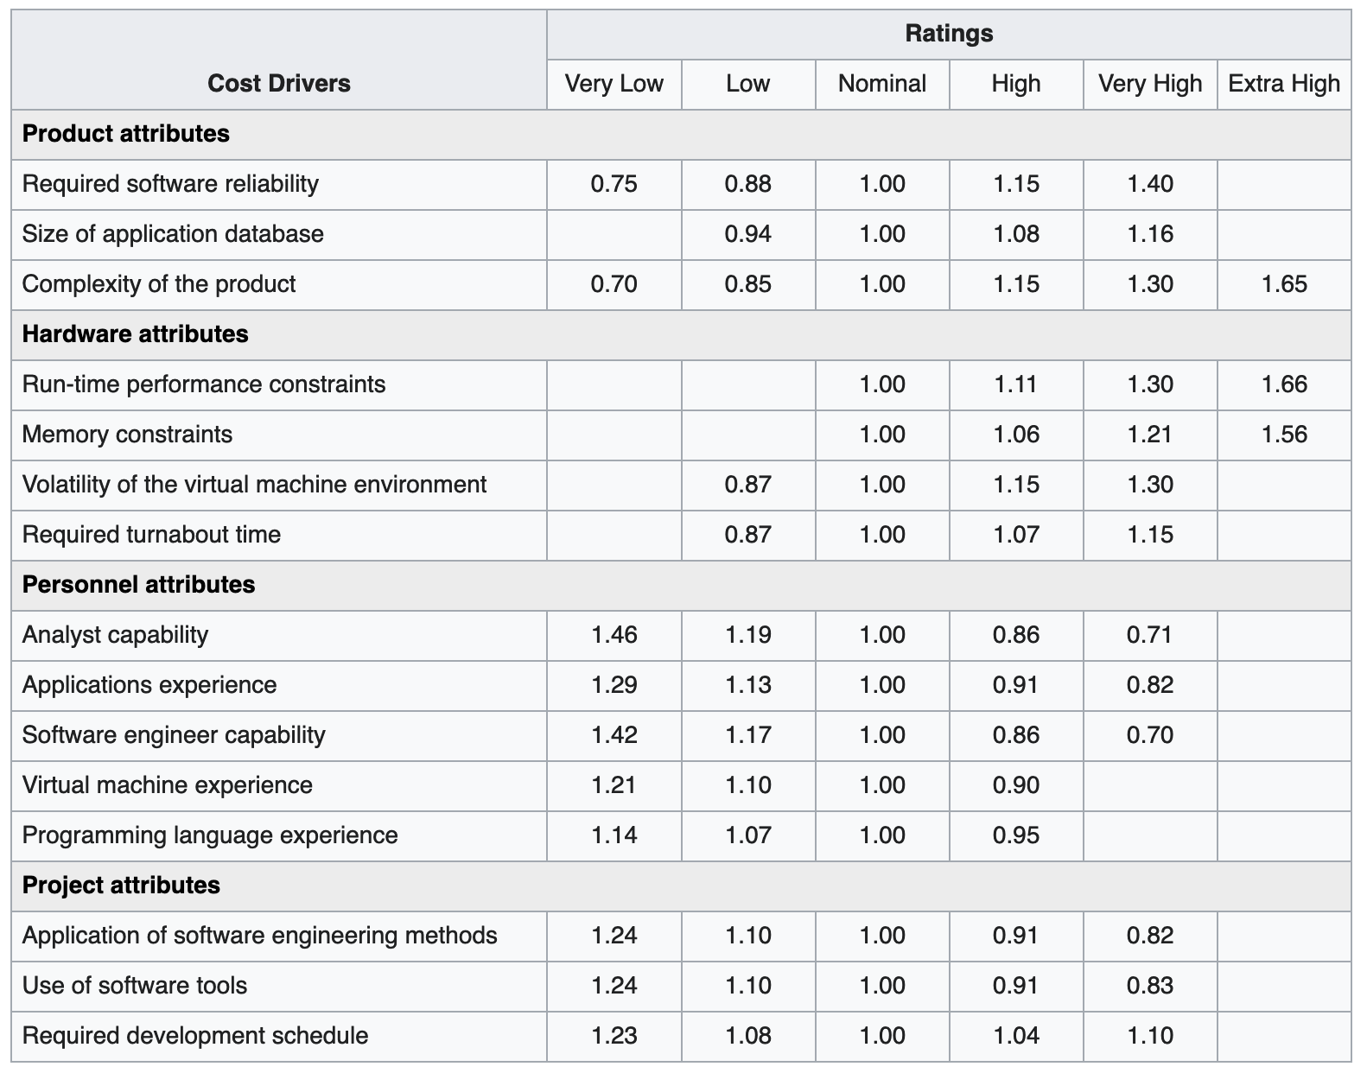
COCOMO Model
https://en.wikipedia.org/wiki/COCOMO

Slide 12
How much does it cost to do custom coding?
Type (web, new/greenfield, software integration, software modification)
Size (number screens, tables, reports, integrations)
Team (PM, UI/UX, Business Analyst, Architect, DB admin, Developer, QA)
Examples from https://www.spheregen.com/cost-of-software-development/
  Bug Fix – known issue
  Resolution of a known issue in existing software that we are maintaining. This assumes that the cause of the issue is known, and the issue affects a minimal number of objects.
  Type – Software Modification
  Size – Small
  Time Frame – 1-2 weeks
  Cost – $2k-$10k

Slide 13
How much does it cost to do custom coding?
Type (web, new/greenfield, software integration, software modification)
Size (number screens, tables, reports, integrations)
Team (PM, UI/UX, Business Analyst, Architect, DB admin, Developer, QA)
Examples from https://www.spheregen.com/cost-of-software-development/
  Proof of Concept Applications
  Often the first step for many startups, these projects tend to focus more on the look and feel of a new application and the possibility of achieving the desired outcome, more than providing functionality.
  Type – New Software
  Size – Small
  Time Frame – 4-8 weeks
  Cost – $25k-$35k

Slide 14
How much does it cost to do custom coding?
Type (web, new/greenfield, software integration, software modification)
Size (number screens, tables, reports, integrations)
Team (PM, UI/UX, Business Analyst, Architect, DB admin, Developer, QA)
Examples from https://www.spheregen.com/cost-of-software-development/
  Mobile Applications
  Standalone application for iOS and Android. Moderate data collection, location awareness, secure cloud database interaction, push notifications, and administrative portal/functions.
  Type – New Software
  Size – Med
  Time Frame – 4 Months
  Cost – $60k-$70k

Slide 15
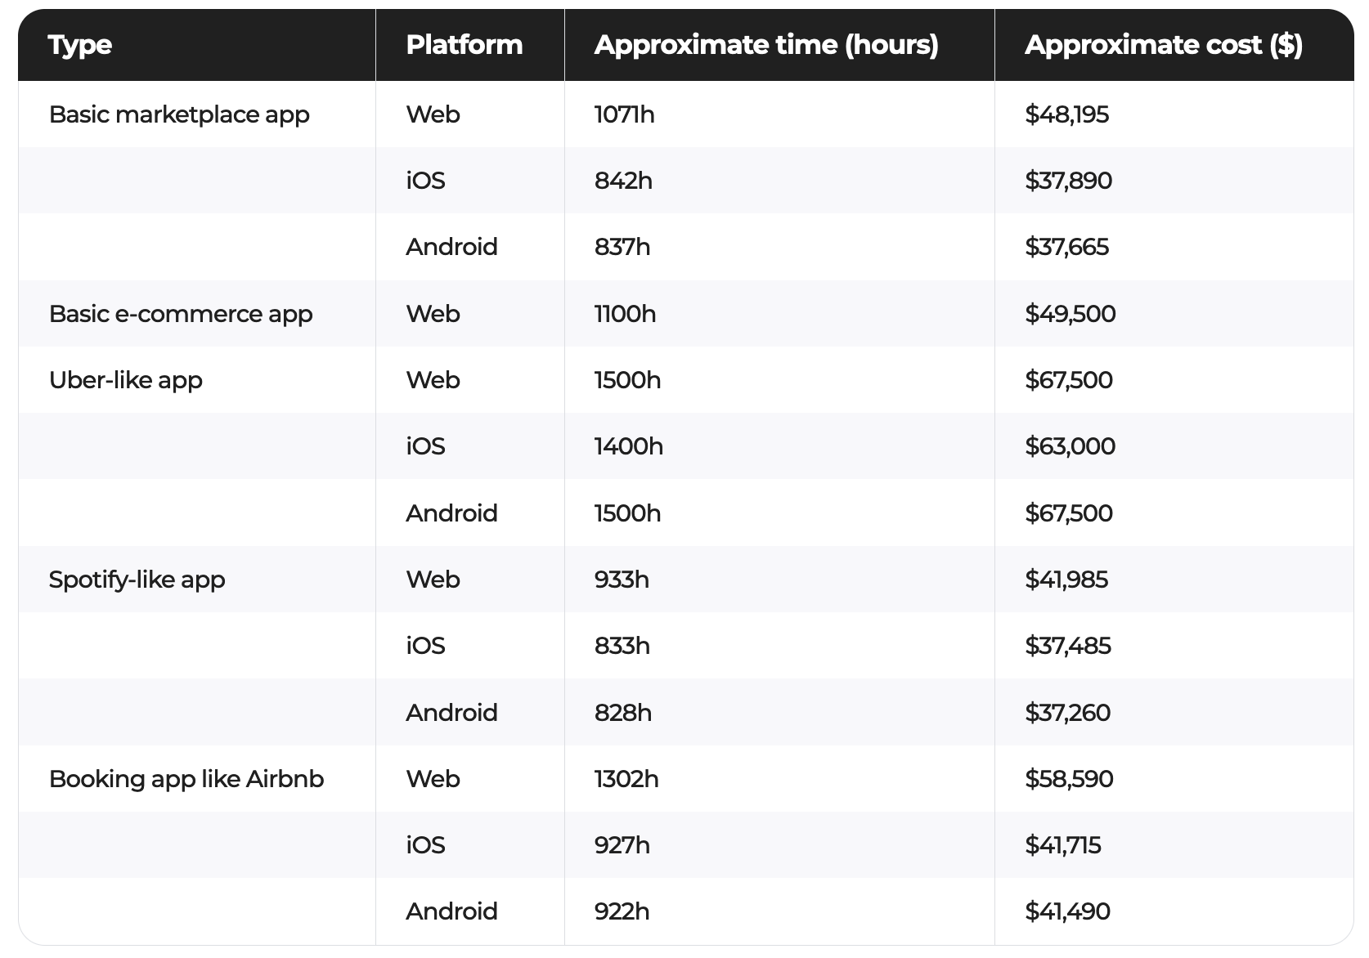
Ha!
https://www.cleveroad.com/blog/software-development-cost

Slide 16
R&D Spending
Uber R&D 1.5b in 2018
Spotify 10% of revenue
Pandora 11% of revenue
https://hbr.org/2019/01/its-time-to-stop-treating-rd-as-a-discretionary-expenditure
  First, R&D is an economically significant expense for digital companies, much larger than for physical product companies. For example, in 2017, established digital companies such as Facebook and Alphabet spent 19% and 15% of their sales, respectively, on R&D. Smaller digital companies might even spend more than 50%. For example, in 2013, Twitter spent 76% of its revenues on R&D. Compare these numbers to 2% for General Motors, zero for Walmart, and 12% for Tesla in 2017.

Slide 17
Custom software isn’t a one & done – ongoing maintenance and development

Slide 18
Outsourcing
Advantages
Disadvantages
Allows companies to concentrate on core competencies
Asset utilization
Access to greater expertise and better technology
Lower costs by standardizing user applications and splitting development and maintenance costs between projects
Less development time
Elimination of peaks-and-valleys usage
Facilitates downsizing
Inflexibility
Loss of control
Reduced competitive advantage
Locked-in system
Unfulfilled goals
Poor service
Increased risk

Slide 19
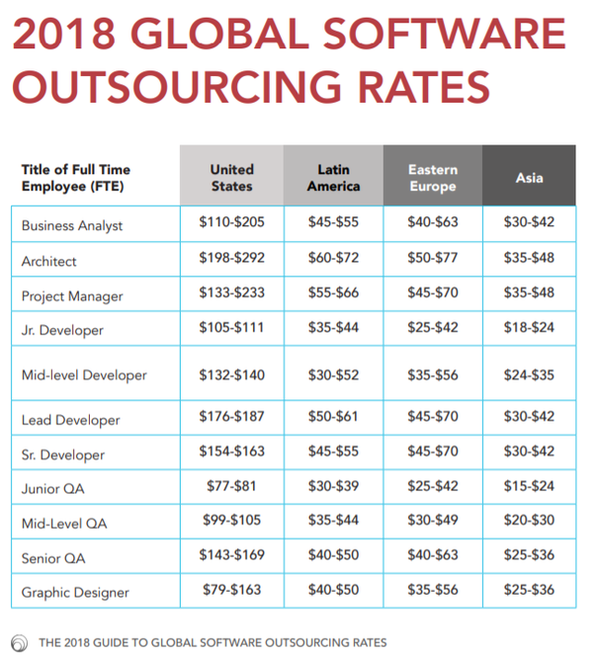

Slide 20
Business Process Management Systems
Automate and facilitate business process improvements using:
  Process engine to model and execute applications and business rules
  Business analytics to identify issues, trends, and opportunities
  Collaboration tools to remove communication barriers
  Content manager to store electronic documents and images
Notes:
Business process management (BPM) is a continuous approach to improving and optimizing business processes. Business processes help the organization get things done (e.g., sell and ship goods to customers). It is understood that information technology can leverage the business process for organizations to achieve their goals and objectives. The fundamental principles for BPM are:
Business processes can produce competitive advantages.
Business processes must be managed end to end.
Business processes should be agile.
Business processes must be aligned with organizational strategy and needs.

Slide 21
Flowcharts
Describe an information system showing:
Inputs and outputs
Information activities (processing data)
Data storage
Data flows
Decision steps
Key strengths of flowcharts are that they can easily capture control via decision points, show manual versus. automated processes.

Slide 22
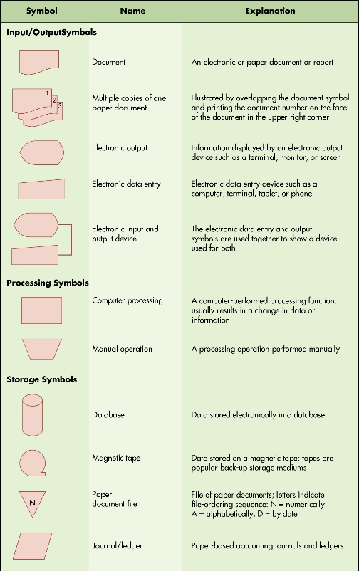
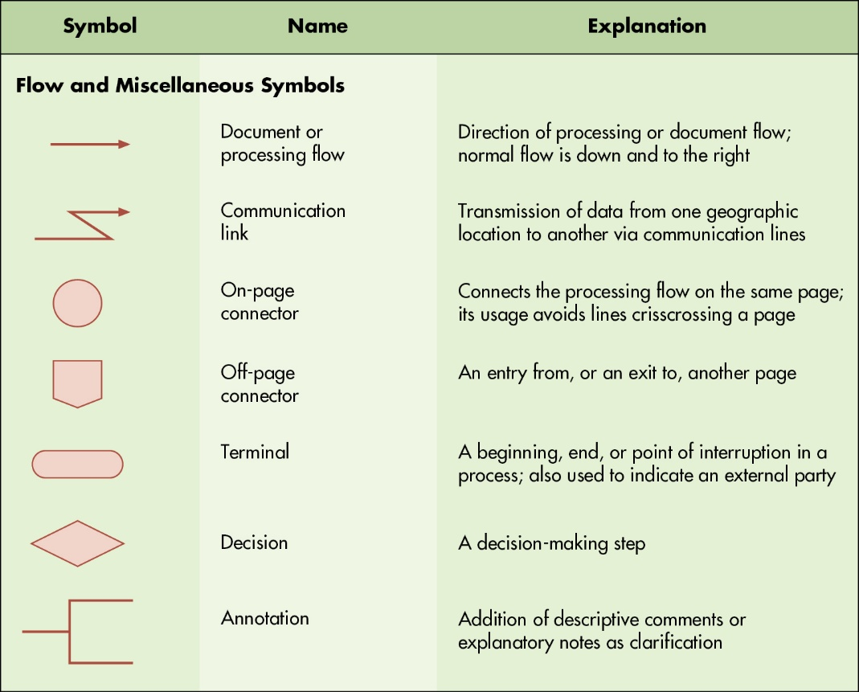
Figure 3.3 Common Flowcharts Symbols
Notes:
Long Description:
The table with common flowcharting symbols for input/output, processing, and storage appears as follows:
Symbol
Name
Explanation
Input/Output Symbols
A rectangle with a wave-like base
Document
An electronic or paper document or report
Three rectangles numbered 1, 2, and 3, each with a wave-like base
Multiple copies of one paper document
Illustrated by overlapping the document symbol and printing the document number on the face of the document in the upper right corner
A pentagon with one curved side
Electronic output
Information displayed by an electronic output device such as a terminal, monitor, or screen
A trapezoid with non-parallel sides much longer than the parallel sides
Electronic data entry
Electronic data entry device such as a computer, terminal, tablet, or phone
Symbol for electronic output connected to symbol for electronic data entry
Electronic input and output device
The electronic data entry and output symbols are used together to show a device used for both
Processing Symbols
Rectangle
Computer processing
A computer-performed processing function; usually results in a change in data or information
Trapezoid
Manual operation
A processing operation performed manually
Storage Symbols
Cylinder
Database
Data stored electronically in a database
A circle with a terminal point at the bottom
Magnetic tape
Data stored on a magnetic tape; tapes are popular back-up storage mediums
An inverted triangle with letter N inside it
Paper document file
File of paper documents; letters indicate file-ordering sequence: N: numerically, A: alphabetically, D: by date
Parallelogram
Journal/ledger
Paper-based accounting journals and ledgers
Long Description:
The table with common flow and miscellaneous symbols appears as follows:
Symbol
Name
Explanation
Flow and Miscellaneous Symbols
Right arrow
Document or processing flow
Direction of processing or document flow; normal flow is down and to the right
Right arrow with a zig-zag tail
Communication link
Transmission of data from one geographic location to another via communication lines
Circle
On-page connector
Connects the processing flow on the same page; its usage avoids lines crisscrossing a page
Pentagon
Off-page connector
An entry from, or an exit to, another page
Rounded rectangle
Terminal
A beginning, end, or point of interruption in a process; also used to indicate an external party
Rhombus
Decision
A decision-making step
A line connected to a square open on the right
Annotation
Addition of descriptive comments or explanatory notes as clarification

Slide 23
Guidelines for Drawing Flowcharts
Understand the system you are trying to represent.
Identify business processes, documents, data flows, and data processing procedures.
Organize the flowchart so that it reads from top to bottom and left to right.
Clearly label all symbols.
Use page connectors (if it cannot fit on a single page).
Edit/review/refine to make it easy to read and understand.

Slide 24
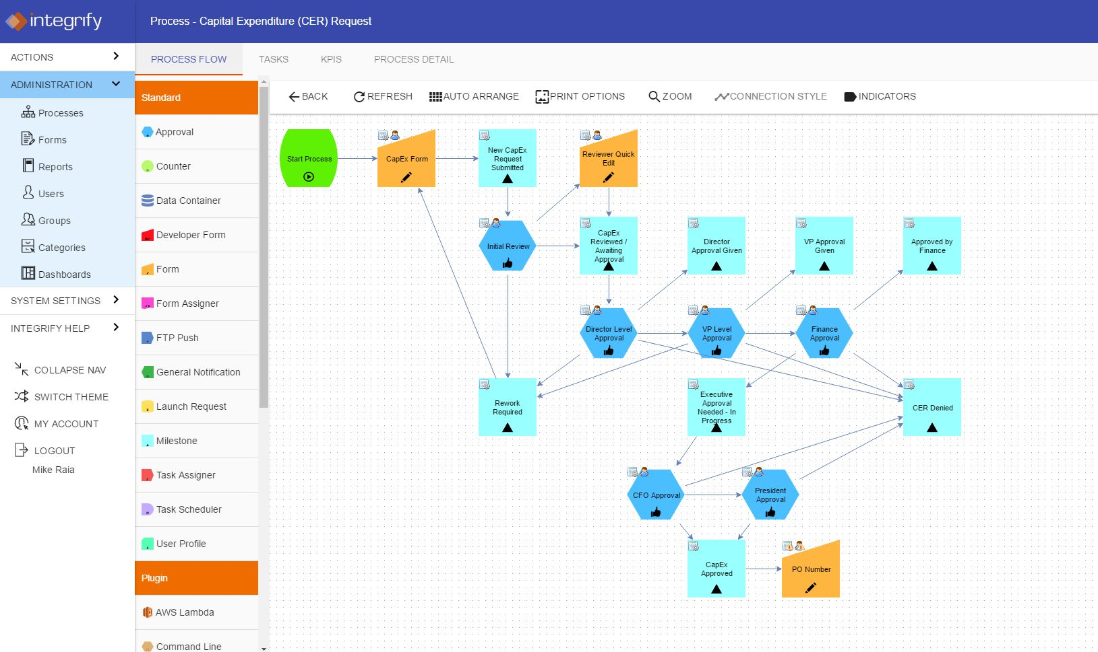
https://www.integrify.com/site/assets/files/1593/workflow-software.jpg

Slide 25
Prototyping
Advantages
Disadvantages
Results in well-defined user needs
Higher user satisfaction and involvement
Faster development time
Fewer errors
Opportunities to suggest changes
Less costly
Requires significant user time
Resource efficiency may not be achieved
Inadequate testing and documentation
Negative behavioral reactions
Continuous development of iterations leaves a feeling of no project completion
Notes:
Prototyping is a way to create a simplified model of an AIS to get feedback from users. It is used sometimes in the development stage when there is uncertainty, meaning that users may be unable to specifically define their needs, the tasks are not well structured, or the inputs and outputs are not known.

Slide 26
Agile Development Processes
More
Less
Responding to change
Individuals & interactions
Customer collaboration
Quality software
Following plan
Tools, processes, controls
Contract negotiation
Quality documentation
Notes:
Prototyping is a way to create a simplified model of an AIS to get feedback from users. It is used sometimes in the development stage when there is uncertainty, meaning that users may be unable to specifically define their needs, the tasks are not well structured, or the inputs and outputs are not known.

Slide 27
Key Terms (1 of 2)
Commercial software
Turnkey systems
Software-as-a-Service (SaaS) providers
Request for proposal (R F P)
Benchmark problem
Point scoring
Requirement costing
Custom software
End-user computing (E U C)
Help desk
Outsourcing
Business process reengineering (B P R)
Business process management (B P M)
Business Process Management System (B P M S)
Prototyping
Operational prototype
Nonoperational (throwaway) prototype
Agile development
Scrum methodology
Scrum development

Slide 28
Key Terms (2 of 2)
Product owner
User stories
Product backlog
Scrum team
Sprint
Scrum master
Extreme programming (X P)
Unit tests
Acceptance tests
Integration tests
Unified process
Executable architecture baseline
Computer-aided software (or systems) engineering (C A S E)

Slide 29
Breakout Problem 23.9 Quickflix

Slide 30
Quickfix is rapidly losing business, and management wants to redesign its computer repair processes and procedures to decrease costs and increase customer service. Currently, a customer needing help calls one of five regional service centers. A customer service representative records the relevant customer information, finds the closest qualified technician, and calls the technician’s cell phone to see whether the repair fits into his or her schedule. If not, the representative finds the next closest technician. When a technician is located, customer repair information is texted or e-mailed to the technician. The technician calls the customer and arranges to pick up the computer and replace it with a loaner. Making these arrangements takes one to two days and sometimes more if technicians are not available or do not promptly return calls.
Technicians are not available or do not promptly return calls. If a broken computer cannot be quickly repaired, it is sent to a repair depot. These repairs take another four to seven days. If problems arise, it can take up to two weeks for an item to be repaired. When a customer calls to see whether the computer is ready, the service representative calls the technician to find out the status and calls the customer back. The repair process usually takes five phone calls between the customer, the service representative, and the technician.
Several problems with this process led to a significant drop in business: (1) it is time-consuming; (2) it is inconvenient for a customer to have a computer removed, a new one installed, and then the old one reinstalled; and (3) service representatives do not have immediate access to information about items being repaired. Quickfix decides to use BPM principles to redesign its business processes.
a. Identify the repair processes that occur, and decide which should be redesigned.
b. Describe how the repair process can be redesigned to solve the problems identified.
c. What benefits can Quickfix achieve by redesigning the repair process?

Slide 31

Copyright
This work is protected by United States copyright laws and is provided solely for the use of instructors in teaching their courses and assessing student learning. Dissemination or sale of any part of this work (including on the World Wide Web) will destroy the integrity of the work and is not permitted. The work and materials from it should never be made available to students except by instructors using the accompanying text in their classes. All recipients of this work are expected to abide by these restrictions and to honor the intended pedagogical purposes and the needs of other instructors who rely on these materials.

