Slide 1


Accounting Information Systems
Sixteenth Edition
Chapter 24
Systems Design, Implementation, and Operation
Copyright © 2024, 2021, 2018 Pearson Education, Inc. All Rights Reserved
Notes:
If this PowerPoint presentation contains mathematical equations, you may need to check that your computer has the following installed:
1) MathType Plugin
2) Math Player (free versions available)
3) NVDA Reader (free versions available)

Slide 2
Learning Objectives
Discuss the conceptual systems design process and the activities in this phase.
Discuss the physical systems design process and the activities in this phase.
Discuss the systems implementation process and the activities in this phase.
Discuss the systems conversion process and the activities in this phase.
Discuss the systems operation and maintenance process and the activities in this phase.

Slide 3
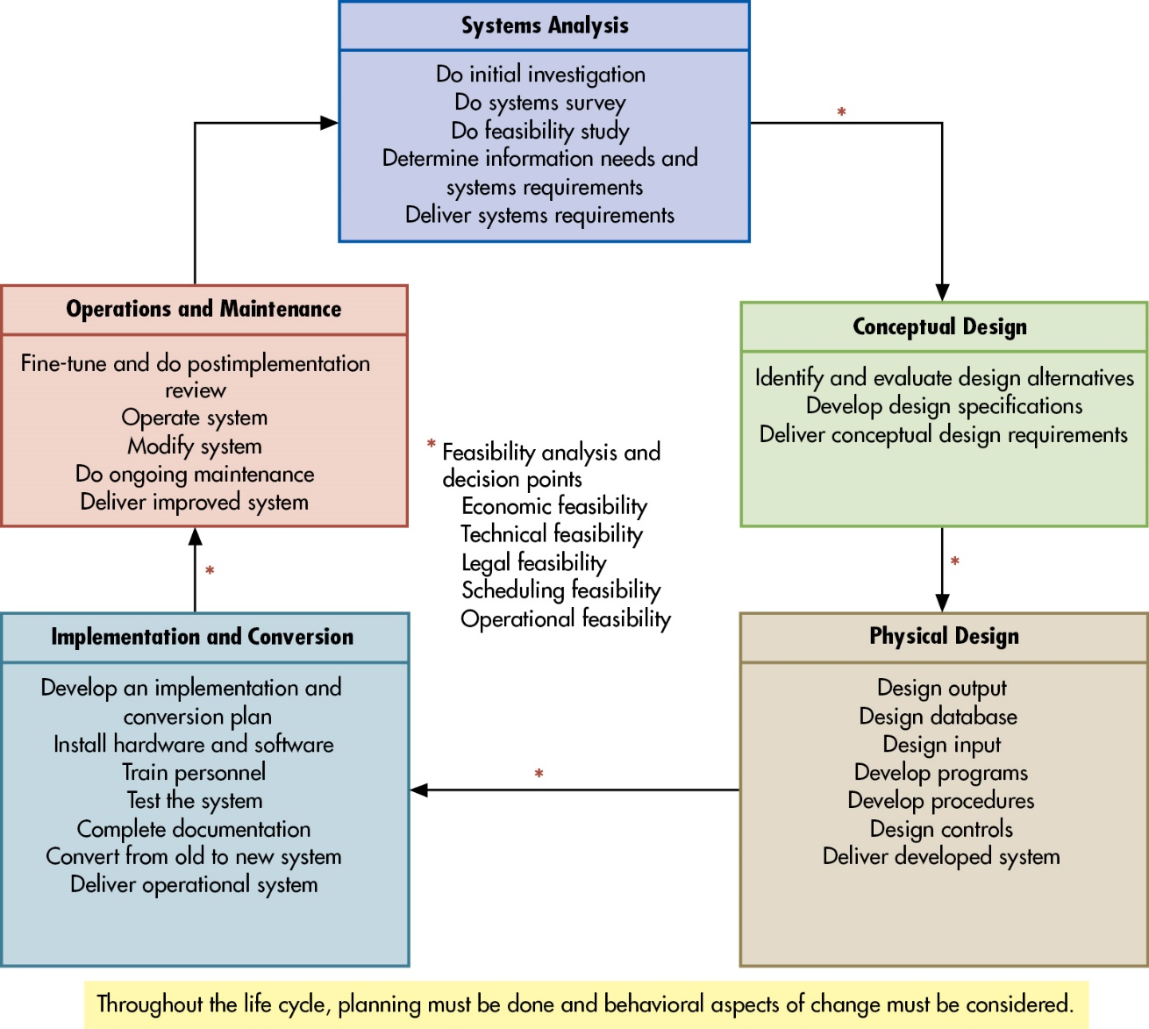
Figure 22.1 The Systems Development Life Cycle
Notes:
There are many reasons why organizations continue to change their information systems whether it’s a full systems replacement or an upgrade to an existing system. This can be due to technology changes, to become more effective and efficient in the organization (productivity gains), improve business processes, or for competitive advantage reasons.
Because of an organization’s desire to change an information system, it’s best to proceed using the following five steps known as the systems development lifecycle (SDLC):
Systems analysis: feasibility of the proposed project occurs. What is actually needed and when will it be done (scope of the project)? If it is feasible, then identify system requirements with an analysis report provided to the steering committee.
Conceptual design: determine how to meet user needs. Does project involve purchasing software, developing program in house, or outsourcing?
Physical design: translates broad conceptual design into the specific code, input and output source documents, and building the database.
Implementation and conversion: install and test new hardware and software, train employees after which conversion to the new system will be complete.
Operations and maintenance: ongoing reviews of the system with improvements and modifications made if necessary.
Long Description:
The steps in the systems development life cycle are as follows:
Systems Analysis
Do initial investigation
Do systems survey
Do feasibility study
Determine information needs and systems requirements
Deliver systems requirements
Conceptual Design
Identify and evaluate design alternatives
Develop design specifications
Deliver conceptual design requirements
Physical Design
Design output
Design database
Design input
Develop programs
Develop procedures
Design controls
Deliver developed system
Implementation and Conversion
Develop an implementation and conversion plan
Install hardware and software
Train personnel
Test the system
Complete documentation
Convert from old to new system
Deliver operational system
Feasibility analysis and decision points
Economic feasibility
Technical feasibility
Legal feasibility
Scheduling feasibility
Operational feasibility
Operations and Maintenance
Fine-tune and do post implementation review
Operate system
Modify system
Do ongoing maintenance
Deliver improved system

Slide 4
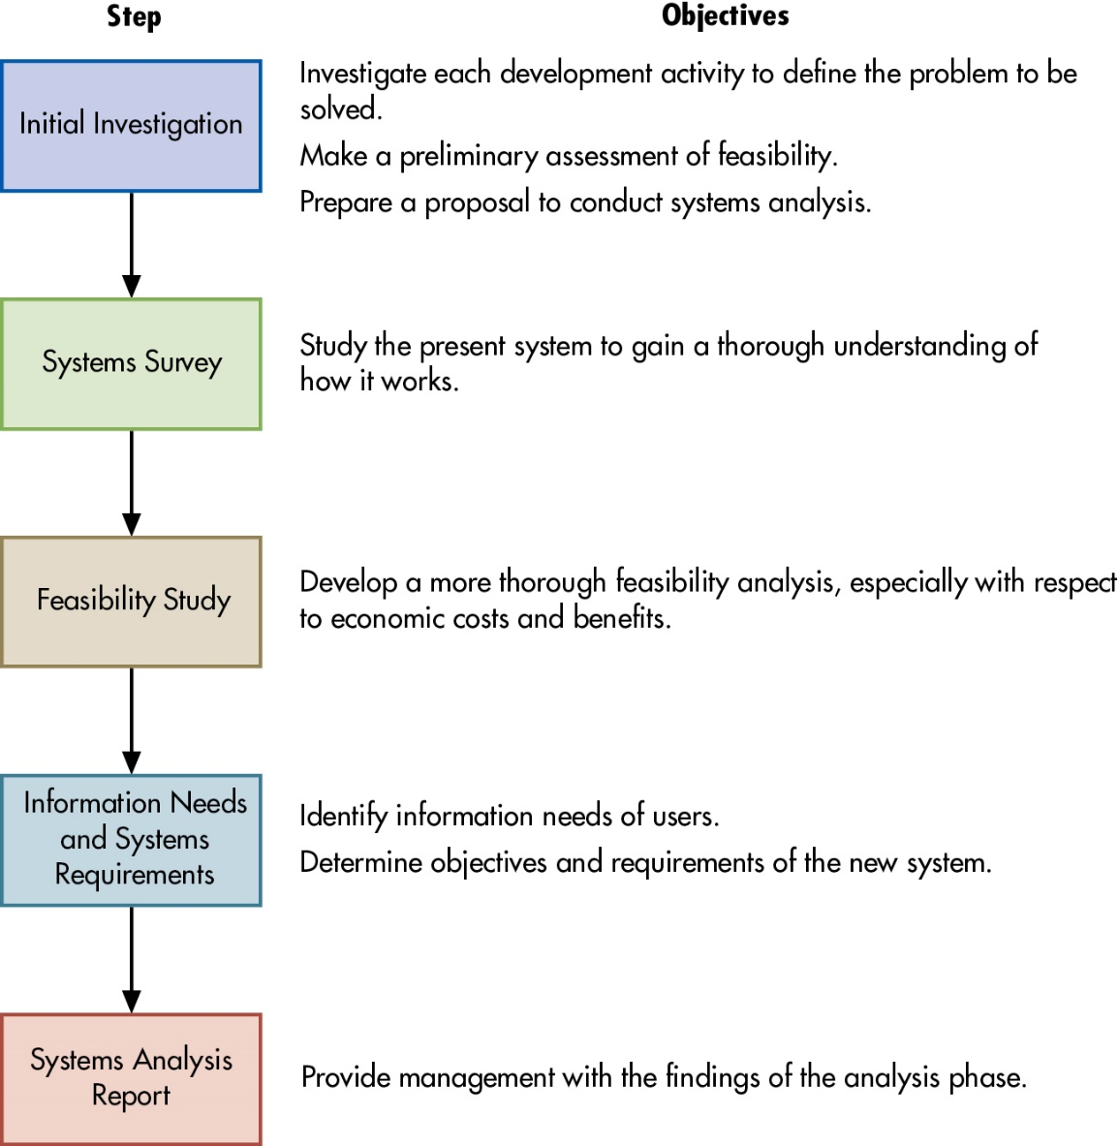
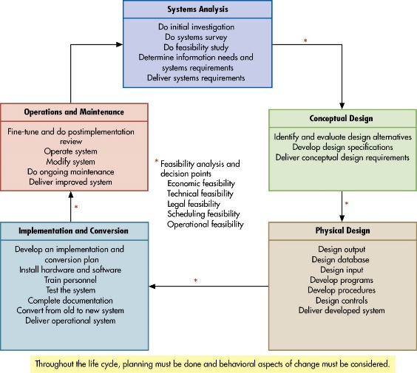
Figure 22.4 Steps in Systems Analysis
Notes:
For the first phase of the SDLC, systems analysis, there are five steps:
Initial investigation—examines the IS problem to be solved, determine the project scope (what the project should and should not accomplish)
Systems survey—studies the current system to understand how it works, its strengths, and weaknesses. Collect data to identify user needs. Data can be gathered by interviews, questionnaires, observations, and systems documentation.
Feasibility study is formally conducted (usually with one of the three methods discussed on Slide 20-8).
Information needs and assessments requirements—this is usually determined by:
Asking users what they need
Analyzing external systems (if solution exists, no need to recreate it)
Examining existing systems (determines if modification or replacement is needed)
Creating a prototype
Systems analysis report—summarizes and documents analysis activities
Long Description:
The steps involved in the process of systems analysis are as follows:
Step
Objective
Initial Investigation
Investigate each development activity to define the problem to be solved.
Make a preliminary assessment of feasibility.
Prepare a proposal to conduct systems analysis.
Systems Survey
Study the present system to gain a thorough understanding of how it works.
Feasibility Study
Develop a more thorough feasibility analysis, especially with respect to economic costs and benefits.
Information Needs and Systems Requirements
Identify information needs of users.
Determine objectives and requirements of the new system.
Systems Analysis Report
Provide management with the findings of the analysis phase.

Slide 5

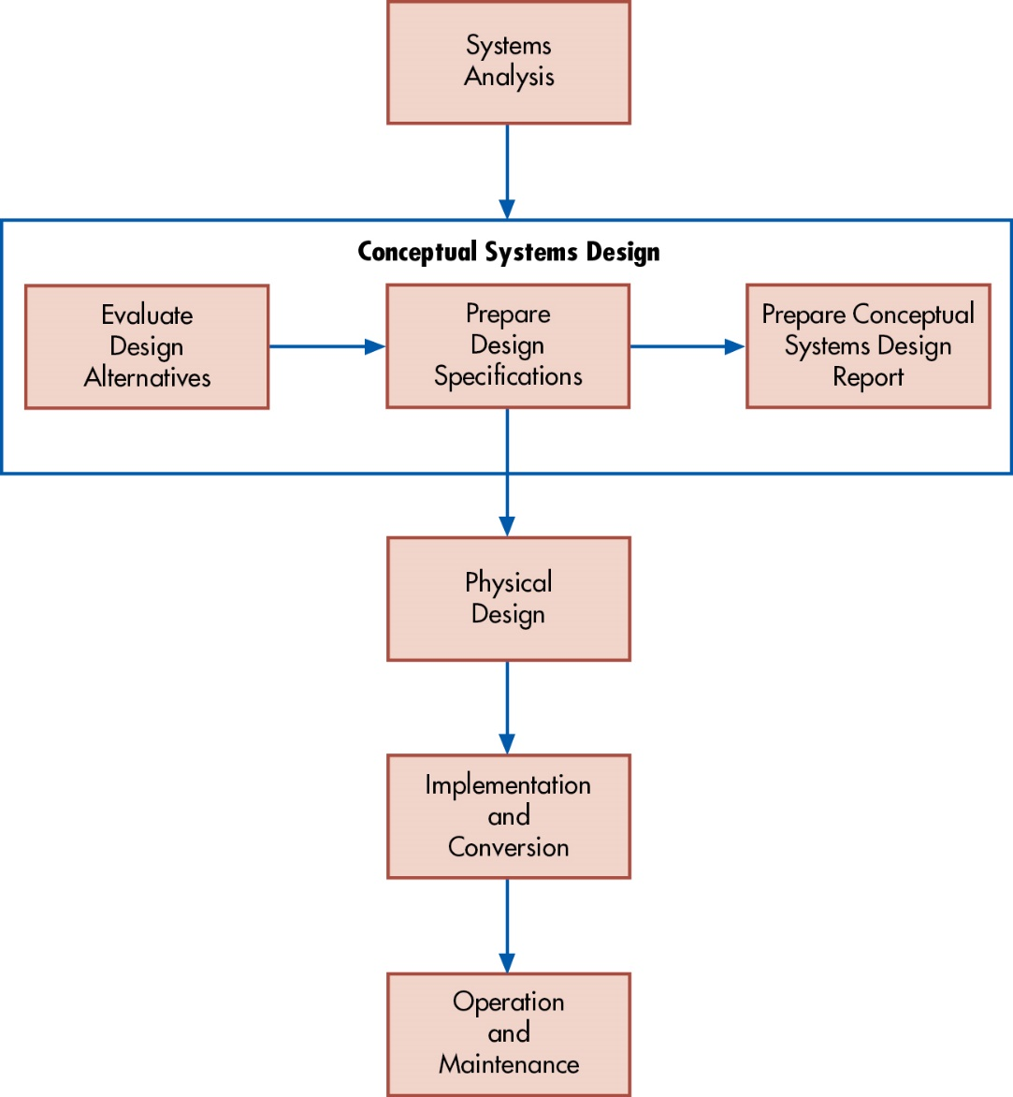
Figure 24.1 Conceptual Systems Design Activities
1) Input
2) Processing / Operations
3) Data Storage
4) Output
Define goals / intent
Written documents (not code)
Use and test cases
Notes:
Developer creates a general framework for implementing user requirements and solving the problems identified in the analysis phase.
1. Evaluating design alternatives—how well does it meet the objectives and user needs, is it feasible, what are the advantages and disadvantages?
2. Preparing design specifications—created for output, data storage, input, and processing procedures.
3. Preparing the conceptual systems design report to the steering committee.
Long Description:
The conceptual design steps (in sequence) depicted in the diagram are as follows:
Systems Analysis
Conceptual Systems Design
Evaluate Design Alternatives
Prepare Design Specifications
Prepare Conceptual Systems Design Report
Physical Design
Implementation and Conversion
Operation and Maintenance

Slide 6
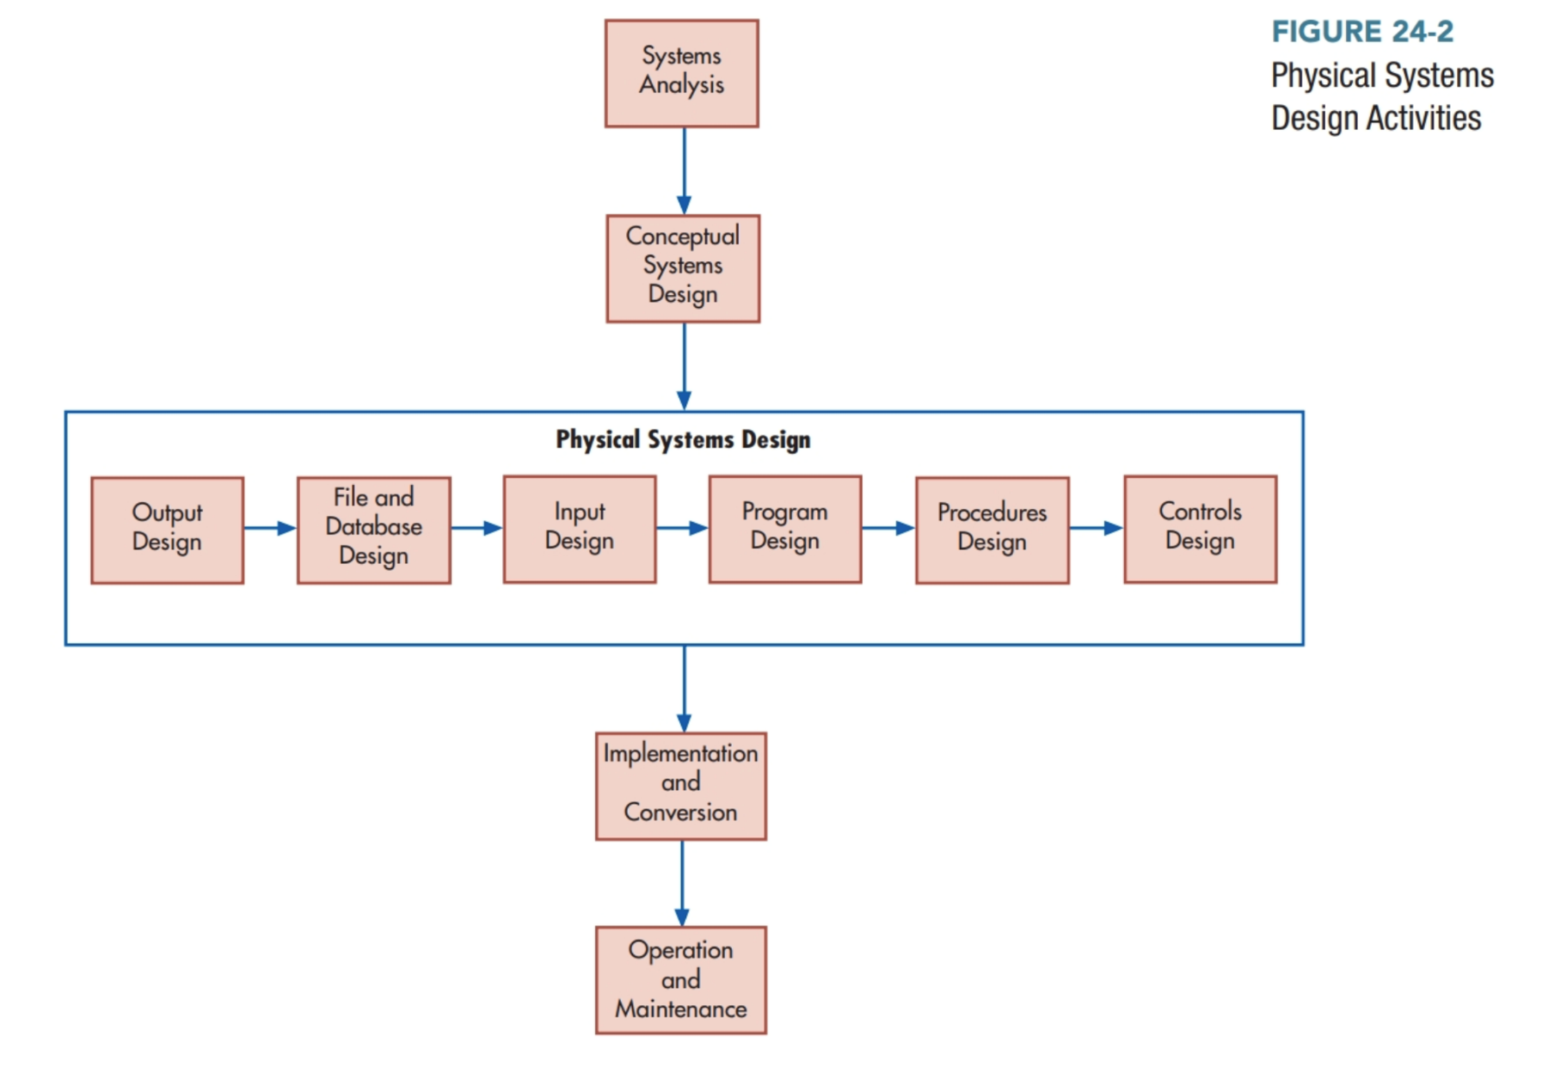
Phase 3: Physical Systems Design
Scheduled, special-purpose, trigger exceptions, and on-demand reports
Code!
Notes:
Output design is to determine the nature and timing of reports which can be one of:
—scheduled reports
—special-purpose analysis reports
—triggered exception reports
—demand reports
File and Database design—this was covered in Chapter 4.
Input design includes forms and computer screen design.

Slide 7
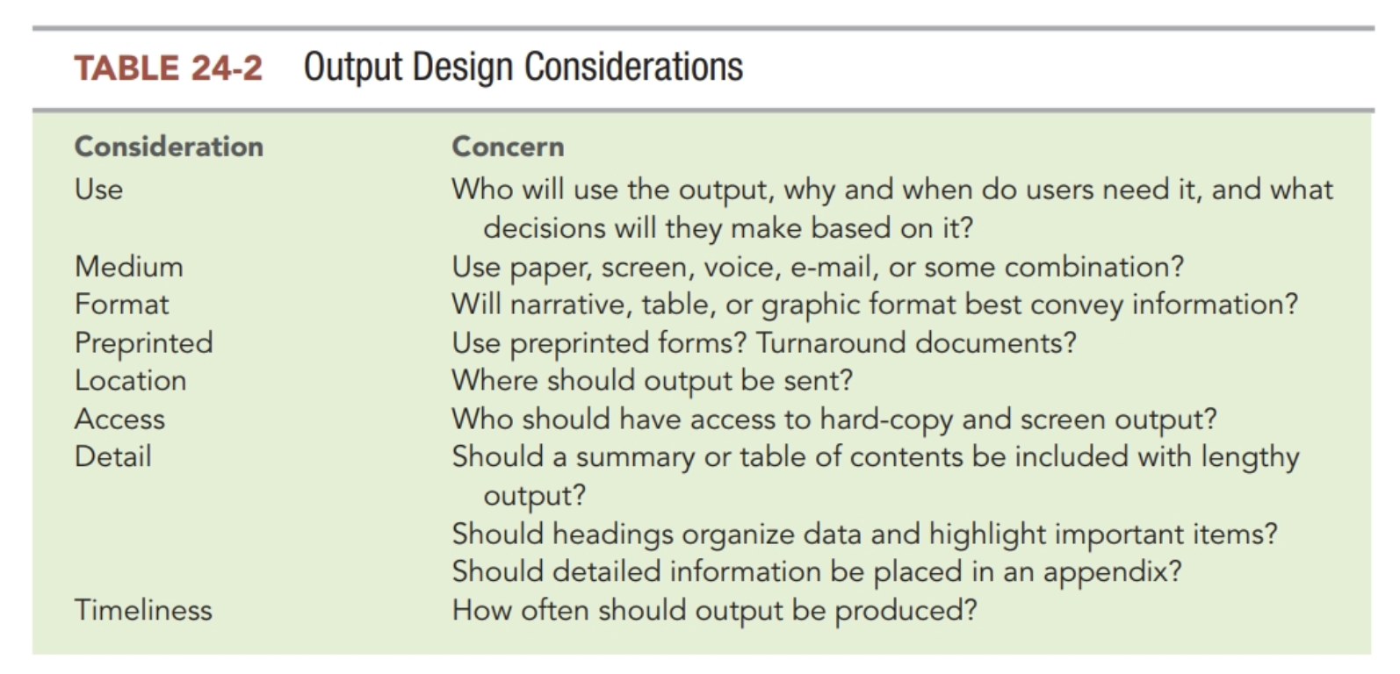

Slide 8
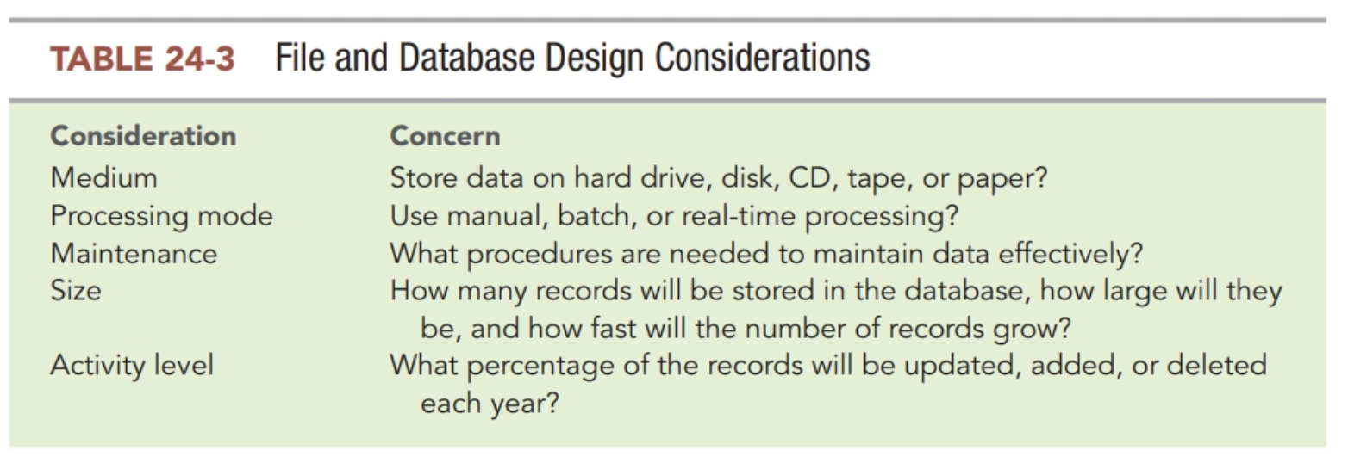

Slide 9
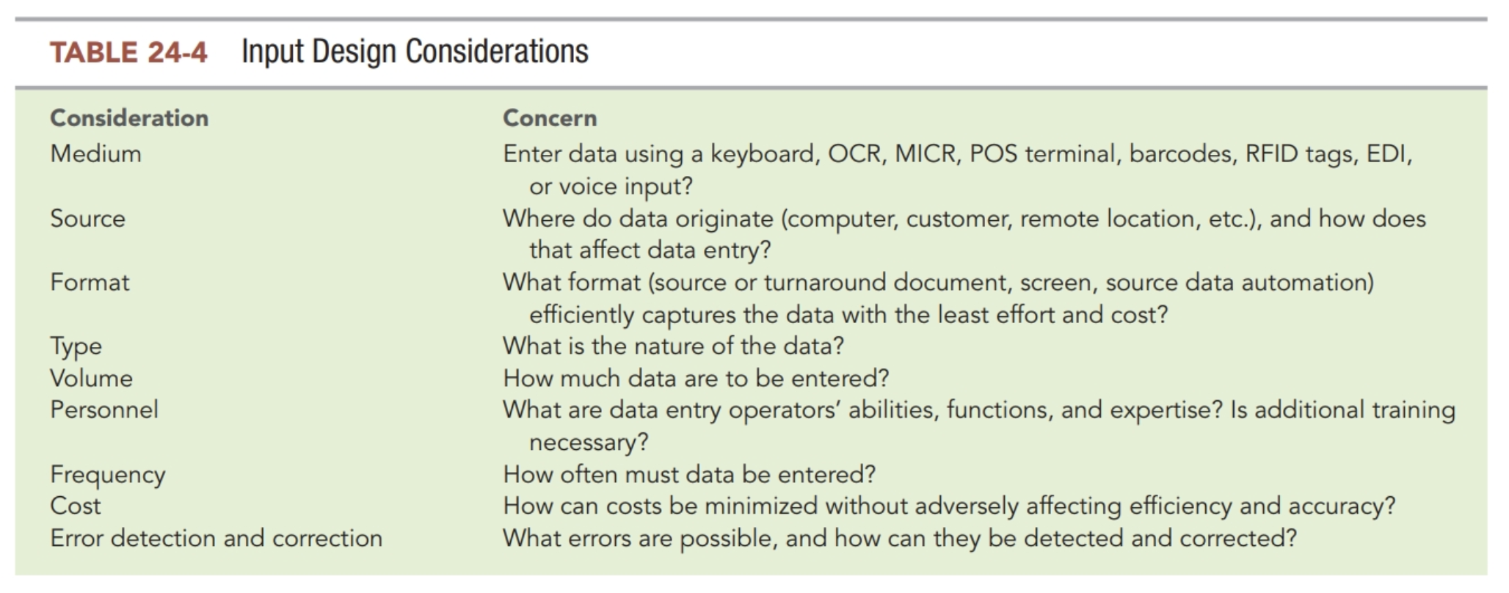

Slide 10
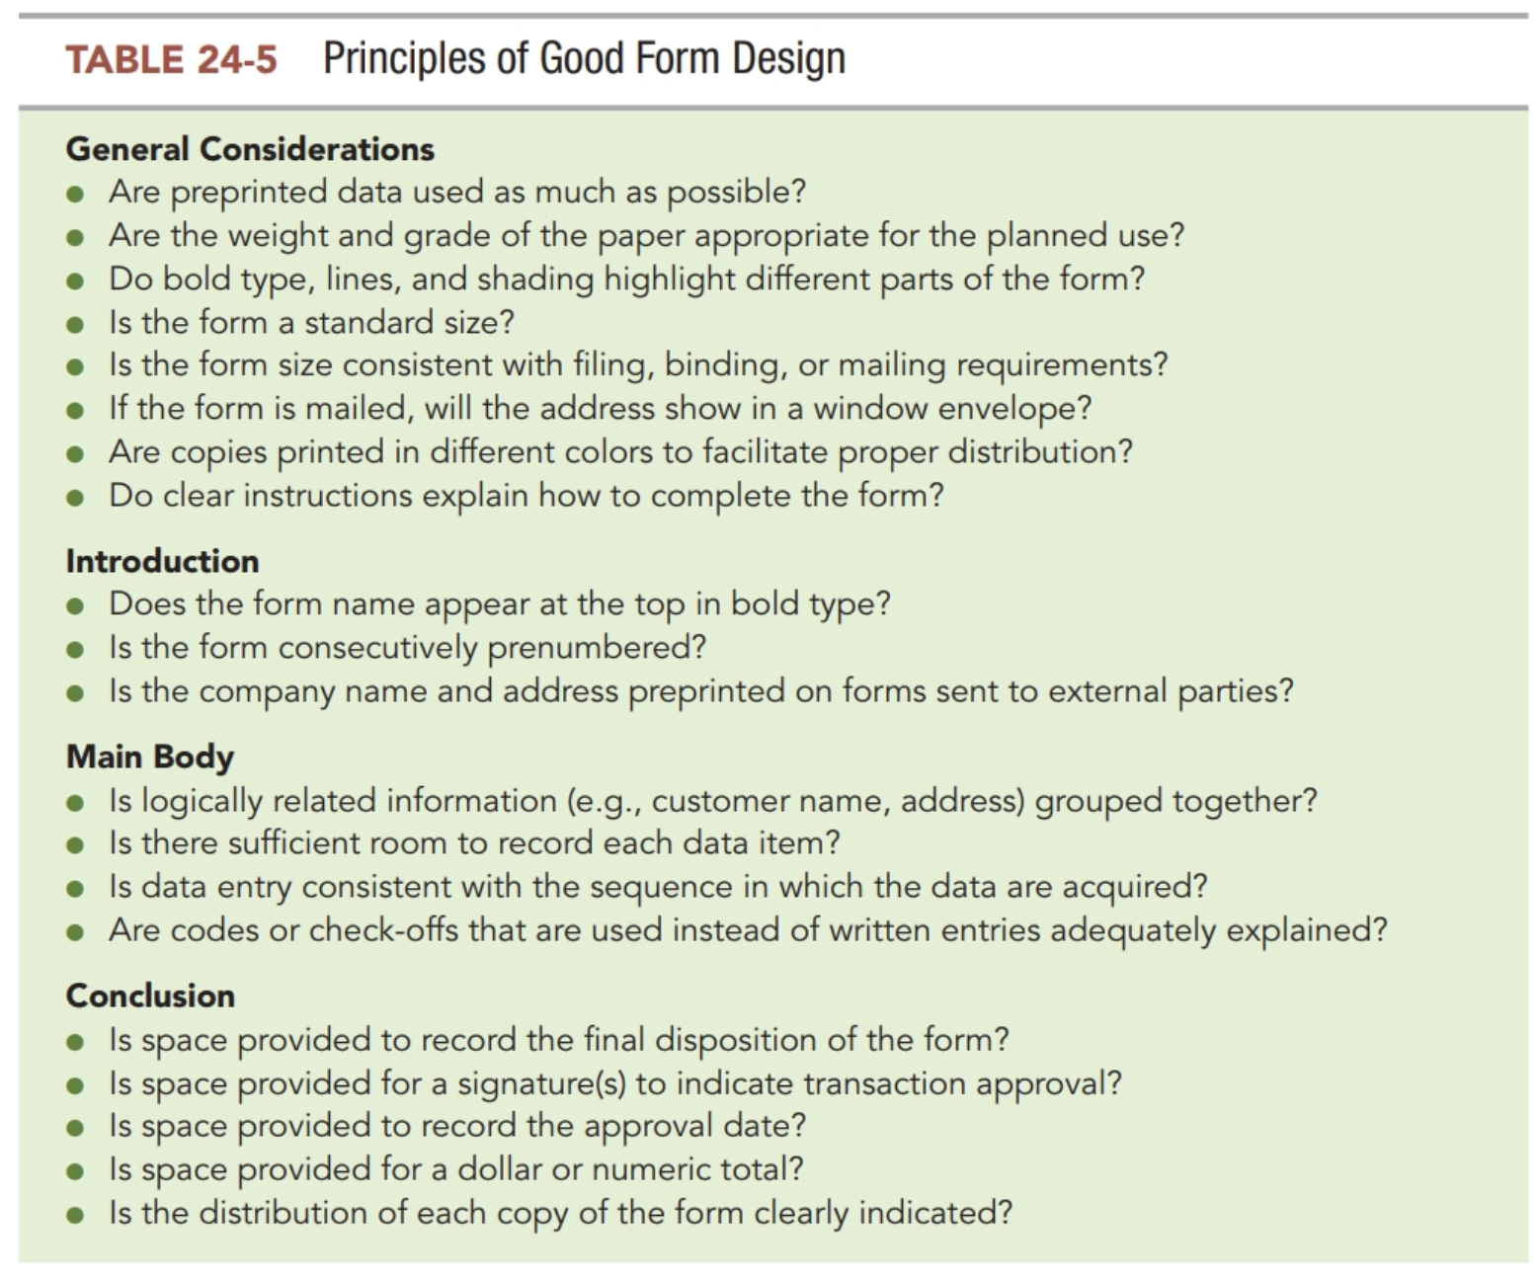

Slide 11
Stop 3/12/26

Slide 12
Phase 4: Systems Implementation
Implementation plan (phased, direct, parallel, pilot)
Select and train personnel
Complete documentation
  Development documentation
  Operations documentation
  User documentation
Testing the system

Slide 13
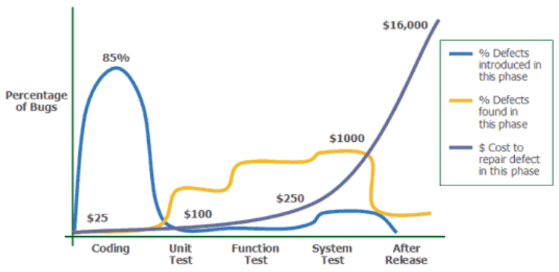
https://blog.atinternet.com/en/rd-behind-the-scenes-combining-testing-agility/

Slide 14
Testing the System
Walk-throughs
  Step by step review
Processing test data
  Test all valid transactions and error conditions
Acceptance tests
  Use copies of real data

Slide 15
Systems Conversion
Direct conversion
  Terminates the old and begins with the new system
Parallel conversion
  Operate old and new systems for a period of time
Phase-in conversion
  Gradual replacement of old elements with new system elements
Pilot conversion
  Implement a system in a part of an organization (e.g., a branch)

Slide 16
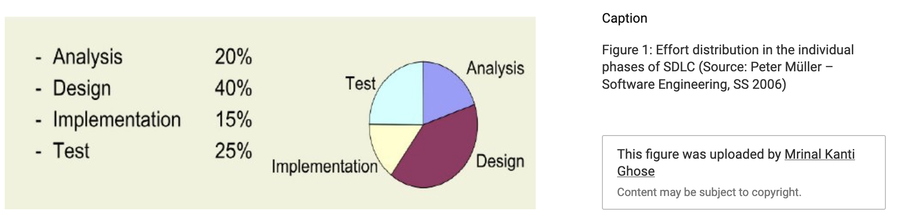
https://www.researchgate.net/publication/224871705_Comparing_Soft_Computing_Techniques_For_Early_Stage_Software_DevelopmentEffort_Estimations/figures?lo=1

Slide 17
Phase 5: Operations and Maintenance (75% of $)
Conduct post-implementation review
Answering these questions:
  Does the system meet the organization’s goals?
  Are users satisfied?
  Were expected benefits achieved?
  Were actual costs in line with expected costs?
  Is the system reliable?
  Does the system produce accurate and complete data and on a timely basis?
  Is the system compatible with existing systems?
  Is the system safeguarded from errors, fraud, and intrusion?
  Are there adequate error-handling procedures in place?
  Is everyone trained to use the new system?
  Is systems documentation complete and accurate?
Notes:
Problems are often uncovered during the post-implementation review and may require adjustments to the system.

Slide 18
Key Terms
Conceptual design specifications
Conceptual systems design report
Scheduled reports
Special-purpose analysis reports
Triggered exception reports
Demand reports
Structured programming
Debugging
Program maintenance
Physical systems design report
Systems implementation
Implementation plan
Walk-throughs
Processing test data
Acceptance tests
Conversion
Direct conversion
Parallel conversion
Phase-in conversion
Pilot conversion
Post-implementation review
Post-implementation review report

Slide 19
Copyright
This work is protected by United States copyright laws and is provided solely for the use of instructors in teaching their courses and assessing student learning. Dissemination or sale of any part of this work (including on the World Wide Web) will destroy the integrity of the work and is not permitted. The work and materials from it should never be made available to students except by instructors using the accompanying text in their classes. All recipients of this work are expected to abide by these restrictions and to honor the intended pedagogical purposes and the needs of other instructors who rely on these materials.

