Slide 1


A Comprehensive Classification of Deep Learning Libraries
Hari Mohan Pandey
Department of Computer Science
Edge Hill University
Pandeyh@edgehill.ac.uk

Slide 2
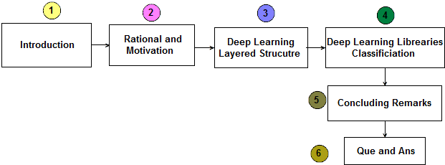
Outline of the Presentation

Slide 3
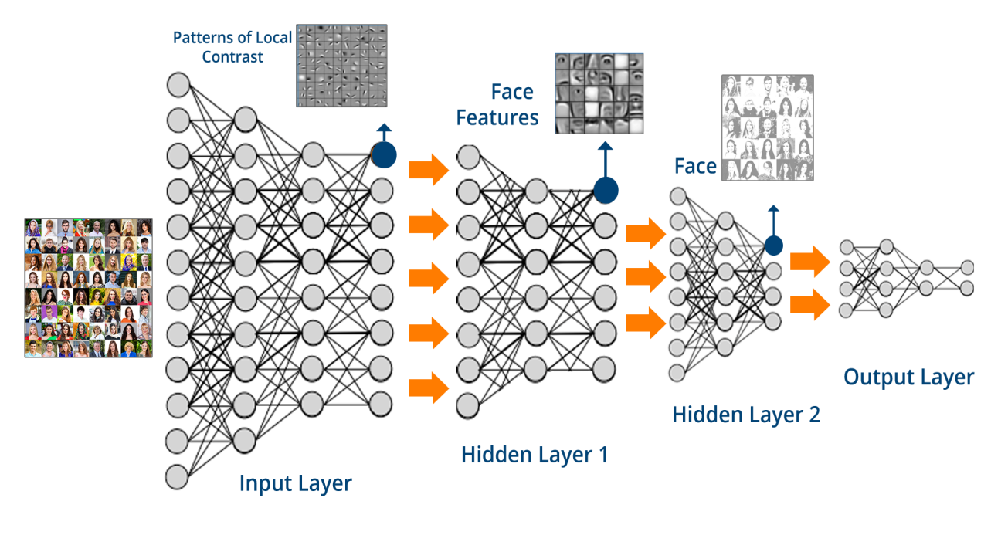
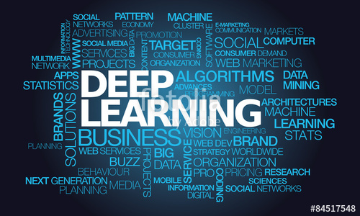
Introduction to Deep Learning
Deep Learning (DL) networks are composed of multiple processing layers that learn data representations with multiple levels of abstraction.

Slide 4
Rational and Motivation
Creation of a standard Neural Network (NN)
requires neurons producing real valued activations in relation to inputs which are trained by adjusting connection weights until the network as a whole shows the desired behaviour.
Layered Wise Greedy Learning (LWGL) (Hinton et al. 2006)
LWGL overcome difficulties associated with back-propagation learning of >3 layer networks, thereby marking the birth of DL networks.
Why to use Deep Learning
better handling of data over fitting and better guarantees of convergence (Erhan et al. 2010)
Wide range of applications
Natural Language Processing, Image processing, Data Mining, Big data Analytics, Robotics, Symbolic Reasoning and others.

Slide 5
Rational and Motivation
Exploring the Deep Learning software libraries
to create awareness among researchers, especially beginners, regarding the various languages and interfaces that are available to implement deep learning, and to provide a simplified ontological basis for selecting between them.

Slide 6
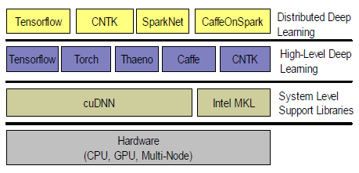
Deep Learning Layered structure

Slide 7
Deep Learning Software Libraries Classification
Table | Factors Used in classification | Link
Table-1 | Total factors used = 11 (represented A1....A11) | Table-1.pdf
 | Interface, Platform (A1), Open Source (A2), Pre-Trained Model (A3), Recurrent nets (A4), Convolution nets (A5), Restricted Boltzmann Machine (A6), Deep Belief Network (A7), OpenMP (A8), OpenCL (A9), CUDA (A10), Parallel Execution (A11).
Table-2 | Classification according to the features | Table-2.pdf
Applications | Track identifications (in DREAM4CAR project) | Curve_50.mp4C_ 200.mp4 Curvy_road.mp4

Slide 8
Conclusions and Future Plans
Introduction of DL
Illustrated layered structure
Classification of DL libraries.
Plan to utilize DL methods for symbolic reasoning.
Utilize meta-heuristic algorithms to tune the weights of DL network.
Explore the possibilities of hybrid approach (heuristic + DL ) for symbolic reasoning and extraction of rules.

Slide 9
Thank you...

