Slide 1

Optimizing Ad Messaging for UConn’s MSBAPM Program
By Pratik More
OPIM-5510-Web Analytics-SEC712-1248

Slide 2
Introduction
Objective:
Test the impact of ad content focusing on "Project Management" vs. "Analytics" to improve number of clicks among prospective students.
Business Context:
UConn’s MSBAPM program seeks to attract both domestic and international students. As demand for analytics professionals grows, optimizing ad content may better engage international students.
UConn MSBAPM
Domestic
International

Slide 3
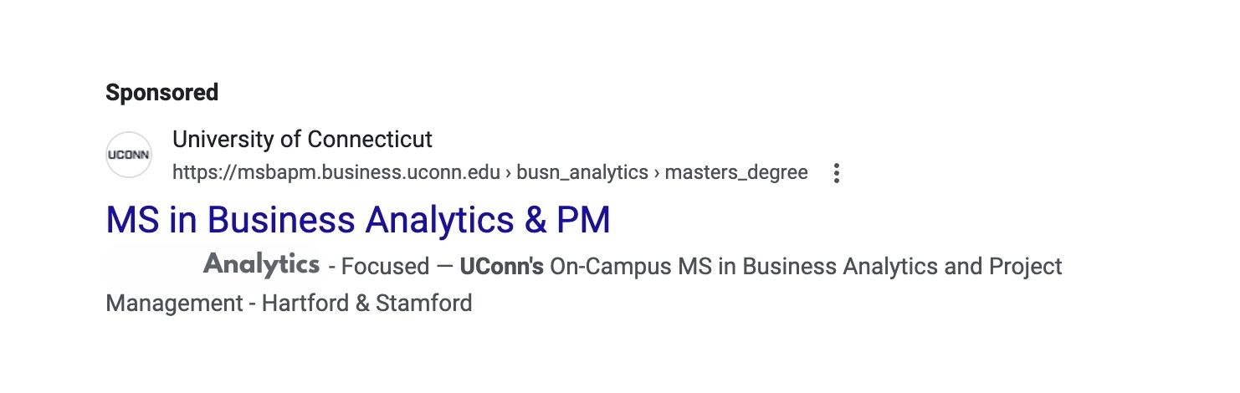
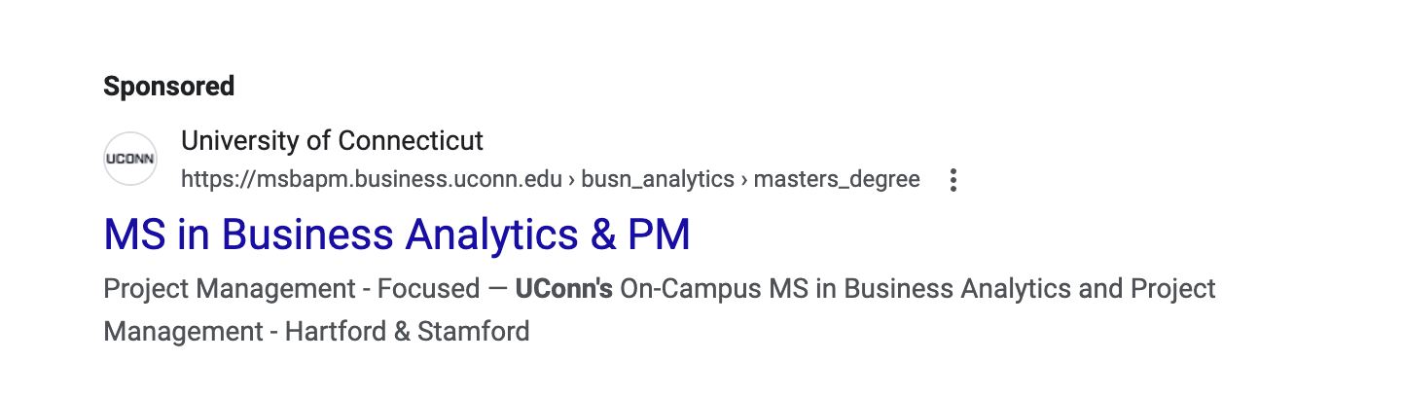
Strategy
Strategy Overview:
Leverage Google Search Ads campaign to test two ad versions, targeting domestic and international students.
Hypothesis:
Switching the ad focus to "Analytics" will increase clicks from international students, while domestic students will show stable engagement across both ad type.

Slide 4
Experimental Design
Test Setup: A/B test on Google Ads with two ad versions:
Ad Version A: Project Management-focused
Ad Version B: Analytics-focused
Target Audience: Segment A - International students; Segment B - Domestic students.
Data Collection: Tracking Clicks by ad type and audience segment.
Clicks = A + B. Student Type + C. Ad Version + D (Student Type* Ad version)

Slide 5
Hypothesis
Null Hypothesis (H₀):
There is no difference in the number of clicks between the "Analytics Focused" and "Project Management Focused" ads for both domestic and international students.
Alternative Hypothesis (H₁):
The number of clicks for domestic as well as international students will be higher with the "Analytics Focused" ad than with the "Project Management Focused" ad

Slide 6
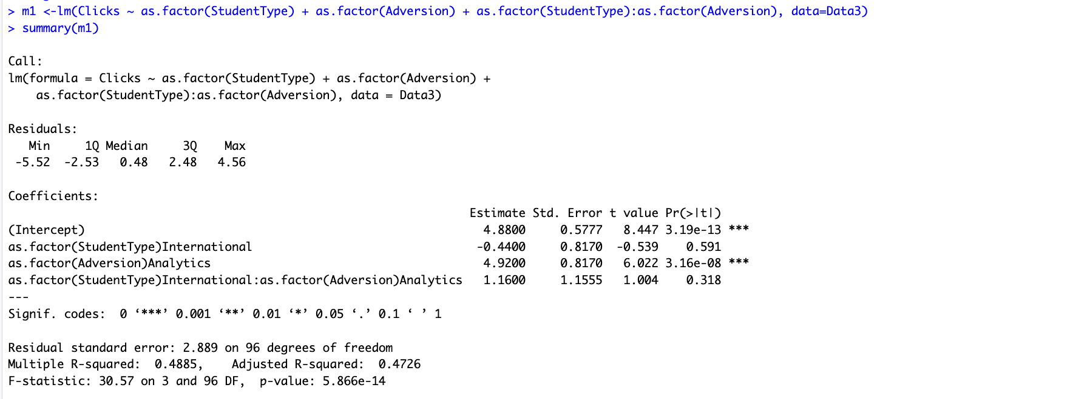
Results Overview
Domestic Students: The Analytics ad significantly increased Clicks by 4.92 clicks per unit over the Project Management ad version (p < 0.05).
International Students: Analytics ad also significantly increased Click by 6.08 clicks per unit over Project Management. (p < 0.05).

Slide 7
Business Recommendations
Emphasize "Analytics" Messaging Across Both Domestic and International Campaigns
Prioritize the Analytics-focused ad version in both domestic and international campaigns as this messaging is clearly resonating more than the Project Management focus.
Optimize Landing Page to Reinforce Analytics-Centric Messaging
Ensure that the landing page aligns closely with the Analytics-focused ad by prominently showcasing program strengths in analytics, such as:
Analytics coursework details.
Success stories of graduates in analytics roles.
Partnerships with analytics-driven companies.

Slide 8
Thank you!

