Slide 1

Final Project:
Lung Cancer Prediction
Luke Profio

Slide 2
Project Overview
Early detection of lung cancer dramatically increases survival rates, but diagnosis is often delayed until advanced stages.
In this project, we build a supervised learning pipeline that predicts whether a patient is likely to have lung cancer from an anonymous survey covering demographics, lifestyle habits and respiratory-related symptoms.

Slide 3
Objectives
Clean, explore and visualize the survey data.
Build and evaluate predictive models (Logistic Regression as baseline; Random Forest as ensemble)
Interpret which features drive the predictions.
Summarize findings and outline limitations of the study.

Slide 4
About the Dataset
This is a publicly-available Kaggle dataset of hypothetical lung cancer patients that was synthetically generated.
  Nelson, S. G. (2023). Lung Cancer Prediction [Kaggle Notebook]. Kaggle. Retrieved July 15, 2025, from https://www.kaggle.com/code/sandragracenelson/lung-cancer-prediction/notebook
This contains 11kB of tabulated data, with over 310 records and 16 features (14 numeric, 2 non-numeric). Outside of demographic features such as gender and age, there are a variety of symptom-based features such as anxiety and allergy, in addition to the target feature, LUNG_CANCER which is converted into a numeric value.

Slide 5
Data Cleaning
Missing values were checked for, while duplicates and outliers were not relevant for this dataset given it didn’t have an identifier, and all numeric columns were re-encoded as 1’s/0’s.
The target variable was mapped from “YES/NO” to 1/0 to provide the numeric form needed by classifiers.
All 2’s were replaced with 1’s, and all 1’s were replaced with 0’s (where 2 = true/positive and 1 = false/negative) across non-object columns to ensure consistency in Boolean features, and avoid unintended ordinal interpretations.
Gender was re-encoded from M/F to 1/0 to ensure a uniform numeric representation of the data for downstream analysis.

Slide 6
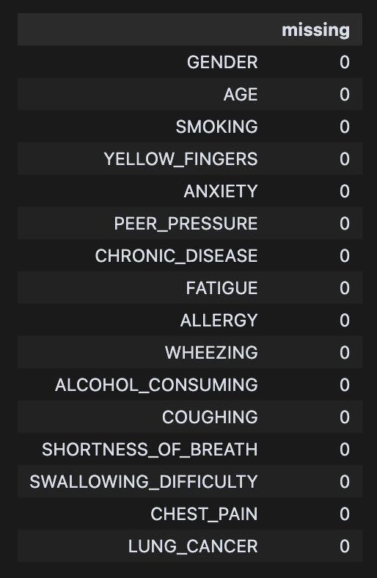
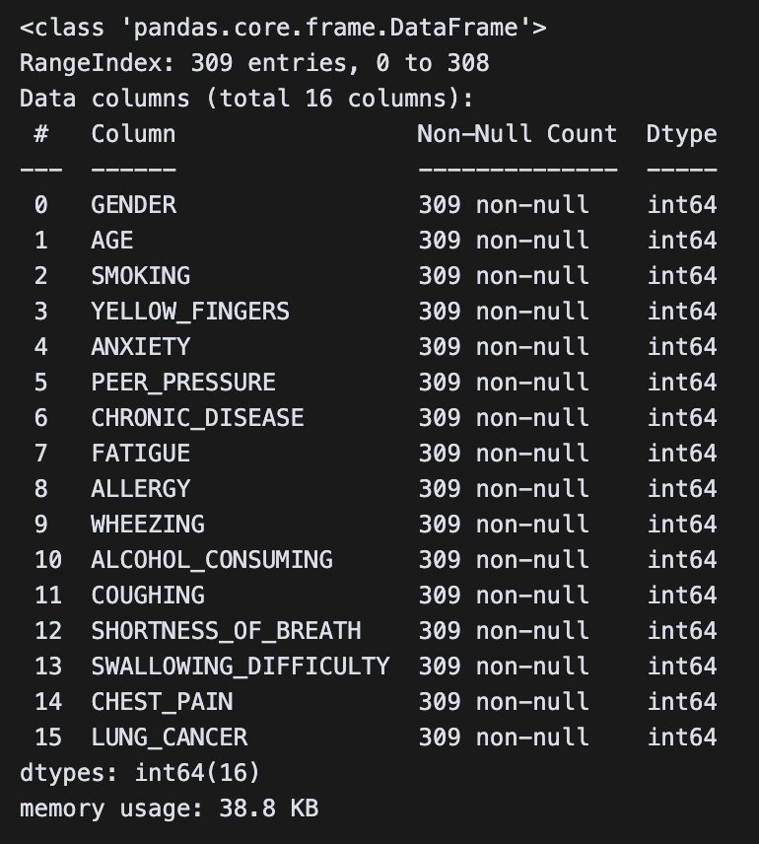
Data Cleaning

Slide 7
Data Cleaning – Conclusions
There were no missing values found.
There weren’t any major issues with data cleaning.
  This is likely due to the dataset being synthetic. In real-world, scaled datasets there would be outliers, duplicates, and missing values to be cleaned.
Overall, the strategy involved remapping the dataset into 0’s and 1’s which were logical and compatible with the analytic modelling to be performed.

Slide 8
Exploratory Data Analysis
The purpose of EDA with this dataset was to identify bias, skewness, multicollinearity, and other factors that may impact the subsequent analysis.
Plotted a histogram of age and each target variable to identify potential bias in the dataset.
Generated a heatmap of pairwise correlations among targets to assess multicollinearity and strong associations.
Tree-based importance scores were used to rank predictors, helping to guide feature selection.

Slide 9
Exploratory Data Analysis - Conclusions
The dataset is not balanced in terms of age, with a majority of older individuals.
A minority of individuals actually have lung cancer.
Anxiety is strongly correlated with yellow fingers, and moderately correlated with swallowing difficulty. Shortness of breath is moderately correlated with fatigue.
Age, allergy, alcohol consumption, and peer pressure are among the most important features.

Slide 10
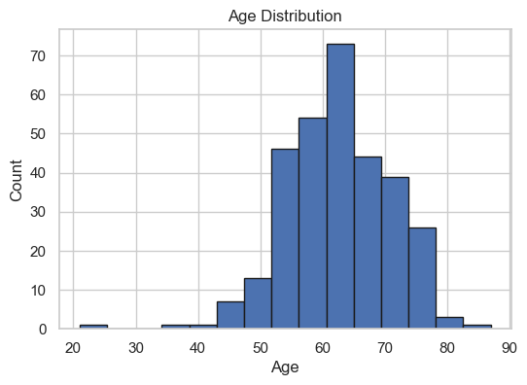
Exploratory Data Analysis

Slide 11
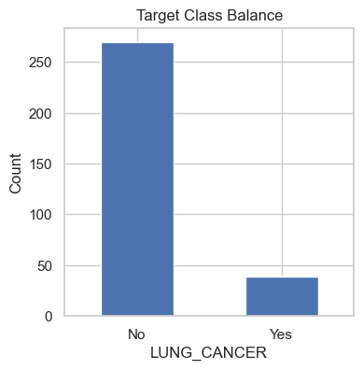

Slide 12
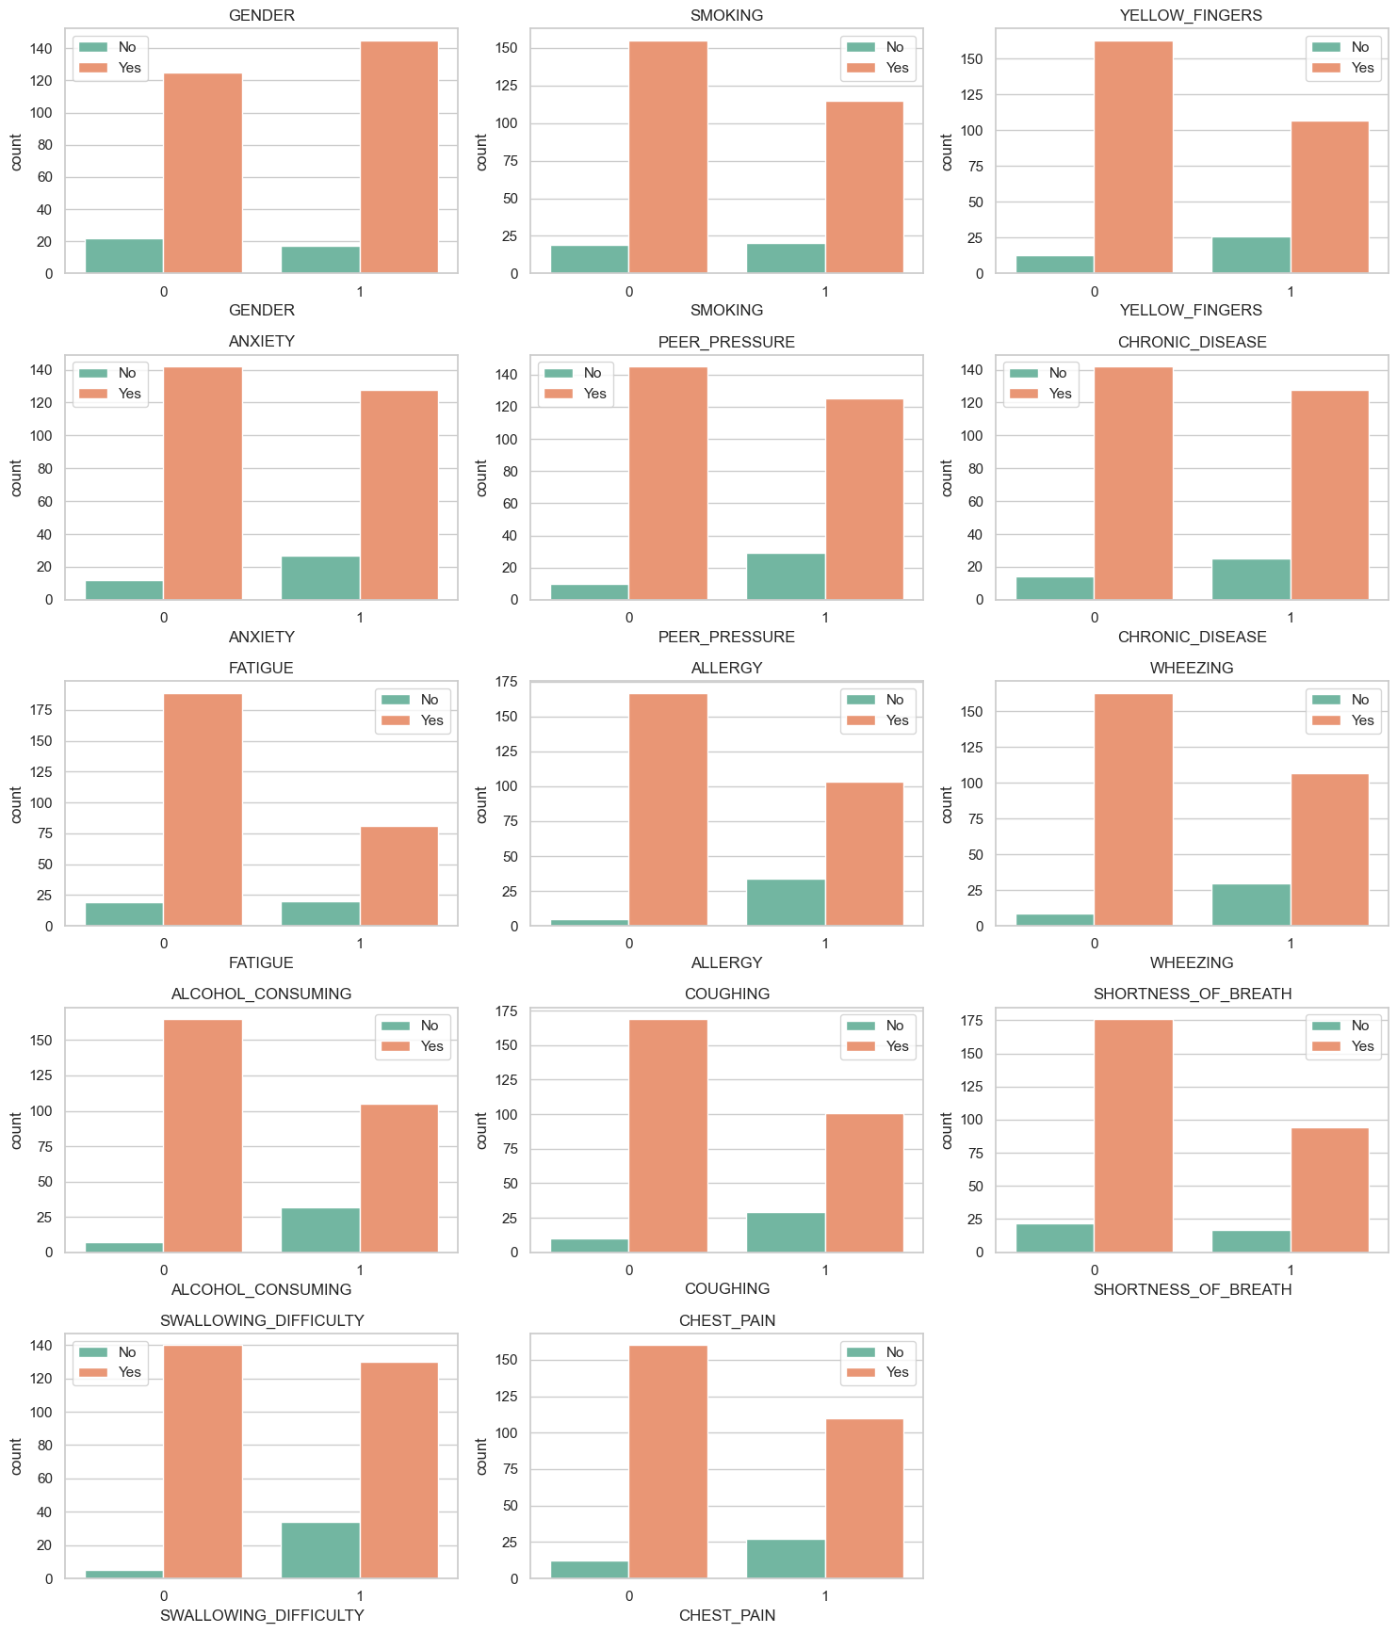

Slide 13
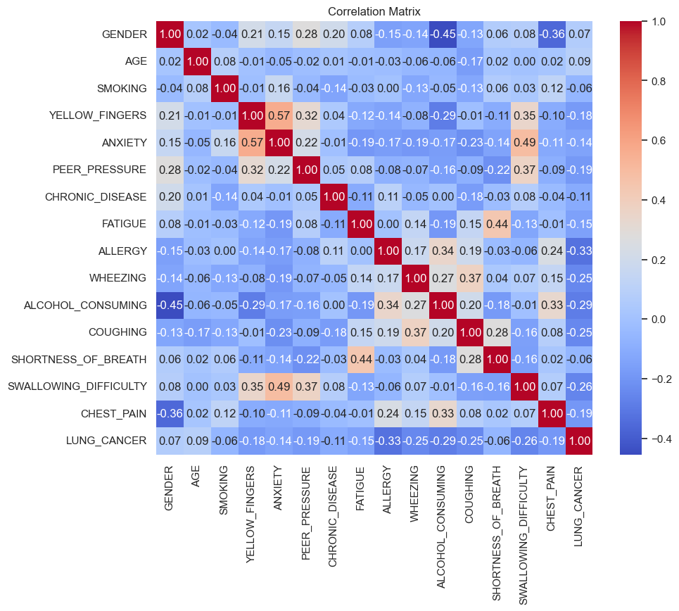

Slide 14
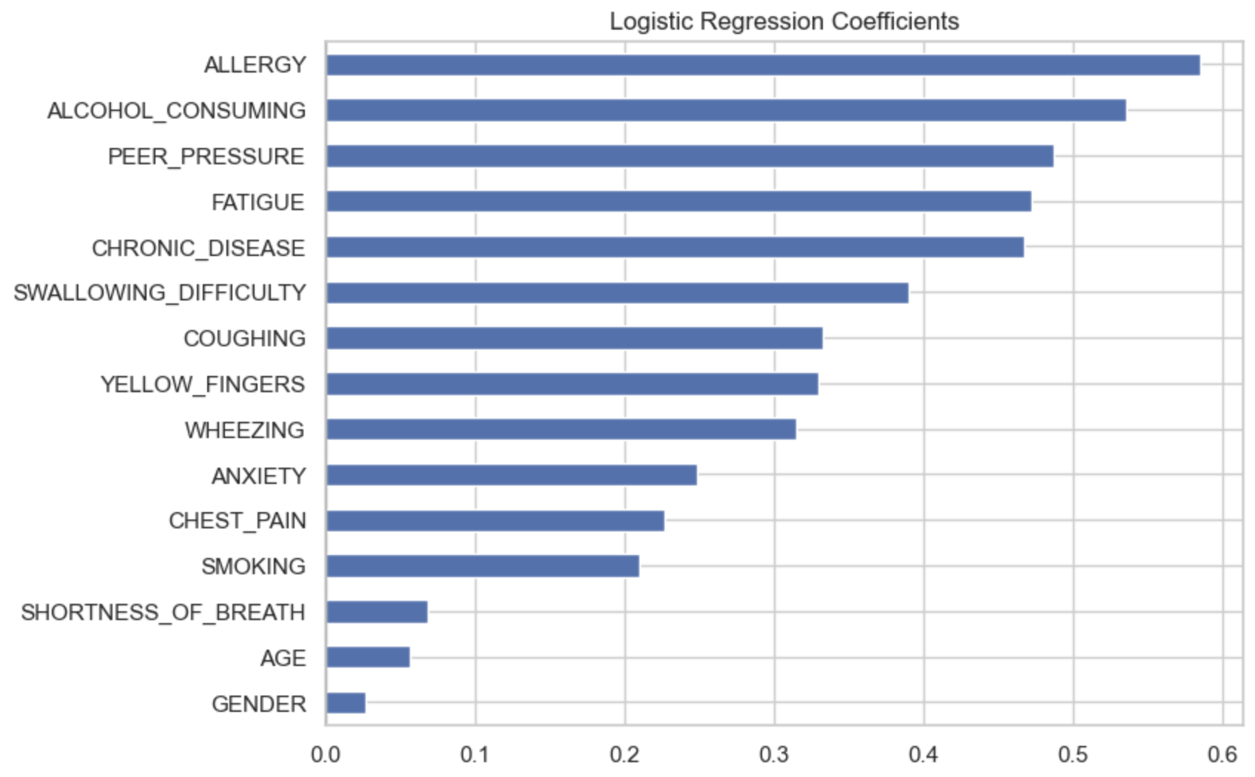
Logistic Regression Feature Importance

Slide 15
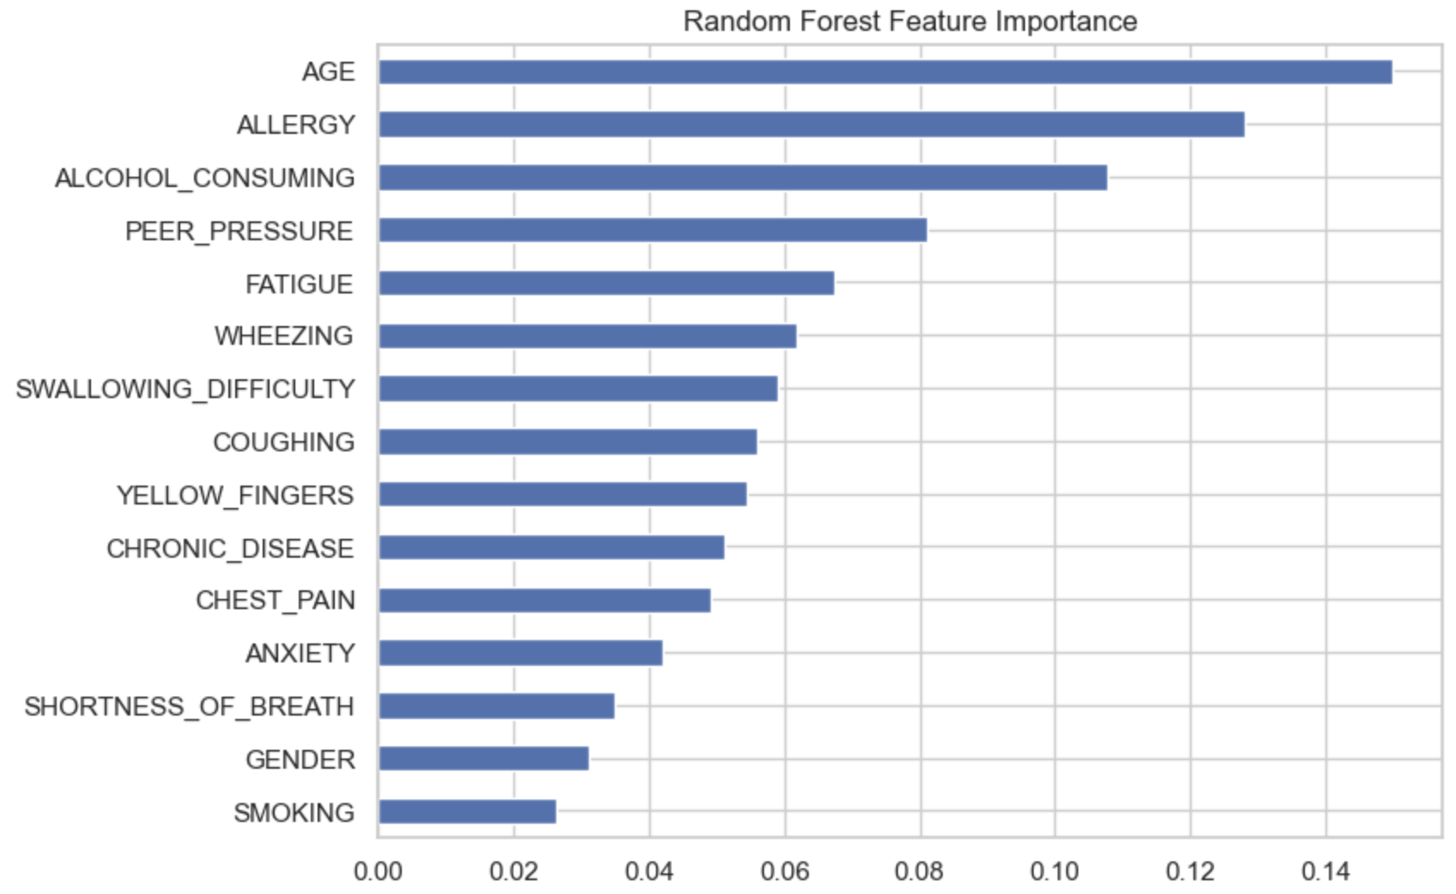
Random Forest Feature Importance

Slide 16
Modeling
Logistic regression and random forest models are utilized.
Hyperparameter tuning is performed, and the best parameters are included (e.g. clf_c = 0.001).
L2 regularization is applied by default through logistic regression, helping to prevent overfitting by penalizing large coefficient values.
Feature engineering is performed by generating interaction terms through polynomial feature expansion, capturing nonlinear relationships between variables.

Slide 17
Results
Logistic regression performed without hyperparameter tuning, regularization and feature engineering has an ROC AUC that is 0.01 lower than that of the optimized model.
Optimized LR misclassifies ~18% of all samples with an accuracy of 82.3%.
Random forest has an AUC comparable to that of non-optimized LR but with an accuracy of almost 89%.
This means that random forest ranks predictions roughly the same as LR, but makes more correct predictions at the given threshold.

Slide 18
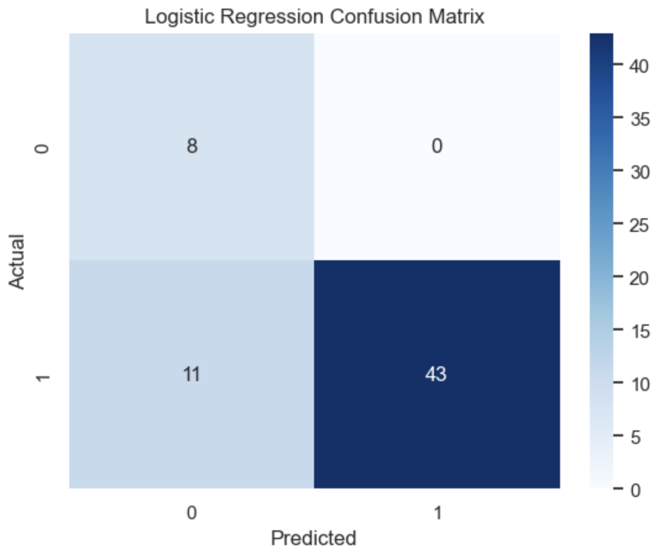
Logistic Regression Confusion Matrix

Slide 19
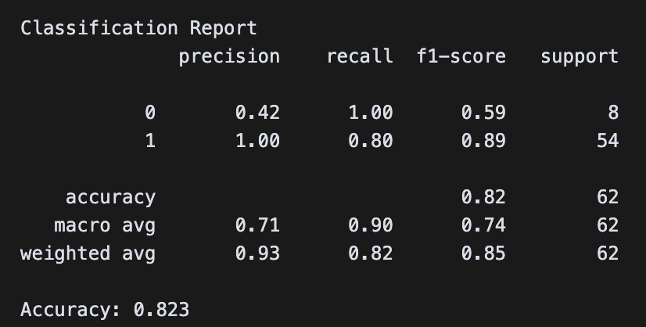
Logistic Regression Analytics

Slide 20
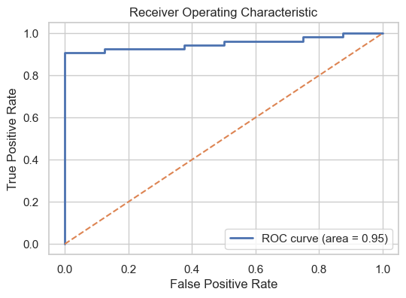
LR Non-Optimized ROC

Slide 21
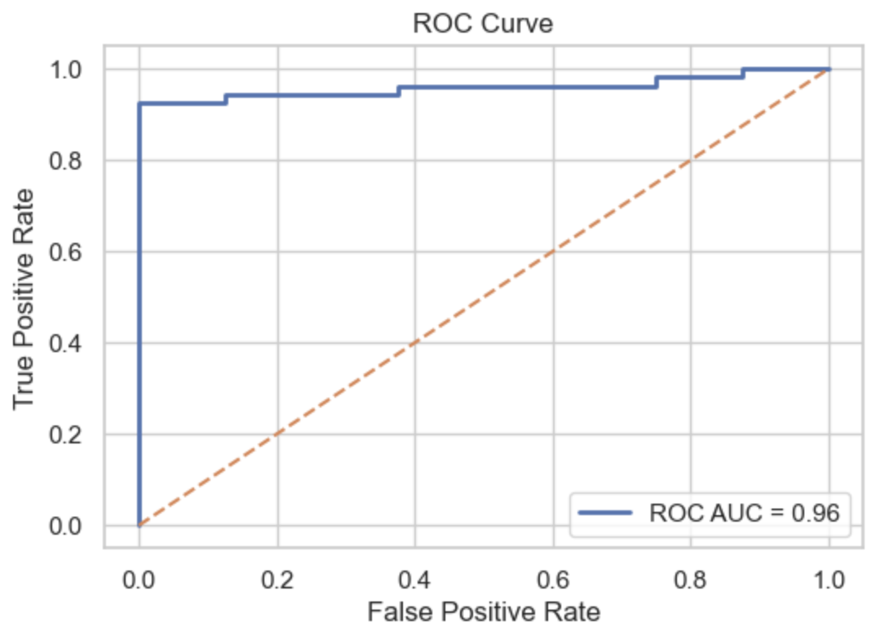
LR Optimized ROC

Slide 22
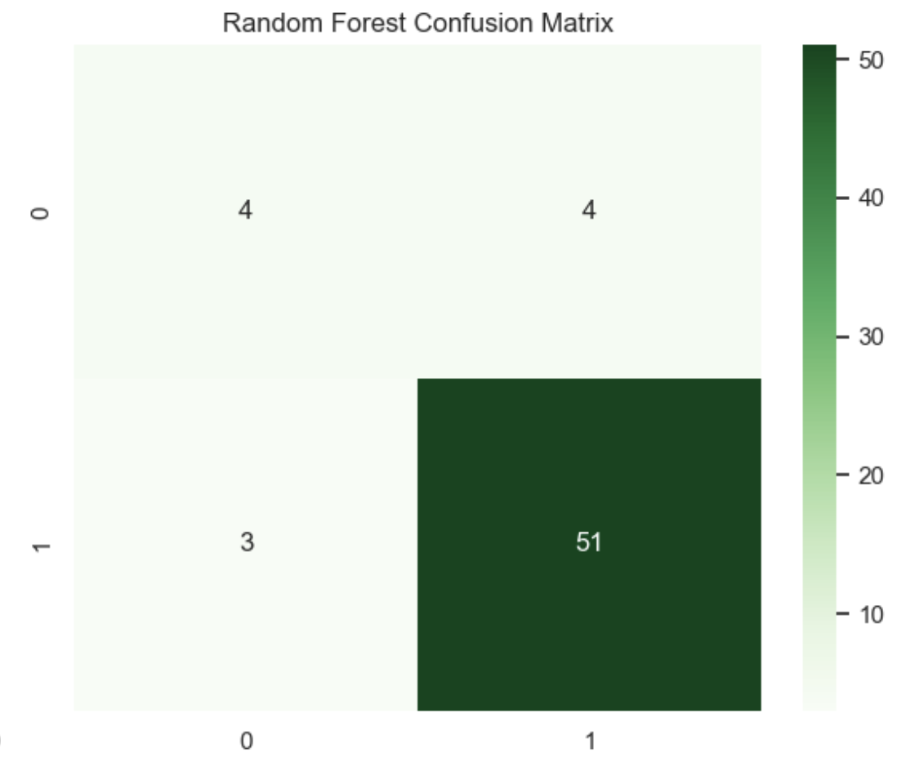
Random Forest Confusion Matrix

Slide 23
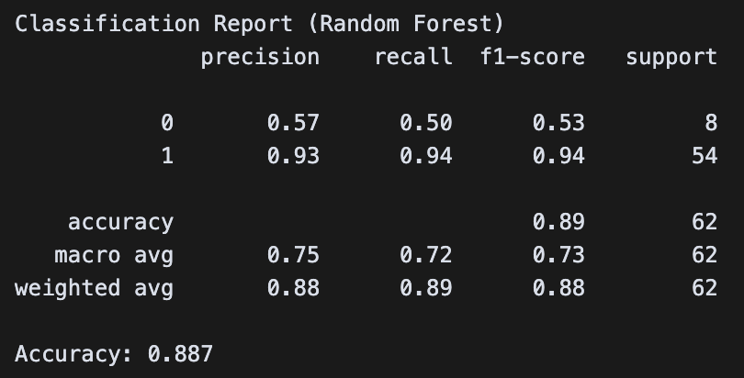
Random Forest Analytics

Slide 24
Random Forest Non-Optimized ROC

Slide 25
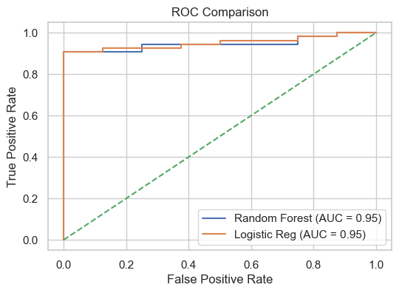
Model Comparison

Slide 26
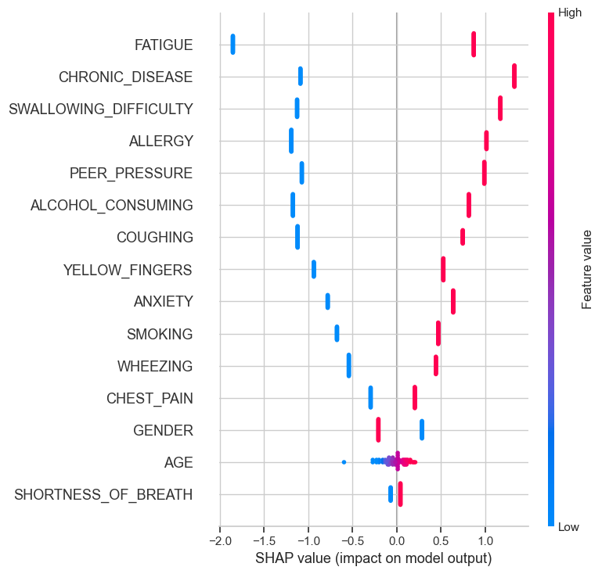
Logistic Regression SHAP Summary

Slide 27
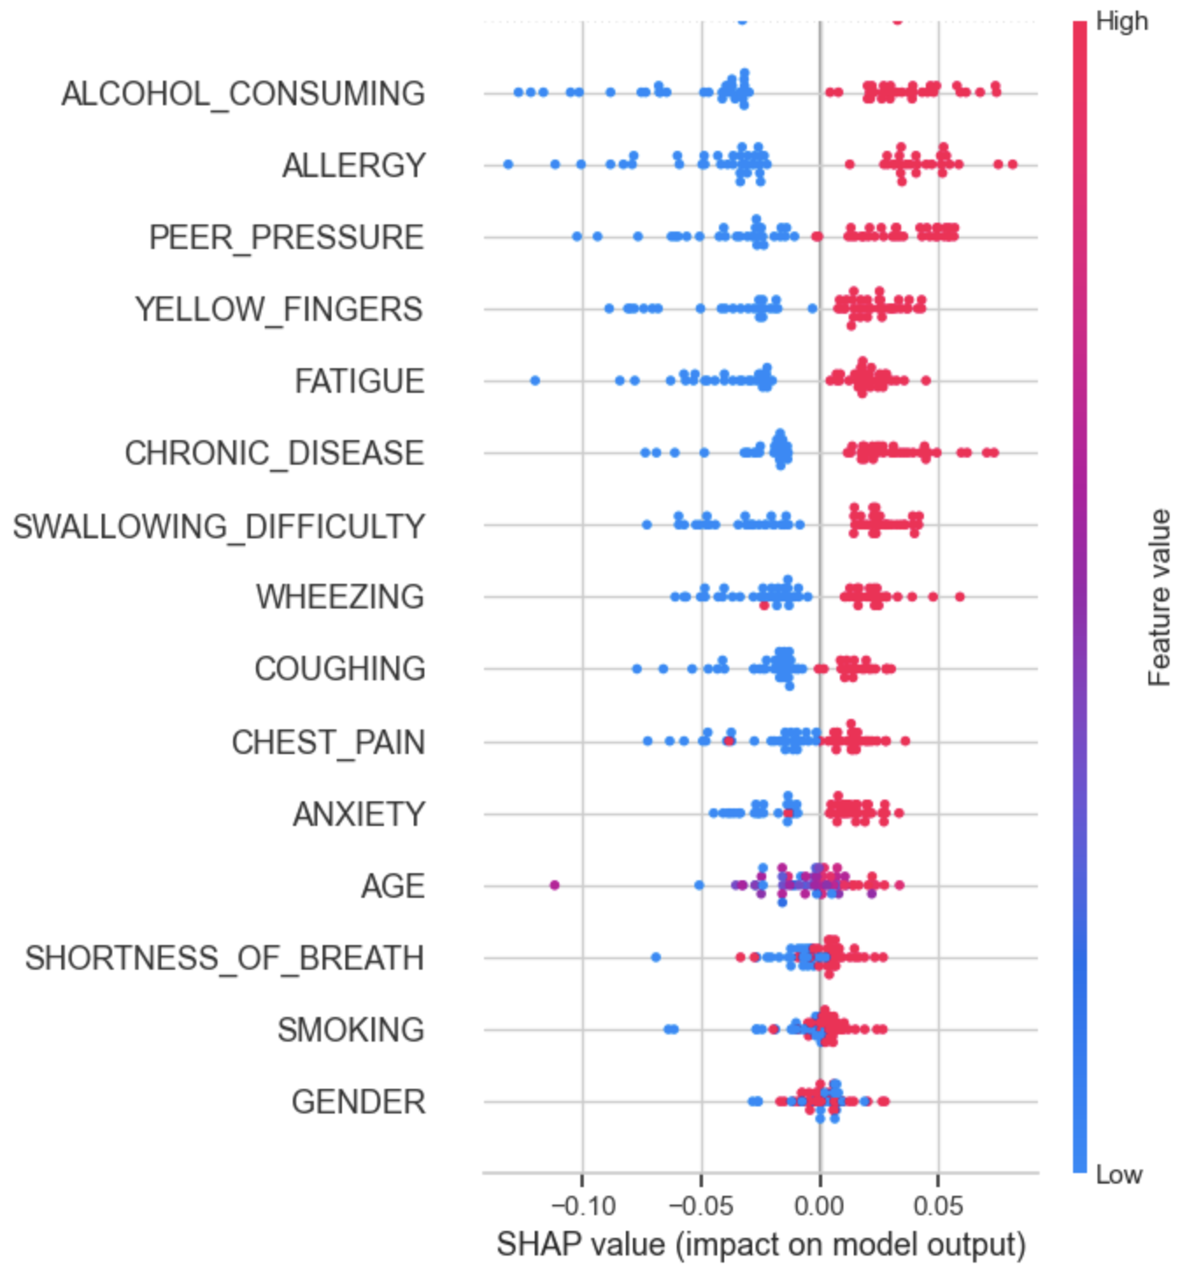
Random Forest SHAP Summary

Slide 28
Conclusion
Logistic regression with tuned regularization parameters reach relatively high AUC and accuracy, while Random Forest slightly improves AUC but at the cost of interpretability.
The highest-weighted features include SMOKING, AGE, and respiratory symptoms such as COUGHING, SHORTNESS_OF_BREATH, and CHEST_PAIN.
This aligns with the medical literature, stating that tobacco exposure is the leading risk factor for lung cancer and respiratory symptoms are common in patients that have a diagnosis.

Slide 29
Limitations & Future Directions
The dataset size (n ~ 300) is relatively small; collecting more samples would improve the accuracy of these models.
Survey responses might be self-reported, which can add bias and potentially mis-annotate the data.
Other AI/ML techniques should be explored (e.g. Gradient Boosting, XGBoost) along with more involved hyper-parameter optimization with nested CV.
A web application should be developed to allow clinicians to input survey responses and receive risk scores; this will address the data gap outlined previously.

Slide 30
Q&A

Slide 31
Thank You!

