Slide 1

Docker – Technical Details
COMP-10097 – Virtual Infrastructure

Slide 2

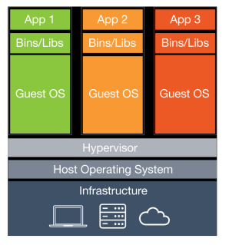
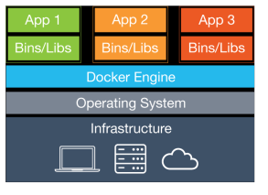
Traditional Type 2 VM
(e.g. VirtualBox)
Container
(e.g. Docker)

Slide 3
Docker: Image vs Container
Image
A union of layered filesystems
Never changes
Example Dockerfile
Final Image
FROM alpine:3.5 (Layer 0)
# Install python and pip
RUN apk add --update py2-pip (Layer 1)
# install Python modules needed by the Python app
COPY requirements.txt /usr/src/app/ (Layer 2)
Layer 2
Layer 1
Layer 0 (Base image)

Slide 4
Docker: Image vs Container
Container
Runtime instance of an image + a writeable layer
Many containers each with a unique writeable layer can be run from the same image
Container
Changes written here!
Image
Writeable layer
Layer 2
Layer 2
Persistent
Layer 1
Layer 1
Layer 0 (Base image)
Layer 0 (Base image)

Slide 5
I found an image called “ubuntu” on DockerHub – Huh?
This image contains parts of the file system, utilities and libraries found in Ubuntu.
It is not a complete kernel.
It requires the host kernel to be linux-like
Try it:
docker run –it ubuntu

Slide 6
Try this!
1. docker run –it ubuntu
(then from within container install the wget application)
2a. apt-get update
2b. apt-get install wget
2c. wget (it runs!)
Ctrl+d to exit container. Now, run another container based on the same image:
3a. docker run –it ubuntu
3b. wget (FAIL! WHY?!)
Notes:
Explain that ubuntu is just an image of libs and bins typically found in an ubuntu install. It does not contain a kernel.

Slide 7
Docker Networking
By default, docker creates three networks: Host, Bridge and None
Host -> container added to host network
Bridge -> container(s) added on new network.
Containers can communicate with host & each other
Containers added to Bridge network by default
None -> no network

Slide 8
Docker Networking, cont’d
Start two containers: docker run –it bash
They will start in bridge mode, by default
a. What are their IP address?
b. Can the two containers communicate?
c. Can they communicate with the host? The internet?
(172.17.0.x, YES, YES)

Slide 9
Docker Networking, cont’d
More details…
https://docs.docker.com/engine/userguide/networking/#the-default-bridge-network

Slide 10
Key Docker Commands
docker run –i <image> -> run a docker image
docker run –it <image> -> run a docker image and attach to host terminal
docker images -> list all docker images
docker ps -> list running containers
docker ps -a -> list running containers, even those that have exited.

