Slide 1
DNS

Slide 2
DNS – Domain Name Service
This lecture is based closely on ZyTrax excellent “DNS For Rocket Scientists” found at: http://www.zytrax.com/books/dns/
The DNS Graded lab is probably the most difficult activity in this course.

Slide 3
What Does DNS Do?
A DNS translates (or maps) the name of a resource to its physical IP address - typically referred to as forward mapping
A DNS can also translate the physical IP address to the name of a resource - typically called reverse mapping.

Slide 4
Why bother? Can’t we just use a hosts file?

Slide 5
Three Needs:
The need for a hierarchy of names
The need to spread the operational loads on our name servers
The need to delegate the administration of our Name servers

Slide 6
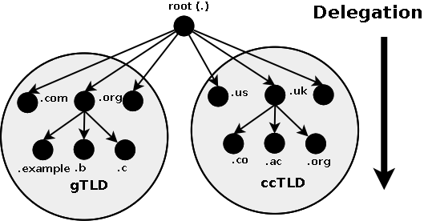
Domain Structure Delegation

Slide 7
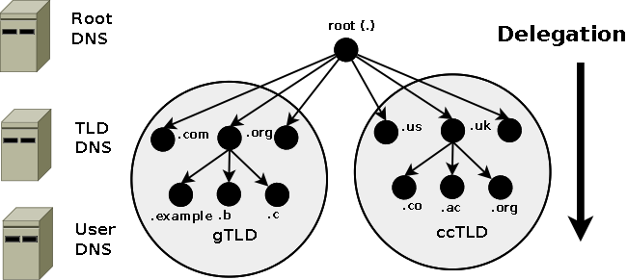
DNS mapped to Domain Delegation

Slide 8
Zones and Zone Files
Zone files contain Resource Records that describe a domain or sub-domain. The format of zone files is an IETF standard defined by RFC 1035. Almost any sensible DNS software should be able to read zone files.

Slide 9
DNS Queries
The major task carried out by a DNS server is to respond to queries (questions) from a local or remote resolver or other DNS acting on behalf of a resolver. A query would be something like 'what is the IP address of fred.example.com'.

Slide 10
Three types of queries
A recursive query - the complete answer to the question is always returned. DNS servers are not required to support recursive queries.
An Iterative (or non-recursive) query - where the complete answer MAY be returned or a referral provided to another DNS. All DNS servers must support Iterative queries.
An Inverse query - where the user wants to know the domain name given a resource record. Reverse queries were poorly supported, very infrequent and are now obsolete (RFC 3425).

Slide 11
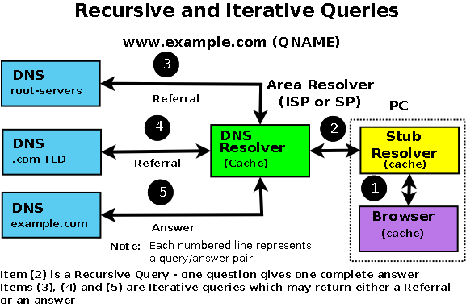

Slide 12
Types of DNS Servers
Master (a.k.a. Primary)
Slave (a.k.a. Secondary)
Caching (a.k.a Resolver)
Primary and Secondary servers offer ‘Authoritative’ answers
Primary servers get data from Zone file(s)
Secondary servers get data from Primary servers
A server can be authoritatve for some zones and caching for others
Primary and Secondary offer ‘Authoritative’ answers
Primary gets data from zone file(s)
Secondary gets data from a Primary
A server can be both ‘Authoritative'

Slide 13
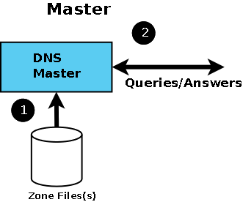

Slide 14
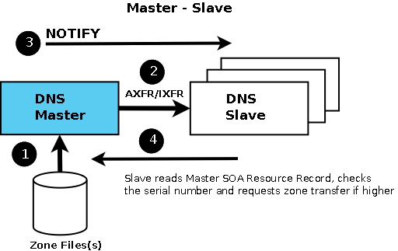

Slide 16
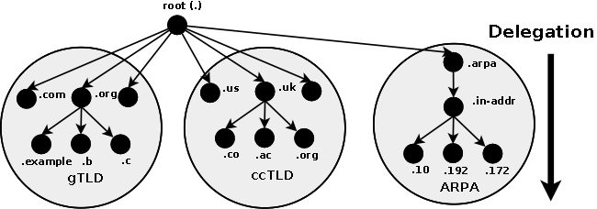
Reverse Mapping
The hierarchy we have seen so far is very good at turning names into IP addresses, but not so good at turning IP addresses into names.
The ‘trick’ is to add a domain .arpa.in-addr to handle reverse lookups.

Slide 17
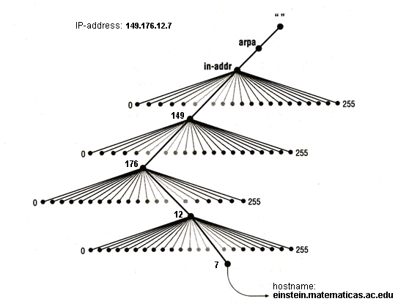
Source: http://www.linuxfocus.org/Russian/May1998/article45.html

