Slide 1
Performance

Slide 2
Performance – why bother
Performance tuning is not as important as it used to be.
“Buy more or use less”

Slide 3
Key Areas
CPU
Memory
Disk

Slide 4
CPU
A well tuned system, running at it’s limit will be CPU bound*
Processes ‘compete’ for CPU time the scheduler decides who get’s how much
Completely Fair Scheduler is the default for current Linux systems (http://www.linuxjournal.com/magazine/completely-fair-scheduler)
*limited by

Slide 5
Memory
Linux/Unix systems use virtual memory.
Memory is a lot like money, “It doesn’t matter very much until you don’t have enough.”
Some applications allow you specify how much memory they use.
Virtualization is memory intensive.

Slide 6
I/O - Network
Latency vs. Throughput
Network isolation
Testing:
scp is a terrible network test
ping is not much better
Test every interface
Use NetPerf

Slide 7
I/O – Disk (HDD)
“Spinning Rust”
Throughput vs IOPS
IOPS usually more important for commercial systems

Slide 8
Factors Effecting IOPS
Seek time
Rotation speed
Number of drives

Slide 9
Consider the recent history of drives
In 1995 a typical enterprise drive could deliver 50 IOPS and was 100MB in size.
Today a typical enterprise drive delivers 500 IOPS and is 500GB in size.
Anything strike you as troubling?

Slide 10
Enter SSD
On the order of 1000 IOPS
Expensive per GB
Mixed solutions

Slide 11
Buffer Cache
A section of system RAM devoted to local copies of data from the file systems
By default file system I/O passed through the buffer cache
Try this at home:
time cat LargeFile > /dev/null
time cat LargeFile > /dev/null

Slide 12
Ever wonder why CPUs have so many cores and threads?

Slide 13
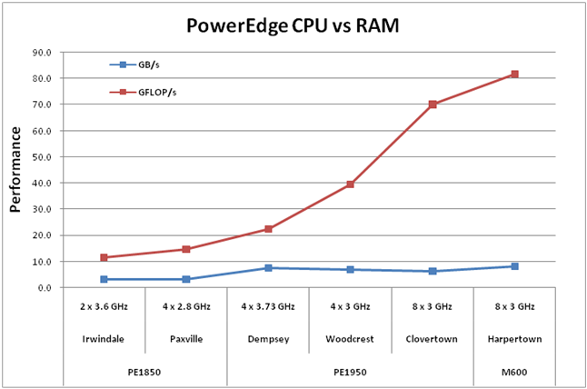
From:http://en.community.dell.com/techcenter/high-performance-computing/w/wiki/2284
Notes:
As CPU performance has increased relative to memory performance much more time is spent by the CPU waiting for data to be fetched from RAM. One way around this is the have multiple threads of execution in the CPU so when one thread is blocked waiting on memory an other thread can do work. This is a major challenge in CPU design and a very large portion of CPU real-estate is devoted to trying to predict what memory will be accessed so that it’s contents can be pre-fetched.

