Slide 1
IP Routing An Administrator’s Survival Guide
Notes:
1

Slide 2
Overview
IP routing is very simple, that’s why is works so well
The “I” in IP stands for Internet
The key here is inter, this implies a way of connecting a number of networks
Each IP address is made up of two parts: Network and Node
Subnet masks are used to define the split between the Network and Node portions
This guide will only use IP-v4 examples (not IP-v6)
Notes:
2

Slide 3
Network – Node Split
IP-v4 address consists of 32 bits
The first <n> bits are the network portion
The remainder are the node portion
These 32 bits are usually written as 4 octets (e.g. 10.1.1.2)
Notes:
3

Slide 4
Network – Node Split (cont.)
The ‘split’ point is defined by the network mask
If no netmask is given, it is assumed based on address class (for this guide we will always declare a netmask)
Notes:
4

Slide 5
Netmask examples
Consider s01’s IP address: 10.1.1.20/24
The /24 sets the netmask at 24 bits, or 255.255.255.0
10.1.1.20
Network
Node
If we change the netmask to 16 (255.255.0.0)…
10.1.1.20
Network
Node
Notes:
5

Slide 6
Netmasks’ Implications For Routing
Every time a node has a packet to send it must decide whether to send the packet directly to the destination node or to send it through a router.
Let’s look at what happens when the node sends the packet directly…
Source node sends an ARP request broadcast to all other nodes on the same network.
Destination node replies with its MAC address
Source node builds an IP packet with the MAC address it just received
Notes:
6

Slide 7
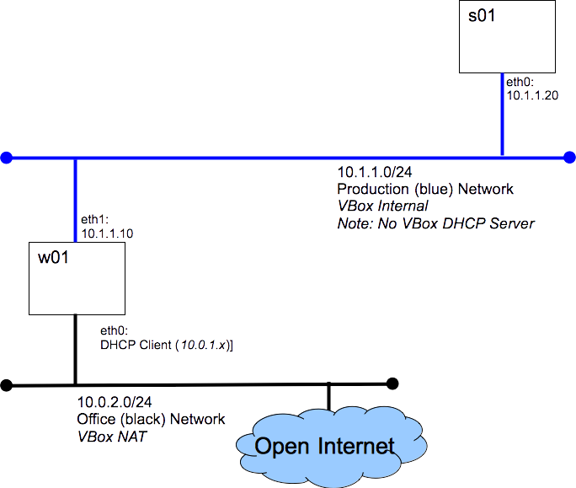
Destination on same network
ARP: Who “is” 10.1.1.10
I am 10.1.1.10 and my MAC=﻿08:00:27:a3:c4:37
Enet: Dest=08:00:27:a3:c4:37
IP: Src=10.1.1.20 Dest=10.1.1.10
Notes:
7

Slide 8
Destination on different network
When the destination node is on different network we must send the packet to a router.
Lets look at what happens when there is router between s01 and w01, like in the routing lab.
Notes:
8

Slide 9
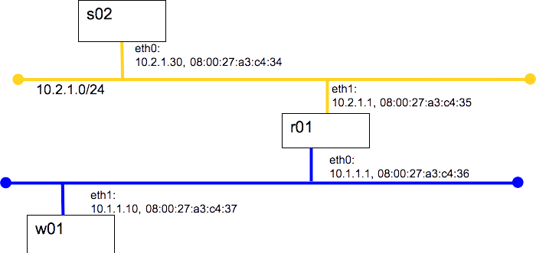
Enet: Dest=08:00:27:a3:c4:35
IP: Src=10.2.1.30 Dest=10.1.1.10
Enet: Dest=08:00:27:a3:c4:37
IP: Src=10.2.1.30 Dest=10.1.1.10
s02 sends IP packet with w01 IP but r01 MAC
r01 builds now IP (note change to MAC)
r01 sends IP packet to w01
How does s02 know to send the packet to r01?
Notes:
9

Slide 10
Routing Tables
Every node has a routing table.
When packets are to be sent, the node ‘walks’ the table and sends the packet via the first match.
s02
Destination | Route
10.2.1.0/24 | eth0
Default | 10.2.1.1
r01
Destination | Route
10.2.1.0/24 | eth1
10.1.1.0/24 | eth0
w01
Destination | Route
10.1.1.0/24 | eth1
10.2.1.0/24 | 10.1.1.1
Notes:
10

Slide 11
Routing Tables
Consider:
s02 sends a packet to w01
W01 send a response packet
s02
Destination | Route
10.2.1.0/24 | eth0
Default | 10.2.1.1
r01
Destination | Route
10.2.1.0/24 | eth1
10.1.1.0/24 | eth0
w01
Destination | Route
10.1.1.0/24 | eth1
10.2.1.0/24 | 10.1.1.1
Notes:
11

Slide 12
Routing Table - Destination
The destination column contains a list of Networks.
Two possible options:
a) A Network
b) Default

Slide 13
Routing Table - Route
The route column tells the node where to send the packet.
Two possible options:
a) Network interface (for networks to which the node is directly connected)
b) IP Address of a router

Slide 14
What makes a Linux/Unix system a router?
If IP-forwarding is turned off, the node does not process packets that have a destination IP address other then their own.
If IP-forwarding is enabled, the node will try to forward packets not addressed to it.

Slide 15
Magic of the ‘default’ route
Each node may have at most one default route.
The default route usually points toward the open Internet.
Most nodes have only ‘local’ routes and a default router.

Slide 16
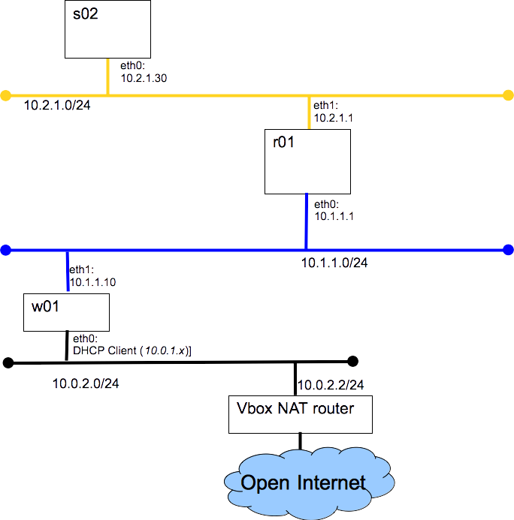
Exercise: Produce the routing tables for each node in the graded lab

