Slide 1
COMP-10018
Unix Administration

Slide 2
Logistics
Each week:
- 60 Minute Lecture
- Two 90 Minute Labs

Slide 3
Basic Course Structure
Each Module*:
    Lecture
    “Cook Book” Lab
    Quiz
    Graded Lab
*Logging and Performance are Graded Lab only

Slide 4
Grading
Grading Scheme:
Quizzes 5%
Graded Labs 10%
Tests 85%

Slide 5
Quizzes
11 Quizzes
5 Questions each
Two attempts per quiz
  You will be able to see your attempts after submission.

Slide 6
Graded Labs
10 Graded Labs
Each scored out of 10

Slide 7
Tests
3 Hands-On Tests
Best 2 count
Similar in content and structure to Graded Labs

Slide 8
Virtual-Lab
Oracle VirtualBox Appliance
Contains three VMs:
  Server (s01)
  Workstation (w01)
  YUM software server (y01)

Slide 9
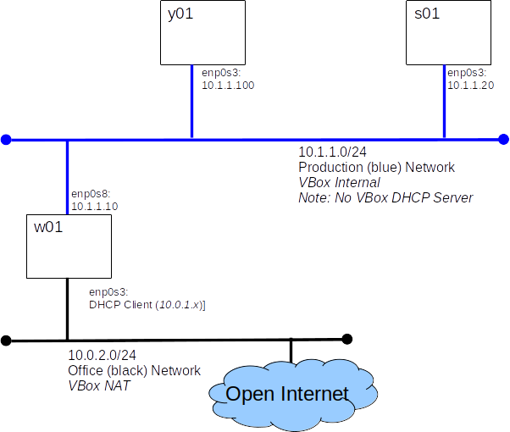
Virtual Lab

