Slide 1
Using netfilter
Basic configuration for a simple packet filtering implementation

Slide 2
Architectue
Uses the kernel’s netfilter interface
Rules are grouped into chains
Chains are grouped into tables
Each table is assigned to a family

Slide 3
Sample nftables.conf accepting all packets
table inet filter {
chain input {
type filter hook input priority filter; policy accept;
}
chain forward {
type filter hook forward priority filter; policy accept;
}
chain output {
type filter hook output priority filter; policy accept;
}
}

Slide 4
Sample nftables.conf accepting just ssh
table inet filter {
chain input {
type filter hook input priority filter; policy drop;
tcp dport 22 accept
}
chain forward {
type filter hook forward priority filter; policy accept;
}
chain output {
type filter hook output priority filter; policy accept;
}
}

Slide 5
Chain evaluation
Chains evaluated in order
Rules evaluated left-to-right
Rules are a mix of ‘matches’ and actions
If a match is true, evaluation continues
Actions executed as encountered
Sample rule
tcp dport 22 iif enp0s8 log accept

Slide 6
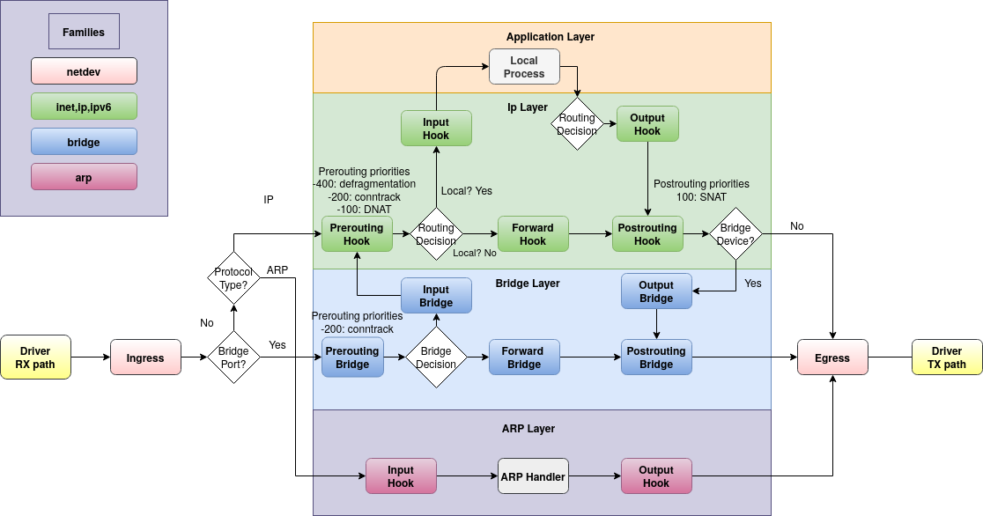
Hooks

Slide 7
Examples
Walk through Lab 06b - Firewall

