Slide 1
Business in Canada

Slide 2
What’s a business?
A profit making organization
What’s profit? (π)
π = revenue – expenses
Are there ‘businesses’ that don’t fit this definition?

Slide 3
The Economy
Economic System:
“The way in which a nation allocates its resources among its citizens” Business Essentials
“The field on which our business must play”

Slide 4
Factors of Production
Labour
Capital
Entrepreneurs
Natural Resources

Slide 5
Economic Systems
Command
Market
communism
socialism
capitalism
Size of government
Nationalization
Privatization

Slide 6
Government – Involvement
Regulator
Competitor
Customer
Banker

Slide 7
Competition Act
Collusion
Mergers (monopoly, oligopoly)
Predatory pricing
Misleading marketing
Pyramid selling
Sale price maintenance
Bait-and-switch

Slide 8
Government as competitor
Crown corporations:
Canada Post
Wheat Board
Hydro Quebec
Government Monopolies:
OHIP
Government Services:
Schools
Police

Slide 9
Government as Customer
Canada 2011 GDP=1,800
USA 2011 GDP=15,000
 | 2012 (billions)
Debt charges | 30
Operating and capital | 69
Transfer payments | 151
Total | 250
2012 (billions)
2,500
 | 2012 (billions)
Social Programs | 117
International, Immigration, Defense | 34
Parliament | 1/2
2012 (billions)
785
State
Defense
½ NASA
½ Energy
http://www.tbs-sct.gc.ca/est-pre/20112012/me-bpd/docs/me-bpd-eng.pdf
http://en.wikipedia.org/wiki/2012_United_States_federal_budget
https://www.cia.gov/library/publications/the-world-factbook

Slide 10
Government as Bank
Monetary policy
Bank of Canada interest rate
Some control over foreign exchange rate

Slide 11
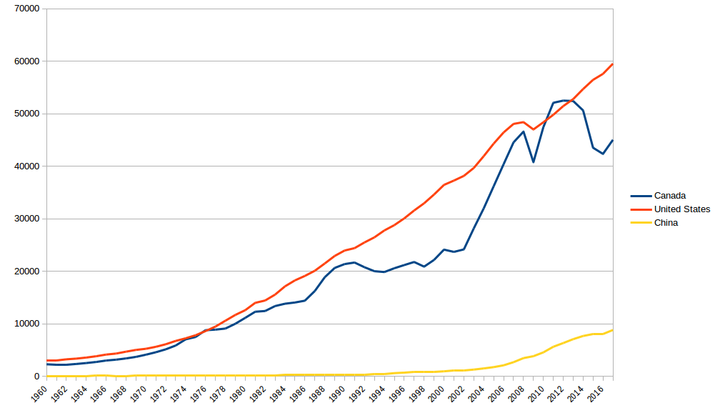
Per Capita GDP in 2017 US Dollars

Slide 12
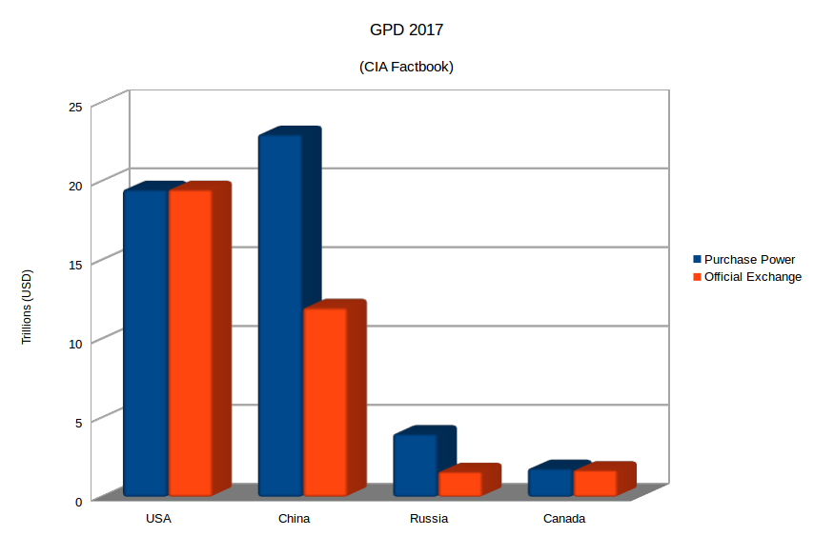

Slide 13
Foreign Exchange
What is it?
Why do we care?
What drives it?

Slide 14
Inflation
What is it?
What drives it?
Why does the Bank of Canada target 2%?

Slide 15
Managing the Economy
Fiscal Policy
Monetary Policy
Dampers

Slide 16
Forms of Ownership
Sole proprietor
Partnership
Corporation:
Private
Public
Holding company

Slide 17
What form to choose?
Often chosen for you:
Medical corporation
IT contractor
Get some advice:
Lawyer
Mentor
Accountant (familiar with your business)

