Slide 1
From the
Glorious Revolution to the
Civil Rights Movement
Justifying opposition to government

Slide 2
Locke
The end of government
is the good of mankind.

Slide 3
Locke
Revolutions happen not upon
every little mismanagement
in public affairs.

Slide 4
Locke
Jefferson
But if
But when
a long train of abuses,
a long train of abuses
prevarications, and artifices, all tending the same way, make the design visible to the people…it is not to be wondered that they should then rouse themselves.
and usurpations, pursuing invariably the same Object evinces a design to reduce them under absolute Despotism,
it is [the people’s] right,
it is their duty,
to throw off such Government.

Slide 5
Racial Disparity
June 11, 1963:
President John F. Kennedy’s
Report to the American People
on Civil Rights

Slide 6
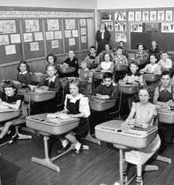
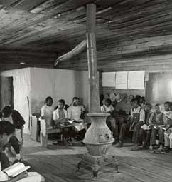

Disparity in Education

Slide 7
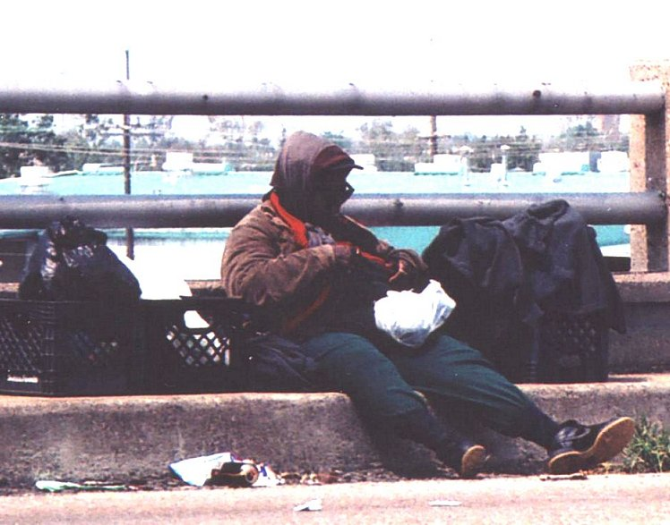
Employment

Slide 8
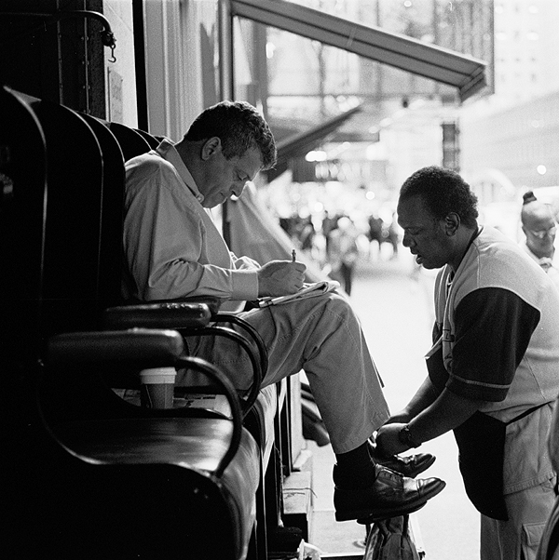
Earning Power
$10,000 in 1963
=
$65,000 today

Slide 9
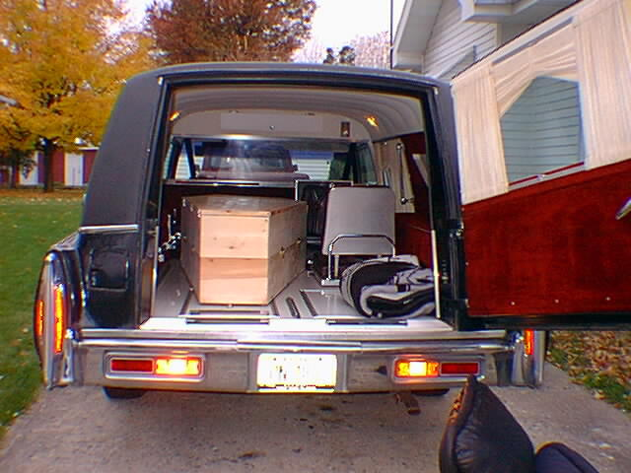
Longevity

Slide 10
Legitimate Expectations
Declaration of Independence
US Constitution
  Preamble
  Bill of Rights

Slide 11
Declaration of Independence
Self-evident truths:
All created equal
Endowed with “unalienable rights”
  Life, liberty, pursuit of happiness
Government is to secure these
If gov’t fails to, may “alter or abolish it”

Slide 12
Preamble
We the People of the United States, in Order to
form a more perfect Union,
establish Justice,
insure domestic Tranquility,
provide for the common defence,
promote the general Welfare, and
secure the Blessings of Liberty to ourselves and our Posterity,
do ordain and establish this Constitution for the United States of America.

Slide 13
Bill of Rights

Slide 14
Sources
John Locke, Second Treatise of Government, sections 225, 229.
JFK speech clip: Free Information Society, http://www.freeinfosociety.com/site.php?postnum=460, accessed May 30, 2007
Schoolroom images: Smithsonian National Museum of American History Web site for the special exhibition “Separate Is Not Equal: Brown v. Board of Education”, http://americanhistory.si.edu/brown/index.html, accessed 1/10/2006.
Bag lady image: Photographs for Articles on Surviving Katrina, by Mary Gehman, http://www.margaretmedia.com/katrina/gallery.htm, accessed June 1, 2007.
Shoe shine image: Black and White Photography of New York by Dave Beckerman, http://www.davebeckerman.com/photo_blog/2005_10_01_archive.html, accessed June 1, 2007.
Hearse image: The Hearse, http://www.nightcoaster.com/hearse/, accessed June 1, 2007.

