Slide 1



Eventual Consistency Done Right
Code It Up Online Vol. 6

Slide 2
For questions
https://sli.do #eventual
The YouTube Live Chat Is Not Monitored
Presentation & Code https://github.com/ivaylokenov/Microservices-Eventual-Consistency-Done-Right

Slide 3
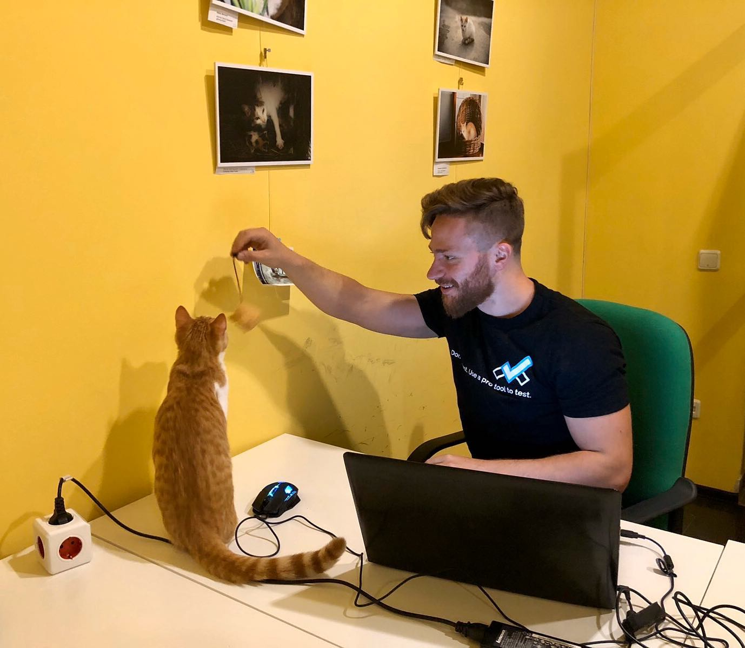
The Presenter
Ivaylo Kenov – Quality Code Advocate
Various job titles at the same time:
Organizer & Speaker @ Code It Up
CTO @ SoftUni
Full Stack Technical Trainer @ Everywhere
Code General @ https://MyTestedASP.NET
Meme Copy Machine @ Daily Programming Fun
{Insert Job Title Here}
Contacts
https://github.com/ivaylokenov
https://facebook.com/ivaylo.kenov
https://linkedin.com/in/kenov
https://www.instagram.com/ivaylokenov/
YouTube
https://youtube.com/MyTestedASPNETTV

Slide 4
What Are We Going To COVER
About Code It Up
Microservice Communication Types
Consistency Between Services
Communication Between Services
Using A Message Broker
Partial Failures
Messages Resiliency
The Outbox Pattern

Slide 5
ABOUT CODE IT UP

Slide 6
Code it up
The Code It Up initiative:
Aims to provide detailed knowledge on advanced .NET topics
Aimed at people with at least 1 year of C# experience
Code It Up Online
Free live-streamed online events
Code It Up Networking
Free on-sight events with live streaming
Guest speakers from the industry
Networking part (with pizza and beer)
Code It Up Workshop
Paid events containing practical exercises for the attendees

Slide 7
Upcoming Code it up Events
Events with set dates:
December 19 – Becoming a Software Architect: The Knowledge Path
Events with no specific order or dates:
Automate Your Process with CI/CD
The Limits of the C# Runtime
API Scenarios - REST, GraphQL & gRPC
Serverless Real-Time C# Applications On AWS? Yes, It’s Possible & Easy!
Software Engineering – Patterns & Anti-Patterns
Plus many more! For example Microservices Details?
The SoftUni course for Microservices DevOps is starting soon!
Use CODEITUP-Process-20 for a 20% discount!

Slide 8
Thankful if you share a story
You can be extremely helpful to the initiative
Just share a story on Facebook or Instagram during the lecture
Make sure you tag me so that I can reshare your post - @ivaylokenov
Bonus – add the #codeitup hashtag
Thank you! You rock!

Slide 9
Why eventual consistency?

Slide 10
Why eventual consistency
Because:
People demanded the lecture ☺
The previous microservices talk needed some code demos
Partial failures happen
Systems need to communicate with each other
Eventual consistency is both easy and hard
Easy, if you do not think to much about it
Hard, when you realize what you got yourself into

Slide 11
Microservice Communication Types

Slide 12
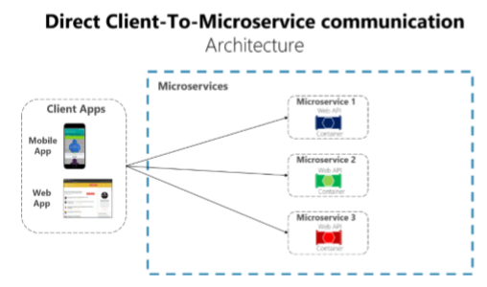
Direct Client-Server Communication
Used when different parts of a client’s page requests different microservices

Slide 13
Direct Client-Server Communication
Usually the client calls a load balancer, which requests data from the internal microservice infrastructure
Should be used when
The application is not huge
The data is independent and does not need additional aggregation
Otherwise the client needs to process business logic
Breaking separation of concerns

Slide 14
Direct Client-Server Communication
Drawbacks
Two many Internet round-trips outside of the internal microservice network
Microservices must be exposed to the “external world”
Cross-cutting concerns like authentication and authorization
Using synchronous communication like HTTP
Different client applications require different APIs
Consider web versus mobile clients

Slide 15
API Gateway
Provides single-entry endpoint for a group of microservices
Like the Façade design pattern
Also knows as “backend for frontend”
You build it for the specific client needs
Acts as a reverse proxy and man in the middle between the clients and the microservices
Can also provide authentication, cache, and other cross-cutting concerns

Slide 16
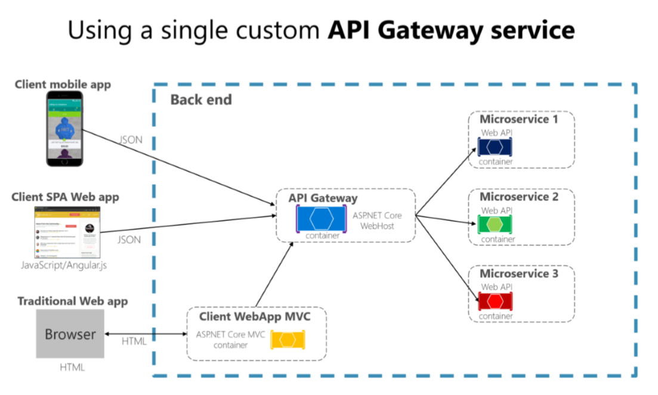
API Gateway

Slide 17
API Gateway
If you are not careful, the API gateway may become a full monolithic app
Bloated with too many endpoints
Couples all microservices, destroying their benefits
API Gateways should also be segregated
At first it may be an API Gateway for each client
But then it may be further split by logical groups based on business boundaries
HTTP or gRPC

Slide 18
API Gateway
Reverse proxy and routing
Decouples the client
Modernize legacy monolithic app
Hide the internal microservices
Request aggregation
Reduces chattiness between client and microservices
Especially important for remote applications
Offloading
Authentication, load balancing, retry policies, response caching, IP whitelisting, and more

Slide 19
API Gateway
Drawbacks
Coupling with the internal microservices
Additional point of failure
Additional network calls
Usually does not have a huge impact considering the alternative
May become a bottleneck
Additional development costs and maintenance

Slide 20
Real-time communication
Real-time communication can be achieved with HTTP Web Sockets
With fallback mechanisms
It is used when you want to push data to the clients directly
ASP.NET Core has SignalR as a real-time communication technology

Slide 21
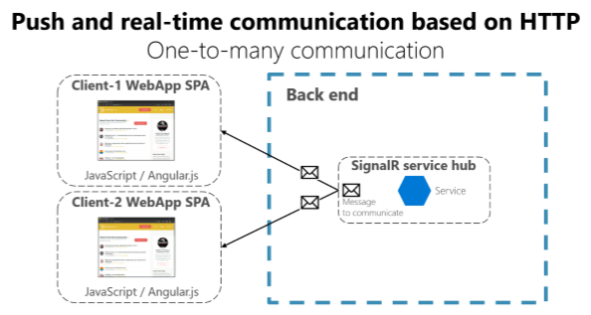
Real-time communication

Slide 22
BEFORE WE CONTINUE…

Slide 23

INDEAVR – The EVENT’s DIAMOND SPONSOR
They provide technology services focused on the Digital, Data, Cloud and Advanced Software Engineering expertise.
They are always in search for creative and passionate people with the combination of a sharp strategic mind, emotional maturity, entrepreneurial instincts, and the ability to deliver results.
https://www.indeavr.com/en/technology/application-services
https://www.indeavr.com/en/careers

Slide 24
Consistency Between Services

Slide 25
Consistency Between Services
The challenge is to implement end-to-end business processes while keeping consistency across microservices
Catalog microservice - maintains information about products (including price)
Shopping Cart microservice - maintains current chosen products and price
When a product price is updated - you need to update the cart too (and show a message)
In monolithic application this should be fairly easy
But with microservices - no service should include tables/storage from another one
And it should never call direct queries to them
The solution is event-based communication
Publish-Subscribe pattern

Slide 26
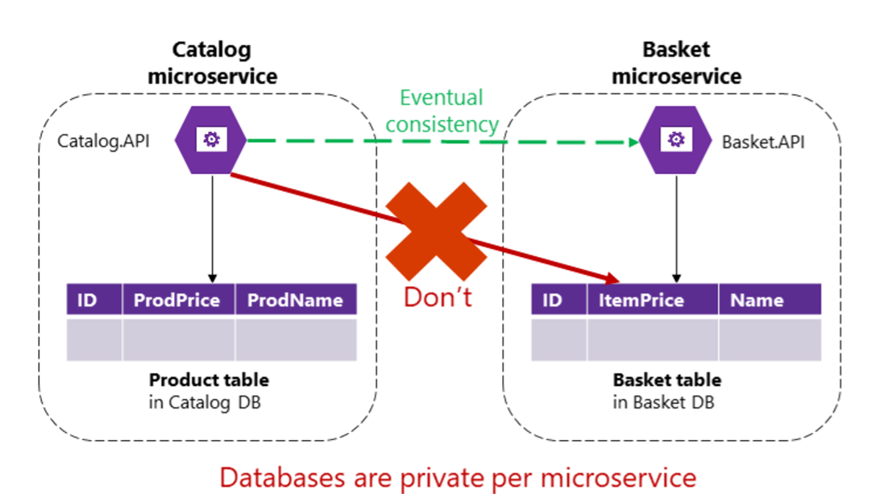
Consistency Between Services

Slide 27
Consistency challenges
The challenge about communication is not so much about the protocols
But more about the style and couplings
Because when failure occurs - the more coupled the system, the bigger issues you will have
Partial failures will happen, so you need to design the system considering the common risks

Slide 28
Consistency challenges
Popular approach is HTTP, because it is simple
HTTP is perfectly acceptable, but it depends on how you use it
Acceptable HTTP requests are
Client-Microservice
Client-API Gateway
API Gateway-Microservice
Unacceptable HTTP requests are
Microservice-Microservice

Slide 29
Consistency challenges
Consider the following scenario
The client call the Orders microservice
Then the Orders microservice calls additional microservices for more information
Sounds reasonable at first…
But these are the pitfalls
Blocking and low performance - scalability is impacted
HTTP coupling on a business level - this should not occur
Failure will be difficult to manage - and failures occur
This way - we achieve a monolithic application across many processes
Solution is event-driven asynchronous communication

Slide 30
Communication types

Slide 31
Communication types
Sync or Async
Synchronous - HTTP/HTTPS - tasks can continue after the response
Asynchronous - AMQP - the client usually don't expect a response
Single or Multiple receivers
Single receiver - the Command pattern
Multiple receivers - the Publish/Subscribe pattern

Slide 32
Communication types
Microservices usually uses a combination of these communication types
If possible, never depend on request-response communication
It breaks the autonomous feature of the microservices
And may turn into a bottleneck
Always consider "the rule of 1 hop"

Slide 33
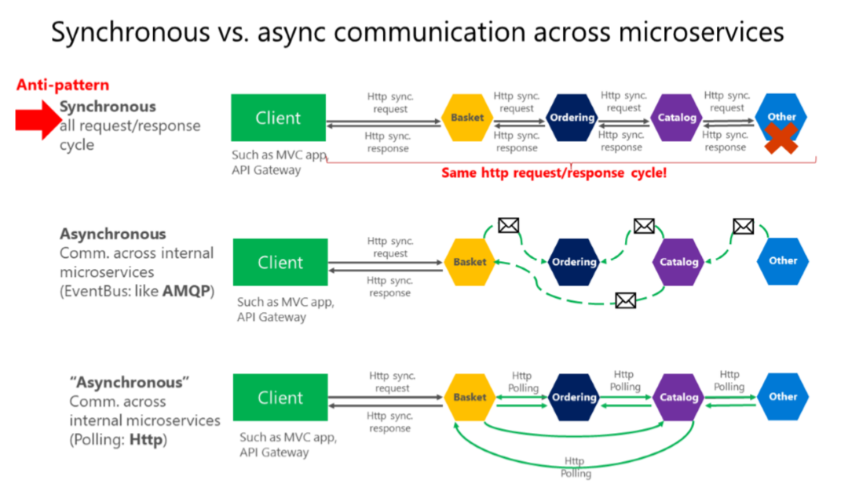
Communication types

Slide 34
BEFORE WE CONTINUE…

Slide 35
Huge THANKS for your support & TRUST!
Everyone who got a paid ticket – 81 people in total! Thank you!
Top supporter – Georgi Georgiev – 20 BGN! Thank you, man! <3
Personal thanks to – Борислав, Михаил, Miroslava, Stoil, Zlatko, viktor, Petar, Zlatin, Nikolai, Ilian, Maria, Svetoslav, Tsvetan, Vasil, Vladimir, Plamen, Bilyan
Thanks also to – Petar, Kalin, daniel, Bojidar, Lachezar, Svetlana, Boyan, Teodora, Angel, Martin, Pavel, Ivanela, Zdravko, Pavel, Plamen, Pavel, Teodor, Петьо, Angel, Veselin, Tsvetelin, Radoslav, Ivo, Hristo, Radoslav, Hristo, Dobromir, Живко, Svilen, Pavel, Ilian, Petar, Kristiyan, Viktor, Kalina, Диана, Martin, Petar, Evlogi, Alexander, Николай, Riva, Hristo, Marin, Mira, Kristian, Marin, Mariyan, Ruslan, Dimitar, Andrey, Martin, Велислав, Димитър, Kiril, Momchil, Darin, Gergana, Deyan, Osman, Svilen, Kosta, Панайот, Todor, Hristo

Slide 36
These events are not Exactly free
I prefer to call them “Pay what you want”
Depending on how much you value the provided knowledge
It takes me a considerable amount of free time to prepare these lectures
And I want them to be perfect and complete!
I put my soul in them!
For this reason I will be extremely thankful, if you decide to support me and my projects!
It is never expected, but always appreciated!
The easiest way is via
PayPal: http://paypal.me/ivaylokenov
Revolut: @ivaylowrlt

Slide 37
Mentorship program ON Patreon
These events are part of my mentoring program!
Target – junior to regular programmers with 0 to 2 years practical work
Help with:
Becoming better software developers
Code improvement in terms of quality and logic
Career choices and advancement
Interview preparation
And more
Approach – private groups, exclusive lessons, workshops, one-on-one meetings
More information on Patreon: https://www.patreon.com/ivaylokenov

Slide 38
Communication patterns

Slide 39
Communication patterns
Don't rely on request-response, if possible
If you need data from another microservice, consider duplicating it, it's perfectly OK!
If your microservice needs to invoke an action in another microservice do it asynchronously
You can use any protocol to transfer data to have eventual consistency
But don't create synchronous dependencies by waiting for responses

Slide 40
Communication patterns
Asynchronous messages:
Critical for propagating changes throughout multiple services
Eventual consistency + event-driven communication
A client send a message (header and body) and do not expect a response
If the service needs to return a response - it sends another message
Usually sent asynchronously through AMQP

Slide 41
Communication patterns
The preferred infrastructure is a lightweight message broker
Like RabbitMQ or a cloud-ready service bus
The rules are:
Use HTTP for client + API Gateway + First microservice level (Frontend microservices)
Use AMQP for service level (Backend microservices)

Slide 42
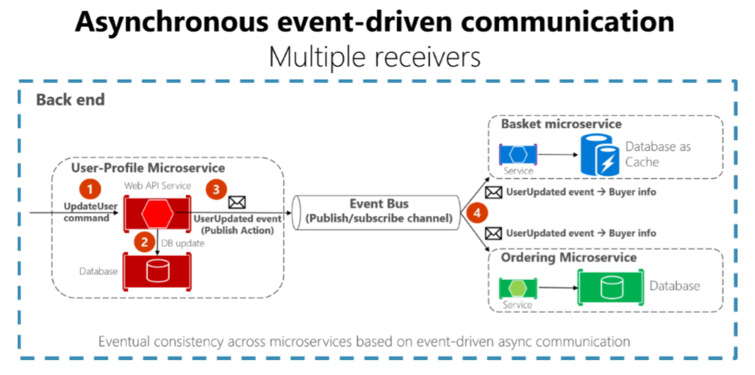
Communication patterns

Slide 43
Communication patterns
The preferred infrastructure is a lightweight message broker
Like RabbitMQ or a cloud-ready service bus
The rules are:
Use HTTP for client + API Gateway + First microservice level (Frontend microservices)
Use AMQP for service level (Backend microservices)

Slide 44
Using A Message Broker

Slide 45
Using A Message Broker
There are various message brokers available
Each one of them will do just fine
For the demo purposes, I am using RabbitMQ
Which is a good enough message broker for a production environment too
Usually each message broker will have a connections string
And user access
More information here
https://www.rabbitmq.com/

Slide 46
Using A Message Broker
Install a library to help you use the message broker
For ASP.NET Core that’s MassTransit
Register the message broker with the library
By using the connection strings and user information
Create your message classes
Create your consumer classes
And register them in your library configuration

Slide 47
Using A Message Broker
// A sample message class
public class CarAdCreatedMessage
{
public int CarAdId { get; set; }
public string Manufacturer { get; set; }
public string Model { get; set; }
public decimal PricePerDay { get; set; }
}

Slide 48
Using A Message Broker
// A sample consumer class
public class CarAdCreatedConsumer : IConsumer<CarAdCreatedMessage>
{
private readonly IStatisticsService statistics;
public CarAdCreatedConsumer(IStatisticsService statistics)
=> this.statistics = statistics;
public async Task Consume(ConsumeContext<CarAdCreatedMessage> context)
=> await this.statistics.AddCarAd();
}

Slide 49
BEFORE WE CONTINUE…

Slide 50
C# Multithreading Workshop
Held on May 2
Threads, Race Condition, Dead Lock, Thread Pool, Synchronisation and Optimization
Tasks include – Folder Synchronization, Parallel Sorting, Own Cache Implementation
3 hours lecture, 5 hours hands-on experience
Step-by-step guidebook about multithreading (20+ pages)
Lifetime support & Money-back guarantee
Recording – more than 5 hours + 20 pages guidebook + practical tasks
Just shoot me a message – wewritesoftware@gmail.com
And I will give you more details!

Slide 51
ASP.NET Clean Architecture Workshop
Held on May 30-31
Create a fully working ASP.NET Core application with DDD
4+ hours lecture, 12+ hours hands-on experience
Step-by-step guidebook about building “clean” apps (70+ pages)
Lifetime support & Money-back guarantee
Recording – more than 12 hours + 70 pages guidebook + fully working app
Just shoot me a message – wewritesoftware@gmail.com
And I will give you more details!

Slide 52
Kubernetes for web developers
Held on September 19
Everything you need to know about Kubernetes as a web developer
8 hours lecture, 8 hours hands-on experience
Step-by-step exercise book about Kubernetes (50+ pages)
Lifetime support & Money-back guarantee
Recording – more than 6 hours + 52 pages guidebook + practical tasks
Just shoot me a message – wewritesoftware@gmail.com
And I will give you more details!

Slide 53
Becoming a Software Architect
Held on December 19
Everything you need to know about software architectural patterns
8 hours lecture, 8 hours hands-on experience
Step-by-step exercise book about software architecture (20+ pages)
The first 15 people receive 15% discount with ARCH15!
Lifetime support & Money-back guarantee
2 types of attendance
Online
Recording
https://bit.ly/ciu-architect

Slide 54
ENTER THE SWARM: Native docker clustering
Dates will be announced soon!
Everything you need to know about Docker Swarm as a web developer
Video lecture + hands-on experience
Step-by-step exercise book about Docker Swarm
I will convert this workshop to a free event! Stay tuned!

Slide 55
SOFTUNI ASP.NET MICROSERVICES COURSES
I teach a module with 3 courses for ASP.NET Microservices:
The Architecture of ASP.NET Core Microservices Applications
Architecture choices and microservices with ASP.NET Core
Best practices with ASP.NET Core microservices
Development of Microservice ASP.NET Core Applications
Domain-driven design with ASP.NET Core microservices
Clean and practical code for the microservice approach
Processes Automation in ASP.NET Core Microservice Applications
Design considerations when using microservices with ASP.NET Core
Containers, clusters, teamwork, deployment, configuration
Each Code It Up attendee can use the following discount codes:
https://bit.ly/su-automation-microservices
CODEITUP-Process-20

Slide 56
Partial failures

Slide 57
Partial failures
In distributes applications there is an ever-present risk of partial failure
Because of unavailability
Because of bad implementation
Because of too many requests
If you do not design your application to tolerate faults, even small downtimes will be amplified
As an example, 50 dependencies each with 99.99% of availability would result in several hours of downtime each month because of this ripple effect
Our applications must be defended against it

Slide 58
Partial failures
Common solutions:
Asynchronous communication
Retries with exponential back off
Network timeouts
Circuit Breaker pattern to skip further calls
Provide fallbacks for queries and return empty values
Limit the number of queued requests
Of course, add health monitoring!

Slide 59
Messages Resiliency

Slide 60
The problem with current approach
What could go wrong here?

Slide 61
The problem with current approach
What could go wrong here?
Our system has a lot of different parts working together
The database in the first microservice may crash
The event bus may be offline
The second or third microservice may be unreachable
Their databases may be offline
All these lead to unstable data
Which is quite problematic

Slide 62
Different Parts of The solution
Some failures are covered by the message broker
If a microservice is not responding, the message broker will try to deliver it again
Some failures are covered by the libraries we use
We can introduce a retry policy, in case of an exception in the consumer
We can introduce a retry policy, in case of an exception in the database
We can introduce a retry policy, in case of an HTTP exception
But other failures need coding solutions and patterns
What will happen if we store the data in the first database but then the event bus is offline to process the message?

Slide 63
Possible patterns
Transaction log mining
Creates coupling to the database
The Event Sourcing pattern
The full pattern requires serious rearchitecting
The Outbox pattern
A separate table, holding the events, part of the transaction

Slide 64
The Outbox Pattern
Create an additional table holding the integration events between microservices
Before publishing to the event bus – create a local database transaction
Updating the entity and saving the event as “pending”
Publish the event for the other microservices
If the publishing is successful – mark the event as “completed” with a new transaction
Have a background job to check periodically for failed “pending” events and publish them to the event bus
Guarantees you eventual consistency
But what will happen, if a message is duplicated?

Slide 65
The Outbox Pattern
The receiver microservice should do one of the following
Make sure the operations can be performed multiple times without affecting the result
Recognize duplicated messages and discard them
Idempotent messages:
Should be like “set the price to $40.00”
And not like “add $5.00 to the price”
Recognizing events can be done by adding a GUID to every event
Or use the infrastructure’s built-in features

Slide 66
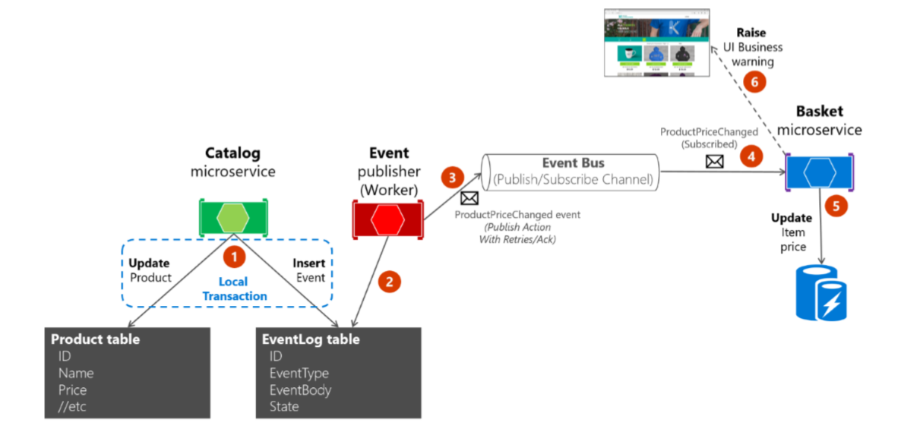
The Outbox Pattern

Slide 67
Running the demo

Slide 68
Running the demo
Go to the Code folder in your terminal
Build all images:
Run the application:
Clean up:
docker-compose build
docker-compose up -d
docker-compose down
docker volume prune

Slide 69
FINAL WORDS

Slide 70
Summary
About Code It Up
Microservice Communication Types
Consistency Between Services
Communication Between Services
Using A Message Broker
Partial Failures
Messages Resiliency
The Outbox Pattern

Slide 71
Upcoming Code it up Events
Events with set dates:
December 19 – Becoming a Software Architect: The Knowledge Path
Events with no specific order or dates:
Automate Your Process with CI/CD
The Limits of the C# Runtime
API Scenarios - REST, GraphQL & gRPC
Serverless Real-Time C# Applications On AWS? Yes, It’s Possible & Easy!
Software Engineering – Patterns & Anti-Patterns
Plus many more! For example Microservices Details?
The SoftUni course for Microservices DevOps is starting soon!
Use CODEITUP-Process-20 for a 20% discount!

Slide 72

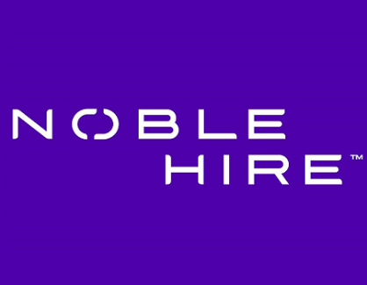
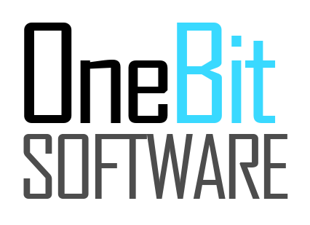
ANY QUESTIONS?
You can support me and my projects:
Via PayPal: http://paypal.me/ivaylokenov
Via Revolut: @ivaylowrlt
On Patreon: https://www.patreon.com/ivaylokenov
On Open Collective: https://opencollective.com/mytestedaspnet
Via Buy Me A Coffee: http://buymeacoff.ee/ivaylokenov
Crypto: http://bit.ly/ik-sponsors
Never expected, always appreciated!

Slide 73
Thank You!
presentation And Code available here: https://github.com/ivaylokenov/Microservices-Eventual-Consistency-Done-Right

