Slide 1
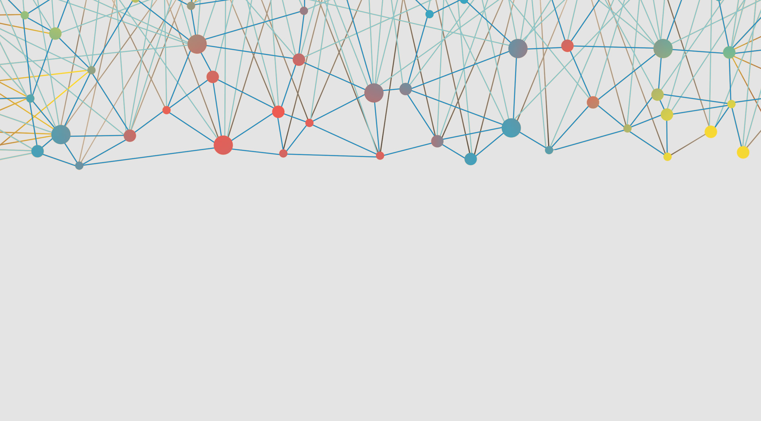
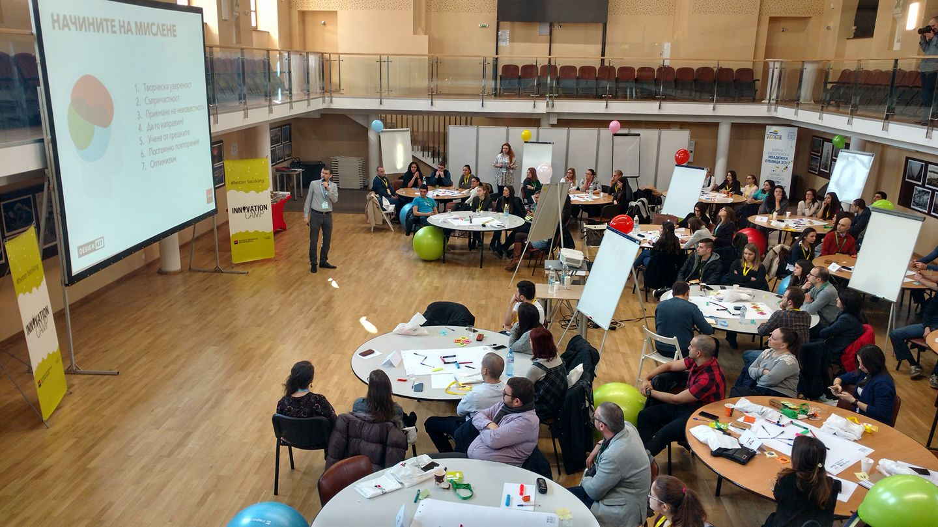
Innovation Camp 2017 by Expressbank

Slide 2
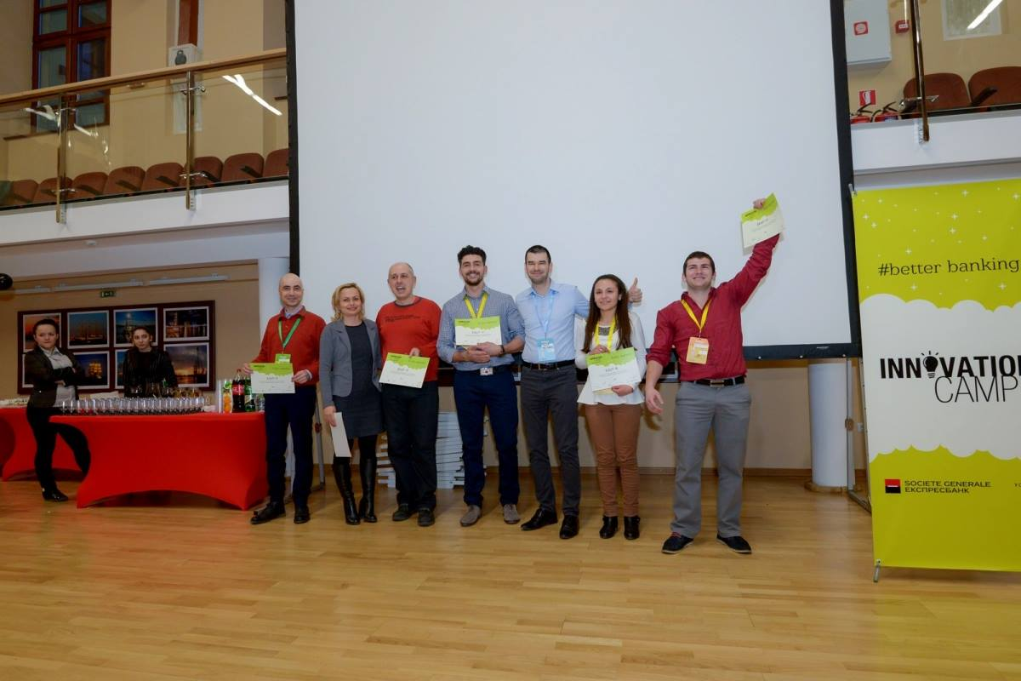

Slide 3
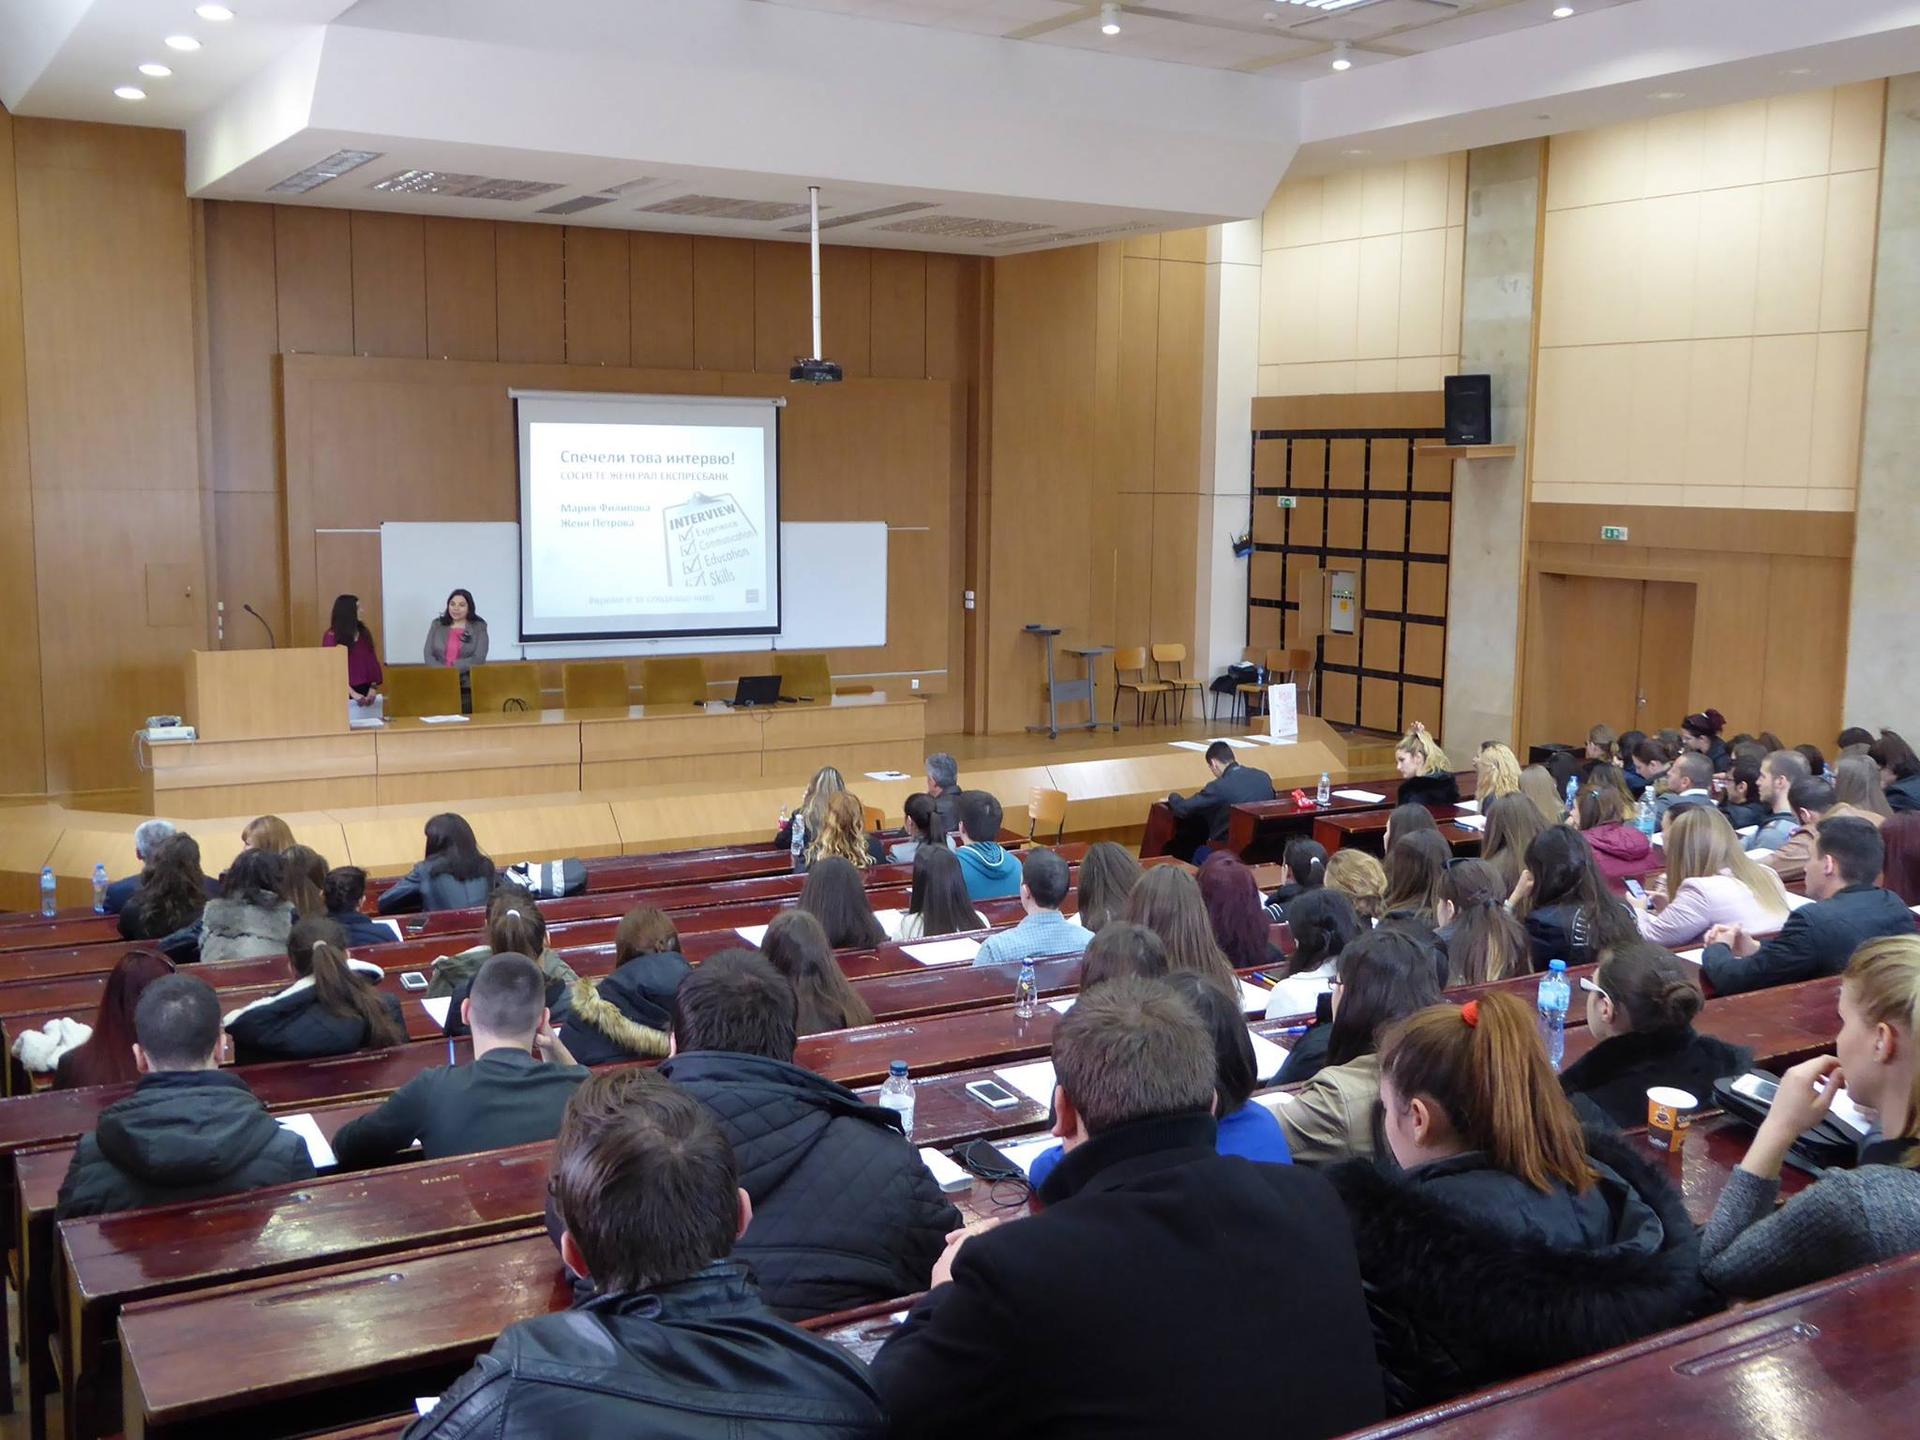
Workshop “Спечели това интервю!”
ИУ-Варна, зала 316

Slide 4
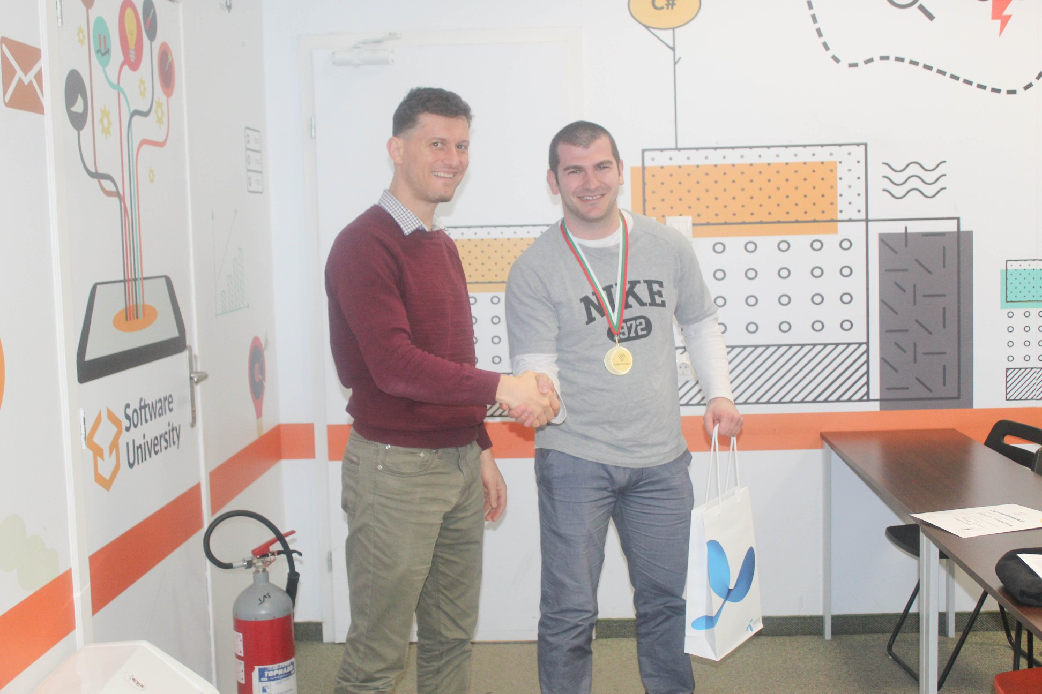
SoftUniada 2020

Slide 5
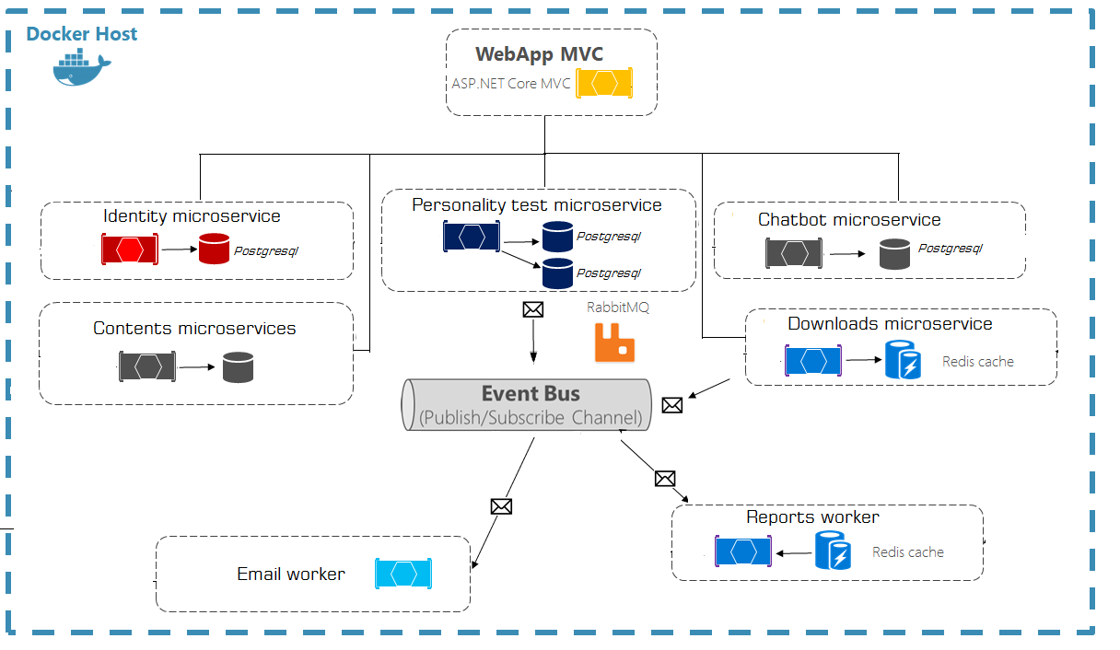

Slide 6
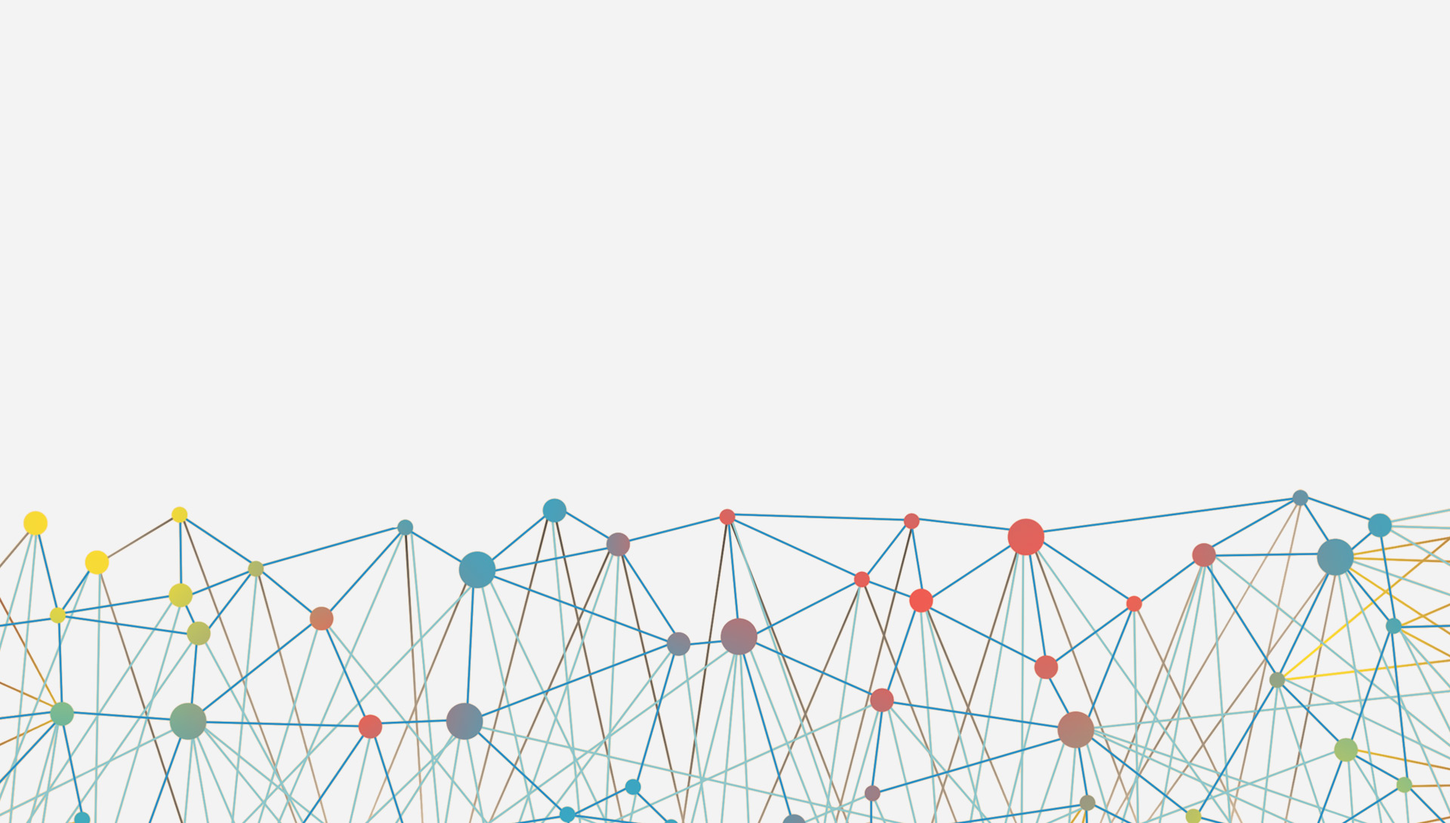
The architecture proposes a micro-service oriented architecture implementation with multiple autonomous micro-services (each one owning its own data or database).
Different approaches are implemented within each micro-service (simple CRUD vs. DDD/CQRS patterns).
HTTP is the communication protocol between the client apps and the micro-services. Asynchronous communication for email sending and reports via Event Bus (RabbitMQ).

Slide 7

Command and Query Responsibility Segregation
Implemented by

Slide 8
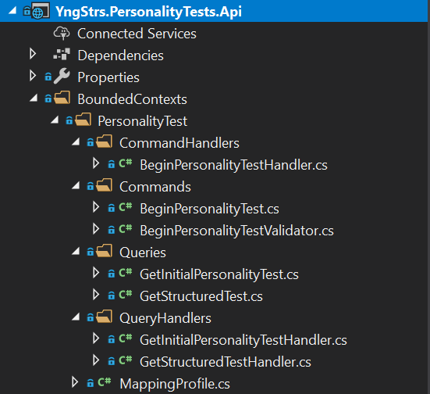

Personality Tests Web Service
Bounded Context is central pattern in
the Domain-Driven Design
A command handler receives a command and
brokers a result. The result is either a successful or an exception.
Fluent Command Validation
Commands are responsible for changing the
application state, i.e. creating, updating and deleting entities.
Queries are responsible for reading the
application state, e.g. to display information to the user.
A query handler implements the logic for the current query.
Implemented with the ediatR

Slide 9

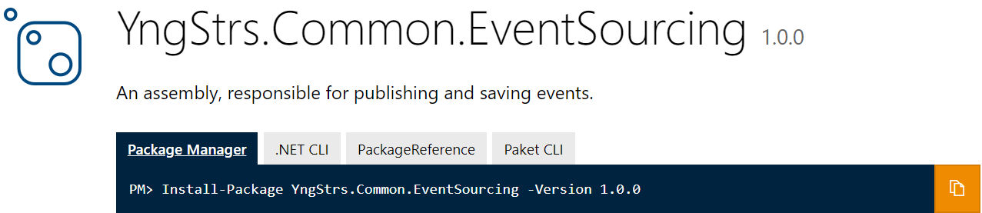
Event Sourcing
Implementing an event-driven architecture and makes it possible to reliably publish events
Provides a 100% reliable audit log of the changes made to a business entity (Very useful for reports)
Implementation via
Polyglot Persistence using PostgreSQL Database

Slide 10
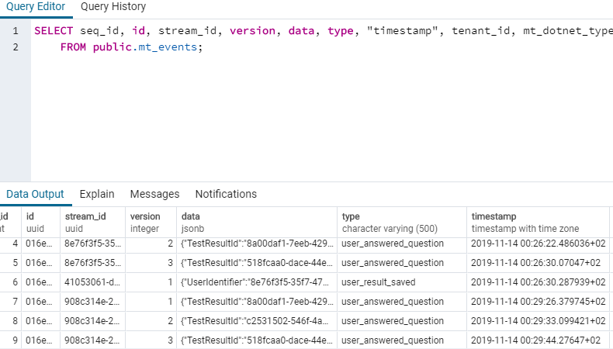

Slide 11




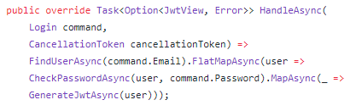
Functional Programming
Why?
Purity
Expressiveness
Type – safety
Ubiquitous language

Slide 12
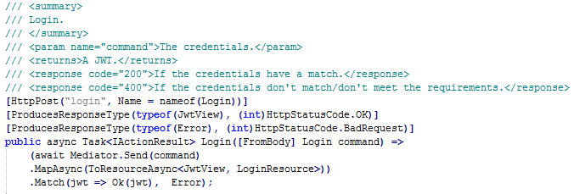
Thin Controllers

Slide 13
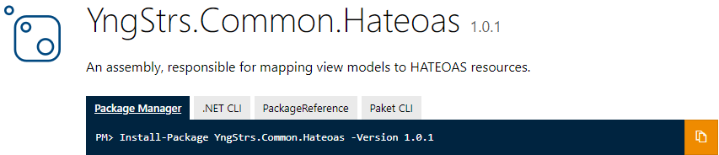
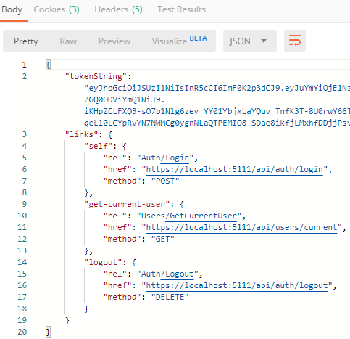
Hypermedia as the Engine of Application State
Provides hypermedia links in the response contents so that the client can dynamically navigate to the appropriate resource by traversing the hypermedia links.

Slide 14
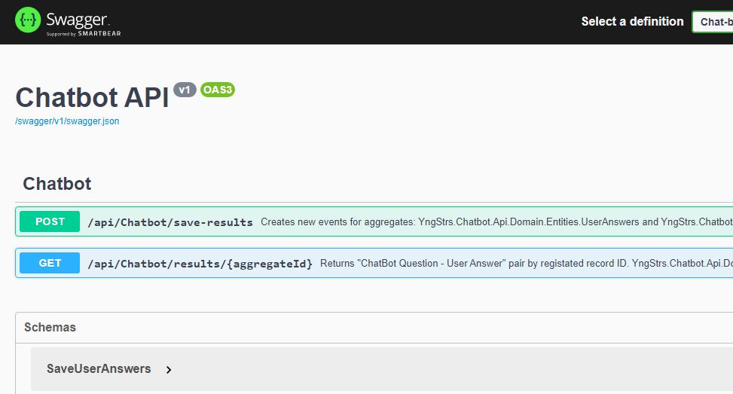
Stylecop & Swagger UI

Slide 15
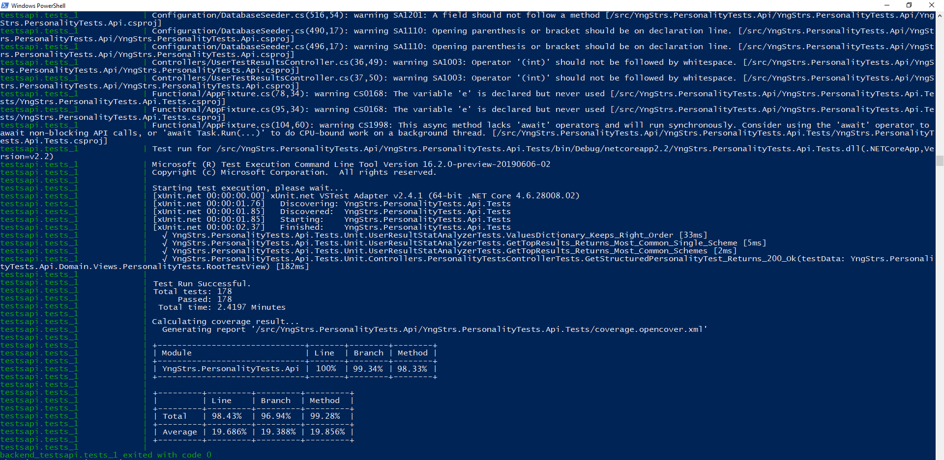
Integration testing via Kastrel and Docker

Slide 16
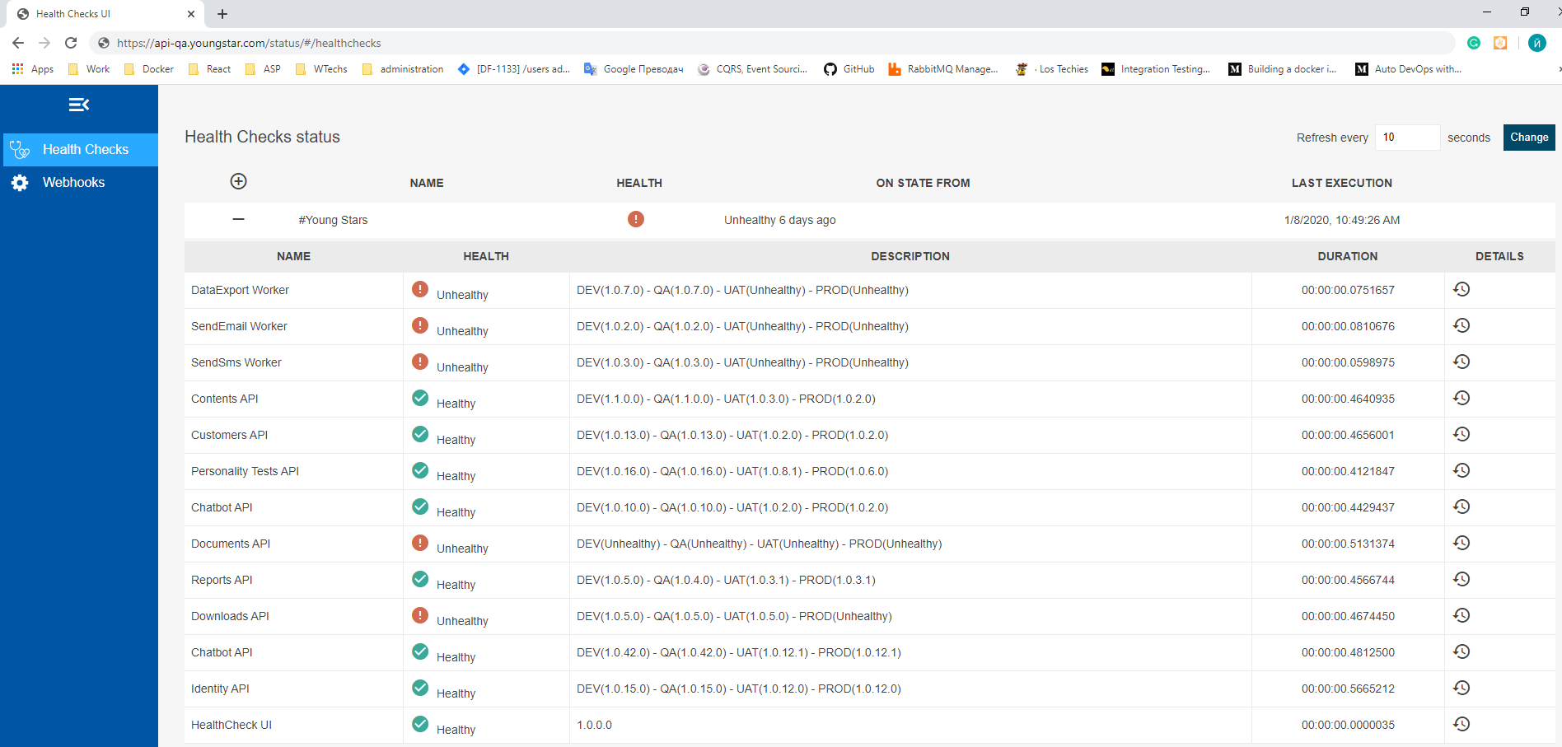
Health Checks UI

Slide 17

Thank you!
Time for questions!

