Slide 1
Облачни комуникационни модели в разпределена система за управление на поръчки
Научен ръководител:
доц. д-р Павел Петров
Докторант:
Йордан Йорданов

Slide 2
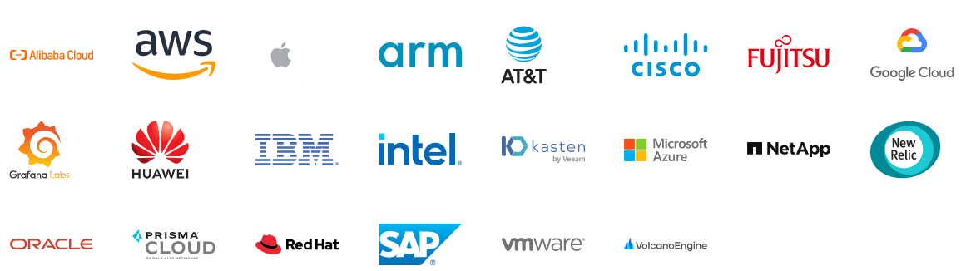
облачните технологии се превръщат в инструменти за дигитализация
Предприятия, част от консорциума
Cloud Native Computing Foundation

Slide 3
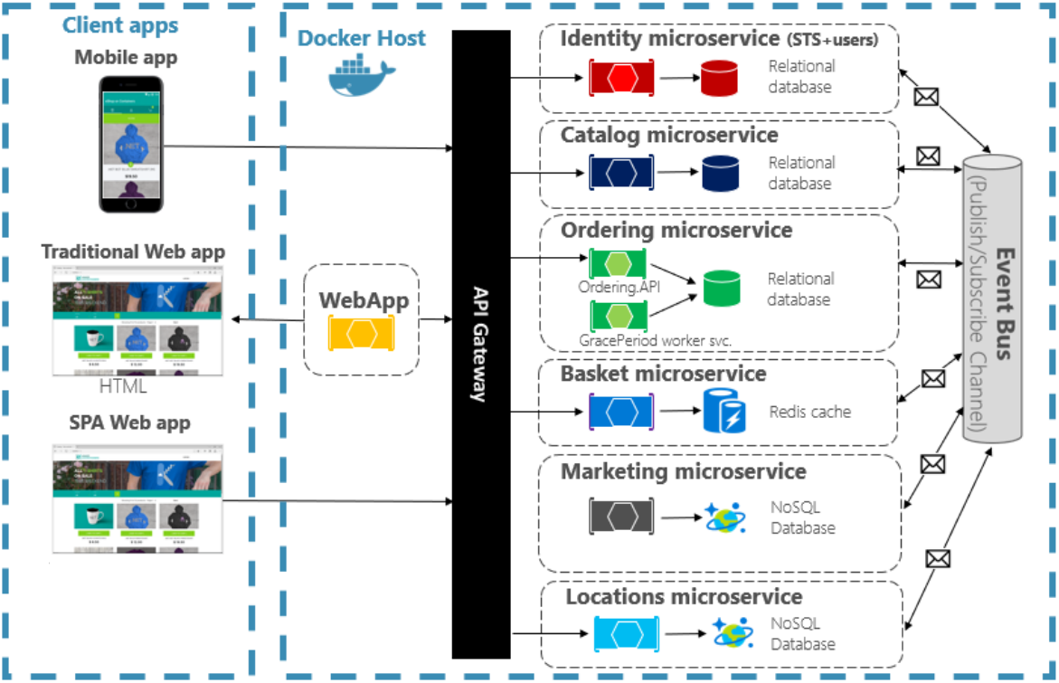
Обект на изследване
Облачна информационна система за управление на поръчки

Slide 4
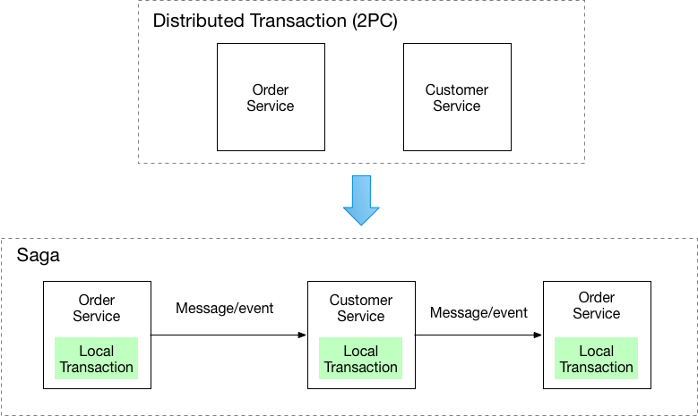
Цел/Насоки/теза

Slide 5
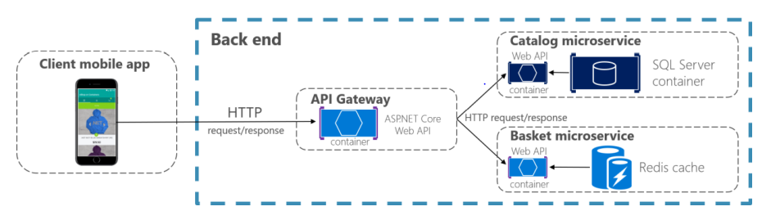
Синхронна комуникация
HTTP/HTTPS
Клиент-сървър
Заявка-отговор

Slide 6
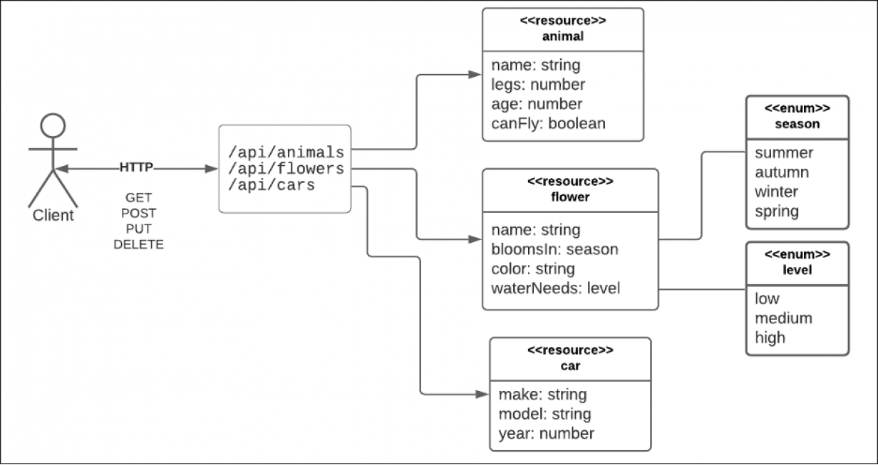
REST
Representational State Transfer
Най-използваният шаблон в днешно време
Използва HTTP методи
GET, POST, PUT, DELETE
На един и същ URL
Комуникационни сценарии:
Браузър към уеб сървър
Мобилно приложение към сървър
Сървър към сървър

Slide 7
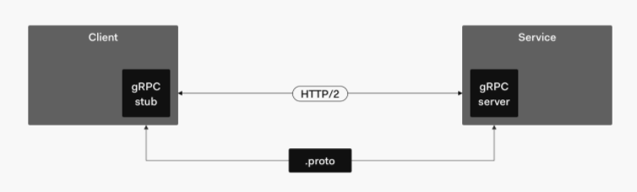
GRPC
Не използва текстов, а двоичен формат на данните
Създава се ".proto" като дефиниция, чрез която данните се кодират и декодират
Увеличава производителността
Поддържа двупосочни и асинхронни съобщения
Oсновава се на протокола HTTP 2

Slide 8
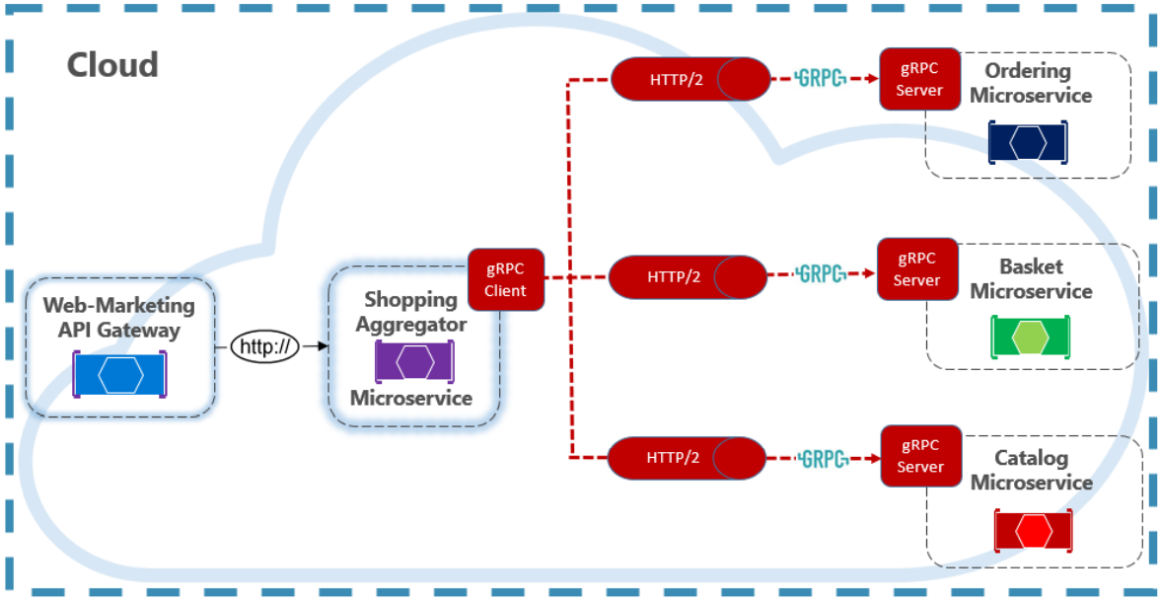

Slide 9
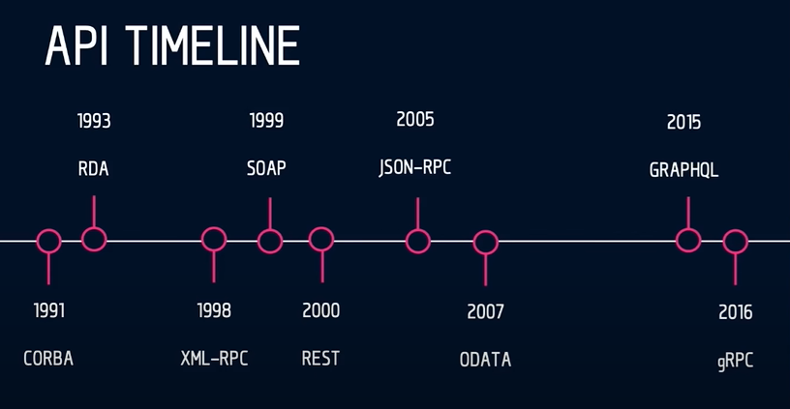
Lesson

Slide 10
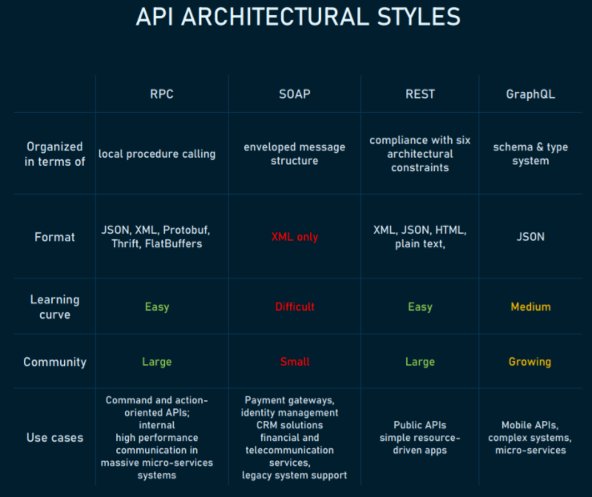
Сравнение на Двата стила

Slide 11
REST
Плюсове:
Разделени клиент и сървър
Удобен за кеширане
Поддръжка на множество формати
Mинуси:
Няма единична REST структура
Проблеми с прекомерно и недостатъчно извличане
Случаи на употреба :
Приложения, управлявани от ресурси

Slide 12
RPC
Плюсове:
Ясен процес
Висока производителност
Лесен за добавяне
Mинуси:
силна връзка към основната система
Поддържа се главно с HTTP/2
Случаи на употреба:
Специфични за клиента API за вътрешни микроуслуги

Slide 13
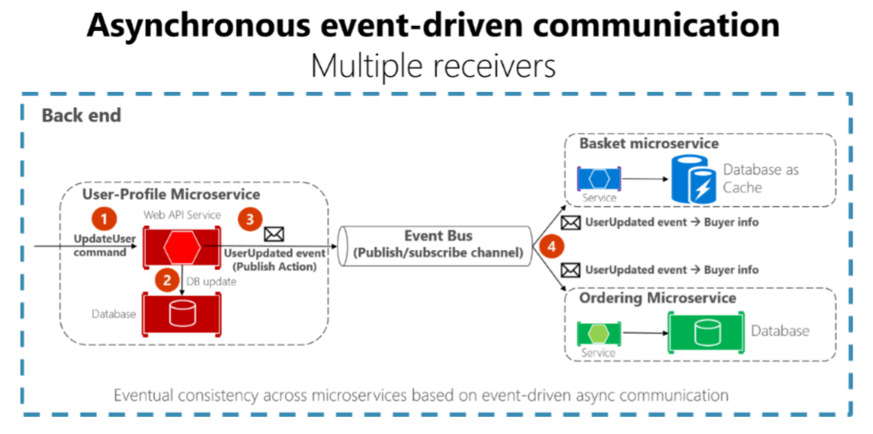
Асинхронна комуникация

Slide 14
Consistency Between Services
The challenge is to implement end-to-end business processes while keeping consistency across microservices
Catalog microservice - maintains information about products (including price)
Shopping Cart microservice - maintains current chosen products and price
When a product price is updated - you need to update the cart too (and show a message)
In monolithic application this should be fairly easy
But with microservices - no service should include tables/storage from another one
And it should never call direct queries to them
The solution is event-based communication
Publish-Subscribe pattern

Slide 15
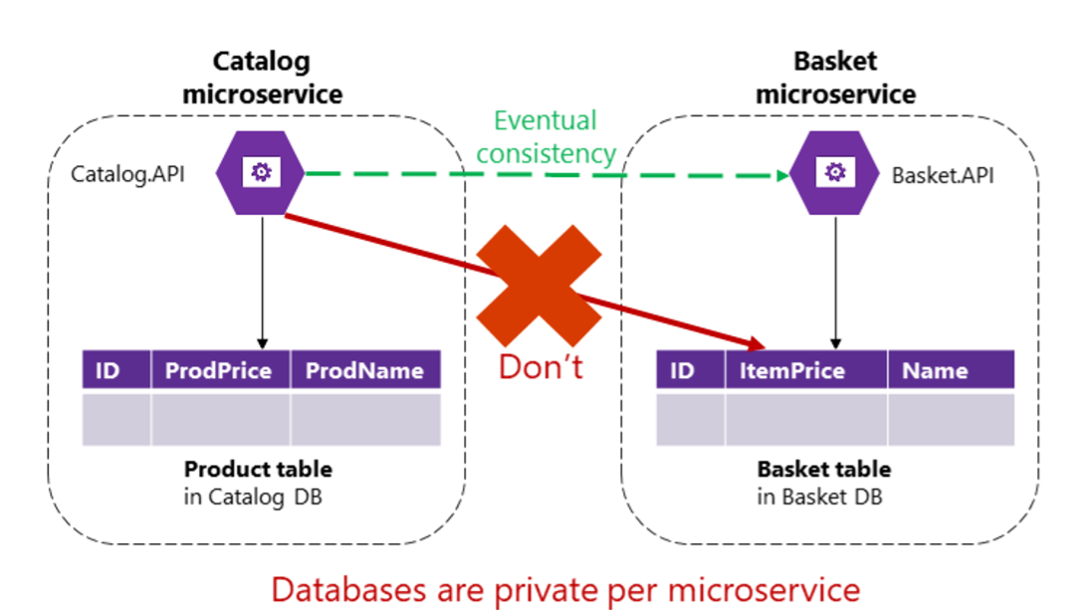
Consistency Between Services

Slide 16
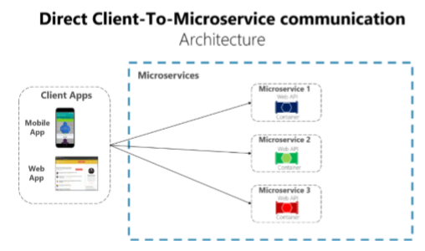
Директна комуникация На клиент със сървър
Използва се, когато различни части от страницата на клиента изискват различни микроуслуги

Slide 17
Direct Client-Server Communication
Usually the client calls a load balancer, which requests data from the internal microservice infrastructure
Should be used when
The application is not huge
The data is independent and does not need additional aggregation
Otherwise the client needs to process business logic
Breaking separation of concerns

Slide 18
Direct Client-Server Communication
Drawbacks
Two many Internet round-trips outside of the internal microservice network
Microservices must be exposed to the “external world”
Cross-cutting concerns like authentication and authorization
Using synchronous communication like HTTP
Different client applications require different APIs
Consider web versus mobile clients

Slide 19
API Gateway
Provides single-entry endpoint for a group of microservices
Like the Façade design pattern
Also knows as “backend for frontend”
You build it for the specific client needs
Acts as a reverse proxy and man in the middle between the clients and the microservices
Can also provide authentication, cache, and other cross-cutting concerns

Slide 20
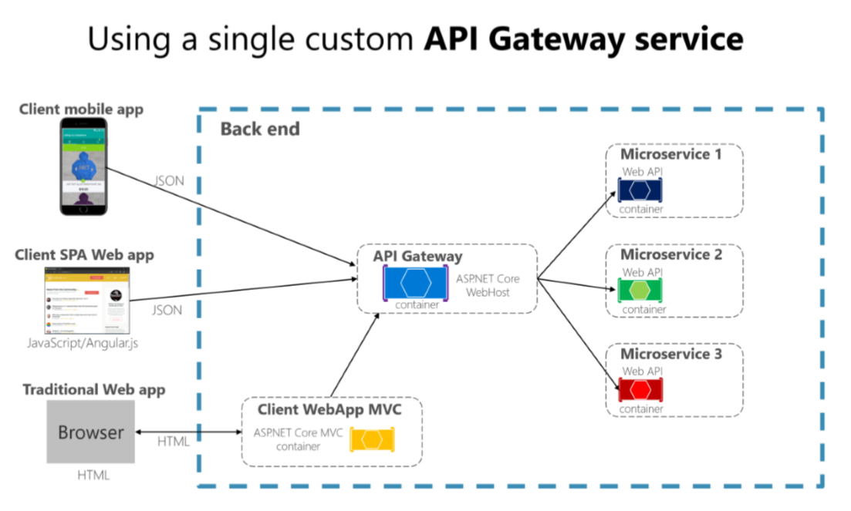
API Gateway

Slide 21
API Gateway
If you are not careful, the API gateway may become a full monolithic app
Bloated with too many endpoints
Couples all microservices, destroying their benefits
API Gateways should also be segregated
At first it may be an API Gateway for each client
But then it may be further split by logical groups based on business boundaries
HTTP or gRPC

Slide 22
API Gateway
Reverse proxy and routing
Decouples the client
Modernize legacy monolithic app
Hide the internal microservices
Request aggregation
Reduces chattiness between client and microservices
Especially important for remote applications
Offloading
Authentication, load balancing, retry policies, response caching, IP whitelisting, and more

Slide 23
Business constraints
General Advice
There are a lot of API decision constraints
Customer constraints
Business constraints
Product requirements
Performance or scalability constraints
If the customer expects REST, you will not be able to use RPC
These are all business constraints
What about the technology ones?

Slide 24
Technology constraints
The team's knowledge
Distributed systems and their fallacies:
The network is reliable
Latency is zero
Bandwidth is infinite
The network is secure
Topology doesn't change
There is one administrator
Transport cost is zero
The network is homogeneous
https://dzone.com/articles/understanding-the-8-fallacies-of-distributed-syste

Slide 25
General Advice
If an API is mostly CRUD and manipulation of related data
Use REST
Example URL: /purchases/2/items
If an API is mostly actions or between servers
Then choose RPC
Example URL: /purchases/increment
Do not build REST-ish APIs
If you cannot simply follow the REST pattern
Choose GraphQL

Slide 26
Various Issues to consider
REST may be slow
Over/under fetching with REST
N + 1 problem
GraphQL allows to fetch all data with one request
The slowest field is the performance indicator
In GraphQL you fetch data all at once
GraphQL is more flexible, if you do not know the client
But way more restrictive than REST

Slide 27
FINAL WORDS

Slide 28
Summary
About Code It Up
Why API Scenarios?
History Lesson
SOAP In a Nutshell
REST In a Nutshell
OData In a Nutshell
GraphQL In More Detail
gRPC in More Detail
API Types
General Advice for API Design
API Styles Comparison
Sample Scenarios

Slide 29
Благодаря ЗА ВНИМАНИЕТО

