Slide 1
The Content Of The Series – A Free Course
Why Software Architecture
What Is Software Architecture?
Unified Modeling Language
Designing Solution Architectures
Common Technology Stacks
Architecture Design Patterns
Choosing The Right Patterns
Architecture Quality Attributes
System-Wide Considerations
Deployment Considerations
Monolithic Architecture
Domain-Driven Design
Microservices
Event Sourcing
The Architecture Document
The Architect And The Team
What Makes A Great Architect
Designing A Real-Life Solution

Slide 2
in The previous part
Why Software Architecture
What Is Software Architecture?
Unified Modeling Language
Designing Solution Architectures
It is not required to watch the parts in order
But it is strongly advised!
Get the previous recording from here:
https://www.eventbrite.com/e/software-architecture-fundamentals- essentials-code-it-up-online-vol-9-registration-222550182587

Slide 3
in this part
Common Technology Stacks
Architecture Design Patterns
Choosing The Right Patterns
Don't Forget The Optional But Practical Guide-Book
3 Real-World Scenarios
70+ Pages
Free Updates
Get It From The Event's Page or write to wewritesoftware@gmail.com
https://www.eventbrite.com/e/software-architecture-technology -patterns-code-it-up-online-vol-10-registration-244365432587

Slide 4
Designing Solution Architectures

Slide 5
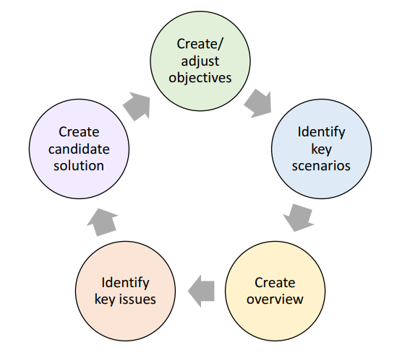
The Process For Designing Architectures

Slide 6
Create Application Overview
Determine application type
Bot? Console? Service? Web? Desktop? Maybe Serverless?
Identify deployment constraints
Where are you going do deploy the application?
Identify architecture pattern
Layered? Component? Microservices?
Determine technologies
What technologies are available? Libraries? Third-party tools?
A lot of factors play here… Choose wisely!
Create your first diagram

Slide 7
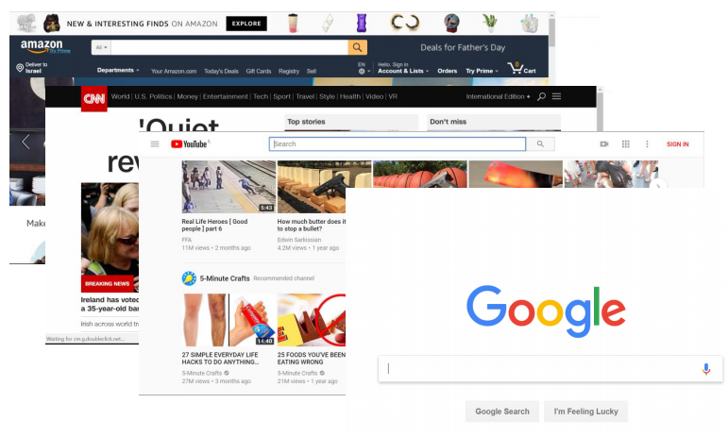
Application Types – Web application
Best suited for:
User interface
User initiated actions
Large scale
Short, focused actions
Request-Response based

Slide 8
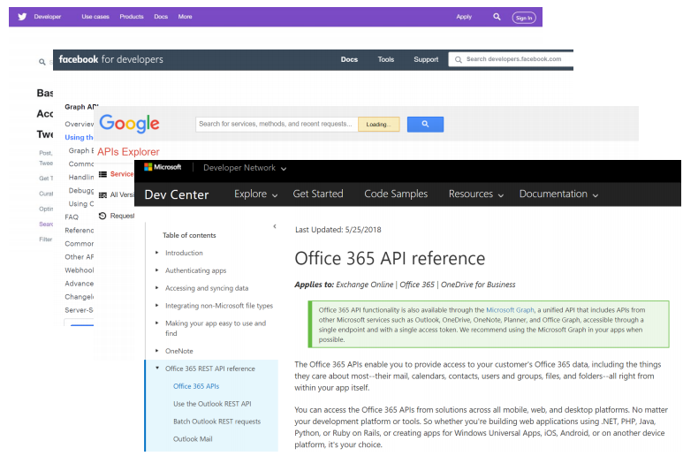
Application Types – Web API
Best suited for:
Data retrieval and storage
Client initiated actions
Large scale
Short, focused actions
Usually REST based
Returns data, not HTML
Combination of:
URL (https://www.mysite.com/api/orders)
Parameters (date=10/10/2017)
HTTP Verb (GET)

Slide 9
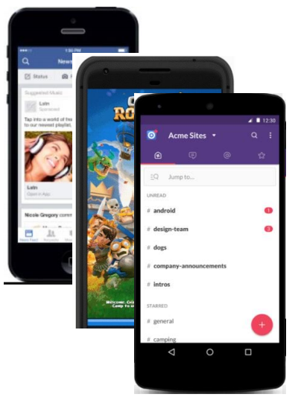
Application Types – Mobile Application
Best suited for:
Well, mobile devices ☺
User interaction (games, social apps)
Front end for Web API
Location & camera-based systems
Usually work with a Web API

Slide 10
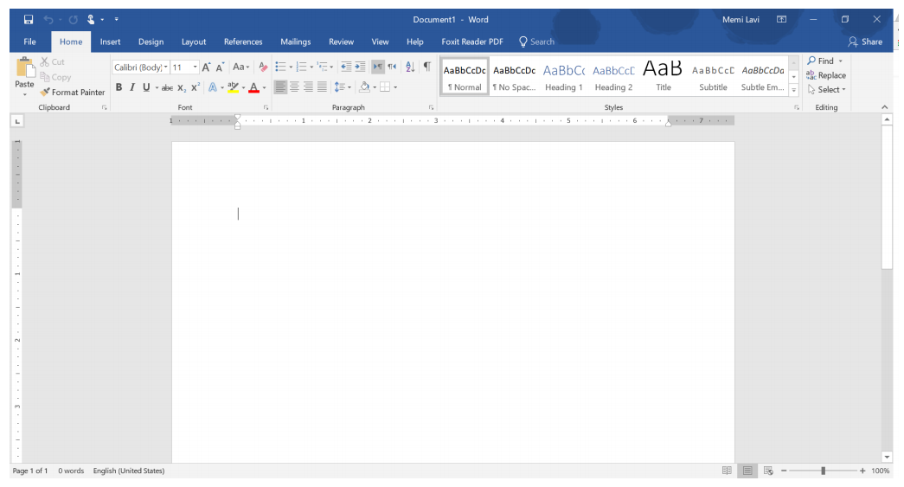
Application Types – desktop Application
Best suited for:
User centric actions
Gaming
Has all its resources on the local PC
Might connect to the web
Great UI

Slide 11
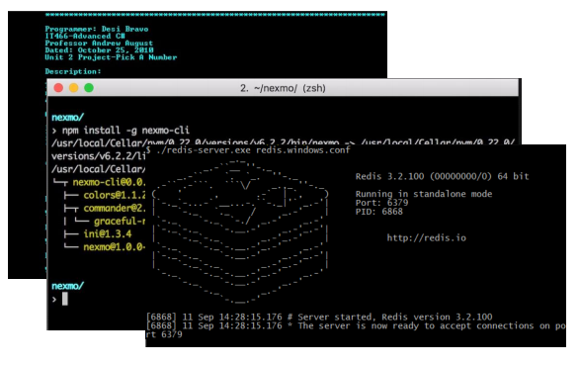
Application Types – Console Application
Best suited for:
Long-running processes
Short actions by trained power-users
No fancy UI
Require technical knowledge
Limited interaction
Long or short-running Processes

Slide 12
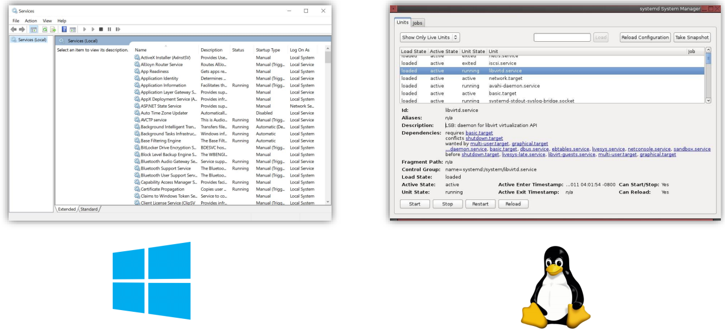
Application Types – Service
Best suited for:
Long-running processes
No UI at all
Managed by the OS service manager

Slide 13
Selecting technology stack
This is a super important decision (especially if you are a consultant)
Mostly because it is almost irreversible
And developers get emotional to their favorite tools
The decision must be:
Made with a clear mind, heavily documented and based on a group effort
Main considerations besides performing the task:
Community – check Stack Overflow
Popularity – check Google Trends
Current developer skills – unknown technologies produce delay and low quality
Deadline – advanced technologies take more time
Support – developers should develop, be careful with shiny new tools
Products – use external and existing tools but always estimate the cost

Slide 14
General tips and tricks
Do not choose on recommendation
Or marketing tricks from vendors
Always do a CBA and ROI (or at least a pros/cons list)
Which type system – static or dynamic?
What is our infrastructure?
Is the community using the tool?
Is performance critical?
Do we need to analyze the learning curve?
Can you easily hire a new team member?
Stay rational and don’t argue with your colleagues!
Use the right tool for the job!
And not vice-versa!

Slide 15
popular technologies
Web applications – back-end
Mature - .NET, Java, PHP
Newer - Node.js, Python, .NET Core, Go
Serverless – Amazon Lambda, Azure Functions
Web applications – front-end
HTML, CSS & JavaScript (or maybe Web Assembly, if you are adventurous)
Which JavaScript framework? Angular? React? Vue? Svelte?
Mobile applications
Native? Hybrid? Cross-Platform?
The battle is development time versus capabilities
Desktop applications
WinForms, WPF, UWP

Slide 16
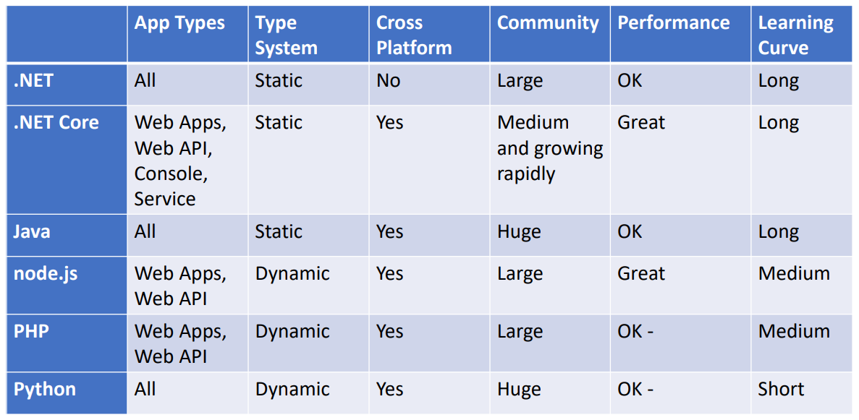
Back-end and service Technologies

Slide 17
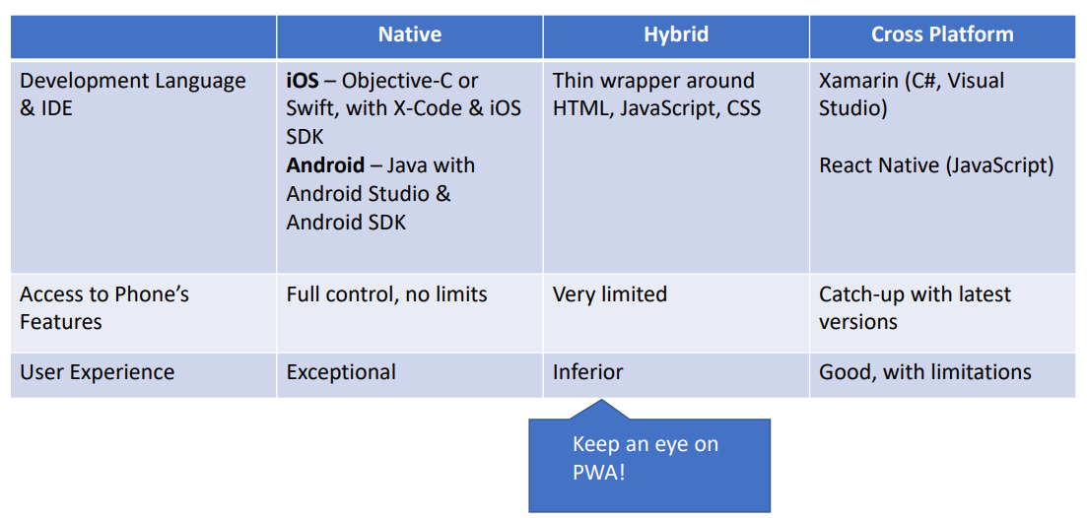
Mobile technologies

Slide 18
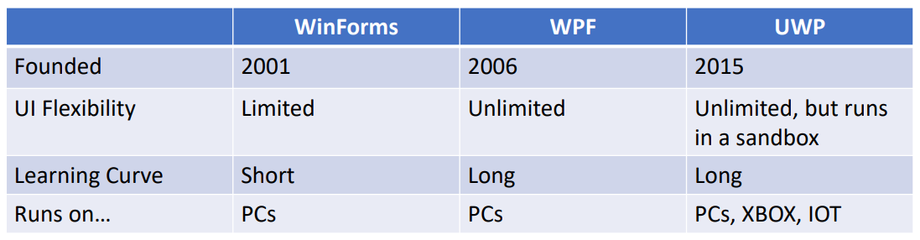
Desktop technologies

Slide 19
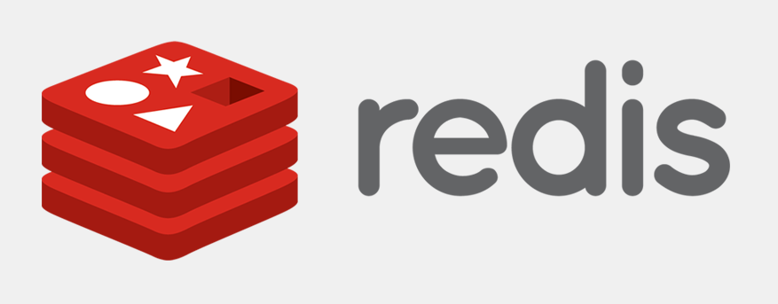

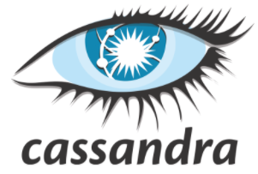
database technologies
Key-value
Useful for cache, publish/subscribe, leaderboards
Not your primary database
Redis, Memcached
Wide column
Each key has multiple columns without a schema
Cannot do joins and scales easily
Useful for time-series (IoT), historical records, high-write/low-read scenarios
Not your primary database
Cassandra, HBase

Slide 20


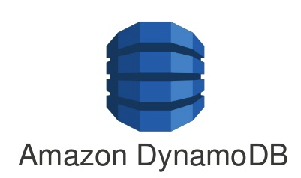
database technologies
Document
Each document is a container for key-value pairs
Fields can be indexed
Columns can be collection – query relational data without joins
Reading data is usually super fast, but writing data tends to be more complex
General purpose – applications, games, IoT, content-management
If you have unstructured data – a document database is a great start
No standard language for queries
Not suitable for huge graphs of data – social networks, for example
MongoDB, Firestore, DynamoDB, CouchDB

Slide 21



database technologies
Relational
Tables are connected through relationships
Requires a schema
ACID compliant – atomicity, consistency, isolation, durability
Good for stable data
More difficult to scale
Supports SQL – a query language
General purpose - perfect for most applications which does not have unstructured data
Some databases support JSON columns
MySQL, PostgreSQL, SQL Server
Modern databases like CockroachDB – designed for scale

Slide 22


database technologies
Graph
Data is represented as nodes
Relationships between the nodes are edges
Instead of many-to-many tables, you have direct connections
Languages like SQL
Better performance than relational databases when datasets are large
Useful for – recommendation engines and well… graphs
Neo4j, CosmosDB

Slide 23

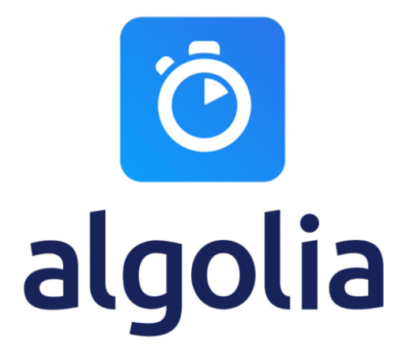
database technologies
Search engine
Full-text search engine
Like document databases but under the hood all the text is indexed
Works like an index at the back of a book
Can easily rank results
Useful for search engines and typeahead scenarios
Elasticsearch, Algolia, MeiliSearch

Slide 24

database technologies
Multi-model
You do not think about data modeling, schemas, shards, replications
You describe how you want to use the data with GraphQL
It chooses the database type behind the scenes
ACID compliant, extremely fast and you do not care about provisioning infrastructure
Useful for… everything?
But is it mature enough?
FaunaDB

Slide 25
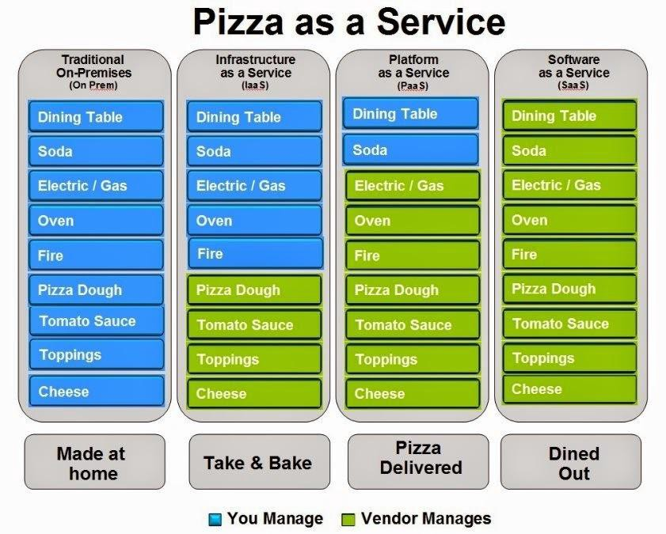
Cloud Technology

Slide 26
Other Important Technologies
Web servers
Nginx & Apache
Containers & orchestrators
Docker & Kubernetes
Message brokers
RabbitMQ & Kafka
Logging
ELK Stack – Elasticsearch, Logstash, Kibana
CDN

Slide 27
Identify Key Issues
Quality attributes:
System, run-time, design, user
Performance, stability, manageability, configurability, etc.
System wide concerns:
Authentication & authorization
Caching
Communication
Configuration management
Logging & exception management
Validation

Slide 28
Create Candidate Solution
Create a Baseline architecture
Create a Candidate architecture
Develop Architectural Spikes
Proof of concept projects to validate unknown concepts
Create Activity, Sequence, State, and Component Diagrams
Create Class Diagram if needed
They are too low-level
Document only the most important classes
Everything else should be done by the Lead Developer

Slide 29
During Each Cycle
Do not introduce new risk
Do not introduce untested technologies and concepts
Mitigate more risk than baseline
Each cycle should reduce the risk
Meet additional requirements
Cover more and more requirements until you meet them all
Enable more key scenarios
Address more key issues
Start communicating architecture when you exceed 50% coverage
If you have the feeling you are half done, invite the developers
You don't want to be the bottleneck

Slide 30
a sample project

Slide 31
Learning system
Here are our business requirements from the Functional Analyst:
A student visits the solution and logs in. He or she is presented with a list of courses. When a student clicks a course, he or she is taken directly to the last visited lecture in that course. The lecture detail page has 3 panels and shows the curriculum on the left, the lecture contents in the middle, and a Q & A panel on the right. The student can use the curriculum to navigate to different lectures and submit questions to the instructor in the Q & A panel.
An instructor visits the solution and logs in. He or she is presented with a list of courses. When the instructor clicks on a course, he or she is taken directly to a course management page. The page shows all questions in the course, with the unanswered questions highlighted. By clicking on a question, the instructor navigates to a new page where he or she can answer the question.

Slide 32
Learning system
And here are our business requirements from the CTO:
Basically, our key attributes are:
Performance
Availability
Scalability
Lectures need to load in 1 second or less. Performance is key, our USP is to be the fastest platform in the business, and our students and instructors will abandon our platform if we are too slow. We also cannot afford to be offline. Every hour we are offline would cost our business thousands of dollars in lost revenue. And we want to scale to millions of students, the platform must be able to accommodate for that with ease.

Slide 33
initial design
We have not learned about architecture patterns yet
So, it's a bit premature to start creating a detailed design
But we know about the process and can get started with our initial diagrams
Our tasks for now are in the first 3 steps of the design process:
1a. What are our objectives? What are our scopes?
1b. Who is the key audience? Any constraints?
2a. What are the key business scenarios? Create a Use Case diagram.
2b. Create an Activity diagrams for the student and the instructor.
3a. Think about the architectural overview. What is the application type?
3b. Decide the technology stack. Back-end? Front-end?
You can use https://draw.io or https://lucid.co/product/lucidchart for the diagrams

Slide 34
Scope and objectives
The scope of this architecture contains:
Login screen for both student and instructor
Student interface for listing courses
Watching course lectures
Q & A panel for submitting questions
Instructor interface for listing courses
Course management page
Q & A panel for answering student questions
Time schedule – 1 week
Audience – CTO and Developers
We can easily include technical stuff

Slide 35
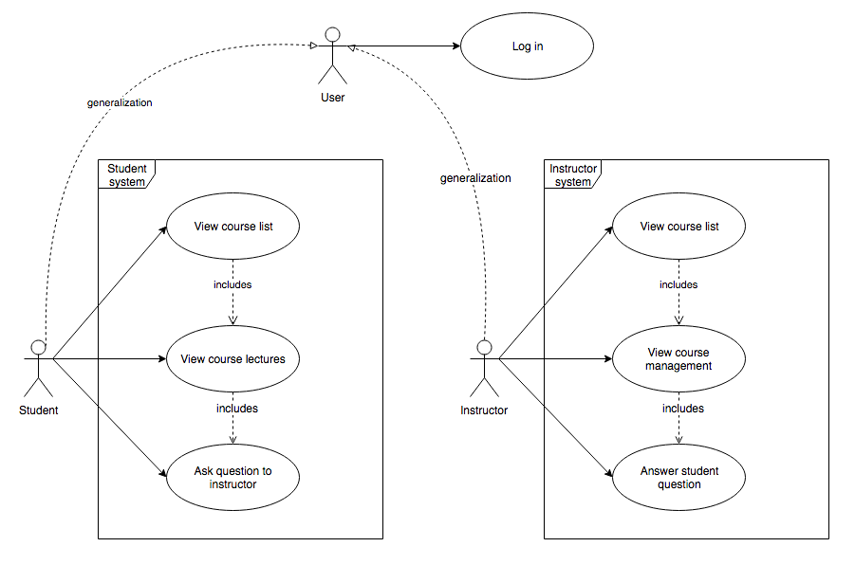
key scenarios Use case diagram example

Slide 36
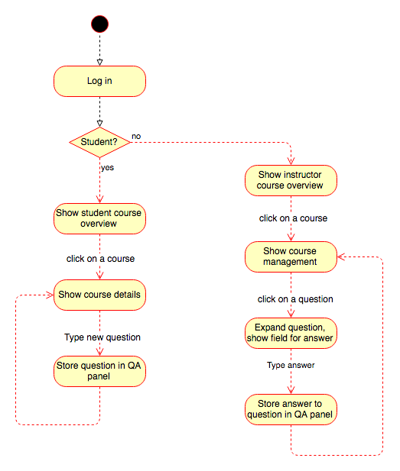
key scenarios activity diagram example

Slide 37
Technology constraints
We are building the solution from scratch
We choose technologies based on our and the developer skills
There is no need to introduce an unfamiliar stack – it will increase the expenses of the project
If you are still building the team – you can experiment a bit more
I am proficient with .NET and JavaScript
And my team has very skilled .NET developers
My technology stack will be Microsoft oriented
We want millions of students and huge availability
On premises servers will require huge maintainability
We are going to use a public cloud
Azure is the perfect choice for Microsoft technology
But consider the other options as well – they may be cheaper

Slide 38
technology options
Back-end technology options:
ASP.NET Core REST API – requires heavy server-side architecting
Serverless with Azure Functions – less architecture burden but less overall control
Front-end technology options:
ASP.NET Core MVC
Server-side rendering is not very suitable for interactive applications
ASP.NET Core Razor Pages
Less overhead in terms of the client
Blazor
Way too new and experimental but the developers may want the bleeding edge
React or Vue
Depends on the knowledge of the developers

Slide 39
Architecture design patterns

Slide 40
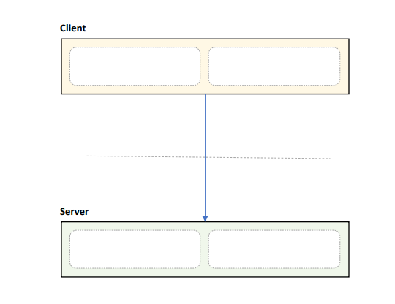
Client/Server Pattern – Layered
Distinct client and server
Separated by network
Communication protocol
Many clients, one server
Pros:
Secure & Simple
Centralized Control
Easy to manage
Cons:
Requires network, difficult to scale
Single point of failure

Slide 41
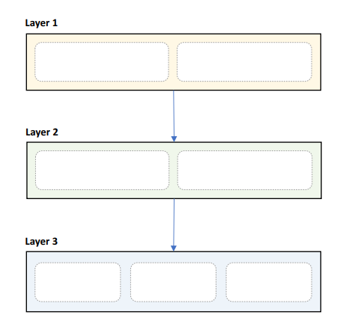
Layered Pattern – Layered
Strict areas of concern
Layers may only communicate with peers above/below
Pros:
High abstraction & High isolation
Structured communication
Easy to scale out
Cons:
Deep call chains
Can hide complexity
May harm performance
Lowest layer must cover all use cases

Slide 42
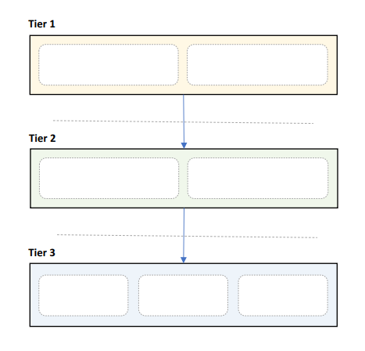
N-Tier Pattern – Layered
Layers deployed to servers
Usually - 3 tiers, always start with them
Communication between layers uses network
Pros:
High abstraction & High isolation
Structured communication
Easy to scale out
Cons:
Network = point of failure
Network may be slow
Coarse interfaces
Hard to debug

Slide 43
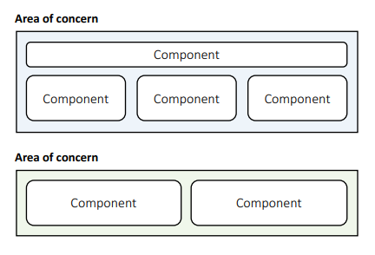
Component-based Pattern - Structural
Components are modular building blocks of software
Grouped into areas of concern
Clearly described interfaces
Containers provide additional services
Pros:
Easy deployment & Allows 3rd party tools
Promotes modularity & Few unanticipated interactions
Cons:
Coarse building blocks & Can be expensive
Initialization may be slow & Harder to develop & maintain

Slide 44
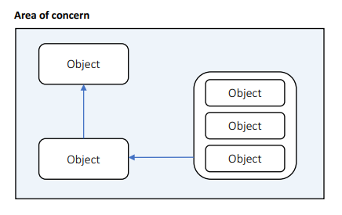
Object-Oriented Pattern - Structural
Uses classes
Grouped into areas of concern
Describes public members
Uses inheritance, composition, aggregation, and associations
Pros:
Easy to understand & Promotes reuse
Easy to test & debug & Highly cohesive
Cons:
Inheritance hard to get right & Useful only if you do not have a Lead Developer
Many unanticipated communications & Too detailed

Slide 45
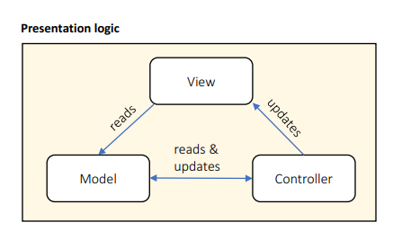
MVC Pattern - Presentation
Designed for presentation layers
View handles output
Model handles data
Controller handles interaction
Pros:
Strict separation of concerns
Scales well
Cons:
High overhead
Scattered code
Hard to data-bind

Slide 46
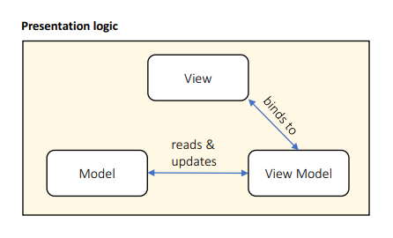
MVVM Pattern - Presentation
Derived from MVC pattern
View handles output
Model handles data
View Model is binding source
Pros:
Strict separation of concerns & Scales well
Easy to data-bind
Cons:
High overhead
Scattered code
Controller not separated

Slide 47
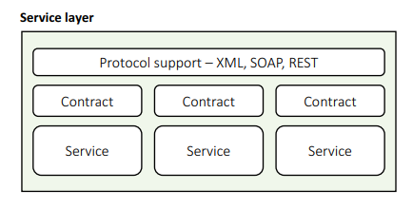
Service-Oriented Pattern - Service
Discrete business services
Use network to communicate
HTTP, XML, SOAP, Binary…
Pros:
Business domain alignment & High abstraction
Discoverable, resilient, Allows 3rd party libraries & Cross-platform
Cons:
Clients must handle slow, offline network
Coarse interfaces
May harm performance
Security issues

Slide 48
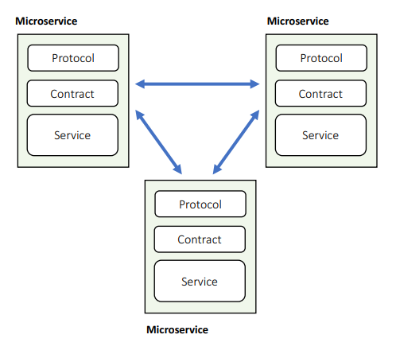
Microservice Pattern - Service
Services calling services
Can use fast private network and RPC
Deployed on multiple servers
Pros:
Modular & Reduced abstraction
Discoverable, resilient & Less coarse interfaces
Can use fast network
Cons:
Must cope with slow, offline network
More unanticipated communications
Hard to do transactions & Hard to test, debug, deploy

Slide 49
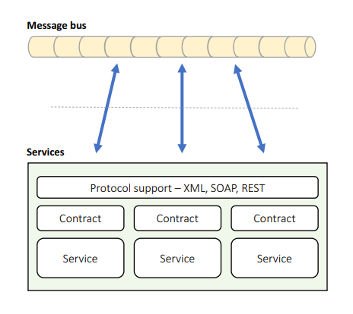
Message Bus Pattern - Service
Services connected to shared data bus
Uses messages for communication
Supports discovery, failover
Pros:
Easy to extend & Simple communication
Very flexible & Easy to scale
Easy discovery, failover
Cons:
Bus = single point of failure
Coarse communications
Can be slow & Hard to test, debug

Slide 50
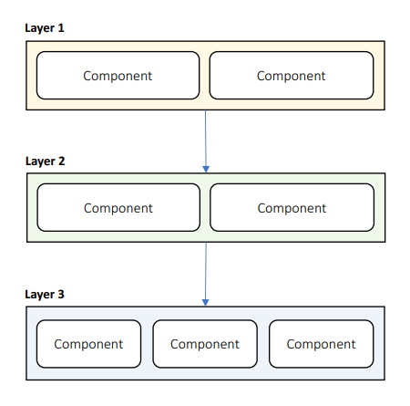
Components In Layers - Hybrid
Layers containing components
Benefits of components
With structured communication, isolation, easy scaling & testing

Slide 51
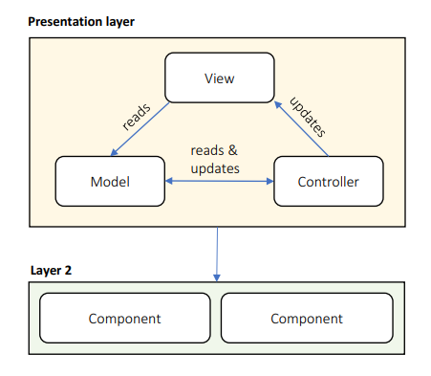
MVC In Presentation Layer - Hybrid
Presentation layer with MVC
Benefits of layers
With separation of concerns, presentation code scalability

Slide 52
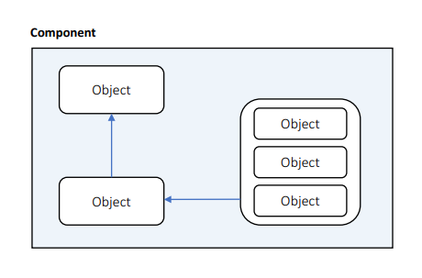
Objects In Components - Hybrid
Components contain objects
Benefits of components
With cohesion & extensibility
You are probably using this pattern already

Slide 53
Want more patterns? You have them!
Pipe and filter
Publish/Subscribe
Stream processing
Multitenancy
Sharding
Circuit breaker
Event-based architecture
Many, many more!

Slide 54
Mixing of patterns
A software architecture is just a mixture of patterns
You can safely nest architectural design pattern inside of each other
For example:
Microservices with components inside them
Microservices with a layered pattern inside them
Create your own hybrid patterns and use them in your design
If the pattern works for you, implement it!

Slide 55
Questions for the learning system
We already chosen an application type and the technology stack
We need to pick architectural pattern and draw a diagram
1a. Choose an architectural design pattern. A great place to start is the layered pattern.
1b. Create a diagram with presentation, service, business, data and systemwide layers.
1c. Choose a pattern for the presentation layer. MVC? MVVM? Components?
2a. Consider authentication, caching, communication, configuration, logging, exceptions and validation.
2b. Consider all third-party tools to help you with these cross-cutting concerns.
3a. This is our first baseline architecture. Think about the components in the layers.
3b. Create diagrams for each layer and describe their public interfaces.
3c. Make sure you keep it simple at this stage. You can go into more detail in later cycles.
4. Design the business domain entities. Create a class diagram and define their public properties.

Slide 56
FINAL WORDS before Q & A

Slide 57
Summary
Common Technology Stacks
Architecture Design Patterns
Choosing The Right Patterns
Don't Forget The Optional But Practical Guide-Book
3 Real-World Scenarios
70+ Pages
Free Updates
Get It From The Event's Page or write to wewritesoftware@gmail.com
https://www.eventbrite.com/e/software-architecture-technology -patterns-code-it-up-online-vol-10-registration-244365432587

