Slide 1
in this part
Architecture Quality Attributes
Scalability & Reliability
System-Wide Considerations
Deployment Considerations
Don't Forget The Optional But Practical Guide-Book
3 Real-World Scenarios
70+ Pages
Free Updates
Get It From The Event's Page or write to wewritesoftware@gmail.com
https://www.eventbrite.com/e/software-architecture-quality-attributes- code-it-up-online-vol-12-registration-256029329617

Slide 2
Architecture quality attributes

Slide 3
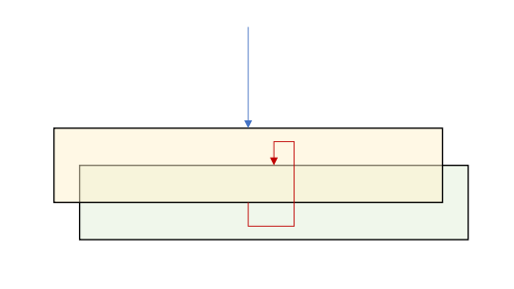
Conceptual Integrity – Design time
Isolated layers and components
Application lifecycle management
How to manage updates
Healthy team collaboration
Awesome relationship with the Lead Developer
Design and coding standards
Automate them in your code reviews
Break away from legacy designs:
Façade pattern
Wrap as service
Rebuild from scratch

Slide 4
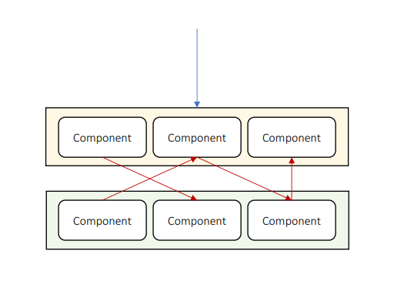
Maintainability – Design time
Isolated layers and components
Structured communication
Follow the same pattern for the whole solution
Rely on platform features
Most modern languages have a lot to offer
Use systemwide layer
Add unit tests
Documentation

Slide 5
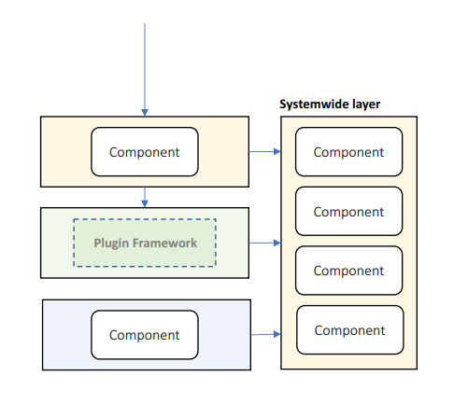
Reusability – Design time
Component-based architecture
Adhere to standards
General-purpose code
Your components should not be specific
Allow 3rd party software
You can buy tools to save time
Use a plugin system
Use systemwide layer

Slide 6
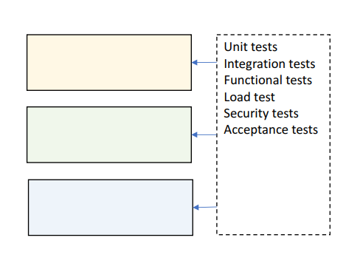
Testability – Design time
Design for testing
Allow mocking
Cover all layers
Automate case studies
Test:
Individual components
Entire layers
Collaboration between layers
Load, Security…

Slide 7
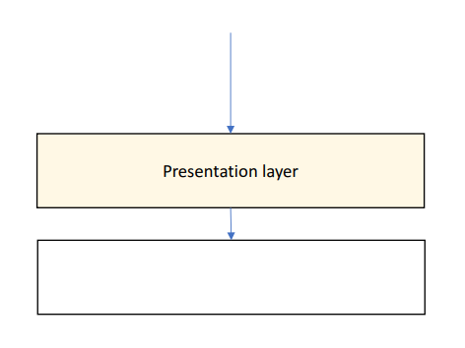
Usability – Design time
Elegant & simple UI
Implements all case studies in minimal number of interactions
Minimize the user interface interactions
Clear multi-step workflows
Ask for minimum number of information
Intuitive feedback
Especially for exceptions
Non-technical

Slide 8
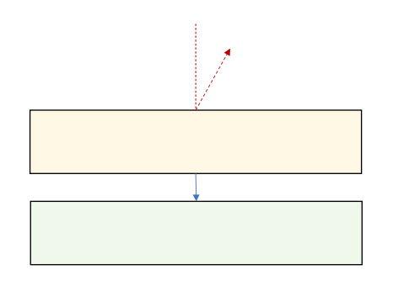
Availability – Runtime
Tier failover
Use rate limiter
Limits the number of calls per second
Short-lived resources locks
Or no locks at all, if that is possible
Recover from exceptions
Do not kill an entire tier with a single exception
Update-friendly architecture
Handle network faults:
Offline support

Slide 9
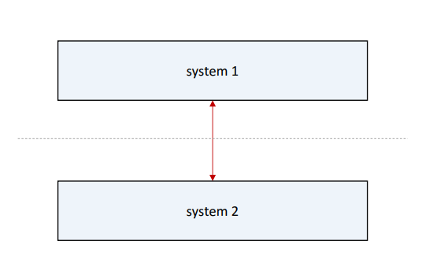
Interoperability – Runtime
Data transformation
Keep systems separate
Adhere to standard:
REST
XML/JSON

Slide 10
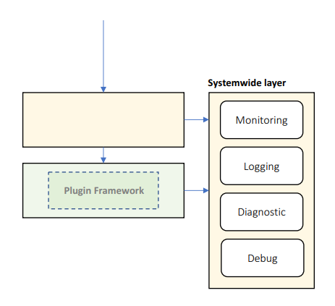
Manageability – Runtime
Health monitoring, logging, and diagnostic tracing
Consider a plugin or modular system
Much more flexible development
Declarative configuration
Add diagnostic tools:
Live tracing
Diagnostic notifications
Runtime log inspection
Runtime debugging
Dangerous so use it only in critical situations

Slide 11
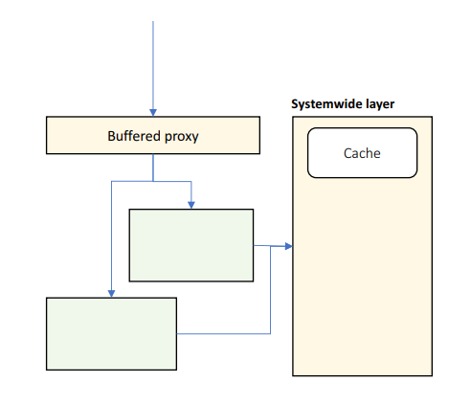
Performance – Runtime
Buffered proxy
Async responses
The client gets immediate response with progress bar
Load-balanced tiers
Caching
Load tests
Minimize throughput:
Rate limiting
Design coarse interfaces
Minimize cache misses

Slide 12
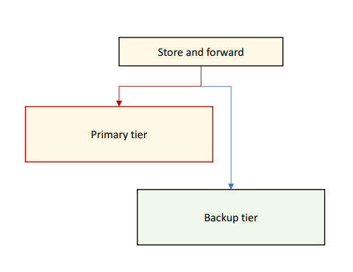
Reliability – Runtime
Self-healing architecture
Use store and forward
Use alternative system if:
Primary system is offline
Primary system is very slow
Primary output is invalid
Replay messages when external resources come back online

Slide 13
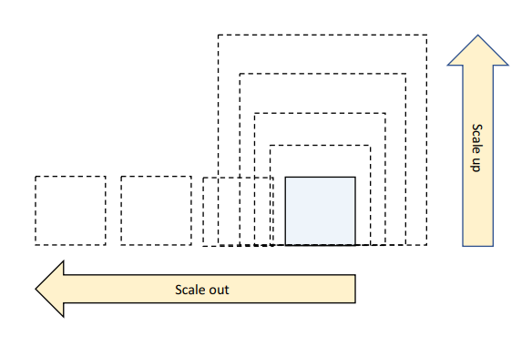
Scalability – Runtime
Adding computer resources without any interruption
Tier scaling:
Scale up – increate resources
Single point of failure
Scale out – duplicate tiers
For stateless applications
The better approach
Handle load spikes:
Async responses
Store and forward
Allow stale data

Slide 14
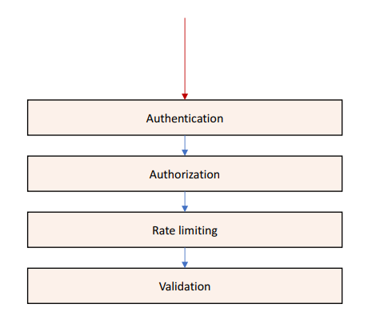
Security – Runtime
Authenticate & authorize clients
Validate input & output
Encrypt sensitive data
Protect against:
Spoofing
Malicious input & output
Malicious use
Data theft
DDoS attacks

Slide 15
Scalability

Slide 16
Performance VS Scalability
Performance
Low latency – response time is very low
High throughput – lots of requests are processed
Improved by concurrency and capacity
Constant load
Scalability
Subset of performance
Ability of a system to increase its throughput by adding more hardware capacity
It can be down both ways – up and down
Vertical scalability – adding more hardware
Horizontal scalability – distributing the processing
Reverse proxy is a common design pattern here

Slide 17
Scale Up And Scale Out
Scale Up
Easy with VMs or containers
But limited results
Scale Out
Requires layered design
Requires partitioned data
Potentially unlimited

Slide 18
Scalability Principles
Decentralization
Monolithic applications are antipattern for scalability
We need more workers (instances)
Independence
Multiple workers are good if they can work independently
Shared resources and shared mutable data are bad for independence
Modularity
Scalable architecture starts with modularity
The 3-tier architecture is a good start
Loose coupling
Especially important for business logic

Slide 19
Application Replication
Stateless (only code) and stateful (code and data)
Stateful web application replication:
Session affinity but occupies memory
Complicated and not a preferred approach
Reliability is impacted
Go stateless if possible
Stateless web or service application replication:
Higher scalability
But higher latency because of call "hops" to the database
Solution is a shared cache for server-side
And cookies/local storage for client-side
Higher reliability

Slide 20
Database Replication
An easy way to scale a database is by introducing a read replica
With automatic write update
And a backup instance for higher reliability
Primary-secondary option
Eventual consistency and data loss
Peer-to-peer option
Write conflicts and transaction issues
Not a very popular but useful in multi-geography situations
Replication cannot scale well
Database partitioning is a good solution after a certain point
Range partitioning and hash partitioning

Slide 21
Load balancer & Other techniques
Load balancer
Single IP address for a component
Hardware and software options
Helps with load distribution
Both external and internal
Round Robin, Least Connection, Weighted RR, Least Response Time
Service discovery
Global server load balancing
Global data replication
Auto scaling
Extreme scalability leads to a microservices architecture

Slide 22
Reliability

Slide 23
Failures in Large-scale systems
Large scale systems are generally distributed
Because of horizontal scalability
Large number of components
Large number of replications
Failures can be:
Partial
Independent
Single point of failures
Partial failures can lead to complete system failures

Slide 24
Partial Failures
No matter how hard we try:
Hardware and networks will fail
Constantly developer software will fail
Disasters will happen
And after a point – it's much more economical to recover
Instead of trying to prevent a failure
Various scenarios:
Network failure – LAN, Load Balancer
Machine failure – CPU, Disk, Memory
Software failure – a process
Operations failure – deployment, configuration, etc.

Slide 25
Fault tolerance
Technique to improve availability and (or) reliability
Automatically:
Detect partial failures
Handle partial failures
Recover from partial failures
We need
Redundancy
Fault detection
Recovery

Slide 26
Techniques
External monitoring service
Ping based
Internal cluster monitoring
Heart-beat based
Hot standby replicas
Almost no downtime but more expensive
Warm standby replicas
Catchups before recovery
Automation in replication
Retries with exponential back-off
Circuit breaker

Slide 27
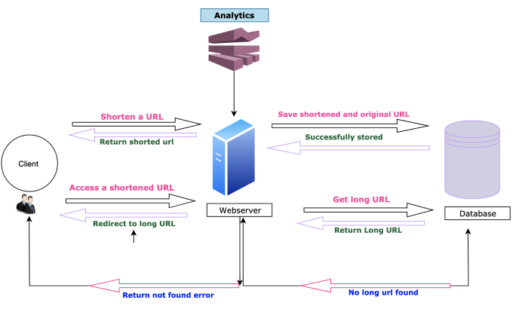
Initial design Example
Remember the URL shortening system?
We started with a 3-tier architecture

Slide 28
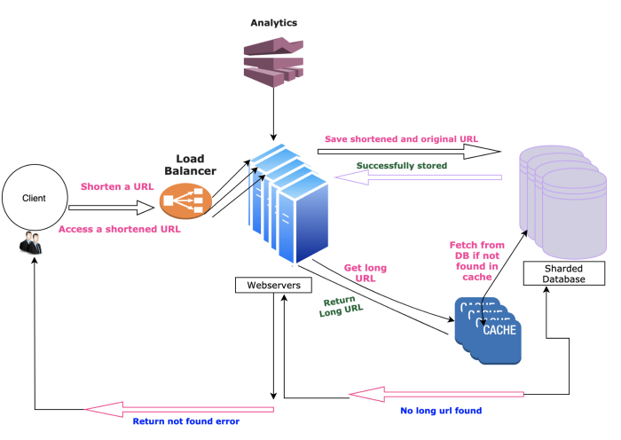
Final design Example
And we introduced scalability and reliability
By analyzing each module of the system step by step

Slide 29
BEFORE WE CONTINUE…

Slide 30
System-wide considerations

Slide 31
General guidelines
Always think about the big picture
Consider the following questions:
How will the system work under heavy load?
What will happen if the system crashes at this exact moment in the business flow?
How complicated can be the update process?
There could be more depending on the specific requirements of the system
Main concerns for the system architecture are:
Loose coupling
Stateless
Caching
Messaging
Error Handling & Logging

Slide 32
Loose coupling on a system level
Making sure our services are not tightly coupled to other services
Every time we change one process, another needs to follow
A good idea is to be platform independent
Do not use Java-specific communication, for example
Because the other service should also be written in Java
Also, the services should be URL independent
Imagine multiple services like in a typical application
They all communicate with each other
If one URL changes – massive issues
Possible solution – yellow pages service used for discoverability
Another solution – a gateway service to route requests

Slide 33
Stateless applications
Super important for scalability and performance
The application's state should be stored only in two places
The data storage
The user interface
No state is stored in application code
Typically, the user-specific data is the application state
Make it stateless
Why it is important?
Scalability - scaling out will be super easy
Redundancy – if one server fails, the other continue to work

Slide 34
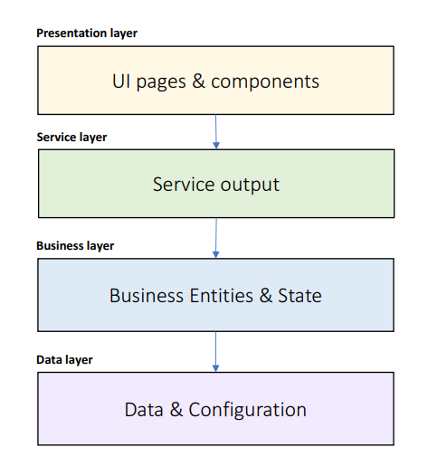
Caching – What To Cache?
UI pages
Mainly useful for seemingly static information
UI components
These parts of the page which do not change often
Service output
Business Entities
Business State
Data query results
Configuration data
List data to be cached in each layer

Slide 35
Caching – definition
Caching is bringing the data closer to its consumer so that its retrieval will be faster
Cache options:
Client-side cache – using headers to store data in the client's machine
CDNs – using a content-delivery network for static assets
Service cache – caching in the application code
Cache types:
In-memory cache – size is limited but easily implemented (static concurrent collection)
Distributed cache – data is stored in separate process, slower performance

Slide 36
Caching – Where To Cache?
Local memory
The fastest
State server
File system
Database
The slowest
User standard solutions:
Redis
Memcached
Framework-specific caches

Slide 37
Caching – How To Manage The Cache?
Expiration strategy:
Time-based
Event-based
Flush strategy:
Manual
Automatic:
Least Recently Used
Least Frequently Used
Priority

Slide 38
Caching – How To Fill The Cache?
Proactive loading
Static data
Known update frequency
Known size
Reactive loading
Volatile data
Unknown lifetime
Large data volume
Fast caching medium

Slide 39
Messaging – definition
Messaging is the communication between the various services
Messaging methods are not exclusive
You can mix them easily
Messaging criteria:
Performance – faster methods are preferred
Size – small or large messages
Execution model – blocking or asynchronous
Feedback – whether the message has failed
Reliability – a message will be received even if there was a problem
Complexity – development effort

Slide 40
Messaging – rest API
The standard for HTTP-based systems
Messaging criteria:
Performance – very fast
Size – same as HTTP limitations
Execution model – request/response – bad for long processes, blocking
Feedback – immediate feedback
Reliability – retry policy should be implemented, the circuit-breaker pattern is great
Complexity – extremely easy
Useful for traditional web applications

Slide 41
Messaging – real-time communication
Using HTTP Web Sockets
Publish/subscribe, push notifications
Socket.io, SignalR
Messaging criteria:
Performance – very fast
Size – limited, no more than a few KB
Execution model – web socket connection or long polling
Feedback – fire & forget
Reliability – complex to implement proper reliable solution
Complexity – extremely easy
Useful for chat, monitoring, and real-time data

Slide 42
Messaging – queue
Services do not communicate directly
The first service pushes to a message queue
The second service pulls from the message queue
Messages will be handled once and only once + in order
Messaging criteria:
Performance – not so good, database persistence involved
Size – unlimited, but keep it small
Execution model – polling
Feedback – excellent feedback
Reliability – very reliable
Complexity – requires training and setup
Useful for complex systems with lots of data

Slide 43
Exceptions – Exception Strategies
Allow to propagate
Catch and Re-throw
Logging
Retains stack trace
Catch, Wrap, and Throw
Add metadata
Expose consistent exception types
Catch and Discard

Slide 44
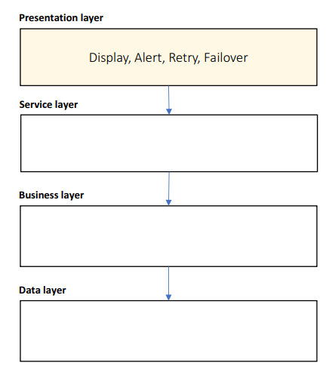
Exceptions – Presentation Layer
Catch, display, and discard
Other layers should never discard exceptions
Attempt to retry
Automatic 3 retries or manual
Switch to secondary system
Alert by Email, SMS, Slack…
Use meaningful messages
Business explanation
Technical information
Steps to resolve

Slide 45
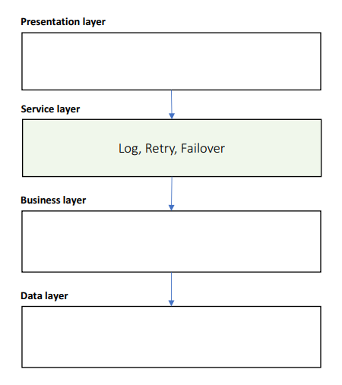
Exceptions – Service Layer
Catch and Re-throw
Attempt to retry
Switch to secondary system
Log exception and input message

Slide 46
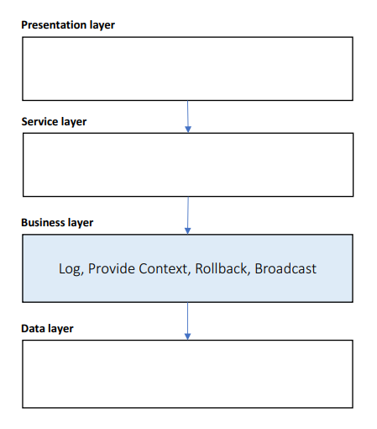
Exceptions – Business Layer
Catch, Wrap, and Throw
Use custom exception types
Provide business context
Rollback transactions
Log exception and input arguments
Broadcast to subscribers

Slide 47
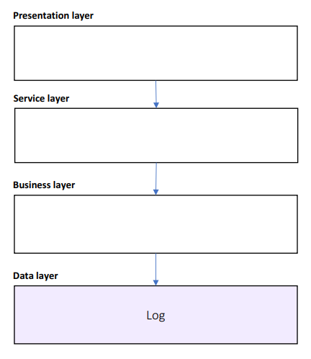
Exceptions – Data Layer
Catch and Re-throw
Log exception and input query

Slide 48
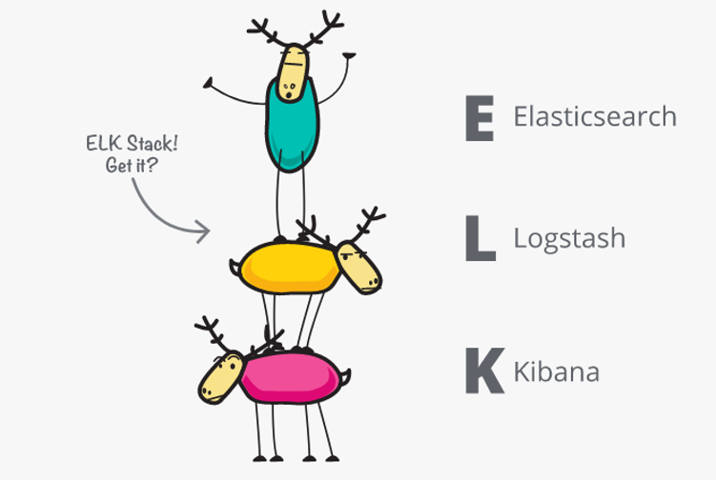
Logging - definition
Logging has two purposes:
Track errors
Gather data
Which module is most visited
Performance scenarios
User's flow
Log storage doesn't really matter
As long it is useful
Files
Database
Event log
Good architectures always includes logging and monitoring!

Slide 49
Logging – best practices
Use a central logging service
Same log format
Same log data
Same log location
Implementation:
Expose an API
Watch specific folders for log files and collect them
Tools like Logstash are perfect for that
Use Correlation ID
If you have multiple services in a flow
Make sure you can link different log entries
You can easily track a complete flow

Slide 50
System-wide attributes
The concepts we covered in this section are super important
They should be part of every single system out there
They allow you to have a fast, secure, reliable, and maintainable solution
Make all choices as informative and early as possible
Many concepts are difficult to replace once made
Changing a REST API with a message queue is not an easy and cheap task
These concepts are not exclusive
Although they are the most important ones
A lot of research should be done for every single system
No tool is a golden hammer

Slide 51
Deployment considerations

Slide 52
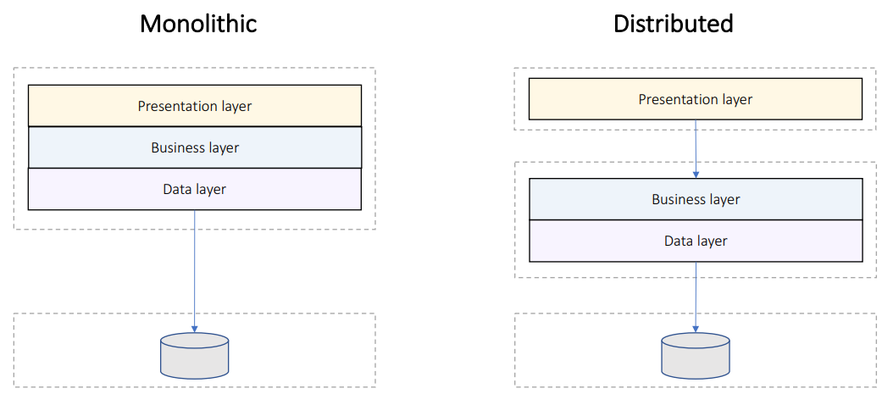
Deployment Models

Slide 53
Distributed Deployment Guidelines
Minimize blocking calls:
Async calls
One-way calls
Buffering
Use distributed transactions
Use coarse-grained interfaces
Manage state:
Stateless design – highly scalable
Stateful design – supports workflows but doesn’t scale
Shared state server

Slide 54
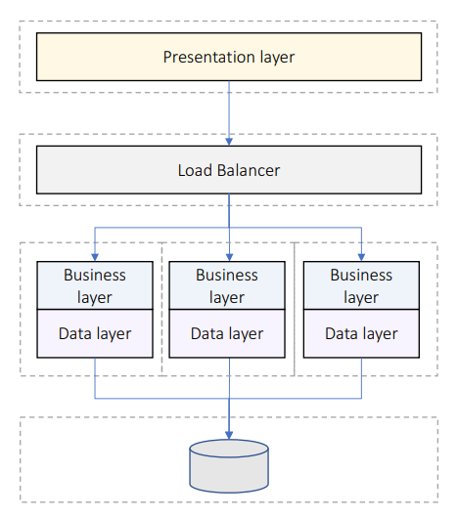
Deploy For Performance
Business/data layers scale out
Can detect failed tiers
Stateless design preferred
Stateful design requirements:
Shared state server
Session affinity

Slide 55
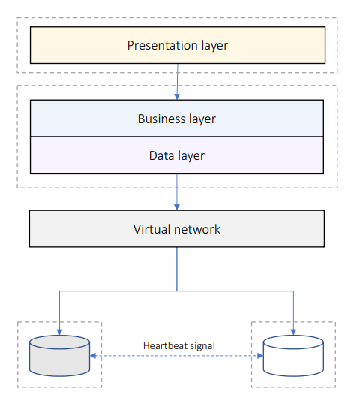
Deploy For Reliability
Secondary tier takes over when primary tier fails
Requires way more hardware
Synchronization considerations:
Sync when secondary tier activates
Or allow stale data

Slide 56
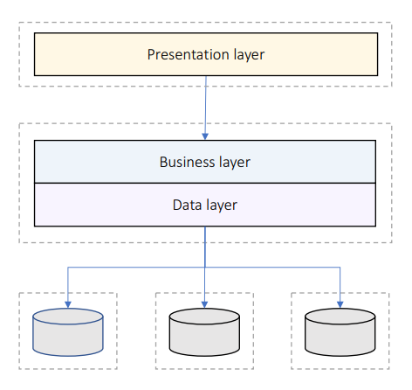
Deploy For Scalability
Data replicated on multiple tiers
Replication breaks consistency and atomicity
Consistency considerations:
Delayed sync in background
Or allow stale data
Or partition data

Slide 57
Modern Deployment Solutions
Application deployment
VM or Containers
Infrastructure deployment
Cloud or data centers
Operations
Kubernetes
Automation
DevOps Tools

Slide 58
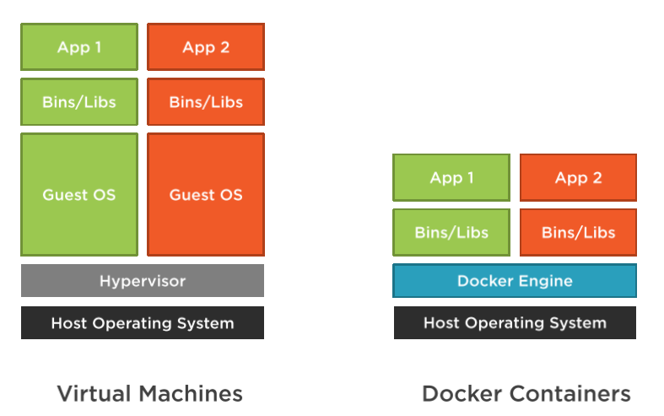
Docker VS Virtual Machines

Slide 59
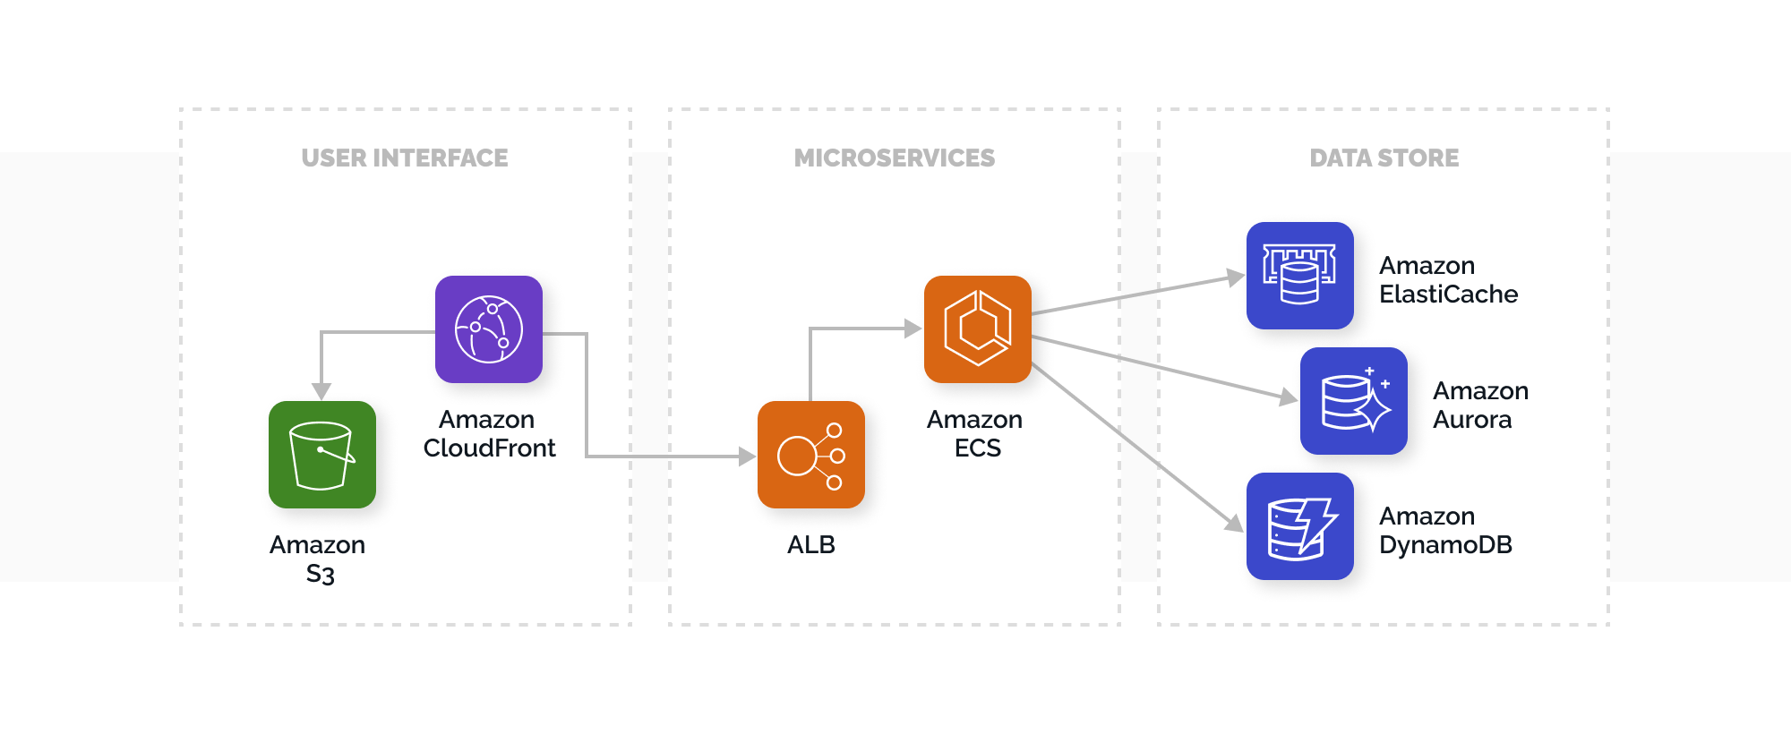
Cloud Infrastructure

Slide 60
Kubernetes Big picture
Kubernetes is an orchestrator for our application
But what does orchestration mean?
Imagine a football team
Each player has its own strengths and role
The coach is responsible for managing the team
They should have a good formation, based on the coach’s decisions
He also watches them and makes sure everyone sticks to the plan
He also may replace injured players when the situation demands it
The environment is constantly changing, and the coach reacts to it

Slide 61
Kubernetes Big picture
Kubernetes and microservices are the same
Our components are orchestrated like a team
But how to do it?
We have an application
We package it in a container
We pass the container to the cluster
We send instructions for our application
And boom – our code is up and running!
We get automatic:
Service discovery, load balancing
Rollouts and rollbacks
Resource requirements and monitoring

Slide 62
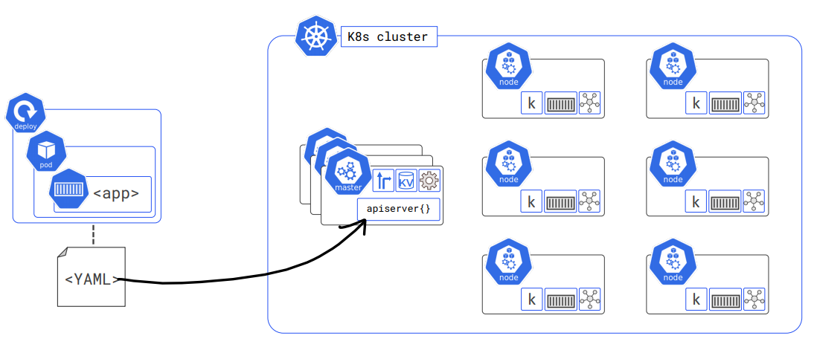
Kubernetes Big picture

Slide 63
Deployment strategies
Rolling updates
Old version and new version work simultaneously
New version replaced the old one slowly
Canary deployment
New update is exposed only to a small fraction of requests
Once confident, we update the whole system
Recreate deployment
Old and new versions cannot run at the same time
Data migrations requires a downtime
Blue Green deployment
The entire environment is switched to a new one
Quick rollback is available but costs extra hardware

Slide 64
Questions for the learning system
We still haven't thought about performance, availability, and scalability
1a. What is our tiering strategy? Scaling up or scaling out?
1b. What is our redundancy and failover strategy?
1c. Write down a load test and validate the scalability? What can we do to improve it?
2a. Is our business layer stateless? What is our state management policy?
2b. Think about all the data in our system. Where can we introduce caching?
2c. Where are we going to store the cache? How are we going to warm it up?
2d. Think about the exception policy for each layer. Consider a third-party logging tool?
3. Do you think you can easily debug problems in your solution? If no, redesign it.
4. Where are we going to deploy the system? Process? CI/CD?

