Slide 1


Software Architecture Part 4
Code It Up Online Vol. 12

Slide 2
For LIVE questions
Check The Link In The Description
Resources https://github.com/ivaylokenov/Software-Architecture-Series

Slide 3
Live stream troubleshooting
Sometimes issues happen during a live stream…
And sometimes disasters happen, this is how memes are born…
If my Internet goes down and the stream stops:
Wait for 5 minutes, I have another one on a different network
If YouTube is showing “stream ended”:
I will post a new link in the comments section below this video
If something else happens unexpectedly:
Well, I will add a solution to this slide during my next event… ☹
If a major showstopper is happening – no electricity, for example
I will create a new event and we will schedule a new live stream…
In any case – write to wewritesoftware@gmail.com

Slide 4
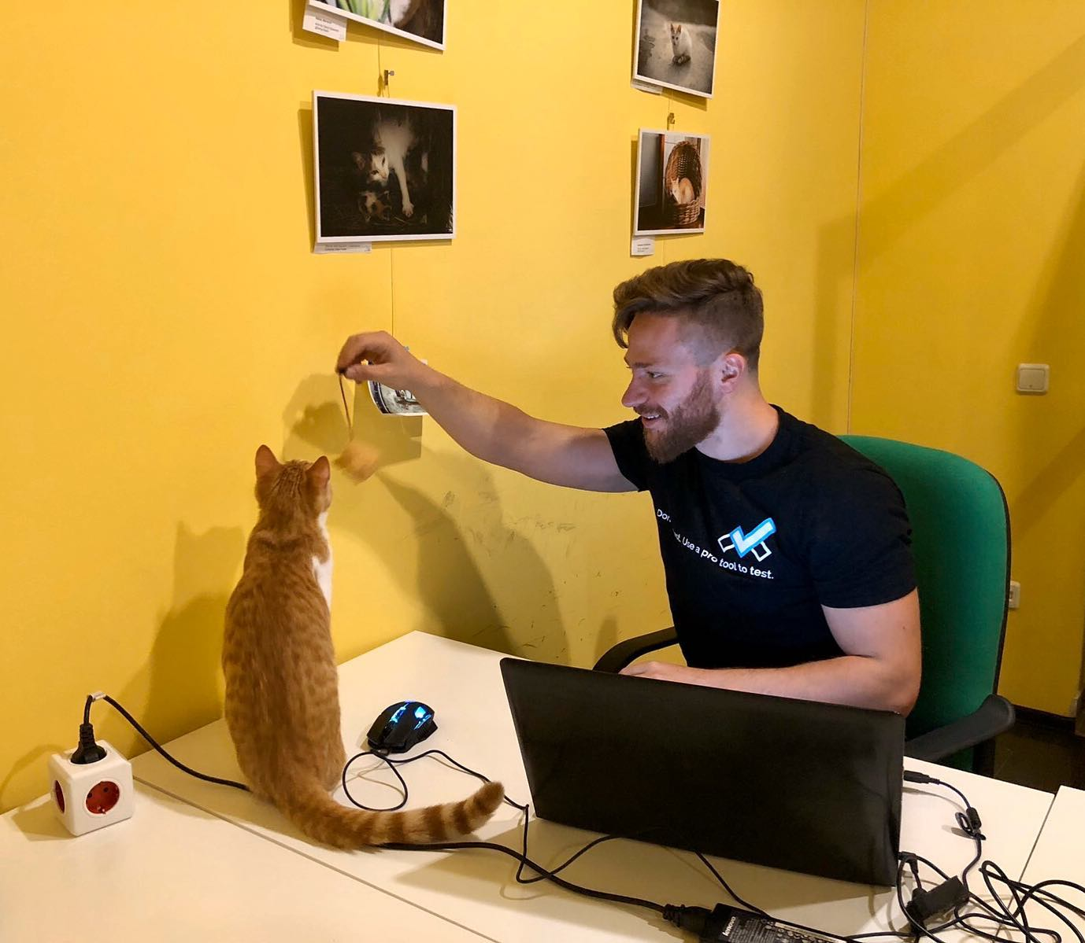
The Presenter
Ivaylo Kenov – Quality Code Advocate
Various job titles at the same time:
Organizer & Speaker @ Code It Up
CTO @ SoftUni
Full Stack Technical Trainer @ Everywhere
Code General @ https://docs.mytestedasp.net/
Meme Copy Machine @ Daily Programming Fun
{Insert Job Title Here}
Contacts
https://github.com/ivaylokenov
https://facebook.com/ivaylo.kenov
https://linkedin.com/in/kenov
https://www.instagram.com/ivaylokenov/
YouTube & Blog
https://www.youtube.com/c/CodeItUpWithIvo
https://codeitup.today/

Slide 5
Sponsors
This lecture is free thanks to our sponsors
Which will interrupt the lecture here and there
Because it takes quite a lot of personal time to prepare the materials
You will help the initiative a lot if you visit their web sites
And consider their propositions to you
I personally select various premium jobs to present them during the talk
These are the current ones:
INDEAVR - https://indeavr.com
Americaneagle.com - https://www.americaneagle.com
SmartIT - https://smartit.bg

Slide 6
ABOUT CODE IT UP

Slide 7
Code it up
The Code It Up initiative:
Aims to provide detailed knowledge on advanced software development topics
Aimed at people with at least 1 year of programming experience (mostly C#)
Sort of acquired by SoftUni last year
Code It Up Online
Free live-streamed online events (2+ hours long)
Led by me – mainly .NET, architecture, and infrastructure
We have 6 more lectures before the initiative ends
Code It Up Workshop
Paid events containing theory & practical exercises for the attendees
No more paid lecture planned for now

Slide 8
Thankful if you share a story
You can be extremely helpful to the initiative
Just share a story on Facebook or Instagram during the lecture
Make sure you tag me so that I can reshare your post - @ivaylokenov
Bonus – add the #codeitup hashtag
Thank you! You rock!

Slide 9
ABOUT The Series Of Events

Slide 10
About This SERIES Of Code It Up Events
Theoretical lectures on software architectures
Widely-used design patterns and concepts in production
Depending on your level, you may be familiar with some of the topics
A real-life project example
A practical guidebook for architecting various solutions
3 real-life projects on more than 70 pages
Legacy systems, vast data load, lots of concurrent users, working with critical data, and more
Please report to wewritesoftware@gmail.com, if you find any “bugs” in the book!
And I have a lot more to add in the future!
You receive free updates of the book!
MOST IMPORTANTLY – HUGE THANK YOU! <3

Slide 11
The Content Of The Series – A Free Course
Why Software Architecture
What Is Software Architecture?
Unified Modeling Language
Designing Solution Architectures
Common Technology Stacks
Architecture Design Patterns
Choosing The Right Patterns
Architecture Quality Attributes
System-Wide Considerations
Deployment Considerations
Monolithic Architecture
Domain-Driven Design
Microservices
Event Sourcing
The Architecture Document
The Architect And The Team
What Makes A Great Architect
Designing A Real-Life Solution

Slide 12
in The previous parts
What Is Software Architecture?
Designing Solution Architectures
Common Technology Stacks
Architecture Design Patterns
Choosing The Right Patterns
It is not required to watch the parts in order
But it is strongly advised!
Get the previous recordings from here:
https://www.eventbrite.com/o/code-it-up-29733808833

Slide 13
in this part
Architecture Quality Attributes
Scalability & Reliability
System-Wide Considerations
Deployment Considerations
Don't Forget The Optional But Practical Guide-Book
3 Real-World Scenarios
70+ Pages
Free Updates
Get It From The Event's Page or write to wewritesoftware@gmail.com
https://www.eventbrite.com/e/software-architecture-quality-attributes- code-it-up-online-vol-12-registration-256029329617

Slide 14
About this topic
HUGE DISCLAIMER! THIS TOPIC IS LIKE THE LITTLE PRINCE BOOK!
There are a lot of things to know about software architectures
You may or may not recognize some of the patterns
And we most probably will not mention all of them
If you are a beginner, just try to absorb what you can
The technology world is moving very fast
Some of the examples shown here may be considered anti-patterns in the future
But the overall concept and process stays the same
As all my other topics – this one is super intense too!
Even though the lectures will be a bit shorter
So, give yourself time and if you get the book – finish it!
And don’t worry! The knowledge provided here will save you weeks of reading!

Slide 15
INDEAVR – The EVENT’s DIAMOND SPONSOR
They provide technology services focused on the Digital, Data, Cloud and Advanced Software Engineering expertise.
They are always in search for creative and passionate people with the combination of a sharp strategic mind, emotional maturity, entrepreneurial instincts, and the ability to deliver results.
https://www.indeavr.com/en/technology/application-services
https://www.indeavr.com/en/careers

Slide 16
Architecture quality attributes

Slide 17
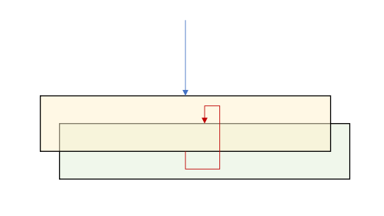
Conceptual Integrity – Design time
Isolated layers and components
Application lifecycle management
How to manage updates
Healthy team collaboration
Awesome relationship with the Lead Developer
Design and coding standards
Automate them in your code reviews
Break away from legacy designs:
Façade pattern
Wrap as service
Rebuild from scratch

Slide 18
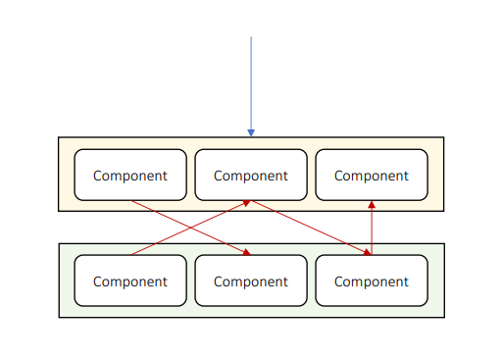
Maintainability – Design time
Isolated layers and components
Structured communication
Follow the same pattern for the whole solution
Rely on platform features
Most modern languages have a lot to offer
Use systemwide layer
Add unit tests
Documentation

Slide 19
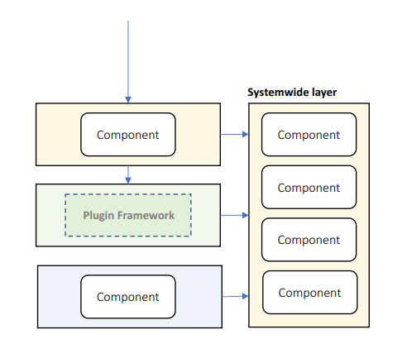
Reusability – Design time
Component-based architecture
Adhere to standards
General-purpose code
Your components should not be specific
Allow 3rd party software
You can buy tools to save time
Use a plugin system
Use systemwide layer

Slide 20
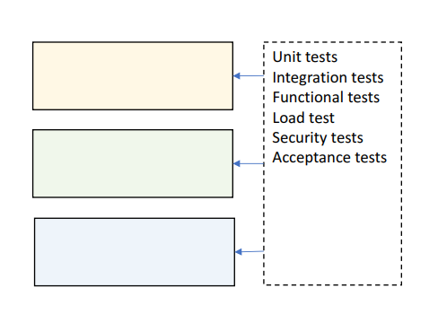
Testability – Design time
Design for testing
Allow mocking
Cover all layers
Automate case studies
Test:
Individual components
Entire layers
Collaboration between layers
Load, Security…

Slide 21
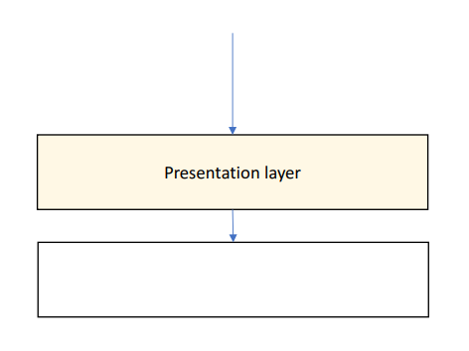
Usability – Design time
Elegant & simple UI
Implements all case studies in minimal number of interactions
Minimize the user interface interactions
Clear multi-step workflows
Ask for minimum number of information
Intuitive feedback
Especially for exceptions
Non-technical

Slide 22
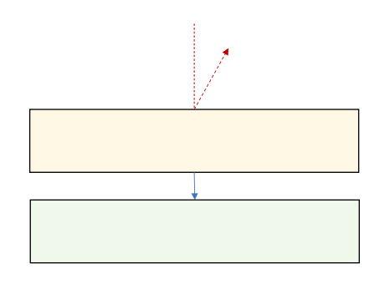
Availability – Runtime
Tier failover
Use rate limiter
Limits the number of calls per second
Short-lived resources locks
Or no locks at all, if that is possible
Recover from exceptions
Do not kill an entire tier with a single exception
Update-friendly architecture
Handle network faults:
Offline support

Slide 23
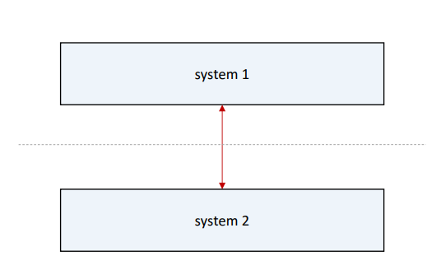
Interoperability – Runtime
Data transformation
Keep systems separate
Adhere to standard:
REST
XML/JSON

Slide 24
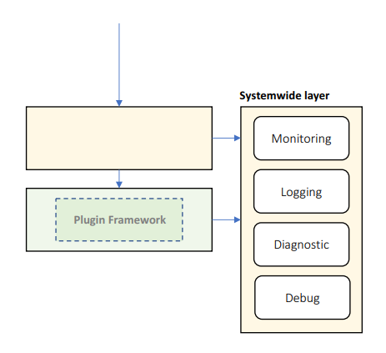
Manageability – Runtime
Health monitoring, logging, and diagnostic tracing
Consider a plugin or modular system
Much more flexible development
Declarative configuration
Add diagnostic tools:
Live tracing
Diagnostic notifications
Runtime log inspection
Runtime debugging
Dangerous so use it only in critical situations

Slide 25
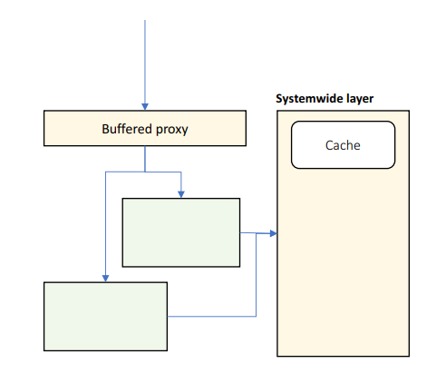
Performance – Runtime
Buffered proxy
Async responses
The client gets immediate response with progress bar
Load-balanced tiers
Caching
Load tests
Minimize throughput:
Rate limiting
Design coarse interfaces
Minimize cache misses

Slide 26
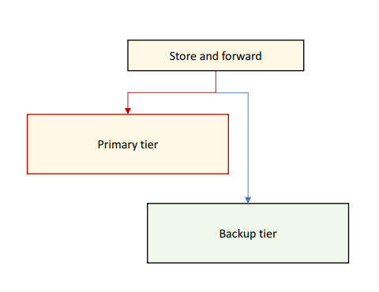
Reliability – Runtime
Self-healing architecture
Use store and forward
Use alternative system if:
Primary system is offline
Primary system is very slow
Primary output is invalid
Replay messages when external resources come back online

Slide 27
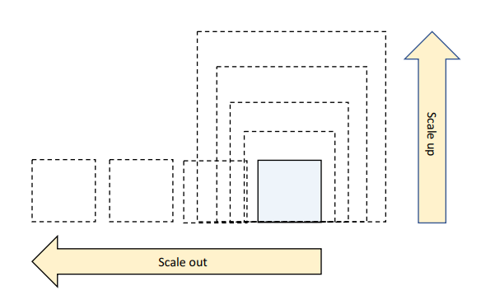
Scalability – Runtime
Adding computer resources without any interruption
Tier scaling:
Scale up – increate resources
Single point of failure
Scale out – duplicate tiers
For stateless applications
The better approach
Handle load spikes:
Async responses
Store and forward
Allow stale data

Slide 28
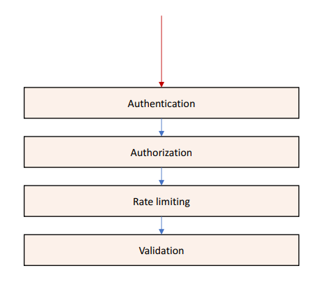
Security – Runtime
Authenticate & authorize clients
Validate input & output
Encrypt sensitive data
Protect against:
Spoofing
Malicious input & output
Malicious use
Data theft
DDoS attacks

Slide 29
Scalability

Slide 30
Performance VS Scalability
Performance
Low latency – response time is very low
High throughput – lots of requests are processed
Improved by concurrency and capacity
Constant load
Scalability
Subset of performance
Ability of a system to increase its throughput by adding more hardware capacity
It can be down both ways – up and down
Vertical scalability – adding more hardware
Horizontal scalability – distributing the processing
Reverse proxy is a common design pattern here

Slide 31
Scale Up And Scale Out
Scale Up
Easy with VMs or containers
But limited results
Scale Out
Requires layered design
Requires partitioned data
Potentially unlimited

Slide 32
Scalability Principles
Decentralization
Monolithic applications are antipattern for scalability
We need more workers (instances)
Independence
Multiple workers are good if they can work independently
Shared resources and shared mutable data are bad for independence
Modularity
Scalable architecture starts with modularity
The 3-tier architecture is a good start
Loose coupling
Especially important for business logic

Slide 33
Application Replication
Stateless (only code) and stateful (code and data)
Stateful web application replication:
Session affinity but occupies memory
Complicated and not a preferred approach
Reliability is impacted
Go stateless if possible
Stateless web or service application replication:
Higher scalability
But higher latency because of call "hops" to the database
Solution is a shared cache for server-side
And cookies/local storage for client-side
Higher reliability

Slide 34
Database Replication
An easy way to scale a database is by introducing a read replica
With automatic write update
And a backup instance for higher reliability
Primary-secondary option
Eventual consistency and data loss
Peer-to-peer option
Write conflicts and transaction issues
Not a very popular but useful in multi-geography situations
Replication cannot scale well
Database partitioning is a good solution after a certain point
Range partitioning and hash partitioning

Slide 35
Load balancer & Other techniques
Load balancer
Single IP address for a component
Hardware and software options
Helps with load distribution
Both external and internal
Round Robin, Least Connection, Weighted RR, Least Response Time
Service discovery
Global server load balancing
Global data replication
Auto scaling
Extreme scalability leads to a microservices architecture

Slide 36
Reliability

Slide 37
Failures in Large-scale systems
Large scale systems are generally distributed
Because of horizontal scalability
Large number of components
Large number of replications
Failures can be:
Partial
Independent
Single point of failures
Partial failures can lead to complete system failures

Slide 38
Partial Failures
No matter how hard we try:
Hardware and networks will fail
Constantly developer software will fail
Disasters will happen
And after a point – it's much more economical to recover
Instead of trying to prevent a failure
Various scenarios:
Network failure – LAN, Load Balancer
Machine failure – CPU, Disk, Memory
Software failure – a process
Operations failure – deployment, configuration, etc.

Slide 39
Fault tolerance
Technique to improve availability and (or) reliability
Automatically:
Detect partial failures
Handle partial failures
Recover from partial failures
We need
Redundancy
Fault detection
Recovery

Slide 40
Techniques
External monitoring service
Ping based
Internal cluster monitoring
Heart-beat based
Hot standby replicas
Almost no downtime but more expensive
Warm standby replicas
Catchups before recovery
Automation in replication
Retries with exponential back-off
Circuit breaker

Slide 41
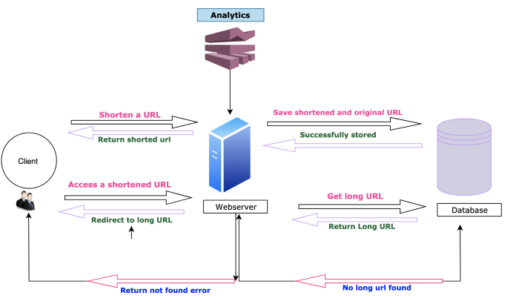
Initial design Example
Remember the URL shortening system?
We started with a 3-tier architecture

Slide 42
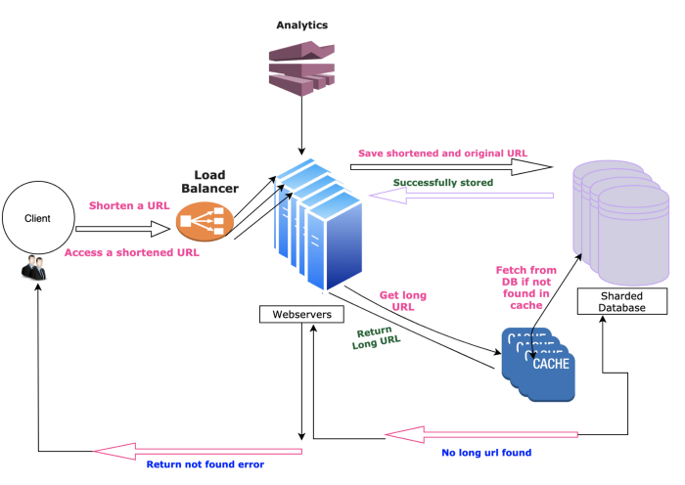
Final design Example
And we introduced scalability and reliability
By analyzing each module of the system step by step

Slide 43
BEFORE WE CONTINUE…

Slide 44
Huge THANKS for your support & TRUST!
Everyone who got a paid ticket – 54 people in total! Thank you!
Top supporter – Nikolay Stoychev – 60 BGN! Thank you, you rock! <3
Thanks to – Plamen, Georgi, Aneliya, Pavel, Albena, Dimitar, nikolay, Mariyana, Калин, Tihomir, Daniel, Borislav, Robert, Stoil, Mira, Teodor, Stefan, Elitsa, Vladimir, Petar, Svetoslav, Ivaylo, Petar, Petar, Lyuboslav, Diana, Hristina, Emiliyan, Dimitar, Рая, Dobromir, Ivan, Kiril, Иван, Teodor, Miroslava, Ivaylo, Hristo, Dobromir, Veselin, Борислав, Vladimir, Martin, Nikolay, nikolay, Valentin, Iva, Pavel, Boyan, Kalina, Dimitar, Spas, Eduard
And everyone who supported the initiative during the years!

Slide 45
These events are not Exactly free
I prefer to call them “Pay what you want”
Depending on how much you value the provided knowledge
It takes me a considerable amount of free time to prepare these lectures
And I want them to be perfect and complete!
I put my soul in them!
For this reason, I will be extremely thankful, if you decide to support me and my projects!
It is never expected, but always appreciated!
The easiest way is via
PayPal: http://paypal.me/ivaylokenov
Revolut: @ivaylokenov

Slide 46
System-wide considerations

Slide 47
General guidelines
Always think about the big picture
Consider the following questions:
How will the system work under heavy load?
What will happen if the system crashes at this exact moment in the business flow?
How complicated can be the update process?
There could be more depending on the specific requirements of the system
Main concerns for the system architecture are:
Loose coupling
Stateless
Caching
Messaging
Error Handling & Logging

Slide 48
Loose coupling on a system level
Making sure our services are not tightly coupled to other services
Every time we change one process, another needs to follow
A good idea is to be platform independent
Do not use Java-specific communication, for example
Because the other service should also be written in Java
Also, the services should be URL independent
Imagine multiple services like in a typical application
They all communicate with each other
If one URL changes – massive issues
Possible solution – yellow pages service used for discoverability
Another solution – a gateway service to route requests

Slide 49
Stateless applications
Super important for scalability and performance
The application's state should be stored only in two places
The data storage
The user interface
No state is stored in application code
Typically, the user-specific data is the application state
Make it stateless
Why it is important?
Scalability - scaling out will be super easy
Redundancy – if one server fails, the other continue to work

Slide 50
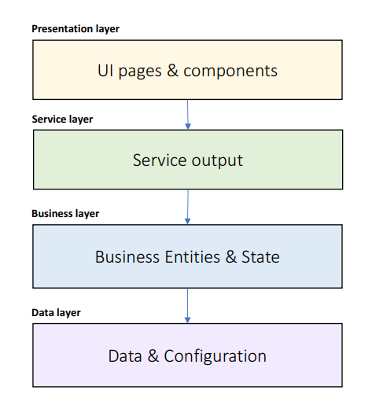
Caching – What To Cache?
UI pages
Mainly useful for seemingly static information
UI components
These parts of the page which do not change often
Service output
Business Entities
Business State
Data query results
Configuration data
List data to be cached in each layer

Slide 51
Caching – definition
Caching is bringing the data closer to its consumer so that its retrieval will be faster
Cache options:
Client-side cache – using headers to store data in the client's machine
CDNs – using a content-delivery network for static assets
Service cache – caching in the application code
Cache types:
In-memory cache – size is limited but easily implemented (static concurrent collection)
Distributed cache – data is stored in separate process, slower performance

Slide 52
Caching – Where To Cache?
Local memory
The fastest
State server
File system
Database
The slowest
User standard solutions:
Redis
Memcached
Framework-specific caches

Slide 53
Caching – How To Manage The Cache?
Expiration strategy:
Time-based
Event-based
Flush strategy:
Manual
Automatic:
Least Recently Used
Least Frequently Used
Priority

Slide 54
Caching – How To Fill The Cache?
Proactive loading
Static data
Known update frequency
Known size
Reactive loading
Volatile data
Unknown lifetime
Large data volume
Fast caching medium

Slide 55
Messaging – definition
Messaging is the communication between the various services
Messaging methods are not exclusive
You can mix them easily
Messaging criteria:
Performance – faster methods are preferred
Size – small or large messages
Execution model – blocking or asynchronous
Feedback – whether the message has failed
Reliability – a message will be received even if there was a problem
Complexity – development effort

Slide 56
Messaging – rest API
The standard for HTTP-based systems
Messaging criteria:
Performance – very fast
Size – same as HTTP limitations
Execution model – request/response – bad for long processes, blocking
Feedback – immediate feedback
Reliability – retry policy should be implemented, the circuit-breaker pattern is great
Complexity – extremely easy
Useful for traditional web applications

Slide 57
Messaging – real-time communication
Using HTTP Web Sockets
Publish/subscribe, push notifications
Socket.io, SignalR
Messaging criteria:
Performance – very fast
Size – limited, no more than a few KB
Execution model – web socket connection or long polling
Feedback – fire & forget
Reliability – complex to implement proper reliable solution
Complexity – extremely easy
Useful for chat, monitoring, and real-time data

Slide 58
Messaging – queue
Services do not communicate directly
The first service pushes to a message queue
The second service pulls from the message queue
Messages will be handled once and only once + in order
Messaging criteria:
Performance – not so good, database persistence involved
Size – unlimited, but keep it small
Execution model – polling
Feedback – excellent feedback
Reliability – very reliable
Complexity – requires training and setup
Useful for complex systems with lots of data

Slide 59
Exceptions – Exception Strategies
Allow to propagate
Catch and Re-throw
Logging
Retains stack trace
Catch, Wrap, and Throw
Add metadata
Expose consistent exception types
Catch and Discard

Slide 60
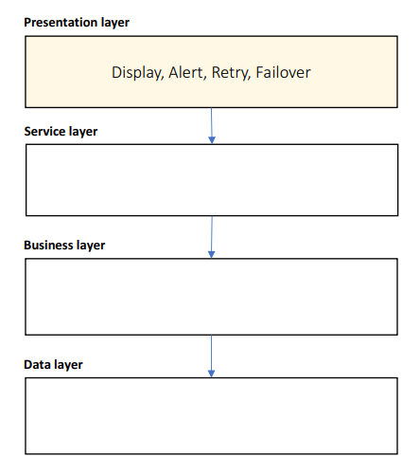
Exceptions – Presentation Layer
Catch, display, and discard
Other layers should never discard exceptions
Attempt to retry
Automatic 3 retries or manual
Switch to secondary system
Alert by Email, SMS, Slack…
Use meaningful messages
Business explanation
Technical information
Steps to resolve

Slide 61
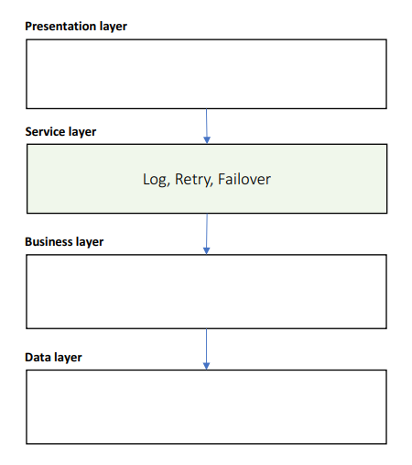
Exceptions – Service Layer
Catch and Re-throw
Attempt to retry
Switch to secondary system
Log exception and input message

Slide 62
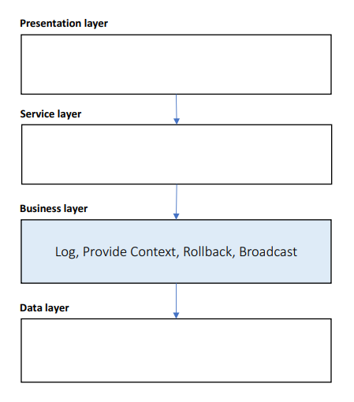
Exceptions – Business Layer
Catch, Wrap, and Throw
Use custom exception types
Provide business context
Rollback transactions
Log exception and input arguments
Broadcast to subscribers

Slide 63
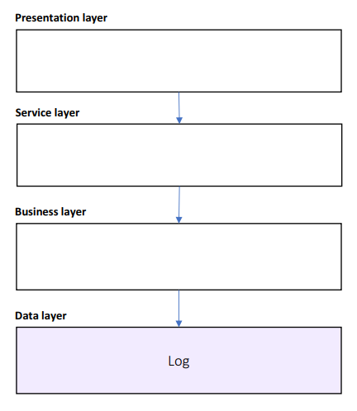
Exceptions – Data Layer
Catch and Re-throw
Log exception and input query

Slide 64
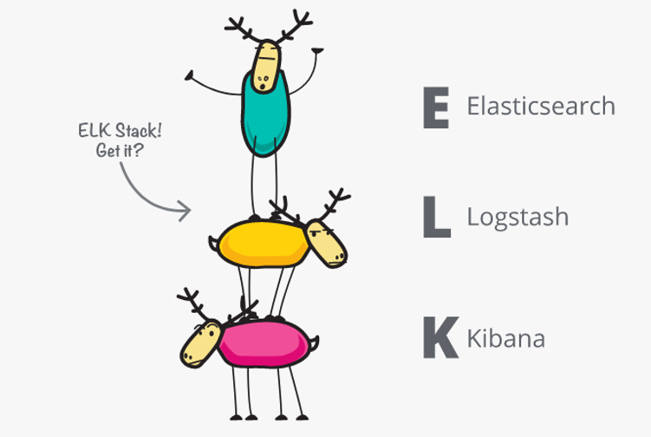
Logging - definition
Logging has two purposes:
Track errors
Gather data
Which module is most visited
Performance scenarios
User's flow
Log storage doesn't really matter
As long it is useful
Files
Database
Event log
Good architectures always includes logging and monitoring!

Slide 65
Logging – best practices
Use a central logging service
Same log format
Same log data
Same log location
Implementation:
Expose an API
Watch specific folders for log files and collect them
Tools like Logstash are perfect for that
Use Correlation ID
If you have multiple services in a flow
Make sure you can link different log entries
You can easily track a complete flow

Slide 66
System-wide attributes
The concepts we covered in this section are super important
They should be part of every single system out there
They allow you to have a fast, secure, reliable, and maintainable solution
Make all choices as informative and early as possible
Many concepts are difficult to replace once made
Changing a REST API with a message queue is not an easy and cheap task
These concepts are not exclusive
Although they are the most important ones
A lot of research should be done for every single system
No tool is a golden hammer

Slide 67
Deployment considerations

Slide 68
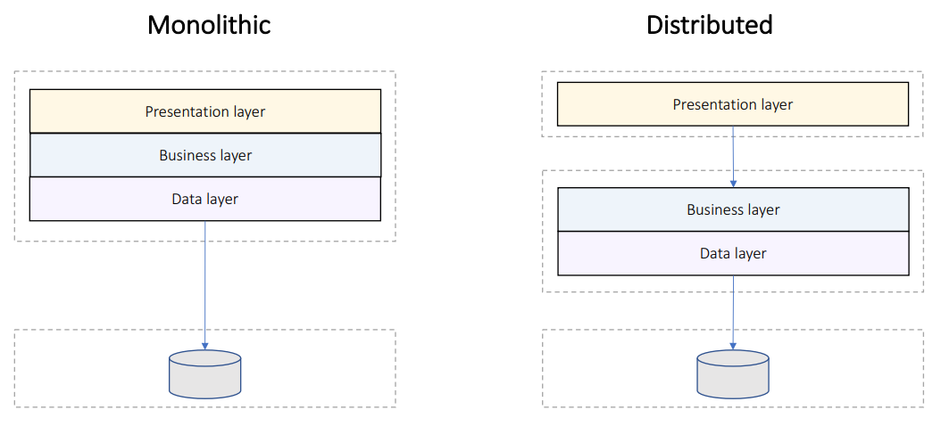
Deployment Models

Slide 69
Distributed Deployment Guidelines
Minimize blocking calls:
Async calls
One-way calls
Buffering
Use distributed transactions
Use coarse-grained interfaces
Manage state:
Stateless design – highly scalable
Stateful design – supports workflows but doesn’t scale
Shared state server

Slide 70
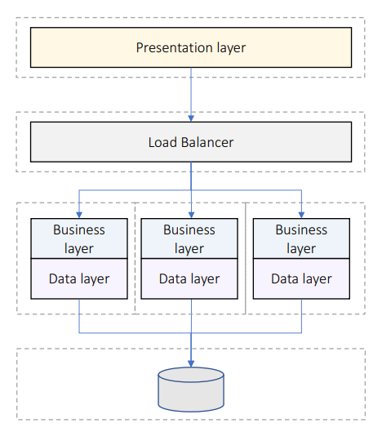
Deploy For Performance
Business/data layers scale out
Can detect failed tiers
Stateless design preferred
Stateful design requirements:
Shared state server
Session affinity

Slide 71
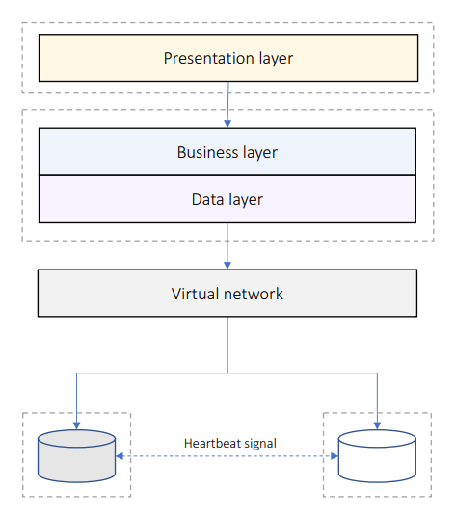
Deploy For Reliability
Secondary tier takes over when primary tier fails
Requires way more hardware
Synchronization considerations:
Sync when secondary tier activates
Or allow stale data

Slide 72
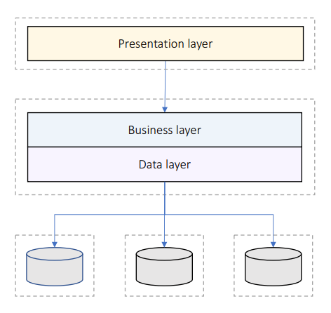
Deploy For Scalability
Data replicated on multiple tiers
Replication breaks consistency and atomicity
Consistency considerations:
Delayed sync in background
Or allow stale data
Or partition data

Slide 73
Modern Deployment Solutions
Application deployment
VM or Containers
Infrastructure deployment
Cloud or data centers
Operations
Kubernetes
Automation
DevOps Tools

Slide 74
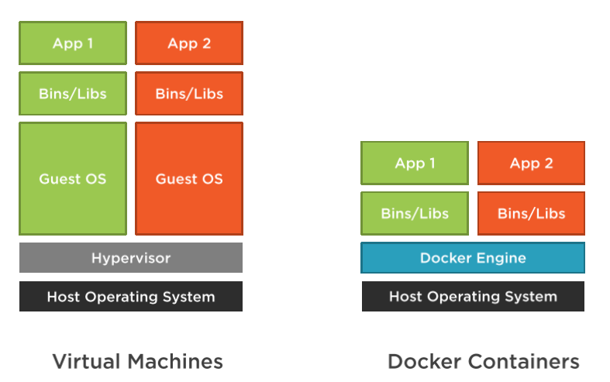
Docker VS Virtual Machines

Slide 75
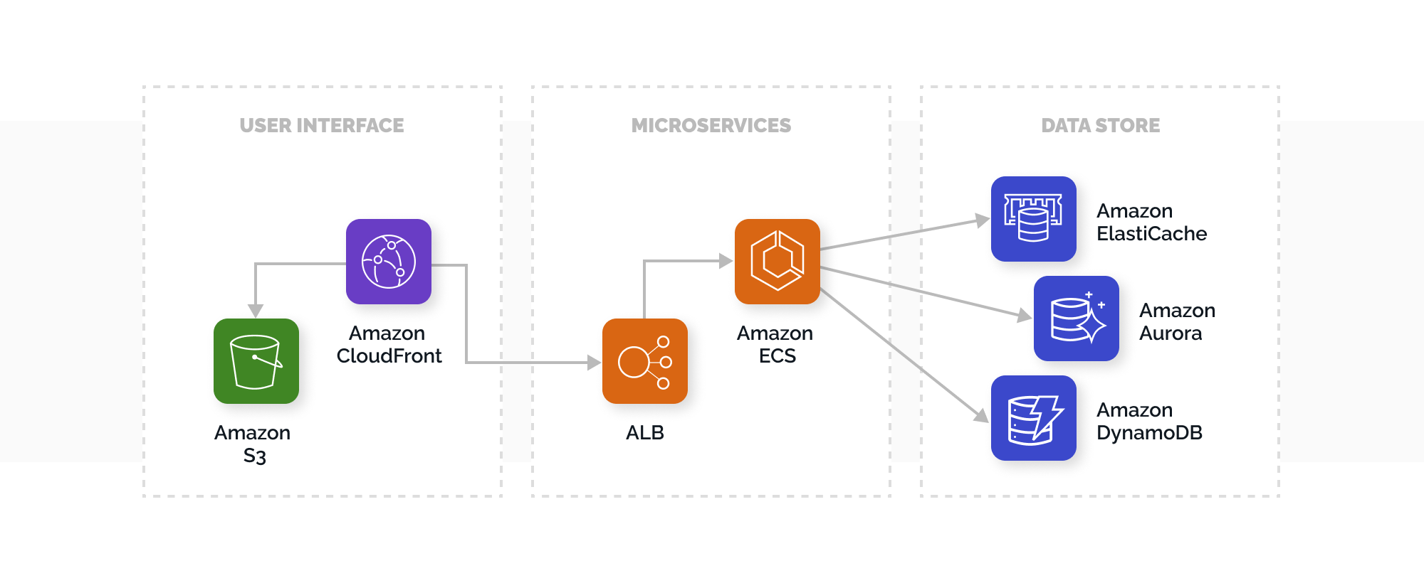
Cloud Infrastructure

Slide 76
Kubernetes Big picture
Kubernetes is an orchestrator for our application
But what does orchestration mean?
Imagine a football team
Each player has its own strengths and role
The coach is responsible for managing the team
They should have a good formation, based on the coach’s decisions
He also watches them and makes sure everyone sticks to the plan
He also may replace injured players when the situation demands it
The environment is constantly changing, and the coach reacts to it

Slide 77
Kubernetes Big picture
Kubernetes and microservices are the same
Our components are orchestrated like a team
But how to do it?
We have an application
We package it in a container
We pass the container to the cluster
We send instructions for our application
And boom – our code is up and running!
We get automatic:
Service discovery, load balancing
Rollouts and rollbacks
Resource requirements and monitoring

Slide 78
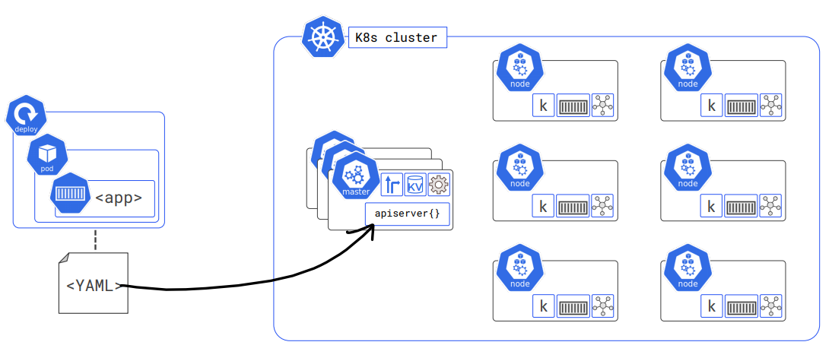
Kubernetes Big picture

Slide 79
Deployment strategies
Rolling updates
Old version and new version work simultaneously
New version replaced the old one slowly
Canary deployment
New update is exposed only to a small fraction of requests
Once confident, we update the whole system
Recreate deployment
Old and new versions cannot run at the same time
Data migrations requires a downtime
Blue Green deployment
The entire environment is switched to a new one
Quick rollback is available but costs extra hardware

Slide 80
Questions for the learning system
We still haven't thought about performance, availability, and scalability
1a. What is our tiering strategy? Scaling up or scaling out?
1b. What is our redundancy and failover strategy?
1c. Write down a load test and validate the scalability? What can we do to improve it?
2a. Is our business layer stateless? What is our state management policy?
2b. Think about all the data in our system. Where can we introduce caching?
2c. Where are we going to store the cache? How are we going to warm it up?
2d. Think about the exception policy for each layer. Consider a third-party logging tool?
3. Do you think you can easily debug problems in your solution? If no, redesign it.
4. Where are we going to deploy the system? Process? CI/CD?

Slide 81
FINAL WORDS before Q & A

Slide 82
Summary
Architecture Quality Attributes
Scalability & Reliability
System-Wide Considerations
Deployment Considerations
Don't Forget The Optional But Practical Guide-Book
3 Real-World Scenarios
70+ Pages
Free Updates
Get It From The Event's Page or write to wewritesoftware@gmail.com
https://www.eventbrite.com/e/software-architecture-quality-attributes- code-it-up-online-vol-12-registration-256029329617

Slide 83
In the next part
Domain-Driven Design
Bounded Contexts
Clean Architecture
Register here:
https://www.eventbrite.com/e/software-architecture-monolithic-approaches- code-it-up-online-vol-13-registration-257838059577
Don't Forget The Optional But Practical Guide-Book
3 Real-World Scenarios
70+ Pages
Free Updates
Get It From The Event's Page or write to wewritesoftware@gmail.com
https://www.eventbrite.com/e/software-architecture-quality-attributes- code-it-up-online-vol-12-registration-256029329617

Slide 84
Other Goodies
You can check the Code It Up blog and subscribe:
https://codeitup.today
You can watch some of the free videos:
https://www.youtube.com/CodeItUpwithIvo
Clean code & The art of testing
Docker, CI/CD, Redis, Elasticsearch
And many more…
The source code in all free lessons is available on Patreon:
https://www.patreon.com/ivaylokenov
Unrelated to the IT sector but check out my art T-Shirts:
https://way-ve.com/
Use CODE10 during checkout for 10% discount

Slide 85
Past Code It Up Events
You can get the recordings of the past C# events from the event page:
C# Async-Await In Detail
The C# ORM Battle
Docker – From ABC To XYZ
Identity Server Demystified
Eventual Consistency Done Right
Let's Get Functional With C#
C# API Scenarios – REST, GraphQL & gRPC
Past workshops are also available:
C# Multithreading
Domain-Driven Design With ASP.NET Core
Kubernetes For Web Developers
If interested, you can write to wewritesoftware@gmail.com

Slide 86
ANY QUESTIONS?
You can support me and my projects:
Via PayPal: http://paypal.me/ivaylokenov
Via Revolut: @ivaylokenov
On Patreon: https://www.patreon.com/ivaylokenov
On Open Collective: https://opencollective.com/mytestedaspnet
Via Buy Me A Coffee: http://buymeacoff.ee/ivaylokenov
Crypto: http://bit.ly/ik-sponsors
Never expected, always appreciated!
Make sure you check my sponsors!
INDEAVR - https://indeavr.com
SmartIT - https://smartit.bg

Slide 87
Thank You!
Resources: https://github.com/ivaylokenov/Software-Architecture-Series

