Slide 1


Software Architecture Part 7
Code It Up Online Vol. 15

Slide 2
For LIVE questions
Check The Link In The Description
Resources https://github.com/ivaylokenov/Software-Architecture-Series

Slide 3
Live stream troubleshooting
Sometimes issues happen during a live stream…
And sometimes disasters happen, this is how memes are born…
If my Internet goes down and the stream stops:
Wait for 5 minutes, I have another one on a different network
If YouTube is showing “stream ended”:
I will post a new link in the comments section below this video
If something else happens unexpectedly:
Well, I will add a solution to this slide during my next event… ☹
If a major showstopper is happening – no electricity, for example
I will create a new event and we will schedule a new live stream…
In any case – write to wewritesoftware@gmail.com

Slide 4
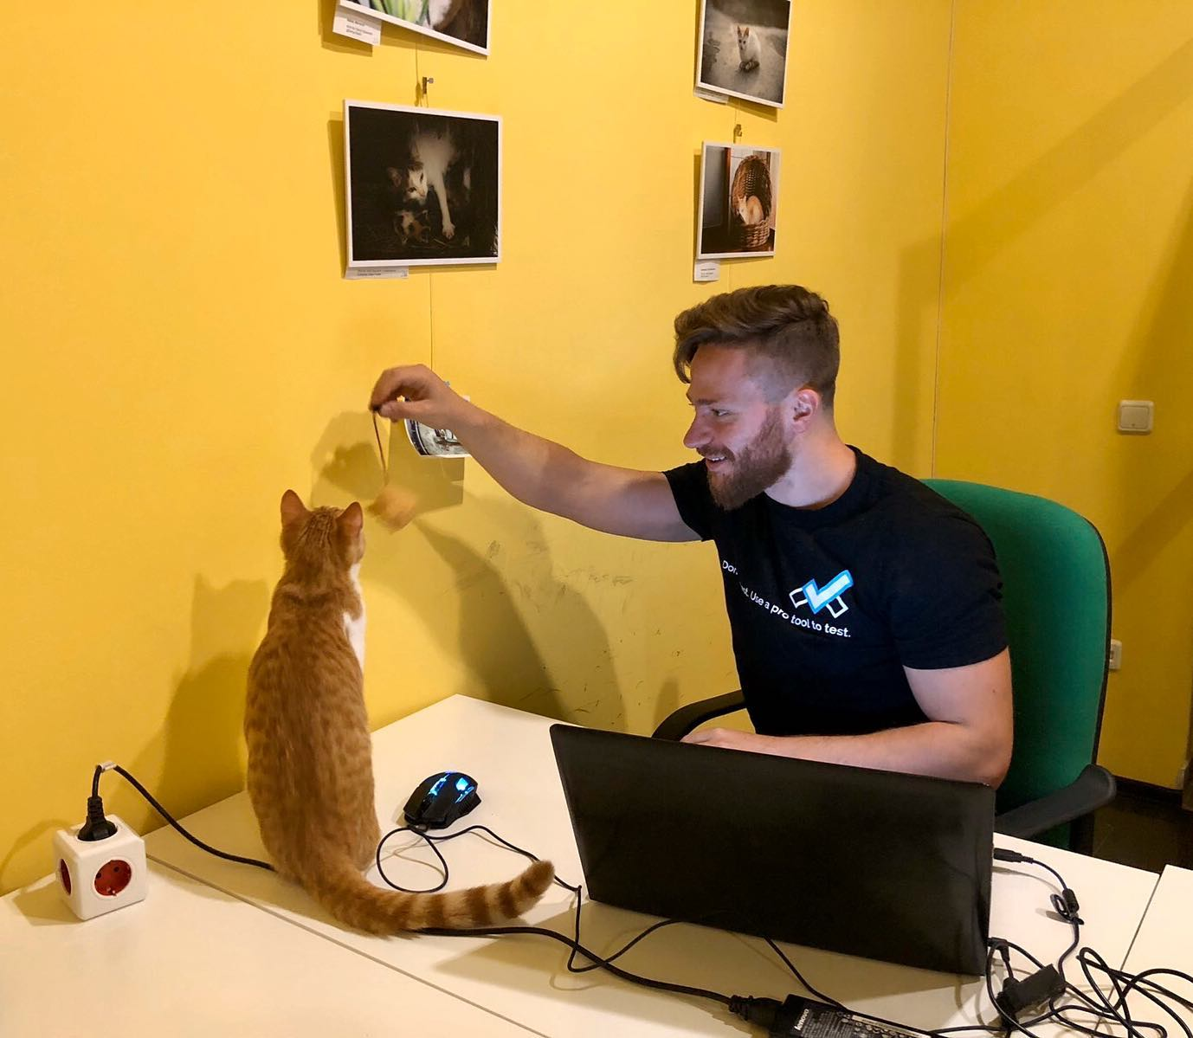
The Presenter
Ivaylo Kenov – Quality Code Advocate
Various job titles at the same time:
Organizer & Speaker @ Code It Up
CTO @ SoftUni
Full Stack Technical Trainer @ Everywhere
Code General @ https://docs.mytestedasp.net/
Meme Copy Machine @ Daily Programming Fun
{Insert Job Title Here}
Contacts
https://github.com/ivaylokenov
https://facebook.com/ivaylo.kenov
https://linkedin.com/in/kenov
https://www.instagram.com/ivaylokenov/
YouTube & Blog
https://www.youtube.com/c/CodeItUpWithIvo
https://codeitup.today/

Slide 5
Sponsors
This lecture is free thanks to our sponsors
Which will interrupt the lecture here and there
Because it takes quite a lot of personal time to prepare the materials
You will help the initiative a lot if you visit their web sites
And consider their propositions to you
I personally select various premium jobs to present them during the talk
These are the current ones:
INDEAVR - https://indeavr.com
Americaneagle.com - https://www.americaneagle.com
SmartIT - https://smartit.bg

Slide 6
ABOUT CODE IT UP

Slide 7
Code it up
The Code It Up initiative:
Aims to provide detailed knowledge on advanced software development topics
Aimed at people with at least 1 year of programming experience (mostly C#)
Sort of acquired by SoftUni last year
Code It Up Online
Free live-streamed online events (2+ hours long)
Led by me – mainly .NET, architecture, and infrastructure
We have 6 more lectures before the initiative ends
Code It Up Workshop
Paid events containing theory & practical exercises for the attendees
No more paid lecture planned for now

Slide 8
Thankful if you share a story
You can be extremely helpful to the initiative
Just share a story on Facebook or Instagram during the lecture
Make sure you tag me so that I can reshare your post - @ivaylokenov
Bonus – add the #codeitup hashtag
Thank you! You rock!

Slide 9
ABOUT The Series Of Events

Slide 10
About This SERIES Of Code It Up Events
Theoretical lectures on software architectures
Widely-used design patterns and concepts in production
Depending on your level, you may be familiar with some of the topics
A real-life project example
A practical guidebook for architecting various solutions
3 real-life projects on more than 70 pages
Legacy systems, vast data load, lots of concurrent users, working with critical data, and more
Please report to wewritesoftware@gmail.com, if you find any “bugs” in the book!
And I have a lot more to add in the future!
You receive free updates of the book!
MOST IMPORTANTLY – HUGE THANK YOU! <3

Slide 11
The Content Of The Series – A Free Course
Why Software Architecture
What Is Software Architecture?
Unified Modeling Language
Designing Solution Architectures
Common Technology Stacks
Architecture Design Patterns
Choosing The Right Patterns
Architecture Quality Attributes
System-Wide Considerations
Deployment Considerations
Monolithic Architecture
Domain-Driven Design
Microservices
Event Sourcing
The Architecture Document
The Architect And The Team
What Makes A Great Architect
Designing A Real-Life Solution

Slide 12
in The previous parts
Designing Solution Architectures
Common Technology Stacks
Architecture Design Patterns
Quality Attributes & Considerations
Low-Level Architecture & Microservices
It is not required to watch the parts in order
But it is strongly advised!
Get the previous recordings from here:
https://www.eventbrite.com/o/code-it-up-29733808833

Slide 13
in this part
Advanced Architecture Patterns
Popular Antipatterns
The Architect Role
Soft Skills Required For A Technical Career
Don't Forget The Optional But Practical Guide-Book
3 Real-World Scenarios
70+ Pages
Free Updates
Get It From The Event's Page or write to wewritesoftware@gmail.com
https://www.eventbrite.com/e/software-architecture-the-architect-the-team- code-it-up-online-vol-15-registration-265180962397

Slide 14
About this topic
HUGE DISCLAIMER! THIS TOPIC IS LIKE THE LITTLE PRINCE BOOK!
There are a lot of things to know about software architectures
You may or may not recognize some of the patterns
And we most probably will not mention all of them
If you are a beginner, just try to absorb what you can
The technology world is moving very fast
Some of the examples shown here may be considered anti-patterns in the future
But the overall concept and process stays the same
As all my other topics – this one is super intense too!
Even though the lectures will be a bit shorter
So, give yourself time and if you get the book – finish it!
And don’t worry! The knowledge provided here will save you weeks of reading!

Slide 15
INDEAVR – The EVENT’s DIAMOND SPONSOR
They provide technology services focused on the Digital, Data, Cloud and Advanced Software Engineering expertise.
They are always in search for creative and passionate people with the combination of a sharp strategic mind, emotional maturity, entrepreneurial instincts, and the ability to deliver results.
https://www.indeavr.com/en/technology/application-services
https://www.indeavr.com/en/careers

Slide 16
Data management Patterns

Slide 17
Data management patterns
Cache-Aside
CQRS
Event Sourcing
Index Table
Materialized View
Sharding
Static Content Hosting
Valet Key

Slide 18
Event Sourcing
Traditional CRUD:
Update directly on the data store – limited scalability
With many concurrent users – lots of conflicts
There is no history
Event Sourcing:
Data is stored as a sequence of immutable events
Reading is done with materialized views
Full data history at any point of time
Multithreaded scenarios should be handled in the application state
Suitable with CQRS

Slide 19
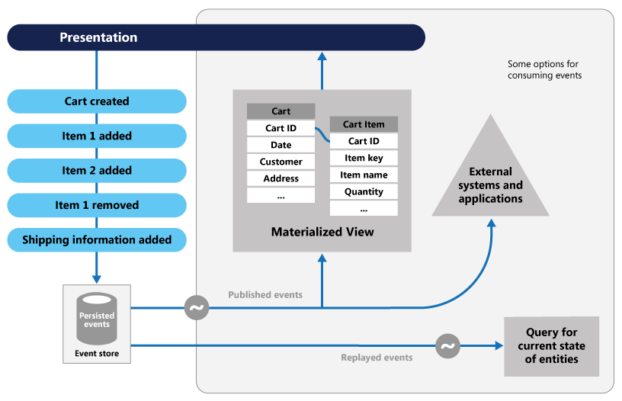
Event Sourcing

Slide 20
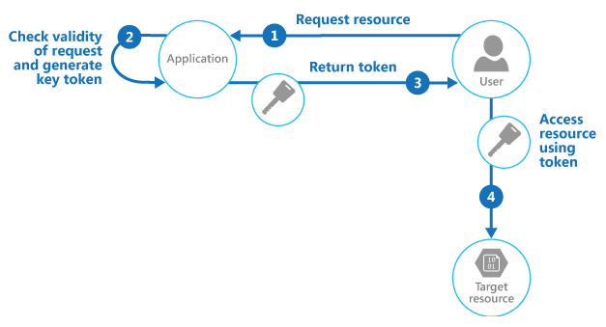
Valet Key
When dealing with files or data streams
The application no longer manages the resource
Only provides a time-limited access to specific resources via a token

Slide 21
Implementation Patterns

Slide 22
Implementation patterns
Ambassador
Anti-Corruption Layer
Backends for Frontends
External Configuration Store
Gateway Aggregation, Offloading, Routing
Leader Election
Pipes and Filters
Sidecar
Strangler Fig

Slide 23
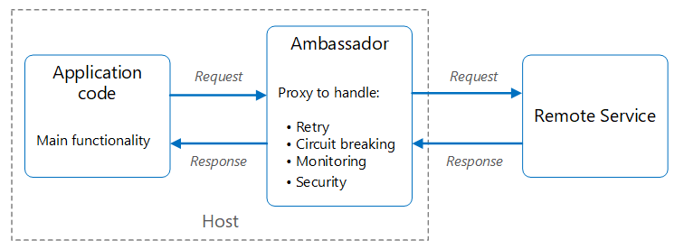
Ambassador
Helper service to send network requests
May help with legacy or difficult to modify applications
Useful for offloading common client connectivity tasks
Monitoring, logging, routing, security, resiliency, etc.

Slide 24
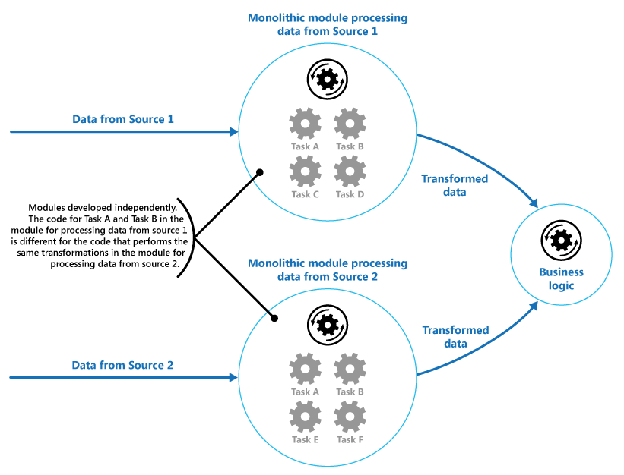
Pipes and filters
Decomposing monolithic tasks to granular services

Slide 25
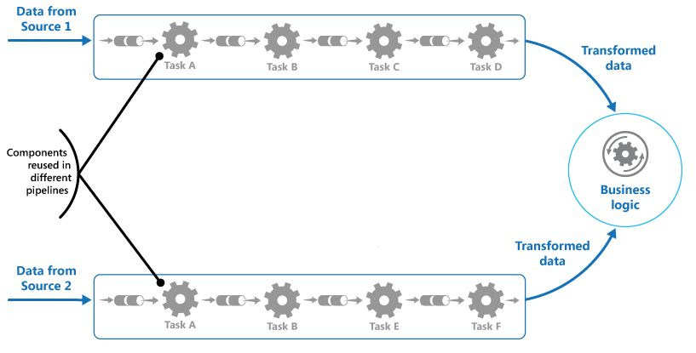
Pipes and filters

Slide 26
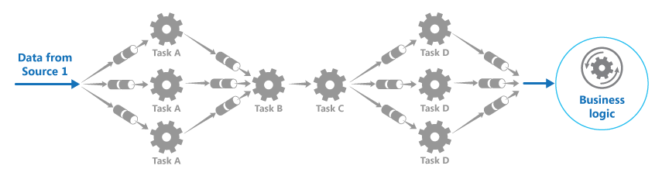
Pipes and filters
Pipes and filters trade flexibility for complexity
It is important to calculate how much granularity to introduce

Slide 27
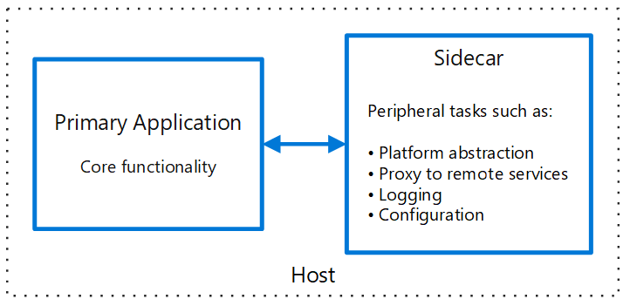
Sidecar

Slide 28
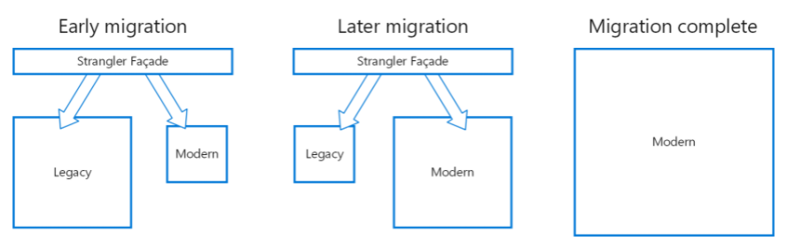
Strangler fig

Slide 29
Messaging Patterns

Slide 30
Messaging Patterns
Asynchronous Request-Reply
Claim Check
Choreography & Orchestration
Competing Consumers
Priority Queue
Publisher-Subscriber
Queue-Based Load Leveling
Sequential Convoy

Slide 31
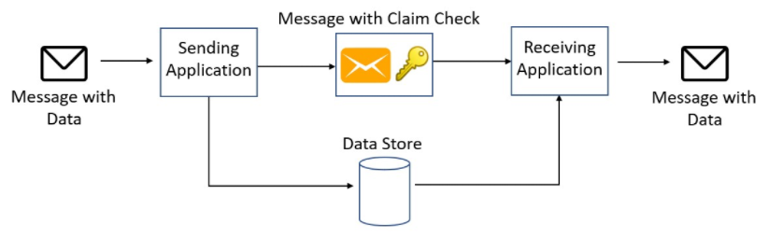
Claim Check
Large messages will reduce a message bus's capacity
Using an external data store and a claim can solve the issue

Slide 32
Popular Antipatterns

Slide 33
Popular Antipatterns
Busy Database
Offloading too much processing to a data store
Busy Front End
Moving resource-intensive tasks onto background threads
Chatty I/O
Continually sending many small network requests
Extraneous Fetching
Retrieving more data than is needed, resulting in unnecessary I/O
Improper Instantiation
Repeatedly creating and destroying objects that are designed to be shared and reused

Slide 34
Popular Antipatterns
Monolithic Persistence
Using the same data store for data with very different usage patterns
No Caching
Failing to cache data
Noisy Neighbor
A single tenant uses a disproportionate amount of the resources
Retry Storm
Retrying failed requests to a server too often
Synchronous I/O
Blocking the calling thread while I/O completes

Slide 35
BEFORE WE CONTINUE…

Slide 36
Huge THANKS for your support & TRUST!
Everyone who got a paid ticket – 42 people in total! Thank you!
Top supporter – Borislav Yordanov– 75 BGN! Thank you, you rock! <3
Thanks to – Nikolay, Veselin, Mariyana, Pavel, Борислав, Georgi , Diana, Emiliyan, Borislav, nikolay, Владимир , Teodor, Radoslav, Miroslava, Daniel, Hristo, Aneliya, Калин, Mira, Veselin, Stoil, Petar, Raya, Svetoslav, Teodor, Elitsa, Zlatko, Lyuboslav, Hristina, Albena, Krasimir, Aleksandar, Goce, Veronika, Vladimir, Borislav, Antoniy, Nikolay, Plamen, Virginia, Anna, Simeon
And everyone who supported the initiative during the years!

Slide 37
These events are not Exactly free
I prefer to call them “Pay what you want”
Depending on how much you value the provided knowledge
It takes me a considerable amount of free time to prepare these lectures
And I want them to be perfect and complete!
I put my soul in them!
For this reason, I will be extremely thankful, if you decide to support me and my projects!
It is never expected, but always appreciated!
The easiest way is via
PayPal: http://paypal.me/ivaylokenov
Revolut: @ivaylokenov

Slide 38
The architect and the team

Slide 39
Principles Of Software Development
The development process is different in each company
But there is always a need to:
Understand business problem
Document non-technical business solution
Convert solution to technical architecture
Convert architecture to code
Manage developers
Test code
Deploy code
Of course, in some companies these responsibilities are mixed

Slide 40
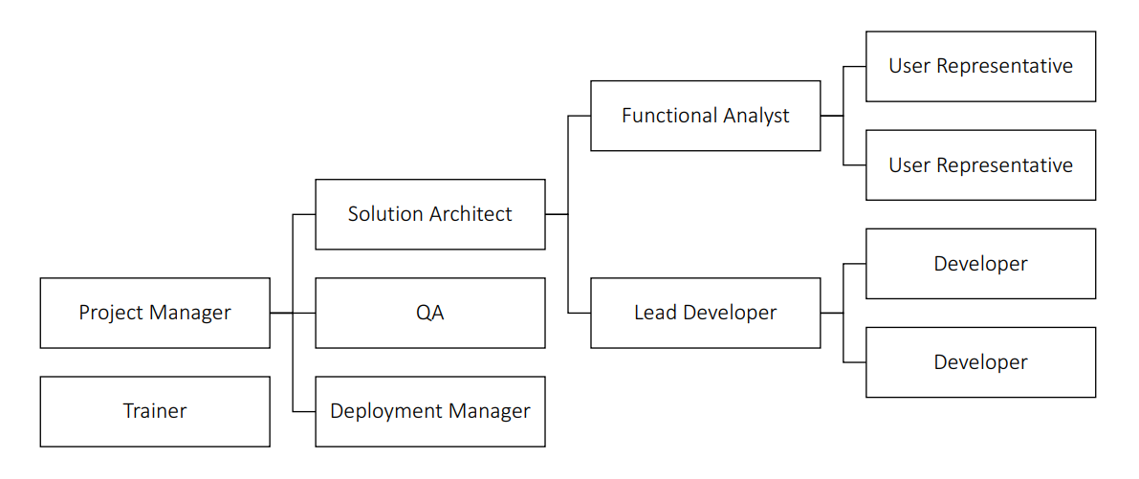
main Roles In Software Development

Slide 41
Required skills by everybody in the team
Understanding the Business
The more business understanding you have, the more useful you will be
Cross-Domain Understanding
You know bits of the other roles in the team as well
Multiple Perspectives
You need to see the problem from everyone's point of view
People Skills
Just to make sure communication goes smoothly
Lifelong Learning
IT is moving super fast; you need to stay relevant

Slide 42
Responsibilities Of The Functional Analyst
A product/project owner
Responsible for functionality
Captures, consolidates, and communicates information
Constantly asks questions:
What do you mean?
How does this fit in with…?
Etc.
Identifies and resolves conflicts
Produces requirements specification

Slide 43
Skills Of The Functional Analyst
Precise communicators
Great attention to detail
Adept at dealing with differing opinions and conflicts
Know when detail is necessary and when not
Great relationship skills
Very good listener
Can create clear and precise documents
Skilled in using Office tools

Slide 44
If you want to be Functional Analyst
Pros:
Key role
Lots of interactions
Cons:
Must work with bad user representatives
Can expect conflict
Will receive blame if functionality is missing

Slide 45
Responsibilities Of The Lead Developer
Leads and mentors developers
Assigns tasks to developers
Based on their skill level
Details and partitions work
Ensures that all developers are successful
It is not always an official role
Usually, it is the person who helps everyone else

Slide 46
Skills Of The Lead Developer
Awesome programming skills
Willing to mentor and be value-driven
Grows out of the Developer role
Requires great relationship with Architect
Wide knowledge of libraries/tools/techniques
Adept at creating technical specifications
Adept at build & configuration management
Adept at debugging, post-mortem log inspection, etc.
Can create own tools if needed

Slide 47
If you want to be Lead Developer
Pros:
Lead-in to a Solution Architect
Involves coding (optional, not necessary, but suggested)
Can pick & choose cool tasks
Cons:
Can get squeezed between the Solution Architect and the Developers
Lifelong learning required
Turns into a Developer if the Project Management is weak
Loses motivation
Team might be too small
Vulnerable to offshoring

Slide 48
Responsibilities Of The Solution Architect
Massive responsibility
Functional understanding, technical knowledge and leadership skills
Responsible for the technology stack
Converts functional requirements to a technical architecture
Carefully balances patterns/requirements/elegance/concepts
Researches key technologies
Has deep understanding of design and architectural patterns
Motivates and guides development team
Ensures that the Lead Developer is successful

Slide 49
Skills Of The Solution Architect
Grows out of Lead Developer role
Requires great relationship with Lead Developer
Always maintains helicopter view
It is not bad to help with code, but there is another role for that
Deep understanding of design patterns
Fluent in UML or other design tools
Experience with tools & code generators

Slide 50
If you want to be Solution Architect
Pros:
High value position
Great salary
Visible role
Lots of interactions
Safe from outsourcing
Cons:
Difficult to stay up to date
Difficult to get right
Can receive bad requirements
First in line to receive blame

Slide 51
Types of architects in the IT world
Infrastructure Architects
Design the infrastructure
Servers, VMs, network, storage, etc.
Familiar with requirements
Promoted from Infrastructure Expert
Solution/Software/System Architect
Responsible for the architecture of the software
Enterprise Architect
Works with top level management - CEO, CIO
Streamlines the IT to support the business
No development-oriented tasks
Promoted from Senior Solution Architect / Project Manager

Slide 52
Ideal world vs real-life
We've looked at software development team roles in an ideal world
Real-life is not exactly like that
Missing roles
Individuals with conflicting roles
Disempowered roles
Other inconsistencies
The organization itself might lack the understanding of how developer teams are supposed to function

Slide 53
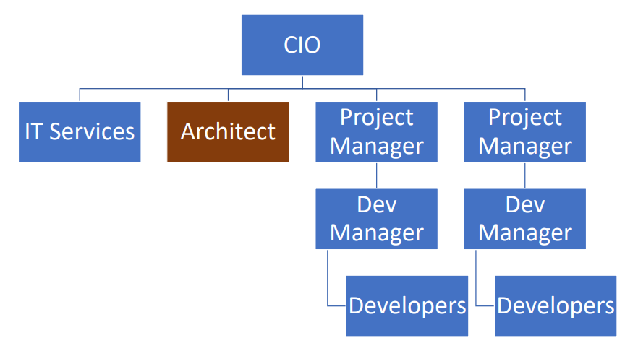
Organizational chart example 1

Slide 54
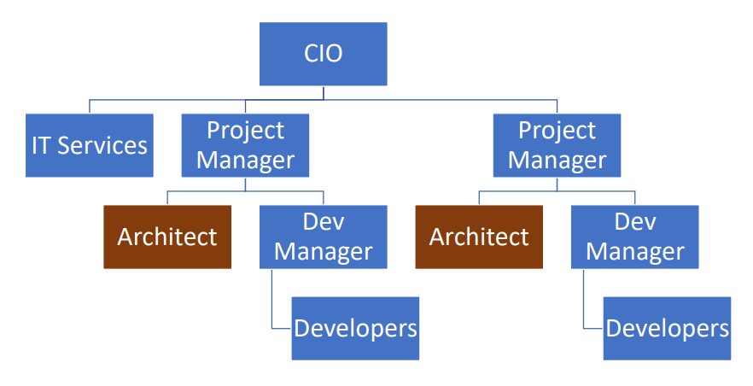
Organizational chart example 2

Slide 55
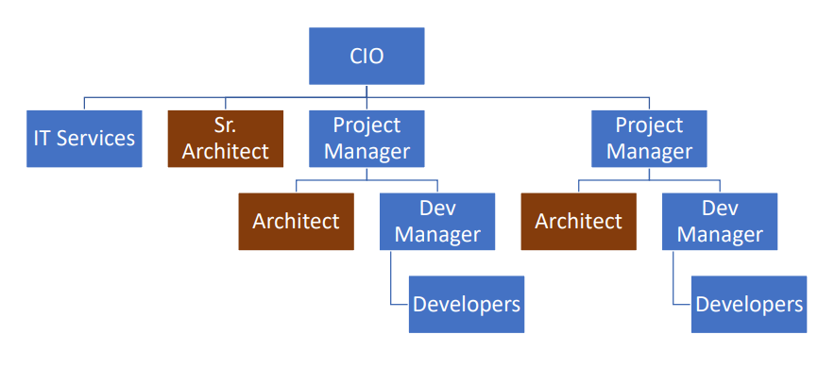
Organizational chart example 3

Slide 56
The typical ways to become architect
From Senior Developer
Usually in small companies
From Team Leader / Lead Developer
Very common path
Usually, the choice is between an Architect and a Project Manager
From Development Manager after being Team Leader
Usually in bigger companies with bigger structures

Slide 57
If you get the role
If you get a more advanced role and the organization is dysfunctional
Do not go into firefighting mode!
Resist the temptation to fix what is not working optimally
You will be swamped with work and you will never have time to fix the process
Allow the old structure to burn into the ground!
And create something better!

Slide 58
Assess youR team
Think about your current team!
Are there individuals embodying more than one role at the same time?
Are these roles compatible, or is there a conflict of interest?
Is the organization knowledgeable about each role?
Is everybody aware of the importance of QA, and the need for frequent user testing?
There is nothing to be worried about though!
My team is not perfect too!
Just try to always improve the process!

Slide 59
My Team assessment
Throughout the years I was in various situations
Without any management (be my own "everything")
In a team without technical leadership
In a team with bad technical leadership
In a team with mixed roles
In a team with being every single role
In my current team, we are almost perfect
Started from having no development management
We build it to the perfect diagram without a functional analyst
I helped a lot of people grow and convinced the CEO we need to hire leaders
And I am quite happy with our accomplishment ☺

Slide 60
What makes a great architect?

Slide 61
Example Job descriptions
"Make intuitive high-level decisions."
"You will see the big picture and create architectural approaches for software design and implementation to guide the development team."
"Strong technical background and excellent IT skills."
"Experienced in designing…"
"Unified vision for software characteristics and functions."
"Provide a framework for the development of a software or system that will result in high quality IT solutions."

Slide 62
Example Real-world responsibilities
Collaborate with team to draft functional and non-functional requirements (mixed)
Use tools and methodologies to create representations for functions and UIs (architect)
Develop high-level product specifications (architect)
Define all aspects of development (lead)
Communicate all concepts and guidelines to development team (lead)
Oversee progress of development team (mixed)
Provide technical guidance and coaching to developers and engineers (lead)
Ensure software meets all requirements (mixed)
Approve final product before launch (mixed)

Slide 63
Example Requirements
Proven experience as software architect
Experience in software development and coding
Excellent knowledge of software and application design and architecture
Excellent knowledge of UML and other modeling methods
Familiarity with UI/UX design
Understanding of software quality assurance principles
A technical mindset with great attention to detail
High quality organizational and leadership skills
Outstanding communication and presentation abilities
MSc/MA in computer science, engineering or relevant field

Slide 64
Responsibilities of a great architect
There are four main groups of responsibilities
Insight
You need to understand the software development and the business domain
Leadership
You need to be able to mentor others and advance their skills
Vision
You need to understand the business and its direction
Communication
You need to be able to express yourself and defend your decisions

Slide 65
Insight
Abstract Complexity
A great architect abstracts the complexity of a system into a manageable model.
The model describes the essence of a system by exposing important details and significant constraints.
Divide a system into subsystems.
Understand Trade-offs
People want cheap, fast, quality products. You need to compromise efferently.
A great architect makes critical decisions in terms of implementation, operations, and maintenance. These decisions must be backed up by an understanding and evaluation of alternative options.
These decisions result in tradeoffs that must be well documented and understood by others.

Slide 66
Leadership
Maintain Control
Often the system starts to deviate from the initial design.
A great architect maintains control over the architecture lifecycle by continuously monitoring that the implementation adheres to the chosen architecture.
Communication with the lead developer is required.
Stay On Course
A great architect needs to be flexible and modify the architecture if challenges occur.
Not always the initial design with be technically possible.
A great architect stays on course in line with the long-term vision. When confronted with scope creep, the architect must know when to say no to some requests in order to say yes to others.

Slide 67
Communication
Explain The Benefits
A great architect works closely with executives to explain the benefits and justify the investment in the chosen software architecture.
He or she must deliver results that have an impact on the business development.
Scale better, attract more customers, sell more products, etc.
Inspire Stakeholders
A great architect inspires, mentors, and educates the team about the solution architecture.
Everyone should think that the project is awesome and cool.
All stakeholders must be able to understand, evaluate, and reason about the software architecture.

Slide 68
Vision
Focus On The Big Picture
A great architect has a holistic view and always sees the big picture to understand how the software system works.
Top level view for at least 6 months or a year ahead is required.
Act As Change Agent
Because of mixed responsibilities. Educate the company. Talk with people.
A great architect acts as an agent of change in organizations were process maturity is not sufficient for creating and maintaining the architecture.

Slide 69
Personality traits to cultivate
Steadfast
The only thing constant in Software Development is change itself. A great architect must be patient and resilient to adapt to the way stakeholders operate.
Budgets get cut. Requirements change. Technologies are deprecated. Systems go offline.
Trustworthy
A great architect conveys a sense of credibility and trust and must be perceived as successful.
An architect can attain such status by prior successful experience, formal training in the field, and by his or her ability to deliver successful and relevant results.
To grow into a trustworthy position, make sure your previous work is absolutely brilliant.
If this is your first architect job – just deliver your first versions as perfect as possible.

Slide 70
Personality traits to cultivate
Persuasive
A great architect is a skilled and diplomatic negotiator. Principled negotiation is the tactic of choice for an architect to seek cooperation with the project stakeholders.
An architect will be expected to deliver better, faster, and cheaper, but must negotiate to decide which two out of three aspects will be considered first and under what conditions.
Confident
You own this technology. If you choose a solution, be proud of it, and defend it.
You can't show your inability to deliver, even if you are insecure about it.
In a leadership position, attitude is everything. A great architect believes in his or her ability to perform.
An architect must have a passion for success.

Slide 71
Common pitfall for new architects
Most of the time, problems occur of not using "power" correctly
There are three types of power:
Implicit Power
The power which goes with your job.
You are the CEO – if you say something, people will do it, because you are in charge.
Granted Power
Everybody approaches you as the leader even though you are not formally one.
You grew as a lead naturally. The team granted you the power to be their superior.
Personal Power
The ability to absorb "punches" and recover.
Stand back to your feet after a disaster.
Every problem creates a power imbalance

Slide 72
Common pitfall for new architects
Every problem creates a power imbalance
Here are the most common issues:
The Lead Developer loses trust
Functional requirements are invalid
The planning is too optimistic
The architect role holds no power

Slide 73
The lead developer loses trust
The Solution Architect is being robbed of his implicit power
He or she wants his/her design
The Lead Developer is being robbed of his granted power
He or she wants to change the design but does not have the power
Developers are also affected by this problem
Endless discussions and implementation starts to deviate from architecture
The Solution Architect's job is to make the Lead Developer succeed!
Empower your Lead Developer
Always present a united front
Be open to feedback
Change architecture if needed

Slide 74
Functional Requirements Are Invalid
It is very difficult to realize this problem
A symptom is usually an unmotivated functional analyst
But the Solution Architect will be the one who is responsible
Executives do not understand the difference between functionality and technology
The analyst is being robbed from his personal power
He is doing a bad job, realizes it, but passes it to the Solution Architect anyway
There might be a conflict between the User Representatives and the Functional Analyst
Solution:
Find the reason – why the Functional Analyst is not doing his job correctly?
Try to restore the personal power of the Functional Analyst
Escalate up if needed – talk to the CTO or CEO

Slide 75
The Planning Is Too Optimistic
The Project Manager is responsible for this problem
And is usually unaware of it
The QA is being robbed of his personal power
"We are in a hurry, no time for testing!"
The Lead Developer is being robbed of his personal power
"There is no time for mentoring, training and reviews, just keep pushing code!"
Solution:
Bring the Project Manager in on the dev team
Find the reason! Optimistic PM? Naïve Lead Developer? Slow Developers?
Coach Lead Developer, Restructure Developers, Readjust schedule, Alter planning

Slide 76
The Architect Role Holds No Power
The Project Manager and Functional Analyst see the Software Architect as a producer of documentation
The Software Architect is being robbed of implicit power
No communication and no leadership
The organization does not understand what an architect should do
The project will most probably fail
"We are in a hurry, no time for testing!"
Solution:
Educate the C-section, be a change-maker
Team up with Project Management, QA, Functional Analyst, and Lead Developer
Become the owner of the entire process
Leave if the organization is unwilling to change

Slide 77
Architects should understand the business
Every architect should understand the business very well
Weaknesses
Strengths
Competition
Growth strategy
Every architect should understand the system goals
Goals are not requirements
They are not "what the system should do"
Goals describe the effect on the organization
They are usually described by a client
Think about the big picture
Work for your client's clients

Slide 78
System goals examples
HR system
Organization – product-oriented company
Goal – streamline the recruitment process
Reporting & mapping criminal incidents system
Organization – large city
Goals
Improve police response time
Attract new residents
Mobile flash sales system
Organization – small startup
Goals
Generate quick revenue stream
Attract investors

Slide 79
Architects should watch their language
With Project Managers – they care about project success and budgets:
Avoid:
Use:
"This is the latest and greatest pattern, and we'll be the first to test it out! We can write a blog post about it!"
"This new technology can help us write the code twice as fast, so we can cut our schedule and budget accordingly!"

Slide 80
Architects should watch their language
With Lead Developer – they care about code and technology:
Use:
"Have you heard about the latest React version? We’re going to use it!"

Slide 81
Architects should watch their language
With CEO/CTO – they care about financial bottom line:
Avoid:
Use:
"Any technical buzzwords/mumbo-jumbo…"
"The architecture I've designed will ensure the continuity of the business, and will be able to cope with the high loads expected during Black Friday sales!"

Slide 82
Soft skill required
Listening
Sounds easy, but it is not. Consider the person you are talking to!
Never think you know all about technology! I learnt new tricks from this series too!
Assume you are not the smartest person in the room!
Collective wisdom is better than individual one!
Dealing with criticism
Your work is going to be criticized! You will be asked to explain the logic behind your decisions!
Don't attack back! It will put you in a bad position!
Consider the reasons:
Genuine questions – provide facts and logic. It is OK to say "Good question, let me think about it!"
Mocking you – think about the "why" here, but never get offended. It is not you, it's probably them!

Slide 83
Soft skill required
Be smart, not right!
For example – you are presenting your architecture in front of the CTO and senior experts
And somebody questions your design in a calm and professional manner:
"I believe the stateless pattern is useless here. It will hinder the performance!"
You know you are right, but do not attack back
Your goal is to get an approval of the architecture
So, don't do the thing to make you feel right. Don’t say:
"You are wrong. The system is under heavy load. The stateless pattern will help us with that!"
Instead, answer smartly to get everyone's approval:
"That's a great point. We actually had a lot of thinking about this specific issue, and we believe this is the better option. Let's have a further meeting to discuss it in more detail?"
This way you got more respect and avoided a long and boring technical argument (and most probably the meeting afterwards)

Slide 84
Soft skill required
Deal with organizational politics
We all want patterns and code, but you must cope with the politics
For example, the CTO of the project doesn't want to do microservices:
"It's new, untested, and immature pattern. It is too risky!"
No matter the case studies we provide him, he refuses to accept microservices
So instead of searching for technical solutions, try to understand the situation
It turns out the CTO is going to be replaced soon and he is just rejecting everything
So, a better approach is to prepare the future CTO and discuss the patterns with him
Being aware of organizational politics, but never be part of them!
It may give you short-term leverage, but in the long-term, it will hurt you badly!

Slide 85
Soft skill required
Public speaking
Architects have no formal authority
They do not take the final decision
Therefore, you can influence using speaking skills
You will be part of many meetings
You must be able to stand in front of an audience and present your solution
Here are the main concepts:
Define a clear goal
Know your audience
Be confident or pretend it
Don't read the content from slides
Maintain eye contact
Take a course on public speaking. It is very important skill!

Slide 86
Soft skill required
Constant learning
The development world changes in a blink of an eye
Always keep learning
A lot of frameworks get completely forgotten in months
Consider jQuery or Grunt
Some of you may have never used it!
Angular is also dying right now
There are better alternative – React, Vue, the new kid Svelte
You may not like that, but keep adapting
You do not have to know the tools in detail
That's the developer's job
You should know when and why to use a tool
Main source – blogs, books and webinars

Slide 87
Assess Yourself
Find your personality traits
There is a good test for that
16 Personalities - https://www.16personalities.com/
Great architect is that it requires somewhat incompatible personality traits
You need very strong intuition, insight, and vision
Introvert-Analytical personalities are quite strong in that area
But you're also going to need strong communication and leadership skills
This requires an Extrovert-Feeling personality
Find your weaknesses in the 4 architect skills
Insight, Leadership, Vision, and Communication

Slide 88
My assessment
My test results in Assertive Commander (and lately Architect)
Like Steve Jobs, Gordon Ramsay, Jim Carrey, Dr. Strange, and others
I love good challenges and achievements
I have ruthless level of rationality
But I overwhelm the more sensitive people
Strength – efficient, energetic, self-confident, strategic, inspiring
Weaknesses – stubborn, impatient, intolerant, arrogant, emotionless
Perfect career path
Executive positions or entrepreneurship
I crave responsibility, growth, and opportunity
Remember the back story?

Slide 89
Assess Yourself - Communication
Bad communication habits:
Criticism – do not criticize without valid arguments and background knowledge
Contempt – do not underestimate people and their abilities
Defensiveness – do not attach yourself to your own solutions and designs
Stonewalling – being stubborn about everything you do not believe in
Remember that you want to inspire and motivate the people around you
You can only accomplish this with healthy, powerful, and uplifting communication
Think how you can improve yourself!

Slide 90
Assess Yourself - Leadership
Leadership is tricky business. You need:
Socio-Political Power – how you present yourself unconsciously
Positional Power – what is current position in a group or organization (paid or unpaid)
Informal Power – what power the other people give you "by default"
Historical Power – growing up, childhood and teen years
Personal Power – make friends, cope with challenges, bounce back from setbacks
Think how you can improve yourself!

Slide 91
My assessment
Throughout the years, I've dealt with all of it
Criticism, contempt, defensiveness, and stonewalling
I learnt with time how to solve these personal issues
Mainly by thinking about them during various situations
I also worked hard for my power
Socio-Political Power – I was never the "cool" guy, so I started doing "cooler" things that I like
Positional Power – I always accepted challenges and learnt on the fly (remember the back story?)
Informal Power – I always try to help and mentor others or at least point them in a direction
Historical Power – anxiety, shame, getting bullied, hard to recover from these
Personal Power – had a great depression 3 years ago after a huge failure

Slide 92
FINAL WORDS before Q & A

Slide 93
Summary
Advanced Architecture Patterns
Popular Antipatterns
The Architect Role
Soft Skills Required For A Technical Career
Don't Forget The Optional But Practical Guide-Book
3 Real-World Scenarios
70+ Pages
Free Updates
Get It From The Event's Page or write to wewritesoftware@gmail.com
https://www.eventbrite.com/e/software-architecture-the-architect-the-team- code-it-up-online-vol-15-registration-265180962397

Slide 94
In the next part
The Architecture Document
Real Life Solutions
Register here:
https://www.eventbrite.com/e/software-architecture-real-life-solutions- code-it-up-online-vol-16-registration-265222346177
Don't Forget The Optional But Practical Guide-Book
3 Real-World Scenarios
70+ Pages
Free Updates
Get It From The Event's Page or write to wewritesoftware@gmail.com
https://www.eventbrite.com/e/software-architecture-the-architect-the-team- code-it-up-online-vol-15-registration-265180962397

Slide 95
Other Goodies
You can check the Code It Up blog and subscribe:
https://codeitup.today
You can watch some of the free videos:
https://www.youtube.com/CodeItUpwithIvo
Clean code & The art of testing
Docker, CI/CD, Redis, Elasticsearch
And many more…
The source code in all free lessons is available on Patreon:
https://www.patreon.com/ivaylokenov
Unrelated to the IT sector but check out my art T-Shirts:
https://way-ve.com/
Use CODE10 during checkout for 10% discount

Slide 96
Past Code It Up Events
You can get the recordings of the past C# events from the event page:
C# Async-Await In Detail
The C# ORM Battle
Docker – From ABC To XYZ
Identity Server Demystified
Eventual Consistency Done Right
Let's Get Functional With C#
C# API Scenarios – REST, GraphQL & gRPC
Past workshops are also available:
C# Multithreading
Domain-Driven Design With ASP.NET Core
Kubernetes For Web Developers
If interested, you can write to wewritesoftware@gmail.com

Slide 97
ANY QUESTIONS?
You can support me and my projects:
Via PayPal: http://paypal.me/ivaylokenov
Via Revolut: @ivaylokenov
On Patreon: https://www.patreon.com/ivaylokenov
On Open Collective: https://opencollective.com/mytestedaspnet
Via Buy Me A Coffee: http://buymeacoff.ee/ivaylokenov
Crypto: http://bit.ly/ik-sponsors
Never expected, always appreciated!
Make sure you check my sponsors!
INDEAVR - https://indeavr.com
SmartIT - https://smartit.bg

Slide 98
Thank You!
Resources: https://github.com/ivaylokenov/Software-Architecture-Series

