Slide 1


Software Architecture Part 8
Code It Up Online Vol. 16

Slide 2
For LIVE questions
Check The Link In The Description
Resources https://github.com/ivaylokenov/Software-Architecture-Series

Slide 3
Live stream troubleshooting
Sometimes issues happen during a live stream…
And sometimes disasters happen, this is how memes are born…
If my Internet goes down and the stream stops:
Wait for 5 minutes, I have another one on a different network
If YouTube is showing “stream ended”:
I will post a new link in the comments section below this video
If something else happens unexpectedly:
Well, I will add a solution to this slide during my next event… ☹
If a major showstopper is happening – no electricity, for example
I will create a new event and we will schedule a new live stream…
In any case – write to wewritesoftware@gmail.com

Slide 4
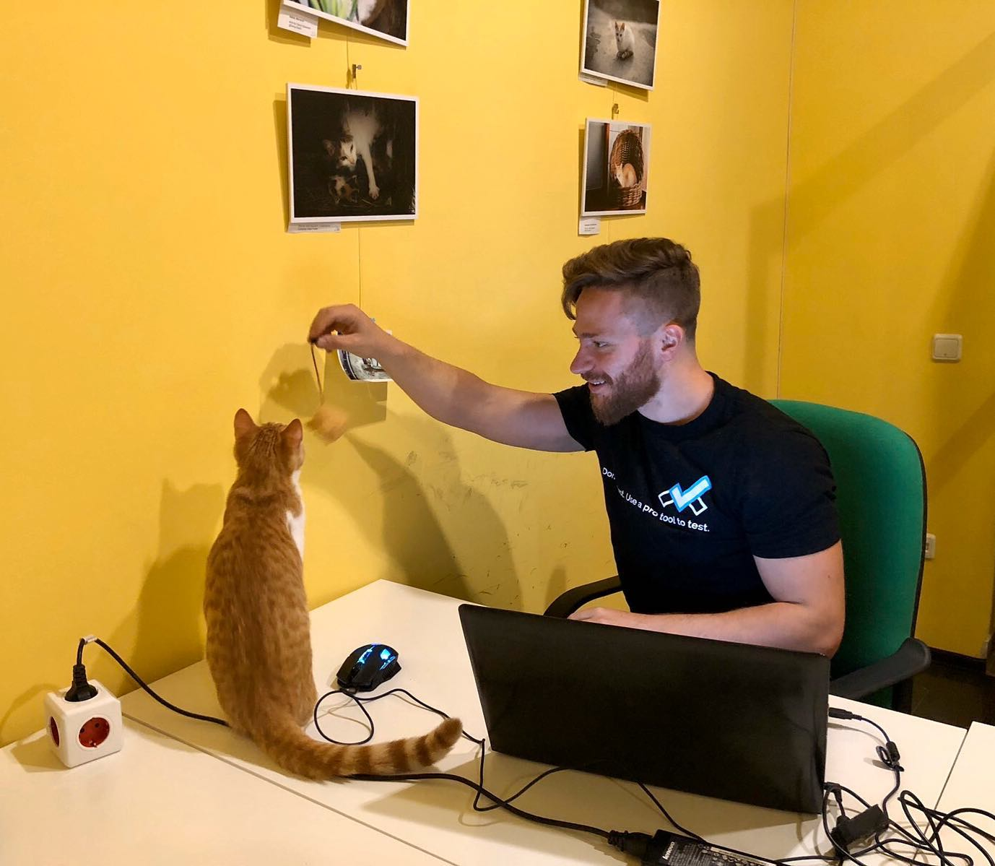
The Presenter
Ivaylo Kenov – Quality Code Advocate
Various job titles at the same time:
Organizer & Speaker @ Code It Up
CTO @ SoftUni
Full Stack Technical Trainer @ Everywhere
Code General @ https://docs.mytestedasp.net/
Meme Copy Machine @ Daily Programming Fun
{Insert Job Title Here}
Contacts
https://github.com/ivaylokenov
https://facebook.com/ivaylo.kenov
https://linkedin.com/in/kenov
https://www.instagram.com/ivaylokenov/
YouTube & Blog
https://www.youtube.com/c/CodeItUpWithIvo
https://codeitup.today/

Slide 5
Sponsors
This lecture is free thanks to our sponsors
Which will interrupt the lecture here and there
Because it takes quite a lot of personal time to prepare the materials
You will help the initiative a lot if you visit their web sites
And consider their propositions to you
I personally select various premium jobs to present them during the talk
These are the current ones:
INDEAVR - https://indeavr.com
Americaneagle.com - https://www.americaneagle.com
SmartIT - https://smartit.bg

Slide 6
ABOUT CODE IT UP

Slide 7
Code it up
The Code It Up initiative:
Aims to provide detailed knowledge on advanced software development topics
Aimed at people with at least 1 year of programming experience (mostly C#)
Sort of acquired by SoftUni last year
Code It Up Online
Free live-streamed online events (2+ hours long)
Led by me – mainly .NET, architecture, and infrastructure
We have 6 more lectures before the initiative ends
Code It Up Workshop
Paid events containing theory & practical exercises for the attendees
No more paid lecture planned for now

Slide 8
Thankful if you share a story
You can be extremely helpful to the initiative
Just share a story on Facebook or Instagram during the lecture
Make sure you tag me so that I can reshare your post - @ivaylokenov
Bonus – add the #codeitup hashtag
Thank you! You rock!

Slide 9
ABOUT The Series Of Events

Slide 10
About This SERIES Of Code It Up Events
Theoretical lectures on software architectures
Widely-used design patterns and concepts in production
Depending on your level, you may be familiar with some of the topics
A real-life project example
A practical guidebook for architecting various solutions
3 real-life projects on more than 70 pages
Legacy systems, vast data load, lots of concurrent users, working with critical data, and more
Please report to wewritesoftware@gmail.com, if you find any “bugs” in the book!
And I have a lot more to add in the future!
You receive free updates of the book!
MOST IMPORTANTLY – HUGE THANK YOU! <3

Slide 11
The Content Of The Series – A Free Course
Why Software Architecture
What Is Software Architecture?
Unified Modeling Language
Designing Solution Architectures
Common Technology Stacks
Architecture Design Patterns
Choosing The Right Patterns
Architecture Quality Attributes
System-Wide Considerations
Deployment Considerations
Monolithic Architecture
Domain-Driven Design
Microservices
Event Sourcing
The Architecture Document
The Architect And The Team
What Makes A Great Architect
Designing A Real-Life Solution

Slide 12
in The previous parts
Designing Solution Architectures
Common Technology Stacks & Design Patterns
Quality Attributes & Considerations
Low-Level Architecture & Microservices
The Architect & The Team
It is not required to watch the parts in order
But it is strongly advised!
Get the previous recordings from here:
https://www.eventbrite.com/o/code-it-up-29733808833

Slide 13
in this part
The Architecture Document
Real Life Solution
System Design Examples
Don't Forget The Optional But Practical Guide-Book
3 Real-World Scenarios
70+ Pages
Free Updates
Get It From The Event's Page or write to wewritesoftware@gmail.com
https://www.eventbrite.com/e/software-architecture-real-life-solutions- code-it-up-online-vol-16-registration-265222346177

Slide 14
About this topic
HUGE DISCLAIMER! THIS TOPIC IS LIKE THE LITTLE PRINCE BOOK!
There are a lot of things to know about software architectures
You may or may not recognize some of the patterns
And we most probably will not mention all of them
If you are a beginner, just try to absorb what you can
The technology world is moving very fast
Some of the examples shown here may be considered anti-patterns in the future
But the overall concept and process stays the same
As all my other topics – this one is super intense too!
Even though the lectures will be a bit shorter
So, give yourself time and if you get the book – finish it!
And don’t worry! The knowledge provided here will save you weeks of reading!

Slide 15
INDEAVR – The EVENT’s DIAMOND SPONSOR
They provide technology services focused on the Digital, Data, Cloud and Advanced Software Engineering expertise.
They are always in search for creative and passionate people with the combination of a sharp strategic mind, emotional maturity, entrepreneurial instincts, and the ability to deliver results.
https://www.indeavr.com/en/technology/application-services
https://www.indeavr.com/en/careers

Slide 16
The architecture document

Slide 17
Definition
Table of contents
The requirements of the system
Functional and non-functional
The technology stack
The architecture diagrams
And many more sections
Do not start development without this document!
Audience – almost everyone involved
Project manager
CTO / CEO
The Developers
The QAs

Slide 18
audience
Management
The requirements reflecting the essence of the system
Executive summary describing best practices and modern patterns
Architecture should be geared towards business goals
Management’s sections appear first
Development team
Technology stack
Modules, services, communication
Other technical details
QA team
Testing infrastructure
Servers, testing tools, coding

Slide 19
Format of the document
The format of the document is subject to hot debates
There are standards but nothing is set in stone
You can use UML, but it is not necessary
Sometimes you may skip it, if the audience is not familiar with it
Keep it as simple as possible
Use plain and simple English
Keep the technical details for the developers
Get into the minds of your readers
Visualize using software you are comfortable with

Slide 20
Main structure of the document
Background
The role of system from a business perspective
Requirements
These dictate the whole architecture
Executive Summary
High-level overview of the solution – for non-technical readers
Architecture Overview
The technical big picture of the solution
Module Drill-Down
The core of the document
Detailed and practical instructions for implementing the architecture

Slide 21
Background section
Describes the system from a business point of view
System's role
For example – solution for the HR team
Reasons for replacing an old system
For example – too much maintenance and old technologies
Expected business impact
For example – increasing HR productivity by at least 20%
Validates the architect's point of view of the system
Maximum 1 page
If there is an error, you can easily correct it
All next sections build upon this one
Boosts your confidence in front of the management
Therefore, you do not use any technical words here

Slide 22
Requirements section
This section should again be maximum 1 page
Keep it brief
Use bulleted lists for describing the requirements
Functional – what should the system do
Non-functional – what should the system deal with
Validates your understanding of the requirements
Whatever you design, it will solve the actual problem of the customer
The architecture is designed against well-defined requirements
It is a high-level overview of the requirements
Do not take the job of a functional analyst ☺

Slide 23
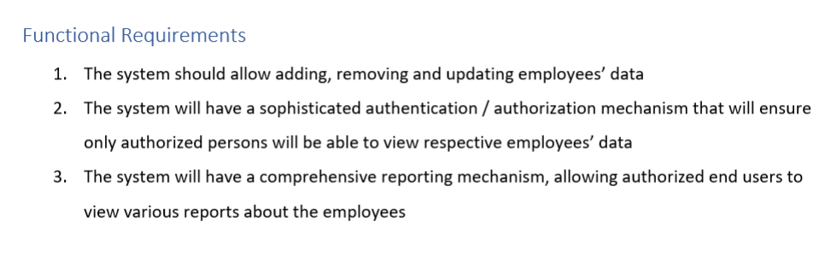
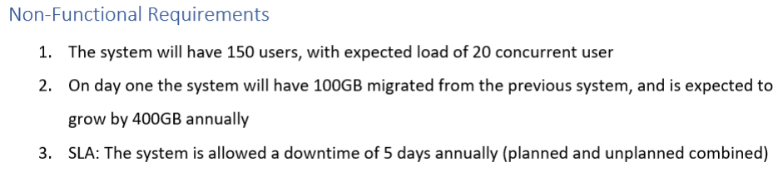
Requirements section example

Slide 24
Executive summary section
This section should be around 3 pages
This section is again for the management team
They will not read your whole document because usually they do not have the time
So, you need to impress them and present yourself as good solution architect
You need to make them believe that their system is in good hands
You need to provide a high-level nontechnical view of the architecture
Get into your readers' mind!
A person who does not have a lot of time available
He or she should be satisfied as quickly as possible with the presented solution
Use charts and diagrams (+ well-known technical terms)
Write this section after you write the rest of the document!

Slide 25
Architecture overview section
This section can reach up to 10 pages
Presents the architecture from a technical point of view
This section should not deep dive into independent modules
It just layers the foundation for these modules
Include these three subsections:
General description - type of the application and major non-functional requirements
High-level diagram – show the separate modules and their connections logically
Do not mix physical hardware here
Diagram walkthrough – describe various parts of the architecture and their roles verbally
Use simple words and include the most relevant details
Include technology stack here only if you use the same stack in each module

Slide 26
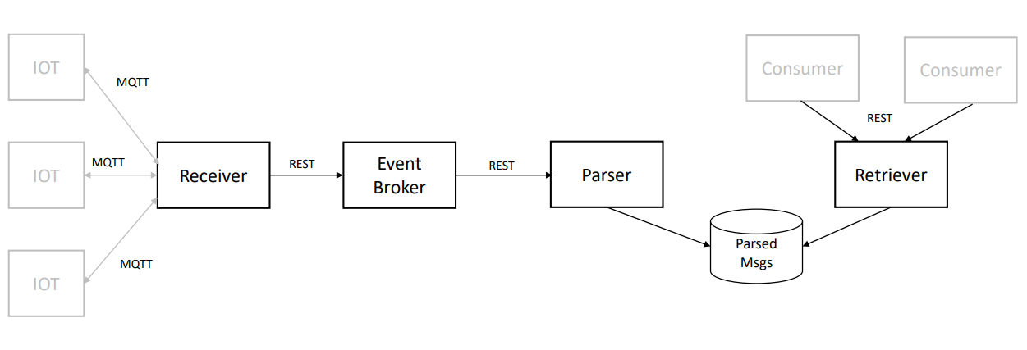
Architecture overview diagram example

Slide 27
Modules drill-down section
This section can have "unlimited" number of pages
You should add for each module in huge detail:
Component's role
Technology stack
Data store, back-end, front-end, etc.
Be extremely detailed here and always include rationale!
But only for the first module of a particular technology!
Module's architecture
The inner architecture of the module
What exactly and the module should do and how
Include layers, diagrams, design patterns, etc.
Describe the API and method names
Development instructions – keep it brief

Slide 28
BEFORE WE CONTINUE…

Slide 29
Huge THANKS for your support & TRUST!
Everyone who got a paid ticket – 51 people in total! Thank you!
Top supporter – Kalin Tsenkov – 85 BGN! Thank you, you rock! <3
Thanks to – Albena, Ani, Pavel, Diana, Борислав, Владимир , Dobromir, Georgi, Stoil, Radoslav , Teodor, Emiliyan, Borislav, Svilen, Dimitar, Калин, Zlatko, Miroslava, Svetoslav, Raya, Mira, Dinyo, Hristo, Teodor, Daniel, Lyuboslav , Hristina, Tanya, Veselin, Elitsa, Yavor, Daniela, Mariyana, Petya, Vladimir, Vasil, Ivo, Цветомир, Anton, Lyuboslav, Pavlina, Kalin, Ventsislav, Jordan, Iva, Georgi, Ivan, Elena, Hristo, Ivan, Simeon, Anna
And everyone who supported the initiative during the years!

Slide 30
These events are not Exactly free
I prefer to call them “Pay what you want”
Depending on how much you value the provided knowledge
It takes me a considerable amount of free time to prepare these lectures
And I want them to be perfect and complete!
I put my soul in them!
For this reason, I will be extremely thankful, if you decide to support me and my projects!
It is never expected, but always appreciated!
The easiest way is via
PayPal: http://paypal.me/ivaylokenov
Revolut: @ivaylokenov

Slide 31
designing a solution

Slide 32
Our main tasks
Here are our main tasks as solution architects in a nutshell:
Understand the system’s requirements
Understand the non-functional requirements
Identify key scenarios and map baseline modules and layers
Select the technology stack
Design the architecture
Write the architecture document
Support the Lead Developer and the team ☺

Slide 33
Real-world project
Let us analyze a real-world application
Our project works with lots of IoT devices
Home cameras and thermostats, for example
Each of these devices has a separate application to control it
But we want to have a unified view of all our registered ones
We should collect status information and format the data to visually pleasing dashboard
This way the customer will know what is going on with all his/her devices

Slide 34
Functional requirements
For our first version the data is read-only and just visualized
Customers cannot update data directly from the application
Customers and their devices are pre-validated because of security protocols
Customers do not need to register in the application
Functional requirements
The Functional Analyst did a good job
We should understand the concept of the system
Receive status updates from IoT devices
Store the updates for future usage
Allow the users to query the updates

Slide 35
Non-Functional requirements
Think for a minute – what are the non-functional requirements of this system?
What information can influence our architecture?
What kind of questions we need to ask our customer?
What we know:
Messages are from IoT devices – there should be a huge amount of messages
What we should ask:
Load - how many concurrent messages should the system expect at peak times?
Volume - what is the total number of expected message per month?
Size – what is the average size of a message?

Slide 36
Client Answers
After a few days of thinking, the client answers:
Maximum 500 concurrent messages at peak times
15 000 000 total number of message per month
300 bytes is the average message size
Let's do some data volume calculations:
15 000 000 x 300 bytes = 4 500 MB / month
4 500 MB x 12 months = 54 GB / year
Almost every database can handle this volume of data easily
Usually in data extensive applications – the data can expire
But we do not think about data archiving or deleting here
Data volume doesn't seem to be a problem here

Slide 37
But what about load?
500 concurrent messages is a super busy system by any standard
We can easily add lots of servers and scale out
But such solution costs money
It is a better solution to design the software so that it can handle such load
There is one more concept we need to think about
Do we care about losing messages?
If we think about it – no. If a message is lost, a new one will be send in a couple of seconds…
Our system is quite tolerant for message lost
Of course, we are not talking about system-wide catastrophe
1 lost message out of 1000 is completely acceptable (99.9%)

Slide 38
users
The next requirement is about users
How many users will the system have?
Total of 2 000 000 users
How many concurrent users should we expect?
No more than 40 concurrent users
Users who are actively accessing the server
Total load calculated – 540 concurrent requests

Slide 39
Service level agreement
Of course, the client expects 100% uptime
But that is not possible in even the most advanced data centers
There are a lot of factors and we do not have control over them
Hardware, virtualization, network, database servers
In such cases – make sure you communicate with the proper people
When talking with the client, you can define three levels of software SLA
Silver, Gold, Platinum
You decide the differences but the best one is
Fully stateless
Easily scaled out
Logging & monitoring
We have live data here, so we choose the Platinum level

Slide 40
Requirements conclusion
Functional:
Receive status updates from IoT devices
Store the updates for future usage
Allow the users to query the updates
Non-functional:
Data volume: 54 GB annually
Load: 540 concurrent requests
Message loss: 0.1%
Total users: 2 000 000
SLA: Platinum level

Slide 41
Mapping baseline Modules
Modules are based on the requirements
We have two separate tasks working with separate entities
Receiving and storing status updates
Querying these status updates
We can distinguish two different modules
Receiver – to receive the messages
It will work on heavy load, so we need to make sure it will not have a thread starvation
Info Provider – to provide information to the end-users
But there is a question here…
Do we directly store the messages in a raw format?
Or do we validate them first?

Slide 42
Mapping baseline Modules
We ask the client, and the answer is:
There are 4 types of devices and formats
3 of them are JSON-based and one of them is a plain string (needs parsing)
Validation is required
We now know the receiver has the following tasks:
Receive the message
Validate the message
Parse the message and convert it to a unified format
Store the message
But the receiver is under heavy load, its request processing should be as fast as possible

Slide 43
Mapping baseline Modules
The parsing task is super important
It will make our data independent from its source
We will have easier queries for the dashboard
Having unified format is a good solution when data is from multiple sources
So, we decide to leave the receiver do just that – receive
For the other tasks – we need additional modules
We can add a Validation module to our architecture
But who should do the parsing? It is a good question…
Since validation and parsing always go hand in hand, we can do them in a single module
There is no justification to split the tasks in different modules for this scenario
Because they will require maintenance

Slide 44
Mapping baseline Modules
To summarize, we defined the following modules:
Receiver – receives messages and dispatches them
Handler – validates, parses and stores messages
Info Provider – gives us the option to query the messages
We can now add one more system-wide module:
Logging – the central logging service for all the other ones
Finally, we need a Data Store module
It should be shared between the Handler and the Info Provider

Slide 45
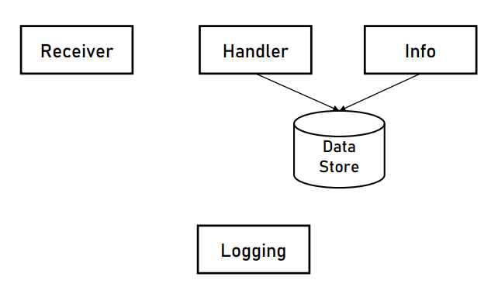
Choosing messaging methods
Our service modules look like this:
What kind of messaging is the right one between each one of them?

Slide 46
Choosing messaging methods
Let us begin with the Receiver:
It receives messages from the IoT devices but how?
We ask the client for device specification, and we see that the IoT devices use HTTP POST requests – REST API then
But here is the tricky part. How to send the data to the Handler?
It should be done as quickly as possible to relieve the load of the receiver
The obvious mechanism here is a message queue
Provides us order of execution and reliability
If we use REST, we will block the working thread – it will be waiting for a response
Additionally, we will have to handle errors and glitches
Hurting the performance by a lot!
The fire and forget approach is perfect!

Slide 47


Choosing messaging methods
Popular queue options:
Self developed
Never developer your own message queue except in single-process applications
RabbitMQ
General purpose message broker
Easy to setup
Easy to use
Kafka
Stream processing platform
Perfect for data-intensive applications
Very complex installation and setup

Slide 48
Choosing messaging methods
What about Info Provider?
That one is easy – the answer is lies within the end-user requirements
How are they using the system?
Via a web browser
And web browsers use HTTP
The Info Provider will implement a REST API for the end-users
Last, but not least – the Logging service
We have large amounts of records – REST API will hurt the performance a lot
We could use file polling, but this solution is not cloud compliant and it is hard to control
We can use a database or a queue. Which one is better?
In this situation – a queue
Just because the database will be used as a queue in this scenario

Slide 49
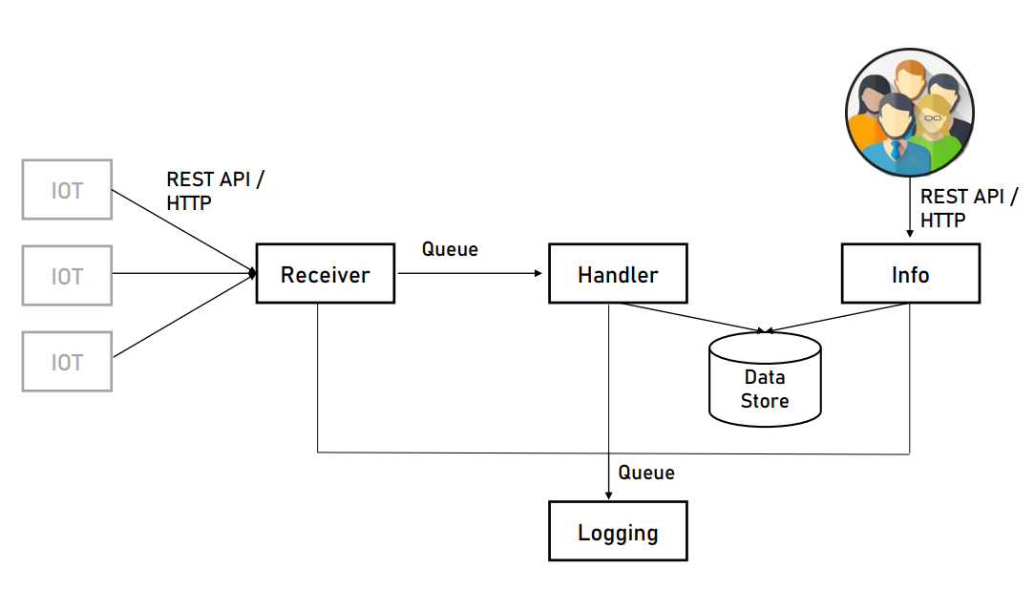
Choosing messaging methods

Slide 50
Designing the logging service
Our architecture is now ready!
Just make sure the client's IT support understands the queue mechanisms!
Our next task is to design the Logging service
It is super important, and it should be treated as a first-class citizen
Besides that – the other services need it
These are the steps:
Design the application type
Design the technology stack
Design the architecture

Slide 51
Designing the logging service
What are the tasks of the Logging service?
Read log records from the queue
Handle the log records
Save in log data store
The Logging service is not based on HTTP, so we do not need a web application
It is not a mobile or desktop application… But is it a console one?
Console is a good fit for long-running applications with limited UI
What about a service? Well, service is also a good fit
The choice is between a console or a service application
It depends on personal taste, so both are fine

Slide 52
Designing the logging service
Let us design the technology stack
Module's code and the data store
Access queue's API
Store data
All technologies provide a solution to these stacks, so we consider our developers' skills - .NET Core and SQL Server, for example
Any combination will work here – Java and MySQL, Python and PostgreSQL, etc.
For operations with lots of writes and less updates, we may consider a wide column or document database here

Slide 53
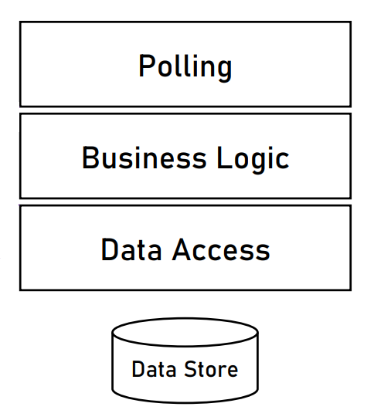
Designing the logging service
Let us design the service layers
Does the classical 3-tier architecture fit?
UI/Service interface
Business logic
Data access
It fits, but we do not have UI here, so let's change it a bit:
Polling
Business logic
Data access

Slide 54
Designing the logging service
We need to specify the responsibilities:
Polling – polls the queue every few seconds for new log records
Business logic – all new log records are sent here for validation
Data access – if everything is ok with the log records, this layer saves them to the database
Other developer instructions:
Use dependency injection – Microsoft.Extensions.DependencyInjection for our .NET case
Use ORM for data access – Entity Framework Core for our .NET case

Slide 55
Designing the Receiver service
What are the tasks of the Receiver service?
Receives messages from the IoT devices
Sends messages to the queue for the Handler
What kind of application is this service? It is an easy one – web application
What is the technology stack?
If we chose .NET Core for the Logging service, we need a very good reason to use another stack as it can create a lot of headaches
The question here is - does .NET Core support REST API?
Yes, it was built for that!
As a bonus point – we receive superb performance!
There is no reason to change the technology!

Slide 56
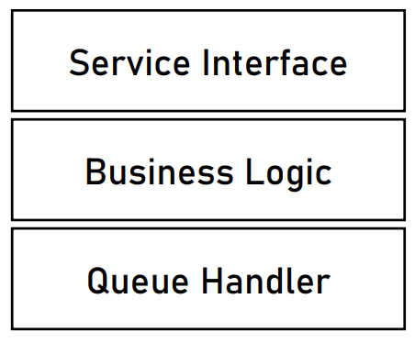
Designing the receiver service
Let us design the service layers
Does the classical 3-tier architecture fit?
UI/Service interface
Business logic
Data access
It fits, but we do not have a data store, so let's change it a bit:
Service interface
Business logic
Queue handler
With these two examples you can see why the layered architecture is so flexible!
Just work with interface contracts and you are great!

Slide 57
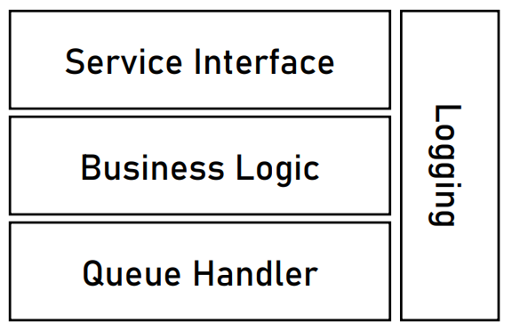
Designing the receiver service
There is one more thing here
We need a cross-cutting concern – logging!
It should receive logs from every single layer
Remember exception handling for the various separations?

Slide 58
Designing the receiver service
Let us look back at our non-functional requirements for validation
Two of the non-functional requirements are relevant here
Load is 500 concurrent messages. Are we compliant?
Yes! Our service is stateless, simple, and easily scaled out in front of a load balancer
Message lost is 0.1%. Are we compliant?
Yes! Our service is super simple and uses a reliable REST API protocol
As a side note – for a better uptime, we should consider a cloud technology
This service is done
We can add additional developer instructions about library usage, for example

Slide 59
Designing the Handler service
What are the tasks of the Handler service?
Polls messages from a queue
Validates messages
Parses messages
Stores messages in data store
What is the application type?
No HTTP and UI are required
A good choice is a service application
There are no special requirements so we can use the same technologies
.NET Core and SQL Server in our example

Slide 60
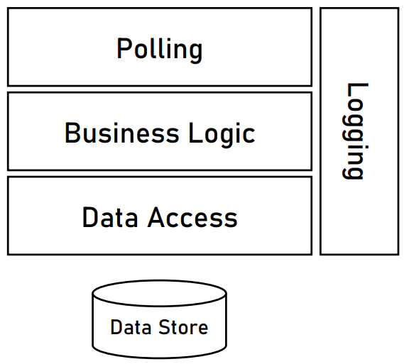
Designing the Handler service
Let us design the service layers
As with the Logging service, we do not need a service interface
So, our first layer will be named Polling
Because it polls data from the queue
For the Business Logic layer, we can add a plugin mechanism
To easily add validation and parsing logic
If new devices with new formats are added in the future
Of course, we need a cross-cutting concern - logging

Slide 61
Designing the Info provider service
What are the tasks of the Info Provider service?
Allows end-users to query the data store
The service is responsible only for data retrieval (it does not display the data)
The application type is easy
A web application with REST API
There are no special requirements so we can use the same technologies
.NET Core in our example

Slide 62
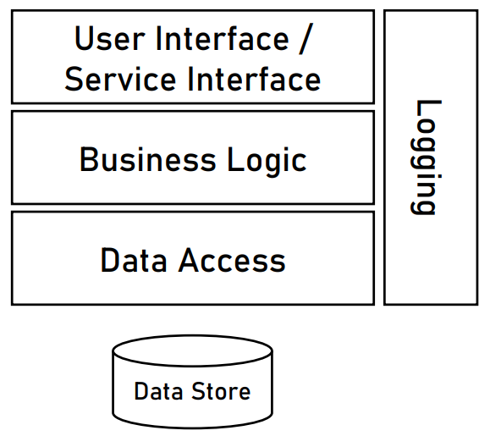
Designing the Info provider service
Let us design the service layers
Does the classical 3-tier architecture fit?
UI/Service interface
Business logic
Data access
Yes, it fits perfectly, just add logging!
But that is not all, we need to design the API
We did not do it in the Receiver service, because the method was dictated by the devices

Slide 63
Designing the Info provider service
After discussing with the client, the end-users need the following:
Current status of their entire house and for specific devices
Past events for their entire house and for specific devices
Required functionality:
Get all the updates for a specific house’s devices for a given time range
Get the updates for a specific device for a given time range
Get the current status of all the devices in a specific house
Get the current status of a specific device
The three main factors for our API are:
Path
Status code
Content

Slide 64
Designing the Info provider service
A sample functionality will be:
Get all the updates for a specific house’s devices for a given time range
The time range is not part of the path because it is not an entity
The status codes should be:
200 OK, if the data is successfully returned
404 Not Found, if the "houseId" could not be found
The response content should contain all the necessary information for the clients
GET /api/house/houseId/devices/updates?from=from&to=to

Slide 65
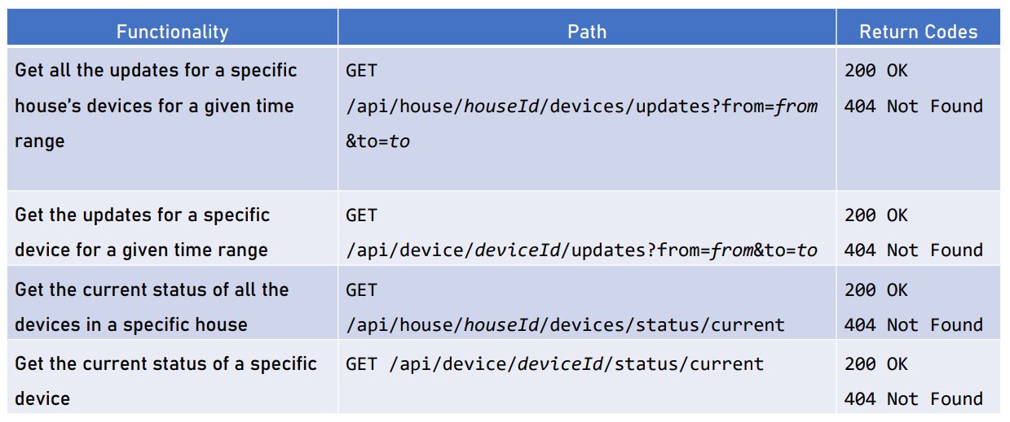
Designing the Info provider service

Slide 66
Writing the architecture document
We need to write an architecture document
Background
Requirements
Overall architecture
Module drill down
Executive summary
There is one provided in the resources
Contains everything we discussed
You may use it as a template, if you like
We are done with this project! Great job!

Slide 67
System Design examples

Slide 68
Notifications Service
Functional requirements:
Send notifications
Plugable
Extendable
Rate limiting for UX
Prioritization
Non-functional requirements:
High availability
High scalability
Lots of clients

Slide 69
Chat application
Functional requirements:
One-on-one chats
Group chats
Image, video, file sharing
"Seen" indication
Last online time of users
Non-functional requirements:
Super low latency
High availability
High scalability
Lots of clients

Slide 70
Hotel Booking application
Functional requirements:
Hotel management
User search and booking
Analytics
Non-functional requirements:
Low latency
High availability
High scalability
High consistency

Slide 71
Other Examples
Amazon
Google Maps
Zoom/Skype
Facebook
Netflix
Twitter
Uber
Examples explained at:
https://www.codekarle.com/

Slide 72
what’s next?

Slide 73
We Covered A lot!
Why Software Architecture
What Is Software Architecture?
Unified Modeling Language
Designing Solution Architectures
Common Technology Stacks
Architecture Design Patterns
Choosing The Right Patterns
Architecture Quality Attributes
System-Wide Considerations
Deployment Considerations
Monolithic Architecture
Domain-Driven Design
Microservices
Event Sourcing
The Architecture Document
The Architect And The Team
What Makes A Great Architect
Designing A Real-Life Solution

Slide 74
Learn by yourself
We covered a lot!
But the topic is endless!
Google how to become a good software architect!
Improve yourself daily!
Work on your soft skills!
Excellent communication is as valuable as computer knowledge!
Keep in mind this field changes very quickly!
New design patterns come and go!
Frameworks are changing all the time!
New libraries are released every day!
The whole IT landscape is constantly evolving!

Slide 75
Must read books
Righting Software
https://www.amazon.co.uk/Righting-Software-Juval-L%C3%B6wy/dp/0136524036
Service Design Patterns
https://www.amazon.co.uk/Service-Design-Patterns-Fundamental-Addison-Wesley/dp/032154420X
The Mythical Man-Month
https://www.amazon.co.uk/Mythical-Man-Month-Software-Engineering-Anniversary/dp/0201835959
Patterns of Enterprise Application Architecture
https://www.amazon.co.uk/Enterprise-Application-Architecture- Addison-Wesley-Signature/dp/0321127420
Enterprise Integration Patterns
https://www.amazon.co.uk/Enterprise-Integration-Patterns-Designing- Addison-Wesley/dp/0321200683

Slide 76
FINAL WORDS before Q & A

Slide 77
Summary
The Architecture Document
Real Life Solution
System Design Examples
Don't Forget The Optional But Practical Guide-Book
3 Real-World Scenarios
70+ Pages
Free Updates
Get It From The Event's Page or write to wewritesoftware@gmail.com
https://www.eventbrite.com/e/software-architecture-real-life-solutions- code-it-up-online-vol-16-registration-265222346177

Slide 78
Other Goodies
You can check the Code It Up blog and subscribe:
https://codeitup.today
You can watch some of the free videos:
https://www.youtube.com/CodeItUpwithIvo
Clean code & The art of testing
Docker, CI/CD, Redis, Elasticsearch
And many more…
The source code in all free lessons is available on Patreon:
https://www.patreon.com/ivaylokenov
Unrelated to the IT sector but check out my art T-Shirts:
https://way-ve.com/
Use CODE10 during checkout for 10% discount

Slide 79
Past Code It Up Events
You can get the recordings of the past C# events from the event page:
C# Async-Await In Detail
The C# ORM Battle
Docker – From ABC To XYZ
Identity Server Demystified
Eventual Consistency Done Right
Let's Get Functional With C#
C# API Scenarios – REST, GraphQL & gRPC
Past workshops are also available:
C# Multithreading
Domain-Driven Design With ASP.NET Core
Kubernetes For Web Developers
If interested, you can write to wewritesoftware@gmail.com

Slide 80
ANY QUESTIONS?
You can support me and my projects:
Via PayPal: http://paypal.me/ivaylokenov
Via Revolut: @ivaylokenov
On Patreon: https://www.patreon.com/ivaylokenov
On Open Collective: https://opencollective.com/mytestedaspnet
Via Buy Me A Coffee: http://buymeacoff.ee/ivaylokenov
Crypto: http://bit.ly/ik-sponsors
Never expected, always appreciated!
Make sure you check my sponsors!
INDEAVR - https://indeavr.com
Americaneagle.com - https://www.americaneagle.com

Slide 81
Thank You!
Resources: https://github.com/ivaylokenov/Software-Architecture-Series

