Slide 1

Kubernetes For Web Developers
Code It Up Workshop Vol. 3

Slide 2
For questions During The Live Event
https://sli.do #kubernetes
The YouTube Live Chat Is Also Monitored

Slide 3
For questions if you watch the recording
Just Send Me A Message
wewritesoftware@gmail.com or Messenger
https://www.facebook.com/groups/codeitup/

Slide 4
RESOURCES
http://bit.ly/ciu-kubernetes

Slide 5
Live stream troubleshooting
Sometimes issues happen during a live stream…
And sometimes disasters happen, this is how memes are born…
If my Internet goes down and the stream stops:
Wait for 5 minutes, I have another one on a different network
If YouTube is showing “stream ended”:
I will post a new link in the comments section below this video
If something else happens unexpectedly:
Well, I will add a solution to this slide during my next event… ☹

Slide 6
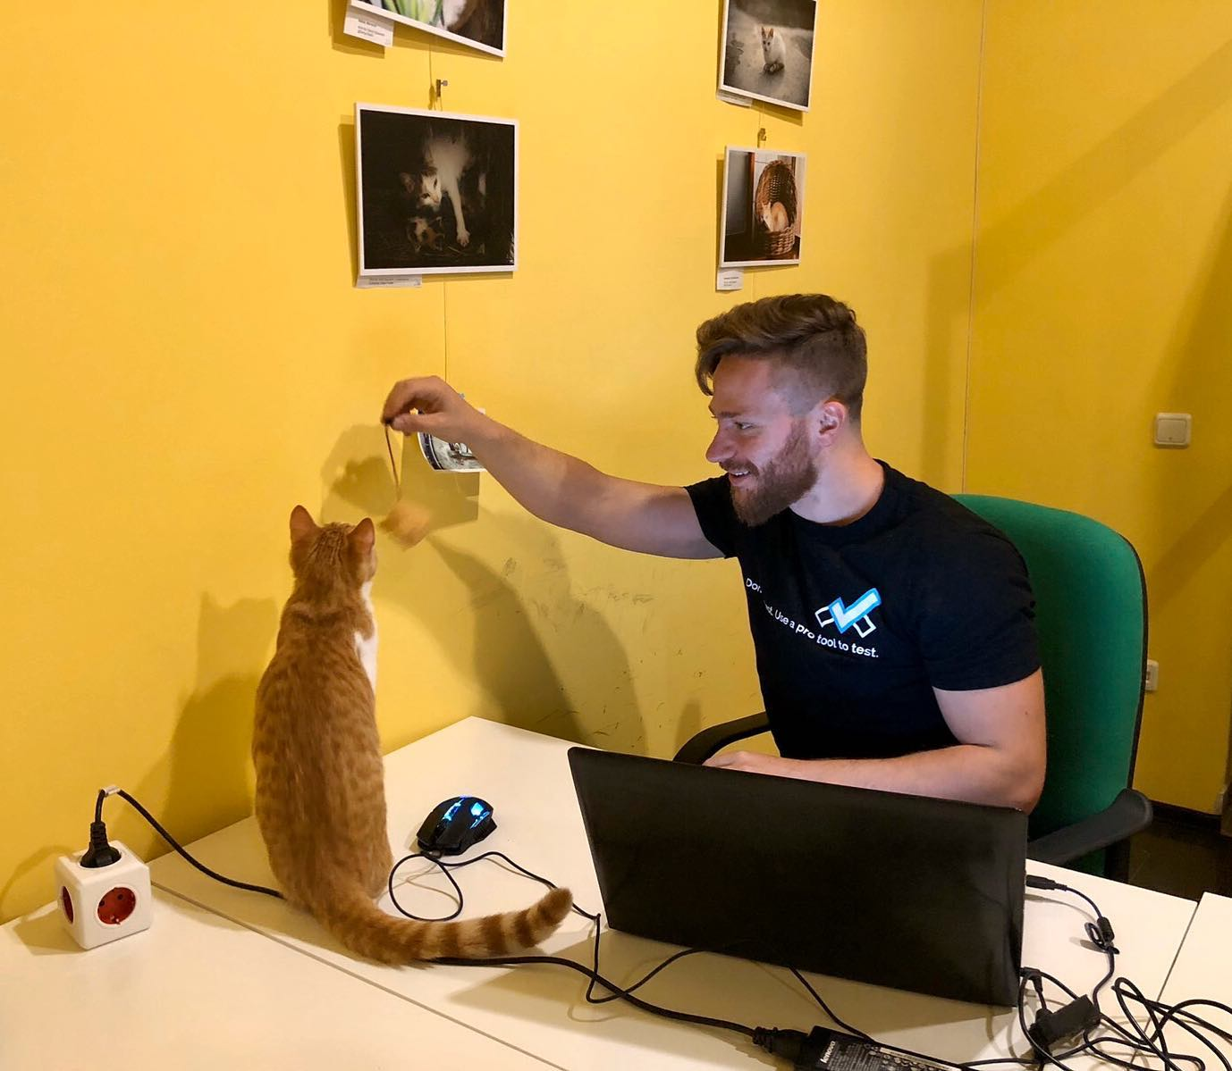
The Presenter
Ivaylo Kenov – Quality Code Advocate
Various job titles at the same time:
Organizer & Speaker @ Code It Up
CTO @ SoftUni
Full Stack Technical Trainer @ Everywhere
Code General @ https://MyTestedASP.NET
Meme Copy Machine @ Daily Programming Fun
{Insert Job Title Here}
Contacts
https://github.com/ivaylokenov
https://facebook.com/ivaylo.kenov
https://linkedin.com/in/kenov
https://www.instagram.com/ivaylokenov/
YouTube
https://youtube.com/MyTestedASPNETTV

Slide 7
What Are We Going To COVER
About Code It Up
About This Workshop
Why Kubernetes
The Kubernetes Architecture
Getting Kubernetes
Working With Pods
Creating Services
Adding Deployments
Moving To The Cloud
Using Storage
Configuration Maps
Secrets
Other Useful Objects
Putting It All Together
Namespaces And Labels
Troubleshooting And Monitoring

Slide 8
ABOUT CODE IT UP

Slide 9
Code it up
The Code It Up initiative:
Aims to provide detailed knowledge on advanced .NET topics
Aimed at people with at least 1 year of C# experience
Code It Up Online
Free live-streamed online events
Code It Up Networking
Free on-sight events with live streaming
Guest speakers from the industry
Networking part (with pizza and beer)
Code It Up Workshop
Paid events containing theory & practical exercises for the attendees

Slide 10
Upcoming Code it up Events
Events with set dates:
September 30 - Eventual Consistency Done Right (ASP.NET Core Edition)
November 14 – Enter the Swarm: Native Docker Clustering
December 19 – Becoming a Software Architect: The Knowledge Path
Events with no specific order or dates:
The Limits of the C# Runtime
API Scenarios - REST, GraphQL & gRPC
Serverless Real-Time C# Applications On AWS? Yes, It’s Possible & Easy!
C# On Rocket Fuel – Writing High Performance .NET
Software Engineering – Patterns & Anti-Patterns
Plus many more!
I currently have a SoftUni course about Domain-Driven Design!

Slide 11
Thankful if you share a story
You can be extremely helpful to the initiative
Just share a story on Facebook or Instagram during the lecture
Make sure you tag me so that I can reshare your post - @ivaylokenov
Bonus – add the #codeitup hashtag
Thank you! You rock!

Slide 12
About this workshop

Slide 13
About this workshop
The theory behind Kubernetes
Everything you need to know about using Kubernetes in production
Live hacking with best practices in mind
A practical guidebook for configuring and deploying Kubernetes
More than 30 pages!
10+ sections, partial solutions, and more!
Please report in the group, if you find any “bugs” in the book!
And I have a lot more to add in the future!
You receive free updates of all resources!
MOST IMPORTANTLY – HUGE THANK YOU! <3

Slide 14
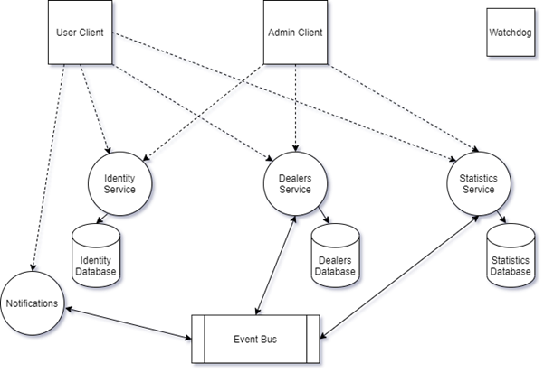
About this workshop
The step-by-step guidebook is important! Get your hands dirty!
You will configure and deploy this microservice application all by yourself!

Slide 15
About this workshop
HUGE DISCLAIMER!
There are a lot of things to know about Kubernetes
And it may seem very difficult and full of buzz words at first
But just stick around, play a bit with it and you will love it!
Kubernetes is moving very fast
Some of the commands shown here may not work in the future
Except the ones labeled as “stable” – they should always stay the same
But the overall concept stays the same so you will find a solution
As all my workshops – this one is super intense too!
So give yourself time and most importantly – finish the book!
But don’t worry! The knowledge provided here will save you weeks of reading!

Slide 16
Why kubernetes

Slide 17
Why containers
With containers:
We accelerate developer onboarding
We eliminate application conflicts
We have environment consistency
We ship software faster
But we also need:
Orchestration of these containers
Zero-downtime deployment
Self-healing of our services
Easy scaling of our applications

Slide 18
Why Kubernetes
Kubernetes is a container management system
Solving challenges from having distributed applications
The leading tool for managing containers at scale
Also known as K8S
Kubernetes was born out of Google
Currently developed by Cloud Native Computing Foundation
One of the biggest Open Source projects currently available
Increasingly stable and mature
More than 5 years in development

Slide 19
Why Kubernetes
Consider the high-level operations you do with code
You write instructions and the OS transfers them to the hardware
Kubernetes is similar in terms of cloud operations
You write instructions and the cluster transfers them to the cloud machines
Imagine a courier business
You prepare the package in a standard format
You write some instructions
All the routing and logistics are done for you
Kubernetes is the same for your cloud-native microservice applications

Slide 20
Why Kubernetes
Back in the days people used to build monoliths
Nowadays “monolith” is used as an insulting word for old legacy applications
All the application components were bundled in a single package
Now people prefer the microservices approach
It is the same application, but separated in “services”
Each service is responsible for a single operation
Microservices give you independent development and deployment
But have bigger complexity – communication, for example
Kubernetes to the rescue! It helps with all that complexity
And can be deployed everywhere
Public clouds, private clouds, on premise data centers, etc.

Slide 21
Developer use cases
Why a developer should learn Kubernetes
Emulate production locally
Big move from Docker Compose
Create end-to-end testing environment
Ensure application scales properly
Ensure secrets/configurations are working properly
Performance testing scenarios
Using it as a CI/CD pipeline
You do not have a dedicated DevOps team
You help the DevOps team create resources and solve problems
You want to be a system administrator?

Slide 22
The Kubernetes Architecture

Slide 23
Kubernetes Big picture
Kubernetes is an orchestrator for our application
But what does orchestration mean?
Imagine a football team
Each player has its own strengths and role
The coach is responsible for managing the team
They should have a good formation, based on the coach’s decisions
He also watches them and makes sure everyone sticks to the plan
He also may replace injured players when the situation demands it
The environment is constantly changing, and the coach reacts to it

Slide 24
Kubernetes Big picture
Kubernetes and microservices are the same
Our components are orchestrated like a team
But how to do it?
We have an application
We package it in a container
We pass the container to the cluster
We send instructions for our application
And boom – our code is up and running!

Slide 25
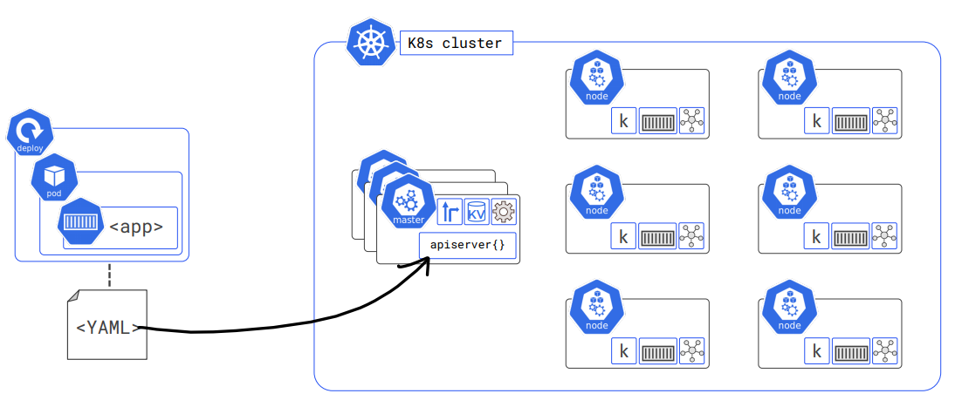
Kubernetes Big picture

Slide 26
Masters (Master Nodes)
In the Kubernetes world masters are the head nodes
Or the control plane
Usually you need to have 3 master nodes
Or 5, if you are really paranoid
Masters are run on a Linux machine
It can be anywhere – physical machine, virtual machine, it doesn’t matter
Keep in mind that on a publicly available cloud Kubernetes service you do not have control
Everything is hidden from you through an API
Each master runs smaller services
Each of them responsible for different features

Slide 27
Masters (Master Nodes)
Masters shouldn’t have user or business applications
You do not deploy your code on them
Their job is to manage operations
The “brains” of Kubernetes
These are the services on a master node:
Kube-apiserver – front-end communication channel to the control plane
Kube-controller-manager – controller of controllers (more details later)
Kube-scheduler – assigns work to cluster nodes and watches for new tasks
Cluster store – persists the cluster state and configuration

Slide 28
Nodes (Worker Nodes)
Nodes are the heavy workers
We deploy our application pieces on them (but not quite directly)
They can be either Linux or Windows machines
Each node has the following services:
Kubelet – the main Kubernetes agent, watches for work tasks, reports to the masters
Container runtime – usually Docker, knows how to run containers
Kube-proxy – the networking component
Each node runs multiple pods
And each pod runs multiple containers
More on pods later

Slide 29
The declarative model
Describes what we want in a manifest file
Our desired state
YAML or JSON
We post the manifest file to the Kubernetes API server
And it does whatever it takes to reach our desired state
It’s like a building contract
We describe what we want for the final result
But we do not care how thick the fundamentals will be
We specify what we want, but not how we want it!

Slide 30
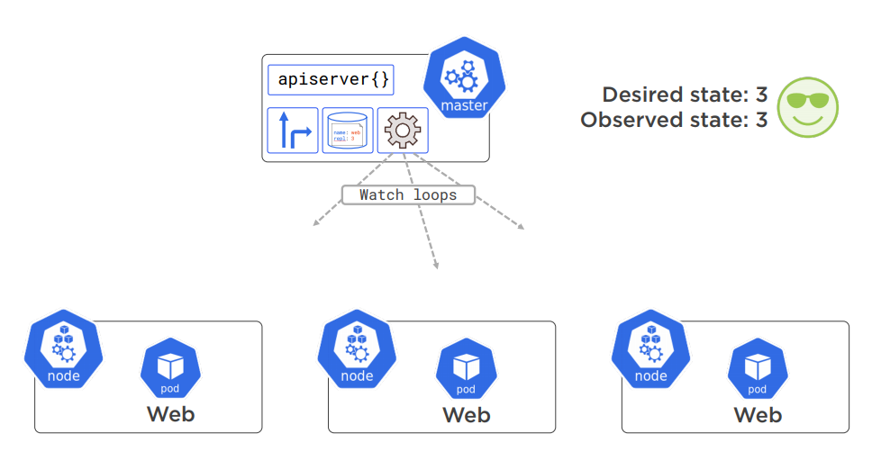
The declarative model

Slide 31
The Desired state
There are two states:
Desired states – what we want
Observed state – the current state of the cluster
Kubernetes is obsessed about the desired state
If one of our nodes fails, for example
Kubernetes will try everything it can to bring it back online
Or replicate its pods on another node
And everything happens without our involvement!

Slide 32
PODS
These are the atomic units of deployment in Kubernetes
For example, in the VM world, one unit is a virtual machine
Or in the Docker world, one unit is a container
You cannot deploy a container directly
You need to run it in a pod
Each pod can run multiple containers
Like a shared execution environment
All containers in it share the pod’s resources
For example, two containers in a pod have the same IP address
And you need to map them to unique ports

Slide 33
PODS
The unit of scaling in Kubernetes is the pod
When you want to scale up or down – you add or remove pods
You do not add or remove containers to a single pod
For this reason, you will run each container in a separate pod
This is the usual scenario
But sometimes, your containers absolutely need to share resources
For example, the same file system is needed
Then for a pod to be up and running, all containers in it should be ready
You can think of:
Nodes – infrastructure machines (physical or virtual)
Pods – applications on these machines

Slide 34
PODS
Pods are “mortal”, and they sometimes fail
Kubernetes never “resurrects” them
It just starts a new pod identical to the previous one
Pods are useful because:
We can annotate them
We can give them labels
We can add policies to them
And more!

Slide 35
Services
When a pod fails, a brand new one is created
With a new IP, which is challenging from a network perspective
When we scale up or down, new IPs are added or removed
Pods are not reliable in terms of networking
Services are the name of the game here
They have stable name and a static IP
They serve as a load balancers between pods
And keep track of the pods’ networking details automatically
Even when we add or remove pods
Services use labels to know which pods are part of them
Labels are very powerful and easy to use

Slide 36
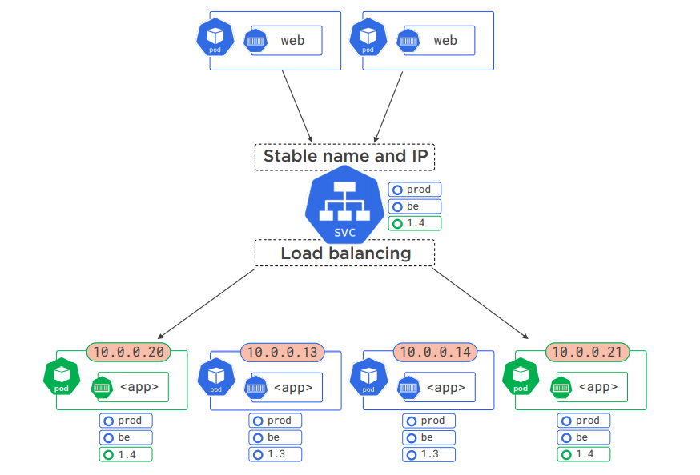
Services

Slide 37
Deployments and API Server
The deployment:
Is defined in a YAML or JSON
Various controllers receive the manifest
One is responsible for updates and rollbacks
Another – for replicas
And make sure you get your desired state in a second
The API server:
Defines all Kubernetes components as objects
They each have properties and features
Normally, we use the CLI command kubectl to communicate with the API

Slide 38
This was the big kubernetes picture
We covered a lot!
Pods
Nodes
Masters
Services
Deployments
It’s a lot of theory, but bare with me!
We are now going to exercise everything!
Things will clear up as we continue the workshop!
There are other important concepts to cover
But we will learn them on the fly!

Slide 39
Getting Kubernetes

Slide 40
Installing Kubernetes locally
The easiest ways to start developing on Kubernetes are:
Docker Desktop
Minikube
These installations are not for production
They run on a single node and require virtualization in your BIOS and OS
We are going to use Docker Desktop
Install it from here: https://www.docker.com/products/docker-desktop
Make sure to follow the documentation for your OS
Go to the Dashboard -> Settings -> Kubernetes to enable it
You can also install the web-based Dashboard:
https://github.com/kubernetes/dashboard

Slide 41
Adding the web-based dashboard
To add the beautiful web-based Dashboard to Kubernetes do the following steps
Install the Dashboard (the URL changes from time to time):
Get an access token:
The token should be on the top of the output
Copy it into your clipboard
kubectl apply -f https://raw.githubusercontent.com/kubernetes/dashboard/v2.0.0/aio/deploy/recommended.yaml
kubectl describe secret -n kube-system

Slide 42
Adding the web-based dashboard
Start the dashboard:
Go to this very long URL:
Login with the token
Done! Enjoy the friendly Dashboard UI!
kubectl proxy
http://localhost:8001/api/v1/namespaces/kubernetes-dashboard/services/https:kubernetes-dashboard:/proxy/

Slide 43
Working with pods

Slide 44
Workflow
This is the typical workflow for a Kubernetes application
We write some code
We add Docker support and build a container image
We store the image in a Docker registry
We define the image in a Kubernetes manifest file
We post that manifest to the Kubernetes API server
Kubernetes does the rest!
First make sure Kubernetes is up and running:
kubectl version
kubectl --help
kubectl explain {name-of-object}

Slide 45
Building the container
Register on Docker Hub
https://hub.docker.com/
Prepare a simple web application
Add a Docker file
Build the image:
Verify the container:
docker build -t codeitup/simple-web-app:1.0 .
docker run -p 8080:8080 codeitup/simple-web-app:1.0

Slide 46
Creating our first pod
Push the image to Docker Hub (you may need to login first)
Create a Kubernetes YAML file to define your pod
You need to define the object type – Pod in this case
You need to define the pod’s metadata – name and labels
You need to define the pod’s container specifications:
Name – the name of the container
Image – the image from Docker Hub (or other registry)
Resources – the limits of your container’s CPU and memory
Ports – ports which your container exposes (but still not publicly available)
docker push codeitup/simple-web-app:1.0

Slide 47
Our pod’s manifest file
apiVersion: v1
kind: Pod
metadata:
name: my-pod
labels:
name: web
# Continues to the next slide…

Slide 48
Our pod’s manifest file
# Continues from the previous slide…
spec:
containers:
- name: my-simple-web-app
image: codeitup/simple-web-app:1.0
resources:
limits:
memory: "128Mi"
cpu: "500m"
ports:
- containerPort: 8080

Slide 49
Explaining the manifest file
Basically, our YAML file defines a container
And wraps it in a pod
The pod and container names are whatever you like
To help you keep track of your application parts
Labels are just key-value pairs used for selecting pods (optional but useful)
Images are always pulled from Docker Hub by default
The container port should match the application’s port
But this port alone doesn’t make the pod available publicly on the Internet
It is internally accessible only in the cluster
You need to expose it by using other mechanisms

Slide 50
Explaining the manifest file
Versions:
Alpha – wild-wild west, experimental features - v1alpha1, for example
Beta – features that are beginning to take shape - v1beta1, for example
GA/Stable – features ready for production - v1, for example
Resources:
CPU – what fraction of a CPU the container should use
Measured in “millicores”
1000m equals to 1 CPU, 500m equals to 0.5 CPU and so on
Memory – how much memory the container should have
Usually measured in “mebibytes” - the power-of-two equivalents to megabytes
More information here:
https://kubernetes.io/docs/concepts/configuration/ manage-resources-containers/#resource-units-in-kubernetes

Slide 51
The api server
The manifest file is literally a “one-to-one” quick-way to call the Kubernetes API server
What is exposed in the API server can be described in the YAML file
Not all features should be done this way though
The API consists of various groups
Each with different objects you can use for your scenarios
For example, the Pod object is part of the Workload group
Those which are not in the Core group, should specify it explicitly
For example, if you decide to describe a Cron Job object:
apiVersion: batch/v1beta1
kind: CronJob

Slide 52
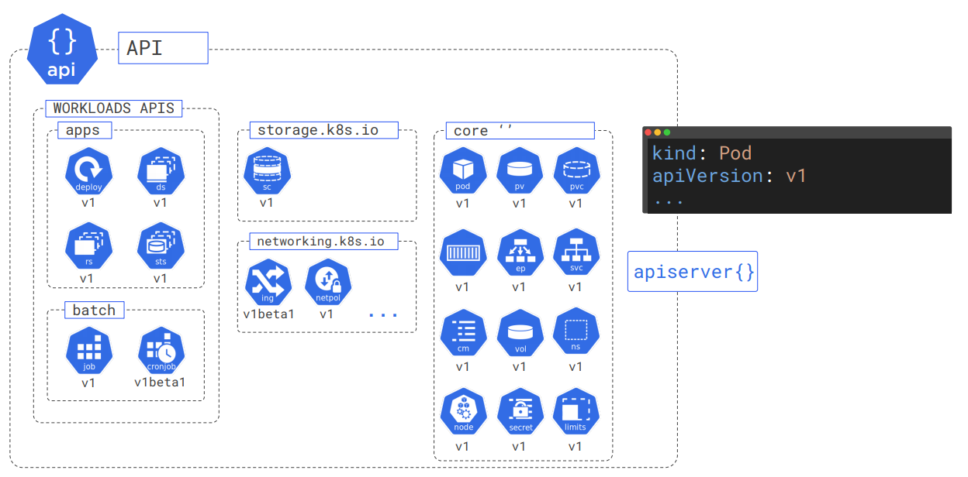
The api server

Slide 53
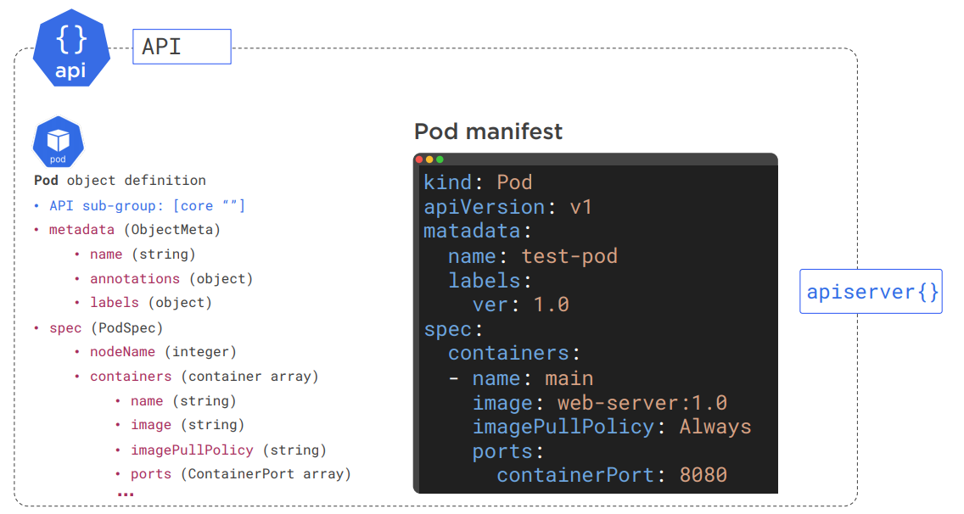
The api server

Slide 54
Applying manifest files
The full object definition can be found here:
https://kubernetes.io/docs/reference/generated/kubernetes-api/v1.18/
However, for common application scenarios, you do not need to know everything
There is a cheat sheet here:
https://kubernetes.io/docs/reference/kubectl/cheatsheet/
To apply a manifest file to Kubernetes:
You can even apply a folder full of manifest files:
kubectl apply –f ./myfile.yml
kubectl apply -f ./.k8s

Slide 55
Inspecting pods
To see all applied objects, we use the “get” command:
To get full information about a pod:
To inspect a pod:
You can expose an internal port temporarily:
kubectl get pods # add “–o wide” for more details
kubectl describe pods my-pod
kubectl logs my-pod # you can specify a container or previous crash
kubectl port-forward my-pod 5000:8080

Slide 56
Manipulation commands
To run commands inside the pod:
Hit Ctrl + D to exit
To edit a YAML file:
If you edit the file, it will be applied by Kubernetes on the cluster
kubectl exec {my-pod-name} -it sh
kubectl edit –f ./myfile.yml

Slide 57
deleting pods
Pods cannot be stopped, they can be deleted
You can stop them by scaling down though
To delete a pod:
To delete all pods:
To delete applied configurations (reversing a configuration):
kubectl delete pod my-pod
kubectl delete pods –all # or services instead of pods
kubectl delete -f ./.k8s

Slide 58
Pod health
You can probe your pods for their health
There are two kinds of probes:
Liveness – determine if pod is running
If the check fails, Kubernetes restarts the pod
Readiness – determine if a pod can receive requests
If the check fails, Kubernetes does not route traffic to the pod
By default the restart policy of pods in case of failure is “Always”
But you can configure it, if you want something else

Slide 59
Liveness probe
# Full deployment configuration skipped for brevity…
ports:
- containerPort: 80
livenessProbe:
httpGet:
path: /index.html
port: 80
initialDelaySeconds: 15
timeoutSeconds: 2 # Default is 1
periodSeconds: 5 # Default is 10
failureThreshold: 1 # Default is 3
# Full deployment configuration skipped for brevity…

Slide 60
Readiness probe
# Full deployment configuration skipped for brevity…
ports:
- containerPort: 80
readinessProbe:
httpGet:
path: /index.html
port: 80
initialDelaySeconds: 3
periodSeconds: 5 # Default is 10
failureThreshold: 1 # Default is 3
# Full deployment configuration skipped for brevity…

Slide 61
Creating services

Slide 62
Our web server is not accessible
Even though our pod is up and running
We cannot access it outside the cluster
It has an IP, but we already now pod IPs are not reliable
And inaccessible, nevertheless!
So how to access our pod?
The answer - services!

Slide 63
services
Services allows us to provide:
Internal access – if two pods need to communicate internally
External access – if you want to expose your pods to the real-world
Services are abstraction for load balancing
They always have a stable and reliable name and IP
And no matter the complexity behind them, they always deliver requests to a pod
They use an internal DNS to resolve their names
They know how to find healthy pods by their labels
Services are just another object in the API server
So we need to describe them in a YAML file

Slide 64
Types of services
There are three major types of Kubernetes services:
ClusterIP – the default service definition
Allows internal cluster connectivity
NodePort
Allows external access directly via nodes
LoadBalancer
Allows external access via load-balancer
It is simulated on a local machine
It uses a cloud-ready load balancer on production
These three types are built on top of each other

Slide 65
Nodeport service’s manifest file
apiVersion: v1
kind: Service
metadata:
name: my-service
spec:
type: NodePort
selector:
name: web
ports:
- port: 80
targetPort: 8080
nodePort: 32000

Slide 66
Inspecting services
Applying the service is done the usual way:
To get information about running services
To get full information about a service:
To access the NodePort service, you need to do it by the node port
In this case 32000
Deleting a service is just reversing a configuration
kubectl apply -f .\.k8s\node-port-service.yml
kubectl get services # add “–o wide” for more details
kubectl describe services my-service

Slide 67
Load balancer service’s manifest file
apiVersion: v1
kind: Service
metadata:
name: load-balancer
spec:
type: LoadBalancer
selector:
name: web
ports:
- port: 80
targetPort: 8080

Slide 68
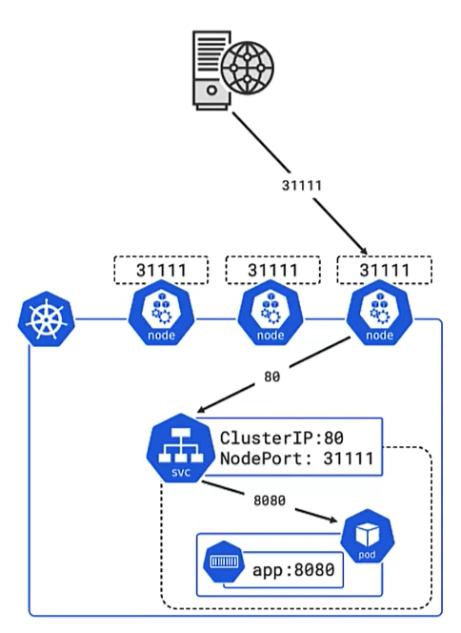
Port madness
A lot of ports are defined and it’s getting tricky
Here are more details:
targetPort – the port exposed by containers
port – the port used by the service itself
nodePort – ports for different nodes
This is how to access your application:
NodePort service – use the nodePort value
LoadBalancer service – use the port value
The default protocol is TCP
But you can change it to UDP

Slide 69
adding deployments

Slide 70
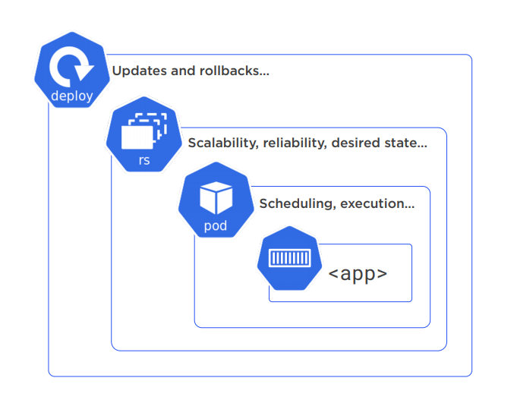
So far so good but…
We already have a running application
And it is exposed to the Internet
But what about all the other good stuff?
Automatic scaling?
Updates and rollbacks?
Replica sets and deployments to the rescue!

Slide 71
deployments
Replica sets and deployments are plain old Kubernetes objects
So we define them the usual way – in a YAML manifest file
Replica sets work behind the scenes
And we interact with deployments directly
We do not need a separate pod configuration
We can safely delete and revert it
The deployment one will take care of everything we need
And if our labels match the service selectors, they will automatically start to serve the new pods

Slide 72
deployment’s manifest file
apiVersion: apps/v1
kind: Deployment
metadata:
name: my-deployment
spec:
replicas: 5
selector:
matchLabels:
name: web
template:
metadata:
labels:
name: web
# Continues to the next slide…

Slide 73
deployment’s manifest file
# Continues from the previous slide…
spec:
terminationGracePeriodSeconds: 1
containers:
- name: my-simple-web-app
image: codeitup/simple-web-app:1.0
imagePullPolicy: Always
resources:
limits:
memory: "128Mi"
cpu: "500m"
ports:
- containerPort: 8080

Slide 74
deployments
In our configuration we need to define:
The pods (like the previous configuration)
Number of desired replicas
Selectors and labels
And that’s pretty much it! We just need to apply it:
To get information about our deployments:
To get information about our replica sets:
kubectl apply -f .\.k8s\deployment.yml
kubectl get deployments
kubectl get rs

Slide 75
Self-healing
Let’s try to delete a pod:
And then get information about the currently running pods
We can see that they are still 5!
But one of them is newer
And it has a new name
The replica set controller does everything it can to reach the desired state
Therefore it self-healed a pod when it was deleted
kubectl delete pod {pod-name}

Slide 76
What about auto-scaling?
We can manually change the replica sets to scale our application
But it is better to configure Kubernetes to auto-scale our pods
But we need to remove the replica sets
Because the replica set controller will “fight” against the scaling rules
The fast way is to use the CLI:
But a better approach is the good old YAML manifest!
We need another object though
Horizontal Pod Autoscaler
In it we must reference the original deployment
kubectl autoscale deployment my-deployment --cpu-percent=50 --min=1 --max=10

Slide 77
Horizontal Pod Autoscaler’s manifest file
apiVersion: autoscaling/v2beta2
kind: HorizontalPodAutoscaler
metadata:
name: my-autoscaler
spec:
scaleTargetRef:
apiVersion: apps/v1
kind: Deployment
name: my-deployment
# Continues to the next slide…

Slide 78
Horizontal Pod Autoscaler’s manifest file
# Continues from the previous slide…
minReplicas: 2
maxReplicas: 10
metrics:
- type: Resource
resource:
name: cpu
target:
type: Utilization
averageUtilization: 50

Slide 79
Configuring autoscaling (Current version)
We need a bit of configuration to run the Horizontal Pod Autoscaler
Install Metrics Server:
Edit its configuration:
Add the following arguments in container section:
kubectl apply -f https://github.com/kubernetes-sigs/metrics-server/releases/download/v0.3.7/components.yaml
kubectl -n kube-system edit deploy metrics-server
- --v=2
- --kubelet-insecure-tls
- --kubelet-preferred-address-types=InternalIP

Slide 80
Configuring autoscaling (Current version)
Validate the Metrics Server is running:
Apply the Horizontal Pod Autoscaler:
Validate that it scaled our pods:
Getting the active pods should show 2 instead of 1 now
kubectl get pods -n kube-system -l k8s-app=metrics-server
kubectl apply -f .\.k8s\horizontal-autoscaler.yml
kubectl describe hpa

Slide 81
Testing the horizontal pod autoscaler
Open a new terminal and run:
Fire lots of requests to our load balancer:
Watch the Horizontal Pod Autoscaler in the original terminal:
You can also scale by other metrics – memory, external, etc.
There are also Cluster Autoscaler and Vertical Pod Autoscaler objects!
kubectl run --generator=run-pod/v1 -i --tty load-generator --image=busybox /bin/sh
while true; do wget -q -O- load-balancer; done
kubectl get hpa -w

Slide 82
Rolling updates
When we have multiple replica pods running
And want to update them, we can use the so-called rolling update
Kubernetes will deploy the application’s new version without having downtime
It will add and remove pods one by one until the whole replica set is updated
This way the pods will not be updated at the same time
Because each update requires image pulling and container running
We need to add some configuration to the deployment file
minReadySeconds – how many seconds to wait between each pod update
maxUnavailable – how many unavailable pods should exist in our replica set
maxSurge – how many pods to update at the same time

Slide 83
Rolling update’s manifest file
# Full deployment configuration skipped for brevity…
selector:
matchLabels:
name: web
minReadySeconds: 5
strategy:
type: RollingUpdate
rollingUpdate:
maxUnavailable: 0
maxSurge: 1
template:
# Full deployment configuration skipped for brevity…

Slide 84
Testing the rolling update
Open a new terminal and run:
Change the image in the deployment configuration:
Apply the new deployment to see the rolling update in action!
You can also watch the status of the update:
kubectl get pods -w
image: ivaylokenov/simple-web-app:2.0
kubectl rollout status deploy my-deployment

Slide 85
rollbacks
OK, that’s great, but how to revert a deployment in case of an error?
All replica sets from old versions are persisted for quick rollback:
You can see old replica set details to validate the revert:
To rollback we need to get a revision:
And then the actual rollback:
kubectl get rs
kubectl describe rs {deployment-name}
kubectl rollout history deploy {deployment-name}
kubectl rollout undo deploy {deployment-name} --to-revision=1

Slide 86
Moving to the cloud

Slide 87
Production-ready Kubernetes
To use Kubernetes outside your local environment you have two options
Install it on your own virtual machines
You need kubeadm - https://kubernetes.io/docs/reference/setup-tools/kubeadm/
This approach is more suitable for system administrators
Basically, you execute “kubeadm init” and “kubeadm join” to bootstrap your cluster
Using cloud-ready Kubernetes
All major clouds provide Kubernetes as a service
Google, Azure, AWS, etc.
You create a cluster and administer it through the web UI
Or through CLI SDK provided by the cloud company

Slide 88
Let’s try google (GKE)
Google Cloud is a good option for learning purposes
They give you free $300 for a 90-day trial period
And do not charge you afterwards, unless you manually upgrade
Go to https://console.cloud.google.com/
Register with your Google account and claim your free credit
Of course, you can try another cloud, if you like
All the examples should work everywhere
Just the Cloud settings will be different
Kubernetes is Kubernetes after all ☺

Slide 89
Create your first cluster
Go to Kubernetes Engine
https://console.cloud.google.com/kubernetes
Select Clusters -> Create Cluster (you may need to create a new project too)
Click “My first cluster” on the right
This will create an affordable cluster with 3 worker nodes
Perfect for experiments
Click “Customize” and fill:
Choose a name
Choose a suitable region (if Europe doesn’t work, choose US Central)
The other options are just “next, next, next” ☺
Click “Make cluster” and wait for it to

Slide 90
Connecting to your cloud cluster
You should enable Google Kubernetes Engine API
It should be enabled by default
You should install the Google Cloud SDK
https://cloud.google.com/sdk/docs/downloads-interactive
Run the Google Cloud initialization command and follow the instructions
Once your cluster is ready, click “Connect”
Copy the given command and execute it
Validate your Kubernetes connection:
gcloud init
kubectl get nodes

Slide 91
Deploying components
Apply deployment and load balancer manifest files
In the cloud platform UI, you can see the changes you’ve made
When your load balancer is ready, you will see an external IP
Open in it the browser and enjoy your application live!
And exposed publicly on the Internet!
kubectl apply -f .\.k8s\deployments\deployment.yml
kubectl apply -f .\.k8s\services\load-balancer-service.yml
kubectl get services

Slide 92
Configuring our Cluster
The current cluster is quire small and without a huge computing power
You can inspect your machine type and see in the documentation what are your limits
Running 5 pods with 500 millicores may be a challenge
You can either adjust your deployment settings
Or update the cluster as you see fit
This is the power of Kubernetes!
It is super easy to configure and deploy an application
Once you understand the basics!

Slide 93
Using storage

Slide 94
Data is important
So far, our cluster has been stateless
But we need storage options
Our data needs to be:
Secure
Persistent
By design containers and data have the same lifecycle
If you delete a container, its data is lost too
Volumes to the rescue here!
You can manipulate and delete them separately from containers

Slide 95
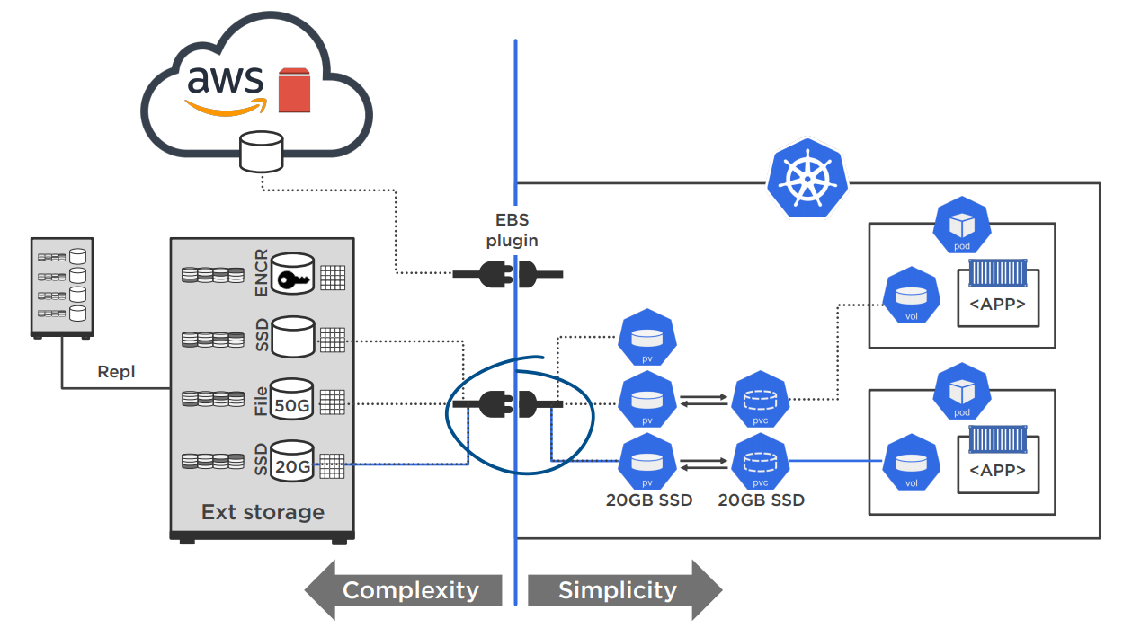
Volumes Infrastructure

Slide 96
volumes
A volume represents a storage location
It must have unique name
It is attached to a pod
But it may not be tied to the pod’s lifetime
Depending on the configuration
A volume mount is a refence to a volume
By name and by mountPath
Each volume can be claimed by one pod at a time
But it is available to all containers in it

Slide 97
Volume types
These are the most common volume types
emptyDir – shares the pod’s lifetime
Useful for sharing data between containers in a single pod
hostPath – pod mounts to the node’s file system
If a node goes down, you can potentially lose data
nfs – Network File System
A file system shared in the network
configMap/secret – for storing key-value pairs
Used for configuration values
persistentVolumeClaim – persistent storage option
It is abstracted from its details
cloud – external storage from a cloud platform

Slide 98
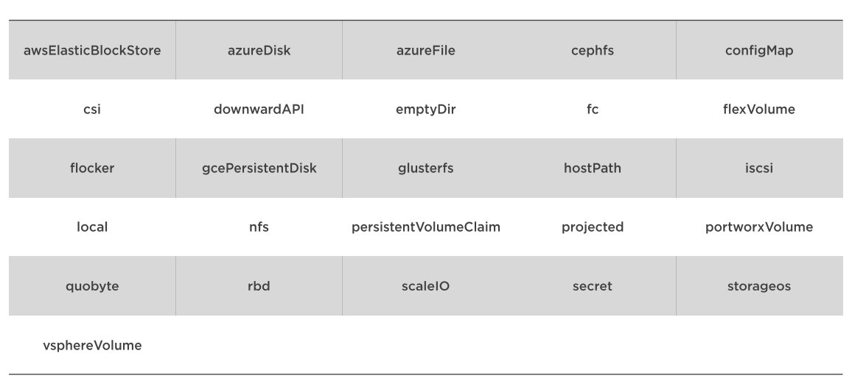
Volume types

Slide 99
Emptydir’s pod manifest file example
# Full deployment configuration skipped for brevity…
kind: Pod
spec:
volumes:
- name: my-volume
emptyDir: {}
containers:
- name: my-container
image: codeitup/my-image
volumeMounts:
- name: my-volume
mountPath: /usr/share/
readOnly: true
# Full deployment configuration skipped for brevity…

Slide 100
Azure’s pod manifest file example
# Full deployment configuration skipped for brevity…
volumes:
- name: my-volume
azureFile:
secretName: {azure-secret}
shareName: {share-name}
readOnly: false
containers:
- name: my-container
image: codeitup/my-image
volumeMounts:
- name: my-volume
mountPath: /data/storage
# Full deployment configuration skipped for brevity…

Slide 101
AWS’s pod manifest file example
# Full deployment configuration skipped for brevity…
volumes:
- name: my-volume
awsElasticBlockStore:
volumeId: {volume-id}
fsType: ext4
containers:
- name: my-container
image: codeitup/my-image
volumeMounts:
- name: my-volume
mountPath: /data/storage
# Full deployment configuration skipped for brevity…

Slide 102
Google’s pod manifest file example
# Full deployment configuration skipped for brevity…
volumes:
- name: my-volume
gcpPersistentDisk:
pdName: {volume-name}
fsType: ext4
containers:
- name: my-container
image: codeitup/my-image
volumeMounts:
- name: my-volume
mountPath: /data/storage
# Full deployment configuration skipped for brevity…

Slide 103
Volume objects
There are three main objects in Kubernetes for storage
Persistent Volume
The mapping between the external storage (hard drive, cloud, etc.) and Kubernetes
Its lifecycle is independent of the pod
Provisioned by a cluster administrator
Persistent Volume Claim
The mapping between the persistent volume and containers
A pod claims storage from the persistent volume
Storage Class
Different storage options available for Kubernetes

Slide 104
Static Persistent Volumes workflow
Create network storage resource
NFS, Cloud, etc.
Define a Persistent Volume
And register it through the Kubernetes API
Create a Persistent Volume Claim
This allows you to use the Persistent Volume
Kubernetes binds that PVC to the Persistent Volume
Bind pod or deployment volumes to the PVC
Done via the manifest file

Slide 105
PV’s manifest file
apiVersion: v1
kind: PersistentVolume
metadata:
name: my-storage
labels:
usage: sample-storage
spec:
capacity:
storage: 10Gi
# Continues to the next slide…

Slide 106
PV’s manifest file
# Continues from the previous slide…
accessModes:
- ReadWriteMany
persistentVolumeReclaimPolicy: Retain
azureFile:
secretName: {azure-secret}
shareName: {share-name}
readOnly: false

Slide 107
PV’s manifest file
apiVersion: v1
kind: PersistentVolumeClaim
metadata:
name: my-storage-claim
annotations: # Do not automatically (dynamically) create a persistent volume
volume.beta.kubernetes.io/storage-class: "" # Storage classes will be explained in a bit
spec:
accessModes:
- ReadWriteMany
# Continues to the next slide…

Slide 108
PV’s manifest file
# Continues from the previous slide…
resources:
requests:
storage: 10Gi
selector:
matchLabels:
usage: sample-storage

Slide 109
POD’s manifest file
apiVersion: v1
kind: Pod
metadata:
name: my-pod
spec:
containers:
- image: codeitup/my-image
# Continues to the next slide…

Slide 110
POD’s manifest file
# Continues from the previous slide…
name: my-container
volumeMounts:
- name: azure
mountPath: /mnt/azure
volumes:
- name: azure
persistentVolumeClaim:
claimName: my-storage-claim

Slide 111
Create a persistent disk on google cloud
Go to Compute Engine -> Disks -> Create Disk
Fill the name of your disk
Choose “SSD persistent disk”
Fill the size of your disk
At least 200 GB
Make sure your disk is in the same zone as your cluster
Create the disk and wait for it to appear online

Slide 112
Persistent Volume’s manifest file
apiVersion: v1
kind: PersistentVolume
metadata:
name: my-volume
labels:
usage: my-storage
spec:
accessModes:
- ReadWriteOnce
storageClassName: ps-fast
capacity:
storage: 10Gi
gcePersistentDisk:
pdName: my-disk

Slide 113
Persistent Volume claim’s manifest file
apiVersion: v1
kind: PersistentVolumeClaim
metadata:
name: my-pvc
spec:
accessModes:
- ReadWriteOnce
storageClassName: ps-fast
resources:
requests:
storage: 10Gi
selector:
matchLabels:
usage: my-storage

Slide 114
Pod’s manifest file
# Full pod configuration skipped for brevity…
spec:
volumes:
- name: attached-volume
persistentVolumeClaim:
claimName: my-pvc
containers:
- image: ubuntu:latest
name: my-ubuntu
volumeMounts:
- mountPath: /data
name: attached-volume
# Full pod configuration skipped for brevity…

Slide 115
Apply volume configurations
Apply the PV, the PVC, and the pod:
You can inspect whether your volumes are bound
kubectl apply -f .\.k8s\volumes\persistent-volume.yml
kubectl apply -f .\.k8s\volumes\persistent-volume-claim.yml
kubectl apply -f .\.k8s\volumes\persistent-volume-pod.yml
kubectl get pv # or pvc
kubectl describe pods
kubectl exec my-volume-pod -it sh # use mkdir to validate “data” persistence

Slide 116
Dynamic provisioning
The previous example used a static disk with fixed storage
It is good enough for certain purposes
But it doesn’t scale!
Here comes dynamic provisioning
Or in other words – requesting storages on the fly
The Storage Class object is helpful here
It acts as a template for different kinds of storage
Makes the process much more flexibility

Slide 117
dynamic Persistent Volumes workflow
Create a Storage Class
It will help us dynamically creating Persistent Volumes
Create a Persistent Volume Claim
It is will claim storage dynamically from the Storage Class
Kubernetes dynamically provisions a Persistent Volume
We do not have to do anything here ☺
The newly created Persistent Volume will be bound to our PVC
We do not have to do anything here too ☺
Bind pod or deployment volumes to the PVC
Done via the manifest file

Slide 118
Storage class’s manifest file
kind: StorageClass
apiVersion: storage.k8s.io/v1
metadata:
name: google-ssd
provisioner: kubernetes.io/gce-pd
volumeBindingMode: WaitForFirstConsumer
parameters:
type: pd-ssd
replication-type: none

Slide 119
Persistent volume claim’s manifest file
apiVersion: v1
kind: PersistentVolumeClaim
metadata:
name: my-pvc
spec:
accessModes:
- ReadWriteOnce
storageClassName: google-ssd
resources:
requests:
storage: 25Gi

Slide 120
pod’s manifest file
# Full pod configuration skipped for brevity…
spec:
volumes:
- name: attached-volume
persistentVolumeClaim:
claimName: my-pvc
containers:
- image: ubuntu:latest
name: my-ubuntu
volumeMounts:
- mountPath: /data
name: attached-volume
# Full pod configuration skipped for brevity…

Slide 121
Apply dynamic volume configurations
Apply the SC, the PVC, and the pod:
You can inspect whether your volumes are bound
kubectl apply -f .\.k8s\storage-class.yml
kubectl apply -f .\.k8s\storage-class-claim.yml
kubectl apply -f .\.k8s\storage-class-pod.yml
kubectl get sc # or pvc
kubectl describe pods
kubectl exec my-volume-pod -it sh # use mkdir to validate persistence

Slide 122
Configuration maps

Slide 123
Configuration maps core concepts
Every application needs configuration settings
Configuration Map objects provide a way to store them
They work like key-value pair data structure
Containers can easily access them no matter their pod’s scheduling
You can access them via environment variables or files

Slide 124
Configuration map’s manifest file
apiVersion: v1
kind: ConfigMap
metadata:
name: my-settings
labels:
app: my-settings
data:
enemies: "zerglings"
total: "100"
myArmy: "zealots"

Slide 125
Configuration maps from environment
You can also define a “environment” file with the key-value pairs:
But to load them you need a different command
The name of the Configuration Map is important for getting data
ENEMIES=zerglings
TOTAL=100
MY_ARMY=zealots
kubectl create configmap {cm-name} --from-env-file={path-to-file}

Slide 126
Using Configuration Maps
Getting details about a Configuration Map:
Storing value to a container’s environment from Configuration Map:
kubectl get cm {config-map-name} -o yaml
spec:
containers: … # skipped for brevity
env:
- name: ENEMIES
valueFrom:
configMapKeyRef:
name: my-settings
key: enemies

Slide 127
Using configuration maps
You can also get all configuration values:
spec:
containers: … # skipped for brevity
envFrom:
- configMapRef:
name: my-settings

Slide 128
secrets

Slide 129
Secrets core concepts
The Secret object contains a small amount of sensitive data:
A password
A token
A key
A connection string
Secrets allows us to avoid storing sensitive data in our:
Images
Files
Deployment manifests

Slide 130
Creating a secret
If you want to store a general secret in your cluster:
This approach is great for connection strings, passwords, tokens, etc.
You can also add them from files
kubectl create secret generic {secret-name} --from-literal={my-secret}
kubectl create secret generic {secret-name}
--from-file=ssh-privatekey=~/.ssh/id_rsa
--from-file=ssh-publickey=~/.ssh/id_rsa.pub
kubectl create secret tls {secret-name}
--cert=path/to/tls.cert --key=path/to/tls.key

Slide 131
Creating a secret through manifest file
apiVersion: v1
kind: Secret
metadata:
name: my-secret
type: Opaque
data:
username: YWRtaW4= # WARNING! NOT SECURE! BASE64 ENCODED!
password: MWYyZDFlMmU2N2Rm # WARNING! NOT SECURE! BASE64 ENCODED!
This approach is suitable for development environments!
If you use it in production – do not commit the file to a source code repository!
Work with your administrator and secure the data!

Slide 132
Using SECRETS
Getting details about a Secret:
The above command should be restricted by your administrator
Storing value to a container’s environment from Configuration Map:
kubectl get secrets {secret-name} -o yaml
env:
- name: DATABASE_PASSWORD
valueFrom:
secretKeyRef:
name: my-secret
key: password

Slide 133
Other useful objects

Slide 134
Stateful sets
Stateful Sets are special kind of deployment
They are useful for stateful applications
Like database, for example
The difference between a deployment is that a Stateful Set
Has unique and stable identifier
Stable persistence storage
When pods from a Stateful Set are rescheduled
They retain their identifiers
They retain their persistence storage

Slide 135
Stateful set’s manifest file
apiVersion: apps/v1
kind: StatefulSet
spec:
serviceName: mongo # has a unique name unlike deployments
replicas: 3 # default is 1
template:
spec:
containers: … # skipped for brevity

Slide 136
daemon sets
Daemon Sets ensure that a pod is run on all available nodes
As nodes are added to a cluster, pods are added to them
As nodes are removed from a cluster, the pods are garbage collected
Daemon Set pods always start before other pods on a node
The manifest file is like the Deployment one
Useful for:
Monitoring all nodes
Collecting logs from all nodes

Slide 137
job
A Job create a pod which performs a task or a batch process
Unlike standard pods, a Job’s pod does not run indefinitely
A job can be configured to run multiple pods in parallel
Successful completions are tracked
Useful for:
Retrieve and cache remote data
Perform backup
Move data from one database to another
Various other scenarios

Slide 138
Cron job
A Cron Job creates Jobs on a time-based schedule
Every 12 hours for example
Uses the standard Cron format
https://crontab.guru/
Cron Job names must be less than 52 symbols
Useful for:
Truncate logs
Move data between databases
Move data backups to a secure location
Clear cache values
Various other scenarios

Slide 139
Replication controller
The Replication Controller is the “old-school” way to create deployments
They have similar role to Replica Sets but are more limited
If your Kubernetes version supports it, prefer using a Deployment
When you read online for different Kubernetes options and configuration – if you see Replication Controller, change it to a Deployment
It’s just the older way of performing the same operation

Slide 140
Putting it all together

Slide 141
Let’s get ready to yaml with mongodb!
We are now going to run MongoDB in a Kubernetes pod
Create the following folders:
Mac/Linux: /tmp/data/db
Windows: c:/temp/data/db
We need a Secret to store our database password
We need a Configuration Map to store some MongoDB configuration
We are going to use a local Persistent Volume (useful for development)
We need a Storage Class and a Persistent Volume Claim
We need a Stateful Set to deploy our database instance

Slide 142
Let’s get ready to yaml with ASP.NET CORE!
We are now going to run SQL Server and ASP.NET Core
The web application should be able to connect to the database
The web application should be exposed via a load balancer
For SQL Server we need:
A Secret to hold our database password
A Configuration Map to configure SQL Server requirements
A Persistent Volume Claim to store the data
A Stateful Set to deploy our pod
An internal Service to expose the database in the cluster network
For ASP.NET Core we need:
A Deployment to deploy our container
A load balancer Service to expose the application externally

Slide 143
Namespaces and labels

Slide 144
Namespaces
Kubernetes supports namespaces
Which basically means that you can group logically resources together
They are meant for projects which span multiple teams and deployments
For clusters with few to tens of users (employees), you should stick to the default namespace
Or use namespaces to separate different environments
Resources created in one namespace are hidden from resources in another namespace

Slide 145
Namespaces
Use cases:
As a cluster operator, I want to support multiple user communities on a single cluster
As a cluster operator, I want to delegate authority to partitions of the cluster to trusted users in those communities
As a cluster operator, I want to limit the amount of resources each community can consume in order to limit the impact to other communities using the cluster
As a cluster user, I want to interact with resources that are pertinent to my user community in isolation of what other user communities are doing on the cluster

Slide 146
labels
Labels provide easy way to mark and select different resources
Like we saw earlier with the services definition
Commonly used labels:
Release versions - "release" : "stable", "release" : "canary"
Environments - "environment" : "dev", "environment" : "qa", "environment" : "production"
Layer - "tier" : "frontend", "tier" : "backend", "tier" : "cache"
Tracking resources - "track" : "daily", "track" : "weekly“
Labels give you fast and reliable management for different common scenarios
kubectl get pods -l environment=production,tier=frontend

Slide 147
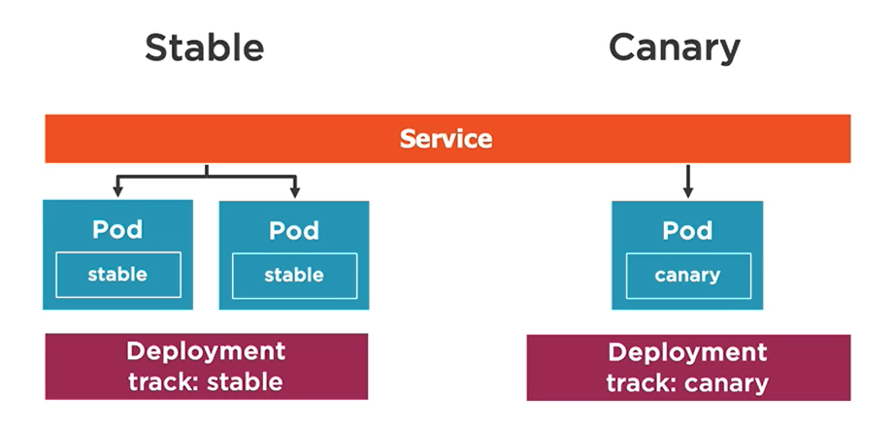
Labels example – canary deployment
Canary deployment means to create two identical production environments
One stable (4 replicas) and one with new features (1 replica)
You route minimal traffic to the testing environment to validate it works correctly

Slide 148
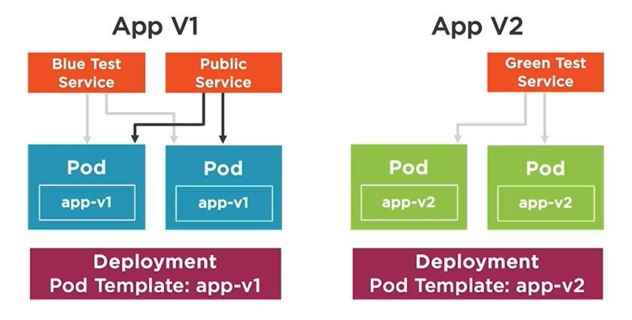
Labels example – blue/green deployment
Blue/green deployment means to create two identical production environments
One stable (blue - 4 replicas) and one with new features (green - 4 replica)
We make green publicly available only when we test everything on it

Slide 149
Troubleshooting and monitoring

Slide 150
Troubleshooting commands
Sometimes containers fail or just don’t start
Use these command to debug your application:
If you are having network issues check your deployment and service selectors!
kubectl get pods {pod-name} –o yaml # current pod state
kubectl describe pod {pod-name} # additional information and events
kubectl exec {pod-name} –it sh # execute commands in a pod
kubectl logs {pod-name} # logs of the pod
kubectl logs {pod-name} –c {container-name} # specific container log
kubectl logs –p {pod-name} # logs for a previously crashed pod

Slide 151
Constant monitoring
Monitoring of your Kubernetes objects is a must
There are various tools you can use to monitor your cluster
The Web UI Dashboard
Metrics Server
Prometheus
Grafana
Many more…
There is a demo for Prometheus and Grafana. You should check it out!

Slide 152
what’s next?

Slide 153
This workshop covers a lot!
But what’s next?
First, do the practical tasks in the workshop’s book! Hands-on experience is important!
Learn about Kubernetes patterns from Red Hat directly:
https://www.redhat.com/cms/managed-files/cm-oreilly-kubernetes-patterns-ebook-f19824-201910-en.pdf
If you want to get your hands dirty, try installing Kubernetes on bare metal:
https://phoenixnap.com/kb/how-to-install-kubernetes-on-a-bare-metal-server
Learn about Service Accounts and Node Affinity in the Kubernetes documentation:
https://kubernetes.io/docs/
Kubernetes Cheat Sheet:
https://kubernetes.io/docs/reference/kubectl/cheatsheet/
Free tier Kubernetes platforms:
https://medium.com/techprimers/free-tiers-in-different-cloud-platforms-for-trying-out-kubernetes-2ccda3f296dc

Slide 154
FINAL Lecture WORDS

Slide 155
Lecture summary
About Code It Up
About This Workshop
Why Kubernetes
The Kubernetes Architecture
Getting Kubernetes
Working With Pods
Creating Services
Adding Deployments
Moving To The Cloud
Using Storage
Configuration Maps
Secrets
Other Useful Objects
Putting It All Together
Namespaces And Labels
Troubleshooting And Monitoring

Slide 156
Any Questions?

Slide 157
Your Turn Now!
Download the resources from here and start the book: http://bit.ly/ciu-kubernetes
Ask questions on sli.do:
https://sli.do #kubernetes
Use the Facebook group for questions after the event:
https://www.facebook.com/groups/codeitup/

