Slide 1

Computational Thinking Overview

Slide 2


What is a Problem?
A problem is a situation where you face a gap between your current state and your desired goal
Problems require you to think critically and find solutions
You encounter problems daily: academic challenges, technical issues, real-world scenarios
Understanding what constitutes a problem is your first step toward solving it effectively
Notes:
Image from: https://foxwellforest.com/problem-solving-activities-for-kids/

Slide 3
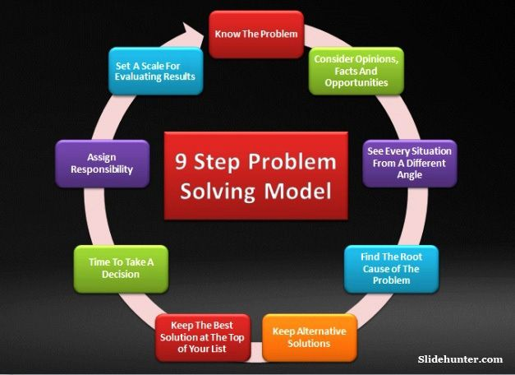
What is Problem Solving?
Problem solving is the process of finding solutions to difficult or complex situations
It involves analyzing the problem, generating possible solutions, and evaluating outcomes
Effective problem solving requires both creativity and logical thinking
You develop problem-solving skills through practice and reflection on your approaches
Notes:
Image from: https://slidehunter.com/an-overview-of-9-step-problem-solving-model/

Slide 4
Problem-Solving Steps
Define the problem clearly and understand what you need to achieve
Gather relevant information and identify constraints or limitations
Generate multiple possible solutions without judging them initially
Evaluate each solution based on feasibility, efficiency, and effectiveness
Implement your chosen solution and monitor the results
Reflect on the process and refine your approach for future problems

Slide 5
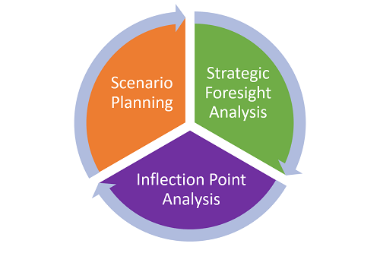
Problem-Solving Strategies
Decomposition: break complex problems into smaller, manageable parts
Pattern recognition: identify similarities with problems you have solved before
Abstraction: focus on essential features and ignore irrelevant details
Algorithm design: create step-by-step procedures to solve problems systematically
Trial and error: test different approaches when the solution path is unclear
Work backwards: start from the desired goal and trace back to the starting point
Notes:
Image from: https://balancedscorecard.org/bsc-basics/articles-videos/webinar-techniques-for-strategic-thinking-and-planning/

Slide 6
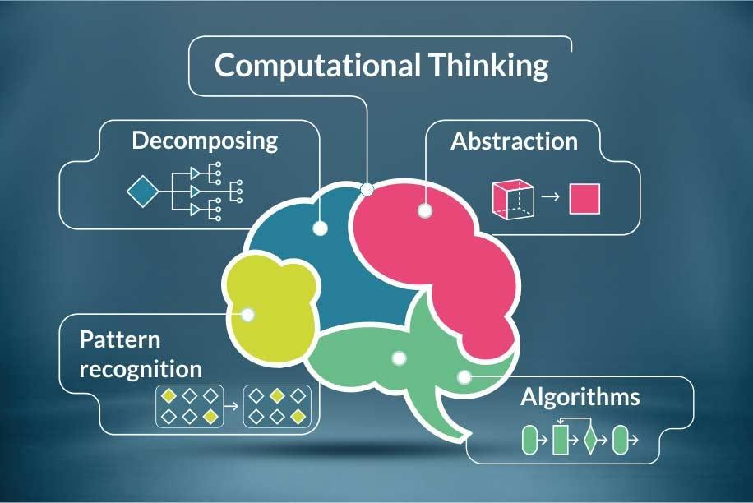
Introducing Computational Thinking
Computational thinking is a problem-solving approach that applies computer science principles to any domain
It emphasizes breaking problems into components, recognizing patterns, and designing algorithms
You use computational thinking to structure complex problems in ways that computers and humans can understand
Computational thinking is not just about programming; it is a universal thinking skill for the digital age
Notes:
Image from: https://medium.com/@deryrahman/computational-thinking-an-important-skill-for-everyone-22f7a28a0f87

Slide 7
Connecting Computational Thinking to Problem Solving
Computational thinking enhances traditional problem solving by adding systematic structure and precision
When you apply computational thinking, you translate real-world problems into computational models
You use decomposition to break problems into algorithmic steps that can be executed reliably
Pattern recognition in computational thinking helps you reuse solutions across different contexts
Turn to a partner and discuss: How might computational thinking improve a problem you recently faced?

Slide 8
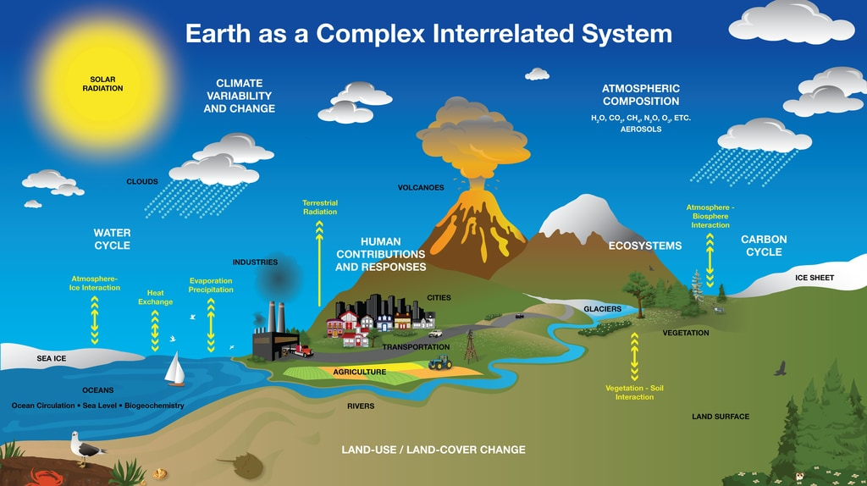
The Link Between Concepts
Problems are the starting point; problem solving is the process; computational thinking is the framework
Computational thinking provides structured strategies that make problem solving more efficient and scalable
You apply problem-solving steps within a computational thinking framework to achieve better outcomes
All three concepts work together: identify problems, solve them systematically, and think computationally about solutions
Understanding their relationship helps you tackle challenges across mathematics, science, engineering, and technology
Notes:
Image from: https://www.sciencelearn.org.nz/resources/3274-earth-systems-and-climate-change

Slide 9

Real-World Applications
Software development: you use computational thinking to design algorithms and write code
Data analysis: you decompose datasets, recognize patterns, and abstract key insights
Business optimization: you break down processes, identify inefficiencies, and design better workflows
Scientific research: you model complex systems and simulate outcomes computationally
Artificial intelligence and machine learning: you structure problems so machines can learn and solve them
Healthcare and medicine: you apply computational approaches to diagnosis, treatment planning, and drug discovery
Notes:
Image from: https://www.cv-library.co.uk/recruitment-insight/technology-in-the-workplace/

Slide 10
Teaching Sequence for University Students
Start with foundational problem-solving: teach students to define problems and understand constraints
Introduce problem-solving strategies: decomposition, pattern recognition, abstraction, and algorithms
Build computational thinking skills: show how to apply these strategies systematically and computationally
Connect theory to practice: use case studies and projects that demonstrate real-world applications
Develop metacognitive awareness: encourage reflection on thinking processes and strategy selection
Advance to complex, interdisciplinary problems: integrate computational thinking across multiple domains

Slide 11

Reflection and Next Steps
You now understand how problems, problem solving, and computational thinking form an integrated framework
Computational thinking empowers you to approach challenges with structure, clarity, and systematic reasoning
As you progress, practice decomposing complex problems and recognizing patterns in different contexts
Consider how you can apply these concepts in your major, research, and professional career
What is one problem you face regularly that you could solve more effectively using computational thinking?
Notes:
Image from: https://nexus-education.com/blog-posts/importance-intentional-reflection/

Slide 12
Key Takeaways
Problems are gaps between current and desired states that require solutions
Problem solving is a systematic process with defined steps and multiple strategies
Computational thinking applies computer science principles to structure and solve any problem
Decomposition, pattern recognition, abstraction, and algorithms are core computational thinking strategies
These concepts are interconnected and applicable across science, technology, business, and everyday life
Mastering computational thinking prepares you for success in an increasingly digital and complex world

