Slide 1
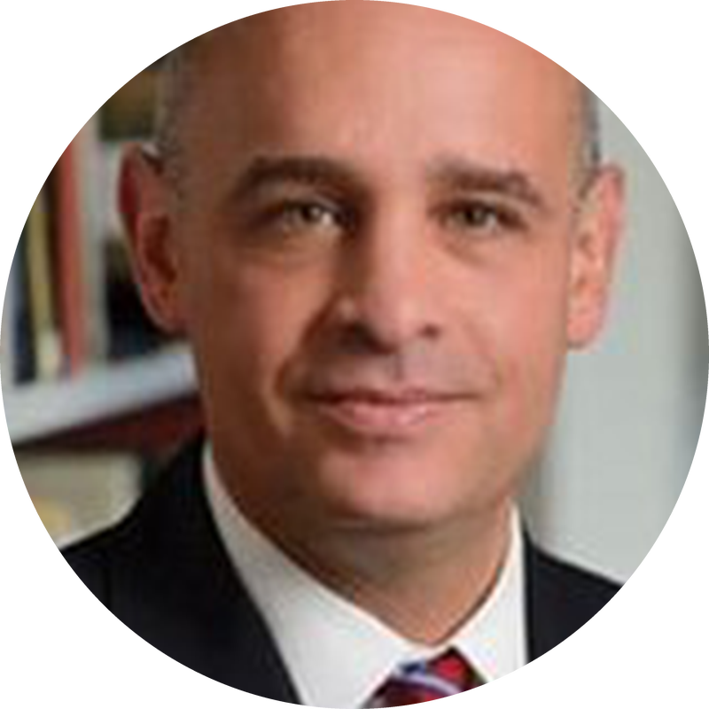



OPENING REMARKS · THURSDAY, OCTOBER 15 · 9:00 AM
Chris Celenza
Dean, Krieger School of Arts and Sciences
Johns Hopkins University
AI and History Conference 2026 · Johns Hopkins University · SNF Agora Institute

Slide 2

OPENING REMARKS · THURSDAY, OCTOBER 15 · 9:00 AM
Louis Hyman
Dorothy Ross Professor of History, Johns Hopkins University
Director, Center for Economy and Society, SNF Agora Institute
AI and History Conference 2026 · Johns Hopkins University · SNF Agora Institute

Slide 3
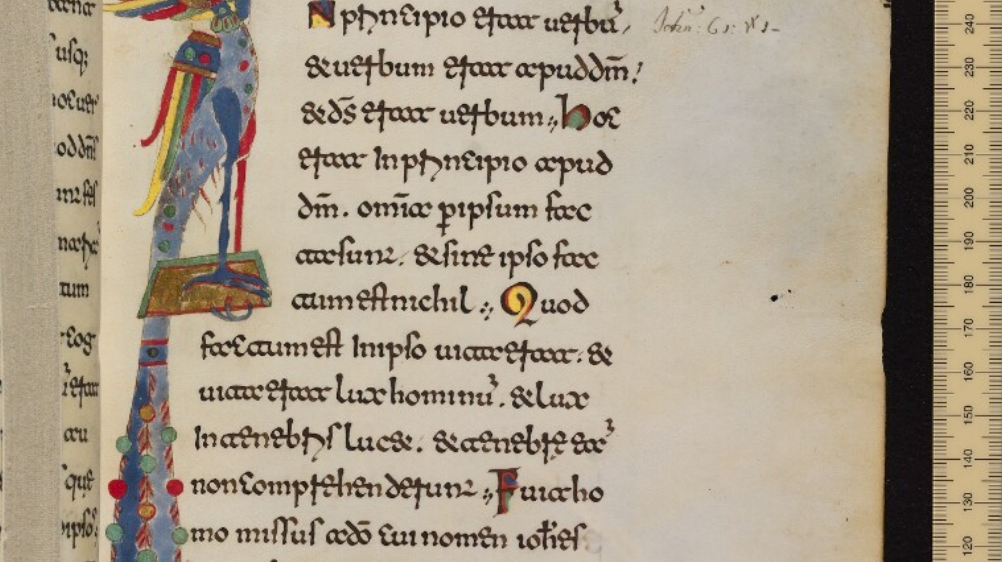
MS Oxford, Bodleian Library, MS. Canon. Bibl. Lat. 61, fol. 10r

Slide 4

OPENING PLENARY · THURSDAY, OCTOBER 15 · 9:30 AM
Marnie Hughes-Warrington
Bradley Distinguished Professor
University of Adelaide
AI and the Misrepresentation of History
AI and History Conference 2026 · Johns Hopkins University · SNF Agora Institute

Slide 5
Algorithmic History Wars
Distinguished Professor Marnie Hughes-Warrington AO
American Historical Association and Johns Hopkins University
AI and History Conference Plenary, October 2026
Statement on the use of AI
This presentation was made with AI-supported spelling, grammar, and search tools.

Slide 6
Artificial Intelligence is an historical field
AI technologies process data from the past to solve problems, create materials, and to make recommendations
Algorithms that make histories: artificial historians
Histories made by AI can shape our access to fair and accurate information, education, health, finance, and insurance

Slide 7

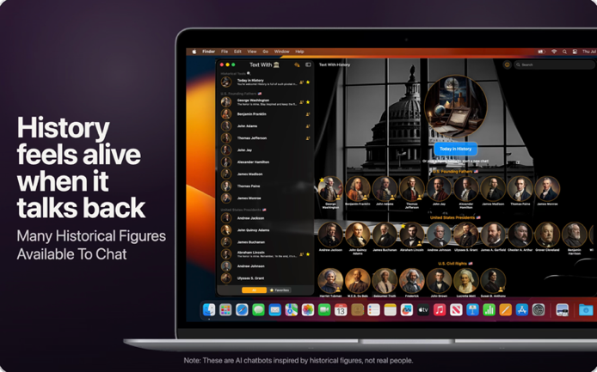
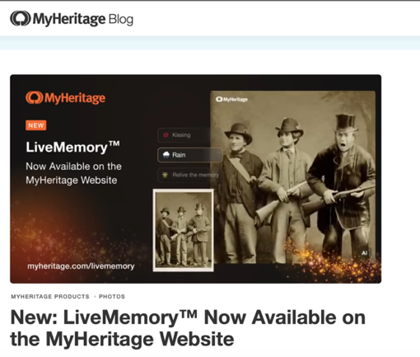
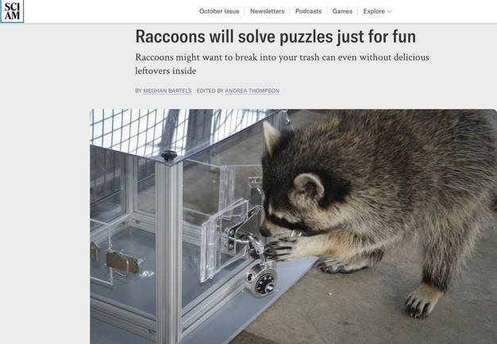
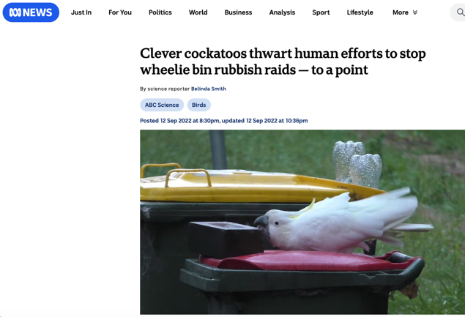
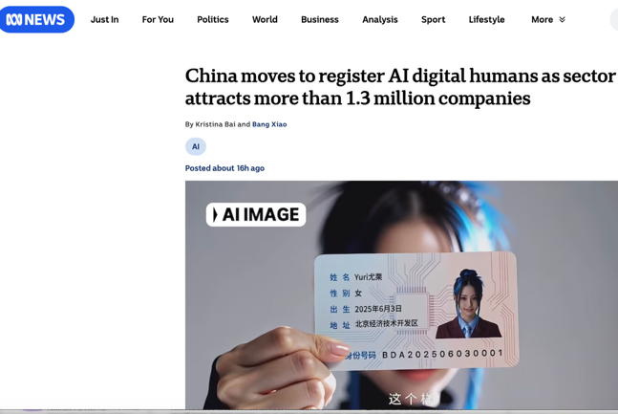
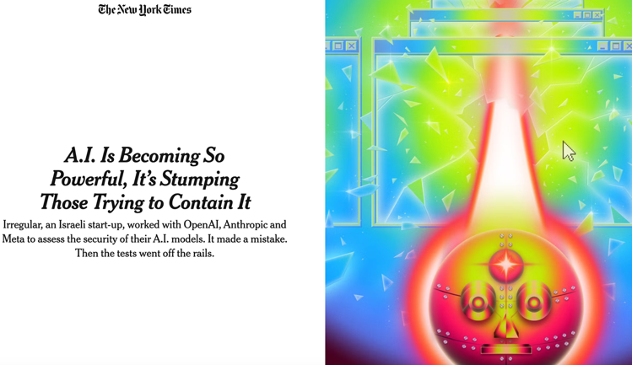
Regular Update

Slide 8





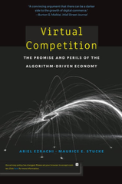
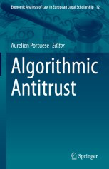

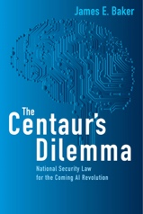
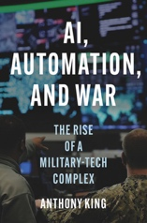
Disinformation and History Wars
Intent to cause harm and denying or limiting access to fair and accurate histories
Person on Person
Hybrid Wars
Algorithmic

Slide 9
From Disinformation to Misinformation
People instruct algorithms to make histories
Mixture of knowing and unknowing actions
Algorithms learn from the same information and from one another without human direction and make histories

Slide 10
Addressing Historical Misinformation Today
Addressing hybrid conflicts—varying combinations of terrorism, insurgency, criminality, kinetic clashes, cybersecurity and misinformation attacks—can be held back by applying principles from past conflicts.
-Lawrence Freeman, The Future of War (2017), Penguin, 222–9
You may rely on
  early ‘knockout blows’ delivered through leading technologies;
  Human oversight;
  Applying nuclear control approaches without adaptation
-Lawrence Freeman, The Future of War (2017), Penguin, 277-88:
-James Baker, The Centaur’s Dilemma (2021), Brookings;
-Anthony King, AI, Automation, and War (2025), Princeton University Press.
Single acts might not be effective where people or AI agents generate historical misinformation at speed, in high volumes, and at relatively low cost.

Slide 11

History is Challenging for AI Safety
Historical prompts can be used to elicit or ‘jailbreak’ illegal, exploitative, hateful or harmful information
-Yu et al., (2024) ‘Don’t Listen to Me;’
Russinovich et al., (2025) ‘Great, Now Write an Article about That.’
Universal safety parameters can lead to the prohibition of legitimate historical materials, or anachronistic results.
Test bank approaches conflate historical reasoning with ‘true/false’ questions about a small number of historical events, and sensitive or contested answers are excluded.
The expertise of historians has yet to be recognised in AI safety research and development.

Slide 12

Potential Approaches to Algorithmic History Wars
Autonomous algorithmic antitrust research
Interacting AI agents in financial trading can reduce market volatility but also enhance the concentration of investment in a smaller range of entities
Yang et al. (2025) ‘Research on the Impact of Algorithmic Trading on Market Volatility,’ Scientific Reports, 15(30073)
AI agents using the same pricing algorithms, or training data can lead to unfavourable price outcomes for consumers
Musolff (2026) ‘Algorithmic Pricing, Price Wars and Tacit Collusion,’ Management Science, https://doi.org/10.1287/mnsc.2022.02462;
Fish et al. (2026) ‘Algorithmic Collusion by Large Language Models,’ arXiv:2404.00806

Slide 13
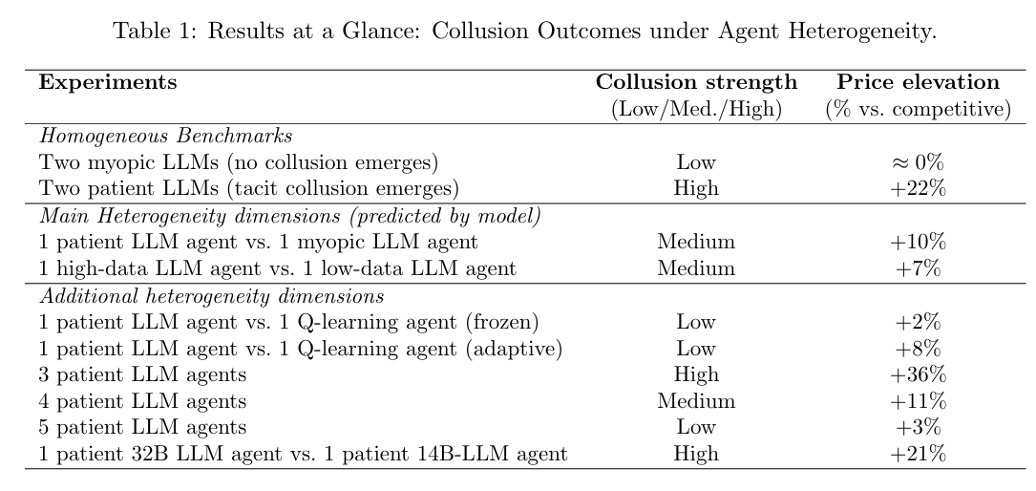
Mitigation of Autonomous Algorithmic Antitrust
The risk of price fixing and higher prices is reduced relative to the number of interacting agents, and when agents set prices at varying intervals.
-Keppo et al. (2026) ‘On the Fragility of AI Agent Collusion,’ arXiv:2603.20281

Slide 14
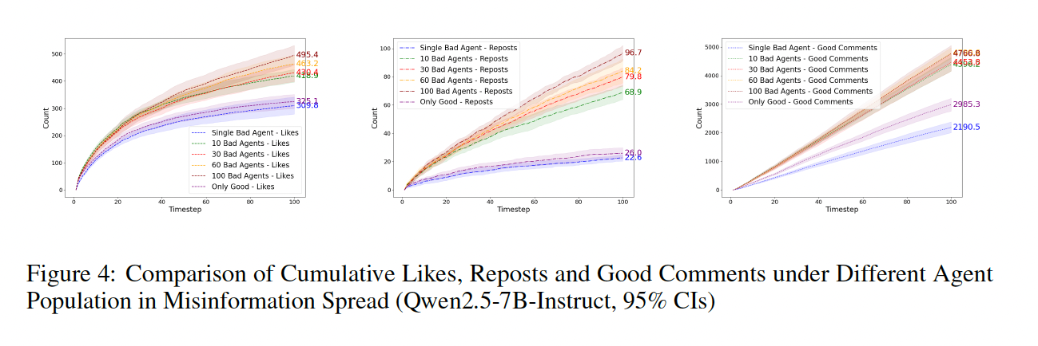
Potential Approaches to Autonomous Algorithmic Misinformation
Increasing the number of intersecting agents can increase the risk misinformation generation and dissemination.
Agents adapt to banning and to debunking.
-Ren et al. (2025) ‘When Autonomy Goes Rogue,’ arXiv:2507.14660

Slide 15
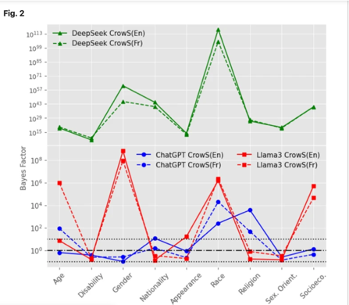
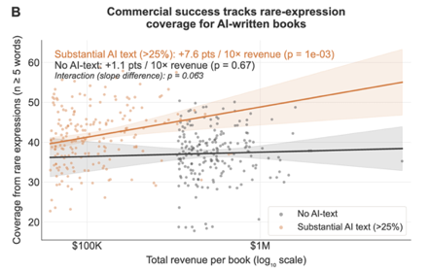
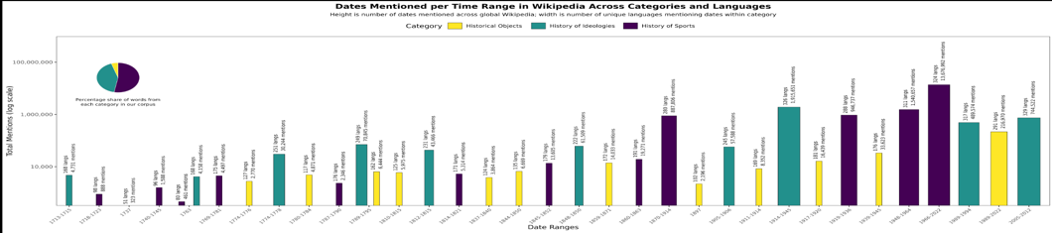
Algorithmic History Wars: A Potential Research Agenda
No Intentions: We might not have evidence of human intent
Multiplicity: focused training data, agent numbers and sales may compound, and provide avenues for misinformation
  Heterogeneity: Variations in agent activity rates, historical topics, languages may be important.
Si, et al. (2025) ‘Detecting Implicit Biases of Large Language Models with Bayesian Hypothesis Testing,’ Scientific Reports 15(12415).
Buongiorno et al. (2026) ‘Multi-Scale Computational Analysis of Wikipedia’s Telling of Global History,’ https://doi.org/10.21203/rs.3.rs-8042139/v1
Chakrabarty et al. (2026) ‘Generative AI Floods and Dilutes the Market for Books, arxiv.org/abs/2607.20349

Slide 16
Historiographical Multiplicity and Heterogeneity
Historians working at different scales, different languages
Historiographers/theorists of history
Digital and AI historians
Historical approaches in cybersecurity, information, and warfare studies

Slide 17
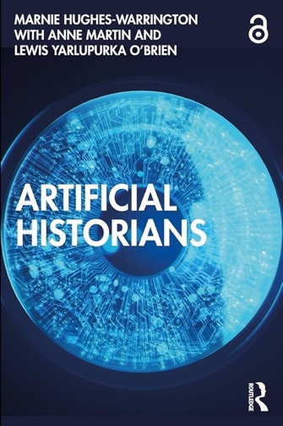

Thanks

Slide 18



PLENARY · FRIDAY, OCTOBER 16 · 9:30 AM
The Discipline We Need to Build
Christopher Phillips
Carnegie Mellon University
Matthew Connelly
Columbia University
Jo Guldi
Emory University
AI and History Conference 2026 · Johns Hopkins University · SNF Agora Institute

Slide 19
CLOSING REMARKS & NEXT STEPS · FRIDAY, OCTOBER 16 · 3:00 PM
Louis Hyman
Dorothy Ross Professor of History, Johns Hopkins University
Director, Center for Economy and Society, SNF Agora Institute
AI and History Conference 2026 · Johns Hopkins University · SNF Agora Institute

Slide 20

ANNUAL MARGARET LEVI LECTURE IN POLITICAL ECONOMY · FRIDAY, OCTOBER 16 · 4:00 PM
Tim O'Reilly
Founder and CEO
O'Reilly Media
From Value Creation to Value Extraction in Silicon Valley
AI and History Conference 2026 · Johns Hopkins University · SNF Agora Institute

