Slide 1
Complexity Estimation of Deep Learning Models
Members:
Niti Wattanasirichaigoon
Hardev Ranglani
CCC:
Manoochehr Assa
Husam Sweidan

Slide 2
Outline
Problem Statement
Goals
Approach- Original Research Paper
Replication of results from the paper
TensorFlow Mirrored Strategy
Method 1 & Method 2 for Mirrored Strategy
Results
Results with Method 1
Results with Method 2
Results with Method 2- with correction
Next Steps
Lessons Learned

Slide 3
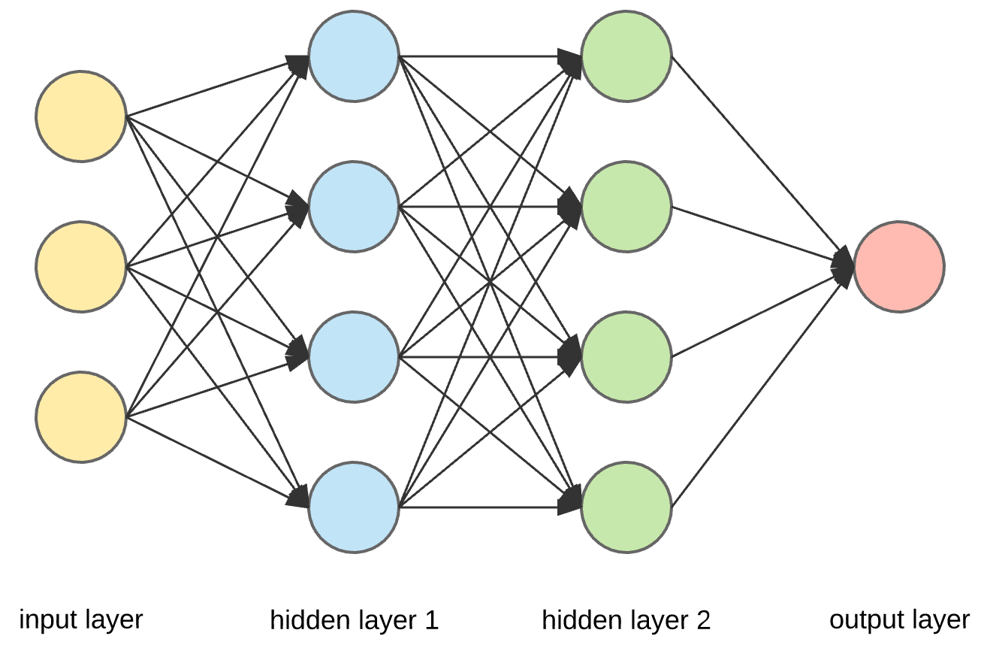
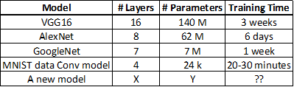
Problem Statement
Deep Learning models have the ability to outperform other ML models and even humans at many problems
Convolution Neural Networks, are a type of Deep Learning models, used for image recognition and CCC uses it to categorize claims from images of car damage
However, training of large models can take days or weeks on GPUs- which can be costly
Prediction of training time for a Model is required for cost benefit analysis
Simple representation of DNN
Run time for various standard DNNs

Slide 4
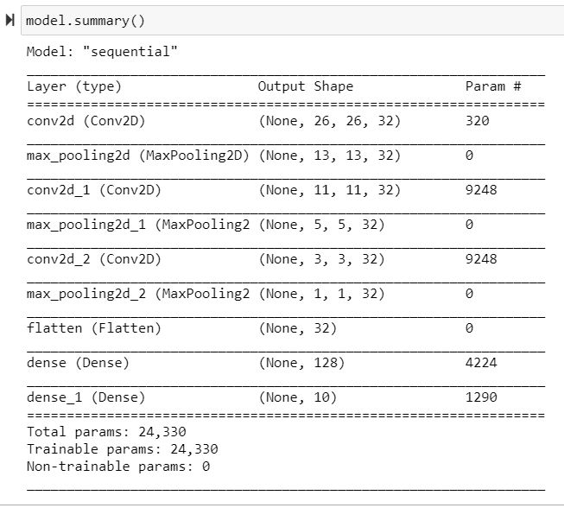
Goals
For a given DNN model with a given model architecture, dataset size and the available hardware, how much time is it going to take for training?
Based on the GPU training time, how much money (or carbon footprint) is it going to take to train the model? Is the cost worth the benefit?
Final Deliverable: A tool/python package which can take the model parameters, data size, hardware specs, etc. as input and can provide the predicted training time for the model with reasonable accuracy

Slide 5
Approach
Our approach is based on the research paper: “Predicting the Computational Cost of Deep Learning Models” (https://arxiv.org/pdf/1811.11880.pdf)
The total run time for the model can be broken down as the sum of the time to process through each of the layers
Each of these layers have various hyper-parameters, such as batch size, input shape, matrix size, kernel size, strides, activation, etc. which can have overall 10^14 possible combinations based on the usual ranges of these parameters
For a random subset of 50k combinations, we define a simple 1-layer model and record the training time for the model

Slide 6
Approach(contd..)
These 50k records of benchmarking data are then used to build a separate DNN model, which can then predict the run time of a layer for any given combination
Hence, for a given new DNN model structure, this model can predict the run time for each layer separately which can be combined to get the predicted run time for the overall model
However, we have had modified this approach based on our findings from our own experiments, which were not mentioned in the research paper(explained later)

Slide 7
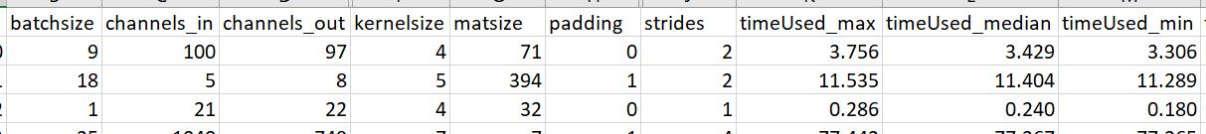
Replication of results from the original paper
Thanks to Prof Shlomo, we were able to use Chameleon cloud, which is a publicly available testbed system for Computer Science experimentation, to access the GPUs which can be used to generate the benchmark data
We were able to use the benchmark script to generate the 15k records data over 4 different GPUs on Chameleon Cloud (2.5k records take about 12 hours to generate), below is a snapshot of the data generated:
Generated data snapshot:

Slide 8
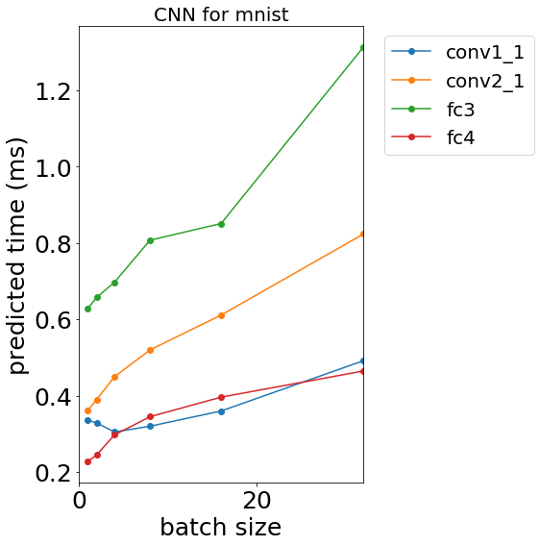
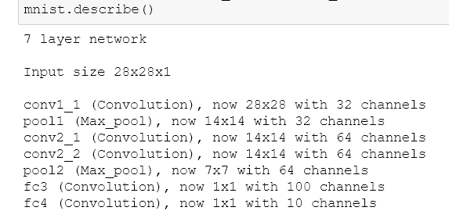
Replication of results from the original paper
Based on the data generated, we built the model to get the predictions of run times for each layer of a given DNN. The model had an RMSE of 10.4 msec
We were also able to get the full-model predictions for different model architectures:

Slide 9
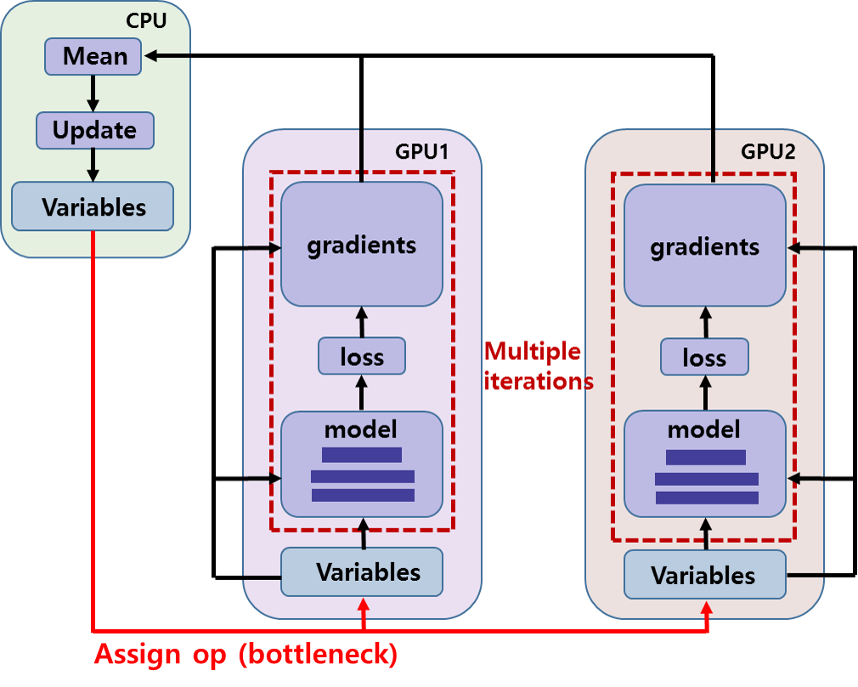
Enter: TF Mirrored Strategy(Module for multi-GPU processing)
The entire methodology and results of the original paper are based on the model training on a single GPU
However, the client wanted to get the predictions of training time using distributed training, i.e. training time using multiple GPUs parallely
The methodology for this was nowhere mentioned in the original paper, so we came up with our own methods to benchmark the training time on multiple GPUs
tf.distribute.MirroredStrategy
Global Batch Size: 64
Replica Batch Size: 32

Slide 10
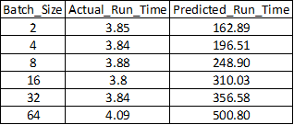
Method 1: Same approach as original paper
We tried the same approach, i.e. generate benchmarking data of the individual layers using Mirrored Strategy and built a model to predict the run times for each layer
We then used this model to get the predictions of run times for a model using Mirrored Strategy and compared it to the actual run times
The results were pretty bad, as the predicted run times for the overall model were in the range of 100’s ms per batch and the actual run times were in 10’ ms per batch
But, why would that be ?
Predicted v/s Actual run times(ms) for Mirrored Stratrgy- MNIST data- Method 1

Slide 11
Method 1: Apply same as original paper
Aggregation of gradients happening ONLY at last layer
We then realised that actually the aggregation of the gradients is only happening at the last layer in the TF mirrored strategy
Hence, except for the last layer, all other layers are performing the same operation as in the case of a single GPU operation
Hence, we can get the predictions of all but the last layers using our original single GPU approach and use mirrored strategy approach to get the predictions of run times for the last layer
Global Batch Size: 64
Replica Batch Size: 32

Slide 12
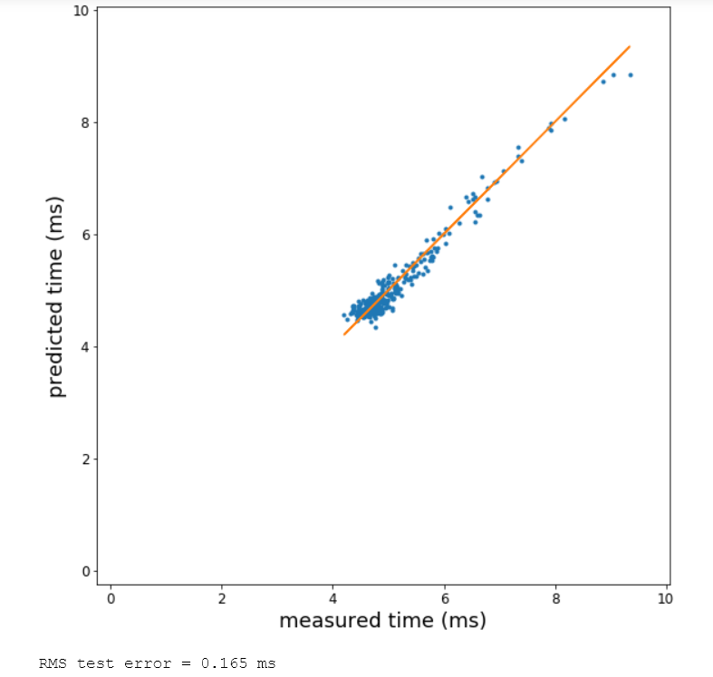
Method 2: MS approach for last layer, original approach for all other layers
We then generated the benchmark data for only the last layer using Mirrored Strategy, and built a model on it to predict the run time of the last layer
The model was pretty accurate, and had an RMSE of 0.165 ms on the test data
We then tried this approach to another dataset, the Patch camelyon dataset, a much larger dataset than the MNIST data
Patch Camelyon dataset: 262,144 images Dimensions: 96 x 96 x 3 Number of classes: 2 Size: 7.46 GB

Slide 13
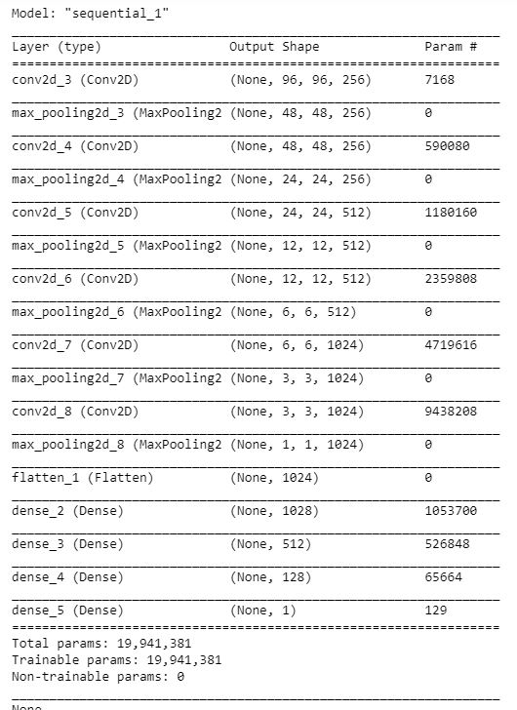

Method 2: New Approach
We also defined a larger model architecture, using 6 conv layers + 4 dense layers
We got the predictions of run time for the Initial layers using the original single GPU Model and the predictions for the last layer using our MS benchmark model
We also recorded the actual run time of the model using mirrored strategy and compared the predicted v/s actual training times….
Predictions using MS benchmark model

Slide 14
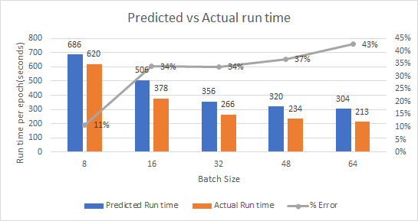
Method 2: Results
From the results, we saw that for the batch size 8, we have a low error of 11% but a higher error for the other batch sizes
However, for the higher batch sizes, we saw that we are constantly over-predicting by 35%-40% each time
We then tried to investigate why this is happening....

Slide 15
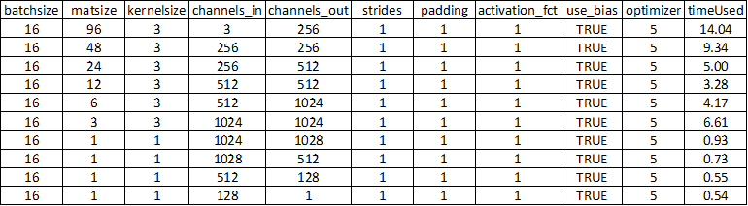
Method 2: Results Deepdive (This gets interesting!)
To look into this further, instead of the model predictions for The initial layers, we got the actual run times for each layer separately using our benchmarking script
We also got actual run times for the entire model on a single GPU & compared these with the sum of the run times of each layer
Using the researcher’s assumption, the sum of these should match, however…..

Slide 16
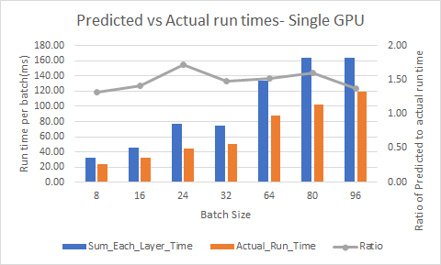
Method 2: Results Deepdive
We found that the predicted run time for the model on a single GPU based on the sum of the run time of each layer is always ~1.5 times the actual run time
This proves that when benchmarking a single layer, there is an overhead which disappears when the layers are combined to form a full model (this wasn’t mentioned In the research paper)

Slide 17

Method 2: New Approach with correction factor
We applied this observation while getting the predicted run times for the initial layers
We divided the predictions of the initial layers by the correction factor, 1.5, and then added It to the predictions of the run time of the last layer from the MS benchmark model
The results improved this time...
Predictions using MS benchmark model

Slide 18
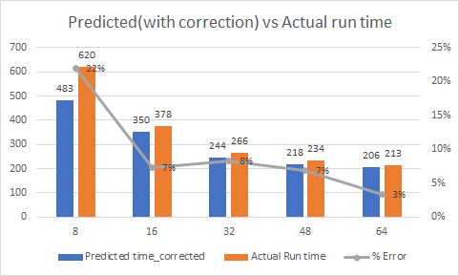
Method 2: Results
After applying the correction factor to the results, we see that the predictions are much more accurate
Except for the first batch size of 8, the predicted run times are closely matching the actual run times for the model using Mirrored Strategy

Slide 19
Correction Factor of 1.5
Even though we are able to get better predictions after applying the correction factor, there are the below questions we are not able to answer:
Is the factor 1.5 only applicable to this particular machine or type of GPU ?
Does this factor change for a different model architecture/dataset ?
What is the exact root cause for this overhead? Can this overhead factor be predicted for a given model/dataset/GPU ?

Slide 20
Next Steps
Perform Hyper-parameter tuning for both the single-GPU model and the Mirrored Strategy approach model to see of the model accuracy can be improved
Research further for the correction factor to see if a similar correction factor is required for the same experiment on a different GPU/dataset/model architecture
Embed the current model in a python package/tool which can take the model parameters/hardware specs as input and get the predicted run times, including the adjustment for the correction factor

Slide 21
Lessons Learned
Technical Learnings:
Conducting experiments following the scientific process
Using a cloud platform and setting up the correct Tensorflow & cuda environments
Working on the linux terminal, transferring files via ssh
Distributed training over multiple GPUs using Tensorflow MirroredStrategy
The mechanisms behind the model training process in Keras and Tensorflow
Other Learnings:
We could have planned our project scope and timeline to better account for the risks that were going to happen.
We could have realized how complex our research is and started sooner.

Slide 22
Questions ?

Slide 23
Correction Factor of 1.5
Even though we are able to get better predictions after applying the correction factor, there are the below questions we are not able to answer:
Is the factor 1.5 only applicable to this particular machine or type of GPU ?
Does this factor change for a different model architecture/dataset ?
What is the exact root cause for this overhead? Can this overhead factor be predicted for a given model/dataset/GPU ?

Slide 24
Complexity Estimation of Deep Learning Models- Overhead Factor Deep Dive
Members:
Niti Wattanasirichaigoon
Hardev Ranglani
CCC:
Manoochehr Assa
Husam Sweidan

Slide 25
Correction Factor of 1.5- Deep Dive
To reiterate, the correction factor of 1.5 is the overhead factor by which the sum of predictions of run time of each layer of a model is higher than the overall actual run time for the model
We ran several experiments to answer the below questions:
Does the overhead factor depend on the number of layers within the model?
We observed the variation in the observed overhead factor for models of 2,3,….10 layers
Does the overhead factor depend on the batch size of the data fed to the model?
We observed the variation in the observed overhead factor for models of batch size 4, 8, 12,….100

Slide 26
Correction Factor of 1.5- Deep Dive Results
We used the model architecture for the patch camelyon dataset again which contained 10 layers
We created smaller models from this architecture by creating model architectures from the first 2, first 3,… first 9 layers
We then observed the actual run time for these models v/s the predicted run times for these models from the benchmark script to compare the overhead factor for these models
We observed that the overhead factor was very consistent for models of different sizes for a fixed batch size

Slide 27
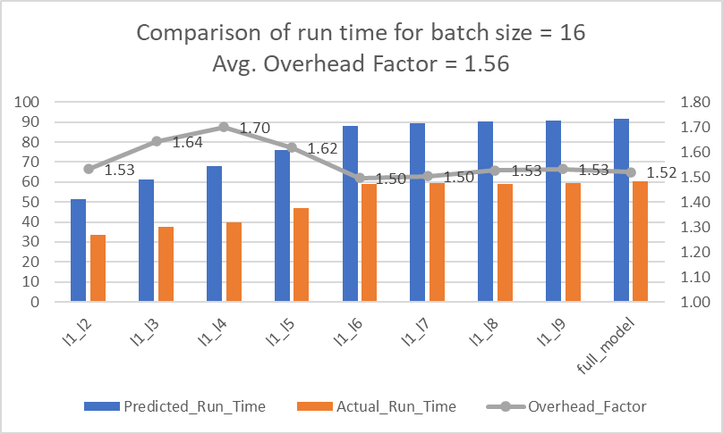
Correction Factor of 1.5- Deep Dive Results
This graph shows the comparison of predicted v/s actual run times for models with different number of layers
This graph shows that the overhead factor is not varying much for the different models

Slide 28
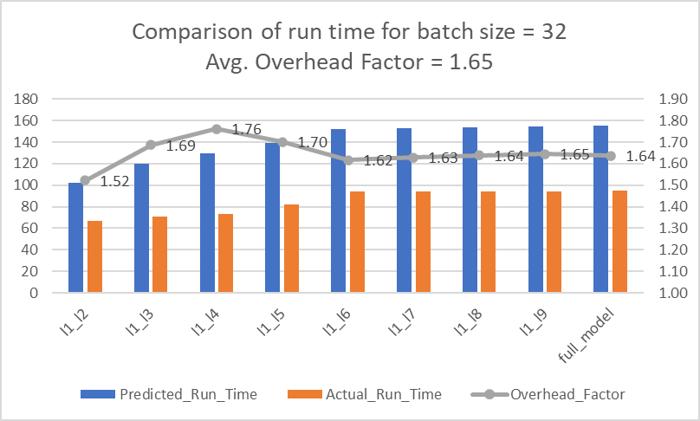
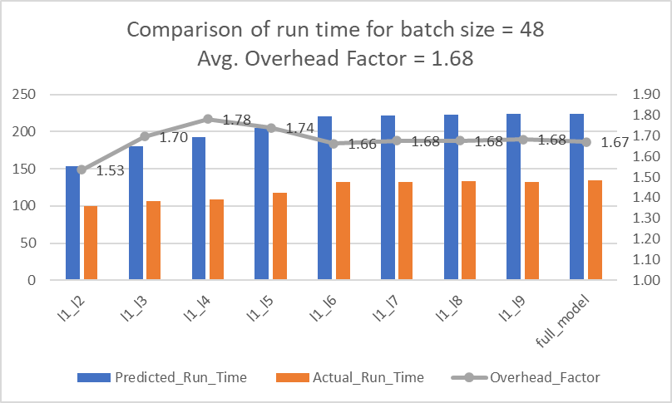
Correction Factor of 1.5- Deep Dive Results
Thus, we can reasonably conclude that the overhead factor does not have a high variation for models with different number of layers

Slide 29
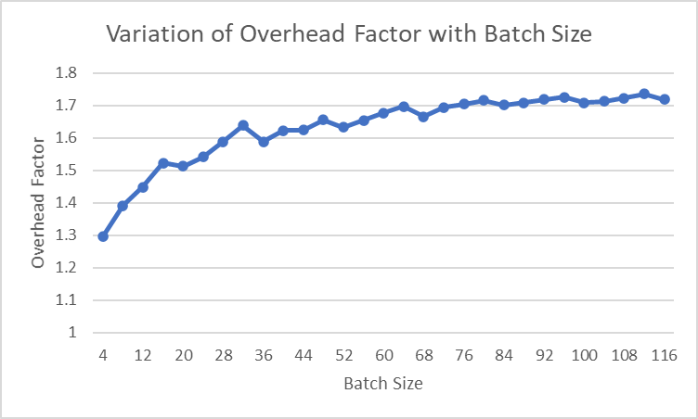
Correction Factor of 1.5- Deep Dive Results
As the overhead factor is seen to be varying with the batch size, we conducted more experiments where we varied the batch size and observed the overhead factor in each case
We ran the model for batch sizes of 4, 8,12…116 and plotted the overhead factor in each case.
The graph is seen to be following a logarithmic curve
Based on this curve, the overhead factor can be predicted for a given batch size and can be applied to the model run time predictions

Slide 30
Next Steps
We believe we have all the required pieces to form together the package required to get the predictions for the full model
We can get the overhead factor based on the batch size and apply it to our predictions to get more accurate predictions of model run time using Mirror Strategy

Slide 31
Questions ?

