Slide 1
helloworld
(shell script file)
libraries
helloworld
(shell script file)
File System
Create container
+ Start container
libraries
docker image
helloworld:latest
File System
run
docker image
helloworld:latest
libraries
File System
docker image
ubuntu:16.04

Slide 2
Images
Create + Start
Run
rmi
Containers
remove
rm
Start
Stop

Slide 3
hub.docker.com
busybox
Template
= Image
= 사용 X
docker build –t example/mysql-data:latest
ex) a:latest
mysql-data:latest
example/mysql-data:0.9
Dockerfile
Create -> Start
Run
docker run --name mysql-data
example/mysql-data:latest
docker run --name mysql
mysql:5.7 --volumes-from
mysql-data

Slide 4
bridge: mongo-networks
mongo
mongo1
mongo2
mongo3
docker-compose.yml
Mongo mongo1:27017 replica_setting.js
Docker engine
Host OS

Slide 5
bridge: mongo-networks
mongo
Dockerfile
Mongo mongo1:27017 replica_setting.js
mongo1
mongo2
mongo3
mongo-client
docker-compose.yml
Docker engine
Host OS

Slide 6
mongo1
mongo3
mongo1
mongo3
mongo1
mongo3
mongo2
mongo-client
mongo2
mongo-client
mongo2
mongo-client
Host: Docker engine
Host: Docker engine
Host: Docker engine
Docker swarm
Host OS

Slide 7
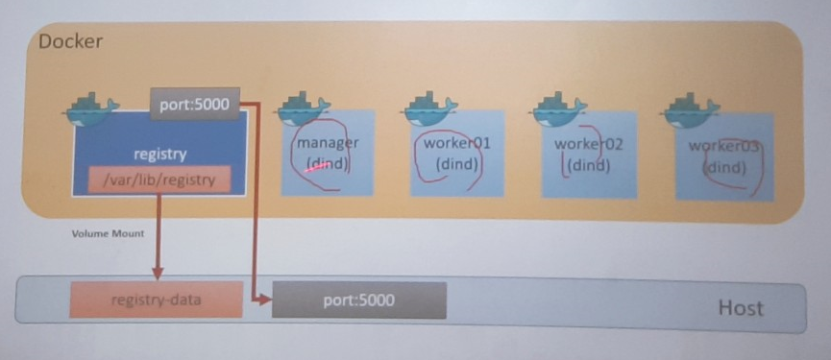
80
/stack
8000
./stack

Slide 8
registry
manager
worker01
worker02
worker03
47a0b76b098c
8266d03bdb76
912c473cbad1
echo_api.1
echo_api.2
echo_api.3
echo_nginx.3
echo_nginx.1
echo_nginx.2

Slide 9
8000
8080
클라이언트 요청
Nginx reverse proxy
Backend web application
(API서비스)
todo_app_api:8080
접근 로그 생성(단일접근)
캐시 제어
라우팅 설정

Slide 10
todo_app_nginx:8000
todo_app_api:8080
Nginx reverse proxy
Backend web application
(API 서비스)
TODO_API_URL
클라이언트 요청
Nginx reverse proxy
Backend web application
(API 서비스)

