Slide 1
THE CHON GAME IN
JAVA
Notes:
<número>

Slide 2
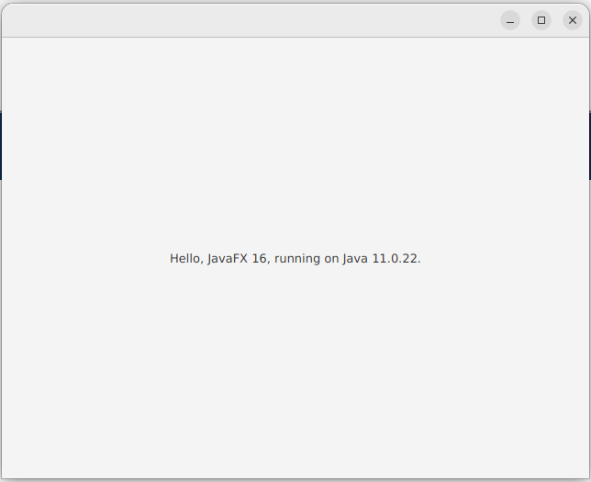
MY FIRST
JAVA FX
APPLICATION
Notes:
<número>

Slide 3
Java FX
JavaFX is a comprehensive software platform for creating and programming client and cross-platform desktop applications.
Notes:
<número>

Slide 4

Project Technologies
Notes:
<número>

Slide 5

Project Technologies
+
Notes:
<número>

Slide 6

Project Technologies
+
+
Notes:
<número>

Slide 7

Project Technologies
+
+
+
Notes:
<número>

Slide 8
VSCode
Notes:
<número>

Slide 9
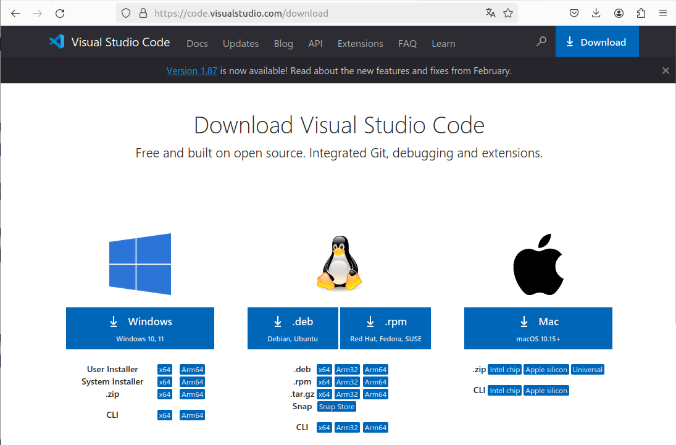
VSCode
Notes:
<número>

Slide 10
VSCode
Notes:
<número>

Slide 11
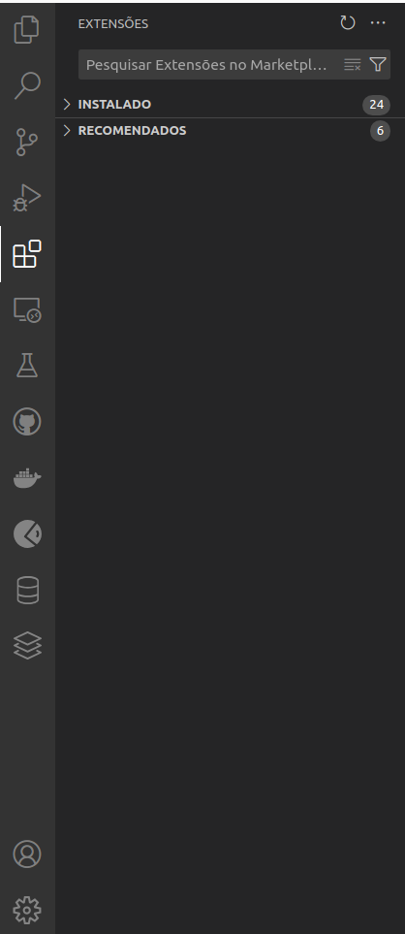
VSCode
Notes:
<número>

Slide 12
VSCode
Notes:
<número>

Slide 13

VSCode
Notes:
<número>

Slide 14




VSCode
Notes:
<número>

Slide 15

VSCode
Notes:
<número>

Slide 16

VSCode
Notes:
<número>

Slide 17
GitHub
Notes:
<número>

Slide 18

GitHub
Notes:
<número>

Slide 19
GitHub
Notes:
<número>

Slide 20
GitHub
Notes:
<número>

Slide 21
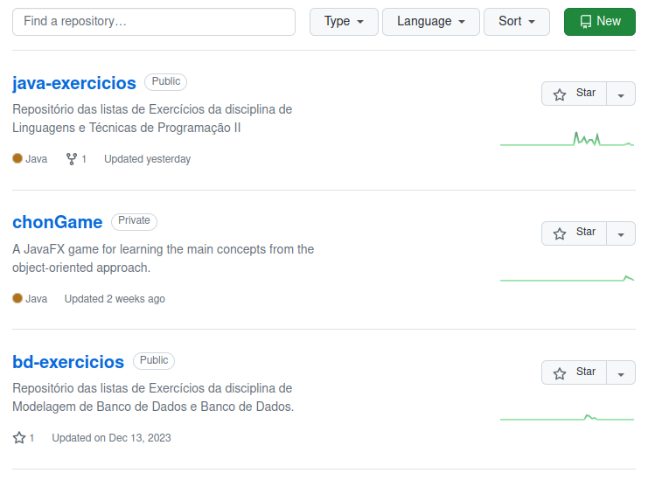
GitHub
Notes:
<número>

Slide 22
GitHub
Notes:
<número>

Slide 23
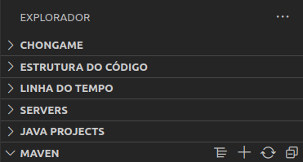
Creating a New Maven Project
Notes:
<número>

Slide 24
Creating a New Maven Project
Notes:
<número>

Slide 25
Creating a New Maven Project
Notes:
<número>

Slide 26
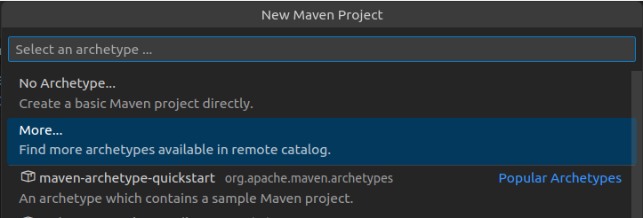

Creating a New Maven Project
Notes:
<número>

Slide 27
Creating a New Maven Project
Notes:
<número>

Slide 28
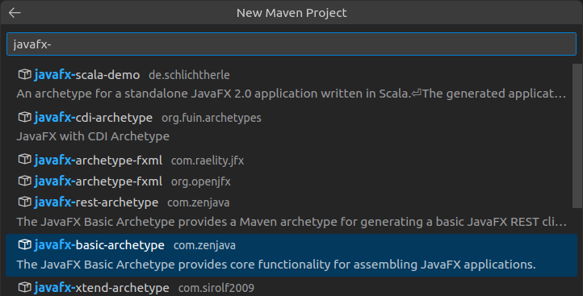
Creating a New Maven Project
javafx-basic-archetype
Notes:
<número>

Slide 29
Creating a New Maven Project
Notes:
<número>

Slide 30
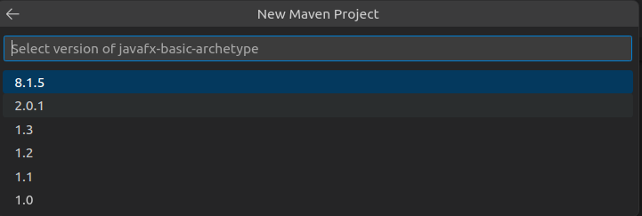
Creating a New Maven Project
Notes:
<número>

Slide 31
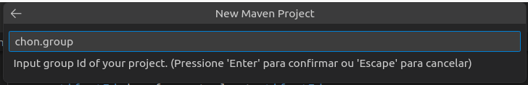
Creating a New Maven Project
Notes:
<número>

Slide 32
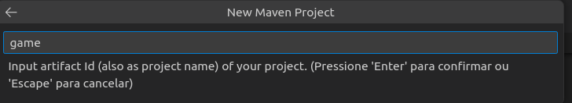
Creating a New Maven Project
Notes:
<número>

Slide 33
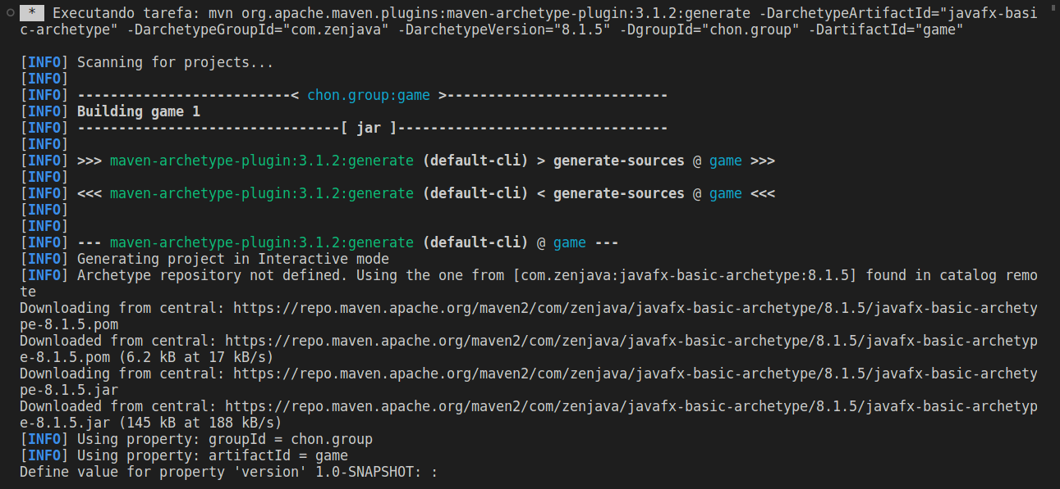
Creating a New Maven Project
Notes:
<número>

Slide 34
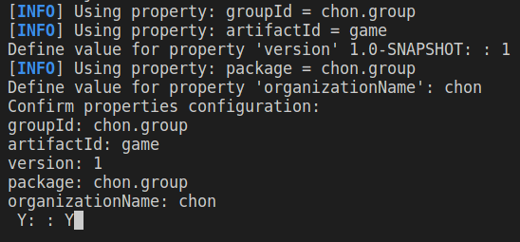
Creating a New Maven Project
Notes:
<número>

Slide 35
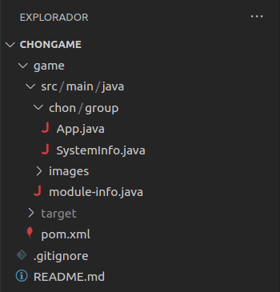
Java FX App Running
Notes:
<número>

Slide 36
Java FX App Running
Notes:
<número>

Slide 37
Java FX App Running
Notes:
<número>

Slide 38
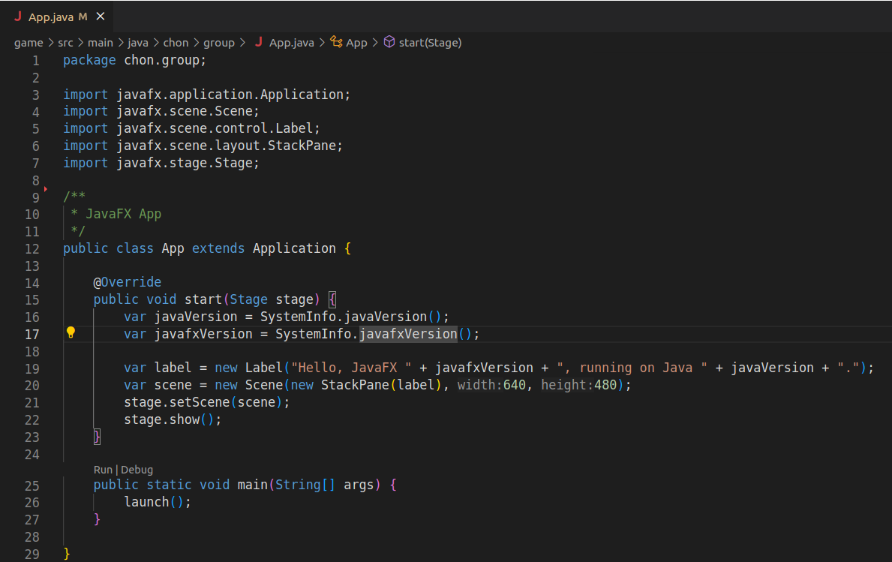
Java FX App Running
Notes:
<número>

Slide 39
Java FX App Running
Notes:
<número>

Slide 40
Java FX App Running
Notes:
<número>

Slide 41
Java FX App Running
Notes:
<número>

Slide 42
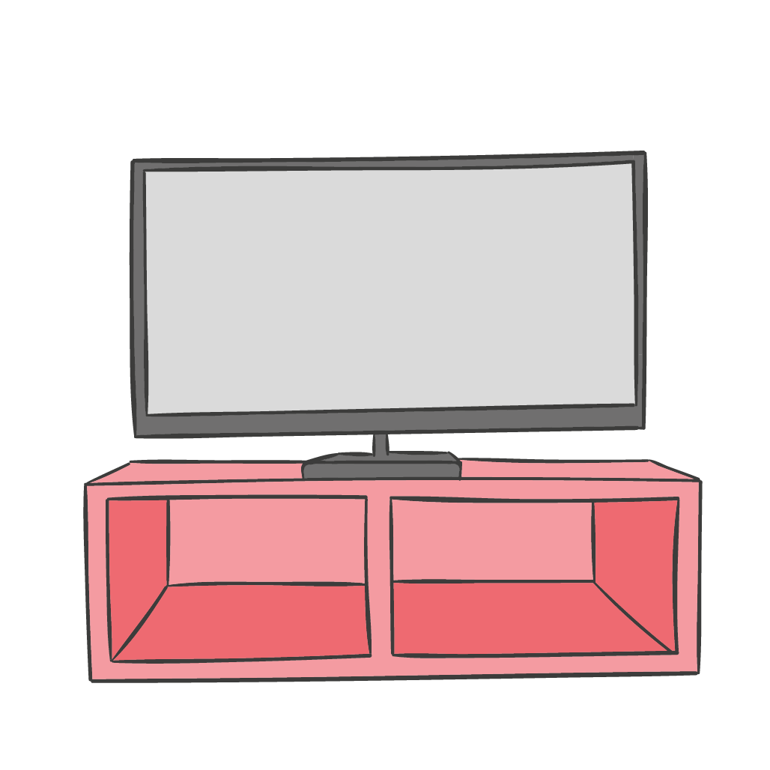
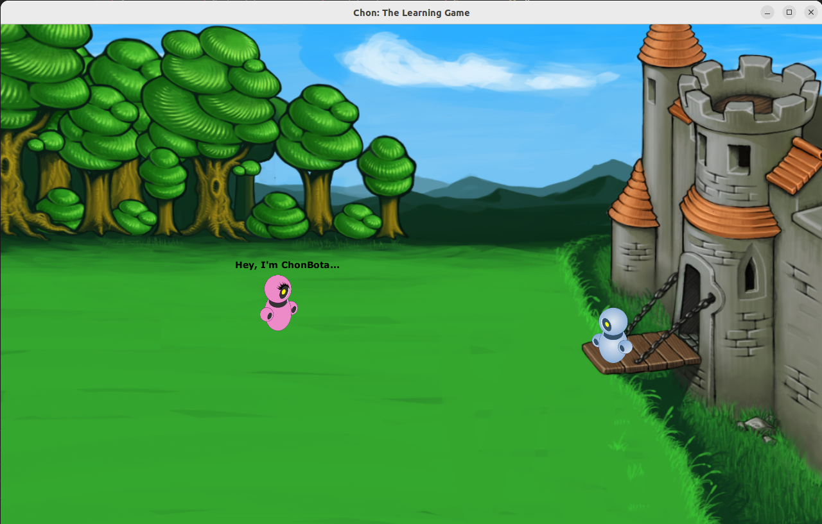

MANIPULATING GRAPHICAL ELEMENTS
Notes:
<número>

Slide 43
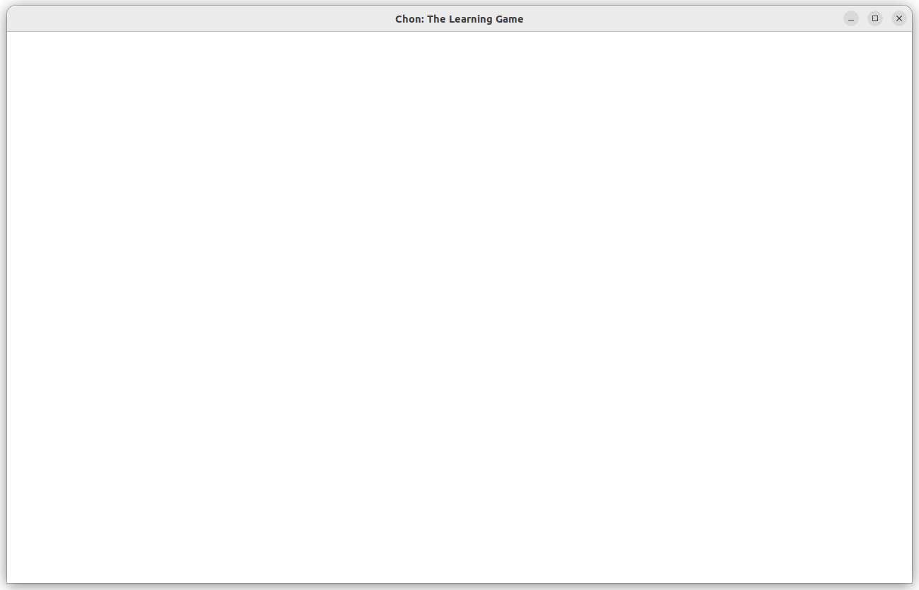
StackPane
Notes:
<número>

Slide 44
StackPane
pane
Notes:
<número>

Slide 45
StackPane
pane
The window that is currently displayed on the screen.
Notes:
<número>

Slide 46
Scene
pane
Notes:
<número>

Slide 47
Scene
pane
scene
Notes:
<número>

Slide 48
Scene
pane
scene
It refers to the initial visible dimensions of a pane.
Notes:
<número>

Slide 49
Canvas
pane
scene
Notes:
<número>

Slide 50
Canvas
pane
scene
canvas
Notes:
<número>

Slide 51
Canvas
pane
scene
The canvas is the part of the screen where graphics are displayed and printed.
canvas
Notes:
<número>

Slide 52
Object’s Dimension: Width and Height
Notes:
<número>

Slide 53
Object’s Dimension: Width and Height
width
Notes:
<número>

Slide 54
Object’s Dimension: Width and Height
height
width
Notes:
<número>

Slide 55
Object’s Dimension: Width and Height
Notes:
<número>

Slide 56
Object’s Dimension: Width and Height
1280
Notes:
<número>

Slide 57
Object’s Dimension: Width and Height
780
1280
Notes:
<número>

Slide 58

Object’s Dimension: Width and Height
780
1280
Notes:
<número>

Slide 59
Object’s Dimension: Width and Height
780
65
65
1280
Notes:
<número>

Slide 60
Object’s Dimension: Width and Height
780
90
65
90
65
1280
Notes:
<número>

Slide 61
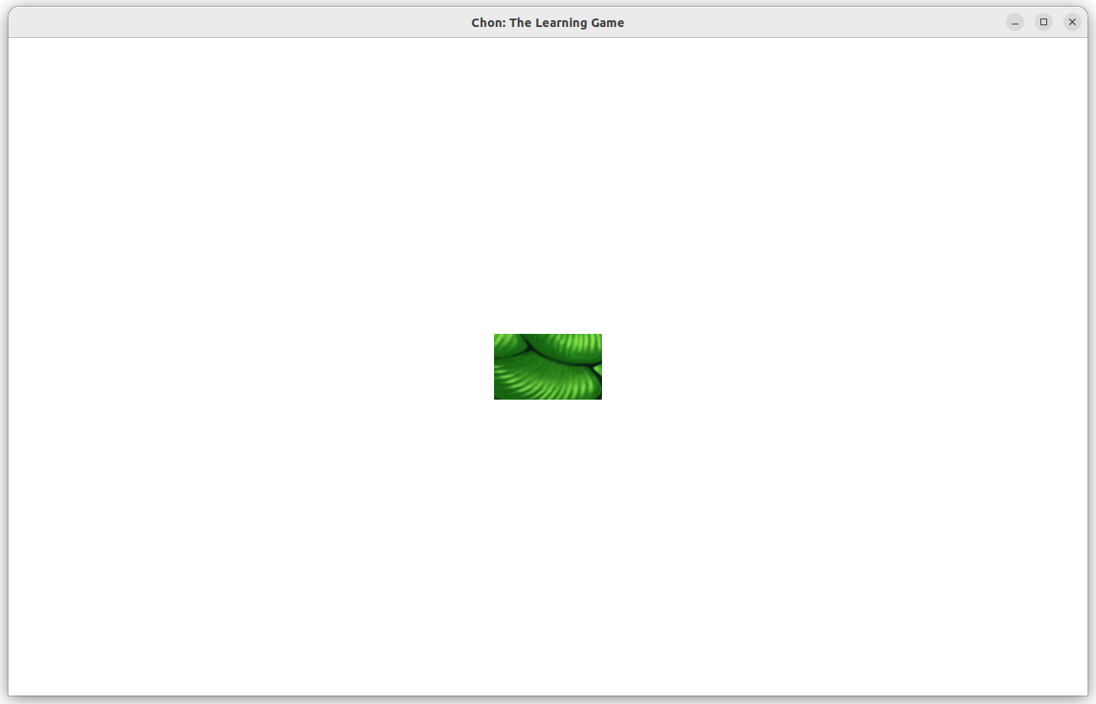
Canvas Example
Notes:
<número>

Slide 62
Canvas Example
1280
780
Notes:
<número>

Slide 63
Canvas Example
1280
128
78
780
Notes:
<número>

Slide 64
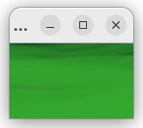
Scene Example
Notes:
<número>

Slide 65
Scene Example
128
78
Notes:
<número>

Slide 66
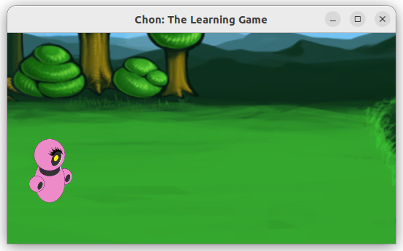
Scene Example
Notes:
<número>

Slide 67
Scene Example
Notes:
<número>

Slide 68
Scene Example
Notes:
<número>

Slide 69
Positioning System
Notes:
<número>

Slide 70
Positioning System
x
Notes:
<número>

Slide 71
Positioning System
x
y
Notes:
<número>

Slide 72
Positioning System
0
x
0
y
Notes:
<número>

Slide 73
Positioning System
0 1 2 3 ...
x
0
y
Notes:
<número>

Slide 74
Positioning System
0 1 2 3 ...
x
0
1
2
3
...
y
Notes:
<número>

Slide 75
Drawing the Background
Notes:
<número>

Slide 76
Drawing the Background
0
0
.
Notes:
<número>

Slide 77
Drawing the Background
0
1280
0
.
780
Notes:
<número>

Slide 78
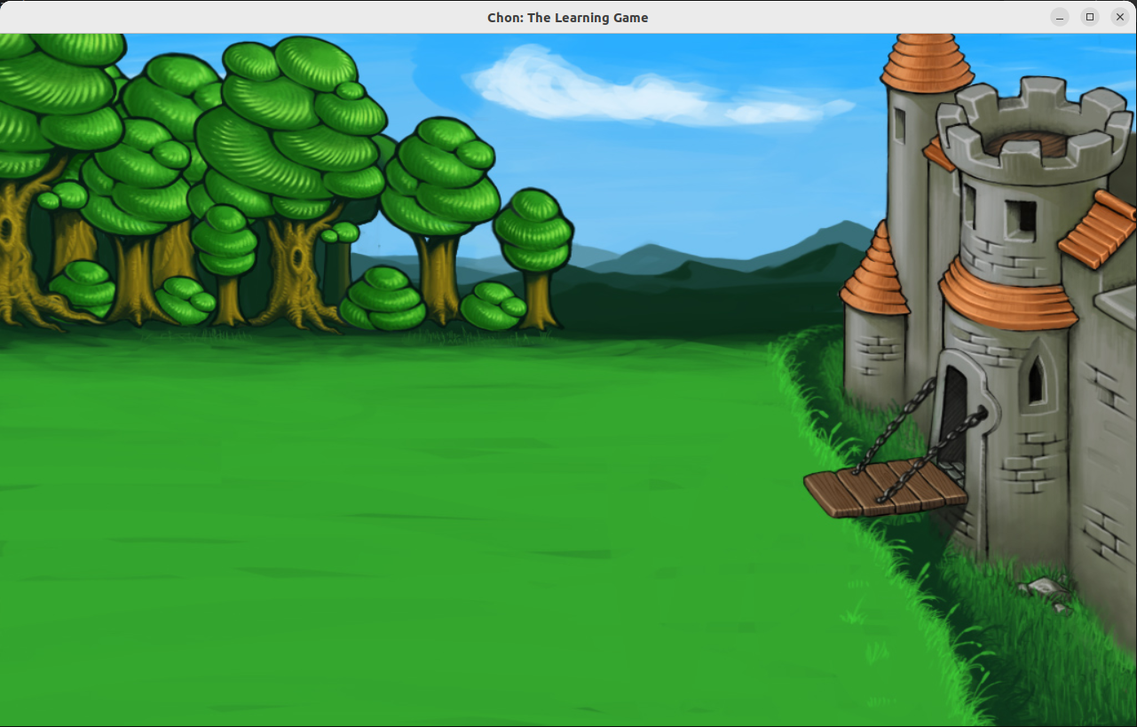
Drawing the Background
0
1280
0
.
780
Notes:
<número>

Slide 79
Drawing the Characters
Notes:
<número>

Slide 80
Drawing the Characters
400
390
.
Notes:
<número>

Slide 81
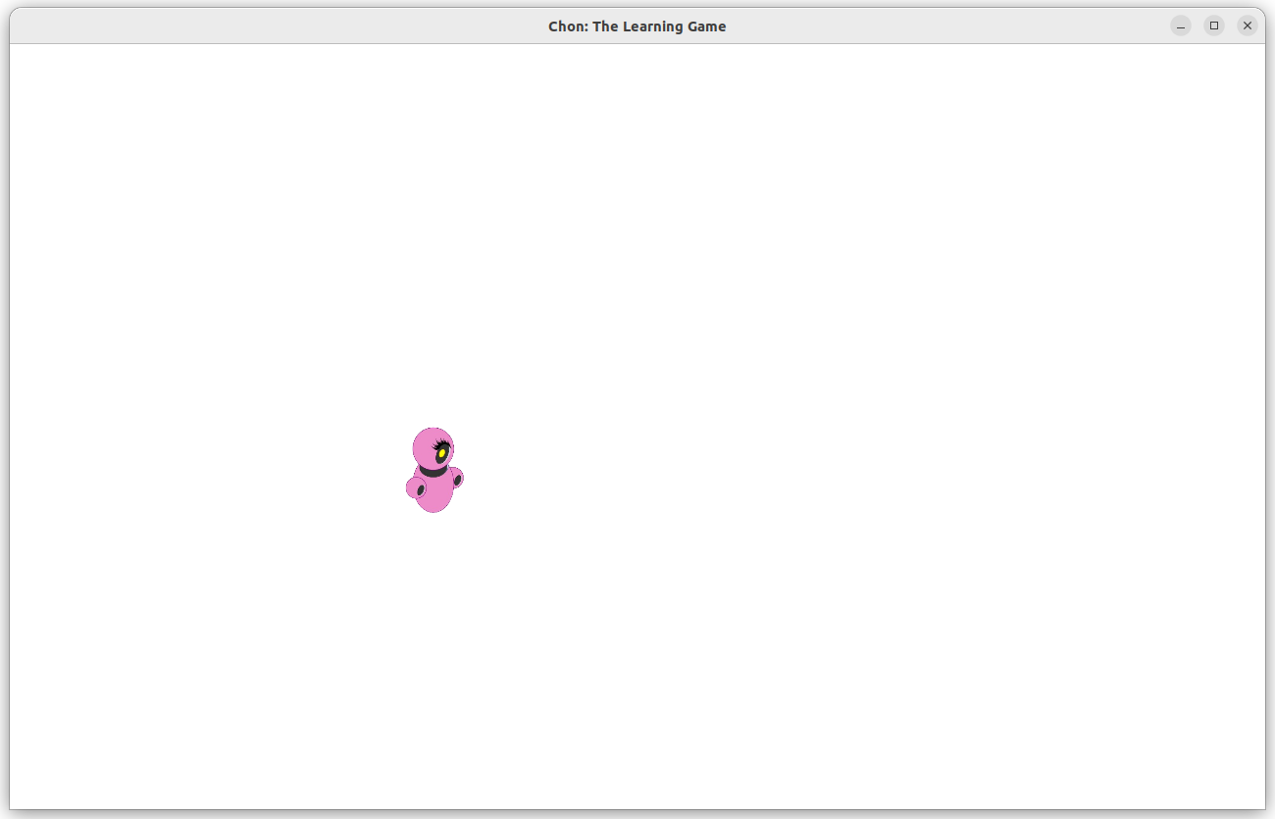
Drawing the Characters
400
390
.
Notes:
<número>

Slide 82
Drawing the Characters
400
920
390
.
.
440
Notes:
<número>

Slide 83
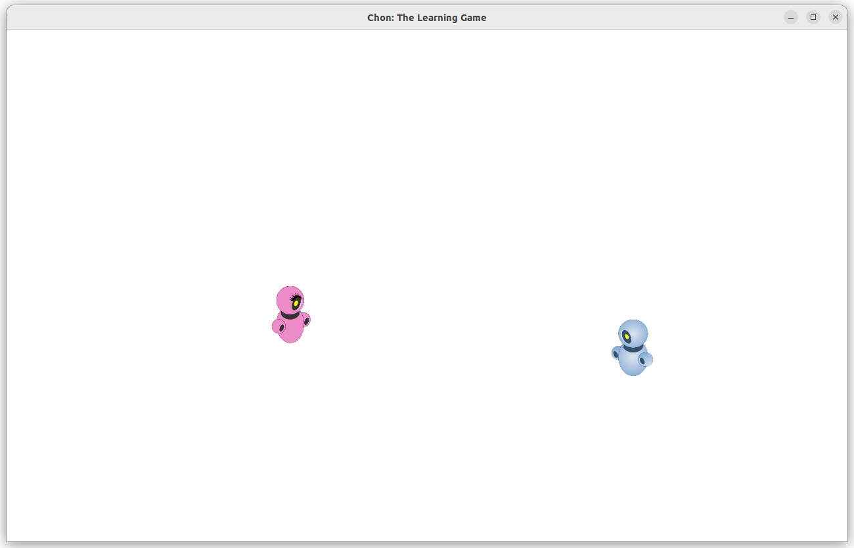
Drawing the Characters
400
920
390
.
.
440
Notes:
<número>

Slide 84
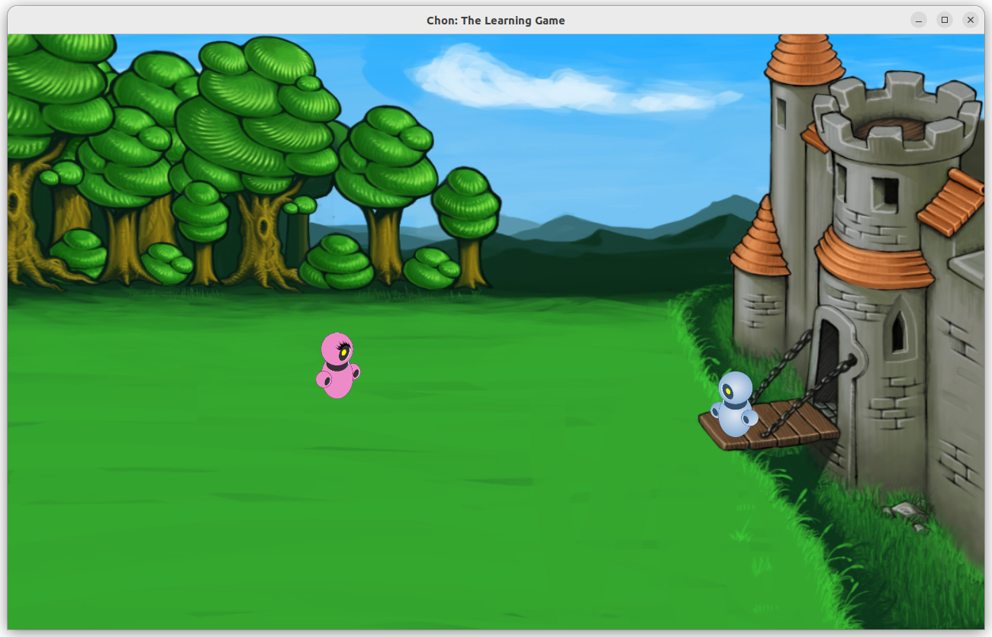
Drawing the Characters
Notes:
<número>

Slide 85

Drawing Other Objects
Notes:
<número>

Slide 86
Drawing Other Objects
Notes:
<número>

Slide 87
MOVING OBJECTS
IN THE
CANVAS
Notes:
<número>

Slide 88
Scene’s Events
In JavaFX, Events represent interactions or changes that happen while running a JavaFX application, such as user inputs (mouse clicks, key presses), window actions (resizing, closing), or internal changes (animation updates).
Notes:
<número>

Slide 89
Events
Notes:
<número>

Slide 90

Events
Notes:
<número>

Slide 91
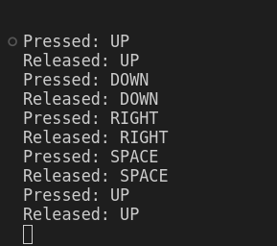
Events
Notes:
<número>

Slide 92
Animation
The AnimationTimer allows the creation of animations by repeatedly executing a code block at each frame.
Notes:
<número>

Slide 93
Animation
The AnimationTimer allows the creation of animations by repeatedly executing a code block at each frame.
It provides a way to perform updates and render graphics, making it suitable for creating animations, game loops, and other time-based tasks.
Notes:
<número>

Slide 94
Animation
Notes:
<número>

Slide 95

Animation
Notes:
<número>

Slide 96

Animation
Notes:
<número>

Slide 97
The RIGHT Logic
400
390
.
Notes:
<número>

Slide 98
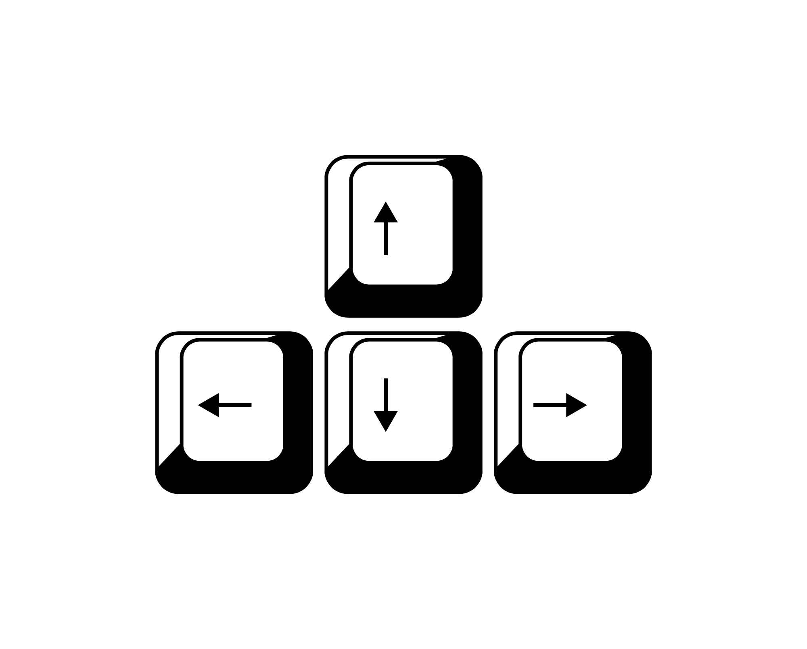
The RIGHT Logic
400
390
.
Notes:
<número>

Slide 99
The RIGHT Logic
400
390
.
x + value
Notes:
<número>

Slide 100
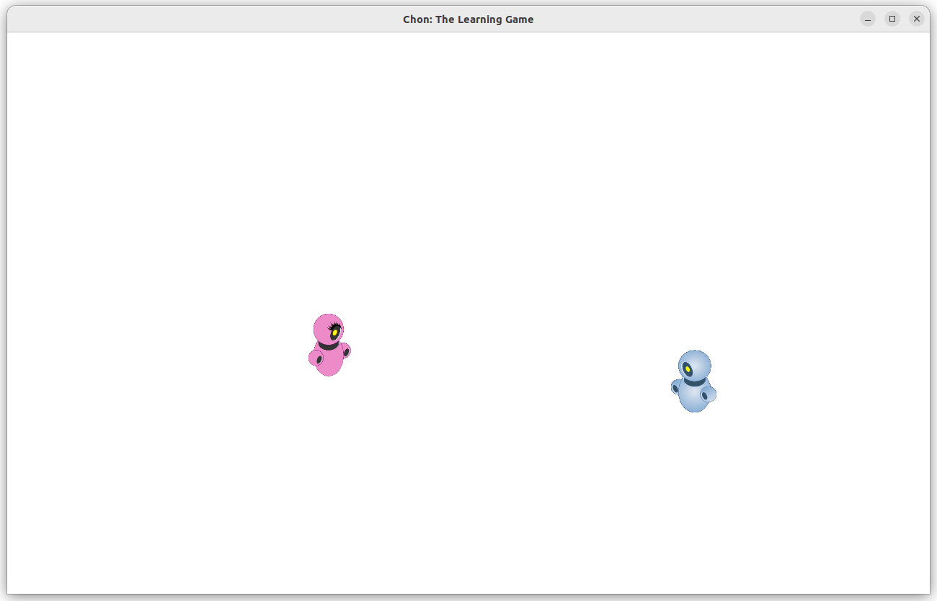
The RIGHT Logic
401
390
.
x + value
Notes:
<número>

Slide 101
The LEFT Logic
400
390
.
Notes:
<número>

Slide 102
The LEFT Logic
400
390
.
x - value
Notes:
<número>

Slide 103
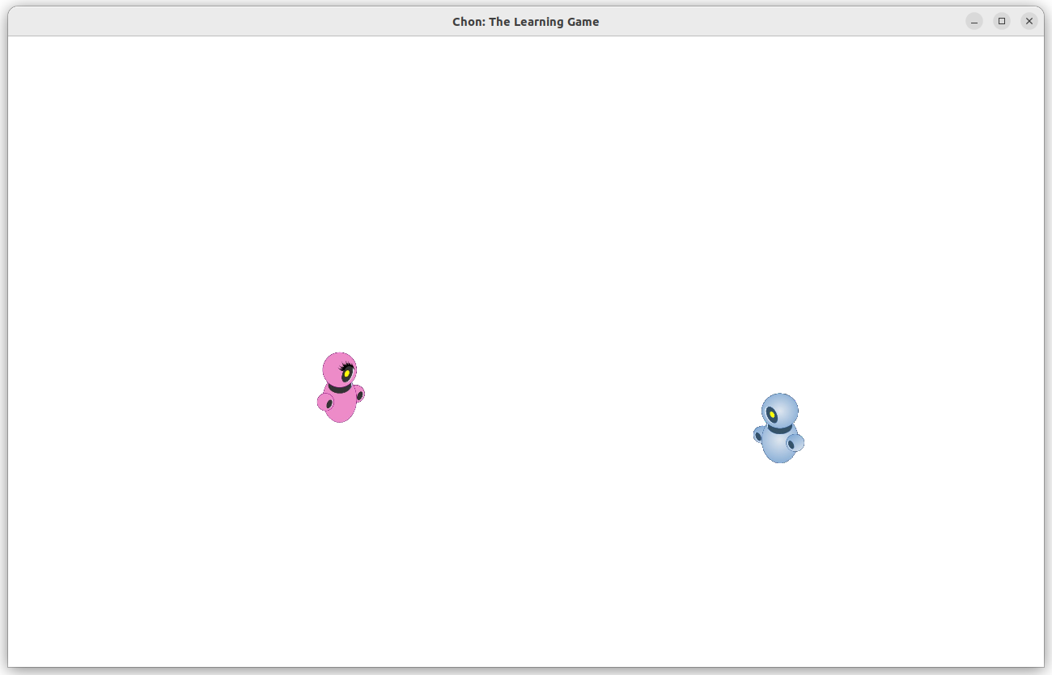
The LEFT Logic
399
390
.
x - value
Notes:
<número>

Slide 104

The DOWN Logic
400
390
.
Notes:
<número>

Slide 105
The DOWN Logic
400
390
.
y + value
Notes:
<número>

Slide 106
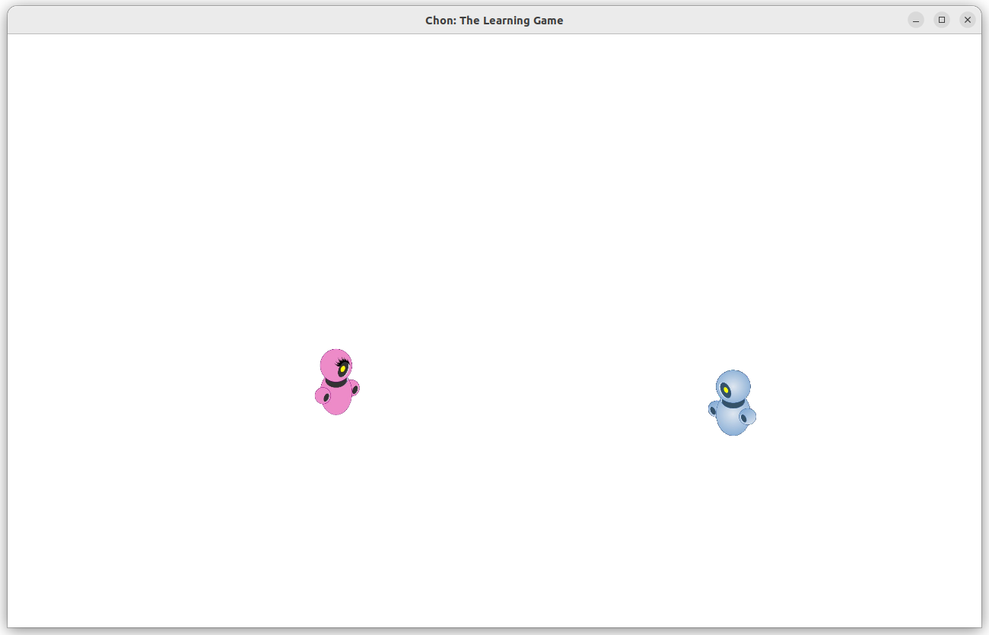
The DOWN Logic
400
391
.
y + value
Notes:
<número>

Slide 107

The UP Logic
400
390
.
Notes:
<número>

Slide 108
The UP Logic
400
390
.
y - value
Notes:
<número>

Slide 109
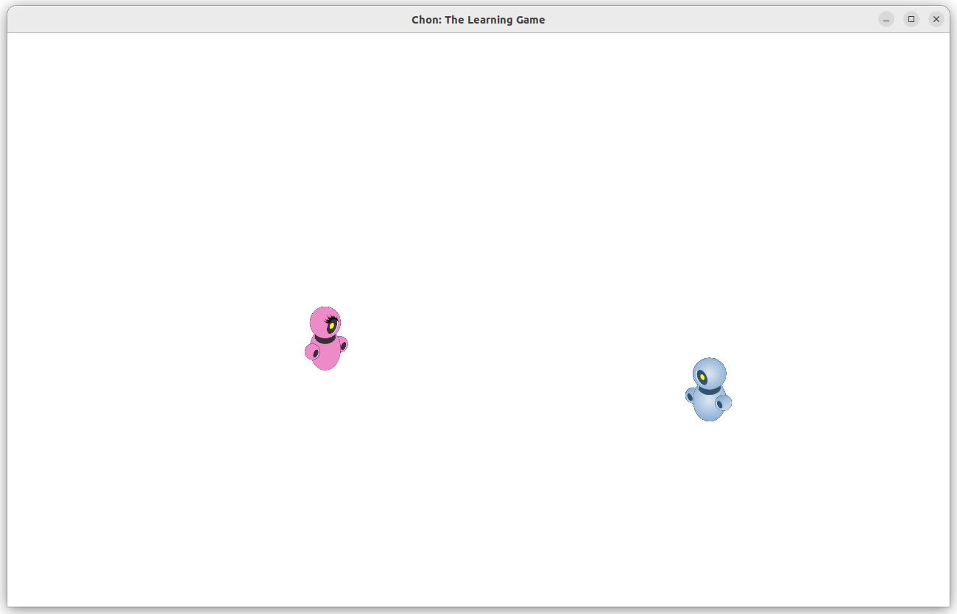
The UP Logic
400
389
.
y - value
Notes:
<número>

Slide 110
Defining Boundaries
Every Image has:
Notes:
<número>

Slide 111
Defining Boundaries
Every Image has:
x and y points;
.
Notes:
<número>

Slide 112
Defining Boundaries
Every Image has:
x and y points;
.
Notes:
<número>

Slide 113
Defining Boundaries
Every Image has:
x and y points;
Width;
w
.
Notes:
<número>

Slide 114
Defining Boundaries
Every Image has:
x and y points;
Width;
w
.
.
Notes:
<número>

Slide 115
Defining Boundaries
Every Image has:
x and y points;
Width;
w
(x+w)
.
.
Notes:
<número>

Slide 116
Defining Boundaries
Every Image has:
x and y points;
Width;
Height.
w
(x+w)
.
.
h
Notes:
<número>

Slide 117
Defining Boundaries
Every Image has:
x and y points;
Width;
Height.
w
(x+w)
.
.
h
.
Notes:
<número>

Slide 118
Defining Boundaries
Every Image has:
x and y points;
Width;
Height.
w
(x+w)
.
.
h
.
(y+h)
Notes:
<número>

Slide 119
Defining Boundaries
0
.
1280
0
780
Notes:
<número>

Slide 120
Defining Boundaries
0
.
1280
0
780
Notes:
<número>

Slide 121
Defining Boundaries at the LEFT
0
.
1280
0
.
780
Notes:
<número>

Slide 122
Defining Boundaries at the LEFT
0
.
1280
0
xCanvas
.
780
Notes:
<número>

Slide 123
Defining Boundaries at the LEFT
0
.
1280
0
xCanvas
.
xImage
780
Notes:
<número>

Slide 124
Defining Boundaries at the LEFT
0
.
1280
0
xCanvas
.
xImage
it can move while
xImage >= xCanvas
780
Notes:
<número>

Slide 125
Defining Boundaries at the LEFT
0
.
1280
0
xCanvas
.
xImage
780
Notes:
<número>

Slide 126
Defining Boundaries at the LEFT
0
.
1280
0
xCanvas
.
xImage
if xImage < xCanvas
it is out of the canvas
780
Notes:
<número>

Slide 127
Defining Boundaries at the LEFT
0
.
1280
0
xCanvas
.
xImage
Then it must be
xImage = xCanvas
780
Notes:
<número>

Slide 128
Defining Boundaries at the RIGHT
0
.
1280
0
.
780
Notes:
<número>

Slide 129
Defining Boundaries at the RIGHT
0
.
1280
0
.
xImage+wImage
780
Notes:
<número>

Slide 130
Defining Boundaries at the RIGHT
0
.
1280
0
xCanvas+wCanvas
.
xImage+wImage
780
Notes:
<número>

Slide 131
Defining Boundaries at the RIGHT
0
.
1280
0
xCanvas+wCanvas
.
xImage+wImage
it can move while
(xImage+wImage) <= (xCanvas+wCanvas)
780
Notes:
<número>

Slide 132
Defining Boundaries at the RIGHT
0
.
1280
0
xCanvas+wCanvas
.
xImage+wImage
780
Notes:
<número>

Slide 133
Defining Boundaries at the RIGHT
0
.
1280
0
xCanvas+wCanvas
.
xImage+wImage
if xImage+wImage > xCanvas+wCanvas
it is out of the canvas
780
Notes:
<número>

Slide 134
Defining Boundaries at the RIGHT
0
.
1280
0
xCanvas+wCanvas
.
xImage+wImage
Then it must be
xImage = (xCanvas+wCanvas)-wImage
780
Notes:
<número>

Slide 135
Defining Boundaries at the TOP
0
.
1280
0
.
780
Notes:
<número>

Slide 136
Defining Boundaries at the TOP
0
.
1280
0
yCanvas
.
780
Notes:
<número>

Slide 137
Defining Boundaries at the TOP
0
.
1280
0
yCanvas
.
yImage
780
Notes:
<número>

Slide 138
Defining Boundaries at the TOP
0
.
1280
0
yCanvas
.
yImage
it can move while
yImage >= yCanvas
780
Notes:
<número>

Slide 139
Defining Boundaries at the TOP
0
.
yImage
.
1280
0
yCanvas
780
Notes:
<número>

Slide 140
Defining Boundaries at the TOP
0
.
yImage
.
1280
0
yCanvas
if yImage < yCanvas
it is out of the canvas
780
Notes:
<número>

Slide 141
Defining Boundaries at the TOP
0
.
.
1280
0
yImage
yCanvas
Then it must be
yImage = yCanvas
780
Notes:
<número>

Slide 142
Defining Boundaries at the BOTTOM
0
0
1280
.
.
780
Notes:
<número>

Slide 143
Defining Boundaries at the BOTTOM
0
0
1280
.
.
780
yCanvas+hCanvas
Notes:
<número>

Slide 144
Defining Boundaries at the BOTTOM
0
0
1280
.
yImage+hImage
.
780
yCanvas+hCanvas
Notes:
<número>

Slide 145
Defining Boundaries at the BOTTOM
0
0
1280
it can move while
(yImage+hImage) <= (yCanvas+yCanvas)
.
yImage+hImage
.
780
yCanvas+hCanvas
Notes:
<número>

Slide 146
Defining Boundaries at the BOTTOM
0
0
1280
yCanvas+
hCanvas
yImage+
hImage
.
780
.
Notes:
<número>

Slide 147
Defining Boundaries at the BOTTOM
0
0
1280
if yImage+hImage > yCanvas+hCanvas
it is out of the canvas
yCanvas+
hCanvas
yImage+
hImage
.
780
.
Notes:
<número>

Slide 148
Defining Boundaries at the BOTTOM
0
0
1280
Then it must be
yImage = (yCanvas+hCanvas)-hImage
yCanvas+
hCanvas
yImage+
hImage
.
.
780
Notes:
<número>

Slide 149
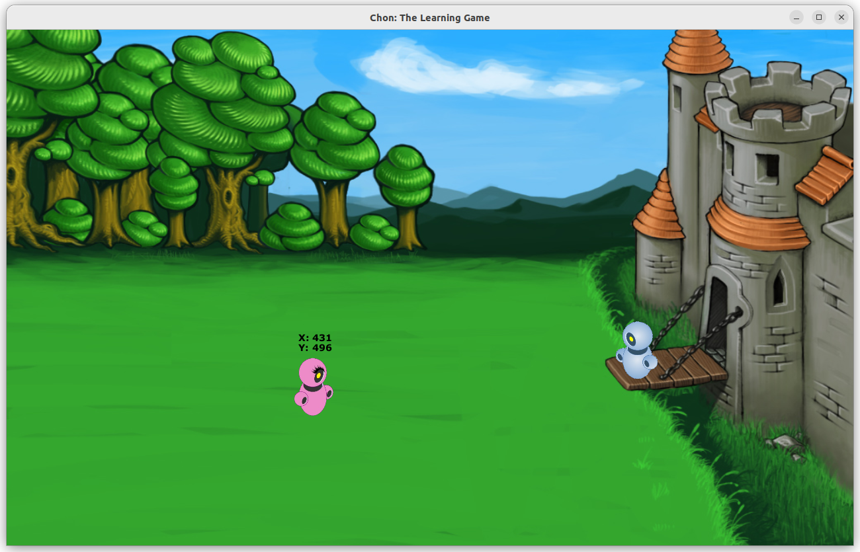
Printing a Status Panel
Notes:
<número>

Slide 150
Printing a Status Panel
Notes:
<número>

Slide 151
Image Overlapping
The order in which you place the Image matters.
Notes:
<número>

Slide 152
Image Overlapping
The order in which you place the Image matters.
Notes:
<número>

Slide 153
Image Overlapping
The order in which you place the Image matters.
Notes:
<número>

Slide 154
Image Overlapping
The order in which you place the Image matters.
Notes:
<número>

Slide 155
Image Overlapping
The order in which you place the Image matters.
Notes:
<número>

Slide 156
Image Overlapping
The order in which you place the Image matters.
Notes:
<número>

Slide 157
Image Overlapping
The order in which you place the Image matters.
Notes:
<número>

Slide 158
Image Overlapping
Notes:
<número>

Slide 159
Image Overlapping
Notes:
<número>

Slide 160
Image Overlapping
Notes:
<número>

Slide 161
Moving Another Object
0
0
1280
.
.
.
780
Notes:
<número>

Slide 162
Moving Another Object
0
0
1280
.
(x,y)
.
(x,y)
.
780
Notes:
<número>

Slide 163
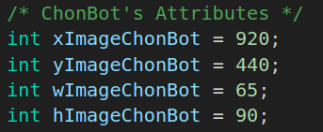
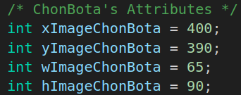
Moving Another Object
0
0
1280
.
(x,y)
.
(x,y)
.
780
Notes:
<número>

Slide 164
Moving Another Object to the LEFT
0
0
1280
.
(400,390)
.
(920,440)
.
780
Notes:
<número>

Slide 165
Moving Another Object to the LEFT
0
0
1280
.
(400,390)
.
(920,440)
It must be
xImageChonBot -= 1
.
780
Notes:
<número>

Slide 166
Moving Another Object to the LEFT
0
0
1280
.
(400,390)
.
(919,440)
.
Until...
780
Notes:
<número>

Slide 167
Moving Another Object to the LEFT
0
0
1280
.
(400,390)
.
(918,440)
.
Until...
780
Notes:
<número>

Slide 168
Moving Another Object to the LEFT
0
0
1280
.
(400,390)
.
(900,440)
.
Until...
780
Notes:
<número>

Slide 169
Moving Another Object to the LEFT
0
0
1280
.
(400,390)
.
(-10,440)
.
Until… infinite and beyond.
780
Notes:
<número>

Slide 170
Moving Another Object to the RIGHT
0
0
1280
.
(400,390)
.
(920,440)
.
780
Notes:
<número>

Slide 171
Moving Another Object to the RIGHT
0
0
1280
.
(400,390)
.
(920,440)
It must be
xImageChonBot += 1
.
780
Notes:
<número>

Slide 172
Moving Another Object to the RIGHT
0
0
1280
.
(400,390)
.
(921,440)
.
Until…
780
Notes:
<número>

Slide 173
Moving Another Object to the RIGHT
0
0
1280
.
(400,390)
.
(1300,440)
.
Until… infinite and beyond.
780
Notes:
<número>

Slide 174
Moving UP Another Object
0
0
1280
.
(400,390)
.
(920,440)
.
780
Notes:
<número>

Slide 175
Moving UP Another Object
0
0
1280
.
(400,390)
.
(920,440)
It must be
yImageChonBot -= 1
.
780
Notes:
<número>

Slide 176
Moving UP Another Object
0
0
1280
.
(400,390)
.
(920,339)
.
Until…
780
Notes:
<número>

Slide 177
Moving UP Another Object
.
0
(920,-10)
0
1280
.
(400,390)
.
Until… infinite and beyond.
780
Notes:
<número>

Slide 178
Moving DOWN Another Object
0
0
1280
.
(400,390)
.
(920,340)
.
780
Notes:
<número>

Slide 179
Moving DOWN Another Object
0
0
1280
.
(400,390)
.
(920,340)
It must be
yImageChonBot += 1
.
780
Notes:
<número>

Slide 180
Moving DOWN Another Object
0
0
1280
.
(400,390)
.
(920,341)
.
Until…
780
Notes:
<número>

Slide 181
Moving DOWN Another Object
0
0
1280
.
(400,390)
.
(920,790)
.
Until… infinite and beyond.
780
Notes:
<número>

Slide 182
Moving Until the Border
0
0
1280
.
(400,390)
.
(920,440)
.
780
Notes:
<número>

Slide 183
Moving Until the Border
0
0
1280
.
(400,390)
.
(920,440)
if (xImageChonBot -= 1 > 0)
xImageChonBot -= 1
else stay in the border
.
780
Notes:
<número>

Slide 184
Moving Until the Border
0
0
1280
.
(400,390)
.
(-10,440)
.
x<0 then
780
Notes:
<número>

Slide 185
Moving Until the Border
0
0
1280
.
(400,390)
.
(0,440)
.
x=0
780
Notes:
<número>

Slide 186
Moving Until the Border
The same mechanics
applies to the
RIGHT, UP and DOWN.
Notes:
<número>

Slide 187
Chasing the Player
0
0
1280
.
(400,390)
.
(920,440)
.
780
Notes:
<número>

Slide 188
Chasing the Player
0
0
1280
.
(400,390)
.
(920,440)
.
(xImageChonBota < xImageChonBot)
780
Notes:
<número>

Slide 189
Chasing the Player
0
0
1280
.
(400,390)
.
(919,440)
Moves closer to chonBota:
xImageChonBot -= 1
.
780
Notes:
<número>

Slide 190
Chasing the Player
0
0
1280
.
(920,390)
.
(400,440)
.
780
Notes:
<número>

Slide 191
Chasing the Player
0
0
1280
.
(920,390)
.
(400,440)
.
(xImageChonBota > xImageChonBot)
780
Notes:
<número>

Slide 192
Chasing the Player
0
0
1280
.
(920,390)
.
(401,440)
Moves closer to chonBota:
xImageChonBot += 1
.
780
Notes:
<número>

Slide 193
Chasing the Player
0
0
1280
.
(400,390)
.
(920,440)
.
780
Notes:
<número>

Slide 194
Chasing the Player
0
0
1280
.
(400,390)
.
(920,440)
.
(yImageChonBota < yImageChonBot)
780
Notes:
<número>

Slide 195
Chasing the Player
0
0
1280
.
(400,390)
.
(920,440)
Moves closer to chonBota:
yImageChonBot -= 1
.
780
Notes:
<número>

Slide 196
Chasing the Player
0
0
1280
.
(920,390)
.
(400,440)
.
780
Notes:
<número>

Slide 197
Chasing the Player
0
0
1280
.
(920,390)
.
(400,440)
.
(yImageChonBota > yImageChonBot)
780
Notes:
<número>

Slide 198
Chasing the Player
0
0
1280
.
(920,390)
.
(400,440)
Moves closer to chonBota:
yImageChonBot += 1
.
780
Notes:
<número>

Slide 199
Chasing the Player
The two conditions
for x and y
apply at the same time.
Notes:
<número>

Slide 200
Chasing the Player
0
0
1280
.
(400,390)
.
(920,440)
.
780
Notes:
<número>

Slide 201
Chasing the Player
0
0
1280
.
(400,390)
.
(919,439)
.
780
Notes:
<número>

Slide 202
Chasing the Player
0
0
1280
.
(400,390)
.
(918,438)
.
780
Notes:
<número>

Slide 203
Chasing the Player
0
0
1280
.
(400,390)
.
(917,437)
.
780
Notes:
<número>

Slide 204
Chasing the Player
0
0
1280
.
(400,390)
.
(916,436)
.
780
Notes:
<número>

Slide 205
Defining Speed
The speed is related to how many unities the object moves in each cycle of the game loop.
Notes:
<número>

Slide 206
Defining Speed
0
0
1280
.
(400,390)
.
(920,440)
.
780
Notes:
<número>

Slide 207
Defining Speed
0
0
1280
.
(400,390)
.
(920,440)
Moving 1 unity in x:
xImageChonBota += 1
.
780
Notes:
<número>

Slide 208
Defining Speed
0
0
1280
.
(400,390)
.
(920,440)
Moving 2 unities in x:
xImageChonBota += 2
.
780
Notes:
<número>

Slide 209
Defining Speed
0
0
1280
.
(400,390)
.
(920,440)
Moving 5 unities in x:
xImageChonBota += 5
.
780
Notes:
<número>

Slide 210
Defining Speed
0
0
1280
.
(400,390)
.
(920,440)
Moving 10 unities in x:
xImageChonBota += 10
.
780
Notes:
<número>

Slide 211
Defining Speed
So, the speed is a pre-defined integer unity.
Notes:
<número>

Slide 212
Defining Speed
0
0
1280
.
(400,390)
.
(920,440)
.
780
Notes:
<número>

Slide 213


Defining Speed
0
0
1280
.
(400,390)
.
(920,440)
.
780
Notes:
<número>

Slide 214
Defining Speed
0
0
1280
.
(402,390)
.
(920,440)
Moving with speed:
xImageChonBota += speedChonBota
.
780
Notes:
<número>

Slide 215

MODELING
THE ENGINE
Notes:
<número>

Slide 216
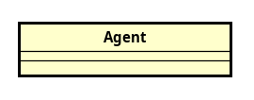
Class Agent
Notes:
<número>

Slide 217
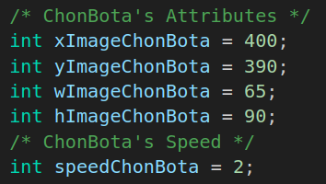
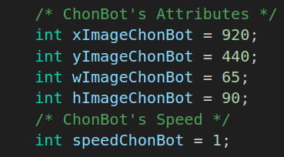
Class Agent
Notes:
<número>

Slide 218
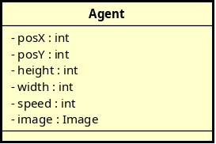
Class Agent
Notes:
<número>

Slide 219
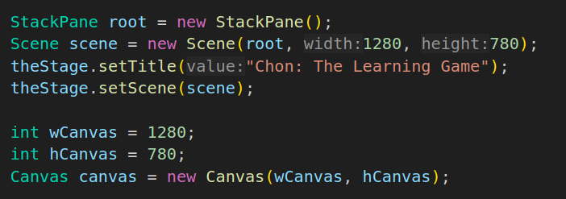
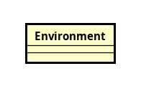
Class Environment
Notes:
<número>

Slide 220
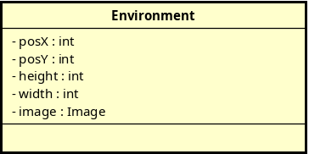
Class Environment
Notes:
<número>

Slide 221
The Class Diagram
Notes:
<número>

Slide 222
The Class Diagram
Notes:
<número>

Slide 223
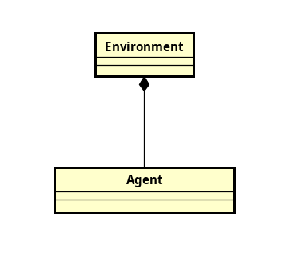
The Class Diagram
Notes:
<número>

Slide 224
The Class Diagram
Notes:
<número>

Slide 225
The Class Diagram
protagonist
Notes:
<número>

Slide 226
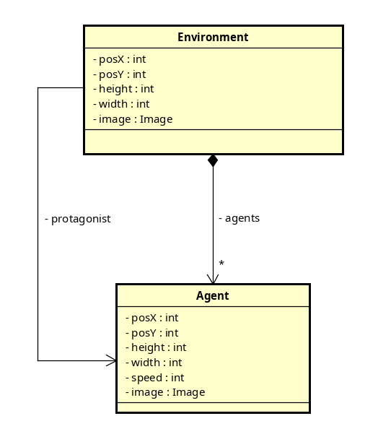
The Class Diagram
protagonist
Notes:
<número>

Slide 227
The Class Diagram
Notes:
<número>

Slide 228

The Class Diagram
Notes:
<número>

Slide 229

The Class Diagram
Notes:
<número>

Slide 230
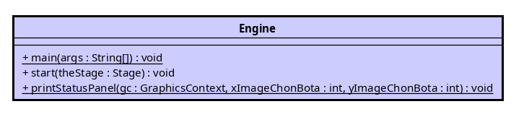
The Class Diagram
Notes:
<número>

Slide 231
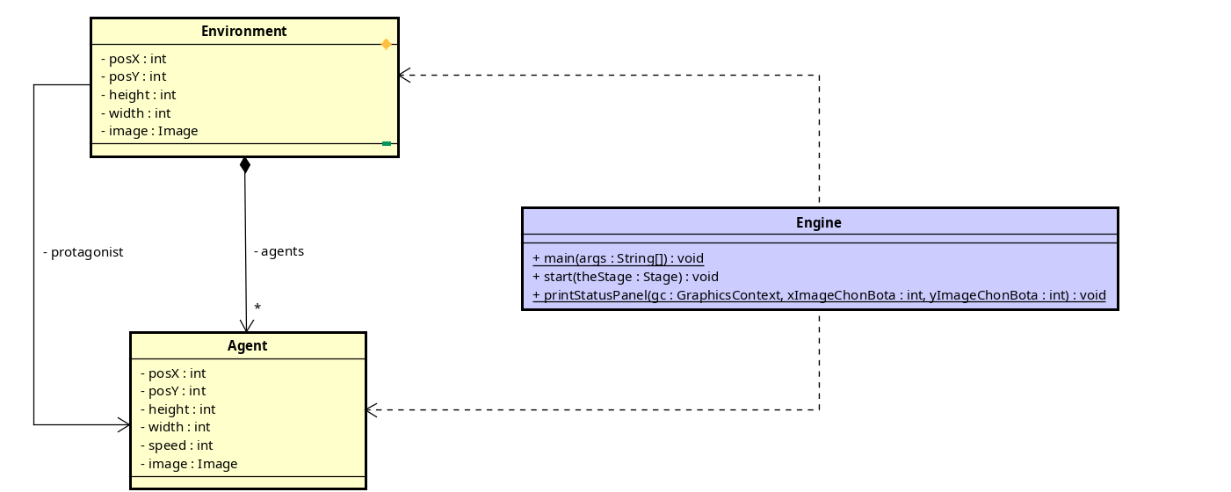
The Class Diagram
Notes:
<número>

Slide 232
The Class Diagram
Notes:
<número>

Slide 233
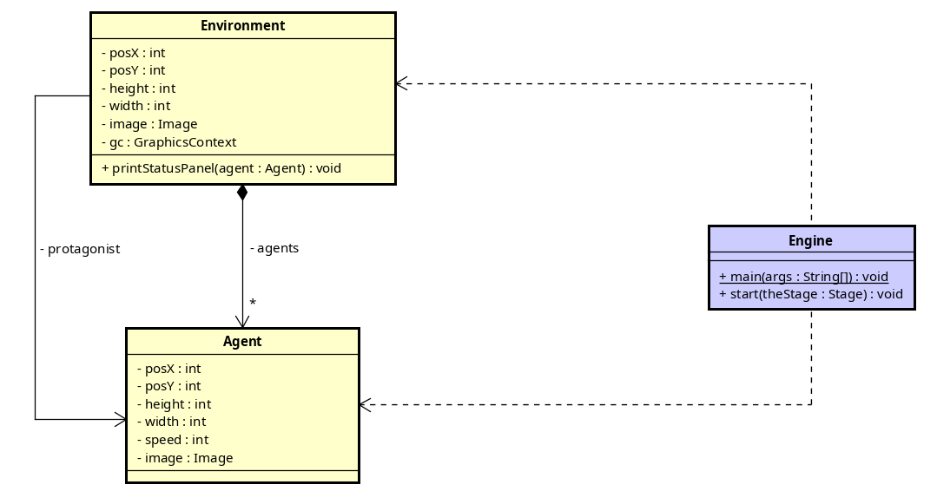
The Class Diagram
Notes:
<número>

Slide 234

The Class Diagram
Notes:
<número>

Slide 235
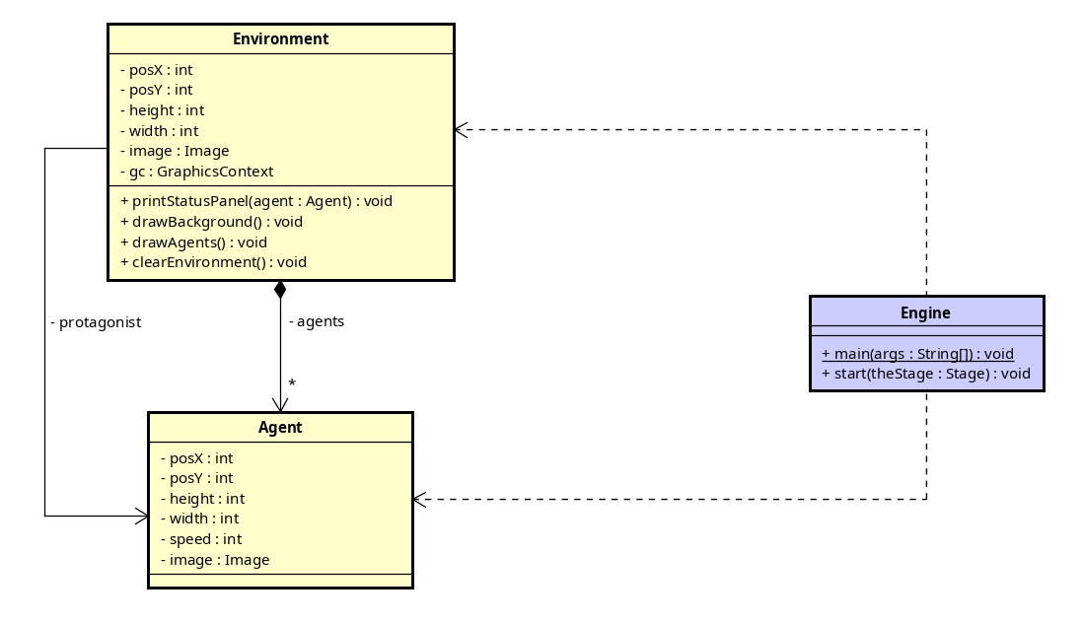
The Class Diagram
Notes:
<número>

Slide 236
The Class Diagram
Notes:
<número>

Slide 237
The Class Diagram
Notes:
<número>

Slide 238
The Class Diagram
Notes:
<número>

Slide 239
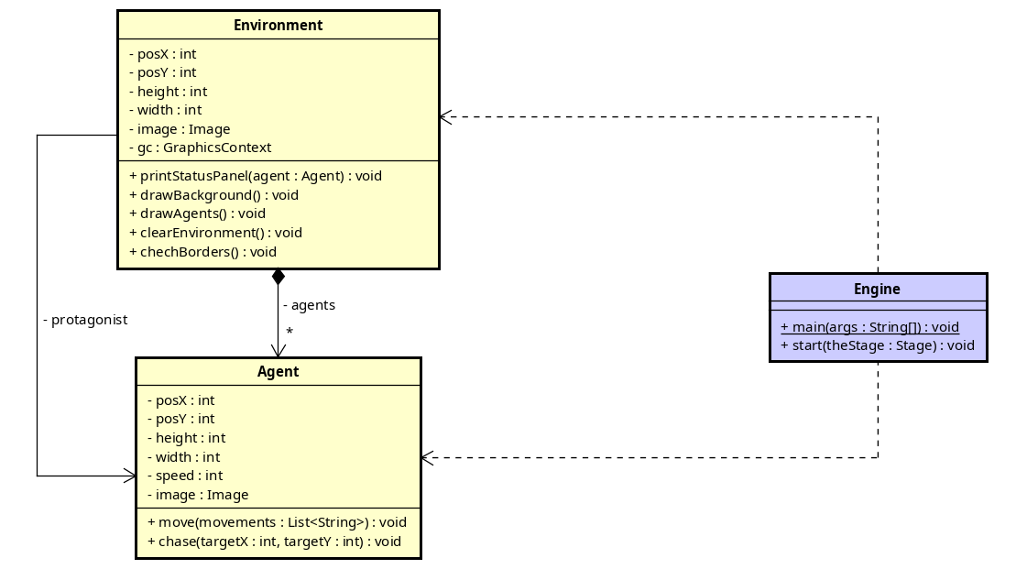
The Class Diagram
Notes:
<número>

Slide 240
The Class Diagram
Notes:
<número>

