Slide 1

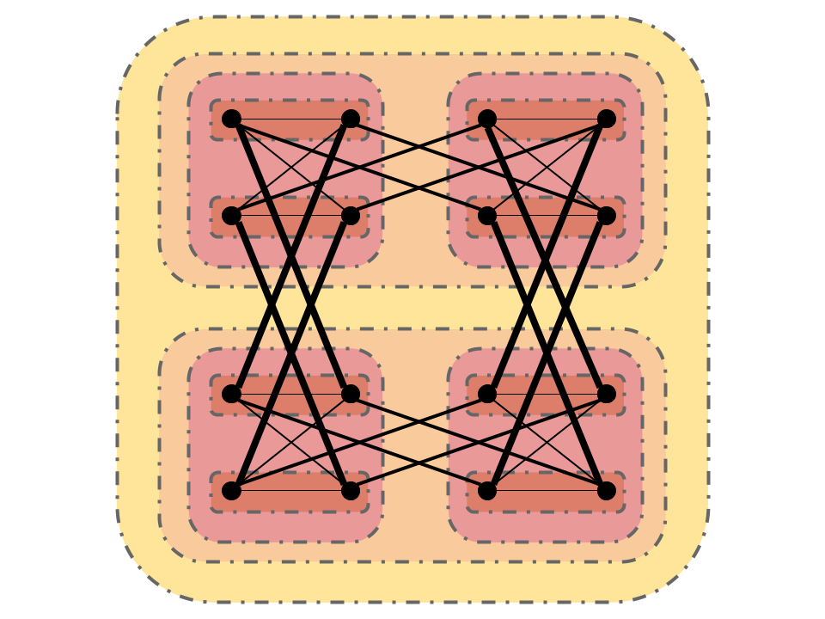

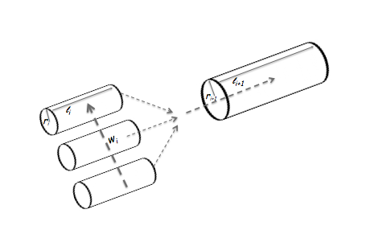
A
C
B
D
l_{i+1}
r_{i+1}
l_{i}
r_{i}

