Slide 1


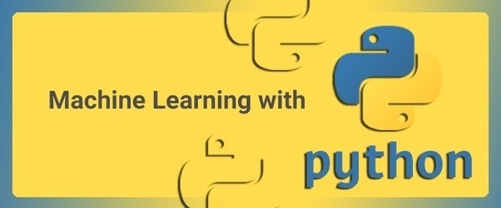

Slide 2
Center of Excellence for Machine Intelligence (CoEMI)

Slide 3
Skill Development Courses
Fundamentals of Python for ML (Mandatory)
Data Analytics using Python (1,2)
Statistical Analysis using Python (1,3)
Big Data using Python (1,2,3,4,6)
Artificial Intelligence using Python (1,5)
Machine Learning using Python (1,2,6)
Deep Learning using Python (1,2,6,7)
Image Processing using Python(1,8)
Video Processing using Python (1,6,7,8,9)
Web Programming using Python(1,10)
App Development using Python (1,11)
Cloud Computing using Python (1,12)
IoT using Python (1,13)
Intelligent App Development (1,2,3,5,6,7,11,12,13,14)
Design and Developing Intelligent Machines using Python (1,2,3,5,6,7,8,9,10,11,12,13,,14,15)
Design and Developing Self Driving Car (1,2,3,5,6,7,8,9,10,11,12,13,14,15,16)
Programming Self Driving Drones using Python (1,2,3,5,6,7,8,9,10,11,12,13,,14,15,16,17)

Slide 4
Course Registration
Minimum intake is 5
Maximum is 30
50 Hours per course
Rs 1000 per individual course
Additional charges for hardware kits if needed
Amount payable@sdmitoffice
Only for First batch , First course Registration amount is 100/- (Rupees 100)
For all course Grade Will be assigned based on continuous evaluation , assignment and projects.

Slide 5
Day 8 - Syllabus
Programming Simple Machine Learning Algorithms using Python

Slide 6
What is Artificial Intelligence?
According to Elaine Rich and Kevin Knight, Artificial Intelligence (AI) is the study of how to make computers/machines do things, which at the moment people do better.
Artificial intelligence (AI) is creation of intelligent machines that work and reacts like humans.

Slide 7
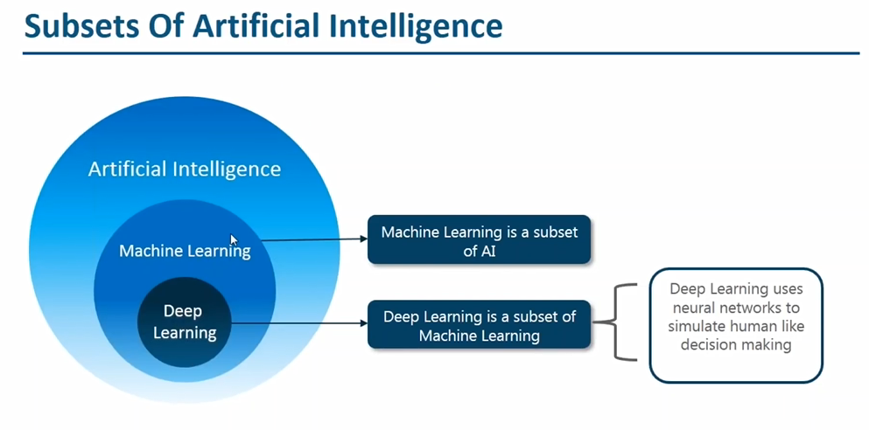

Slide 8
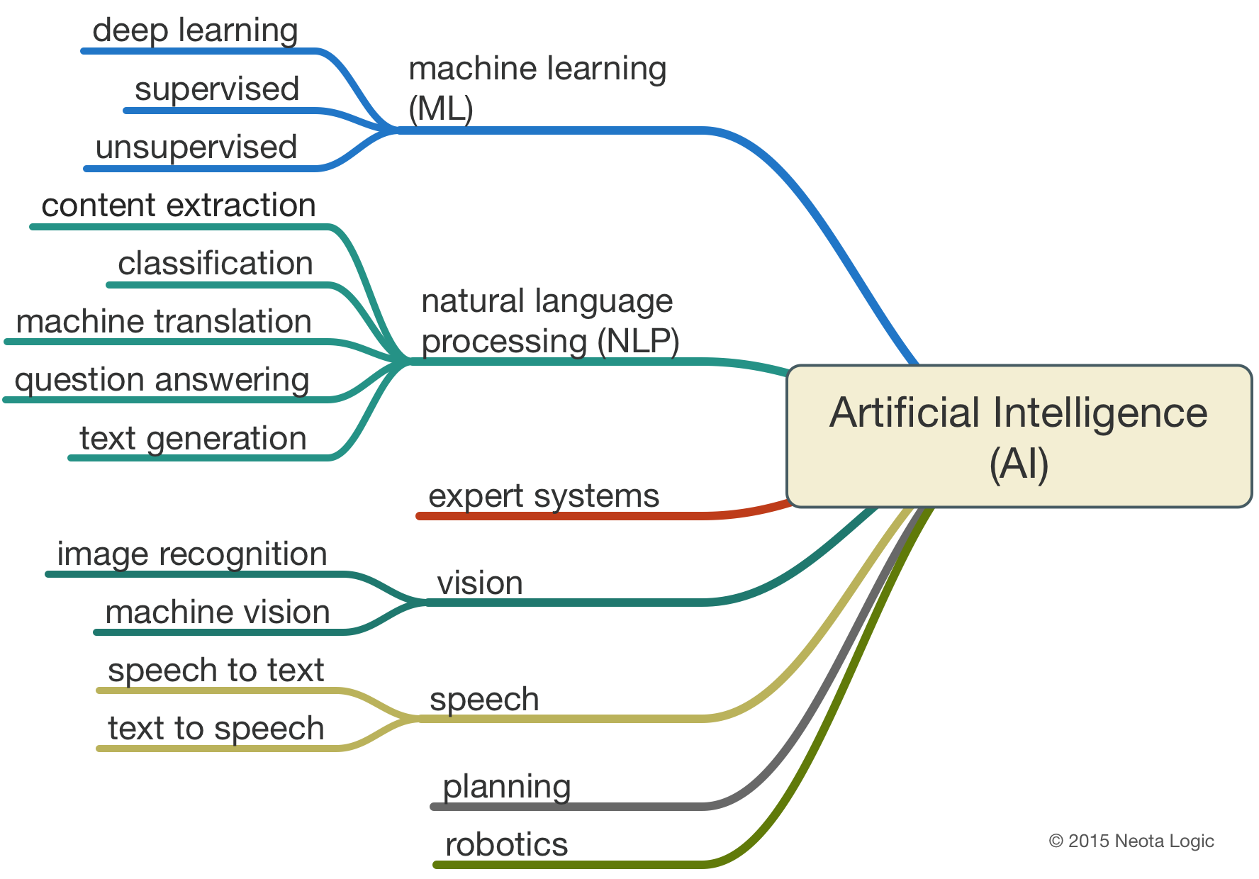

Slide 9
What is Machine Learning ?
Machine learning is an application of artificial intelligence (AI) that provides systems the ability to automatically learn and improve from experience without being explicitly programmed.
Machine learning focuses on the development of computer programs that can access data and use it learn for themselves.

Slide 10
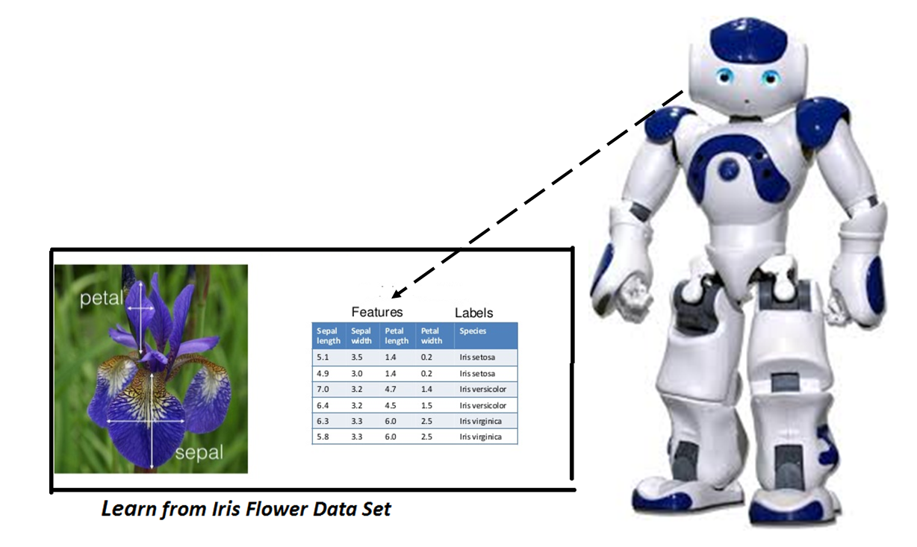
Learning through Data Set

Slide 11
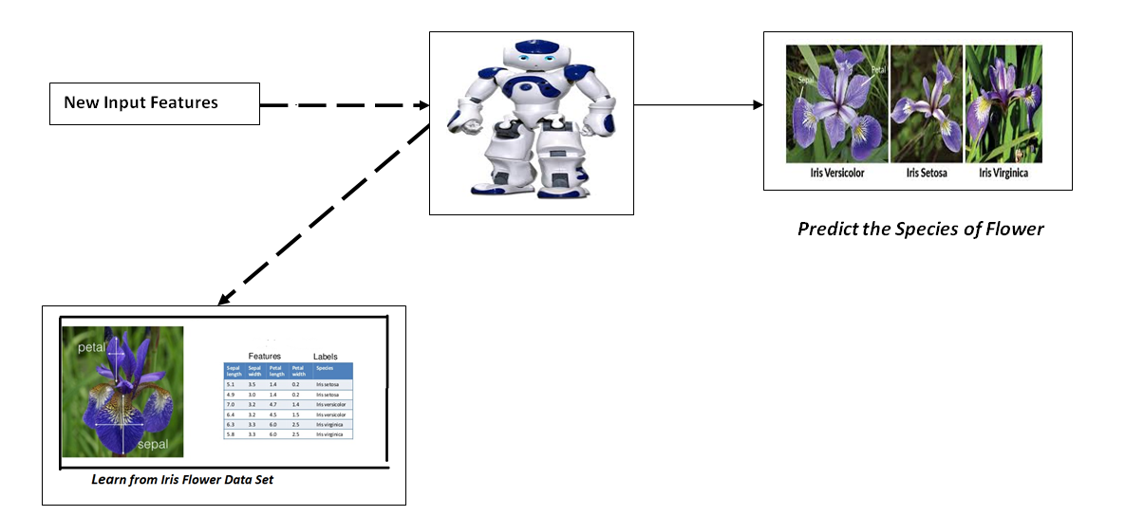
Problem Statement :Determine the Specie Of the Flower

Slide 12
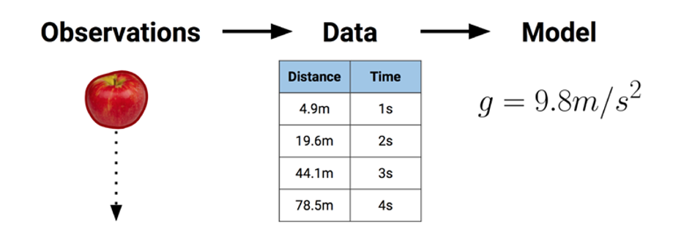

Slide 13
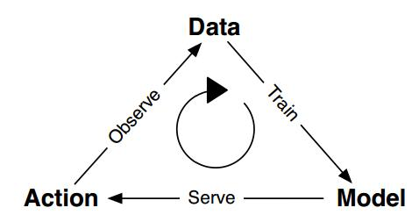
Machine Learning Life Cycle

Slide 14
Types of Machine Learning Techniques
Shallow Learning
Algorithms with Few Layers
Better for Less Complex and Smaller Data sets
Eg: Logistic Regression and Support vector Machines
Deep Learning
New technique that uses many layers of neural network ( a model based on the structure of human brain)
Useful when the target function is very complex and data sets are very large.

Slide 15
Classification of Machine Learning
Supervised Learning
X and Y
Given an observation X what is the best label for Y
Unsupervised Learning
X
Given a set of X cluster or summarize them
Semi Supervised Learning
Reinforcement Learning
Determine what to do based on Rewards and punishments

Slide 16
1. Supervised Learning
Here the training (labeled) data set containing input/predictors and output will be fed to the machine. The machine with the help of algorithm analyze the data set and generates a suitable model /function that best describes the input data. i.e it generates a function f(X) which makes best estimation of the output X for given X.
The generated model / function can be used to predict the output values for new data based on those relationships which it learned from the previous data sets.
When Y is discrete (True /False, ..) – Classification
When X is continuous (Real Numbers )- Regression

Slide 17
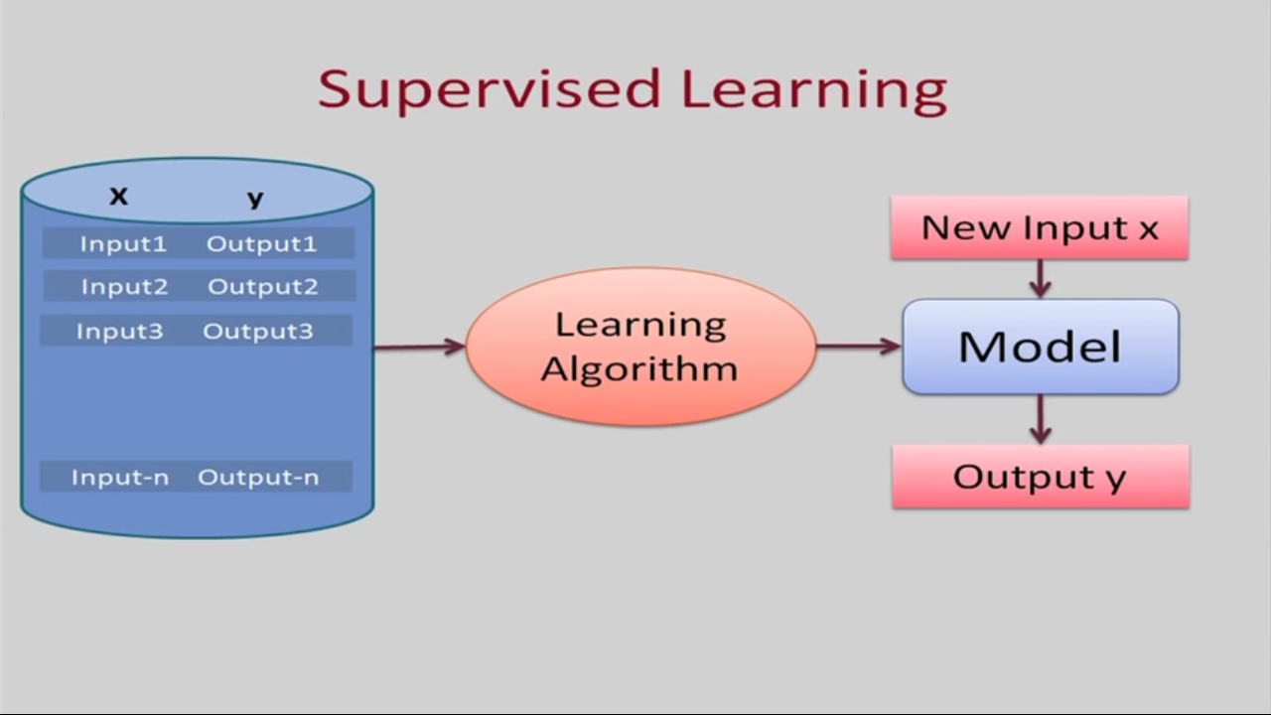

Slide 18
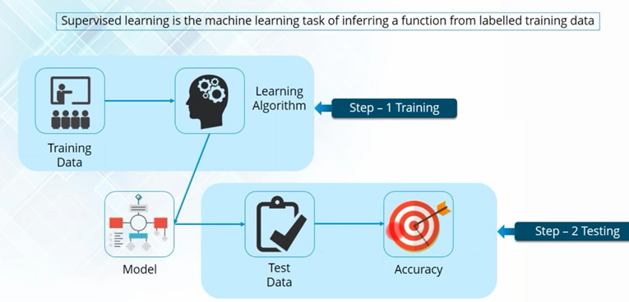

Slide 19
Types of Supervised Learning (Task Driven . Develop Prediction Model based on Input and Output Data)
Classification ( Discrete)
Logistic Regression
KNN
Decision Trees
Support Vector Machines
Naïve Bayesian
Discriminant Analysis
Random Forest
AdaBoost
Neural Networks
Regression ( Continuous)
Linear Regression
SVR
GPR
Ensemble Methods

Slide 20
2. Unsupervised Learning
This approach is data driven . The computer is trained with unlabeled input data.
These algorithms try to use techniques on the input data to mine for rules, detect patterns, and summarize and group the data points which help in deriving meaningful insights and describe the data better to the users.

Slide 21
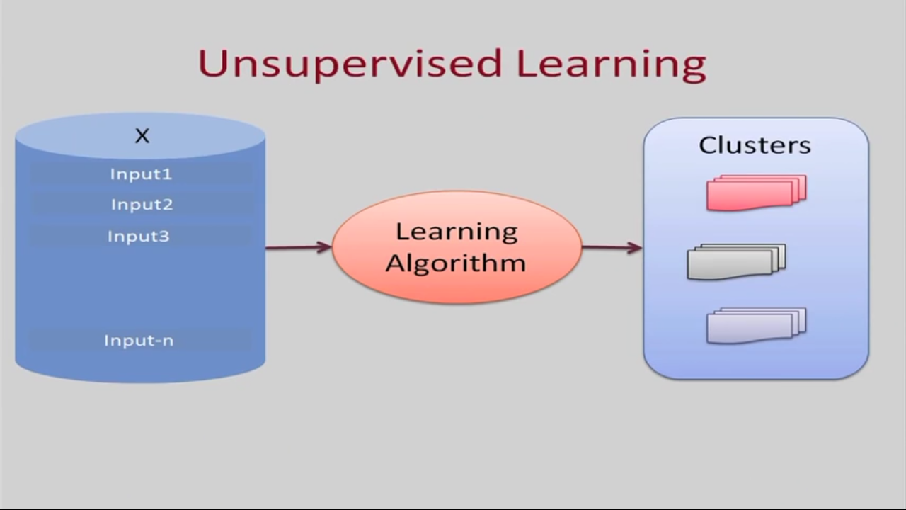

Slide 22
3. Semi Supervised
In the previous two types, either there are no labels for all the observation in the dataset or labels are present for all the observations.
Semi-supervised learning falls in between these two.

Slide 23
4. Reinforcement Learning
This method aims at using observations gathered from the interaction with the environment to take actions that would maximize the reward or minimize the risk.
Reinforcement learning algorithm (called the agent) continuously learns from the environment in an iterative fashion.
In the process, the agent learns from its experiences of the environment until it explores the full range of possible states.

Slide 24
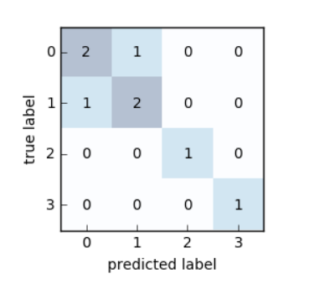
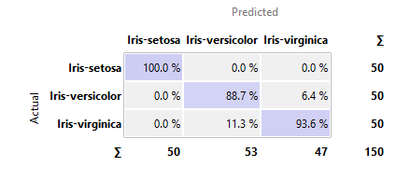
Confusion Matrix

Slide 25
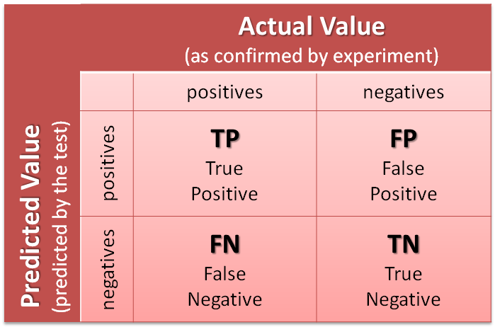

Slide 26
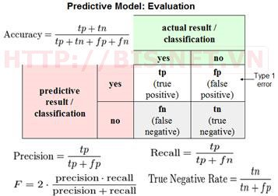

Slide 27
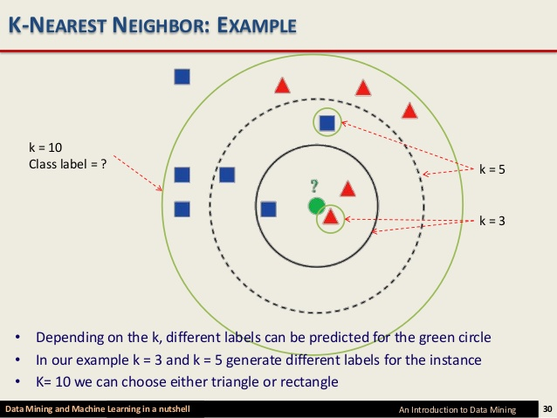
KNN Algorithm

Slide 28
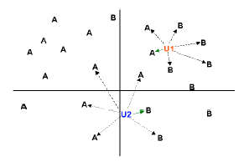
K-Nearest-Neighbor Algorithm
Principle: points (documents) that are close in the space belong to the same class

Slide 29
Definition of Nearest Neighbor
K-nearest neighbors of a record x are data points that have the k smallest distance to x

Slide 30
Nearest Neighbor Classification
Compute distance between two points:
Euclidean distance

Slide 31
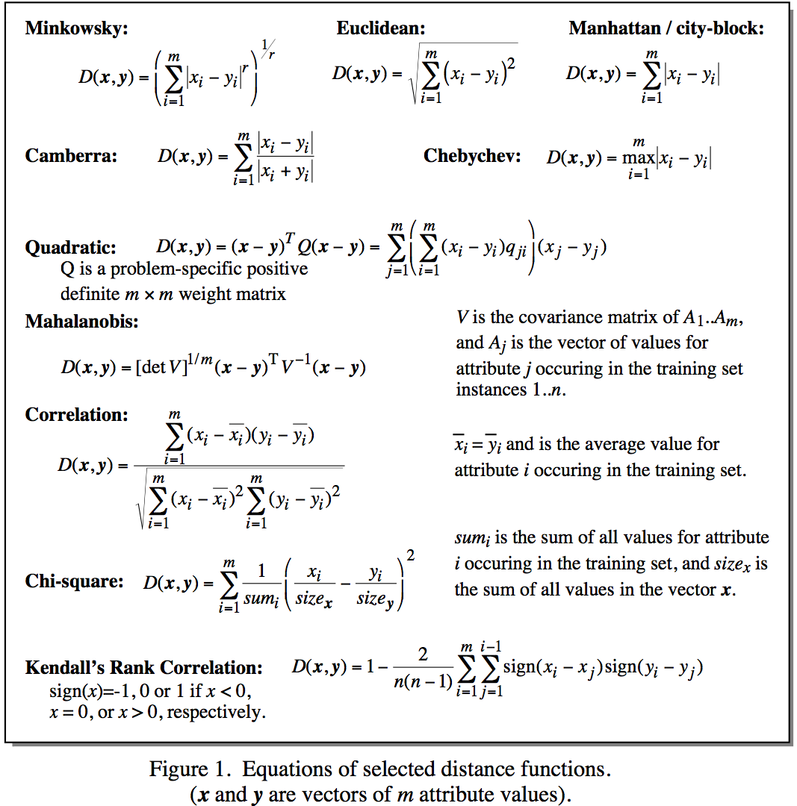
Distance Metrics
Notes:
Minkowsky = l-norm

Slide 32
Nearest Neighbor Classification…
Choosing the value of k:
If k is too small, sensitive to noise points
If k is too large, neighborhood may include points from other classes

Slide 33
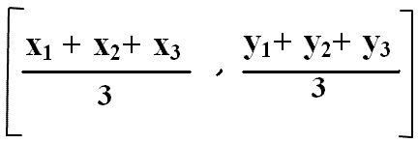
How the K-Mean Clustering algorithm works?

Slide 34
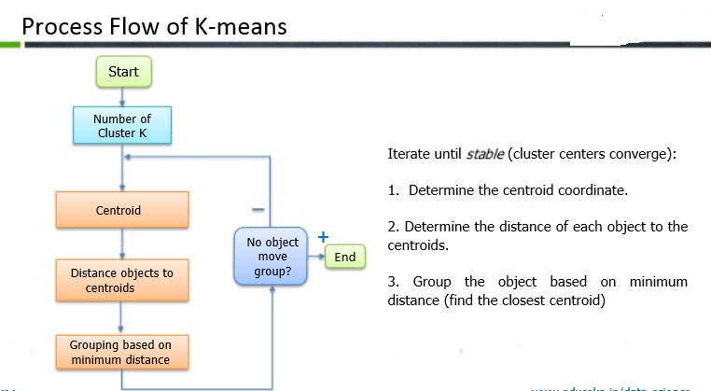

Slide 35
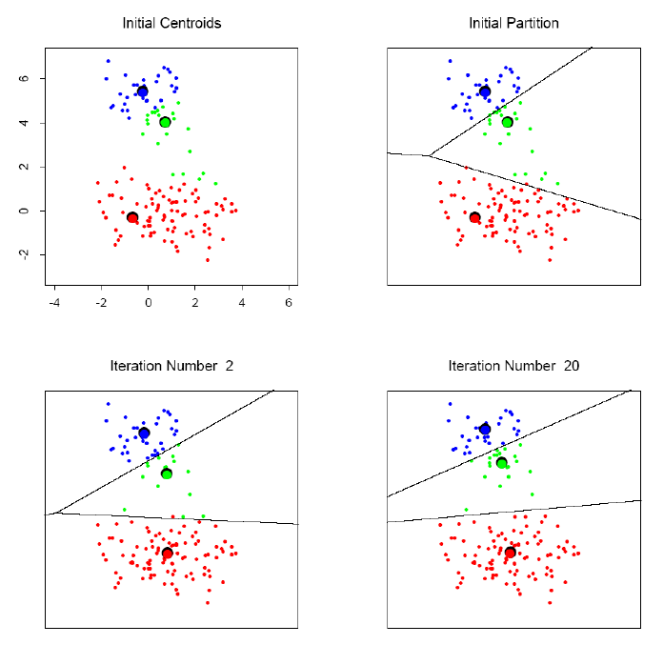
K-means clustering example

