Slide 1
Center of Excellence for Machine Intelligence (CoEMI)

Slide 2
Skill Development Courses
Fundamentals of Python for ML (Mandatory)
Data Analytics using Python (1,2)
Statistical Analysis using Python (1,3)
Big Data using Python (1,2,3,4,6)
Artificial Intelligence using Python (1,5)
Machine Learning using Python (1,2,6)
Deep Learning using Python (1,2,6,7)
Image Processing using Python(1,8)
Video Processing using Python (1,6,7,8,9)
Web Programming using Python(1,10)
App Development using Python (1,11)
Cloud Computing using Python (1,12)
IoT using Python (1,13)
Intelligent App Development (1,2,3,5,6,7,11,12,13,14)
Design and Developing Intelligent Machines using Python (1,2,3,5,6,7,8,9,10,11,12,13,,14,15)
Design and Developing Self Driving Car (1,2,3,5,6,7,8,9,10,11,12,13,14,15,16)
Programming Self Driving Drones using Python (1,2,3,5,6,7,8,9,10,11,12,13,,14,15,16,17)

Slide 3
Course Registration
Minimum intake is 5
Maximum is 30
50 Hours per course
Rs 1000 per individual course
Additional charges for hardware kits if needed
Amount payable@sdmitoffice
Only for First batch , First course Registration amount is 100/- (Rupees 100)
For all course Grade Will be assigned based on continuous evaluation , assignment and projects.

Slide 4
Day2 : Session1
Introduction To Python , Variables , expressions and statements

Slide 5
Introduction to Python
Python is a general-purpose interpreted, interactive, object-oriented, and high-level programming language.
It was created by Guido van Rossum during 1985- 1990. Python is named after a TV Show called ‘Monty Python’s Flying Circus’ and not after Python-the snake.

Slide 6
Features of Python
Python is a Beginner's Language
Simple
Easy to Learn
Free and Open Source
High-level Language
Portable
Interactive
Interpreted
Object Oriented
Extensible
Embeddable
Extensive Libraries
Databases
GUI Programming
Scalable

Slide 7
Data Types
Type: A category or set of data values.
Examples: integer, real number, text string
In Python
A variable's type does not need to be declared.
A variable can change types as a program is running.
Value | Python type
42 | int
3.14 | float
"ni!" | str

Slide 8
Data Types
Python Numbers:
• Number data types store numeric values. Number objects are created when you assign a value to them.
Python Strings:
• Strings in Python are identified as a contiguous set of characters represented in the quotation marks. Python allows either pair of single or double quotes.
Python Lists:
• Lists are the most versatile of Python's compound data types. A list contains items separated by commas and enclosed within square brackets ([ ]).
Python Tuples:
• A tuple is another sequence data type that is similar to the list. A tuple consists of a number of values separated by commas. Unlike lists, however, tuples are enclosed within parenthesis.
Python Dictionary:
• Python's dictionaries are kind of hash-table type. They work like associative arrays or hashes found in Perl and consist of key-value pairs. A dictionary key can be almost any Python type, but are usually numbers or strings. Values, on the other hand, can be any arbitrary Python object.

Slide 9
Numbers
Python recognizes several diﬀerent types of data numbers.
23 and −75 are integers,
5.0 and −23.09 are ﬂoats or ﬂoating point numbers.
2 + 3j is a complex number

Slide 10
To check the number type
type(-75)
type(5.0)
type(12345678901)
type(-1+2j)
complex(2,3)
type("This is a string")
type( [1,3,4,1,6] )
type(True)
type(False)

Slide 11
Operators and operands
Operators are special symbols that represent computations like addition and multiplication. The values the operator is applied to are called operands.
The operators +, -, *, /, and ** perform addition, subtraction, multiplication, division, and exponentiation, as in the following examples:
20+32
hour-1
hour*60+minute
minute/60
5**2
(5+9)*(15-7)

Slide 12
Expressions
An expression is a combination of values, variables, and operators. A value all by itself is considered an expression, and so is a variable, so the following are all legal expressions (assuming that the variable x has been assigned a value):
17
X
x + 17
If you type an expression in interactive mode, the interpreter evaluates it and displays the result:
>>> 1 + 1
2

Slide 13
Exercise 1:
Type the following statements in the Python interpreter to see what they do:
5
x = 5
x + 1

Slide 14
Order of operations
When more than one operator appears in an expression, the order of evaluation depends on the rules of precedence. For mathematical operators, Python follows mathematical convention. The acronym PEMDAS is a useful way to remember the rules:
Parentheses have the highest precedence and can be used to force an expression to evaluate in the order you want.
Exponentiation has the next highest precedence,
Multiplication and Division have the same precedence, which is higher than Addition and Subtraction, which also have the same precedence.
Operators with the same precedence are evaluated from left to right.

Slide 15
Modulus operator
The modulus operator works on integers and yields the remainder when the ﬁrst operand is divided by the second. In Python, the modulus operator is a percent sign (%). The syntax is the same as for other operators:
>>> quotient = 7 // 3
>>> print(quotient)
2
>>> remainder = 7 % 3
>>> print(remainder)
1
So 7 divided by 3 is 2 with 1 left over.

Slide 16
String operations
The + operator works with strings, but it is not addition in the mathematical sense. Instead it performs concatenation, which means joining the strings by linking them end to end.
For example:
>>> first = 10
>>> second = 15
>>> print(first + second)
25
>>> first = '100'
>>> second = '150'
>>> print(first + second)
100150
The output of this program is 100150.

Slide 17
Comments
As programs get bigger and more complicated, they get more diﬃcult to read. Formal languages are dense, and it is often diﬃcult to look at a piece of code and ﬁgure out what it is doing, or why.
For this reason, it is a good idea to add notes to your programs to explain in natural language what the program is doing. These notes are called comments, and in Python they start with the # symbol:
# compute the percentage of the hour that has elapsed percentage = (minute * 100) / 60
percentage = (minute * 100) / 60 # percentage of an hour
This comment is redundant with the code and useless:
v = 5 # assign 5 to v
This comment contains useful information that is not in the code:
v = 5 # velocity in meters/second.

Slide 18
What are operators in python?
Operators are special symbols in Python that carry out arithmetic or logical computation. The value that the operator operates on is called the operand
For example:
>>> 2+3
5
Here, + is the operator that performs addition. 2 and 3 are the operands and 5 is the output of the operation.

Slide 19
Operators
Python language supports the following types of operators −
• Arithmetic Operators
• Comparison (Relational) Operators
• Assignment Operators
• Logical Operators
• Bitwise Operators
• Membership Operators
• Identity Operators

Slide 20
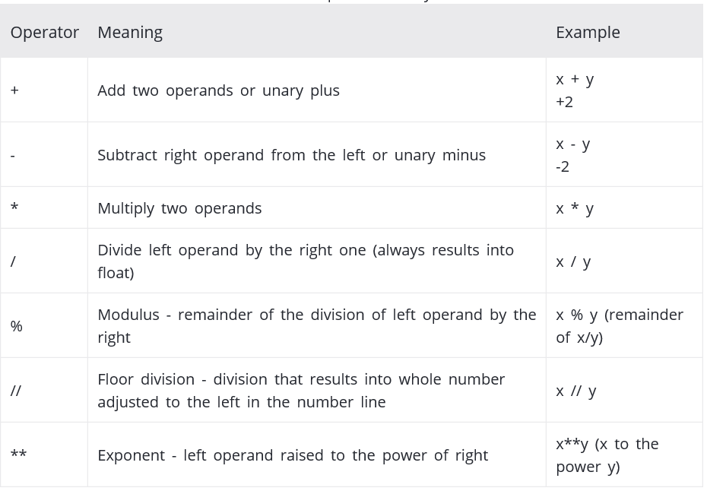
Arithmetic operators

Slide 21
Example #1: Arithmetic operators in Python
x = 15
y = 4
# Output: x + y = 19
print('x + y =',x+y)
# Output: x - y = 11
print('x - y =',x-y)
# Output: x * y = 60
print('x * y =',x*y)
# Output: x / y = 3.75
print('x / y =',x/y)
# Output: x // y = 3
print('x // y =',x//y)
# Output: x ** y = 50625
print('x ** y =',x**y)

Slide 22
Comparison operators
Comparison operators are used to compare values. It either returns True or False according to the condition.
Operator | Meaning | Example
> | Greater than - True if left operand is greater than the right | x > y
< | Less than - True if left operand is less than the right | x < y
== | Equal to - True if both operands are equal | x == y
!= | Not equal to - True if operands are not equal | x != y
>= | Greater than or equal to - True if left operand is greater than or equal to the right | x >= y
<= | Less than or equal to - True if left operand is less than or equal to the right | x <= y

Slide 23
Example #2: Comparison operators in Python
x = 10
y = 12
# Output: x > y is False
print('x > y is', x>y)
# Output: x < y is True
print('x < y is', x<y)
# Output: x == y is False
print('x == y is', x==y)
# Output: x != y is True
print('x != y is', x!=y)
# Output: x >= y is False
print('x >= y is', x>=y)
# Output: x <= y is True
print('x <= y is', x<=y)

Slide 24
Logical operators
Operator | Meaning | Example
and | True if both the operands are true | x and y
or | True if either of the operands is true | x or y
not | True if operand is false (complements the operand) | not x

Slide 25
Example #3: Logical Operators in Python
x = True
y = False
# Output: x and y is False
print('x and y is',x and y)
# Output: x or y is True
print('x or y is',x or y)
# Output: not x is False
print('not x is',not x)

Slide 26
Bitwise operators
Bitwise operators act on operands as if they were string of binary digits. It operates bit by bit, hence the name.
For example, 2 is 10 in binary and 7 is 111.
In the table below: Let x = 10 (0000 1010 in binary) and y = 4 (0000 0100 in binary)
Operator | Meaning | Example
& | Bitwise AND | x& y = 0 (0000 0000)
| | Bitwise OR | x | y = 14 (0000 1110)
~ | Bitwise NOT | ~x = -11 (1111 0101)
^ | Bitwise XOR | x ^ y = 14 (0000 1110)
>> | Bitwise right shift | x>> 2 = 2 (0000 0010)
<< | Bitwise left shift | x<< 2 = 40 (0010 1000)

Slide 27
Assignment operators
Operator | Example | Equivatent to
= | x = 5 | x = 5
+= | x += 5 | x = x + 5
-= | x -= 5 | x = x - 5
*= | x *= 5 | x = x * 5
/= | x /= 5 | x = x / 5
%= | x %= 5 | x = x % 5
//= | x //= 5 | x = x // 5
**= | x **= 5 | x = x ** 5
&= | x &= 5 | x = x & 5
|= | x |= 5 | x = x | 5
^= | x ^= 5 | x = x ^ 5
>>= | x >>= 5 | x = x >> 5
<<= | x <<= 5 | x = x << 5

Slide 28
Special operators
Python language offers some special type of operators like the identity operator or the membership operator.
They are described below with examples

Slide 29
Identity operators
is and is not are the identity operators in Python.
They are used to check if two values (or variables) are located on the same part of the memory.
Two variables that are equal does not imply that they are identical.
Operator | Meaning | Example
is | True if the operands are identical (refer to the same object) | x is True
is not | True if the operands are not identical (do not refer to the same object) | x is not True

Slide 30
Example #4: Identity operators in Python
x1 = 5
y1 = 5
x2 = 'Hello‘
y2 = 'Hello‘
x3 = [1,2,3]
y3 = [1,2,3]
# Output: False
print(x1 is not y1)
# Output: True
print(x2 is y2)
# Output: False
print(x3 is y3)

Slide 31
Membership operators
in and not in are the membership operators in Python.
They are used to test whether a value or variable is found in a sequence (string, list, tuple, set and dictionary).
In a dictionary we can only test for presence of key, not the value.
Operator | Meaning | Example
in | True if value/variable is found in the sequence | 5 in x
not in | True if value/variable is not found in the sequence | 5 not in x

Slide 32
Example #5: Membership operators in Python
x = 'Hello world‘
y = {1:'a',2:'b'}
# Output: True
print('H' in x)
# Output: True
print('hello' not in x)
# Output: True
print(1 in y)
# Output: False
print('a' in y)

Slide 33
Python Program to Add Two Numbers
# This program adds two numbers
num1 = 1.5
num2 = 6.3
# Add two numbers
sum = float(num1) + float(num2)
# Display the sum
print('The sum of {0} and {1} is {2}'.format(num1, num2, sum))

Slide 34
Add Two Numbers Provided by The User
# Store input numbers
num1 = input('Enter first number: ')
num2 = input('Enter second number: ')
# Add two numbers
sum = float(num1) + float(num2)
# Display the sum
print('The sum of {0} and {1} is {2}'.format(num1, num2, sum))
Alternative
print('The sum is %.1f' %(float(input('Enter first number: '))+float(input('Enter second number: '))))

Slide 35
The range function
The range function is often used to create lists of integers. It has three forms. In the simplest form, range(n) produces a list of all numbers 0,1,2,...,n−1 starting with 0 and ending with n−1. For instance,
range(17) # Form1
[0, 1, 2, 3, 4, 5, 6, 7, 8, 9, 10, 11, 12, 13, 14, 15, 16]
You can also specify an optional starting point and an increment, which may be negative. For instance, we have
range(1,10) # Form2
[1, 2, 3, 4, 5, 6, 7, 8, 9]
range(-6,0) # Form2
[-6, -5, -4, -3, -2, -1]
range(1,10,2) #Form3
[1, 3, 5, 7, 9]
range(10,0,-2) #Form3
[10, 8, 6, 4, 2]

Slide 36
Range Function
x= list(range(17)) # Form1
print(x)
x= list(range(1,10)) # Form2
print(x)
x= list(range(-6,0)) # Form2
print(x)
x= list(range(1,10,2)) # Form3
print(x)
x= list(range(10,0,-2)) # Form3
print(x)

Slide 37
Python Keywords
Keywords are the reserved words in Python. We cannot use a keyword as variable name, function name or any other identifier. They are used to define the syntax and structure of the Python language. In Python, keywords are case sensitive. There are 33 keywords in Python 3.3. This number can vary slightly in course of time. All the keywords except True, False and None are in lowercase and they must be written as it is. The list of all the keywords are given below.
Keywords in Python programming language
False | class | finally | is | return
None | continue | for | lambda | try
True | def | from | nonlocal | while
and | del | global | not | with
as | elif | if | or | yield
assert | else | import | pass
break | except | in | raise

Slide 38
Values and types
A value is one of the basic things a program works with, like a letter or a number.
The values we have seen so far are like 1, 2.0, and “Hello, World!”
These values belong to deferent types: 1 is an integer, 2.0 is a real number and “Hello, World!” is a string, so called because it contains a “string” of letters.

Slide 39
What is the output of the following statements?
print(4)
type('Hello, World!')
type(17)
type(3.2)
type('17')
type('3.2')
print(1,000,000)

Slide 40
Variables
A variable is a name that refers to a value. An assignment statement creates new variables and gives them values:
>>> message = 'And now for something completely different'
>>> n = 17
>>> pi = 3.1415926535897931
To display the value of a variable, you can use a print statement:
>>> print(n)
17
>>> print(pi)
3.141592653589793
The type of a variable is the type of the value it refers to.
>>> type(message)
<class 'str'>
>>> type(n)
<class 'int'>
>>> type(pi)
<class 'float'>

Slide 41
Variable names
Variable names can be arbitrarily long.
They can contain both letters and numbers, but they cannot start with a number.
It is legal to use uppercase letters, but it is a good idea to begin variable names with a lowercase letter (you’ll see why later).
The underscore character (_) can appear in a name. It is often used in names with multiple words, such as my_name or airspeed_of_unladen_swallow.
Variable names can start with an underscore character, but we generally avoid doing this unless we are writing library code for others to use.
If you give a variable an illegal name, you get a syntax error:
>>> 76trombones = 'big parade'
Syntax Error: invalid syntax
>>> more@ = 1000000
Syntax Error: invalid syntax
>>> class = 'Advanced Theoretical Zymurgy'
Syntax Error: invalid syntax

Slide 42
Python Identifiers
Identifier is the name given to entities like class, functions, variables etc. in Python. It helps differentiating one entity from another.

Slide 43
Rules for writing identifiers
Identifiers can be a combination of letters in lowercase (a to z) or uppercase (A to Z) or digits (0 to 9) or an underscore (_).
An identifier cannot start with a digit.
Keywords cannot be used as identifiers.
We cannot use special symbols like !, @, #, $, % etc. in our identifier.
Identifier can be of any length.

Slide 44
Statements
A statement is a unit of code that the Python interpreter can execute. We have seen two kinds of statements: print being an expression statement and assignment.
When you type a statement in interactive mode, the interpreter executes it and displays the result, if there is one.

Slide 45
Python Statement
Instructions that a Python interpreter can execute are called statements.
For example, a = 1 is an assignment statement.
if statement,
for statement,
while statement etc.
are other kinds of statements which will be discussed later.

Slide 46
Multi-Line Statement
In Python, end of a statement is marked by a newline character. But we can make a statement extend over multiple lines with the line continuation character (\). For example:
a = 1 + 2 + 3 + \
4 + 5 + 6 + \
7 + 8 + 9
This is explicit line continuation. In Python, line continuation is implied inside parentheses ( ), brackets [ ] and braces { }. For instance, we can implement the above multi-line statement as
a = (1 + 2 + 3 +
4 + 5 + 6 +
7 + 8 + 9)
Here, the surrounding parentheses ( ) do the line continuation implicitly. Same is the case with [ ] and { }. For example:
colors = ['red',
'blue',
'green']
We could also put multiple statements in a single line using semicolons, as follows
a = 1; b = 2; c = 3

Slide 47
Python Indentation
Most of the programming languages like C, C++, Java use braces { } to define a block of code. Python uses indentation.
A code block (body of a function, loop etc.) starts with indentation and ends with the first unindented line. The amount of indentation is up to you, but it must be consistent throughout that block.
Generally four whitespaces are used for indentation and is preferred over tabs. Here is an example.
for i in range(1,11):
print(i)
if i == 5:
break

Slide 48
Try this
Write a program that uses input to prompt a user for their name and then welcomes them.
Write a program to prompt the user for hours and rate per hour to compute gross pay.
Assume that we execute the following assignment statements:
width = 17 height = 12.0
For each of the following expressions, write the value of the expression and the type (of the value of the expression).
1. width//2
2. width/2.0
3. height/3
4. 1 + 2 * 5
Write a program which prompts the user for a Celsius temperature, convert the temperature to Fahrenheit, and print out the converted temperature

Slide 49
Conditional execution, Functions , Iteration

Slide 50
Conditional execution
In order to write useful programs, we almost always need the ability to check conditions and change the behavior of the program accordingly. Conditional statements give us this ability.
The simplest form is the if statement:
if x > 0 :
print('x is positive')
The boolean expression after the if statement is called the condition. We end the
if statement with a colon character (:) and the line(s) after the if statement are indented.

Slide 51
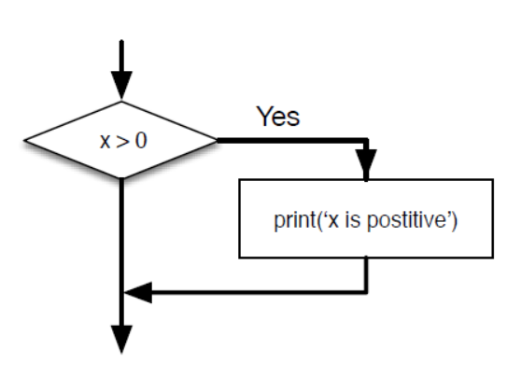

Slide 52
Alternative execution
A second form of the if statement is alternative execution, in which there are two possibilities and the condition determines which one gets executed. The syntax looks like this:
if x%2 == 0 :
print('x is even')
else :
print('x is odd')

Slide 53
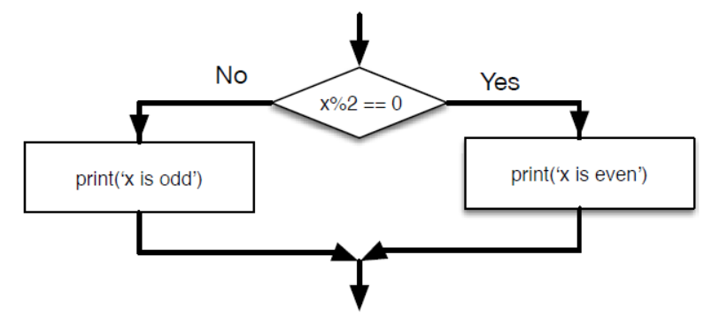

Slide 54
Chained conditionals
Sometimes there are more than two possibilities and we need more than two branches. One way to express a computation like that is a chained conditional:
if x < y:
print('x is less than y')
elif x > y:
print('x is greater than y')
else:
print('x and y are equal')
Note : elif is an abbreviation of “else if.” Again, exactly one branch will be executed.

Slide 55
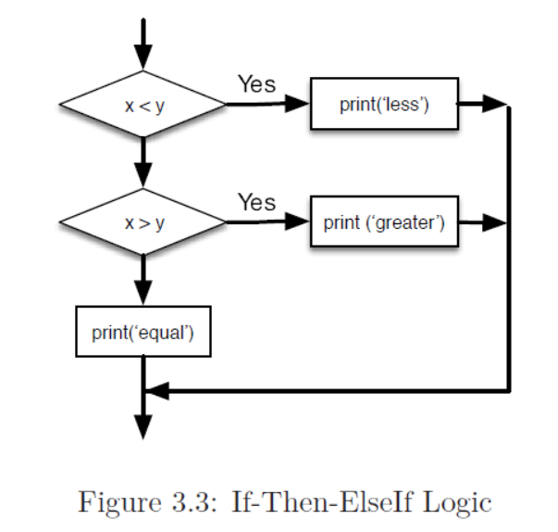
If-Then-Else If Logic

Slide 56
Note
There is no limit on the number of elif statements.
If there is an else clause, it has to be at the end, but there doesn’t have to be one.

Slide 57
Example
if choice == 'a':
print('Bad guess')
elif choice == 'b':
print('Good guess')
elif choice == 'c':
print('Close, but not correct')
Each condition is checked in order. If the first is false, the next is checked, and so on. If one of them is true, the corresponding branch executes, and the statement ends.
Even if more than one condition is true, only the first true branch executes

Slide 58
Nested conditionals
One conditional can also be nested within another. We could have written the three-branch example like this:
if x == y:
print('x and y are equal')
else:
if x < y:
print('x is less than y')
else:
print('x is greater than y')

Slide 59
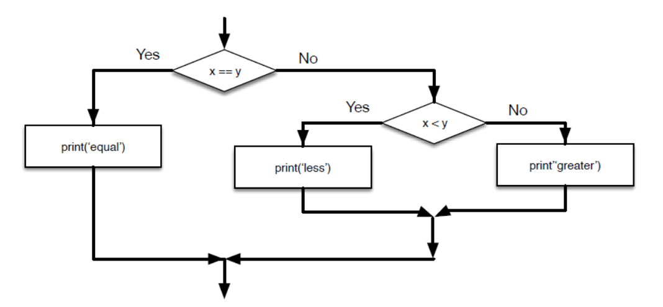

Slide 60
Note
Logical operators often provide a way to simplify nested conditional statements. For example, we can rewrite the following code using a single conditional:
if 0 < x:
if x < 10:
print('x is a positive single-digit number.')
The print statement is executed only if we make it past both conditionals, so we can get the same effect with the and operator:
if 0 < x and x < 10:
print('x is a positive single-digit number.')

Slide 61
Catching exceptions using try and except
There is a conditional execution structure built into Python to handle these types of expected and unexpected errors called “try / except”.
The idea of try and except is that you know that some sequence of instruction(s) may have a problem and you want to add some statements to be executed if an error occurs.
These extra statements (the except block) are ignored if there is no error.

Slide 62
Example
inp = input('Enter Fahrenheit Temperature:')
try:
fahr = float(inp)
cel = (fahr - 32.0) * 5.0 / 9.0
print(cel)
except:
print('Please enter a number')

Slide 63
Short-circuit evaluation of logical expressions
x = 6
y = 0
x >= 2 and y != 0 and (x/y) > 2
x = 6
y = 0
x >= 2 and (x/y) > 2 and y != 0

Slide 64
Functions
In the context of programming, a function is a named sequence of statements that performs a computation. When you define a function, you specify the name and the sequence of statements. Later, you can “call” the function by name.
We have already seen one example of a function call:
type(32)
<class 'int'>

Slide 65
Parameters
parameter: A value supplied to a function as you run it.
Syntax:
function ( value )
function ( value, value, ..., value )
Example:
print ( sqrt(25))
print (sqrt(15 + 10 * 10 + 6))
x = 5
print( sqrt(x + sqrt(16)))
Notes:
You have already called System.out.println and passed parameters to it.

Slide 66
Math Functions and constants
Function name | Description
abs(value) | absolute value
ceil(value) | rounds up
cos(value) | cosine, in radians
floor(value) | rounds down
log10(value) | logarithm, base 10
max(value1, value2) | larger of two values
min(value1, value2) | smaller of two values
round(value) | nearest whole number
sin(value) | sine, in radians
sqrt(value) | square root
Constant | Description
e | 2.7182818...
pi | 3.1415926...
To use these commands, place this line atop your program:
from math import *

Slide 67
Built-in functions
Python provides a number of important built-in functions that we can use without needing to provide the function definition. The creators of Python wrote a set of functions to solve common problems and included them in Python for us to use.
max('Hello world')
min('Hello world')
len('Hello world')

Slide 68
Type conversion functions
int('32')
int('Hello')
int(3.99999)
int(-2.3)
float(32)
float('3.14159')

Slide 69
Random numbers
The random module provides functions that generate pseudorandom numbers
To see a sample, run this loop:
import random
for i in range(10):
x = random.random()
print(x)

Slide 70
Other randoms
random.randint(5, 10)
t = [1, 2, 3]
random.choice(t)

Slide 71
Math functions
import math
print(math)
ratio = signal_power / noise_power
decibels = 10 * math.log10(ratio)
radians = 0.7
height = math.sin(radians)
radians = degrees / 360.0 * 2 * math.pi
math.sin(radians)
math.sqrt(2) / 2.0

Slide 72
Adding new functions
def print_lyrics():
print("I'm a lumberjack, and I'm okay.")
print('I sleep all night and I work all day.')
Check this
print(print_lyrics)
print(type(print_lyrics))
Call this
print_lyrics()

Slide 73
Define another function
def repeat_lyrics():
print_lyrics()
print_lyrics()
And then call repeat_lyrics:
repeat_lyrics()

Slide 74
Definitions and uses
def print_lyrics():
print("I'm a lumberjack, and I'm okay.")
print('I sleep all night and I work all day.')
def repeat_lyrics():
print_lyrics()
print_lyrics()
repeat_lyrics()

Slide 75
Example
def print_twice(bruce):
print(bruce)
print(bruce)
print_twice('Spam')
print_twice(17)
import math
print_twice(math.pi)
print_twice('Spam '*4)
print_twice(math.cos(math.pi))

Slide 76
Example
michael = 'Eric, the half a bee.'
print_twice(michael)

Slide 77
Fruitful functions and void functions
Some of the functions we are using, such as the math functions, yield results; for lack of a better name, I call them fruitful functions. Other functions, like print_twice, perform an action but don’t return a value. They are called void functions.

Slide 78
example
x = math.cos(radians)
golden = (math.sqrt(5) + 1) / 2
math.sqrt(5)
2.23606797749979

Slide 79
example
def addtwo(a, b):
added = a + b
return added
x = addtwo(3, 5)
print(x)

Slide 80
Why functions?
Creating a new function gives you an opportunity to name a group of statements, which makes your program easier to read, understand, and debug.
Functions can make a program smaller by eliminating repetitive code. Later, if you make a change, you only have to make it in one place.
Dividing a long program into functions allows you to debug the parts one at a time and then assemble them into a working whole.
Well-designed functions are often useful for many programs. Once you write and debug one, you can reuse it

Slide 81
Exercise : What will the following Python program print out?
def fred():
print("Zap")
def jane():
print("ABC")
jane()
fred()
jane()

Slide 82
Exercise
Write the grade program using a function called compute grade that takes a score as its parameter and returns a grade as a string.

Slide 83
Iteration
Updating a variable by adding 1 is called an increment; subtracting 1 is called a decrement.

Slide 84
The while statement
n = 5
while n > 0:
print(n)
n = n - 1
print('Blastoff!')

Slide 85
The flow of execution for a while statement:
1. Evaluate the condition, yielding True or False.
2. If the condition is false, exit the while statement and continue execution at the next statement.
3. If the condition is true, execute the body and then go back to step 1.
This type of flow is called a loop because the third step loops back around to the top. We call each time we execute the body of the loop an iteration.

Slide 86
Infinite loops
n = 10
while True:
print(n, end=' ')
n = n - 1
print('Done!')

Slide 87
Example
while True:
line = input('> ')
if line == 'done':
break
print(line)
print('Done!')

Slide 88
Finishing iterations with continue
while True:
line = input('> ')
if line[0] == '#':
continue
if line == 'done':
break
print(line)
print('Done!')

Slide 89
Definite loops using for
friends = ['Joseph', 'Glenn', 'Sally']
for friend in friends:
print('Happy New Year:', friend)
print('Done!')

Slide 90
Example : Loop Pattern
count = 0
for itervar in [3, 41, 12, 9, 74, 15]:
count = count + 1
print('Count: ', count)

Slide 91
Example : Loop Pattern2
total = 0
for itervar in [3, 41, 12, 9, 74, 15]:
total = total + itervar
print('Total: ', total)

Slide 92
Maximum and minimum loops
To find the largest value in a list or sequence, we construct the following loop:
largest = None
print('Before:', largest)
for itervar in [3, 41, 12, 9, 74, 15]:
if largest is None or itervar > largest :
largest = itervar
print('Loop:', itervar, largest)
print('Largest:', largest)

Slide 93
To compute the smallest number,
smallest = None
print('Before:', smallest)
for itervar in [3, 41, 12, 9, 74, 15]:
if smallest is None or itervar < smallest:
smallest = itervar
print('Loop:', itervar, smallest)
print('Smallest:', smallest)

Slide 94
simple version of the Python built-in min() function
def min(values):
smallest = None
for value in values:
if smallest is None or value < smallest:
smallest = value
return smallest

Slide 95
Exercises
Write a program which repeatedly reads numbers until the user enters “done”. Once “done” is entered, print out the total, count, and average of the numbers. If the user enters anything other than a number, detect their mistake using try and except and print an error message and skip to the next number.
Write another program that prompts for a list of numbers as above and at the end prints out both the maximum and minimum of the numbers instead of the average.

Slide 96
Strings
A string is a sequence of characters.
>>> fruit = 'banana'
You can access the characters one at a time with the bracket operator:
In Python, the index is an oﬀset from the beginning of the string, and the oﬀset of the ﬁrst letter is zero.
>>> letter = fruit[1]
>>> print(letter)
a
>>> letter = fruit[0]
>>> print(letter)
b

Slide 97
Strings
So b is the 0th letter (“zero-eth”) of “banana”, a is the 1th letter (“one-eth”), and n is the 2th (“two-eth”) letter.
You can use any expression, including variables and operators, as an index, but the value of the index has to be an integer. Otherwise you get:
>>> letter = fruit[1.5]
TypeError: string indices must be integers

Slide 98
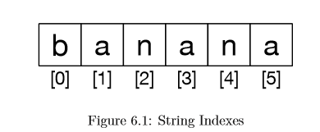

Slide 99
Getting the length of a string using len
len is a built-in function that returns the number of characters in a string:
>>> fruit = 'banana'
>>> len(fruit)
6
To get the last letter of a string, you might be tempted to try something like this:
>>> length = len(fruit)
>>> last = fruit[length]
IndexError: string index out of range
>>> last = fruit[length-1]
>>> print(last)
a
Alternatively, you can use negative indices, which count backward from the end of the string. The expression fruit[-1] yields the last letter, fruit[-2] yields the second to last, and so on.

Slide 100
Traversal through a string with a loop
The process of traversal includes select each character in turn, do something to it, and continue until the end.
fruit = 'banana'
index = 0
while index < len(fruit):
letter = fruit[index]
print(letter)
index = index + 1

Slide 101
Example
Another way to write a traversal is with a for loop:
for char in fruit:
print(char)

Slide 102
Exercise 1:
Write a while loop that starts at the last character in the string and works its way backwards to the ﬁrst character in the string, printing each letter on a separate line, except backwards.

Slide 103
String slices
A segment of a string is called a slice. Selecting a slice is similar to selecting a character:
s = 'Monty Python'
print(s[0:5])
print(s[6:12])
Monty
Python
The operator returns the part of the string from the “n-eth” character to the “m-eth” character, including the ﬁrst but excluding the last.

Slide 104
String slices
If you omit the ﬁrst index (before the colon), the slice starts at the beginning of the string.
If you omit the second index, the slice goes to the end of the string:
>>> fruit = 'banana'
>>> fruit[:3]
'ban'
>>>fruit[3:]
'ana'
If the ﬁrst index is greater than or equal to the second the result is an empty string, represented by two quotation marks:
>>> fruit = 'banana'
>>> fruit[3:3] ''
An empty string contains no characters and has length 0, but other than that, it is the same as any other string.

Slide 105
Strings are immutable
It is tempting to use the operator on the left side of an assignment, with the intention of changing a character in a string.
For example:
>>> greeting = 'Hello, world!'
>>> greeting[0] = 'J'
TypeError: 'str' object does not support item assignment

Slide 106
Example
>>> greeting = 'Hello, world!'
>>> new_greeting = 'J' + greeting[1:]
>>> print(new_greeting) Jello, world!

Slide 107
Looping and counting
#The following program counts the number of times the letter a appears in a string:
word = 'banana'
count = 0
for letter in word:
if letter == 'a':
count = count + 1
print(count)

Slide 108
The in operator
The word in is a boolean operator that takes two strings and returns True if the ﬁrst appears as a substring in the second:
>>> 'a' in 'banana'
True
>>> 'seed' in 'banana'
False

Slide 109
String comparison
To see if two strings are equal:
if word == 'banana':
print('All right, bananas.')
Other comparison operations are useful for putting words in alphabetical order:
if word < 'banana':
print('Your word,' + word + ', comes before banana.')
elif word > 'banana':
print('Your word,' + word + ', comes after banana.')
else:
print('All right, bananas.')

Slide 110
string methods
Strings are an example of Python objects. An object contains both data (the actual string itself) and methods, which are eﬀectively functions that are built into the object and are available to any instance of the object.
Python has a function called dir which lists the methods available for an object. The type function shows the type of an object and the dir function shows the available methods.

Slide 111
string methods
>>> stuff = 'Hello world'
>>> type(stuff) <class 'str'>
>>> dir(stuff) ['capitalize', 'casefold', 'center', 'count', 'encode', 'endswith', 'expandtabs', 'find', 'format', 'format_map', 'index', 'isalnum', 'isalpha', 'isdecimal', 'isdigit', 'isidentifier', 'islower', 'isnumeric', 'isprintable', 'isspace', 'istitle', 'isupper', 'join', 'ljust', 'lower', 'lstrip', 'maketrans', 'partition', 'replace', 'rfind', 'rindex', 'rjust', 'rpartition', 'rsplit', 'rstrip', 'split', 'splitlines', 'startswith', 'strip', 'swapcase', 'title', 'translate', 'upper', 'zfill']
>>> help(str.capitalize)

Slide 112
string methods
>>> word = 'banana'
>>> new_word = word.upper()
>>> print(new_word)
BANANA
>>> word = 'banana'
>>> index = word.find('a')
>>> print(index

Slide 113
The find method can ﬁnd substrings as well as characters:
>>> word.find('na')
2
>>> word.find('na', 3)
4

Slide 114
strip method
>>> line = ' Here we go '
>>> line.strip()
'Here we go'

Slide 115
startswith
>>> line = 'Have a nice day'
>>> line.startswith('Have')
True
>>> line.startswith('h')
False

Slide 116
Example
>>> line = 'Have a nice day'
>>> line.startswith('h')
False >>>
line.lower() 'have a nice day'
>>> line.lower().startswith('h')
True

Slide 117
Parsing strings
>>> data = 'From stephen.marquard@uct.ac.za Sat Jan 5 09:14:16 2008'
>>> atpos = data.find('@')
>>> print(atpos)
21
>>> sppos = data.find(' ',atpos)
>>> print(sppos)
31
>>> host = data[atpos+1:sppos]
>>> print(host)
uct.ac.za
>>>

Slide 118
Format operator
The format operator, % allows us to construct strings, replacing parts of the strings with the data stored in variables. When applied to integers, % is the modulus operator.
But when the ﬁrst operand is a string, % is the format operator.
The ﬁrst operand is the format string, which contains one or more format sequences that specify how the second operand is formatted. The result is a string.
For example, the format sequence “%d” means that the second operand should be formatted as an integer (d stands for “decimal”):

Slide 119
Example
>>> camels = 42
>>> '%d' % camels
'42'

Slide 120
Example
>>> camels = 42
>>> 'I have spotted %d camels.' % camels
'I have spotted 42 camels.‘

Slide 121
Example
The following example uses “%d” to format an integer, “%g” to format a ﬂoating point number (don’t ask why), and “%s” to format a string:
>>> 'In %d years I have spotted %g %s.' % (3, 0.1, 'camels')
‘In 3 years I have spotted 0.1 camels.'

Slide 122
Example
The number of elements in the tuple must match the number of format sequences in the string. The types of the elements also must match the format sequences:
>>> '%d %d %d' % (1, 2)
TypeError: not enough arguments for format string
>>> '%d' % 'dollars'
TypeError: %d format: a number is required, not str

Slide 123
Exercise
Take the following Python code that stores a string:
str = ’X-DSPAM-Confidence:0.8475’
Use find and string slicing to extract the portion of the string after the colon character and then use the float function to convert the extracted string into a ﬂoating point number.

Slide 124
Exercise
Read the documentation of the string methods at
https://docs.python.org/3.5/library/stdtypes.html#string-methods

Slide 125
Exercises
Write a program which repeatedly reads numbers until the user enters “done”. Once “done” is entered, print out the total, count, and average of the numbers. If the user enters anything other than a number, detect their mistake using try and except and print an error message and skip to the next number.
Write another program that prompts for a list of numbers as above and at the end prints out both the maximum and minimum of the numbers instead of the average.

Slide 126
Try This
Simple Calculator Program
Fibonacci
Factorial
Prime Number
Armstrong number

