Slide 1
Center of Excellence for Machine Intelligence (CoEMI)

Slide 2
Skill Development Courses
Fundamentals of Python for ML (Mandatory)
Data Analytics using Python (1,2)
Statistical Analysis using Python (1,3)
Big Data using Python (1,2,3,4,6)
Artificial Intelligence using Python (1,5)
Machine Learning using Python (1,2,6)
Deep Learning using Python (1,2,6,7)
Image Processing using Python(1,8)
Video Processing using Python (1,6,7,8,9)
Web Programming using Python(1,10)
App Development using Python (1,11)
Cloud Computing using Python (1,12)
IoT using Python (1,13)
Intelligent App Development (1,2,3,5,6,7,11,12,13,14)
Design and Developing Intelligent Machines using Python (1,2,3,5,6,7,8,9,10,11,12,13,,14,15)
Design and Developing Self Driving Car (1,2,3,5,6,7,8,9,10,11,12,13,14,15,16)
Programming Self Driving Drones using Python (1,2,3,5,6,7,8,9,10,11,12,13,,14,15,16,17)

Slide 3
Course Registration
Minimum intake is 5
Maximum is 30
50 Hours per course
Rs 1000 per individual course
Additional charges for hardware kits if needed
Amount payable@sdmitoffice
Only for First batch , First course Registration amount is 100/- (Rupees 100)
For all course Grade Will be assigned based on continuous evaluation , assignment and projects.

Slide 4
Day 4 - Syllabus
Object Oriented Programming with Python.

Slide 5
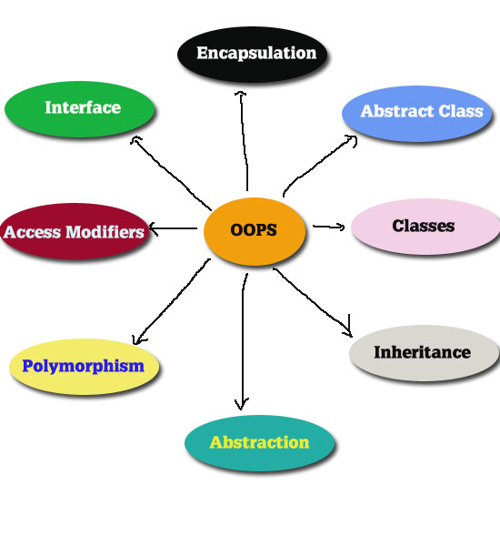

Slide 6
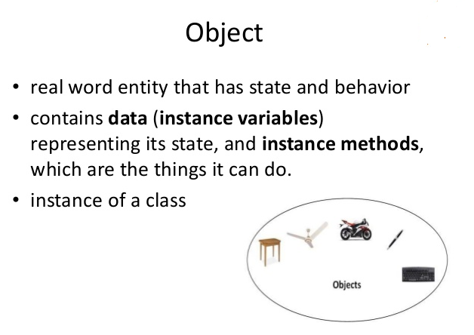

Slide 7
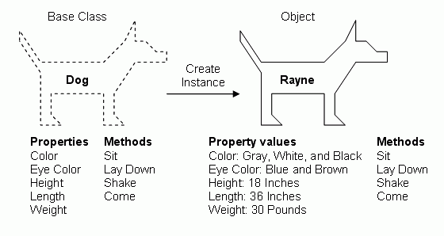

Slide 8
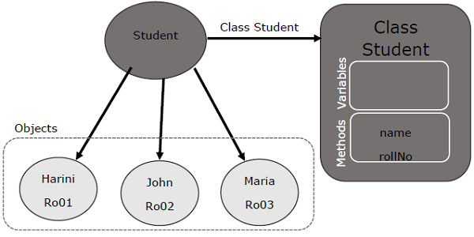

Slide 9
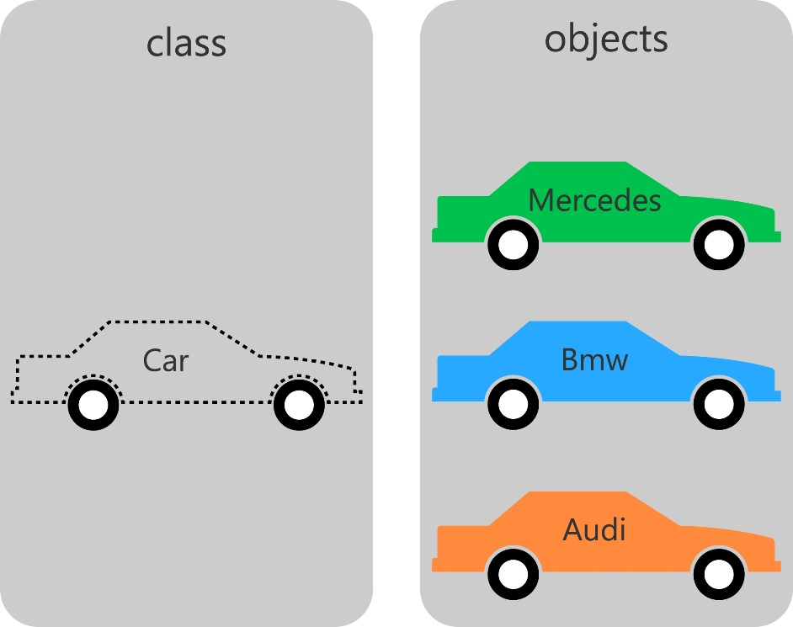

Slide 10
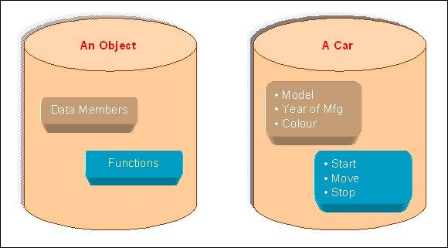

Slide 11
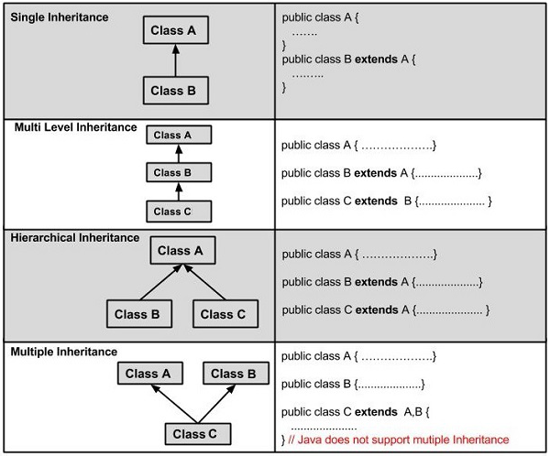

Slide 12
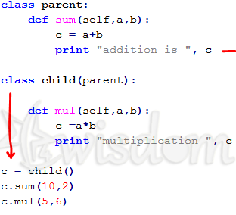

Slide 13
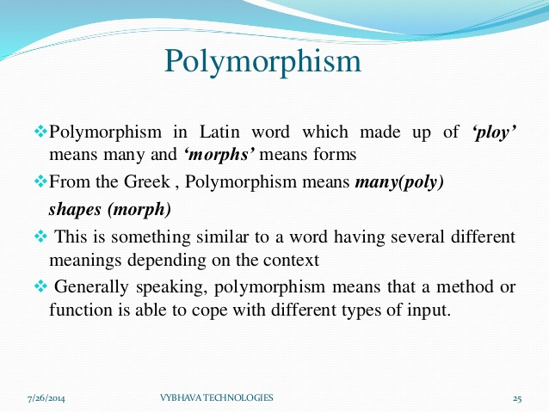

Slide 14
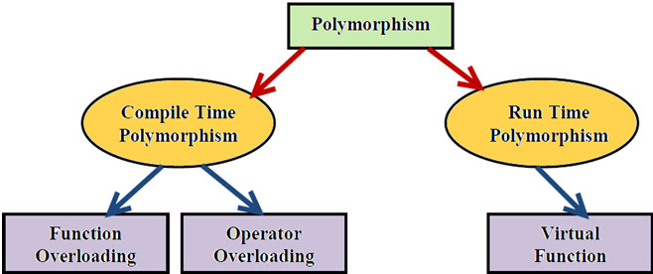

Slide 15
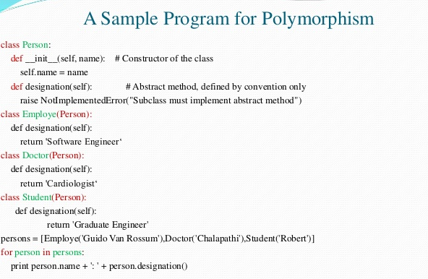

Slide 16
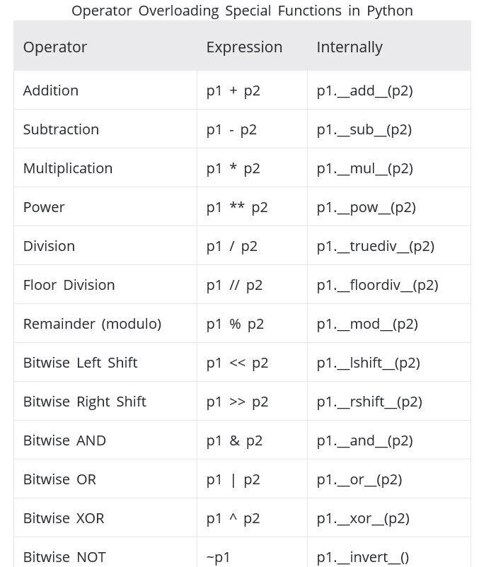

Slide 17
