Slide 1
Center of Excellence for Machine Intelligence (CoEMI)

Slide 2
Skill Development Courses
Fundamentals of Python for ML (Mandatory)
Data Analytics using Python (1,2)
Statistical Analysis using Python (1,3)
Big Data using Python (1,2,3,4,6)
Artificial Intelligence using Python (1,5)
Machine Learning using Python (1,2,6)
Deep Learning using Python (1,2,6,7)
Image Processing using Python(1,8)
Video Processing using Python (1,6,7,8,9)
Web Programming using Python(1,10)
App Development using Python (1,11)
Cloud Computing using Python (1,12)
IoT using Python (1,13)
Intelligent App Development (1,2,3,5,6,7,11,12,13,14)
Design and Developing Intelligent Machines using Python (1,2,3,5,6,7,8,9,10,11,12,13,,14,15)
Design and Developing Self Driving Car (1,2,3,5,6,7,8,9,10,11,12,13,14,15,16)
Programming Self Driving Drones using Python (1,2,3,5,6,7,8,9,10,11,12,13,,14,15,16,17)

Slide 3
Course Registration
Minimum intake is 5
Maximum is 30
50 Hours per course
Rs 1000 per individual course
Additional charges for hardware kits if needed
Amount payable@sdmitoffice
Only for First batch , First course Registration amount is 100/- (Rupees 100)
For all course Grade Will be assigned based on continuous evaluation , assignment and projects.

Slide 4
Day 5 - Syllabus
Using databases and SQL
Networked programs,
Using Web Services

Slide 5
Introduction to Database Programming with Python

Slide 6
Persistent Data
Many software solutions require persistent data, i.e. data stored permanently
There are many ways to have data persist
text files, e.g. comma delimited files
object binary files, e.g. using pickle
databases, e.g. sqlite3

Slide 7
Databases
A database, or Database Management System (DBMS) manages persistent data
The DBMS allows data storage, retrieval, privacy, security and integrity
There are many commercial and open source examples
Commercial - SQL Server, Oracle, MS Access
Open Source - MySQL, Postgresql, sqlite

Slide 8
Types of Databases
There are various kinds of DBMSs, e.g.
object oriented DBMSs
no-SQL DBMSs
relational DBMSs
object-relational DBMSs
Most commonly used systems are Relational Database Management Systems (RDBMS)

Slide 9
Relational DBMSs
Relational DBMSs store sets of data in a tabular format, which are typically related to each other
The data is manipulated with a language called SQL (Structured Query Language)
These RDBMSs work very similarly
Most RDBMSs are client-server based
Examples
SQL Server, Oracle, MySQL, PostgreSQL

Slide 10
Tables, Records, Fields
In a RDBMS data is typically stored in a tabular format in tables, or relations
Each table has fields, or attributes, which indicate what is stored in each column
The table also has many records, or tuples, which indicate what is stored in each row

Slide 11
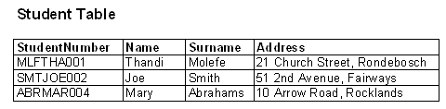
Example
The following example is of a Student table
It has fields for StudentNumber, Name, Surname, Address
It contains 3 records for particular students
field
record

Slide 12
Field Data Types
When creating a new table the data type for each field needs to be specified
RDBMSs have many data types relating to integers, real or floating point numbers, strings or text, images, etc.
Field data types can also be further constrained with size, precision, etc.

Slide 13
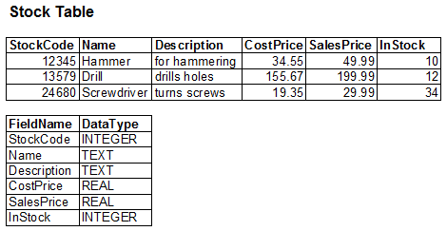
Example
The following example is of a Stock table with fields and corresponding datatypes

Slide 14
Primary Keys
When defining a table, it is useful to specify a field (or set of fields) which uniquely identifies a record
This unique identifier is referred to as the primary key
The primary key is typically an id number or unique code which identifies a record

Slide 15
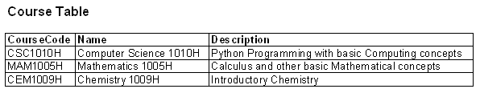
Example
The following example is of a Course table
primary key

Slide 16
Relationships
RDBMSs allow the definition of relationships between data, as they occur in the real world, e.g.
Students and Courses
Employees and Branches
These relationships can have different cardinalities, depending how one record in a table relates to another record in the related table, e.g.
one to one
one to many
many to many

Slide 17
Foreign Keys
These relationships are indicated by using the primary key of the related table
When the primary key of a table is used in another table to specify the relationship, it is referred to as a foreign key

Slide 18
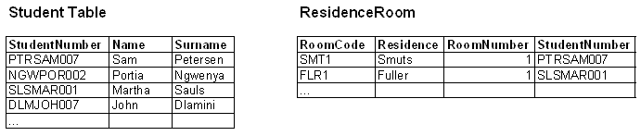
Example
Consider Student and ResidenceRoom tables
A one-to-one relationship exits between Student and ResidenceRoom
foreign key

Slide 19
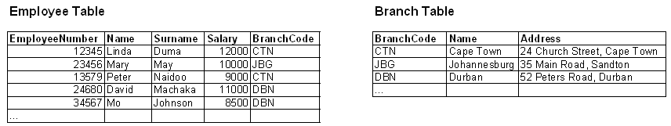
Example
Consider Employee and Branch tables
A one to many relationship exits between Branch and Employee
foreign key

Slide 20
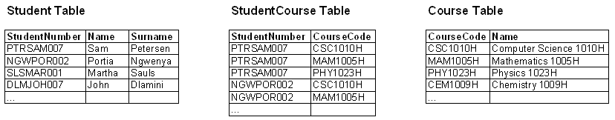
Example
Consider Student and Course tables
A many to many relationship exits between Student and Course
An extra StudentCourse needs to be created
foreign keys

Slide 21
Relationships
Cardinalities are expressed using foreign keys
one to one, the “subset” table contains a foreign key
one to many, the many table contains a foreign key
many to many, a new table is created to contain both foreign keys
Table relationships defined in this way avoids duplication of data

Slide 22
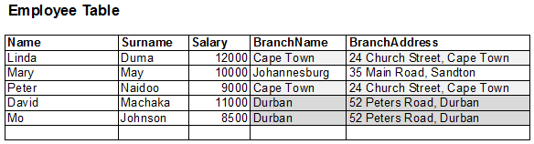
Without Relationships
A database with tables, but no keys and no relationships would duplicate information

Slide 23
sqlite
sqlite is a lightweight, server-less, open source RDBMS engine
It is the “most widely deployed SQL database engine in the world”, e.g.
Apple computers and iphones
Mozilla Firefox
Sqlite is unlike most RDBMSs, since the database is stored in a single file, and it is not client-server based

Slide 24
sqlite
It conforms to the basic principles of RDBMSs
Accessible by many programming languages and management tools
Languages - PHP, Python, Java, C++
Management Tools - SQLite Expert, SQLite Spy
The current version of sqlite is sqlite3

Slide 25
sqlite data types
sqlite has many data types, but the primary ones are the following
text, for storing text or strings
real, for storing floating point number
integer, for storing integers

Slide 26
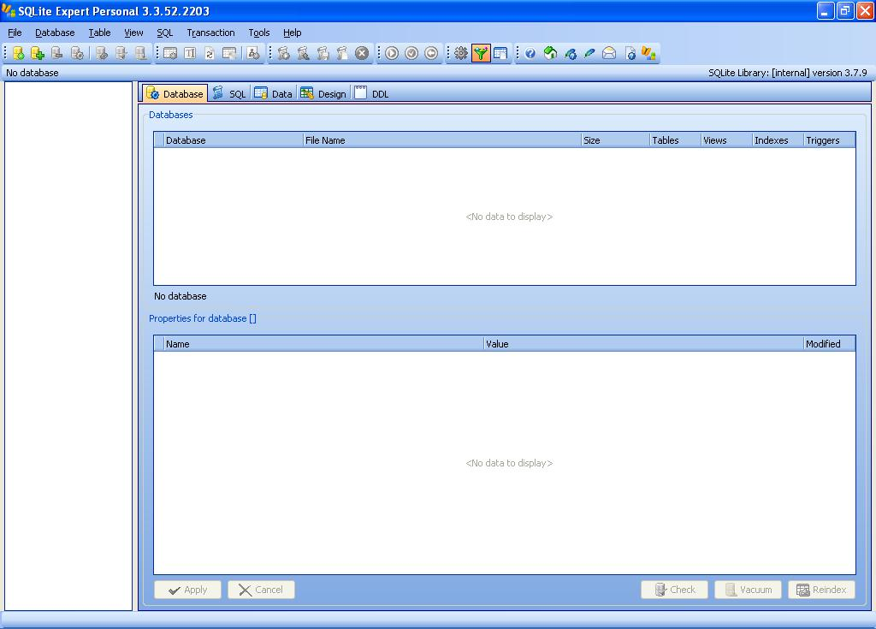
SQLite Expert
SQLite Expert Personal is a free GUI-based management tool for sqlite databases

Slide 27
SQL
Data in RDBMSs is manipulated using SQL (Structured Query Language)
Basic SQL commands:
create, creates a table
drop, drops/deletes a table
insert, inserts a record into a table
update, updates fields in a table record
delete, deletes records from a table
select, selects data from a table

Slide 28
SQL: create and drop
The create SQL command creates a new table
create table <table> (<field1> <datatype1>,…)
When creating a table the field names and their data types need to be specified
create table Person (Name text, Age integer)

Slide 29
SQL: drop
The drop SQL command deletes a table
drop table <table>
When dropping a table only the table name is specified
drop table Person

Slide 30
SQL: insert
The insert SQL command insert records into a table
insert into <table> values (<value1>,…)
When inserting the values need to be specified in order
insert into Person values (“John Smith”, 20)

Slide 31
SQL: delete
The delete SQL command deletes records from a table
delete from <tablename> where <fieldname> = <value>
The delete command has a where clause to indicate which records to delete
delete from Person where Name = “Kim Jones”

Slide 32
SQL: update
The update SQL command updates fields in a table record
update <table> set <field1> = <value1> where <field2> = <value2>
The update command has a set clause to indicate which fields to update
The update command has a where clause to indicate which record to update
update Person set Age=21 where Name=“John Smith”

Slide 33
SQL: select
The SQL select command selects data from a table
select <field1>,… from <table> where <fieldx> = <value>
The field names to select can be specified explicitly, or * for all fields
select Name, Age from Person
select * from Person

Slide 34
SQL: select
The select command can have a where clause specifying which records to select
select Age from Person where Name = “John Smith”

Slide 35
Multiple SQL Commands
When using multiple SQL statements each statement needs to end with a semi colon ;
create table Person (Name text, Age integer);
insert into Person values (“John Smith”, 20);
update Person set Age=21 where Name=“John Smith”;
select * from Person;

Slide 36
Python and sqlite3
Python has a module which enables it to manipulate sqlite3 databases
import sqlite3
A sqlite3 database is created using the connect() function and specifying a filename
db = sqlite3.connect(‘my_database.db’)
An SQL command can be executed by calling the execute method
db.execute(‘create table Person (name text, age int)’)

Slide 37
Python and sqlite3
When executing an insert statement it is possible to use the ? notation as placeholders for the values and pass the values in a tuple
db.execute('insert into Person values (?,?)',('bob',20))

Slide 38
Python and sqlite3
If the SQL command(s) modifies the database the commit() method needs to be called for the command to take effect
db.commit()
Committing can be done after a set of commands
Committing is necessary for the following SQL commands to take effect
create,insert,update,delete,drop

Slide 39
Python and sqlite3
When executing a SQL select command the execute() method returns a cursor which can be iterated over with a for loop to access the records returned
cursor = db.execute(‘select * from Person’)
for row in cursor:
print(row)
Each row/record is returned as a tuple

Slide 40
Databases in Development
Databases are commonly used in the typical software development process on many platforms – desktop, web, etc.
Usually the database is first designed with tables, relationships, etc. with a management tool
Then a software application is developed which interacts with the database

Slide 41
Resources
sqlite
www.sqlite.org
SQL
www.w3schools.com/sql
Python and sqlite3
Python reference documentation

Slide 42
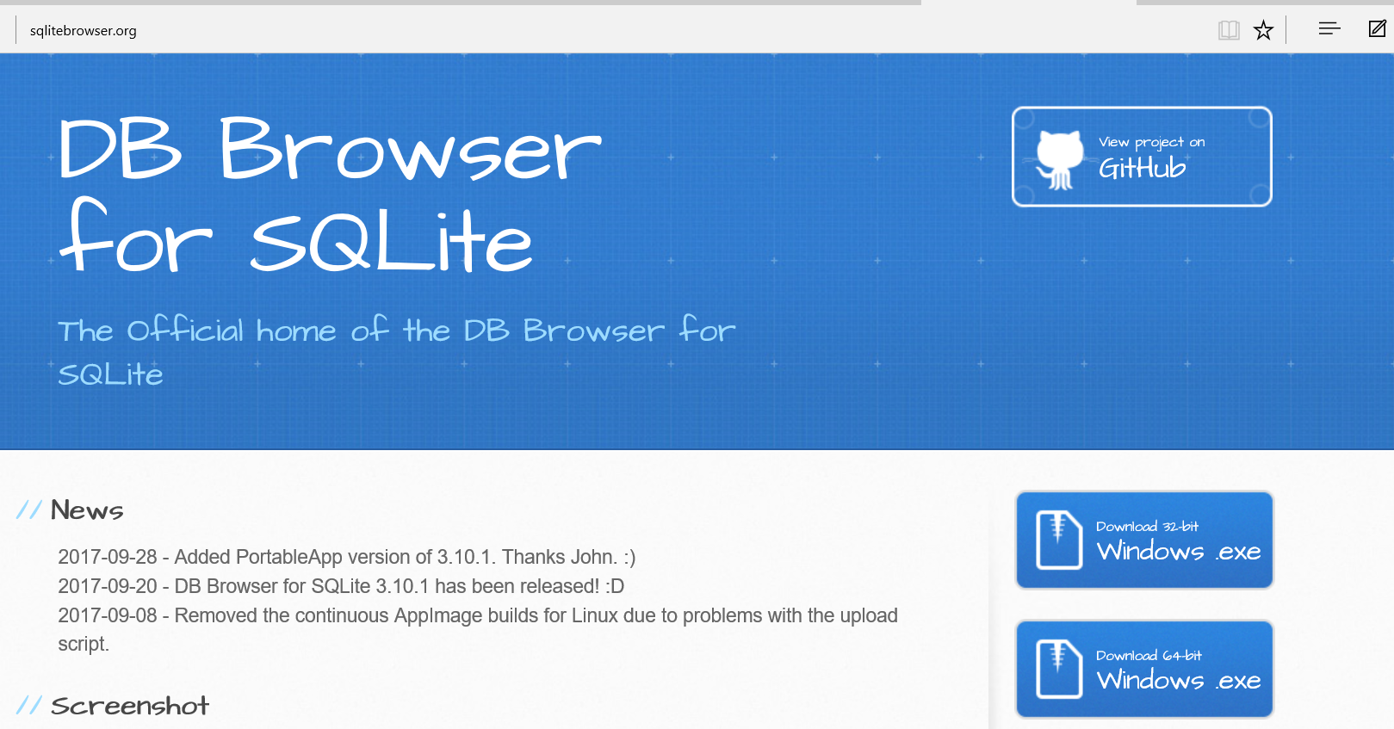
http://sqlitebrowser.org/

Slide 43
Network Programs

Slide 44
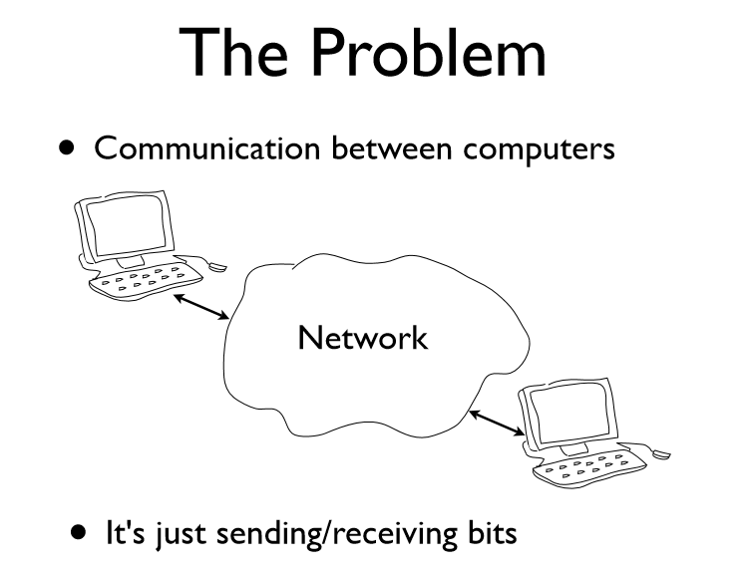

Slide 45
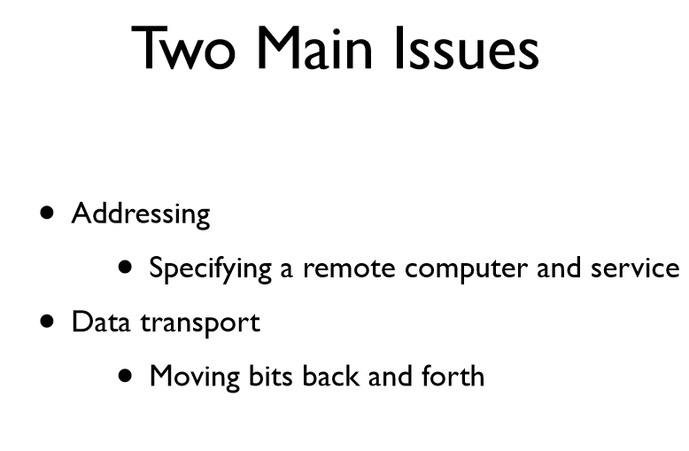

Slide 46
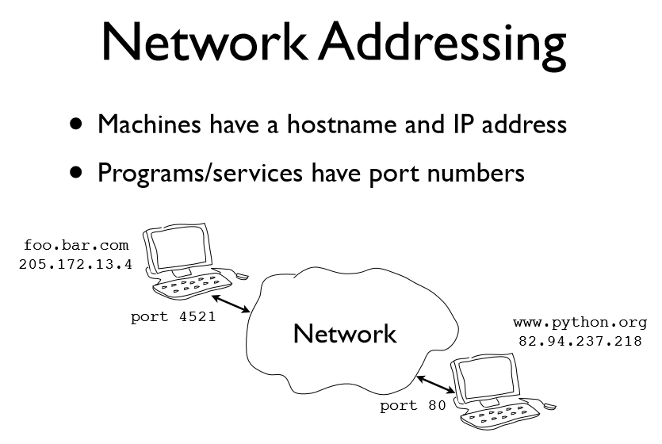

Slide 47
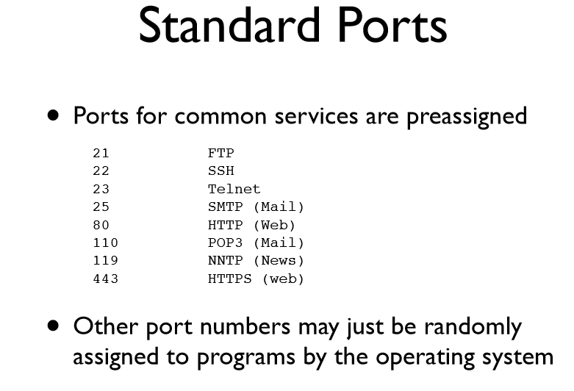

Slide 48
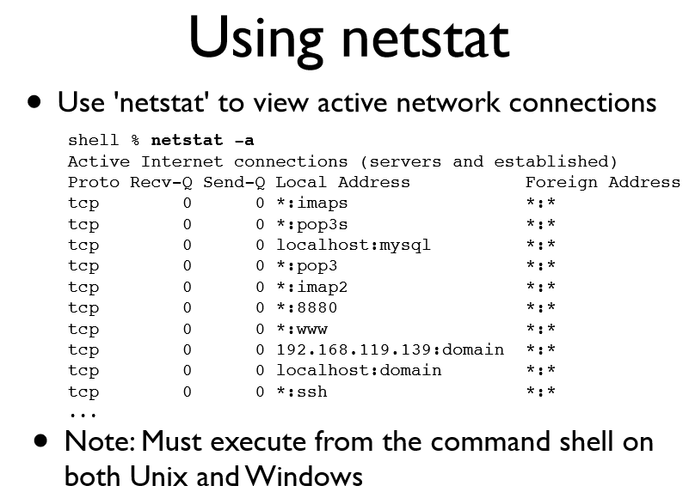

Slide 49
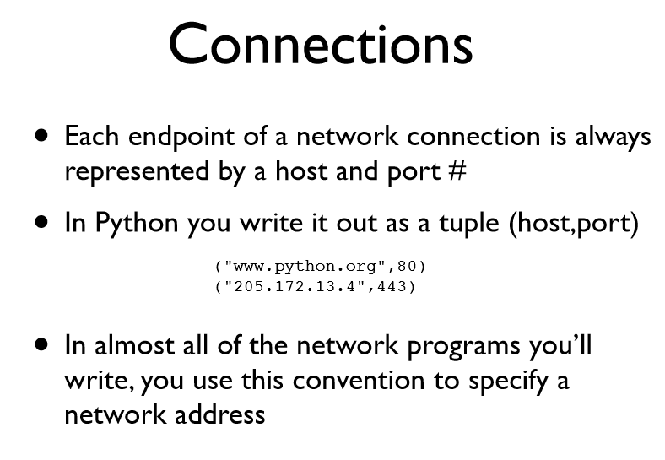

Slide 50
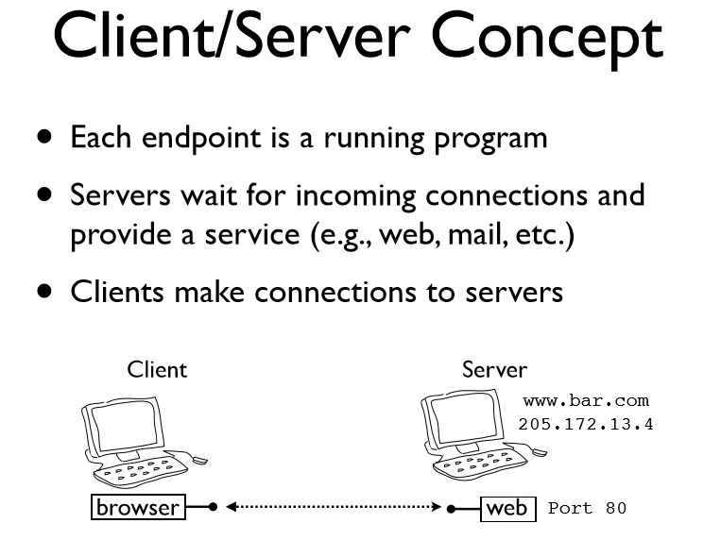

Slide 51
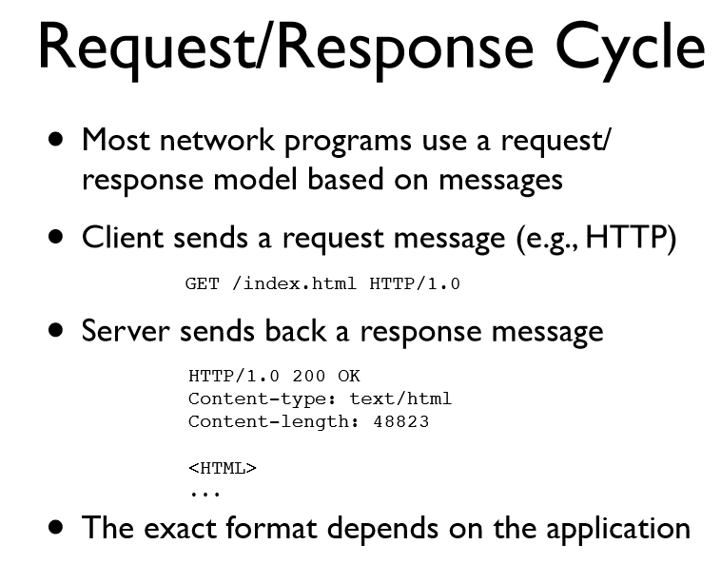

Slide 52
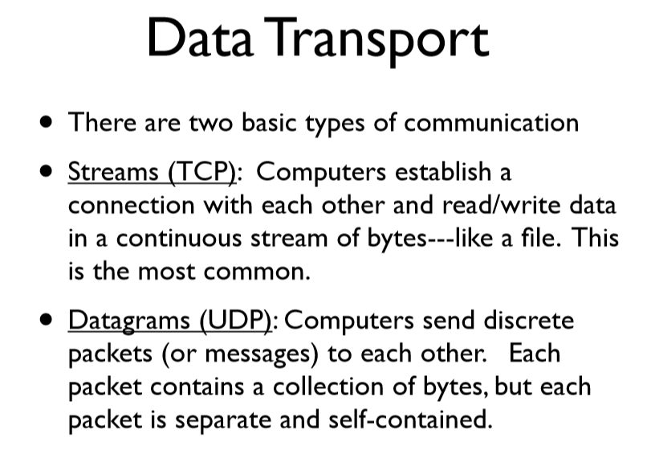

Slide 53
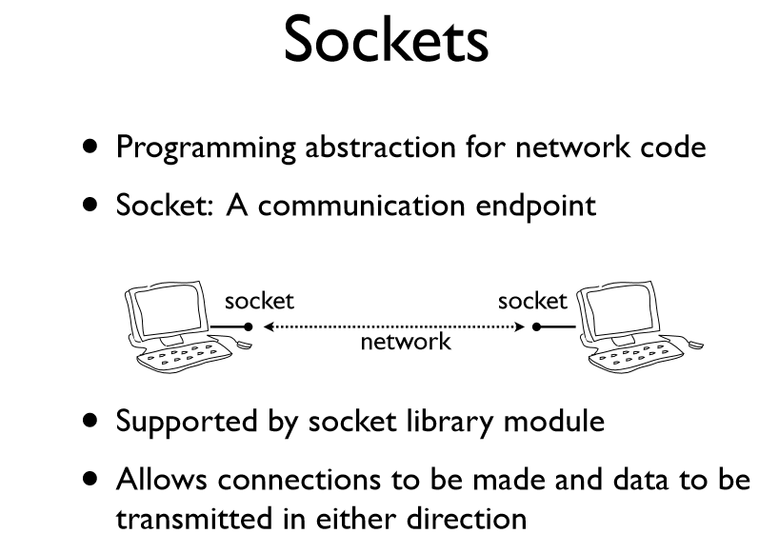

Slide 54
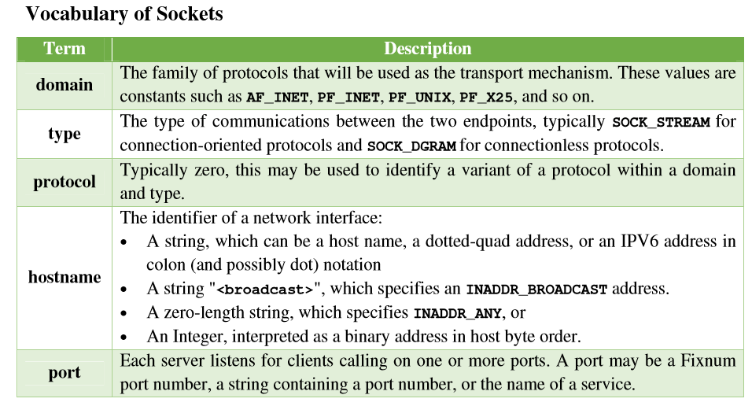

Slide 55
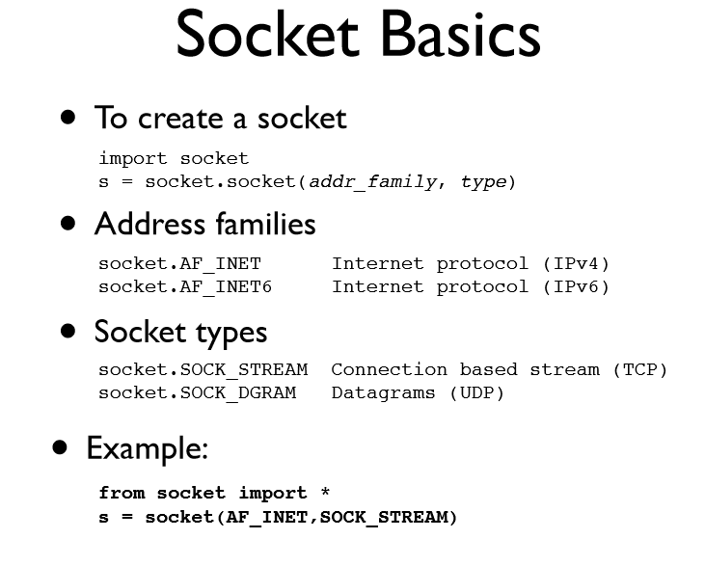

Slide 56
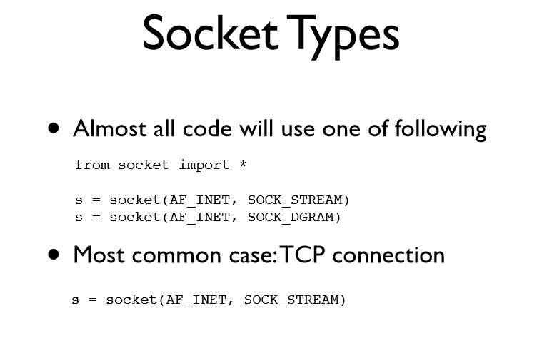

Slide 57
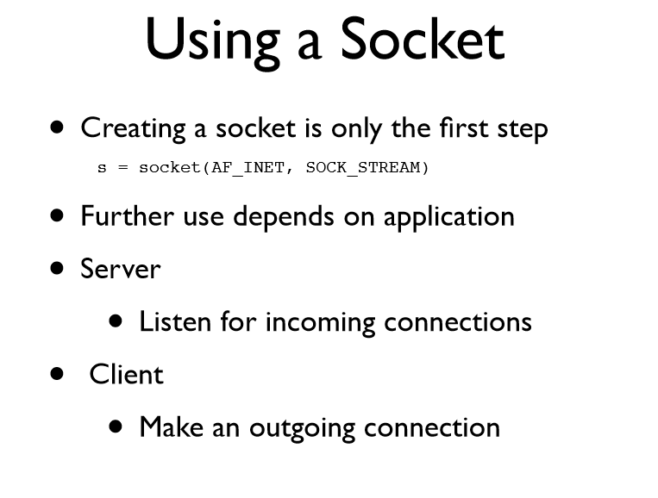

Slide 58


Slide 59
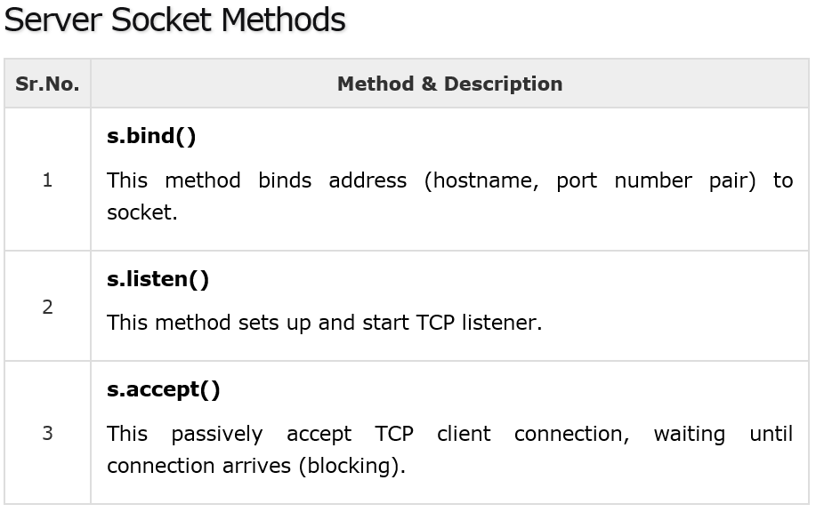

Slide 60
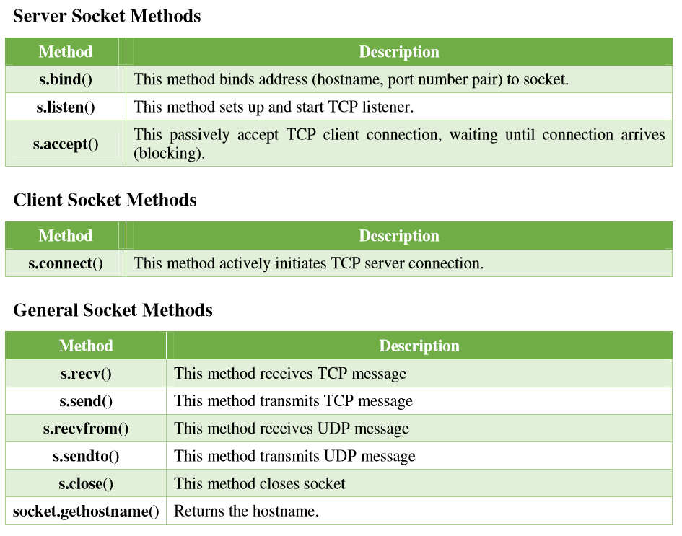

Slide 61
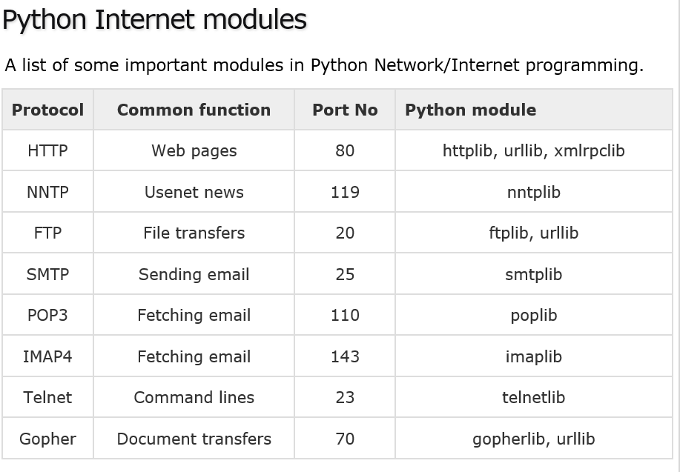

Slide 62
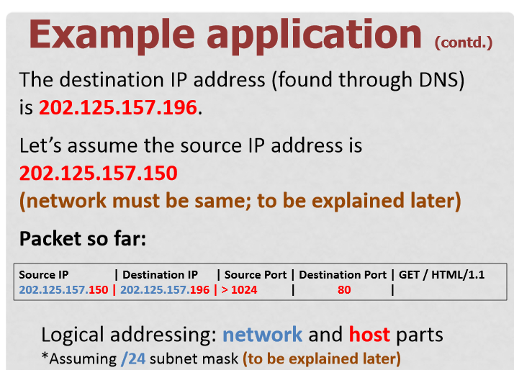

Slide 63
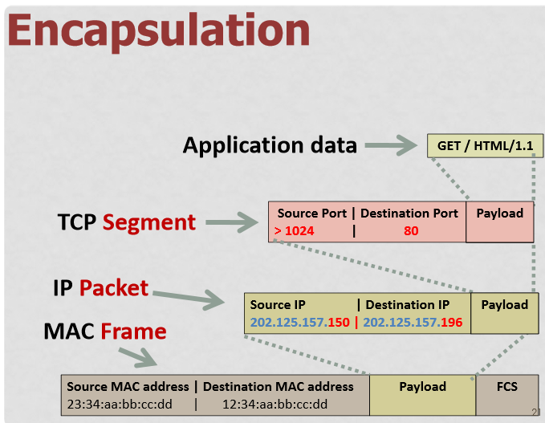

Slide 64
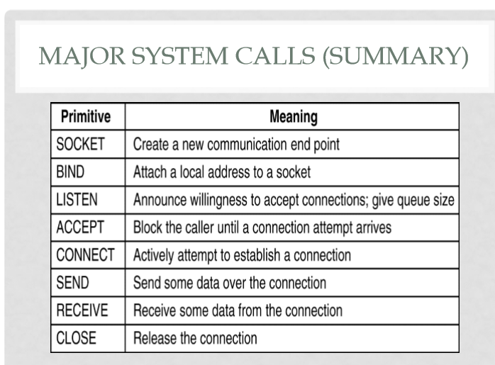

Slide 65
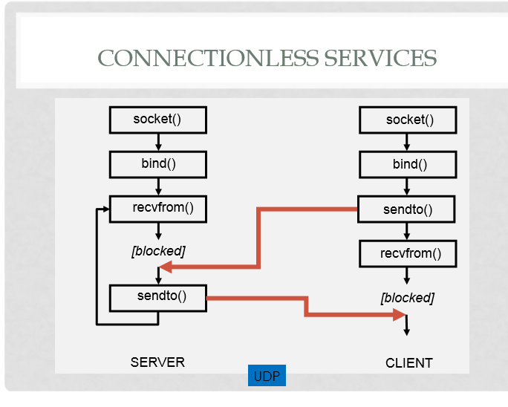

Slide 66
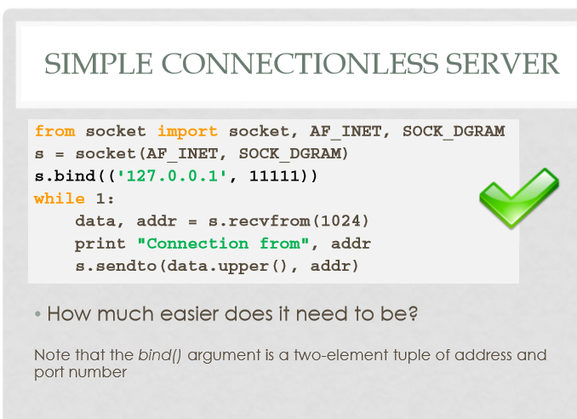

Slide 67
