Slide 1



Sponsored by:
Viewer.js
Jos van den Oever
http://webodf.org
http://viewerjs.org

Slide 2



Slide 3
privacy

Slide 4
part of a solution

Slide 5
writing an office suite

Slide 6
writing javascript

Slide 7
alert("oops");

Slide 8
writing an office suite
in javascript

Slide 9

writing an office suite
in javascript
WebODF

Slide 10
Web + ODF = WebODF

Slide 11









Open Document Format
Format for Office Documents
Open Standard
All-in-one (zip)
Still improving
WebODF
online and offline office
http://webodf.org/demo/
Notes:
The Open Document Format is used by three complete office suites: OpenOffice and derivatives, Microsoft Office since 2007 and it is the native format for KOffice since version 2.0. Also Abiword, Gnumeric and Google Docs have support. There are quite a few commercial tools supporting it.
KDE is now part of OASIS and we have contributed to the standard from the first version.
Version 1.2 is being readied now.
'as good as email' means it should be pervasive simple and just work.

Slide 12
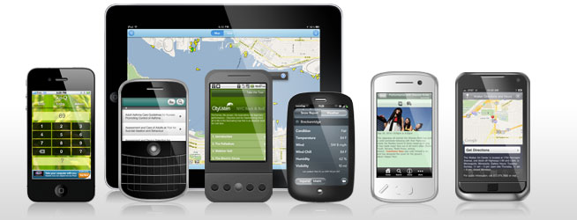
text editor in browser
http://webodf.org/demo/

Slide 13
viewer.js embed documents in website
http://viewerjs.org/

Slide 14
<iframe
﻿ ﻿ ﻿ ﻿ ﻿ src="viewer/index.html#ohm2013.odp
﻿ ﻿ ﻿ ﻿ ﻿ width="700" height="500"
﻿ ﻿ ﻿ ﻿ allowfullscreen="true"></iframe>
http://viewerjs.org/

Slide 15

collaborative text editor

