Slide 1
Soar Basics Soar Tutorial May 6, 2019
Read The Book!
Read The Manual!

Slide 2
The Soar Cognitive Architecture (Laird, Newell, Rosenbloom, et al.; 1981-)
Goal: knowledge-rich, long-living autonomous agents that interact with humans and the world in real time
Over 35 years of development
Inspired by psychology and biology
Look to psychology for useful cognitive mechanisms and capabilities
Look to computer science and AI for efficient and robust implementations
More complex behavior and tasks, longer time scales.
Integrated hierarchical planning and execution
Episodic memory and mental imagery
Large bodies of knowledge, multiple types of learning
Faster than real-time execution over hours of execution
Procedural cycle time < .3 ms.
Available on all major platforms: Windows, iOS, Linux, Android
Open source (BSD) including tools and agents
More than 100 systems implemented in Soar
Notes:
Parlor Trick

Slide 3
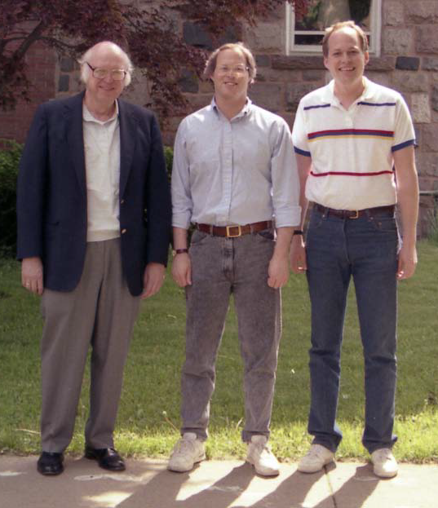
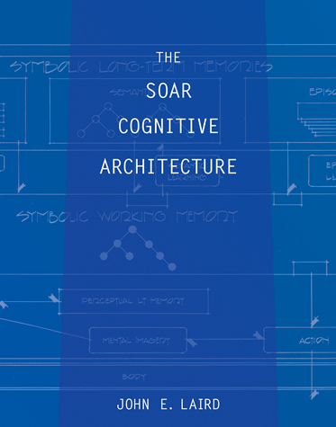
The Soar Cognitive Architecture (Laird, Newell, Rosenbloom, et al.; 1981-)

Slide 4
Research Methodology
Maintain a single integrated architectural implementation
Force everything (and everyone) to work together
Explore new architectural mechanisms or extensions to existing mechanisms
Episodic memory, semantic memory, reinforcement learning, mental imagery, emotion-influenced processing
Develop implementations that scale to large knowledge bases and with minimal computational overhead.
New cognitive capabilities that exploit architectural mechanisms
Choose tasks that require integration of many architectural and cognitive capabilities, and involve large bodies of knowledge
Notes:
Episodic memory, semantic memory, mental imagery, …
Spontaneous retrieval from semantic memory, unified activation, spreading activation in semantic memory
Delayed intentions/prospective memory
Interactive Task Learning

Slide 5
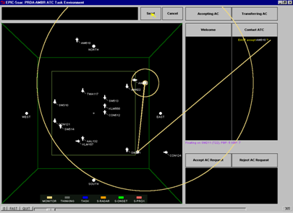
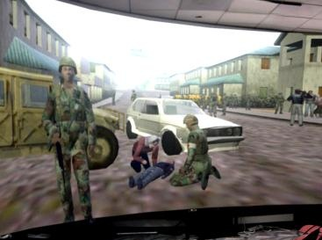
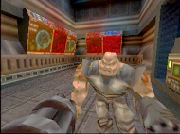
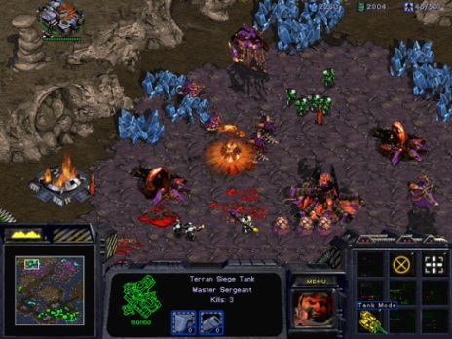
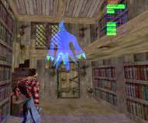
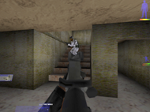
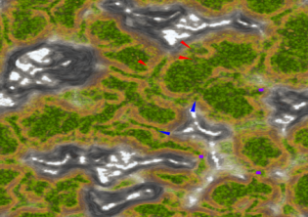
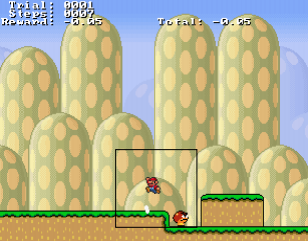
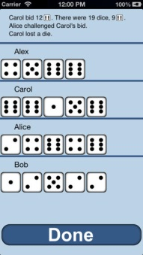


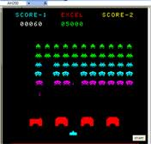
Example Virtual Environments
R1-Soar
Computer Configuration
Amber EPIC-Soar
Modeling Human-Computer Interaction
ICT Virtual Human
Natural Interaction, Emotion
TacAir/RWA-Soar
Complex Doctrine & Tactics
Soar Quakebot
Anticipation
StarCraft
Spatial Reasoning &
Real-time Strategy
Haunt
AI Actors and Director
MOUTbot
Team Tactics
Simulated Scout
Spatial Reasoning &
Mental Imagery
Action Games
Spatial Reasoning & Reinforcement Learning
Liar’s Dice
Probabilistic reasoning and reinforcement learning
Viewpoints
Creative Human Interaction

Slide 6
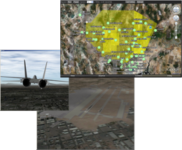
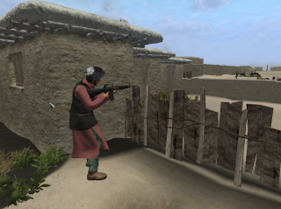
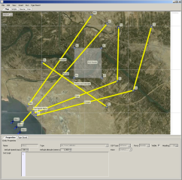
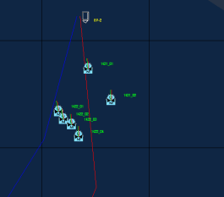
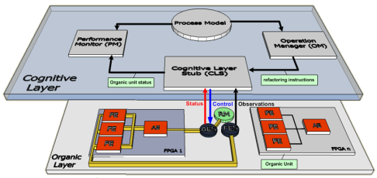
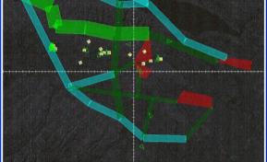
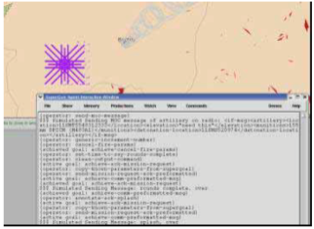
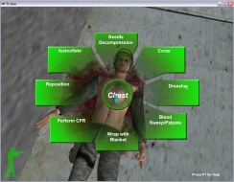
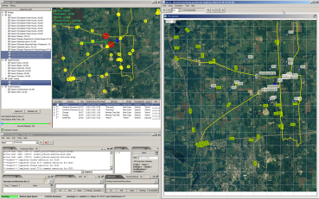
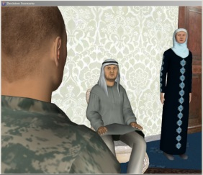
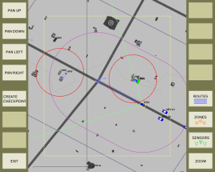
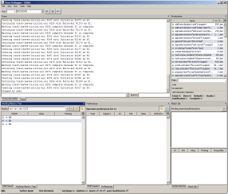
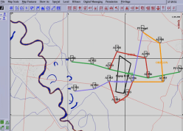
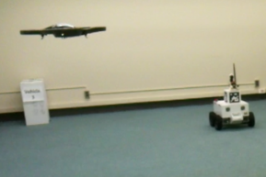
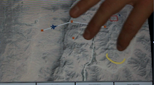
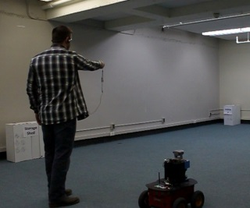
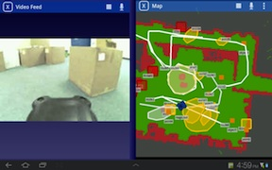
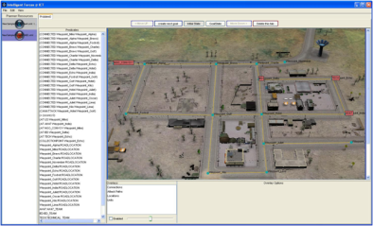
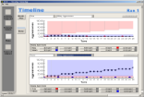
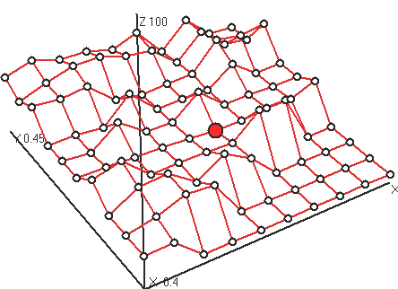

Example Environments from Soar Technology
RedRef
EDGE
TigerBoard
AutoWingman
Soar Longevity
AutoATC
ISAT
SAGIS
SUMET
CCA
ECGF
SID Cargo UAV
ICF
CERES
SID Mav
SID MAGIC
AGILE
JFETS
SID UGV
Notes:
Over the years we’ve used Soar in many applications
More than I could fit on a single slide

Slide 7
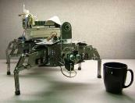
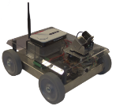

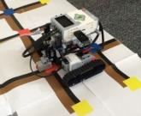
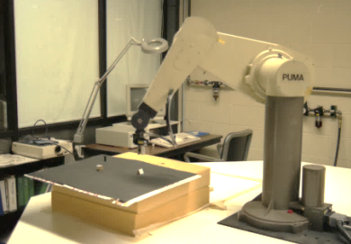

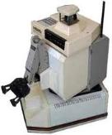
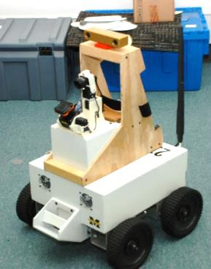
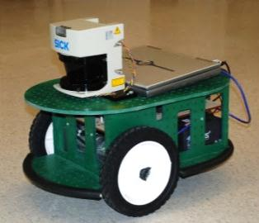
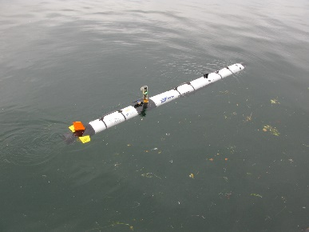
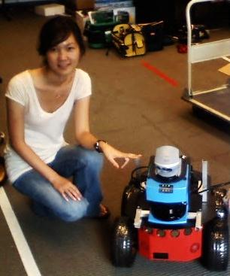
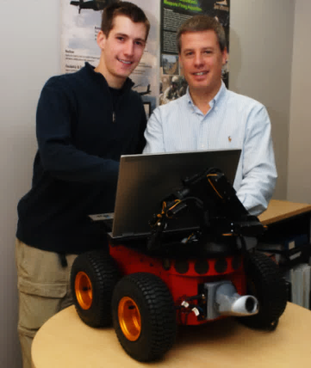
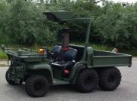
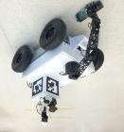
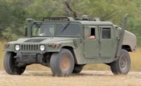
Soar Robotic Platforms
1988: Robo-Soar, UM
2009: Penn State
2011: Superdroid, PSU
2012: BOLT, UM/ST
2014: Mindstorms, UM
1990: Hero-Soar, UM
2009: Splinter, UM
2011: Magic, ST
2013: REEM-C
Pal Robotics
2015: Penn State
2004: Adapt, Pace U
2010: Soar Tech
2012: rGator, ST
2013: Summit, ST
2015: Magic 2, UM

Slide 8
Interactive Task Learning
Learn new tasks through natural interactions with humans
Concept definitions, hierarchical goal descriptions, failure states, task constraints, task actions, heuristics, procedures, …
Rosie (Soar)
Pre-encoded procedural and semantic knowledge implements task learning strategy
No new learning mechanisms
Learns >35 puzzles, games, and mobile robot tasks

Slide 9
James Kirk

Slide 10
Early Soar Structure
Symbolic Long-Term Memories
Procedural
Chunking
Symbolic Working Memory
States
Operators
…
Decision Procedure
Perception
Action
Input
Fire rules to Propose
operators
Fire rules to Evaluate operators
Decide
Fire rules to
Apply selected
operator
Output
Output
Notes:
Emphasize the importance of large WM

Slide 11
Soar 9 Structure
Long-Term Memories
Procedural
Semantic
Episodic
Skills: When and how to move, how to pick up an object, how to communicate, …
Facts: ontology, task objectives, topology of world, equipment capabilities, …
Experiences: what was last room visited; what happened last time I tried to pick up this kind of box, …
Reinforcement
Learning
Chunking
Decision Procedure
Semantic
Learning
Episodic
Learning
Symbolic Working Memory
Active goals: Explore this building, explore this room, maintain power
Perception: nearby objects, communication for other agents
Retrievals from memory: current equipment capabilities
Internal reasoning: is object close enough to pickup
Models of others: what will human do?
Prior experiences: what happened last time was in similar situation
Possible actions: turn, move, pickup, …
Spatial Visual System
Object-based continuous metric space
Action
Perception
Notes:
Emphasize the importance of large WM

Slide 12
Long-Term Memories
Procedural
Semantic
Episodic
If goal is to place block on a table and block is clear, then propose move block to table
If unknown word, then search semantic memory for its meaning.
Word definitions and groundings (red3 = “red”)
Reinforcement
Learning
Chunking
Decision Procedure
Semantic
Learning
Episodic
Learning
Symbolic Working Memory
(x77 ^type goal ^relation on ^arg1 x23 ^arg2 x37)
(x77 ^type action ^name move-right
^arg1 x23 ^arg2 x37 ^visualize)
(x23 ^color red3 ^shape cube ^type block ^clear yes)
(x34 ^color blue4 ^shape cube ^type block)
(x37 ^color grey32 ^type table)
(x44 ^relation on ^arg1 x23 ^arg2 x34)
(x55 ^relation on ^arg1 x34 ^arg2 x37)
(x78 ^action x77 ^result failure)
Spatial Visual System
Object-based continuous metric space
Action
Perception
“Put the red block on the table.”
Notes:
Emphasize the importance of large WM

Slide 13
Long-Term Memories
Procedural
Semantic
Episodic
If unknown word, then search semantic memory for its meaning.
Word definitions and groundings (red3 = “red”)
Reinforcement
Learning
Chunking
Decision Procedure
Semantic
Learning
Episodic
Learning
Symbolic Working Memory
(x81 ^type action ^name move-left
^arg1 x23 ^arg2 x37 ^real)
(x77 ^type goal ^relation on ^arg1 x23 ^arg2 x37)
(x79 ^type action ^name move-left
^arg1 x23 ^arg2 x37 ^visualize)
(x23 ^color red3 ^shape cube ^type block ^clear yes)
(x34 ^color blue4 ^shape cube ^type block)
(x37 ^color grey32 ^type table)
(x44 ^relation on ^arg1 x23 ^arg2 x34)
(x55 ^relation on ^arg1 x34 ^arg2 x37)
(x80 ^action x79 ^result success)
Spatial Visual System
Object-based continuous metric space
Action
Perception
“Put the red block on the table.”
Notes:
Emphasize the importance of large WM

Slide 14
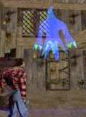

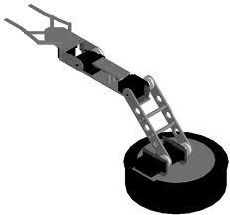
Integration with an External Environment
Types of External Environments:
Simulators:
ModSAF, JSAF, OneSAF, NGTS, HLA, DIS
Games/Game engines:
Unity, Unreal, Quake, Gamebryo, XPlane, EDGE, Full Spectrum Command, Full Spectrum Leader, Starcraft
Robotics systems:
ROS, LCM, JAUS, Player/Stage
Notes:
No examples of multiple layers – looking @ co-integrations

Slide 15
Integrating Soar with External Environments: Soar Markup Language (SML)
Domain independent API support all external integration
Connects to multiple languages: C/C++, Java, Python, TCL, Flash
Supports:
single process, across processes, across machines
dynamic connection at runtime to multiple clients
asynchronous and synchronous operation
communication of I/O, run-time and debugging commands
Integration is fast and straight forward (hours)
High performance (especially if within process)

Slide 16
Core Soar Function
?
?
Agent in real or virtual world
Agent in new state
Agent in new state
Operator Proposal
Operator Selection
Operator Application

Slide 17
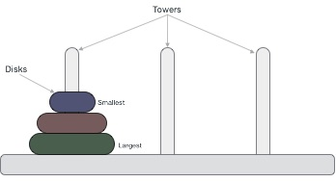
Problem Spaces
State: the current situation the agent is in
Operators: transition to new state
Internal reasoning steps with changes to working memory
Logical deduction and inference, simple math, …
Retrievals from long-term semantic or episodic memory
Mental imagery actions
External motor actions
Goals: states to be achieved

Slide 18
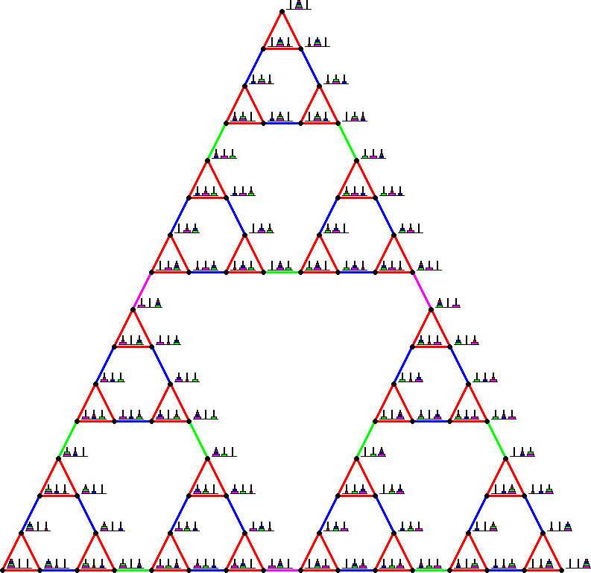

Slide 19
Examples of Using Knowledge
Counting
Planning a trip
Tic Tac Toe
Robot control
Natural language processing

Slide 20
Knowledge Search vs. Problem Search
Problem Search
Generative & combinatorial
Controlled by knowledge
Improve with experience
Knowledge Search (match)
Finding the right rule to fire
Retrieving something from semantic or episodic memory
Search is over existing knowledge
Very fast
Fixed mechanisms
Knowledge
Key idea: Use knowledge search to control problem search

Slide 21
Early Soar Structure
Symbolic Long-Term Memories
Procedural
Symbolic Working Memory
States
Operators
…
Decision Procedure
Perception
Action
Notes:
Emphasize the importance of large WM

Slide 22
Representation of State in Working Memory
Working memory consists of individual elements.
Elements are organized as a graph.
Element: (identifier ^attribute value)
(s1 ^color red)
The graph is rooted in the state.
(S1 ^block B14)
(S1 ^block B23)
(S1 ^color red)
(S1 ^color blue)
(S1 ^color green)
(B14 ^type block)
(B14 ^name A)
(B14 ^color white)
(B23 ^type block)
(B23 ^name B)
(B23 ^color blue)
(S1 ^block B14 B23
^color red blue green)
(B14 ^type block ^name A
^color white)
(B23 ^type block ^name B
^color blue)
type
block
name
A
B14
color
white
block
type
block
block
name
B
S1
B23
color
color
blue
red
color
blue
A
B
green

Slide 23
Subset of Initial Working Memory
nil
^superstate
^output-link
I2
^io
S1
I1
I3
^input-link
^type
(S1 ^superstate nil)
state
(S1
^io I1)
(S1 ^type state)
(I1 ^output-link I2)
(I1 ^input-l
ink I3)
(S1 ^
io I1 ^superstate nil ^type state)
(I1 ^input-link I3 ^output-link I2)

Slide 24
Soar Basic Functions
Soar uses rules to represent procedural knowledge.
Input from environment
Elaborate current situation: parallel rules
Propose and evaluate operators via preferences: parallel rules
Select operator
Apply operator: Modify internal data structures: parallel rules
Output to motor system [and access to long-term memories]
State
Elaboration
Operator
Proposal
Operator
Evaluation
Operator
Elaboration
Operator
Application
Input
Operator
Decision
Output
Assumptions:
Complex behavior arises from multiple cycles.
Each cycle is bounded processing to maintain reactivity.
Notes:
Operator = deliberate act
Generally two rules for each operator
No set methods – methods arise from either task dependent knowledge or general indirect strategies

Slide 25
Soar 101 Internal Problem Solving
Elaborate
State
Apply
Operator
Elaborate
State
Propose
Operator
Propose
Operator
Compare
Operators
Compare
Operators
Select
Operator
Select
Operator
Decision
Procedure
sp {apply*hello-world
(state <s> ^operator <o>)
(<o> ^name hello-world)
-->
(write |Hello World|)
(halt)}
sp {propose*hello-world
(state <s> ^type state)
-->
(<s> ^operator <o> +)
(<o> ^name hello-world)}
sp {apply*hello-world
(state <s> ^operator <o>)
(<o> ^name hello-world)
-->
(write |Hello World|)
(halt)}
sp {propose*hello-world
(state <s> ^type state)
-->
(<s> ^operator <o> +)
(<o> ^name hello-world)}
sp {propose*hello-world
(state <s> ^type state)
-->
(<s> ^operator <o> +)
(<o> ^name hello-world)}
Production
Memory
(s1 ^type state
^superstate nil
^io i1
…)
Working
Memory
(s1 ^operator o1 +)
(o1 ^name hello-world)
(s1 ^operator o1)
Hello World

Slide 26
Soar Agent to Count to 10
Operators:
Initialization of count to 0 (s1 ^count 0)
Count: add 1
State:
Current count
(s1 ^count 0)
Goal detection:
Count = 10
(<s> ^count 10)

Slide 27
Count Working Memory
nil
^superstate
^count
S1
0
(S1 ^superstate nil
^count 0)

Slide 28
Operator Definition
For every operator, must be defined by at least two rules:
Proposal rule creates operator structure in working memory and acceptable preference
Application rule tests for selected operator
Makes changes to the state
Application must change state so proposal no longer matches

Slide 29
Count Operators
Proposal: when operator should be considered
propose*initialize-count:
if the state exists and there is no count, then propose initialize-count.
propose*count:
if there is a count, then propose count.
Application: how the operator changes the state
apply*initialize-count:
if initialize-count is selected, then create a count of 0.
apply*count:
if count is selected, then replace the current-count with (+ 1 current-count).

Slide 30
if the state exists and there is no count, then propose initialize-count.
sp {propose*initialize-count
(state <s> ^superstate nil)
-(<s> ^count)
-->
(<s> ^operator <o> +)
(<o> ^name initialize-count)}
if initialize-count is selected, then create a count of 0.
sp {apply*initialize-count
(state <s> ^operator <o>)
(<o> ^name initialize-count)
-->
(<s> ^name count
^count 0)}

Slide 31
if there is a count, then propose count.
sp {propose*count
(state <s> ^count < 10)
-->
(<s> ^operator <o> +)
(<o> ^name count)}
if count is selected, then replace current-count with (+ 1
current-count).
sp {apply*count
(state <s> ^operator <o>
^count <count>)
(<o> ^name count)
-->
(<s> ^count <count> -)
(<s> ^count (+ 1 <count>))}

Slide 32
if there is a count, then propose count.
sp {propose*count
(state <s> ^count < 10)
-->
(<s> ^operator <o> +)
(<o> ^name count)}
if count is selected, then replace the current-count with (+ 1 current-count).
sp {apply*count
(state <s> ^operator.name count
^count <count>)
-->
(write (crlf) |Count: | (+ 1 <count>))
(<s> ^count <count> -
(+ 1 <count>))}

Slide 33
Goal Detection
if the count is 10, then halt.
sp {detect*count10
(state <s> ^count 10)
-->
(halt)}

Slide 34
Persistence!
Actions of non-operator application rules retract when rule no longer matches
No longer relevant to current situation
Operator proposals and state elaboration
Instantiation-support = i-support
Rule doesn’t test the selected operator and modify state.
Propose operator:
If the current count is less than 10, propose the count operator.
Elaborate state:
If the count is 1, 3, 5, 7 or 9, the number is odd.
Create operator preferences:
If playing hearts and not shooting the moon, avoid taking tricks with hearts or the Queen of Spades.

Slide 35
Persistence!
Actions of operator application rules persists indefinitely
Otherwise actions retract as soon as operator isn’t selected
Operators perform non-monotonic changes to state
Operator-support = o-support
Rule tests the selected operator and modifies the state
Operator application:
if count is selected, then replace the current-count with (+ 1 current-count).

Slide 36
Review of Operators in Working Memory
To be considered for selection, an operator must have an acceptable preference on the state.
(s1 ^operator o1 +)
Operators must have a declarative representation in working memory (something rules can test, such as name).
(o1 ^name count)
When an operator is selected, there is a working memory element in the state (different than the preference)
(s1 ^operator o1)
Rules that test for a selected operator
(<s> ^operator <o>) apply the operator by modifying the state.

Slide 37
Fibonacci
Create operators that compute the Fibonacci sequence.
0 1 1 2 3 5 8 13 …
State representation:
Need last numbers
count0, count1
(<s> ^count0 …
^count1 …)
Operator updates counts
count0 ← count1
count1 ← (+ count0 count1)

Slide 38
Fibonacci Operators
propose*initialize-count:
if the state exists and there is no count0, then proposal initialize-count.
apply*initialize-count:
if initialize-count is selected, then create a count0 of 0, count1 of 1.
propose*count-fibonacci:
if there is a count0, then proposal count-fibonacci.
apply*count-fibonacci:
if count-fibonacci is selected, then replace the count0 with count1 and replace count1 with (+ count0 count1)

Slide 39
sp {propose*initialize-count-fibonacci
(state <s> ^superstate nil
-^name fibonacci)
-->
(<s> ^operator <o> +)
(<o> ^name initialize-count-fibonacci)}
sp {apply*initialize-count-fibonacci
(state <s> ^operator <o>)
(<o> ^name initialize-count-fibonacci)
-->
(<s> ^name fibonacci
^count0 0
^count1 1)}

Slide 40
sp {propose*count-fibonacci
(state <s> ^count0
^count1)
-->
(<s> ^operator <o> +)
(<o> ^name count-fibonacci)}
sp {apply*count
(state <s> ^operator.name count-fibonacci
^count0 <c0>
^count1 <c1>)
-->
(write (crlf) |Next Number: | <c1>)
(<s> ^count0 <c0> -
<c1>
^count1 <c1> -
(+ <c0> <c1>))}

Slide 41
Operators and States for Colored Blocks World
States
Objects
blocks [color, name]
paint brushes for specific colors [color]
Initially all blocks are white
Operators:
Initialize-blocks-world
Paint a block with a different paint brush color
Goal:
All blocks are red
Multiple operators can be proposed at the same time.
Use preferences to select between them.
A
B

Slide 42
Basic Soar Operation
State
Operators proposed
by rules
Proposed operators evaluated by rules
Operator selected by decision procedure
Operator applied by rule
If block [X] is not color [Y]
Then propose Paint [X] with [Y].
If operator has color [Red]
Then make best preference
If operator selected to paint block [X] with color [Y]
Then change color of [X] to [Y].
(O1 >) Best preference
A
B
A
Select O1
(O4 >) Best preference
O1+. Paint [A] [Red]
O2+. Paint [A] [Blue]
O3+. Paint [A] [Green]
O4+. Paint [B] [Red]
…

Slide 43
Example Working Memory
State: blocks [color, name]
paint brushes for specific colors [color]
(S1 ^block B14)
(S1 ^block B23)
(S1 ^color red)
(S1 ^color blue)
(S1 ^color green)
(B14 ^type block)
(B14 ^name A)
(B14 ^color white)
(B23 ^type block)
(B23 ^name B)
(B23 ^color white)
(S1 ^block B14 B23
^color red blue green)
(B14 ^type block ^name A
^color white)
(B23 ^type block ^name B
^color white)
A
B
type
block
name
A
B14
color
white
block
type
block
block
name
B
S1
B23
color
color
white
red
color
blue
green

Slide 44
Defining the Task in Soar
Create rules for:
Initialize-color-block operator
Propose Initialize-color-block
Apply Initialize-color-block
Color-block operator
Propose color-block
Apply color-block
Select color-block
Detect goal achieved

Slide 45
If there the top state does not have the name “color-block”
then propose the operator to initialize-color-blocks.
sp {propose*initialize-color-blocks
(state <s> ^superstate nil
-^name color-block)
-->
(<s> ^operator <o> +)
(<o> ^name initialize-color-blocks)}
If the initialize-color-blocks operator is selected,
then add the name to the state and add the colors, and create the blocks A, B, and C.
sp {apply*initialize-color-blocks
(state <s> ^operator.name initialize-color-blocks)
-->
(<s> ^name color-block
^color red green blue
^block <b1> <b2> <b3>)
(<b1> ^type block
^color white
^name A)
(<b2> ^type block
^color white
^name B)
(<b3> ^type block
^color white
^name C)}

Slide 46
If there is a block that has a color different than an existing color,
then propose the operator to color that block that color,
also create an indifferent preference.
sp {propose*color-block
(state <s> ^color <color>
^block <block>)
(<block> ^color <> <color>)
-->
(<s> ^operator <o> +)
(<s> ^operator <o> =)
(<o> ^name color-block
^color <color>
^block <block>)}
If there is an operator selected to color a block a color,
color that block that color.
sp {apply*color-block
(state <s> ^operator <o>)
(<o> ^name color-block
^color <color>
^block <block>)
(<block> ^name <name>
^color <old-color>)
-->
(write (crlf) |Paint block | <name> | | <color>)
(<block> ^color <old-color> -
^color <color>)}
(<s> ^operator <o> + =)

Slide 47
sp {prefer*color-red
(state <s> ^operator <o> +)
(<o> ^color red)
-->
(<s> ^operator <o> > =)}
sp {prefer*avoid*color-green
(state <s> ^operator <o> +)
(<o> ^color << green blue >>)
-->
(<s> ^operator <o> <)}
# alternative
sp {prefer*color-red-to-blue
(state <s> ^operator <o1> +
^operator <o2> +)
(<o1> ^color red)
(<o2> ^color blue)
-->
(<s> ^operator <o1> > <o2>)}

Slide 48
Goal Detection
If all blocks are color “red’ then halt.
sp {detect*color-red
(state <s> ^block <a> <b> <c>)
(<a> ^name A ^color red)
(<b> ^name B ^color red)
(<c> ^name C ^color red)
-->
(halt)}

Slide 49
More Complex Operator Application
Count the number of times an operator applied.
Modify initialization rule so includes ^count 0 for each color.
Add application rule that increments count in parallel with painting:
sp {apply*color-block*count
(state <s> ^operator <o>)
(<o> ^name color-block
^block <block>)
(<block> ^count <count>)
-->
(<block> ^count <count> -
^count (+ 1 <count>))}
Change goal to print count.

Slide 50
What you don’t do in Soar productions
Must explicitly add and remove structures in WM
No replace command
Complex calculations should be done via I/O or SVS
External computational aids (calculators, …)
Can’t do math in conditions
Conditions can only test existence or absence of WME’s
Equality or inequality of identifiers and constants
Simple inequality of numbers (>, <, >=, <=, <>)
Only simple calculations in actions
Cannot match variables in actions

Slide 51
Break

Slide 52
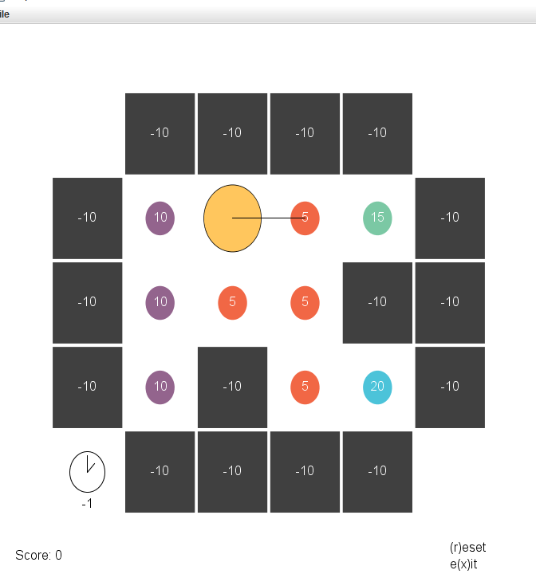
Simple Eater
Actions:
forward: move one cell
rotate: turn right
State:
sensory data: input-link
internally maintained: state
Get points for eating food.
-1 for each forward/rotate.

Slide 53
Input/Output in Soar
All input and output happens through working memory.
Input is added by perception during input phase:
(<s> ^io.input-link <input>)
Output commands are created by rules on:
(<s> ^io.output-link <output>)
Sent to motor system in output phase

Slide 54
Subset of Initial Working Memory
nil
^superstate
^input-link
I2
^io
S1
I1
^output-link
I3
^type
S1 ^superstate nil
state
S1
^io I1
S1 ^type state
I1 ^output-link I2
I1 ^input-l
ink I3
(S1 ^
io I1 ^superstate nil ^type state)
(I1 ^input-link I3 ^output-link I2)

Slide 55
Propose and apply initialize-random
If there the top state does not have the name “eater”
then propose the operator to initialize-eater.
sp {propose*initialize-eater
(state <s> ^superstate nil
-^name eater)
-->
(<s> ^operator <o> +)
(<o> ^name initialize-eater)}
sp {apply*initialize-eater
(state <s> ^operator.name initialize-eater)
-->
(<s> ^name eater)}
Included in the base agent – you don’t need to write these rules.

Slide 56
“Blinking”
When does a value change on the input-link?
Why is that important?

Slide 57
Simple Eater Input-link
The input-link maintains all sensory data.
(<s> ^io.input-link <input>)
(<input> ^east red # absolute directions and contents
^north wall ^south red # these change with forward
^west purple
^back purple # relative directions and contents
^front red
^left wall # these change with rotate or forward
^right red
^orientation east # this changes with rotate
^score 0
^score-diff 0
^food-remaining 10 # 0 when eaten all food
^x 1 # these change with forward
^y 2
^time 1 # this changes with rotate/forward)

Slide 58
Propose and Apply Forward
sp {random*propose*forward
(state <s> ^name eater
^io.input-link.front) # will blink
-->
(<s> ^operator <op> + =)
(<op> ^name forward)}
sp {apply*forward
(state <s> ^operator <op>
^io.output-link <out>)
(<op> ^name forward)
-->
(<out> ^forward <f>)}

Slide 59
Propose and Apply Rotate
sp {random*propose*rotate
(state <s> ^name eater
^io.input-link.front) # will blink
-->
(<s> ^operator <op> + =)
(<op> ^name rotate)}
sp {apply*rotate
(state <s> ^operator <op>
^io.output-link <out>)
(<op> ^name rotate)
-->
(<out> ^rotate <r>)}

Slide 60
Cleaning up output-link
Need to remove structures on the output-link.
Can do this when an operator is selected and get back ^status complete.
sp {apply*cleanup*output-link
(state <s> ^operator <op>
^io.output-link <out>)
(<out> ^<cmd> <id>)
(<id> ^status complete)
-->
(<out> ^<cmd> <id> -)
}
Included in the base agent – you don’t need to write this.

Slide 61
Detecting Completion
If the task is complete, halt.
sp {task*complete
(state <s> ^name eater
^io.input-link.food-remaining 0)
-->
(halt)
}

Slide 62
Smarter Eater
Reject moving forward into walls
Avoid moving forward into empty cells

Slide 63
Reject wall, Avoid empty
sp {eater*reject*forward*wall
(state <s> ^operator <o> +
^io.input-link.front wall)
(<o> ^name forward)
-->
(<s> ^operator <o> -)}
sp {eater*avoid*forward*empty
(state <s> ^operator <o> +
^io.input-link <input>)
(<input> ^<< back left right >> { <> empty <> wall }
^front empty)
(<o> ^name forward)
-->
(<s> ^operator <o> <)}

