Slide 1

Soar Tutorial Day 1
John E. Laird, and Nate Derbinsky
May 6-7, 2019
http://soar.eecs.umich.edu/tutorial19/
laird@umich.edu
Supported in part by NSF, ONR & AFOSR

Slide 2
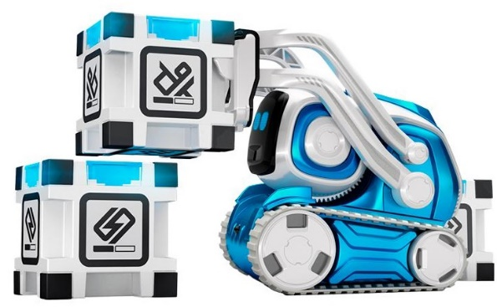
Tutorial Outline
Cognitive Architecture
Core Soar
Reinforcement Learning
Substates and Impasses
Chunking
Semantic Memory
Episodic Memory
SML
Cozmo-Soar Hackaton!
Monday
Tuesday
Wednesday

Slide 3
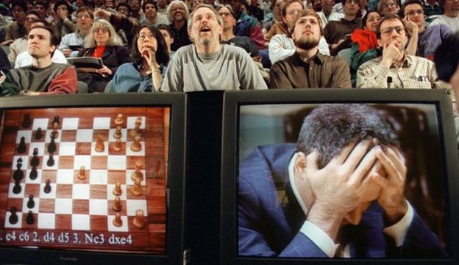
1997: Deep Blue [Chess]

Slide 4
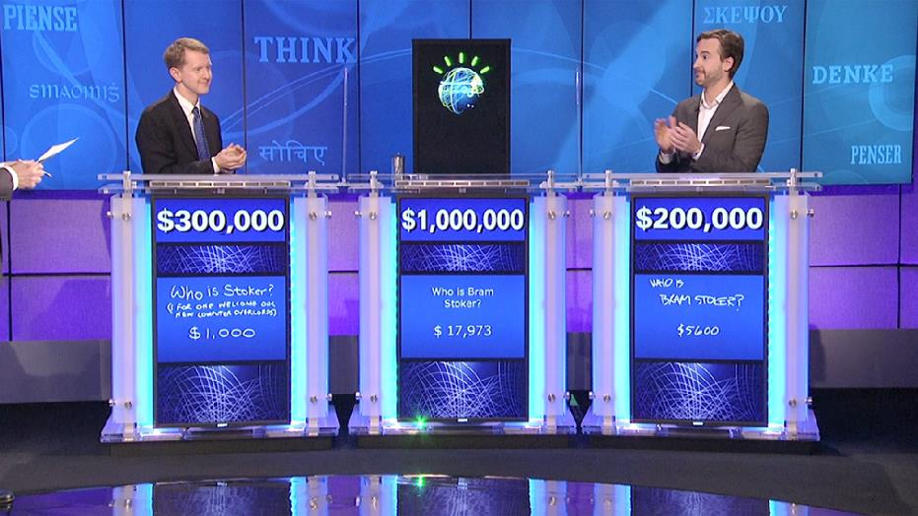
2011: Watson [Jeopardy]

Slide 5
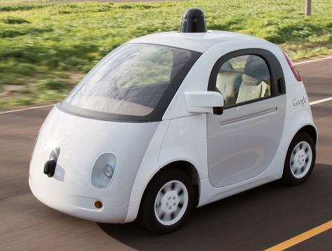

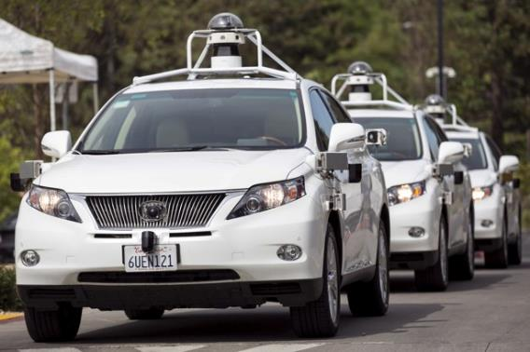
Autonomous Driving

Slide 6

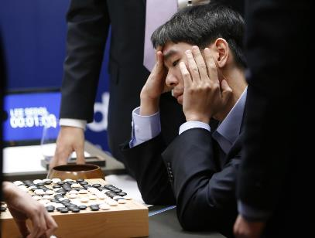
2016: Alpha-Go

Slide 7
Observations
Task specific –
One-off systems
Use specialized algorithms that are appropriate for those particular problems.
Very successful…
Hypotheses:
Ʃ AI Technologies ≠ General Intelligence.
You need to work on how all of the pieces fit together to develop General Intelligence.

Slide 8
Newell’s Time Scale of Human Action
Scale (sec) Time Units System Band
10⁷ months
10⁶ weeks Social
10⁵ days
10⁴ hours Task
10³ 10 min Task Rational
10² minutes Task
10¹ 10 sec Unit task
10⁰ 1 sec Compositional Cognitive
10⁻¹ 100 ms Deliberate act
10⁻² 10 ms Neural Circuit
10⁻³ 1 ms Neuron Biological
10⁻⁴ 100 µs Organelle
System 2
System 1
System 0
Implementation
Notes:
Different regularities at different time scales. Different goals of research.

Slide 9
Cognitive Band
Time Units System Cognitive Capabilities
Complex Reasoning
Analogy
Planning
Meta Reasoning
Theory of Mind
10 sec Unit tasks
Simple Reasoning
Mental Imagery Access
Language Processing
1 sec Compositional acts
Reactive Decisions
Skilled Behavior
Primitive Internal Actions
Access Long-term Memories
100 ms Deliberate acts
Perception
Automatic responses
Promiscuous intermixing of cognitive capabilities.
Ubiquitous learning: automatic and continuous.
“Compiles” System 2 to System 1.
Notes:
Different regularities at different time scales. Different goals of research.
4 words per second

Slide 10
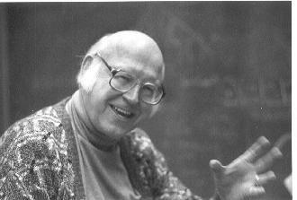



Cognitive Architecture Hypothesis
How are sensing, action, reasoning, and learning integrated in a general, autonomous intelligent agent?
Complex cognition arises from a combination of:
a fixed set of computational building blocks (memories, processes, representations, learning mechanisms); and
knowledge (learned through experience).
Allen Newell
John Anderson

Slide 11
Different Goals of Cognitive Architecture Research
Biological modeling:
Model what we know about the brain: neurons, neural circuits, …
Predict neural activity and cognitive behavior
Examples: LEABRA, SPAUN
Psychological modeling:
Model human performance in a wide range of cognitive tasks
Predict human reaction time and error rates for psychological tasks
Examples: ACT-R, EPIC, CLARION, LIDA, CHREST, 4CAPS
AI Functionality:
Toward human-level intelligence inspired by psychology and biology
Emphasizes more complex cognitive processing, longer time scales
Examples: Soar, Companions, Sigma, ICARUS, CogPrime

Slide 12
Newell’s Time Scale of Human Action
Scale (sec) Time Units System Band
10⁷ months
10⁶ weeks Social
10⁵ days
10⁴ hours Task
10³ 10 min Task Rational
10² minutes Task
10¹ 10 sec Unit task
10⁰ 1 sec Compositional Cognitive
10⁻¹ 100 ms Deliberate act
10⁻² 10 ms Neural Circuit
10⁻³ 1 ms Neuron Biological
10⁻⁴ 100 µs Organelle
System 2
System 1
System 0
Implementation
Notes:
Different regularities at different time scales. Different goals of research.

Slide 13
Newell’s Time Scale of Human Action
Scale (sec) Time Units System Band
10⁷ months
10⁶ weeks Social
10⁵ days
10⁴ hours Task
10³ 10 min Task Rational
10² minutes Task
10¹ 10 sec Unit task
10⁰ 1 sec Compositional Cognitive
10⁻¹ 100 ms Deliberate act
10⁻² 10 ms Neural Circuit
10⁻³ 1 ms Neuron Biological
10⁻⁴ 100 µs Organelle
Soar
ACT-R
Sigma
SPAUN
EPIC
LEABRA
Notes:
Different regularities at different time scales. Different goals of research.

Slide 14
Computer and Cognitive Architectures
Behavior
Behavior
Software
Knowledge and Goals
Run Time
System
Application Software
Task
Specific
General
Capabilities
Computer Architecture
Cognitive Architecture
Computer Hardware
Computer Hardware
Notes:
Problem: how to develop applications that are specific to a given technology – create an interface level that is fixed.
Problem: how to have agents that learn have a set of capabilities to build on.
Sharp distinction between
task-independent architecture and
task-dependent knowledge

Slide 15
Common Model of Cognition
What needs to be in a human-like cognitive architecture
An abstract community consensus
Not itself a cognitive architecture
Consensus of existing cognitive architectures
Soar, Act-R, Sigma
Potential benefits
Coherent baseline to facilitate shared cumulative progress
Focus efforts to extend and break the consensus
Framework around which evaluation data can be organized
Interlingua for describing and comparing architectural approaches
Guidance in
Extending research on individual components
Interpreting experiments and suggesting new ones
Constructing intelligent applications
Testable theory for different structures and functions of the mind
Notes:
Cognitive architecture: Working model of fixed structures that define a mind
For example, extending deep learning with memory, attention, etc.

Slide 16
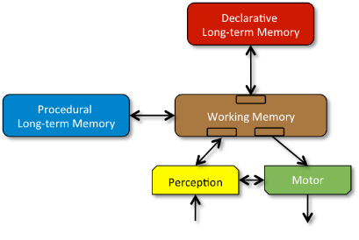
Common Model of Cognition
Structure and Processing
Memory and Content
Learning
Perception and Motor

Slide 17
A. Structure and Processing
Processing yields bounded rationality, not optimality
Processing based on a few task-independent modules
There is significant parallelism in architectural processing
Processing is parallel across modules
Processing is parallel within modules
A cognitive cycle that runs at ~50 ms per cycle in humans drives behavior via sequential action selection
Complex behavior arises from a sequence of independent cognitive cycles that operate in their local context
Notes:
Not distinct modules for more complex behavior

Slide 18
B. Memory and Content
Declarative and procedural LTMs contain symbol* structures and associated quantitative metadata
Global communication is provided by a short-term WM
Global control is provided by procedural LTM
Composed of rule-like conditions and actions
Exerts control by altering contents of WM
Factual knowledge is provided by declarative LTM
Notes:
*Symbols as earlier discussed

Slide 19
C. Learning
All forms of LTM content are learnable
Learning occurs online and incrementally, as a side effect of performance and is often based on an inversion of the flow of information from performance
Procedural learning involves at least reinforcement learning and procedural composition
Reinforcement learning yields weights over action selection
Procedural composition yields behavioral automatization
Declarative learning involves the acquisition of facts and tuning of their metadata
More complex forms of learning involve combinations of the fixed set of simpler forms of learning

Slide 20
D. Perception and Motor
Perception yields symbol* structures with associated metadata in specific WM buffers
There can be many different such perception modules
Perceptual learning acquires new patterns & tunes existing ones
Attentional bottleneck constrains information available in WM
Perception can be influenced by top-down information from WM
Motor control converts symbol* structures in its buffers into external actions
There can be multiple such motor modules
Motor learning acquires new action patterns & tunes existing ones
Notes:
*Symbols as earlier discussed
Least well defined aspect of SMM

Slide 21
Soar 9
Long-Term Memories
Procedural
Semantic
Episodic
Reinforcement
Learning
Chunking
Decision Procedure
Semantic
Learning
Episodic
Learning
Symbolic Working Memory
Spatial Visual System
Object-based continuous metric space
Action
Audio Perception
Visual Perception
Notes:
Emphasize the importance of large WM
[Wow Task]

Slide 22
Soar 9
Long-Term Memories
Procedural
Semantic
Episodic
“Imagine”
Skill: Imagine
“Wow”
Reinforcement
Learning
Chunking
Decision Procedure
Semantic
Learning
Episodic
Learning
Symbolic Working Memory
(sound “Imagine Wow”)
(symbol Imagine wow)
Spatial Visual System
WOW
Action
Audio Perception
Visual Perception
“Imagine Wow”
Notes:
Emphasize the importance of large WM
[Wow Task]

Slide 23
Soar 9
Long-Term Memories
Procedural
Semantic
Episodic
“Rotate”
Skill: rotate
Reinforcement
Learning
Chunking
Decision Procedure
Semantic
Learning
Episodic
Learning
Symbolic Working Memory
(sound “Rotate”)
(symbol rotate)
Spatial Visual System
WOW
Action
Audio Perception
Visual Perception
“Rotate”
Notes:
Emphasize the importance of large WM
[Wow Task]

Slide 24
Cognitive Architecture
Like a programming language but …
A fixed, continual processing cycle
Serial and parallel processing with no program counter
Conditional action is the norm instead of the exception
Fixed small set of data representations
Symbolic and non-symbolic
Has multiple long-term memories and learning mechanisms
Can have significant innate knowledge

