Slide 1
Welcome! Graph Training Letterkenny, Ireland November 13th
Dan McCreary
Jamie O’Leary

Slide 2
TigerGraph 2.5 Update
November 2019
Release Notes
https://docs.tigergraph.com/release-notes-change-log/release-notes-tigergraph-2.5

Slide 3
New features in 2.5
The new Docker image does not automatically start the TigerGraph server
You must ssh in $ ssh -p 14022 tigergraph@localhost
and then run:
tg$ gadmin start
2.4 had pattern matching and interpreted mode
Interpreted mode is ideal for learning GSQL (no long compile step)
Users can upload their own vertex icons

Slide 4
Useful URLs (bookmark in a folder)
ATC Graph Training:
https://github.optum.com/ATC/graph-training
Your Local Graph Studio
http://localhost:14240/#/home
Docker Startup
https://github.com/tigergraph/ecosys/blob/master/guru_scripts/docker/README.md

Slide 5
Check your version
GSQL-Dev > version
GSQL version: 2.5
GSQL commit number: f608e6c848ea2dd39b25844ecd746202ed32582f
GSQL commit date: 2019-09-04 06:34:43 -0700
Copyright (c) 2014-2019 TigerGraph. All rights reserved. This product is protected by U.S. and international copyright and intellectual property laws.

Slide 6
Docker Run
$ docker run -d
-p 14022:22 -p 9000:9000 -p 14240:14240
--name tigergraph_dev
--ulimit nofile=1000000:1000000
-v ~/data:/home/tigergraph/mydata
-t docker.tigergraph.com/tigergraph-dev:latest

Slide 7
Docker Run command options
"-d" make the container run in the background.
"-p" map docker 22 port to host OS 14022 port, 9000 port to host OS 9000 port, 14240 port to host OS 14240 port.
"--name" name the container tigergraph_dev.
"--ulimit" set the ulimit (the number of open file descriptors per process) to 1 million.
"-v" mount the host OS ~/data folder to the docker /home/tigergraph/mydata folder using the -v option. Note that if you are using windows, change the above ~/data to something using windows file system convention, e.g. c:\data

Slide 8
Cleanup old container
stop and remove existing container in shell only if an old version is being used
docker ps –a | grep tigergraph_dev
docker stop tigergraph_dev
docker rm tigergraph_dev

Slide 9
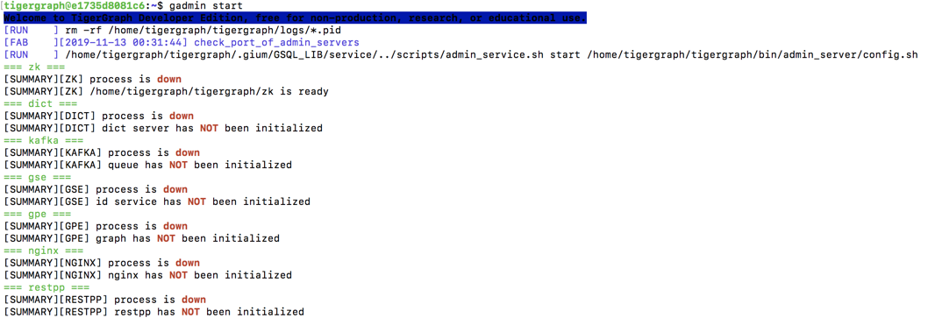
docker$ gadmin start

Slide 10
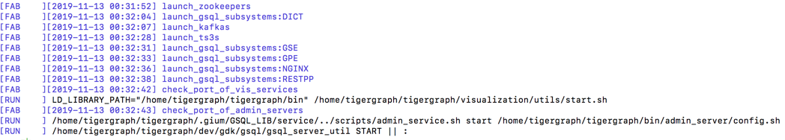
Startup log (2 of 3)

Slide 11
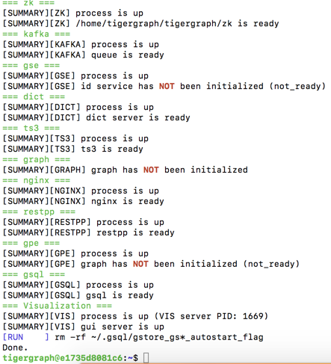
Startup Log 3 of 3

Slide 12
Doctor Properties
Vertex: Doctor
doctorID
givenName
familyName
specialty

Slide 13
Sample REST service
http://localhost:9000/query/MyGraph/countDoctors
{"version":
{"edition":"developer","api":"v2","schema":0},
"error":false,
"message":"",
"results":[{"doctors.size()":10}]
}

Slide 14
# curl -X GET http://localhost:9000/query/MyGraph/countDoctors
{"version":{"edition":"developer","api":"v2","schema":0},"error":false,"message":"","results":[{"doctors.size()":10}]}

Slide 15
GSQL
laptop$ ssh -p 14022 tigergraph@localhost
$ gsql
GSQL-DEV> ls
GSQL-DEV> USE GRAPH MyGraph
GSQL-DEV> SELECT COUNT() FROM Doctor
GSQL-DEV> SELECT * FROM Doctor LIMIT 3

Slide 16
Finding GSQL
echo $PATH
/usr/local/sbin:/usr/local/bin:/usr/sbin:/usr/bin:/sbin:/bin:/usr/games:/usr/local/games:/home/tigergraph/.gium:/home/tigergraph/.gium/

Slide 17
Clean up prompt
tigergraph@e1735d8081c6:~$
\u – user
\h - host
if [ "$color_prompt" = yes ]; then
PS1='${debian_chroot:+($debian_chroot)}\[\033[01;32m\]\[\033[00m\]docker:\[\033[01;34m\]\w\[\033[00m\]\$ '
# PS1='${debian_chroot:+($debian_chroot)}\[\033[01;32m\]\u@\h\[\033[00m\]:\[\033[01;34m\]\w\[\033[00m\]\$ '
else
PS1='${debian_chroot:+($debian_chroot)}\w\$ '
# PS1='${debian_chroot:+($debian_chroot)}\u@\h:\w\$ '
fi

Slide 18
GSQL-Dev > SELECT * FROM Doctor WHERE primary_id=="d1"
[{
"v_id": "d1",
"attributes": {
"specialty": "Family Practice",
"doctorID": "d1",
"givenName": "Sue",
"familyName": "Smith"
},
"v_type": "Doctor"
}]

Slide 20
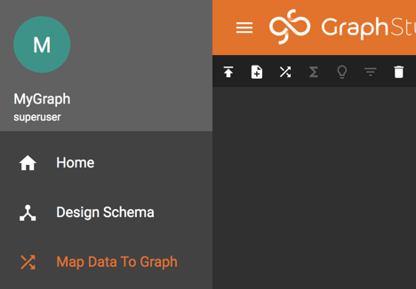
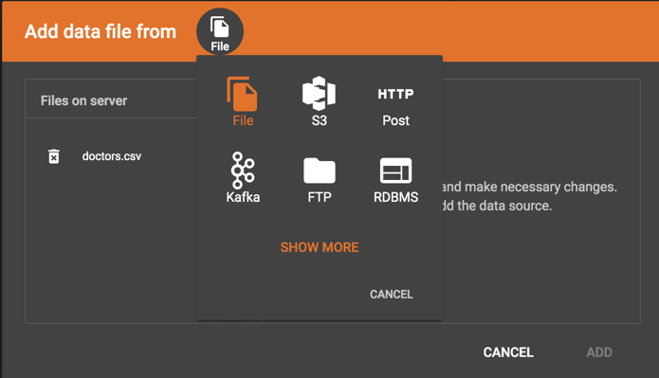
Add data from file, S3, HTTP, Kafka, FTP or RDBMS

Slide 21
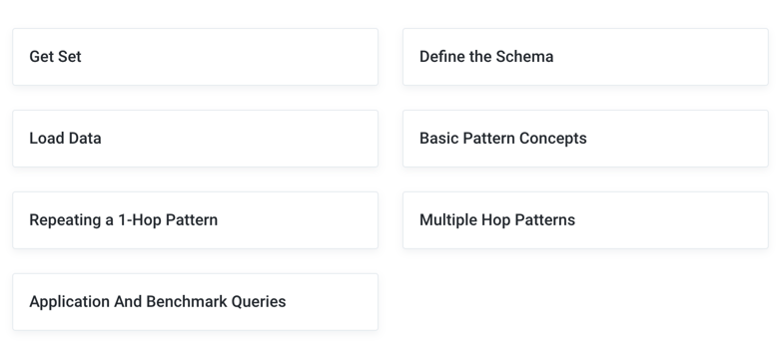
GSQL 102 – Pattern Matching
https://docs.tigergraph.com/v/2.4/intro/gsql-102

Slide 22
Pattern Matching Example
Friends of Friends
Friendship
Friendship
Person
Person
Person
Person - (Friendship) - Person - (Friendship) – Person
Person - (Friendship*2) - Person

