Slide 1
Forti
Q
ode
A project by Dhruv Singh

Slide 2
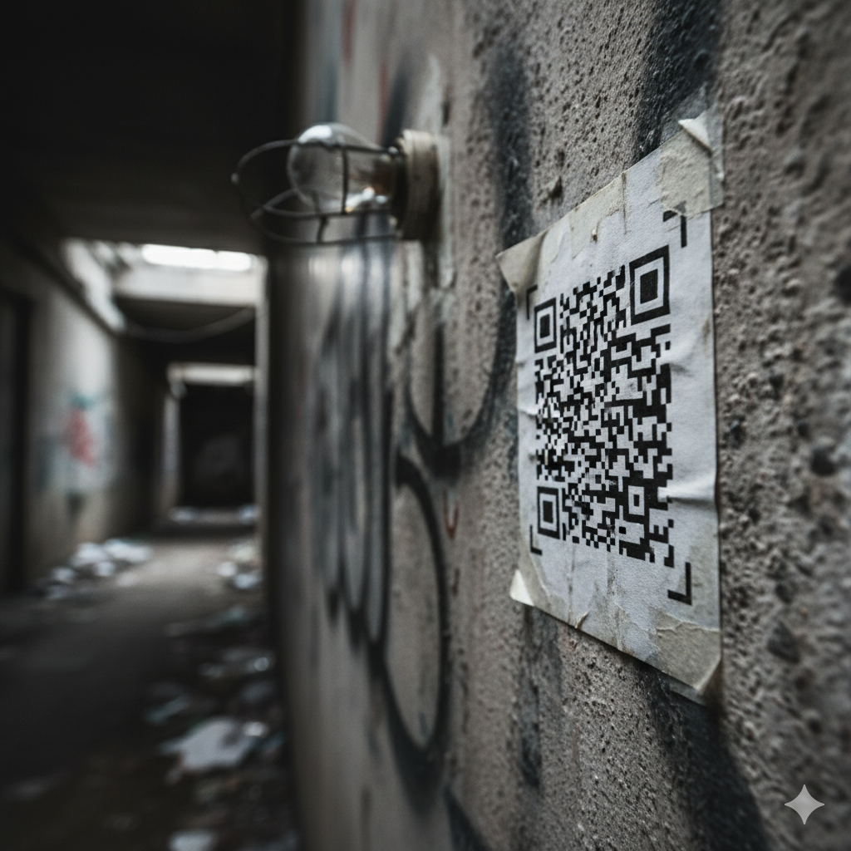
Games
Secret Parties
Cult

Slide 3
Using Fernet (python)

Slide 4
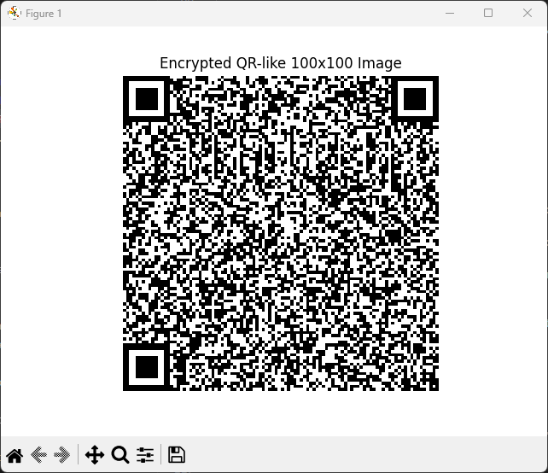
Secret Message is here

Slide 5
Input text
+ Salt
_pineapple
Convert to Binary
AES Symmetric Encryption
MatplotLib
QR like image

Slide 6
Yep, That’s me

