Slide 1
Secure File Storage Using AES Encryption
Prepared by :
Razan Alothaim

Slide 2
Introduction
A secure application for encrypting and decrypting files with user authentication, file upload, AES encryption, and simple file retrieval.

Slide 3
Functions
  User Interface
  User Authentication
  File Upload
  AES Encryption
  Retrieval and Decryption

Slide 4
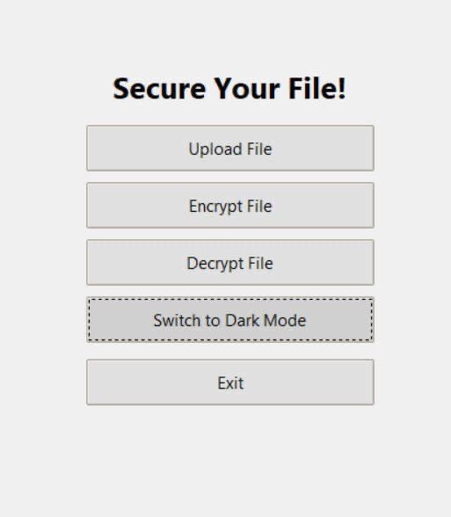
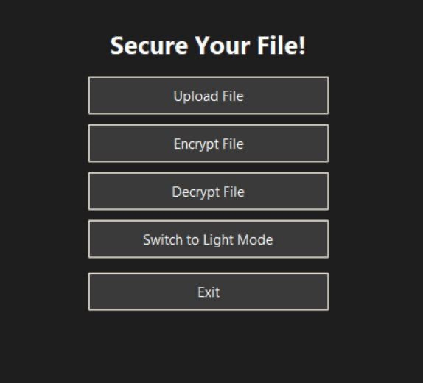
User Interface
Built with Tkinter for simplicity and responsiveness.
Supports Dark Mode and Light Mode.
Full-Screen display for better user experience.
  Dark Mode
  Light Mode.

Slide 5
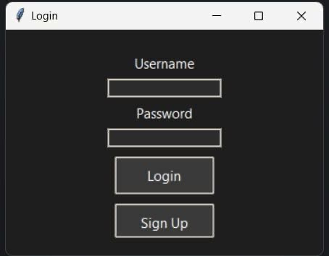
User Authentication
Users can Register and Login securely.
Passwords are hashed using SHA-256 before being stored.
Protects against password leaks or exposure.

Slide 6
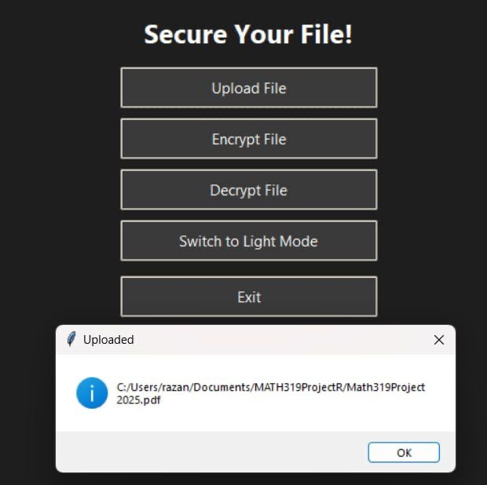
File Upload
Users can easily select files from their computer.
Supports different file types.
Uploaded file path is displayed in the application.

Slide 7
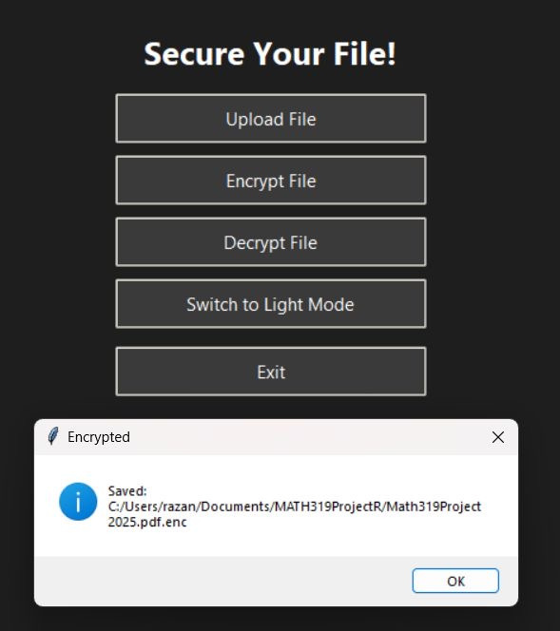
AES Encryption
Files are encrypted using Fernet, which is based on AES encryption.
A secure encryption key is generated and stored safely.
Ensures strong protection for user files.

Slide 8
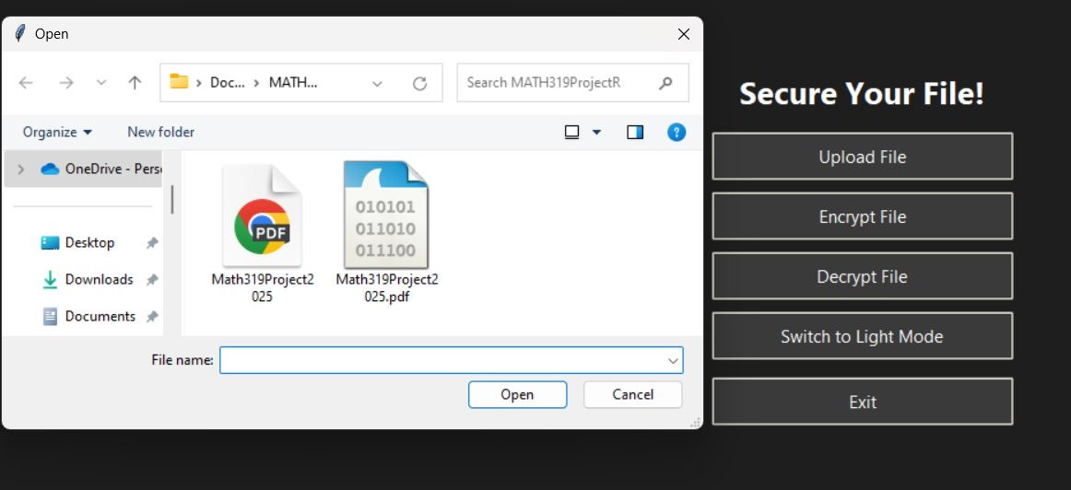
AES Encryption

Slide 9
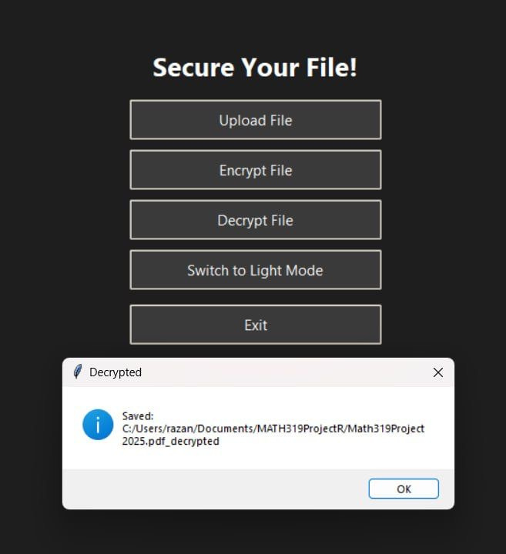
Retrieval and Decryption
Encrypted files can be decrypted back to their original form.
Only users with the correct key can decrypt the files.
Safe and reliable retrieval process.

Slide 10
Technologies Used
  Python
  Tkinter (GUI)
  Cryptography (AES)
  hashlib (Password Hashing with SHA-256)

Slide 11
Thank you

