Slide 1
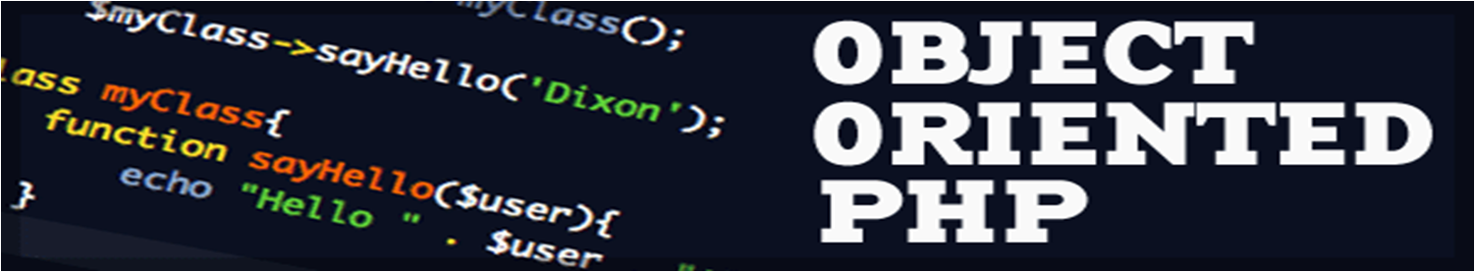
Introduction to PHP
By : Alaa Abdelmonem

Slide 2
Introduction to PHP
  “PHP is a server-side scripting language designed specifically for the Web. Within an HTML page, you can embed PHP code that will be executed each time the page is visited. Your PHP code is interpreted at the Web server and generates HTML or other output that the visitor will see” (“PHP and MySQL Web Development”, Luke Welling and Laura Thomson, SAMS)

Slide 3
PHP History
1994: Created by Rasmis Lesdorf, software engineer (part of Apache Team)
1995: Called Personal Home Page Tool, then released as version 2 with name PHP/FI (Form Interpreter, to analyze SQL queries)
Half 1997: used by 50,000 web sites
October 1998: used by 100,000 websites
End 1999: used by 1,000,000 websites
80% of the web powered by PHP (Facebook,wikipedia,Yahoo,flicker,tubmblr)

Slide 4
Server Side Scripting
Python
Active Server Pages (ASP.net)
Java server pages (JSP)
Ruby
NodeJS

Slide 5
PHP Features
Open-source
Easy to use ( C-like and Perl-like syntax)
Stable and fast
Servers support and Community
Many databases support
Many common built-in libraries
Pre-installed in Linux distributions

Slide 6
How PHP generates
HTML/JS Web pages
Client Browser
1
4
3
PHP module
Apache
2
1: Client from browser send HTTP request (with POST/GET variables)
2: Apache recognizes that a PHP script is requested and sends the request to PHP module
3: PHP interpreter executes PHP script, collects script output and sends it back
4: Apache replies to client using the PHP script output as HTML output

Slide 7
Hello World! (web oriented)
<html>
<head>
<title>My personal Hello World! PHP script</title>
</head>
<body>
<?
echo “Hello World!”;
?>
</html>
PHP tag, allow to insert PHP code. Interpretation by PHP module will substitute the code with code output

Slide 8
Variables (I)
To use or assign variable $ must be present before the name of the variable
The assign operator is '='
There is no need to declare the type of the variable
the current stored value produces an implicit type-casting of the variable.
A variable can be used before to be assigned
$A = 1;
$B = “2”;
$C = ($A + $B); // Integer sum
$D = $A . $B; // String concatenation
echo $C; // prints 3
echo $D;// prints 12

Slide 9
Strings (I)
A string is a sequence of chars
$stringTest = “this is a sequence of chars”;
echo $stringTest[0]; output: t
echo $stringTest; output: this is a sequence of chars
A single quoted strings is displayed “as-is”
$age = 37;
$stringTest = 'I am $age years old'; // output: I am $age years old
$stringTest = “I am $age years old”; // output: I am 37 years old
Concatenation
$conc = ”is “.”a “.”composed “.”string”;
echo $conc; // output: is a composed string
$newConc = 'Also $conc '.$conc;
echo $newConc; // output: Also $conc is a composed string

Slide 10
Strings (II)
Explode function
$sequence = “A,B,C,D,E,F,G”;
$elements = explode (“,”,$sequence);
// Now elements is an array with all substrings between “,” char
echo $elemets[0]; // output: A;
echo $elemets[1]; // output: B;
echo $elemets[2]; // output: C;
echo $elemets[3]; // output: D;
echo $elemets[4]; // output: E;
echo $elemets[5]; // output: F;
echo $elemets[6]; // output: G;

Slide 11
Connecting PHP with Database

Slide 12
Databases for PHP
MySQL
PostGreSQL
Oracle
Sybase
DB2
NoSQL(MongoDB)

Slide 13
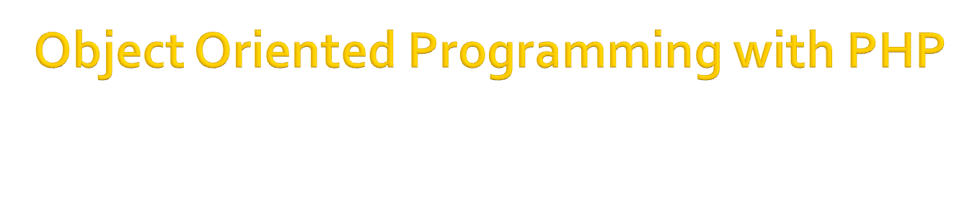

Slide 14

Classes, which are the "blueprints" for an object and are the actual code that defines the properties and methods.
Objects, which are running instances of a class and contain all the internal data and state information needed for your application to function.
Encapsulation, which is the capability of an object to protect access to its internal data
Inheritance, which is the ability to define a class of one kind as being a sub-type of a different kind of class (much the same way a square is a kind of rectangle).

Slide 15
Interface, An interface is a description of the actions that an object can do , Interface is written in the same way as the class the declaration with interface keyword..
Abstract Classes, An abstract class is a class that contains at least one abstract method. The abstract method is function declaration without anybody and it has the only name of the method and its parameters.
Access Modifiers (public – protected - private)

Slide 16

Let's start with a simple example. Save the following in a file called class.lat.php:
<?php
class Demo
{
}
?>

Slide 17
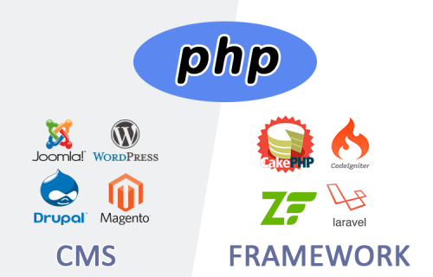
CMS VS Framework

Slide 18
Model View Controller ( MVC ) in PHP

Slide 19
PHP & MVC
The model view controller pattern is the most used pattern for today’s world web applications
It has been used for the first time in Smalltalk and then adopted and popularized by Java
At present there are more than a dozen PHP web frameworks based on MVC pattern

Slide 20
PHP & MVC
The model is responsible to manage the data
The view (presentation) is responsible to display the data provided by the model in a specific format
The controller handles the model and view layers to work together

Slide 21
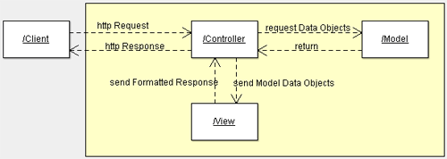
PHP & MVC

Slide 22
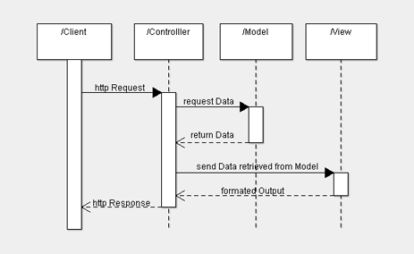
PHP & MVC

Slide 23
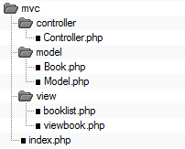
PHP & MVC

