Slide 1
CIS 170C Project
By: Pierce Rogg

Slide 2
Purpose
To learn fundamentals of the C++ programming language and create a Console application

Slide 3
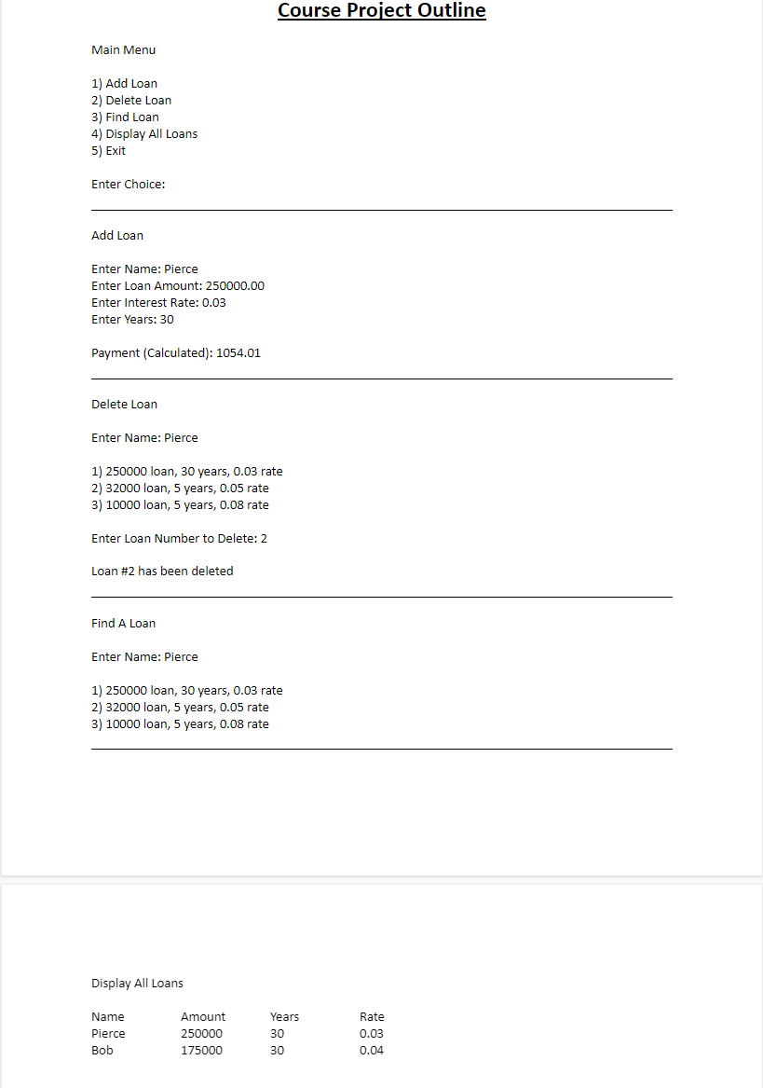
Come up with IPO Chart

Slide 4
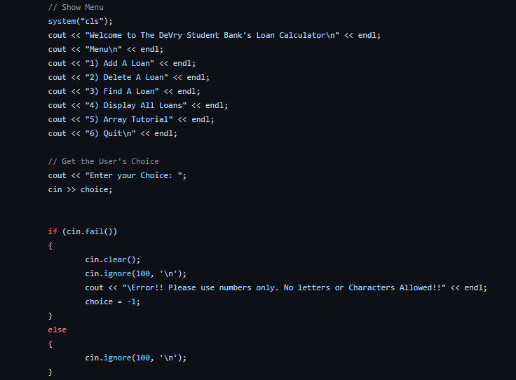
Create Menu System

Slide 5
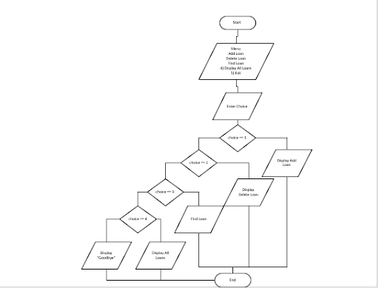
Create Flow Chart

Slide 6
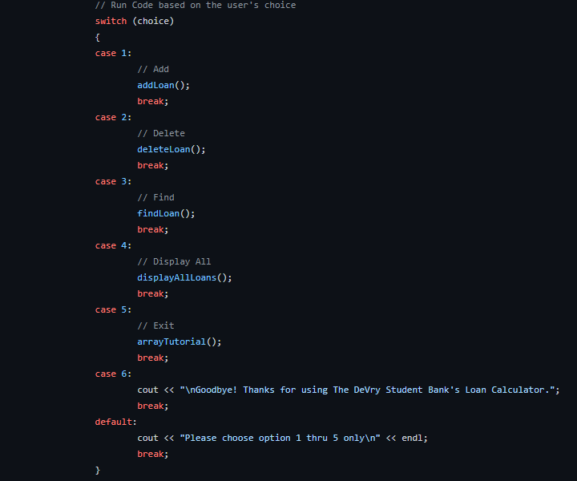
Implement Switch Statement

Slide 7
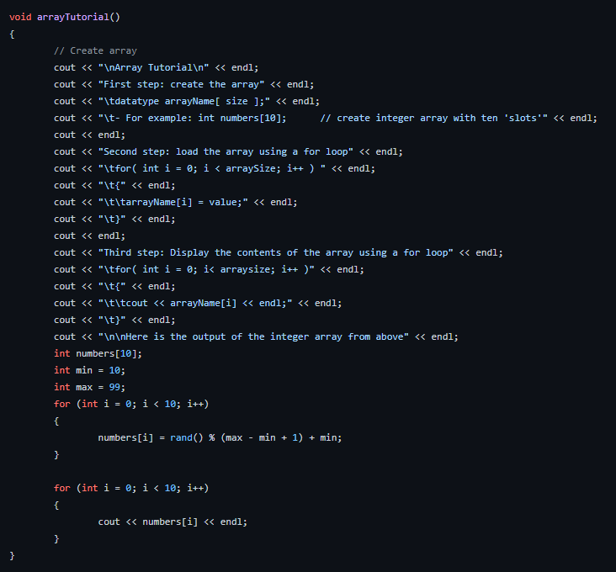
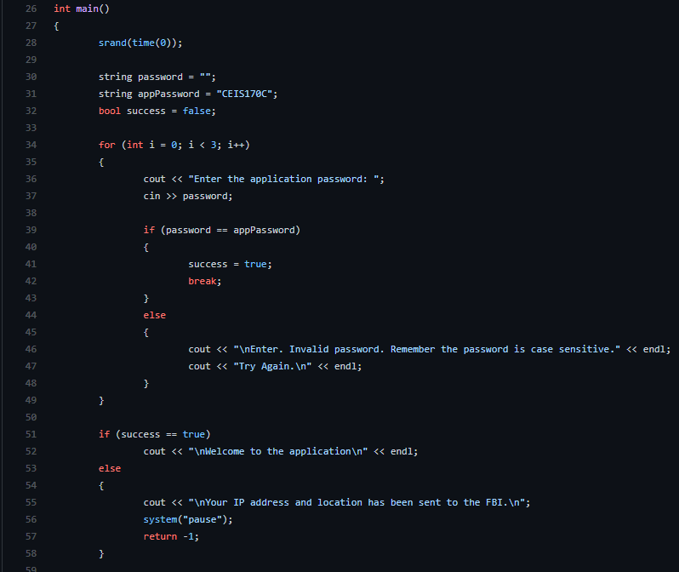
Added Authentication and Array Tutorial

Slide 8
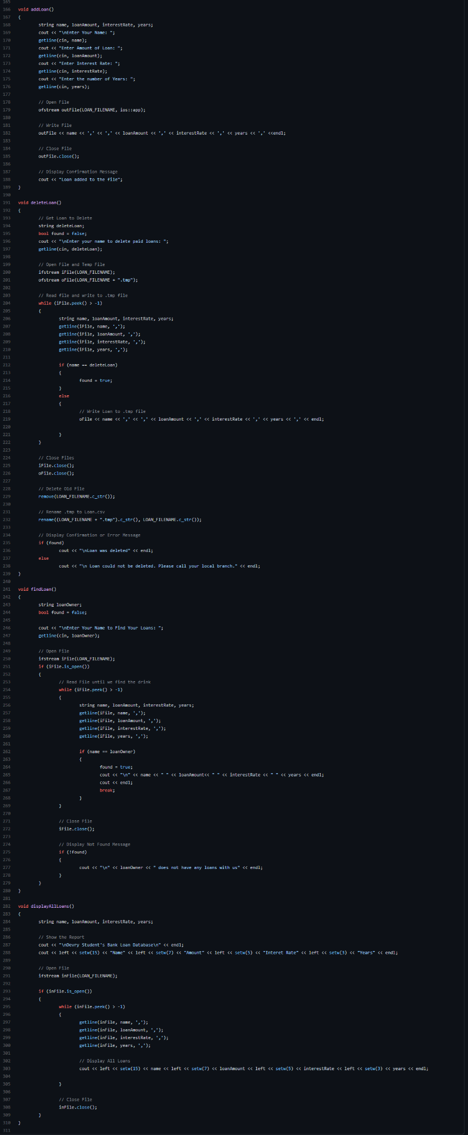
Added Prototypes for Adding, Deleting, Searching and Displaying information to/from Files

Slide 9

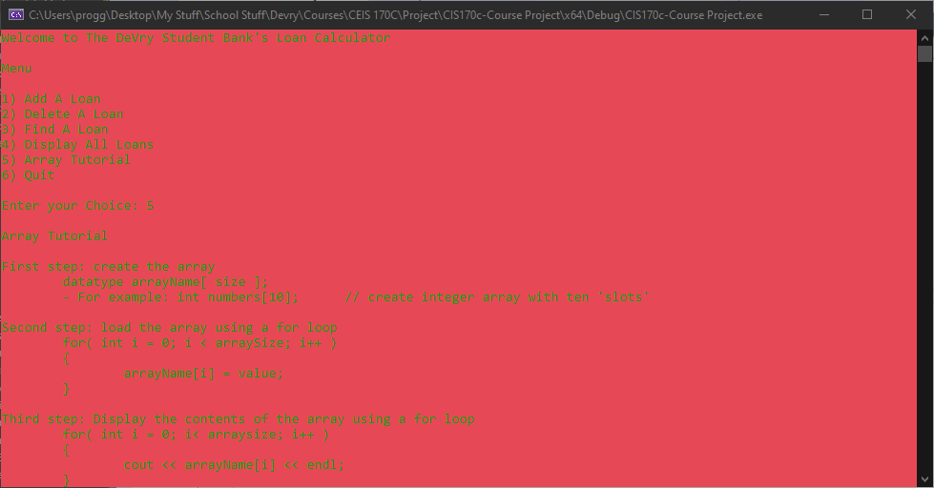
Changed Color of The Console

Slide 10
Challenges
Trying to do the project myself without watching the live lectures.
Utilized Stack Overflow, Microsoft Docs, cplusplus.com and sololearn.com.
Having to limit what my application can do.
Tried to add a database but could not get it to work.

Slide 11
Conclusion
Future Development
Add a Database
Add a GUI
Implement Classes and other OOP concepts and design

