Slide 1
Linux Operating System
By: Pierce rogg

Slide 2
Introduction
Linux is an opensource operating system.

Slide 3
Development Process

Slide 4
Linux Filesystem Hierarchy

Slide 5
Navigate the Linux filesystem tree
What is the pwd command an acronym for? What about the cd command?
Print Working Directory
Explain the differences between a relative path and an absolute/full path in Linux.
absolute path is the path to get to a specific file from the home directory and the relative path is the path to a file from where you currently are.

Slide 6
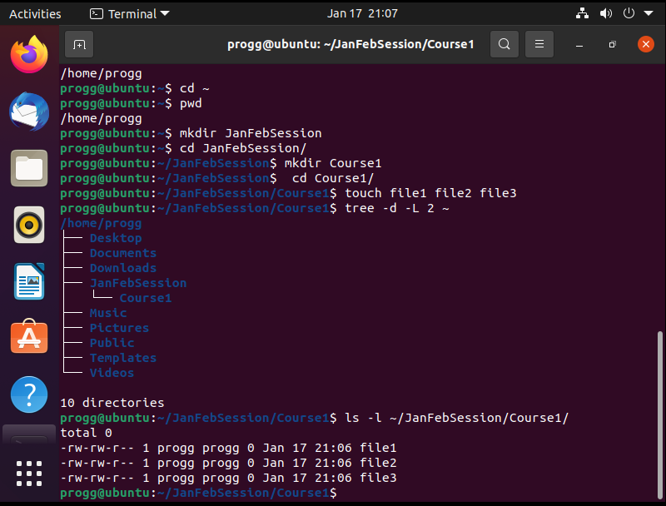
Create directories and files

Slide 7
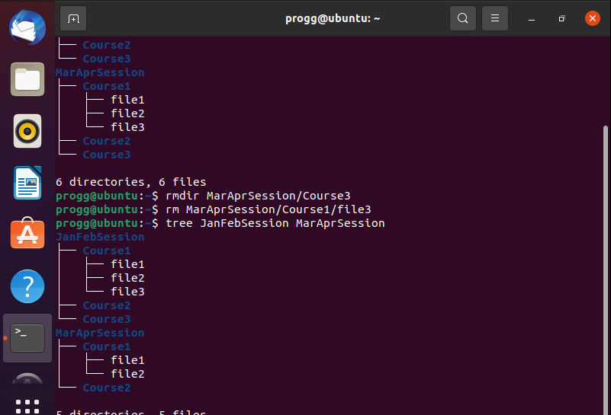
Copy and remove directories and files

Slide 8
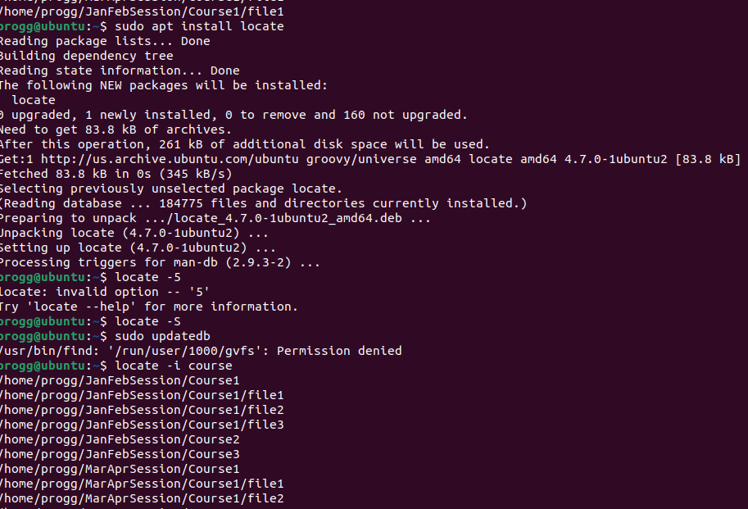
Locate directories and files

Slide 9
Linux Shell Scripts

Slide 10
Create a Shell Script
What are the file permissions of the script?
-rw-rw-r--
What’s the name of the user-defined variable in the script?
text
Which redirection meta-character is used in the script? What does it do?
Adds the script to MyToDoList file

Slide 11
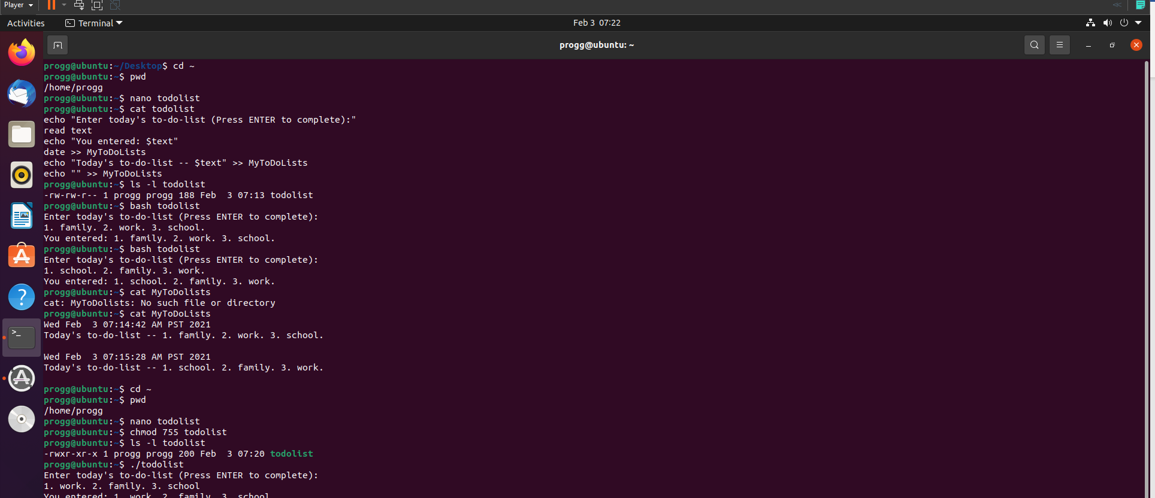
Change Script File Permissions

Slide 12
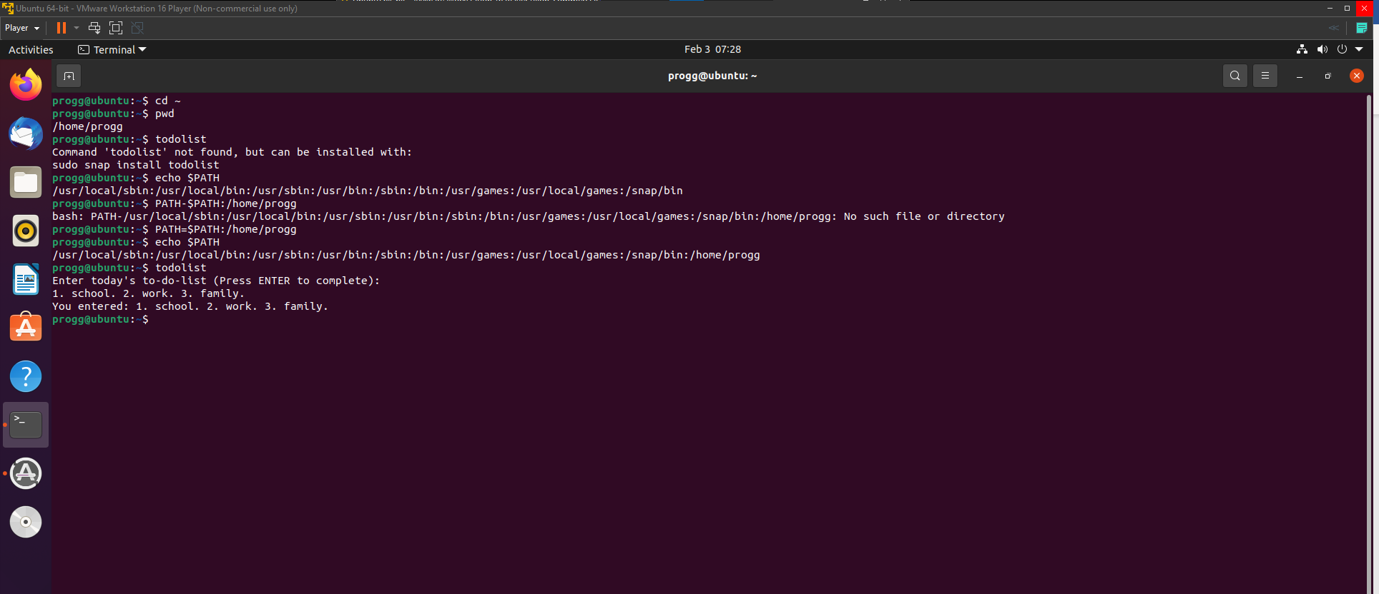
Set the PATH Variable

Slide 13
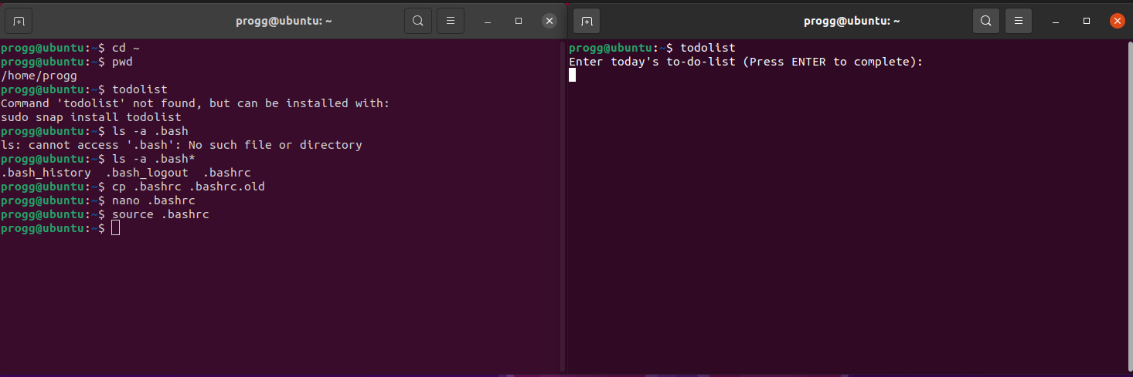
Make the PATH Variable Permanent

Slide 14
User and Group Management

Slide 15
Add Users and Groups in CLI
What does the -3 option in the tail command do?
it displays the last 3 lines of the file instead of the default 10
Which line of the /etc/group file lists members of the “students” group?
students:x:1002:progg,mary

Slide 16
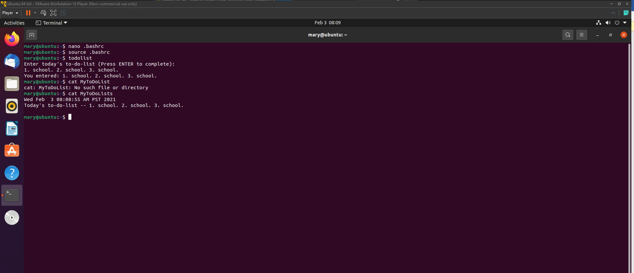
Test User and Group Settings

Slide 17
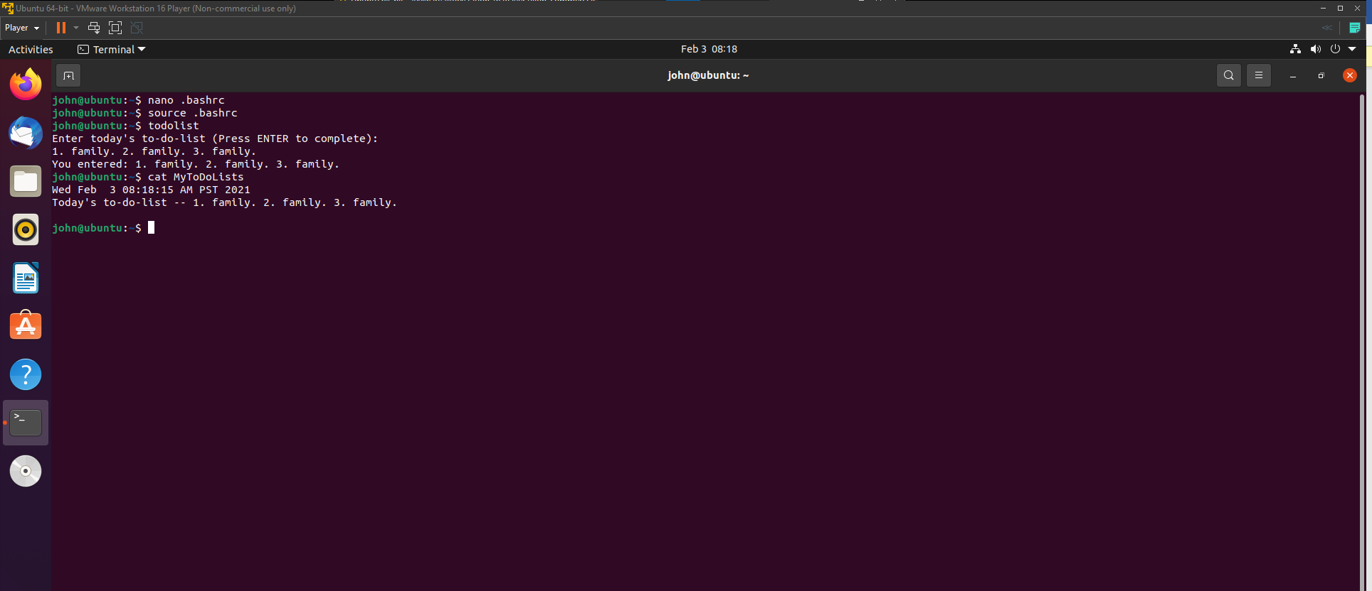
Add Users in GUI

Slide 18
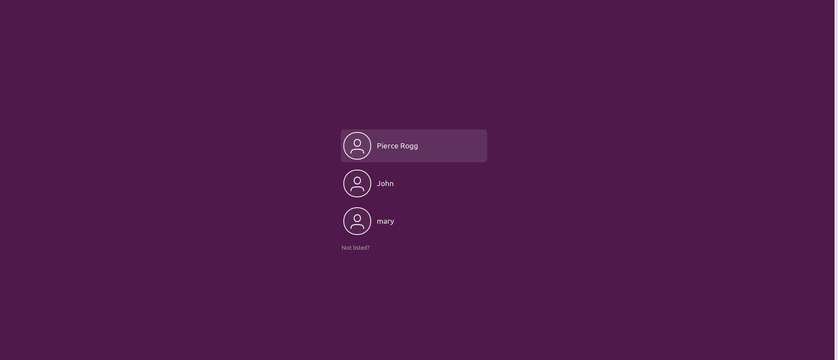
Remove Users and Groups

Slide 19
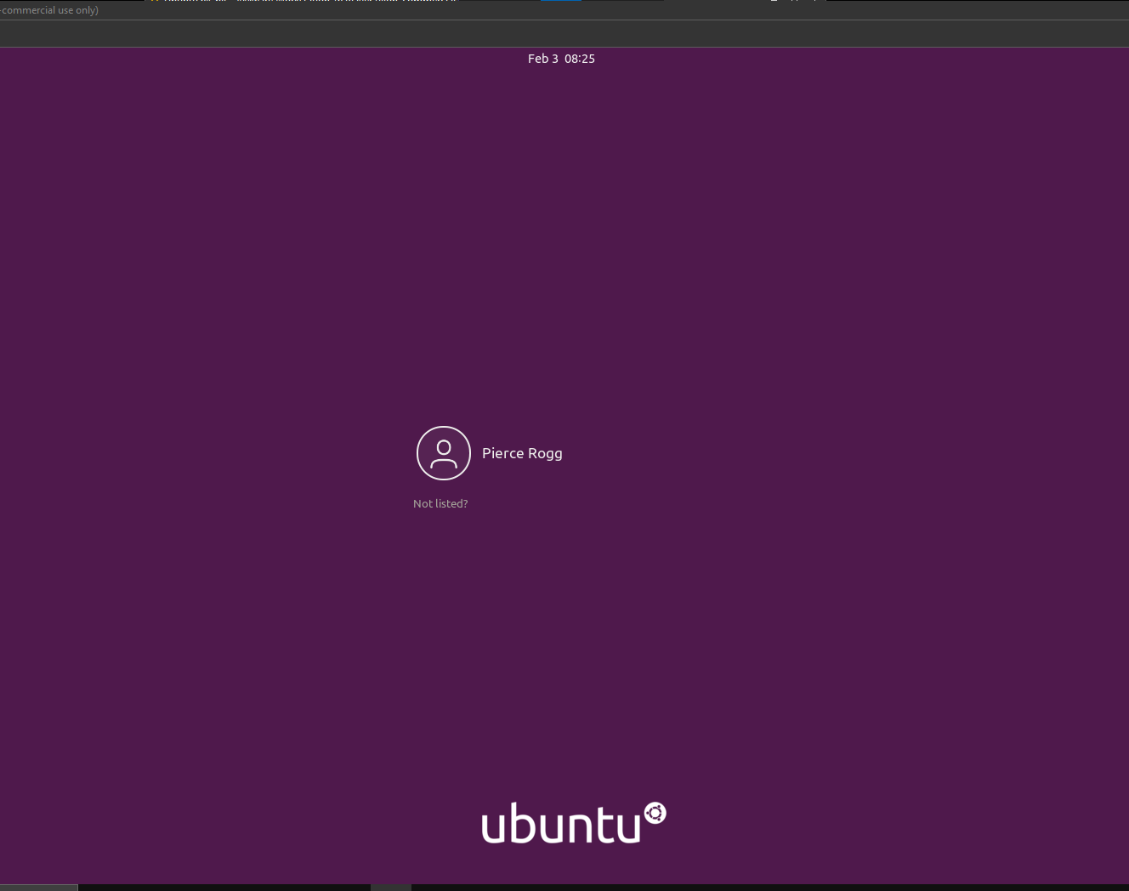
Remove Users and Groups

Slide 20
Network Configuration

Slide 21
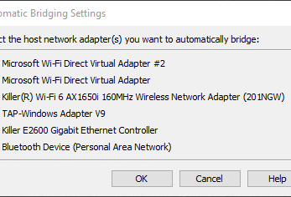
Connect the Ubuntu VM to the Internet

Slide 22
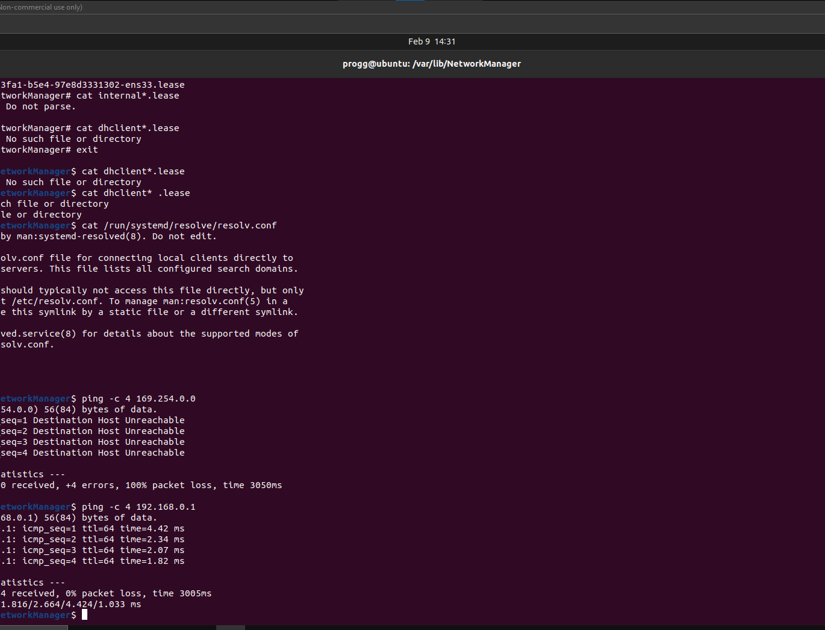
Discover Host IP Configurations
What is the IP address of your Ubuntu machine
192.168.0.1
What is the IP address of its default gateway?
169.254.0.0
What is the IP address of its DNS server?
8.8.8.8

Slide 23
Manage Network Interfaces
Which DHCP message is shown in the output of the sudo dhclient –v –r ens33 command?
the default gateways

Slide 24
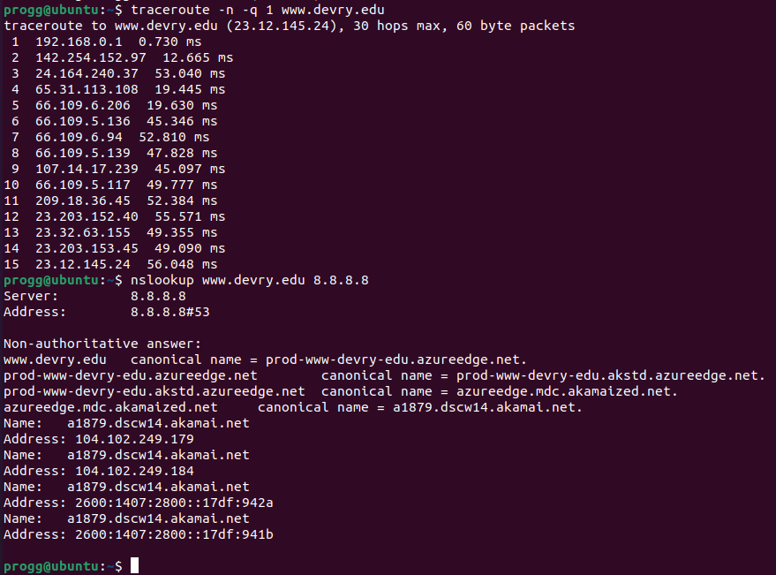
Use Network Utilities

Slide 25
System Performance Monitoring

Slide 26
Monitor Linux Processes
What is the default action of the 15 SIGTERM kill signal?
end the process with force
In the System Monitor window, click on % CPU to sort the processes by CPU load. Which process shows the highest percentage of CPU usage?
Gnome Shell

Slide 27
What flag value is displayed in the output?
-s
.Why is the name of the user who ran the processes shown as root, not your username?
Because the –s command shows that the command was ran by the super or root user.

Slide 28
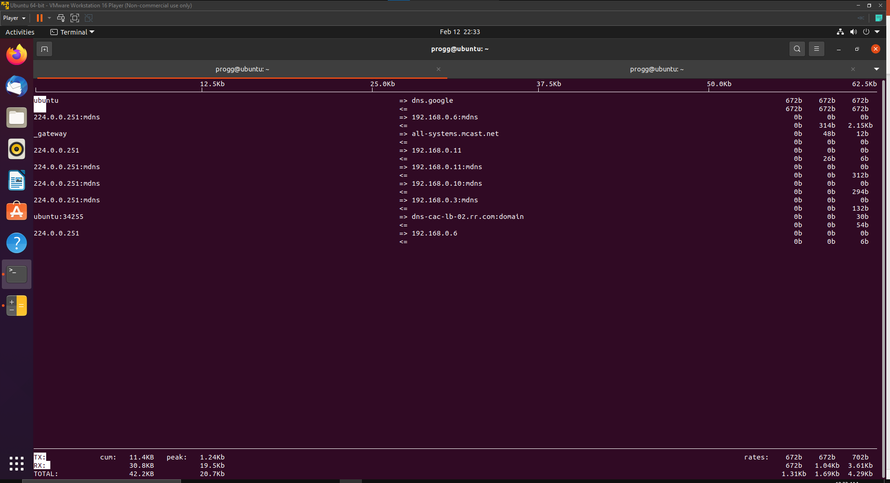
Monitor Network Bandwidth Usage

Slide 29
Challenges
The biggest challenge was learning all of the commands and getting the spacing and everything exact.

Slide 30
Career Skills Learned
Linux System Administration
Command Line Knowledge
Virtual Machine usage

Slide 31
Conclusion
All in all, this was a fun project and I really enjoyed learning how to interact with an operating system through the command line.

